Slide 1
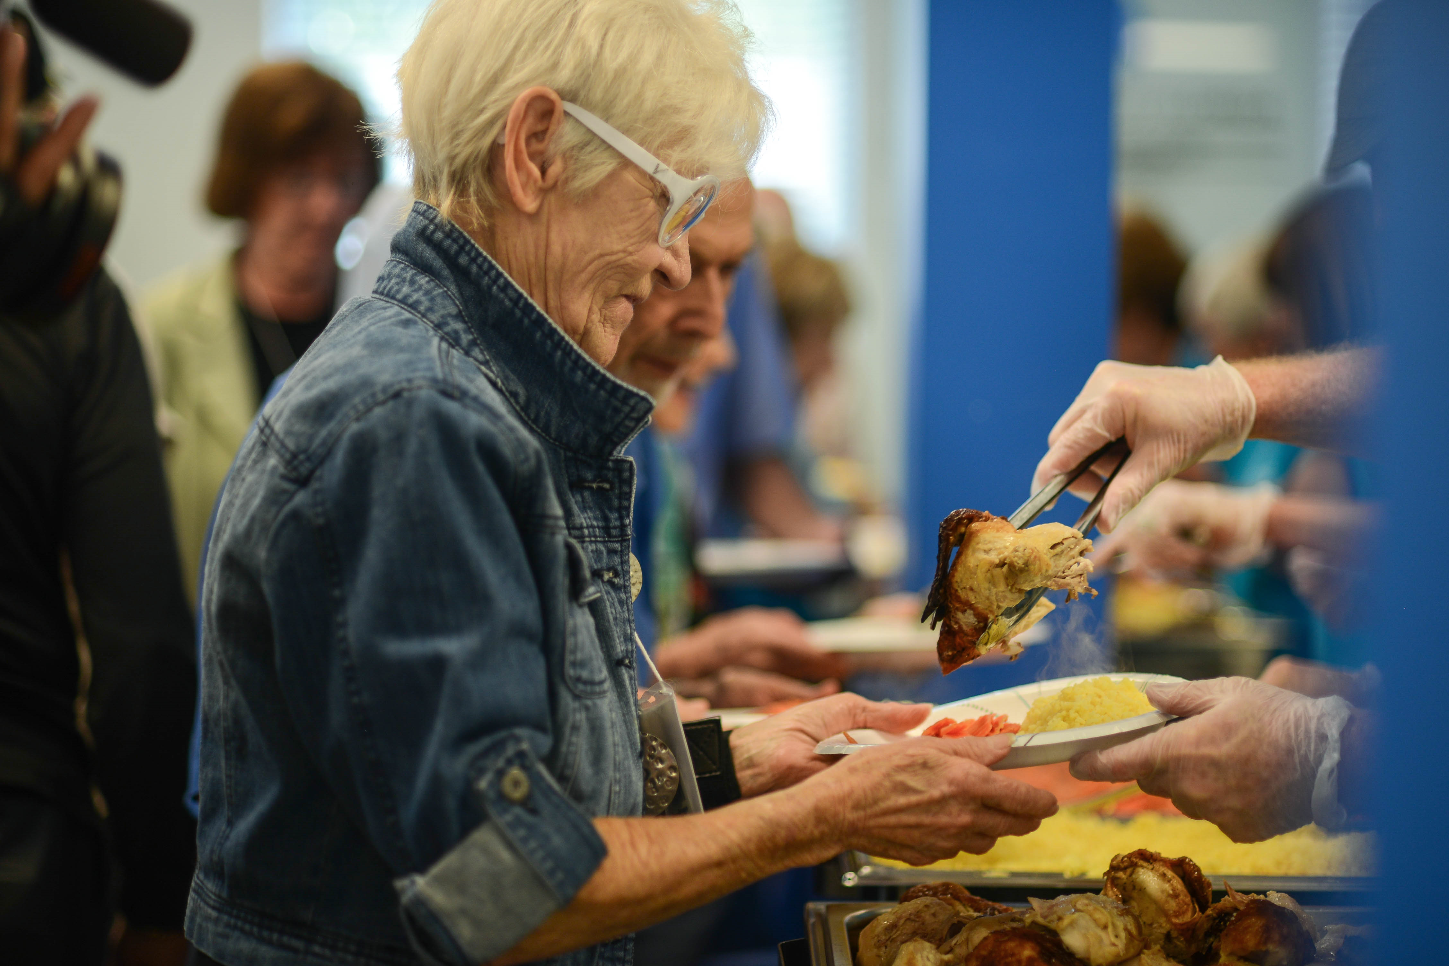
What a Waste
An Innovative Solution to Address Senior Hunger
Kristie Sharp & Jobcy Alexander
September 14, 2017

Slide 2
Senior Hunger Statistics

Slide 3
Ways Georgia is addressing Senior Hunger
Senior Hunger Summit
State Plan on Senior Hunger
What a Waste

Slide 4
What a Waste

Slide 5
Implementation
Measuring Food Waste
Prep Waste
Pan Waste
Nutrition Analysis
Education and Awareness

Slide 6
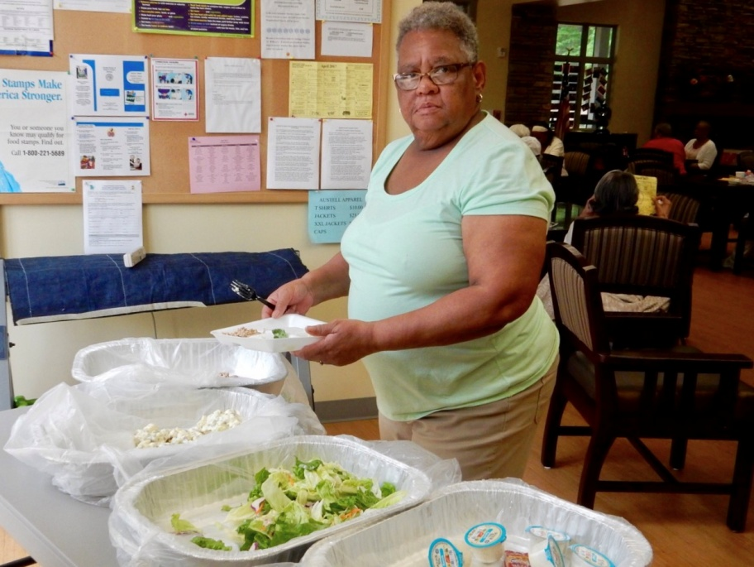
Plate Waste

Slide 7
Baseline Report
Annual Waste of 12,728 lbs
Plate waste
Pan waste
82% of reservations kept by clients
Inadequate nutrient intake: Magnesium, Potassium, Fiber, Folate, Vitamin D

Slide 8
SMART Goals
Reduce pan waste by 5%
Focus group & detailed feedback collected from each center
Consider using green card yellow card system for reservation
Advertise monthly menu in advance
Create a composting program for garden
Educate client on contributions and center goals at site council meeting

Slide 9
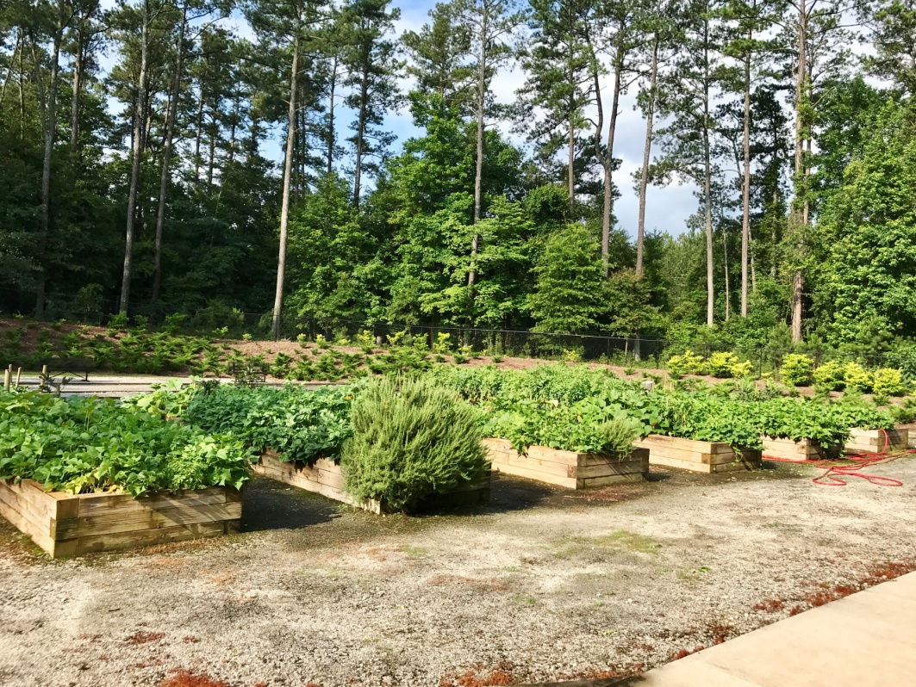
Austell Senior Center

Slide 10
Impact of WAW: Short Term Engagement
Reduction in pan waste
Food donation to pantry and shelter
Recruiting intern to assist with education on composting
Impact of WAW: 10 Year Master Plan
Improving Environmental Sustainability
Reusable dinnerware
Composting for gardens
Selling excess food
Allowing leftovers to be taken home

Slide 12
Kristie Sharp
ksharp@atlantaregional.org
Jobcy Alexander
jobcy.alexander@cobbcounty.org

