Slide 1
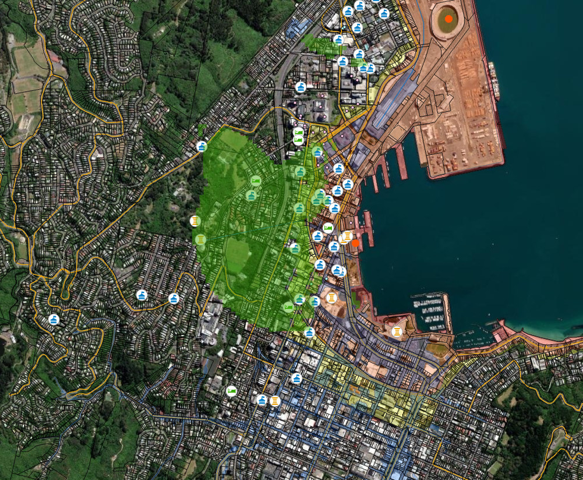
Utilizing Geospatial Analysis for United States Embassy Site Acquisitions

Slide 2
Objective: Provide suitable U.S. embassy locations to the U.S. Department of State’s Bureau of Overseas Buildings Operations (OBO)
Security Considerations
Protection from Natural Hazards
Accessible and Desirable Location
Site must be large enough to accommodate desired building along with 30 meter security buffers
Limit proximity to security threats, such as shooting ranges and large gathering places
Site must front on two bidirectional streets with multiple means of egress
Limit proximity to areas prone to natural hazards, such as floodplains, areas of high seismic activity, tsunami zones, wildfire zones, etc.
Proximity to other foreign missions
Proximity to host government buildings
Central and easily accessible location to maximize convenience for Americans abroad
Proximity to desirable amenities, such as upscale hotels, museums, and restaurants

Slide 3
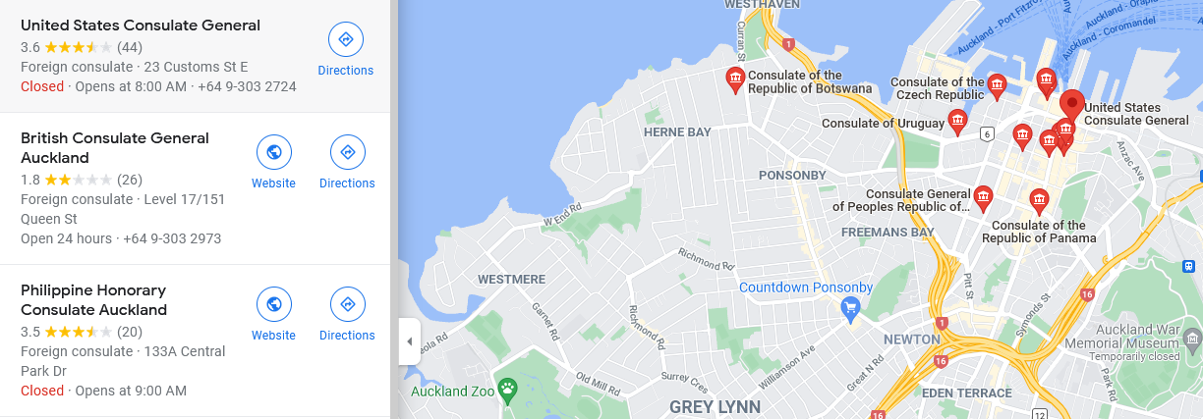
Research Methods
ArcGIS Living Atlas
Regional and national geospatial data hubs
Geocoding publicly available location data
ESRI maintains an online “Living Atlas” containing spatial data that is available for download. By searching relevant key terms, the team has been able to locate existing data sets and examine their metadata to ensure accuracy and reliability.
Geospatial data hubs in host countries and regions often provide the most accurate, recent, and specific data for any given city. Much of the data acquired in each city came directly from national and municipal data hubs.
When existing shapefiles were not available, addresses of points of interest were collected individually using Google Maps or other publicly available data sources and geocoded to create point files that could be analyzed in ArcGIS.

Slide 4
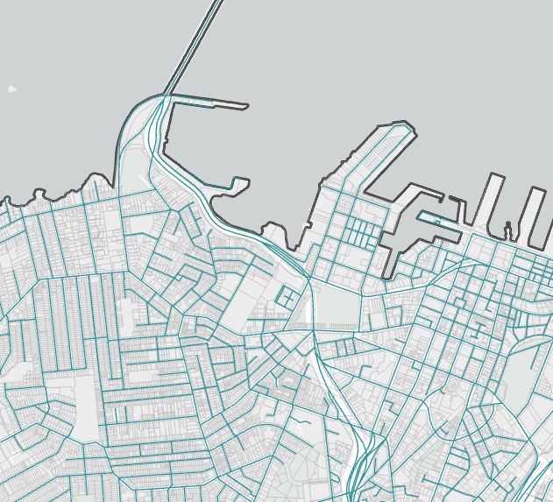
Base Data
City Boundaries
Census-designated areas
Parcels
Roads
Addresses
Land Use/Zoning

Slide 5
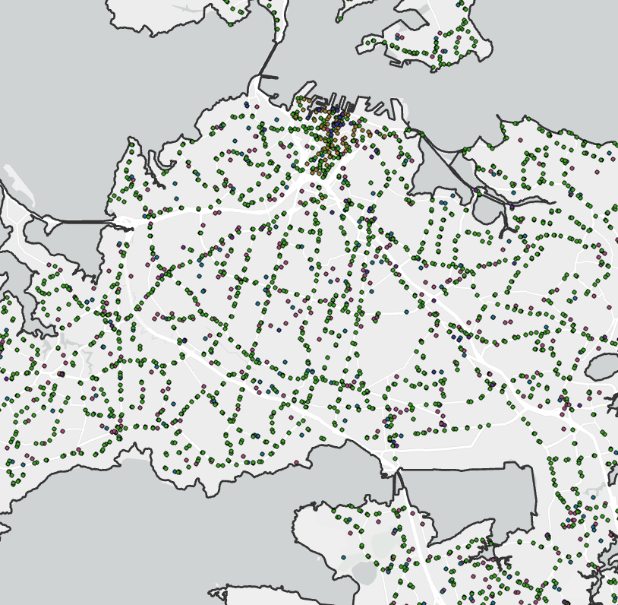
Points of Interest
Public Transportation
Foreign Missions
Crowd-Gathering Places
Hotels
Cell Towers
Shooting Ranges
Host Government Buildings
Museums
Public Services

Slide 6
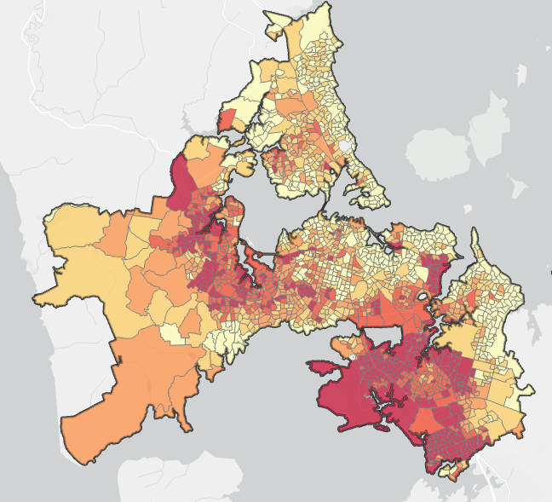
Socioeconomic Data
Population
Crime Rates
Income
Housing
Education
Access to Services

Slide 7
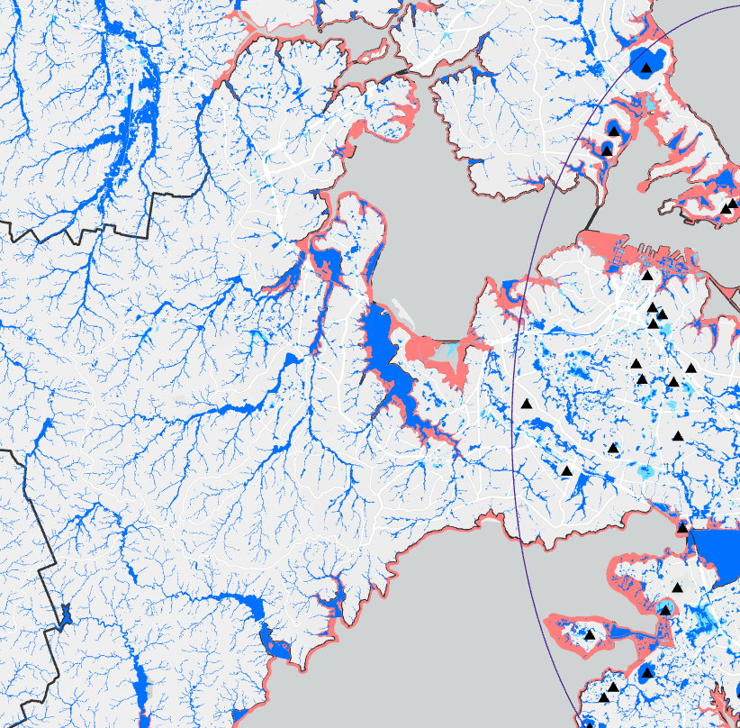
Natural Hazards
Flooding
Volcanic Fields
Tsunami Evacuation Zones
Severe Wind Zones
Areas of Seismic Activity
Wildfire Hazard Areas

Slide 8
Model Builder
By utilizing the Model Builder function of ArcGIS Pro, we can tailor a chain of spatial analyses that will prioritize favorable qualities while avoiding unfavorable qualities. We can also create a hierarchy of importance to ensure that the most crucial decision factors are considered above anything else. When we run this customized analysis on the data we have collected, the result is a map that contains only the areas that best meet the requirements we’re searching for.

Slide 9
Weighted Overlay
After running the model, we are left with a Weighted Overlay, a shaded area in which all criteria are satisfied. This area will guide further visual analysis to find sites that meet remaining criteria, such as bidirectional street adjacency and vacancy. If no parcels are identified that meet all criteria, then the weighted overlay is included in the final deliverable to assist the OBO in focusing future site searches.

Slide 10
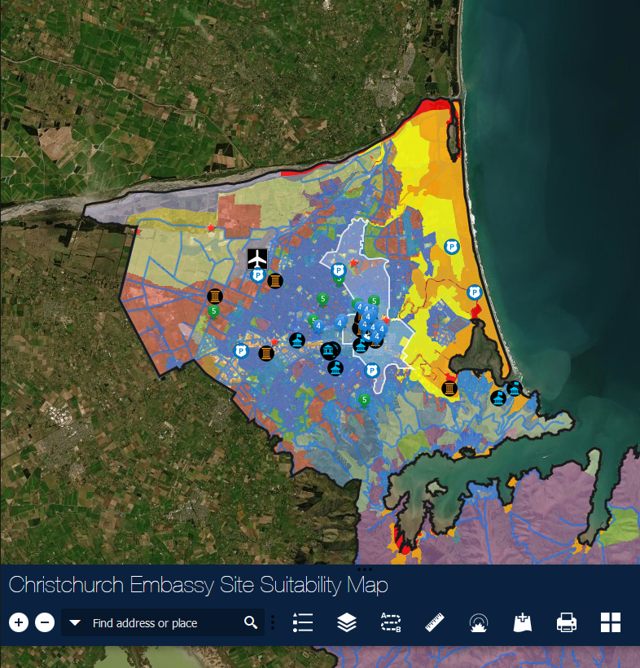
Delivery of Information
Once all data collection and analysis is complete, a final written report is generated with all findings, challenges, and recommendations. Finally, all data is exported to an interactive web application to provide further utility to the OBO for all studied cities after the term is over.

