Slide 1
Regional Development Plan Component Update
Jared Lombard October 31st, 2019
Lake Lanier, Gwinnett County

Slide 2
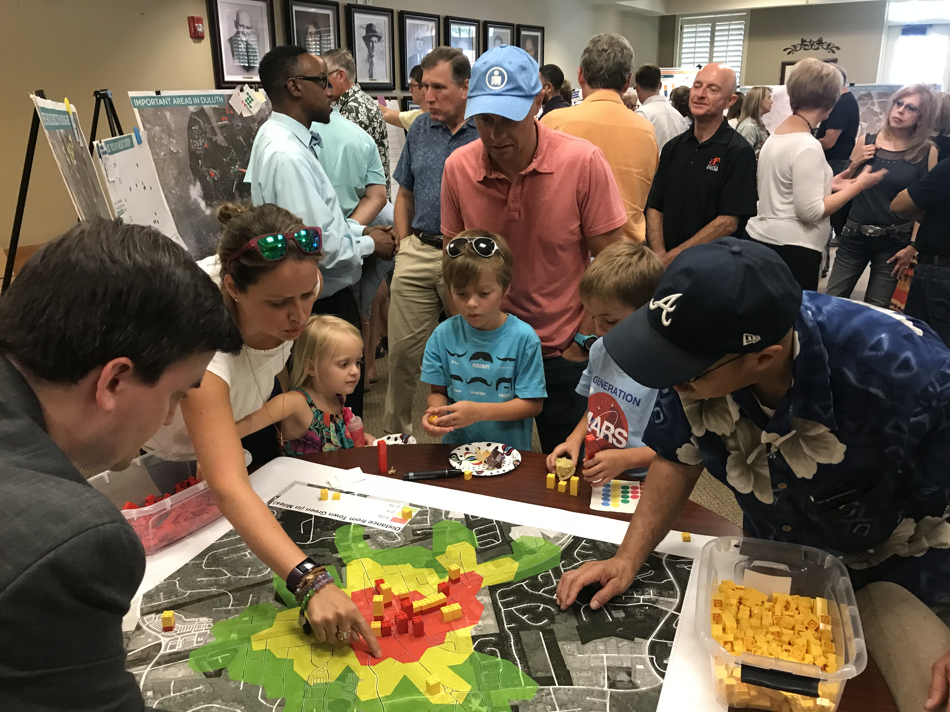
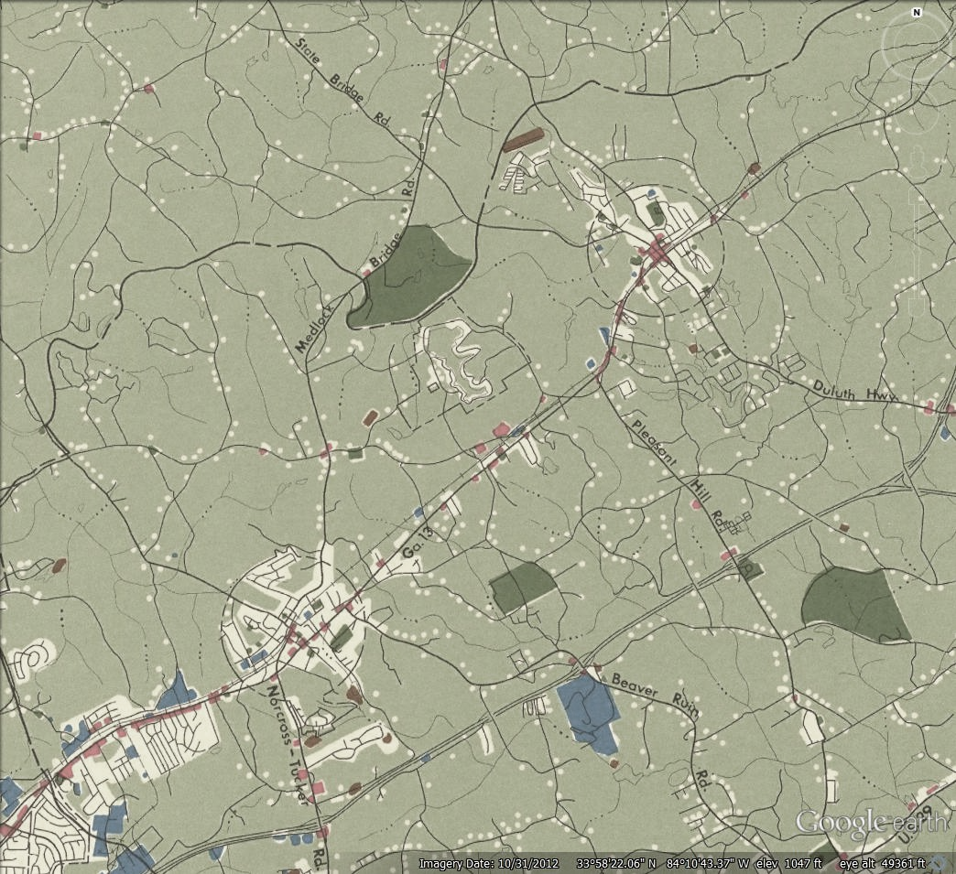
Schedule
Identify Assets & Challenges
1
Mapping (UGPM)
2
Develop Work Program
3

Slide 3
Purpose
Describes the growth vision of the region
Provides policy guidance for ARC programs and programing
Provides input into the Regional Forecast
Provides recommendations to local governments about future growth

Slide 4
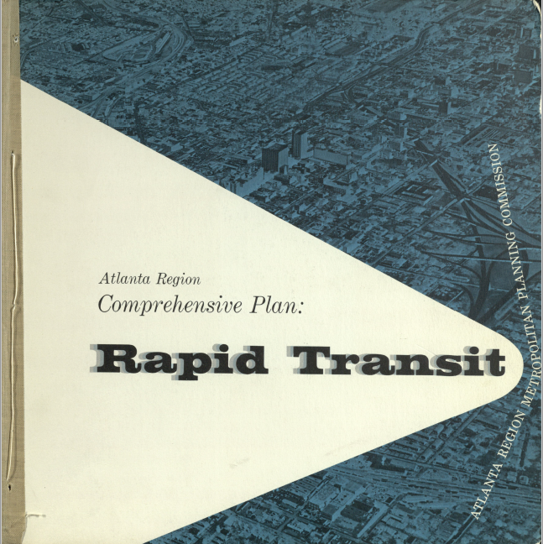

Slide 5
Regional Assets and Challenges
The region is a global business hub. The continued investment in infrastructure, workforce, and quality of life will continue to ensure its success.
To ensure the region’s economic success, everyone must be prepared to advance in a productive career.
The Atlanta region has successfully managed its limited water resources. Continuing the good stewardship will require conservation, new technology, and greater awareness.
Market and land use factors are limiting housing opportunities and choice in the region.
The region has strong but limited transit options. With the creation of a regional transit authority, significant coordination and prioritization will be required to maximize transit options.
Funding to for transportation has increased in recent years but the need for transportation investments continues.

Slide 6
Regional Assets and Challenges
Metro communities will have to overcome more frequent environmental shocks and stressors to their infrastructure and residents.
A person’s race too often determines economic opportunity.
Hartsfield-Jackson International Airport is the largest economic asset in the region and its continued success will require the region to coordinate land use, transportation, and economic development.
Older adults need to have opportunities for active living and ongoing participation in civic life.
Recognizing that place matters will help build a stronger regional and local identity.

Slide 8
UGPM Area Comparisons
8%
49%
51%
54%
44%
43%

Slide 9
Population by UGPM Area

Slide 10
Residential Density by UGPM Area Type

Slide 11
Activity Center Residential Change
141%
68%
142%
50%
139%
262%
46%
78%
49%
162%
Notes:
All of the centers have seen residential growth and combined they have added over 42,000 new housing units since 2000.

Slide 12
Proposed 2020-2025 Work Program
Austell CSX Intermodal Terminal, Austell, Cobb County

Slide 13
LCI By the Numbers
122
142
116
total LCI studies
supplemental studies
transportation projects
$16.8 M
$237 M
in transportation funds
in total study funds

Slide 14
LCI By the Numbers
166,000
107,000
population increase from 2000
new housing units from 2000
62,000
955,000
businesses
employees
Notes:
1 in 3 jobs in the Atlanta MSA are in LCI communities
Do the how long have you been involved in LCI Game
Close with how did this begin

Slide 15
LCI Work Program
Continue the LCI program to 2050 with $2 million per year in study funds
Add $100 million in transportation funds in LCI funds from 2040-2050.
DRAFT
Notes:
So what will the next 20 years look like for LCI in the region….
To help with that discussion, Jon is going to moderate a panel about the emerging trends in plans to help give you ideas about topics to explore in your LCI areas and plans.

Slide 16
ARC Aerotropolis Implementation since 2015
5
3
Finding the Flint
LCI Studies
CDAP Projects
6
Staff Assistance
Freight Cluster Study
Comprehensive Plans

Slide 17
ARC Aerotropolis Work Program
Continue supporting the Alliance and communities with Technical Assistance
Partner on an updated Blueprint
DRAFT
Notes:
So what will the next 20 years look like for LCI in the region….
To help with that discussion, Jon is going to moderate a panel about the emerging trends in plans to help give you ideas about topics to explore in your LCI areas and plans.

Slide 18
ARC Regional Housing Strategy
Strategy Framework​
Six Strategies
100 Local Government Tactics ​
​
Housing Subareas​
10 Sub Areas identified through outreach and research
​
Online Tool​
Interactive Map
Recommended Strategies and Tactics by Subarea
Dashboard with Performance Measures

Slide 19
ARC Regional Housing Work Program
Provide Technical Assistance to local governments on strategies
Continue to update Online Tool
Develop a Housing-Transportation Program
DRAFT
Notes:
So what will the next 20 years look like for LCI in the region….
To help with that discussion, Jon is going to moderate a panel about the emerging trends in plans to help give you ideas about topics to explore in your LCI areas and plans.

Slide 20
ARC TOD Work
Developed TOD Plans at East Lake, Kensington Station, East Point, Edgewood-Candler Park and West End
Conducted Housing and Economic Development Research at TOD
Currently working on BRT Land Use Study in Gwinnett County
$42 million in LCI funds to TOD supporting projects

Slide 21
ARC TOD Work Program
Develop a TOD/Transit Access Program
Assist Local Governments in Road Safety Audits
DRAFT
Notes:
So what will the next 20 years look like for LCI in the region….
To help with that discussion, Jon is going to moderate a panel about the emerging trends in plans to help give you ideas about topics to explore in your LCI areas and plans.

Slide 22
Upcoming Schedule
Nov
Dec
Feb
Draft Plan Review
Regional Review Period
Adoption

