Slide 1
Local Government Information Model

Slide 2
Why?
Supports data sharing between local governments and regional, state, and federal agencies
Modern data structure following national standards

Slide 3
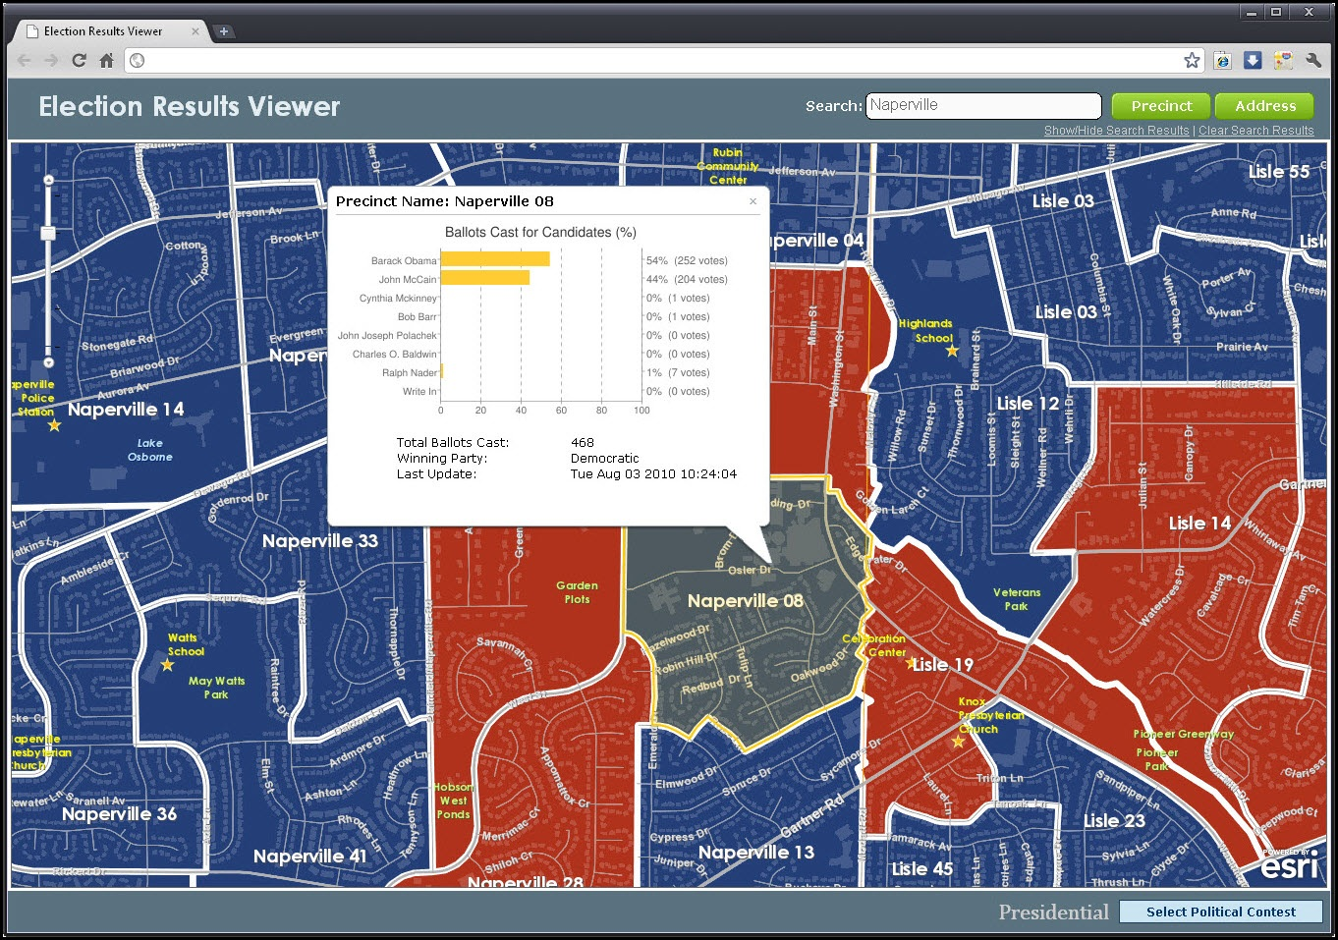
Election App

Slide 4
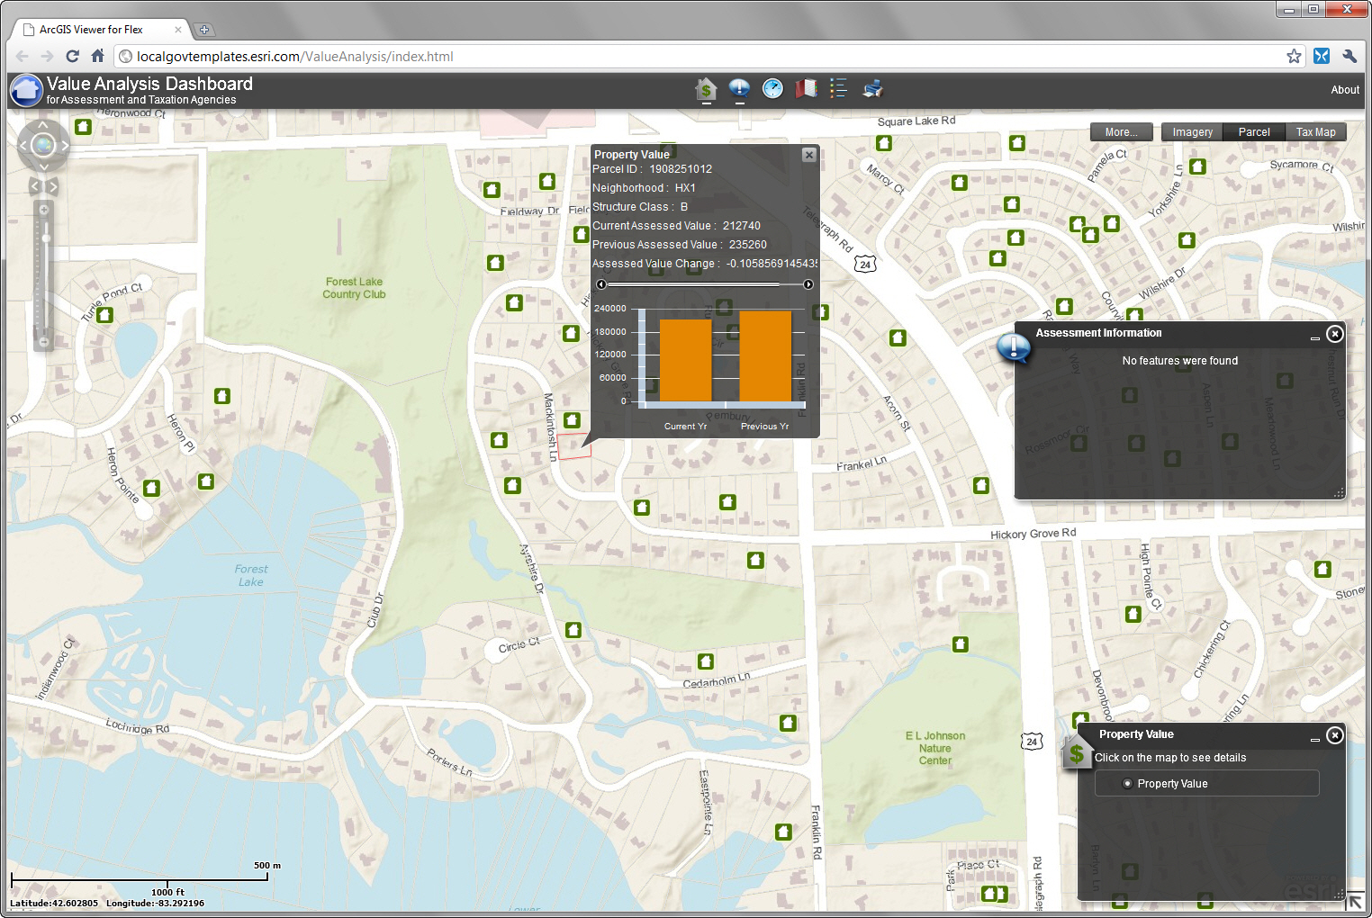
Property Value

Slide 5
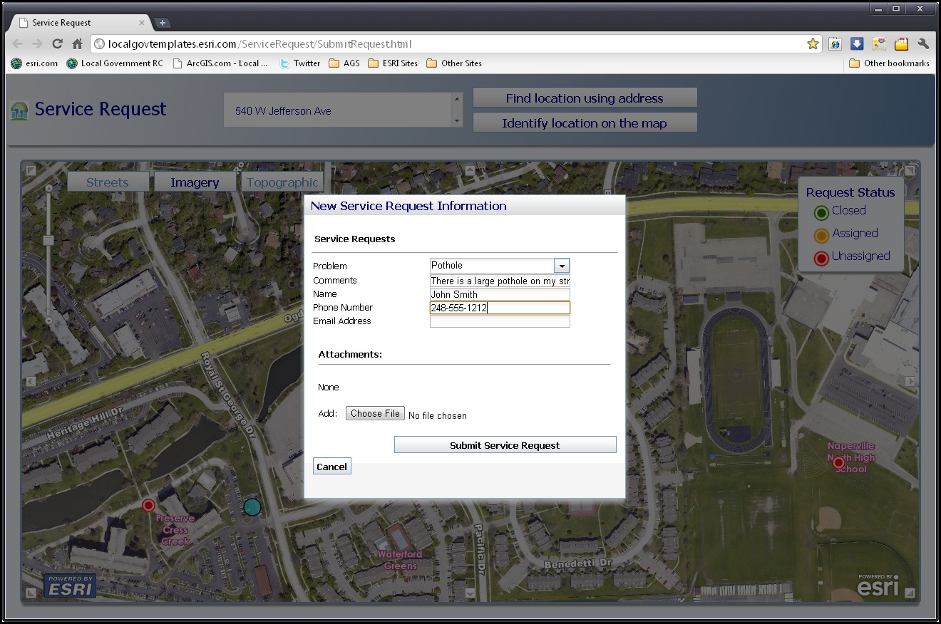
Service Request

Slide 6
Advantages
Plug-in Maps and Apps
App store for ArcGIS
Support from ESRI
Apps and model move to latest release
Many organizations with same structure
Shared enhancements
Shared knowledge

Slide 7
Disadvantages
Less customizations
Adds complexity
Requires ArcGIS Server
Tables and fields irellevant for Atlanta area
You must do it the ESRI way

Slide 8
Transition
Current version requires ArcGIS 10
Download layer package and load into geodatabase
Create temporary staging tables
Load data into staging tables and format for loading
Load data from staging tables into local government geodatabase

Slide 9
Example Apps
Local Government basemaps
Infrastructure
Land Records
Elections
Public Safety
Planning and Development
Facilities and Campus
Public Works

Slide 10
The Parcel Fabric

Slide 11
Parcel Fabric
Maintains dimensions of each parcel separately
Strict topology rules
Uses least squares adjustment and control points for spatial accuracy
Lines are used to create polygons

Slide 12
Coincidental boundaries
45
82 ft
46
87 ft
Same line from different surveys
Adjustments are based on accuracy of data

Slide 13
When to use the Parcel Fabric
Spatial accuracy is critical
Parcels in the same layer have different levels of accuracy
Accuracy needs to get better with new accurate data
Layer has good topology before import
Each parcel needs to preserve its original geometry and history
You aren’t in a hurry

Slide 14
When not to use the Fabric
Quick adjustments are required
Original data isn’t clean
You need easy access to parcel layer
No ground control points
What’s a COGO?

Slide 15
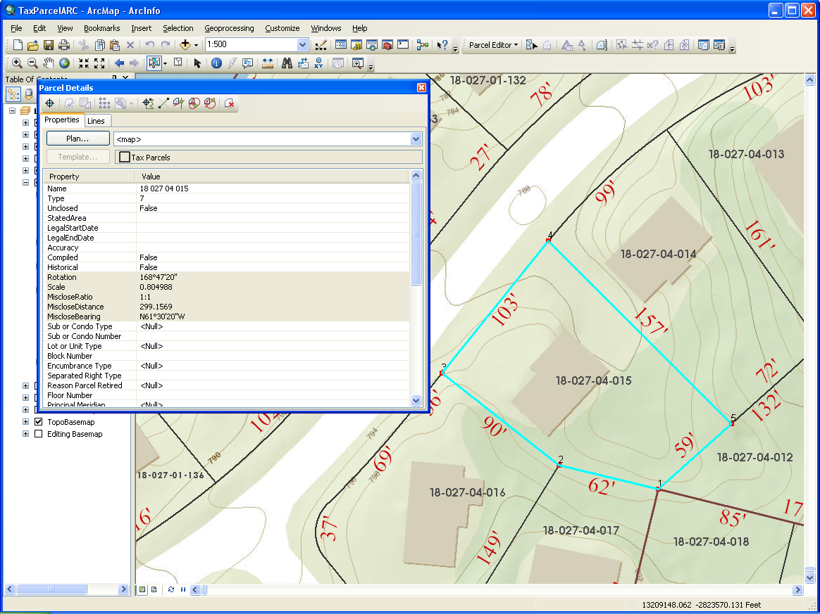

Slide 16
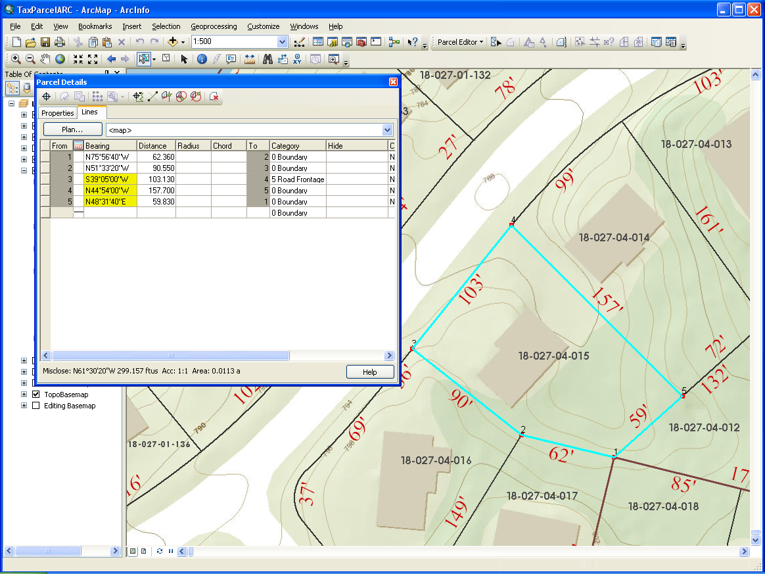

Slide 17
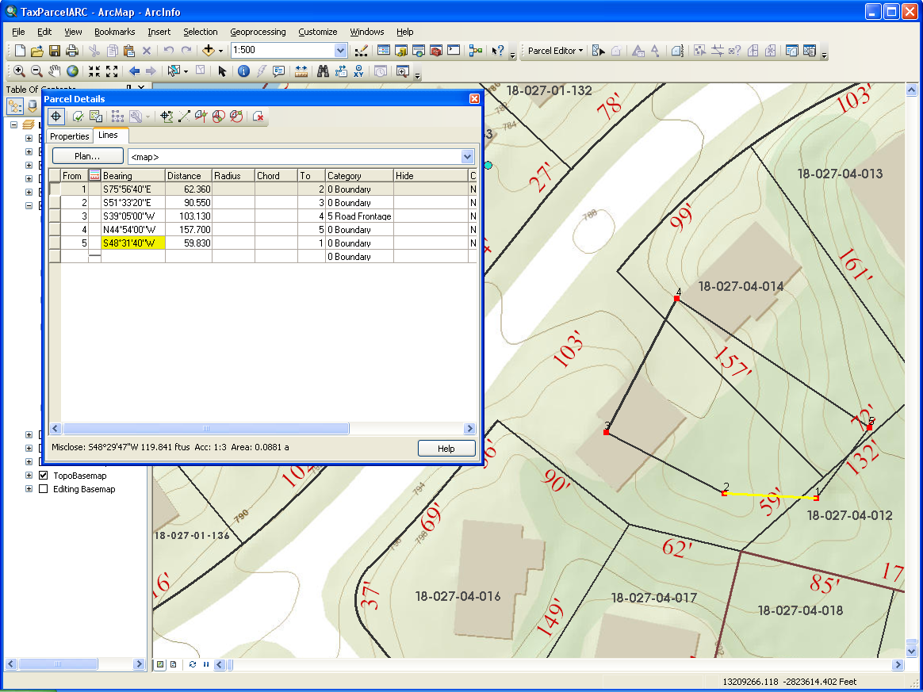

Slide 19
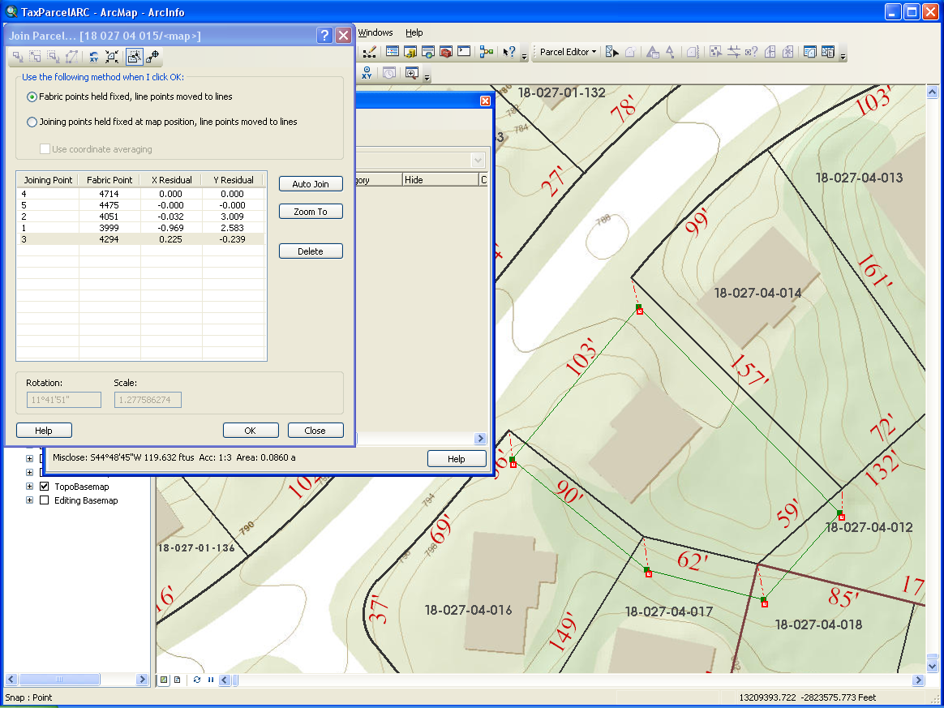

Slide 20
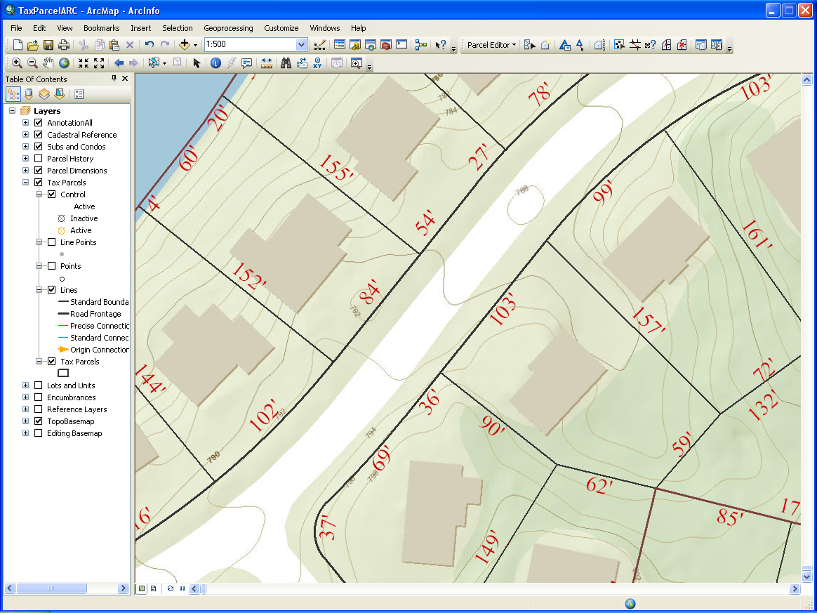

Slide 21
Where is DeKalb Today?
Migrated legacy data out of old data model
Internal web maps using new data model
Received initial delivery of data from parcel conversion
Testing fabric with work flows
Waiting on ArcMap 10.1

