Slide 1
An Overview of the Metropolitan River Protection Act and Chattahoochee Corridor Plan

Slide 2
Why Protect the Chattahoochee?
It provides over 50% of the Region’s water supply
It provides recreation for millions of visitors per year
It is a major trout fishery
It is green space in a rapidly urbanizing area

Slide 3
What Are the Issues?
Growth along the river became a concern in the late 1960s and early 1970s
Increasing development and activity stress the river and the surrounding lands
This activity can lead to increased runoff, erosion and pollution
Protection measures are needed to prevent these problems and preserve water quality

Slide 4
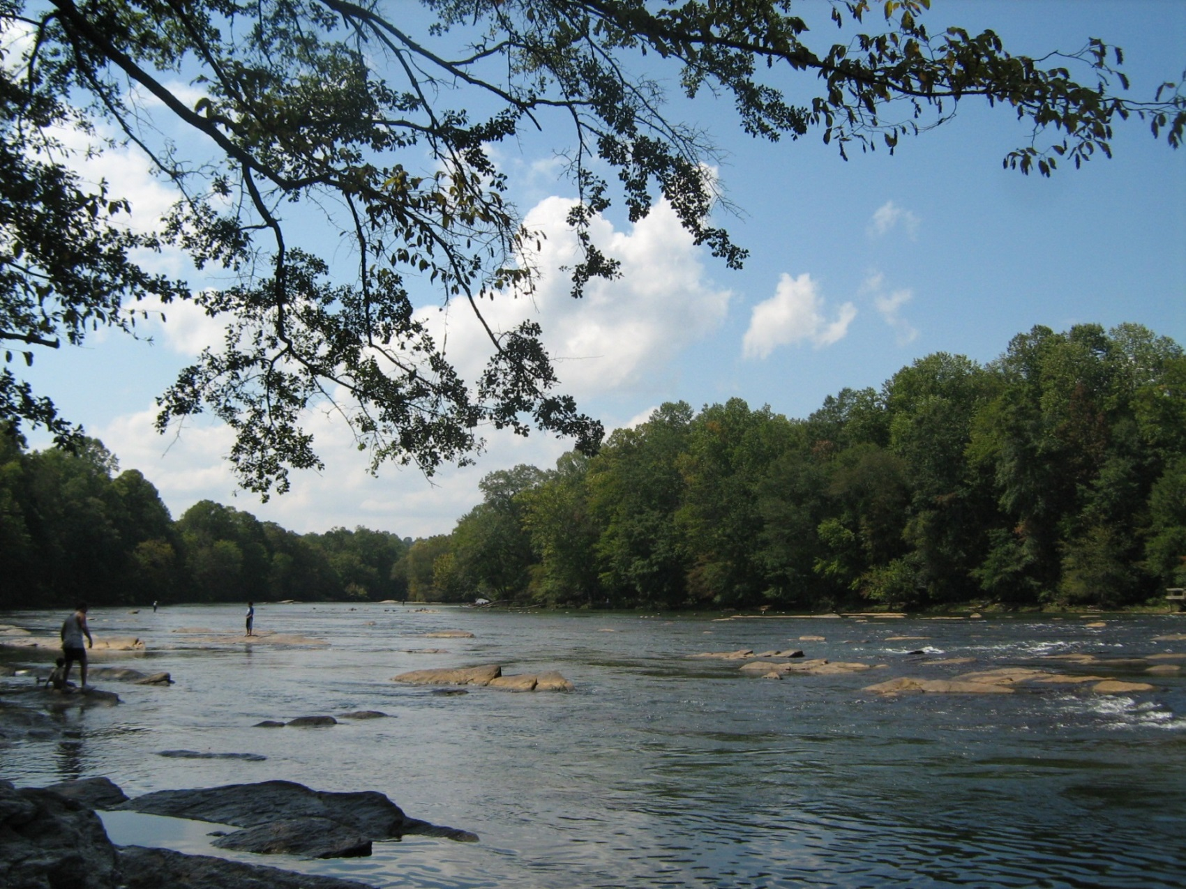
Fishing and Wading at Jones Bridge Park

Slide 5
Chattahoochee River near Rogers Bridge

Slide 6
Chattahoochee Corridor Study
In 1972 ARC conducted a study of the river and the surrounding lands
Looked at the river’s issues and their causes
Developed a plan for protecting the river and its resources by working with the existing natural conditions
Identified possible lands for protection and sites for public access

Slide 7
Study Led to Legislation
Metropolitan River Protection Act
Adopted in 1973
Established the Chattahoochee River Corridor

Slide 8
Chattahoochee River Corridor
2000 feet on both sides of the Chattahoochee
From Buford Dam to downstream limits of Fulton and Douglas Counties
Includes parts of five counties (including Forsyth) and thirteen cities (including South Fulton)

Slide 9
The Chattahoochee River Corridor

Slide 10
Act Requirements
Regional Commission must develop, adopt and implement a Corridor Plan
Proposed land-disturbing activity subject to review under Plan
Sets development standards in Corridor
Standards must be met for consistency with Plan

Slide 11
Plan Standards
Vulnerability Standards
Limit land disturbance and impervious surface based on land conditions
Floodplain Standards
Balance cut and fill, height limits in river floodplain
Buffer Zone Standards
50-foot undisturbed buffer, 150-foot impervious setback along river
35-foot undisturbed buffer along tributary streams

Slide 12
Review Process
Applications must meet all applicable standards to be consistent with Plan
ARC reviews an application and makes a finding
Can be consistent or inconsistent with the Plan
Local government votes on whether to approve ARC finding

Slide 13
Consistent Findings
Consistent with Plan
Meets all applicable Plan standards
Equivalent to a Consistent Project
Cannot meet all standards due to pre-existing conditions and provides measures to offset problem
Both handled administratively

Slide 14
Inconsistent Findings
Inconsistent with Plan:
Recommendations can be attached to finding
Recommendations must bring proposal into consistency or equivalent consistency
Can include “No build” recommendation
Finding presented to CRC and Board as resolution

Slide 15
Inconsistent Review Procedure
CRC, then full Board, must vote on resolution
Per Section V.H.3. Of ARC’s MRPA Rules and Regulations
Local government can override recommendations
Must follow process specified in the Act

Slide 16
After the Review
Local governments monitor development activity
Changes to design are possible
Must remain within approved total limits

Slide 17
In Summary
The Act and Plan have been in place for 44 years
Have continued to work as Region has grown and circumstances have changed
Have withstood several legal challenges
Allow for development while protecting the land and water resources of the river
Have helped to protect our most valuable natural resource and will continue to do so in the future

Slide 18
Clear Water on the Chattahoochee

Slide 19
ARC Contact Info
Jim Santo
Email: jsanto@atlantaregional.com
Phone: 404-463-3258

