Slide 1
Utilizing GIS to Improve
Regional Water Planning
Stormwater Forecast & River Basin Profiles
Shellby Miller & Ansley Murphy
Metropolitan North Georgia Water Planning District

Slide 2
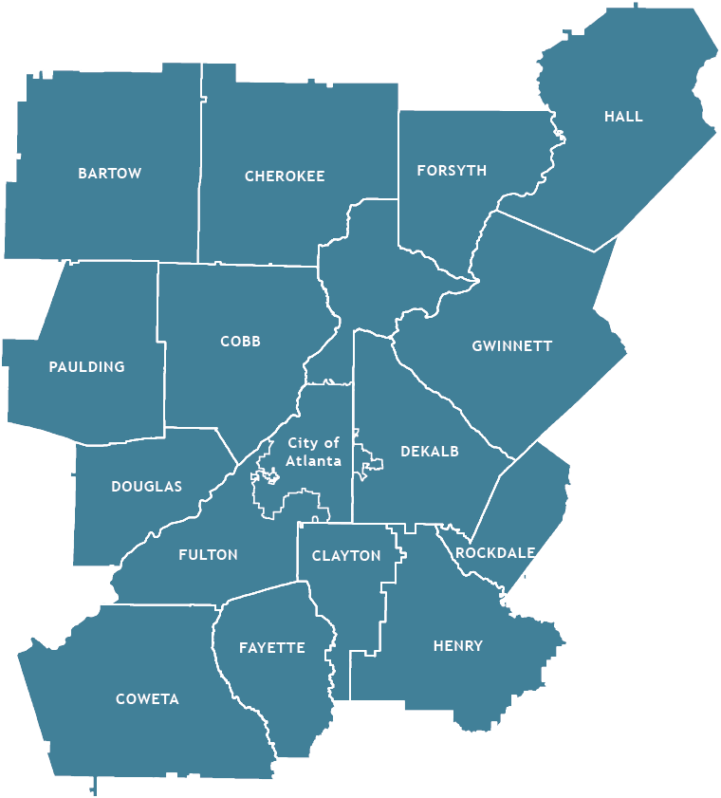
Metropolitan North Georgia Water Planning District
15 Counties
96 Cities
99% of our drinking water is supplied through Surface Water Sources

Slide 3
Created by the Georgia Legislature in 2001
Metro Water District
develops regional Water Resources Management Plan
Local governments responsible for implementing plans
Georgia EPD approves plans and enforces implementation via permits and state funding eligibility

Slide 4
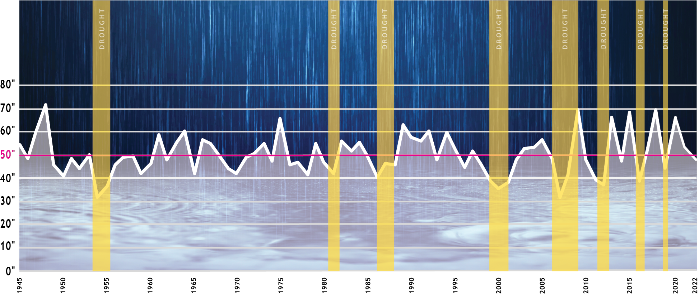
Metro Atlanta’s Rainfall is Changing
Annual Rainfall
Average Annual Rainfall = 50 inches

Slide 5
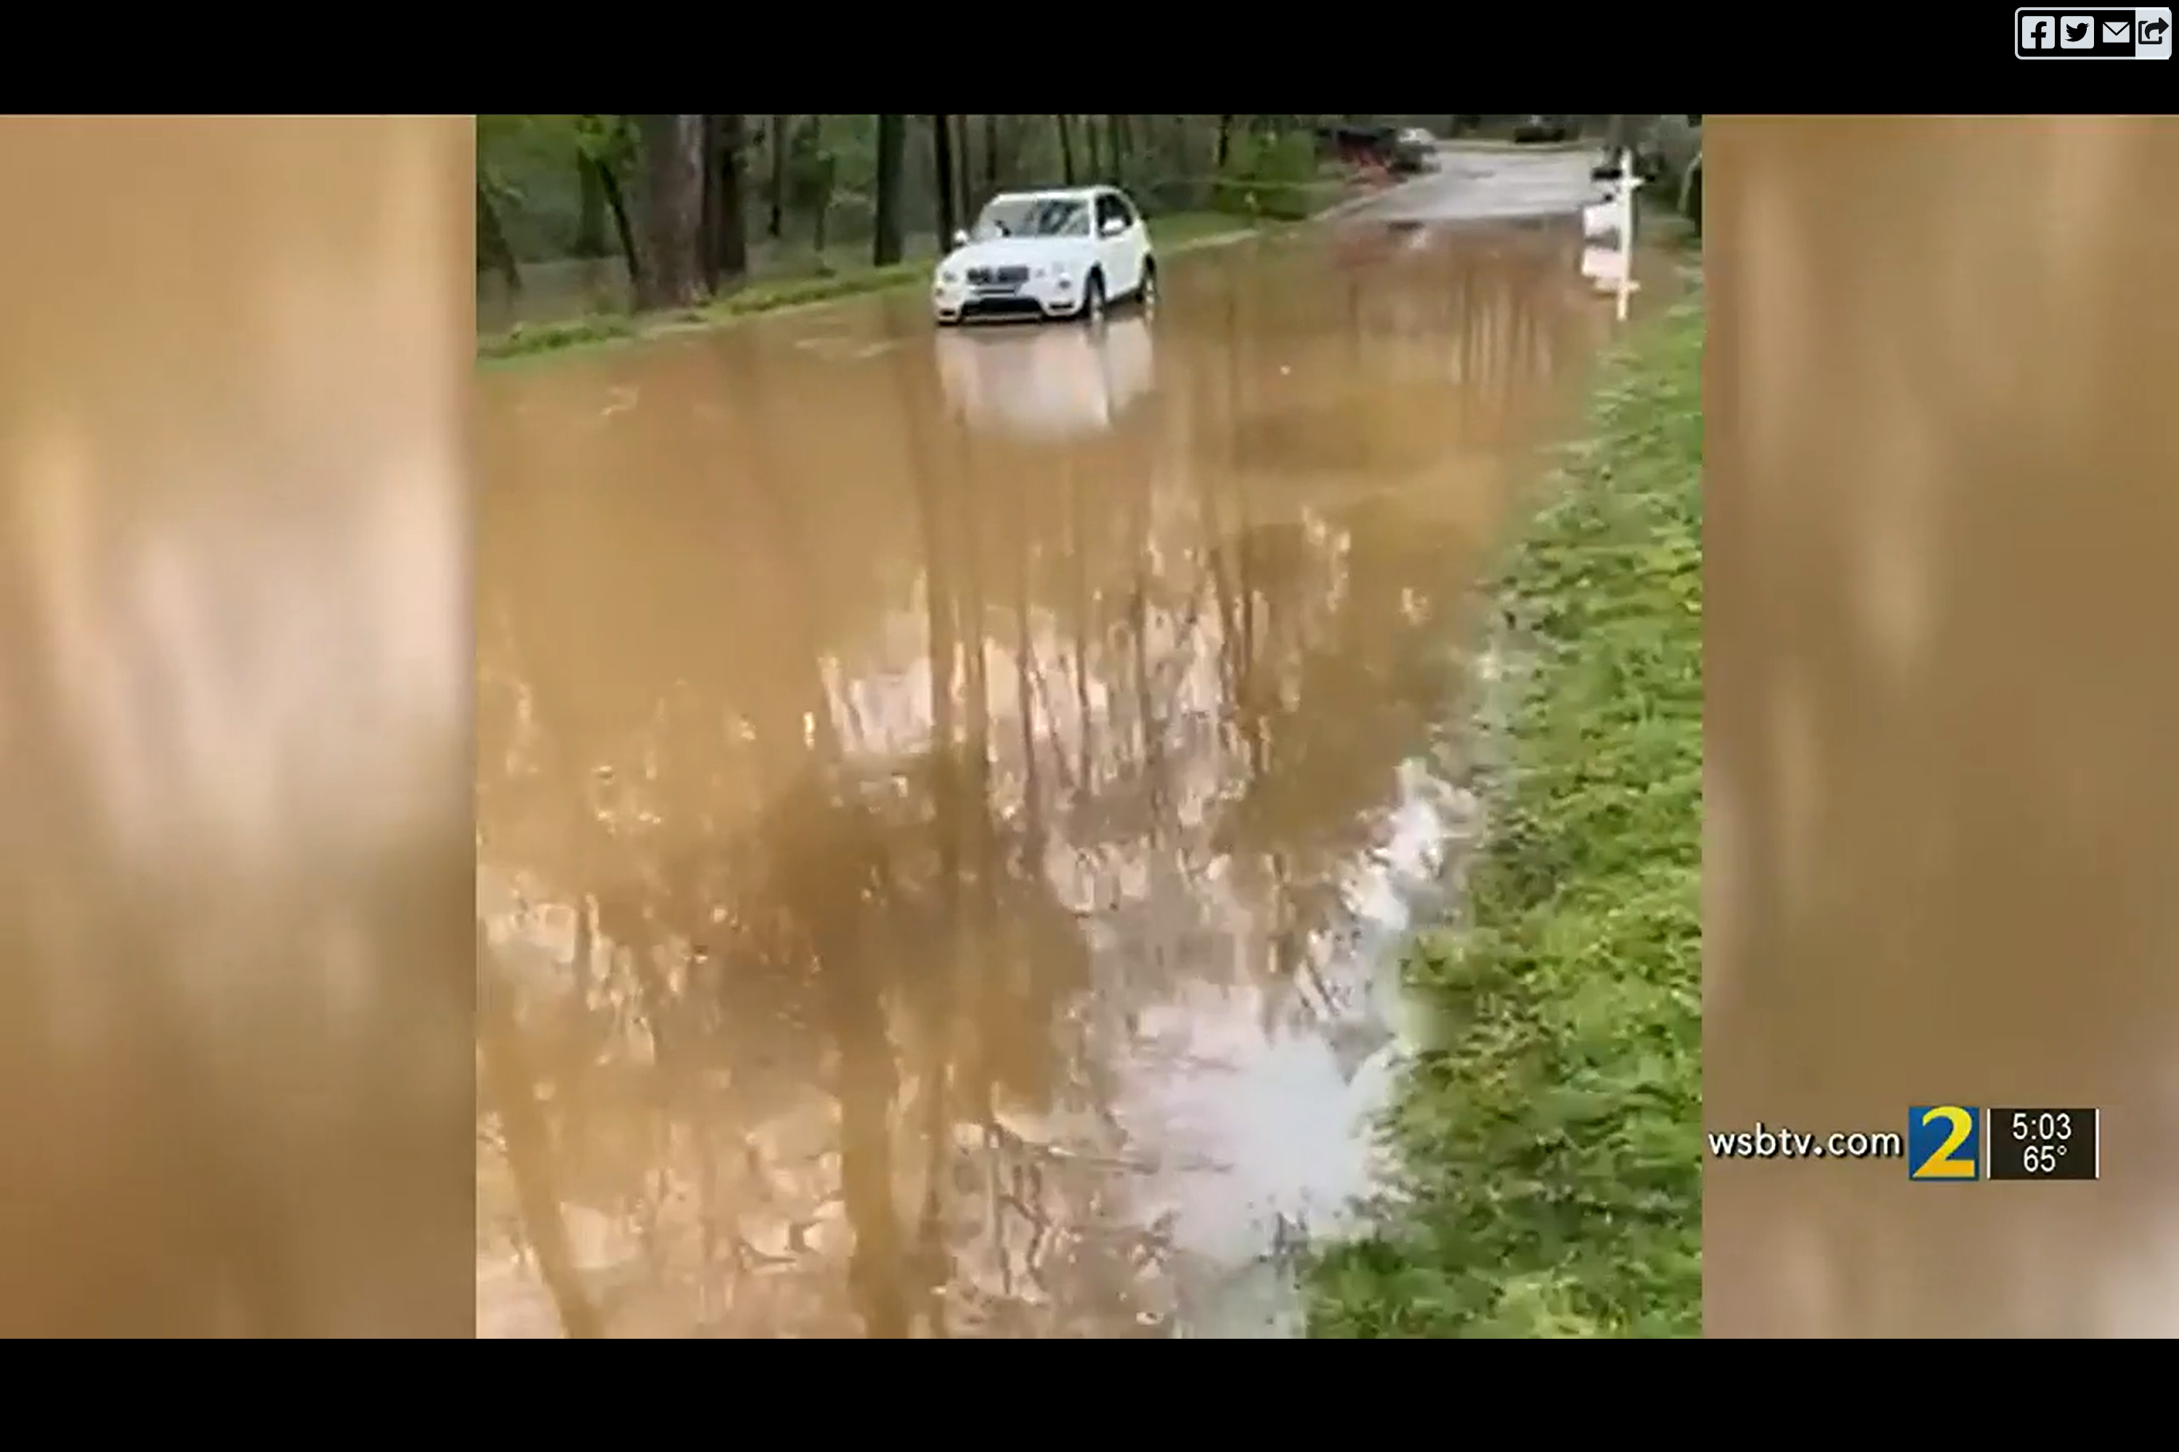
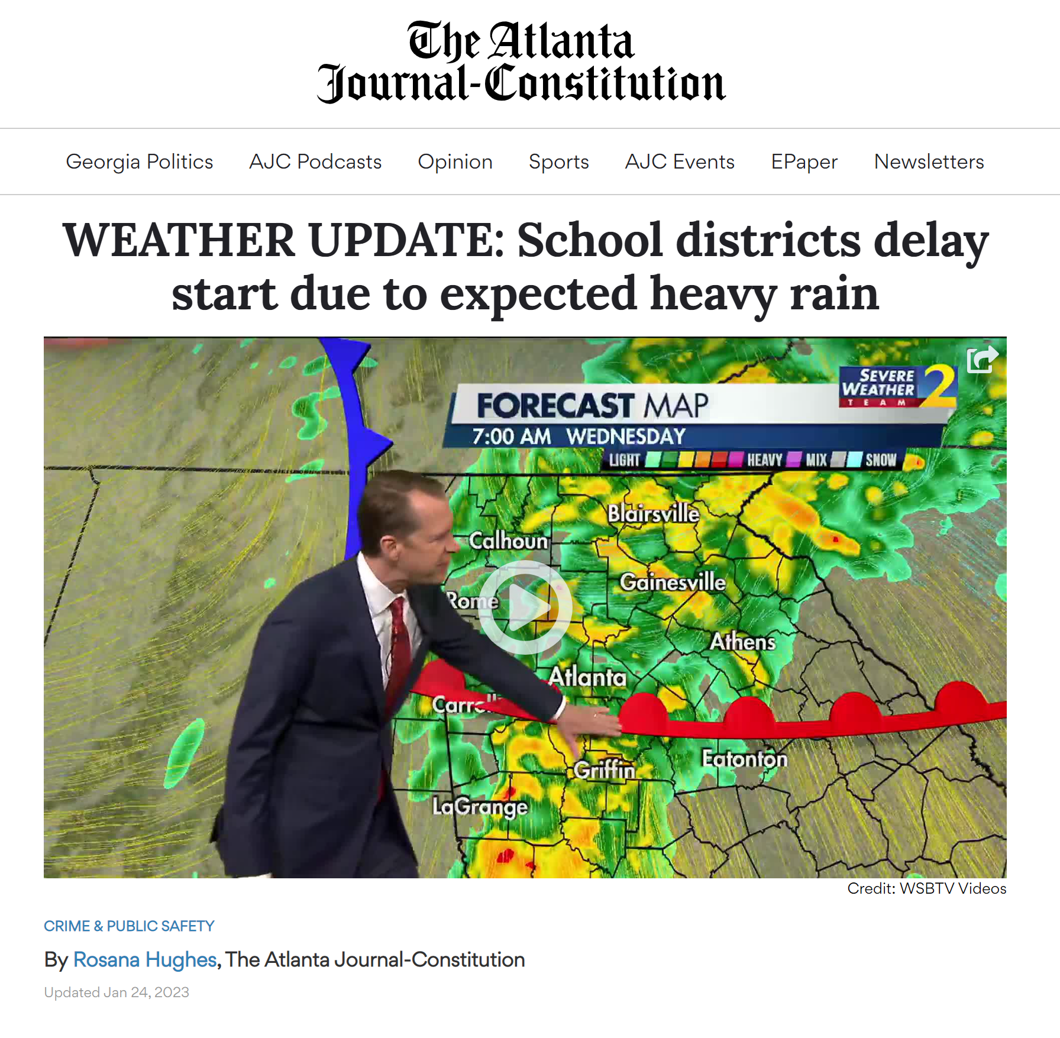

Slide 6
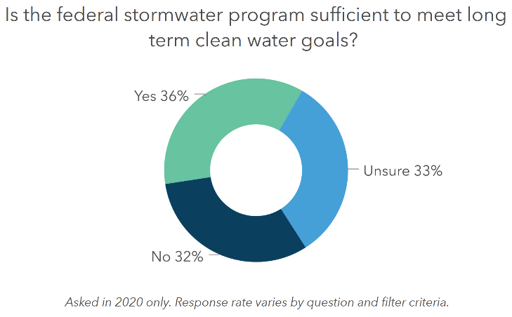
Current stormwater metrics
Municipal Separate Storm Sewer System Compliance (MS4)
303(d)/ 305(b) List of Impairment
Land Use Plans Reviewed
Stormwater Projects Completed
Citizen Complaints
Flooding
Sinkholes
Stream Bank Erosion
https://wefstormwaterinstitute.org/programs/ms4survey/

Slide 7
Goals for a New Approach
Identify a metric that facilitates new conversations in stormwater management
Shift the stormwater paradigm from activity and compliance-based management to performance and function-based management
Evaluate existing and future watershed conditions through 2040
Future development
Future meteorological trends

Slide 8
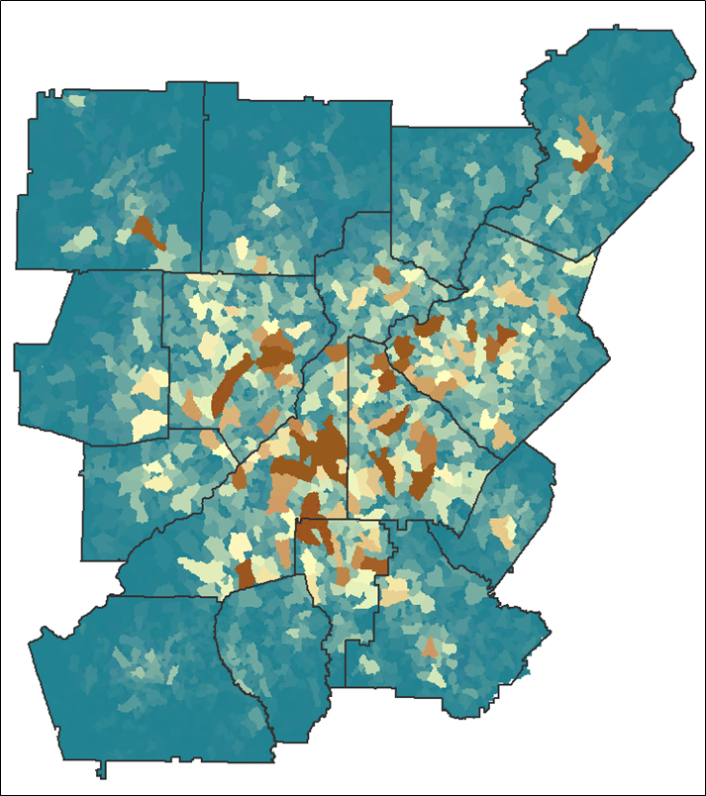
Stormwater Forecast Overview
Planning-level estimate of the total potential runoff management volume from development
Calculated at a Basin Scale
Four Planning Scenarios
Predevelopment, 2019, 2030, & 2040
Using three Post-Construction SW Management Standards
Water Quality Volume (WQv)
Channel Protection Volume (CPv)
Overbank Flood Protection Volume (OFPv)
2019 WQv

Slide 9
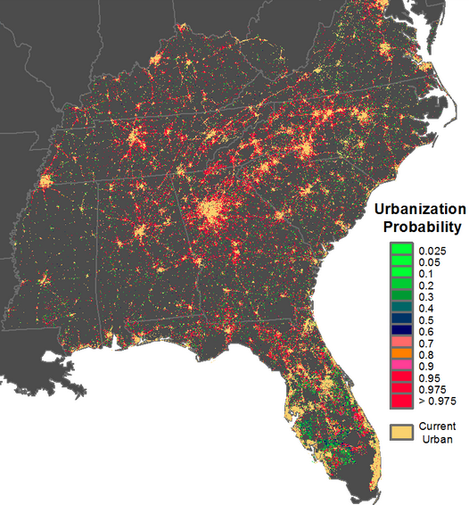
Stormwater Forecast Calculations
Input Data
Watershed Characteristic
Runoff Volume Results
County, HUC-12, & NHD Subcatchment Boundaries
USGS 1/3 Arcsec DEM
USGS NLCD – 2001 & 2019
NRCS SSURGO (Soils)
NOAA Atlas 14 Rainfall
USGS Future Urbanization – through 2040*
Future Rainfall Depths – through 2040
Rainfall Depths
Drainage Area
Basin Slope
Land Cover
Imperviousness
Hydrologic Soil Groups
Time of Concentration
Direct Runoff
Initial Abstraction
Curve Number
Peak Discharge
Water Quality
Channel Protection
Overbank Flood Protection
USGS Southern Megalopolis Study: https://doi.org/10.1371/journal.pone.0102261

Slide 10
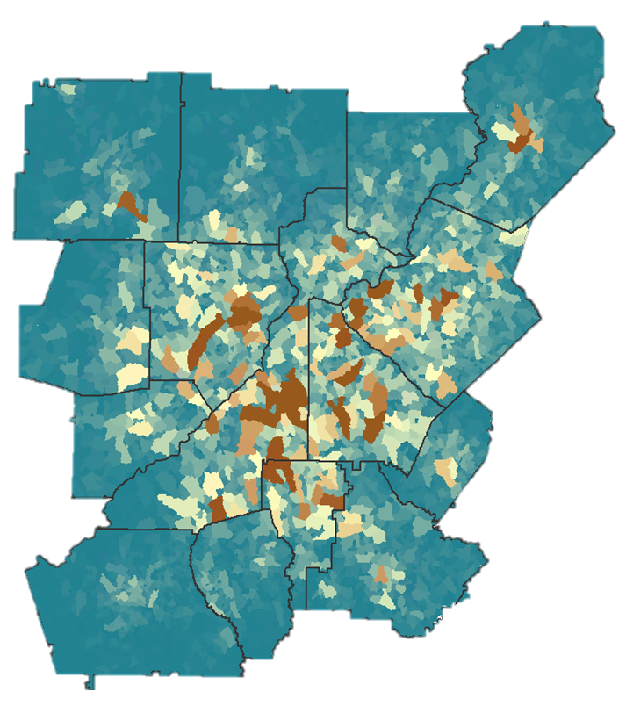
Stormwater Forecast as a New Metric
New Home Price
Current Savings
Amount needed for the new home
New Metric for Stormwater Program Management
?
Total Potential Runoff Volume
Runoff
Currently Managed
Gap to manage

Slide 11
District-wide Stormwater Forecast Information
Current And Future District-wide Rainfall Depths by Design Storm
11% Increase from 2019
14% Increase from 2019
16% Increase from 2019

Slide 12
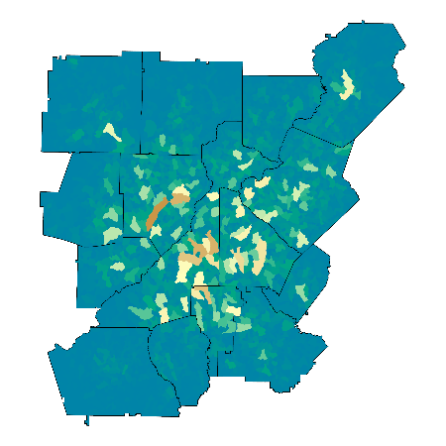
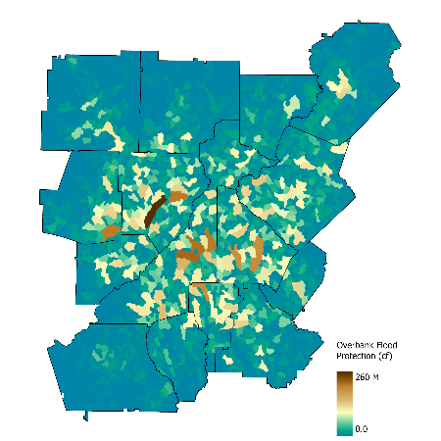
Stormwater Management Volumes are Increasing
Percent change: 2019 to 2040
2019
116% - Water Quality Volume
89% - Channel Protection Volume
103% - Overbank Flood Protection Volume
Overbank Flood Protection Volume
2040

Slide 13
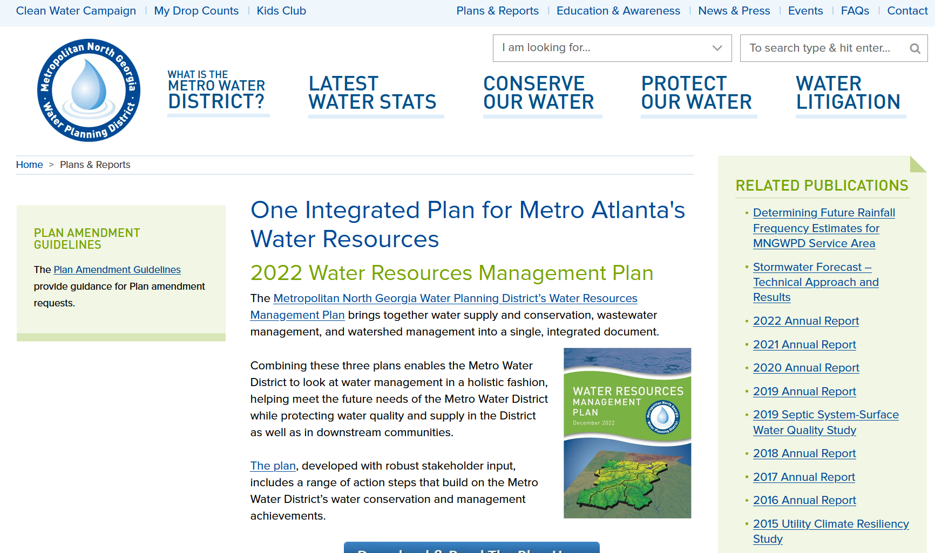
Want to know more?
District Website: northgeorgiawater.org
Select: Plans & Reports

Slide 14
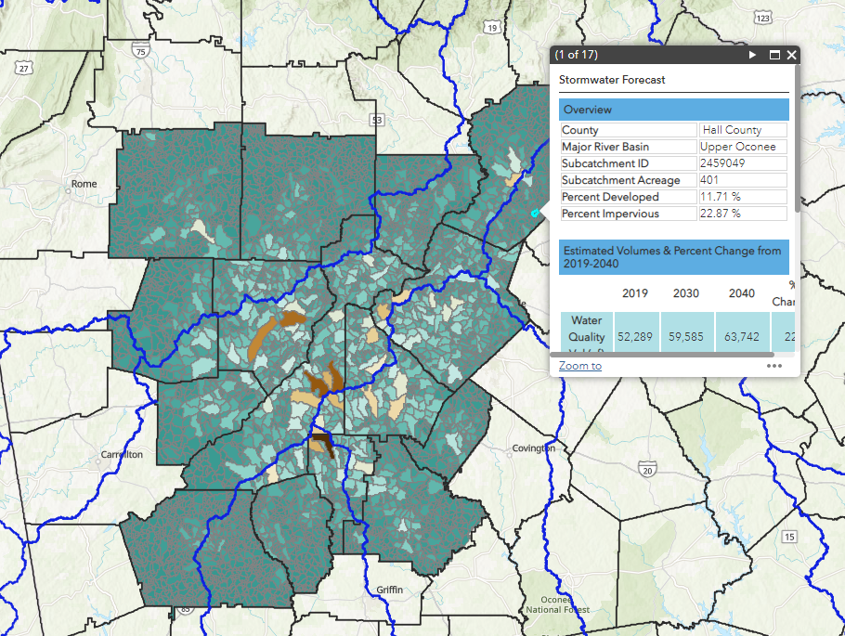
What’s Next?
Publish to ARC Data Hub
Develop Snapshot tool using ArcGIS API for JavaScript and React

Slide 15
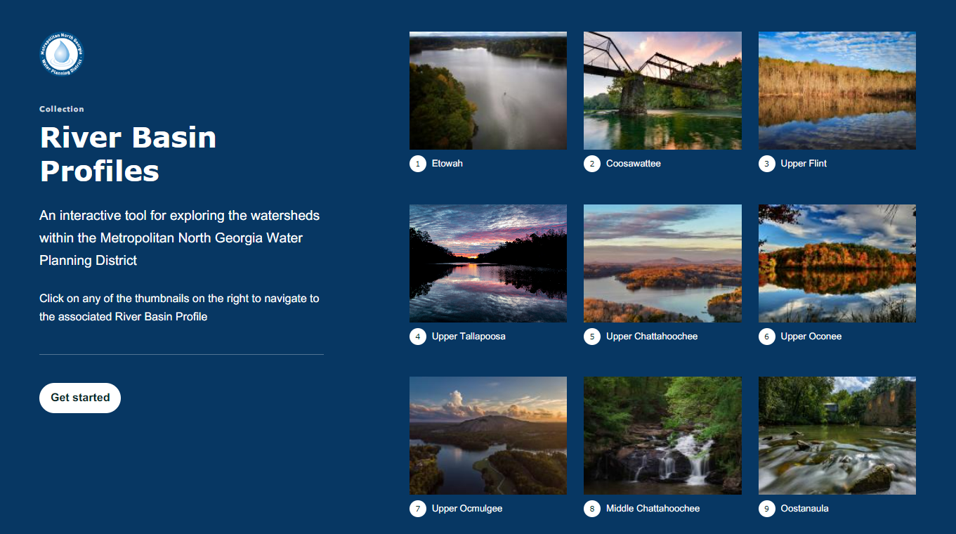
https://arcg.is/1DjqWn

Slide 16
Thank you
Shellby Miller, Senior Data & GIS Analyst
smiller@atlantaregional.org
Ansley Murphy, GIS Intern
amurphy@atlantaregional.org

