Slide 1
High Accuracy GPS Collection on Emergency Assets
Kelly Daire
9/8/2022

Slide 2
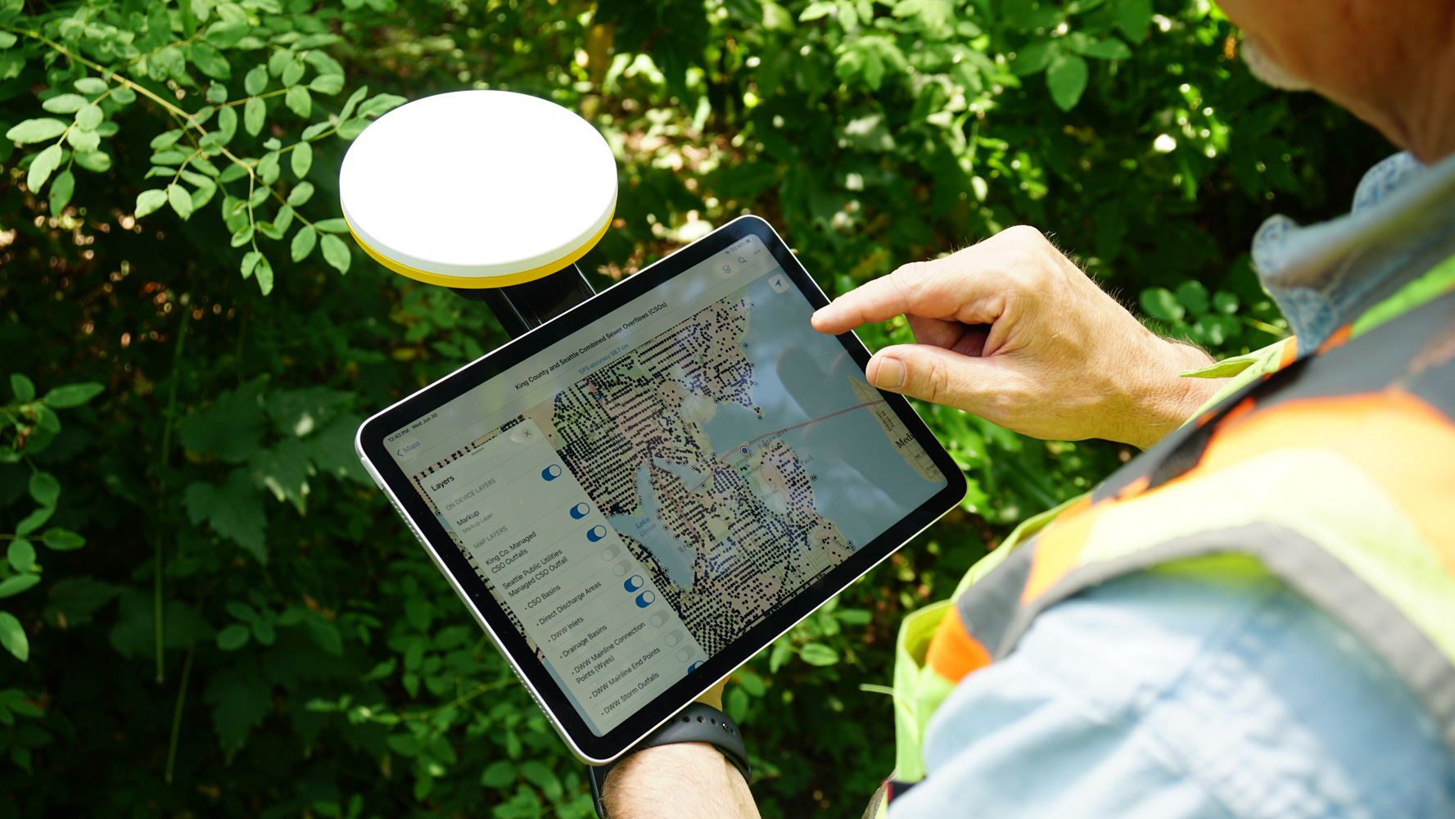
Tools used
Trimble DA2 Catalyst
ESRI Fieldmaps
ESRI Dashboards

Slide 3
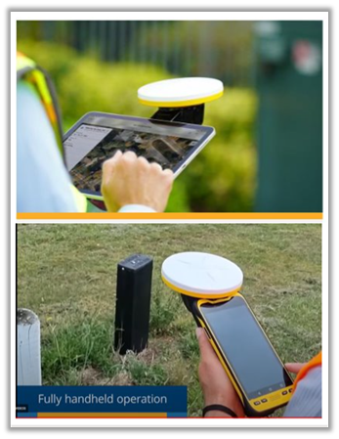
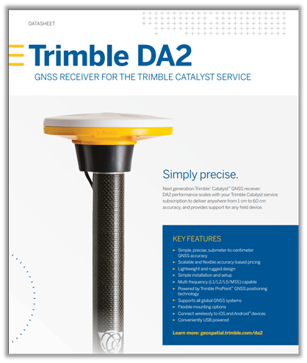
GPS Units
Trimble DA2 GNSS Receiver with Catalyst
Precise accuracy
Centimeter to sub-meter
Lightweight and easy-to-use design
Affordable & flexible
Change subscription at any time

Slide 4
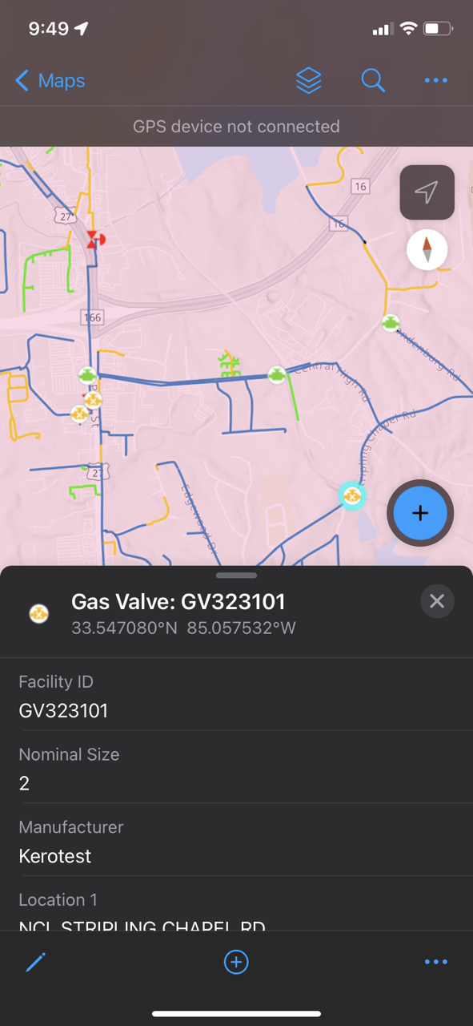
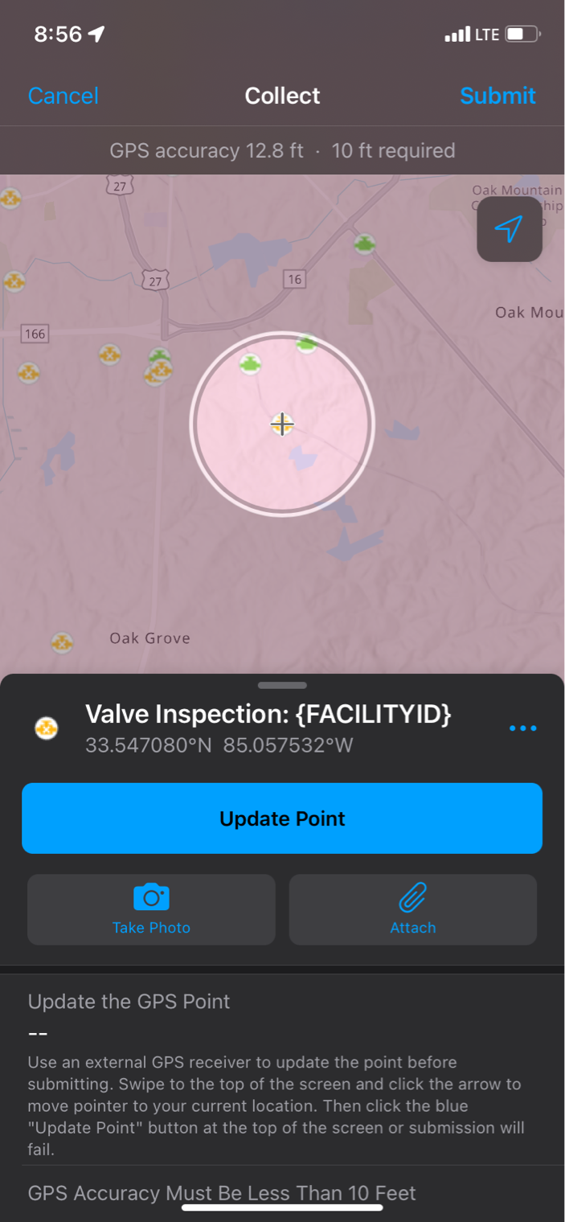
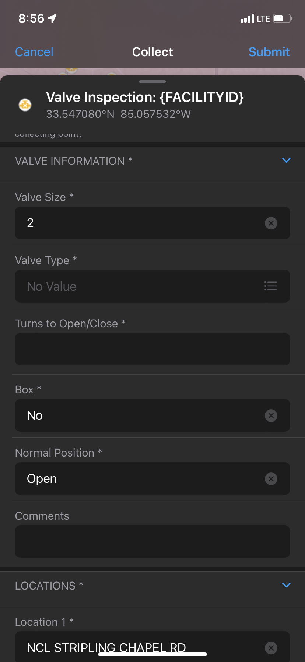
ESRI Field Maps

Slide 5
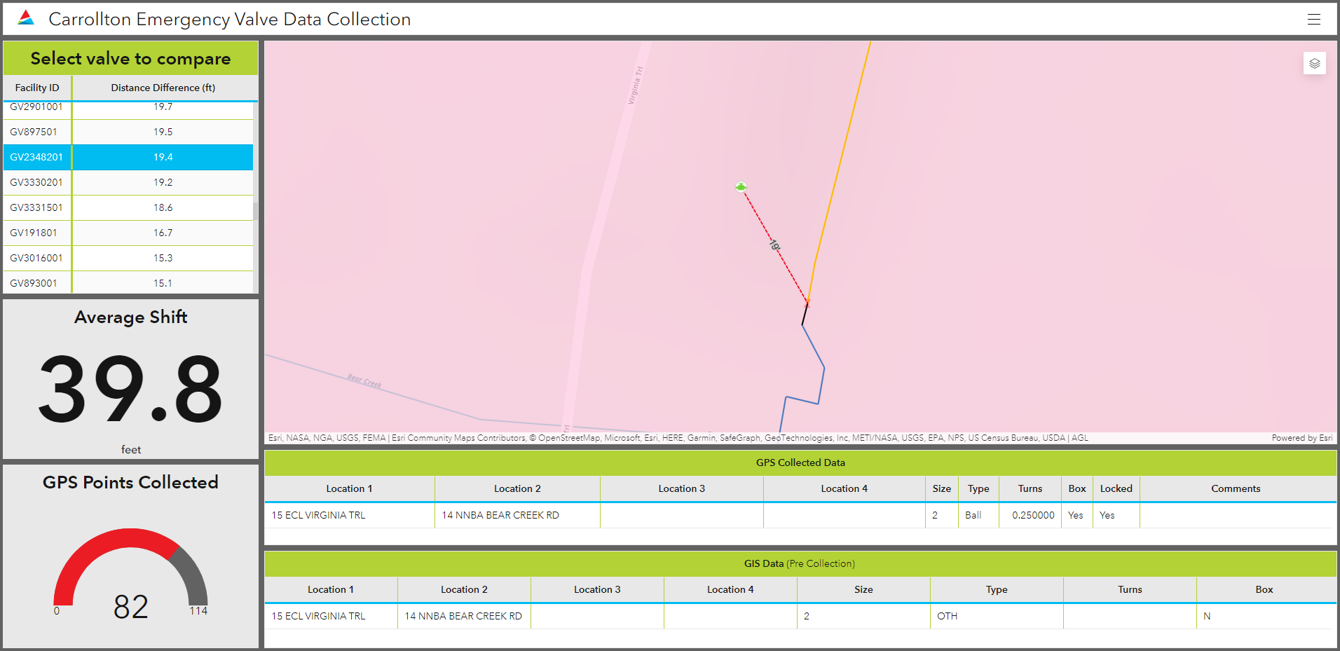
Dashboard

Slide 6
Next Steps…
Rollout
Expand Data Collection
Other Service Centers
Other assets
Digital as-builting
Update Current Date
Records Research
Time Study

Slide 7
Lessons Learned
Bugs within Field Maps
Reported accuracy discrepancy (Trimble vs ESRI)
Patience is key!
2-5 minutes to connect to GPS
Verify login

Slide 8
Thank you!

