Slide 1

Managing Mobility in the Atlanta Region
A Strategic update to the human services transportation plan

Slide 2

Plan Vision
“…provide integrated, multimodal transportation for low-income populations, older adults, veterans, limited English proficiency populations and persons with disabilities. Local and regional actors will coordinate to deliver comprehensive and mutually supportive service.”

Slide 3
Plan Goals
Establish a decision-making framework based on the personal process HST populations use to evaluate mobility options.
Develop a menu of local and regional tactics that will work in a coordinated manner to improve mobility in the Atlanta region.

Slide 4
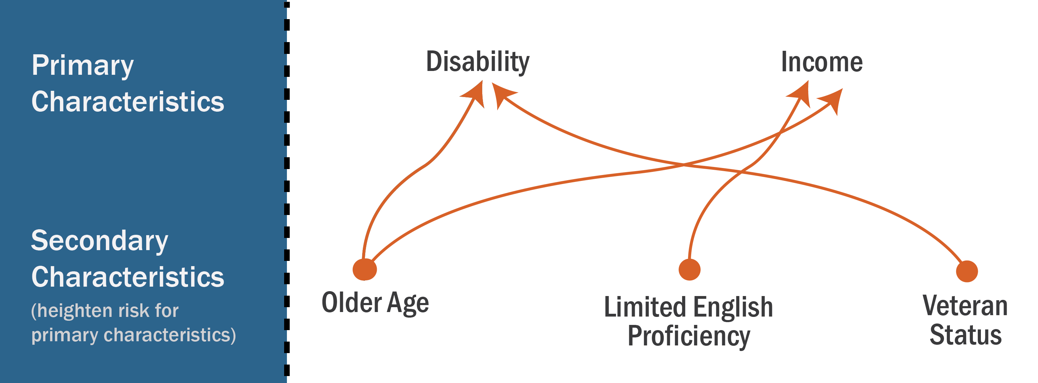
Needs Assessment:
Human Service Transportation (HST) Population

Slide 5

Needs Assessment: Service Options
Fixed-Route/Guideway
ADA Paratransit
Carpool/Vanpool
Specialized Services
Telework/Teleconnect

Slide 6
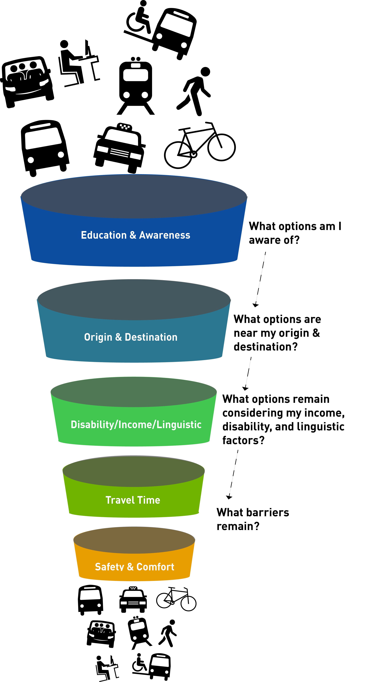
Exploring Barriers
Education and Awareness
Origin and Destination
Disability/Income/Linguistic
Travel Time
Safety and Comfort

Slide 7
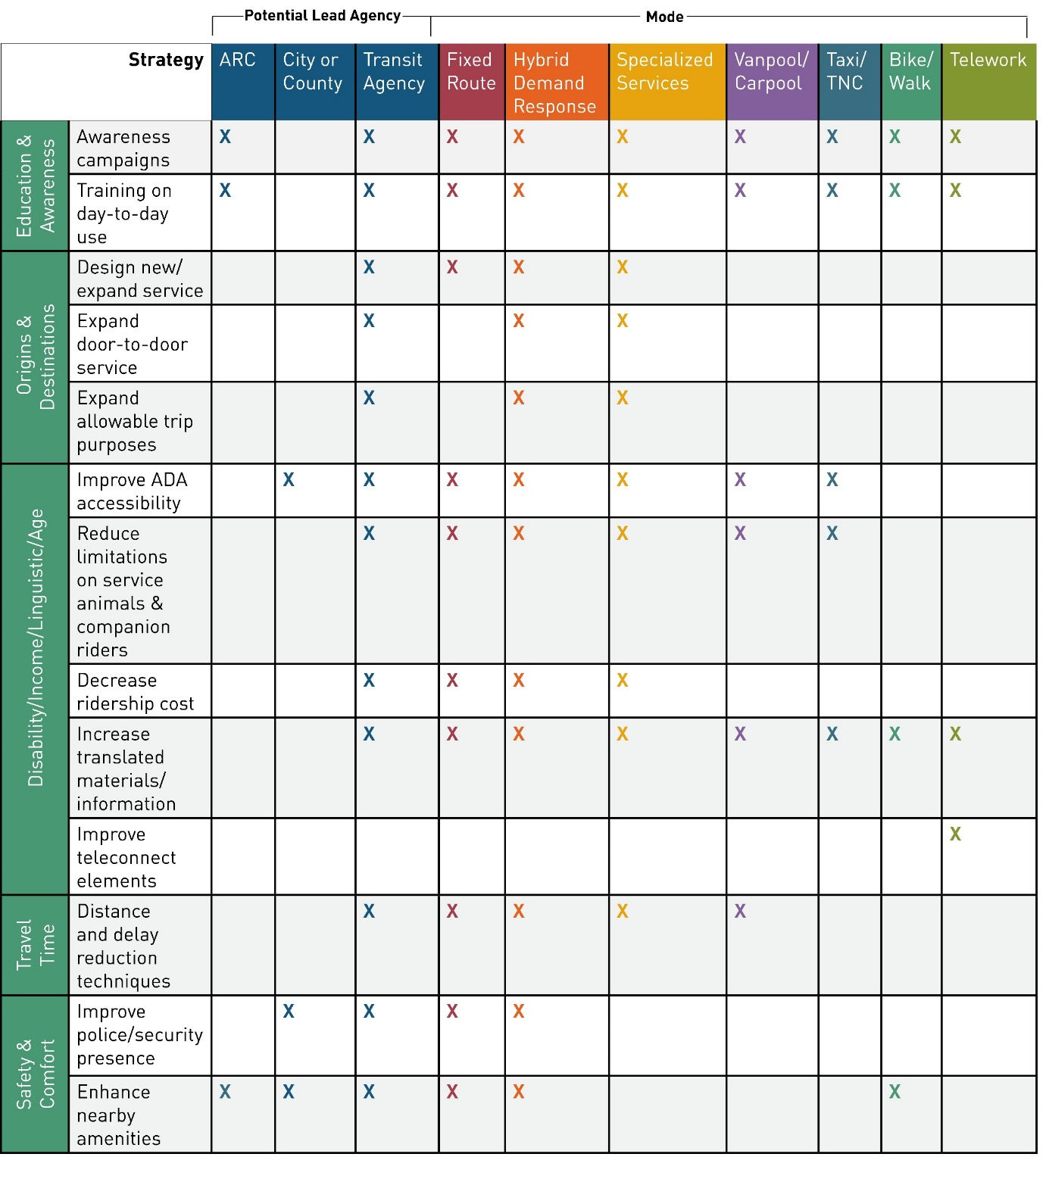
Targeted Improvements
Barriers
Strategies to Address Barriers
Potential Lead Agency
Notes:
Objectives and Policies from the Atlanta Region’s Plan Policy Framework are directly incorporated into the project evaluation through the use of Key Decision Points (KDP)
Some objectives are incorporated as policy filters
Some objectives are incorporated as performance measures and metrics

Slide 8
Targeted Improvements
Enhance awareness of HST populations
Design new/expand service
Improve teleconnect elements
Enhance amenities/infrastructure

Slide 9
Regional Improvements
Enhance education and awareness of HST options
Improve the application process
Implement a common fare structure and procurement protocol
Develop service agreements to assist with streamlined service provision
Develop common legal frameworks and reporting mechanisms
Embrace regional technology applications

Slide 10
Evaluate and Monitor
Ridership Figures
HST Populations and Origins/Destination with transit services areas
Qualitative Policy Improvement
Amenities that are ADA Accessible
Improved Linguistic Access
Amenity Improvements

Slide 11
Questions/Comments
Lori Sand
lsand@atlantaregional.com

