Slide 1
DeKalb County 2018 Annual Development Report
Using Story Maps to Track Annual Development in DeKalb County, Georgia
Atlanta Regional Commission Geospatial Community Meeting
Andrew Baker, Planning Director
Katherine Pearson Wells, GIS Specialist
February 5, 2020

Slide 2
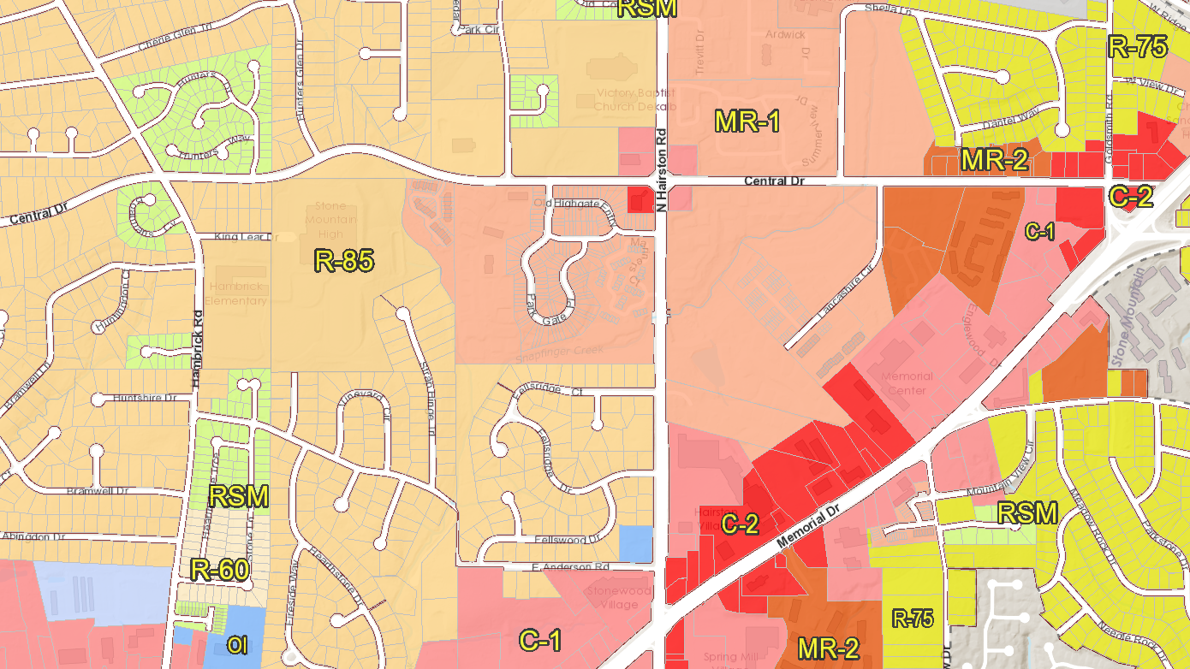
Why Make Our ADR a Story Map?
Multi-media content gives users a comprehensive picture
It is easier to harness the power of maps and spatial data to craft a narrative
Interactive experience that communicates quick, baseline information to planners, policymakers and residents.

Slide 3
LINK:
https://arcg.is/0Pav0v

Slide 4
What's Next?
Post current story maps to website
Begin work on 2019 Annual Development Report story map
Utilize new ArcGIS StoryMaps platform
Break down residential and non-residential uses even further (ex: new townhomes, new businesses, etc.)

Slide 5
Thank You

