Slide 1
Sandy Springs Takes Shape in 3D
Tyler Lents and Bridget Lawlor
March 1, 2023

Slide 2
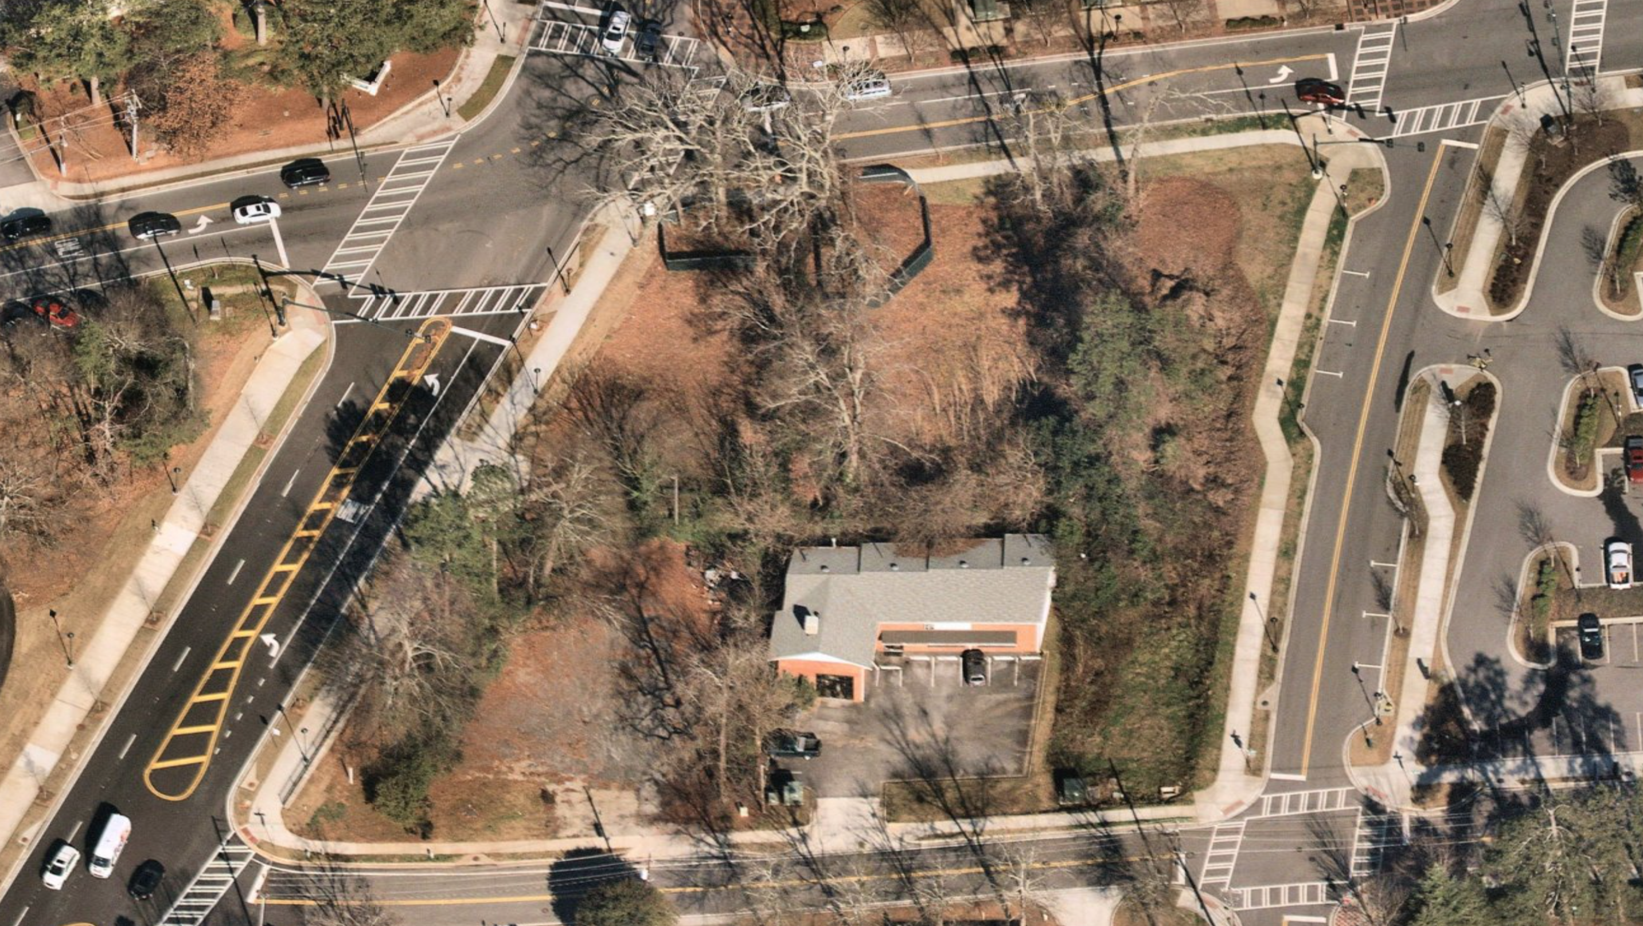
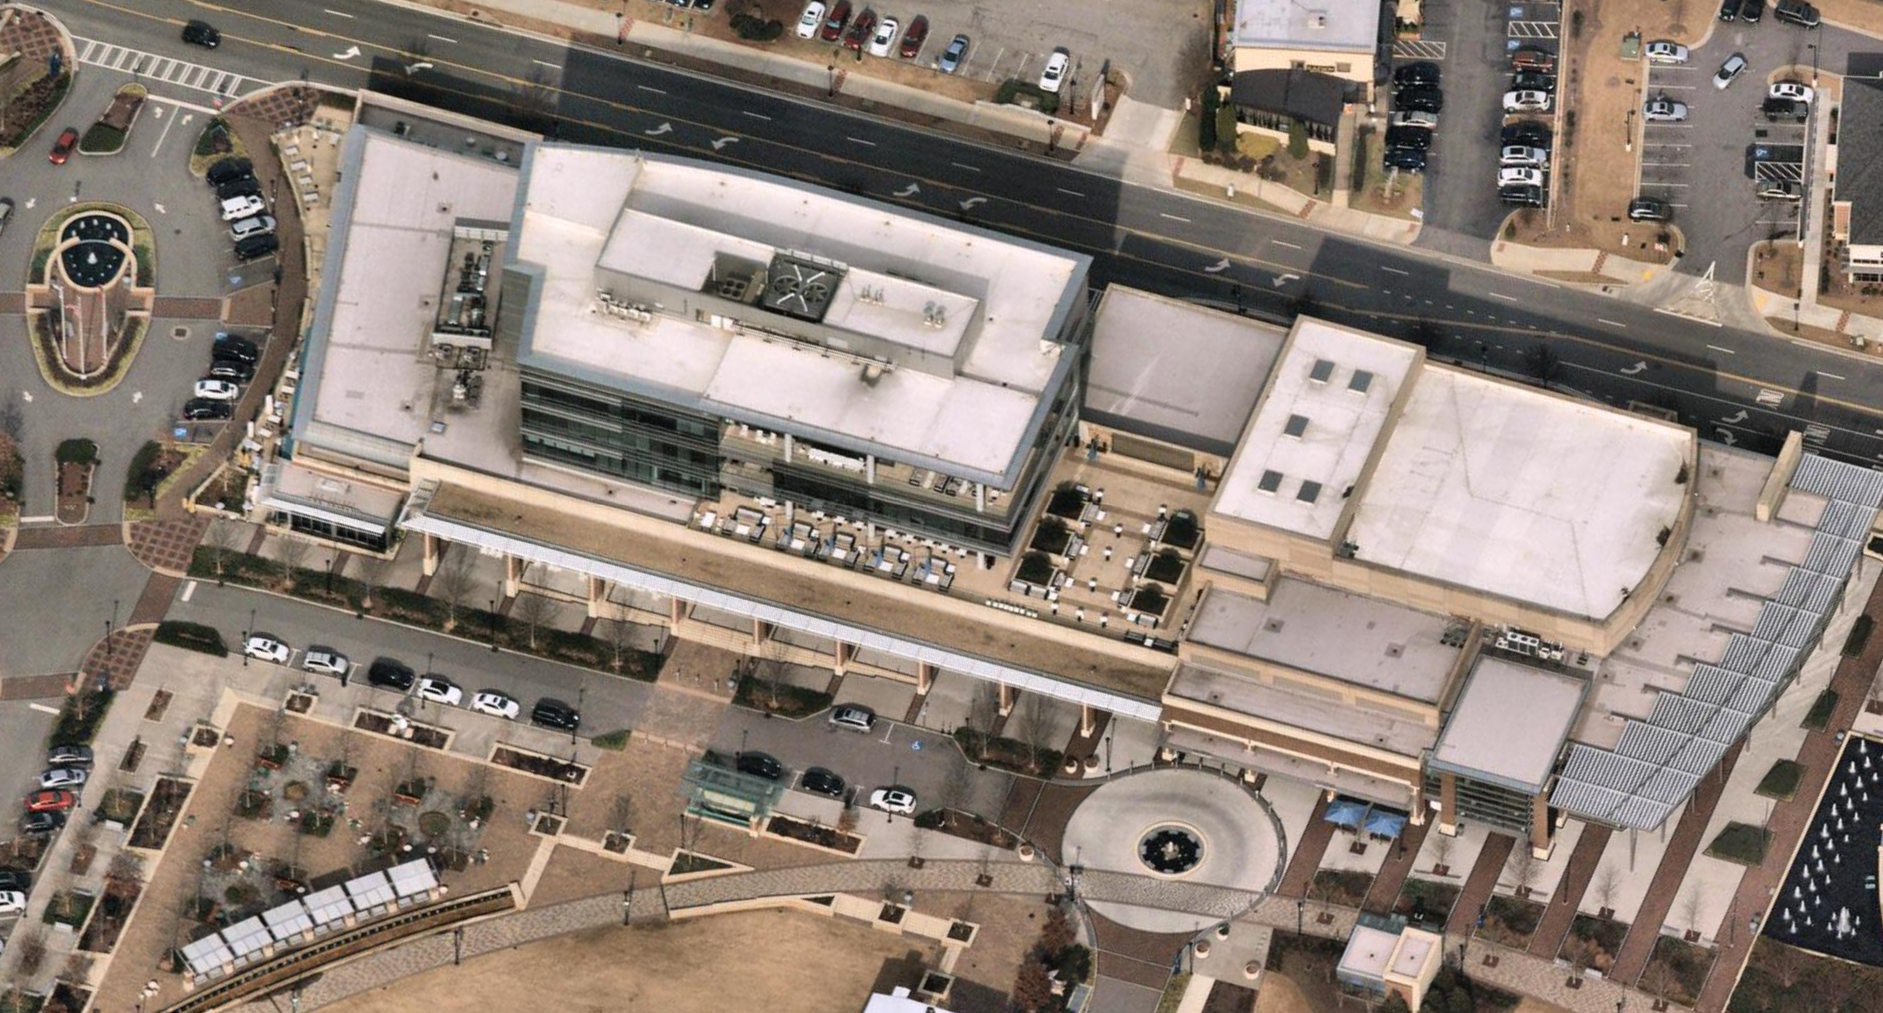
Sandy Springs Takes Shape in 3D
Creating our Digital Twin
Extruding building footprints
Roof segmentation
Vegetation generation
ArcGIS Urban
New study area
Development scenario
Future plans

Slide 3
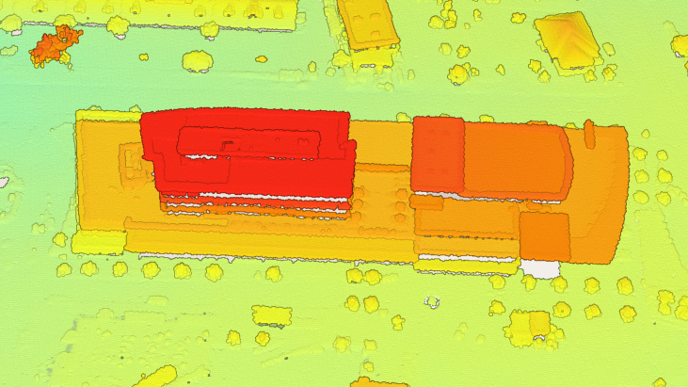
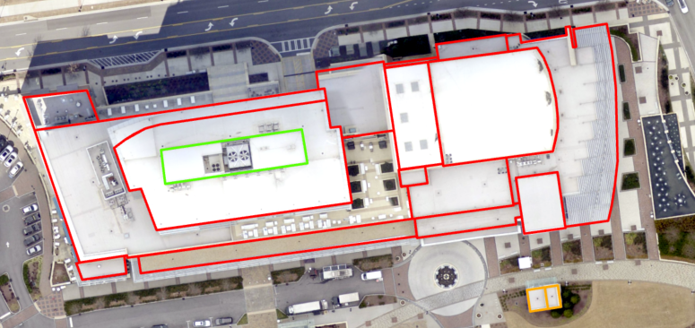
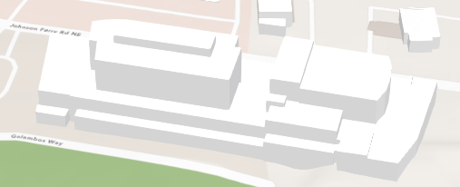
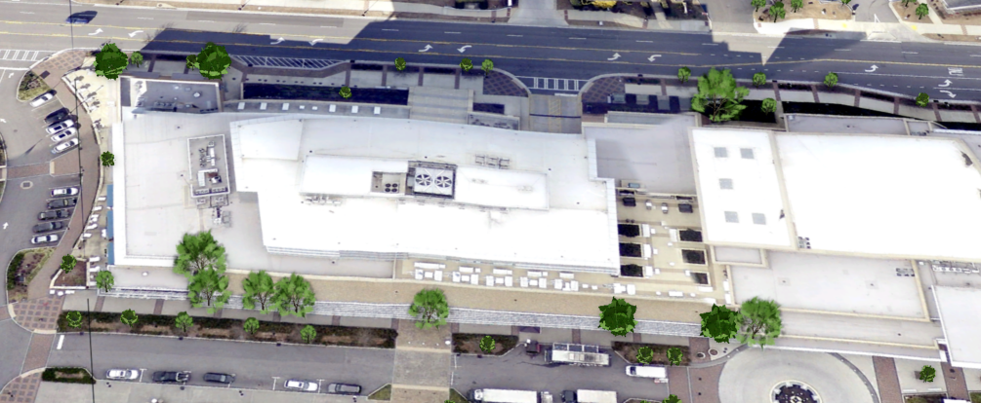
Digital Twin
Level of Detail 0-3
Roof segmentation
Generating buildings
Tree extraction using LiDAR

Slide 4
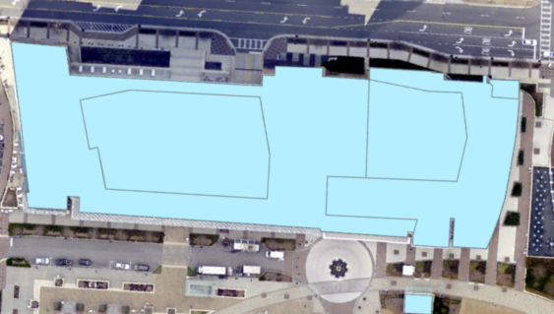
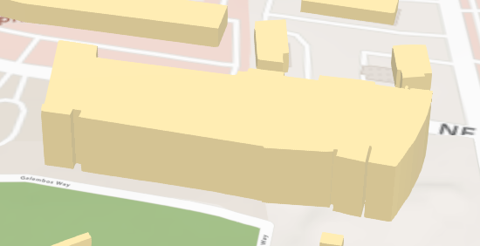
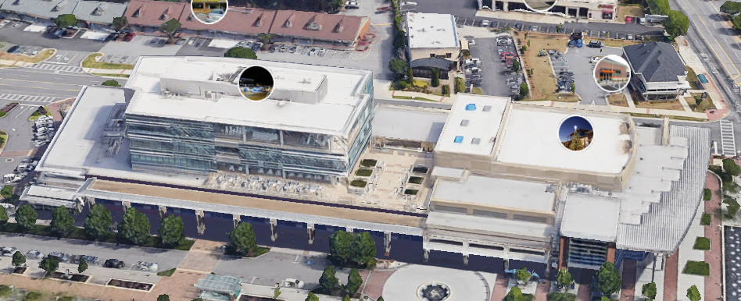
LoD – Level of Detail
LoD0 – flat, 2D
LoD1 – extrude buildings based on heights, look like Lego
LoD2 – segment roof lines
LoD3 – 3D mesh, Google Earth

Slide 5
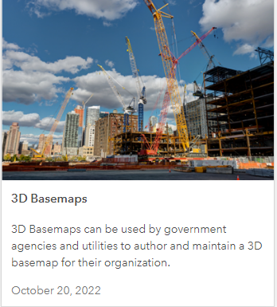
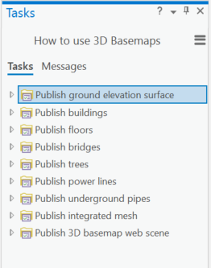
How do we get to LoD2?
All of the required tools are part of the 3D Basemaps Solution from Esri
Terrain and surface model
Segment roof lines
Create multipatch
Create trees

Slide 6
Terrain and Surface Model
LAS dataset + building footprints ➔ surface rasters
DSM, DTM and nDSM

Slide 7
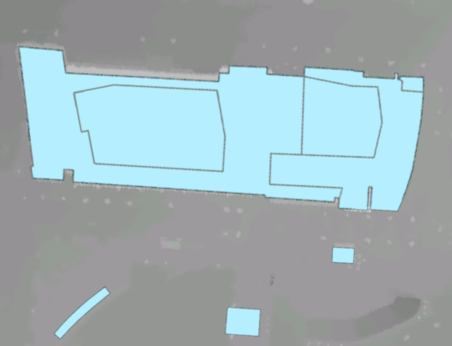
Segment Roof Lines
In the Preprocess Building Footprints task, going through the steps will attempt to automatically segment the roof parts.
In order to better determine where there may be inaccuracies in the building and roof shapes, run the Review Buildings task.

Slide 8
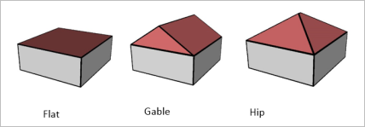
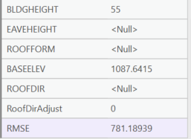
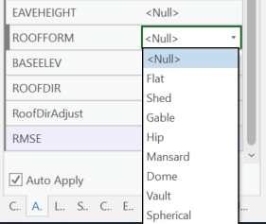
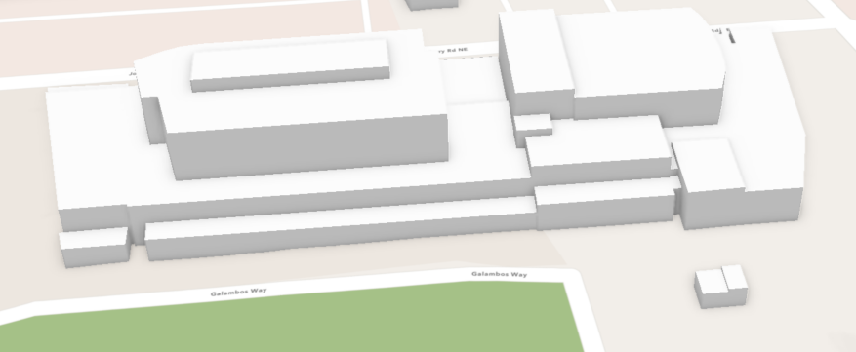
Multipatch Buildings
After the roof forms have been segmented, you can adjust their heights and roof type to more accurately match the real building if needed.
There are several different roof types to choose from. Flat, Gable, and Hip were most frequently used.
The buildings can be adjusted in both the Scene and Map viewers.

Slide 9
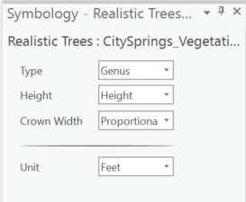
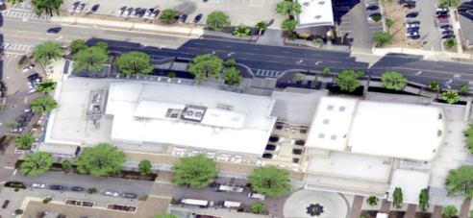
Trees
Use the LAS dataset to extract vegetation. Vegetation classes are 3, 4, and 5.
Can use either Surface Analysis or Cluster Analysis depending on LAS quality and level of accuracy desired.
Under the Layer section in the Map tab, select Add Preset and add the points generated from the analysis. Change the Type to Genus or Name to change the tree appearances.

Slide 10
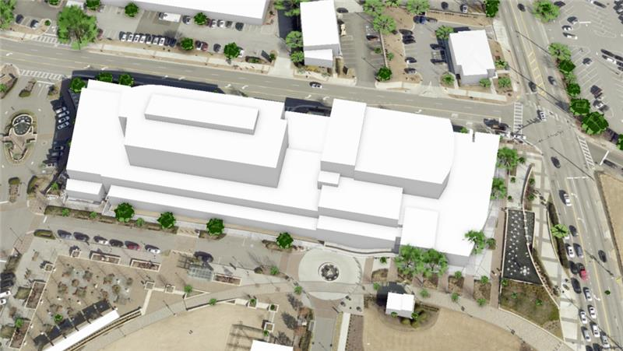

Slide 11
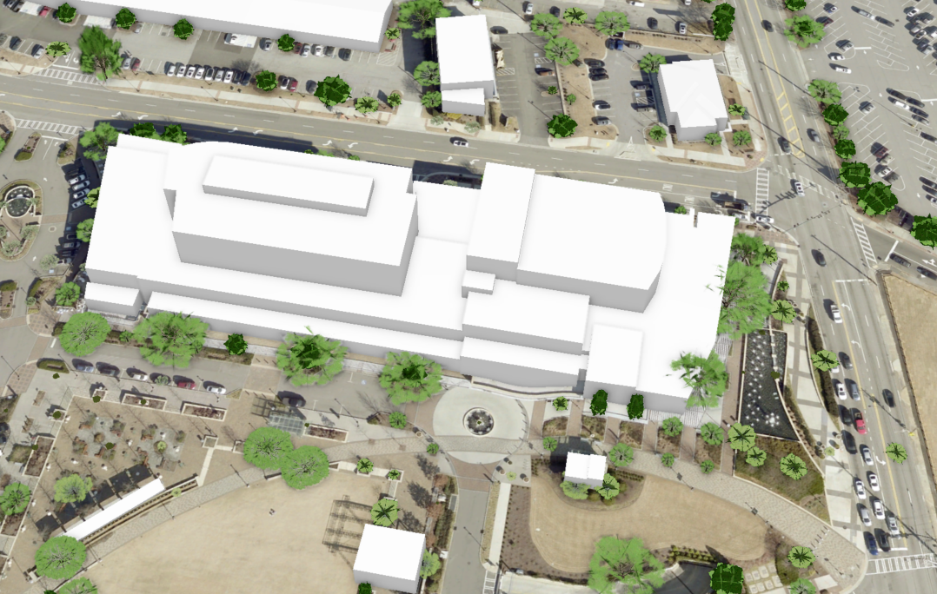

Slide 12
ArcGIS Urban

Slide 13
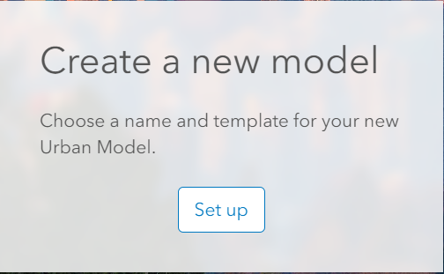
Setting Up ArcGIS Urban
Publish buildings and trees using the solutions provided in the 3D Basemap.
Add the trees and buildings to a Scene in ArcGIS Online.
In ArcGIS Urban, select Create a new model and choose your city.
Click Create Urban Model.

Slide 14
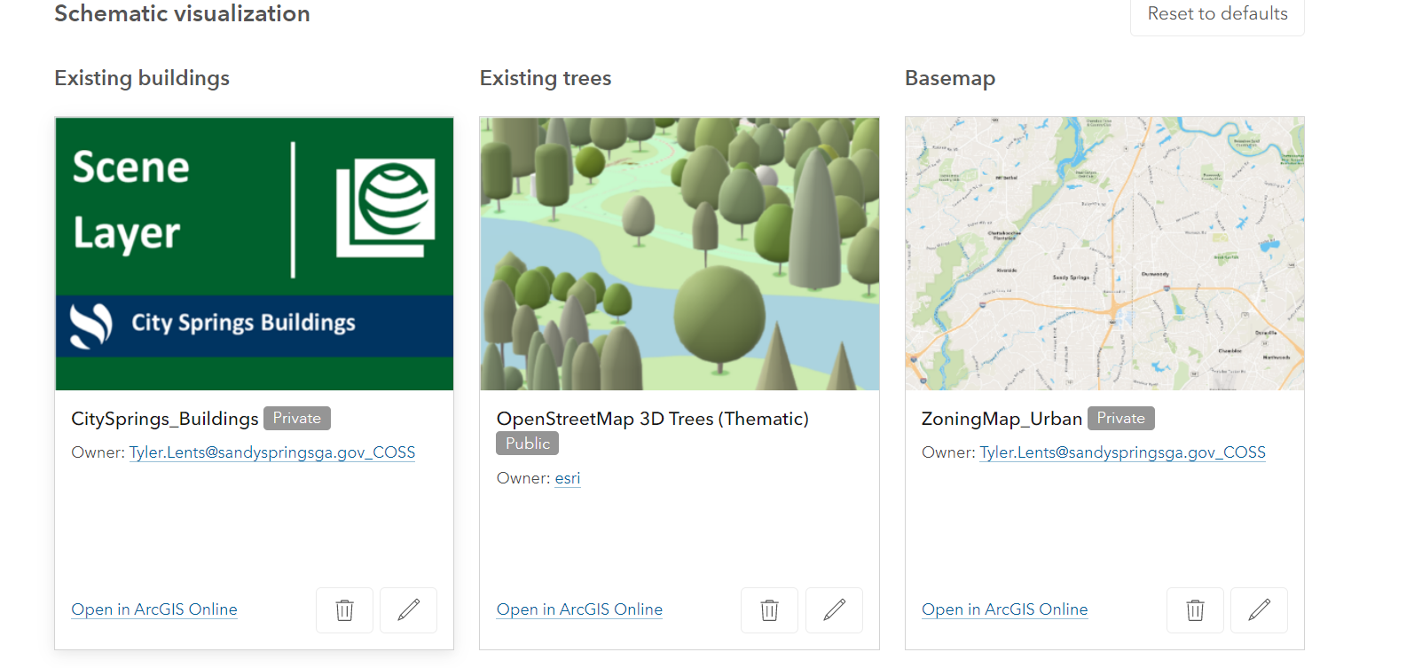
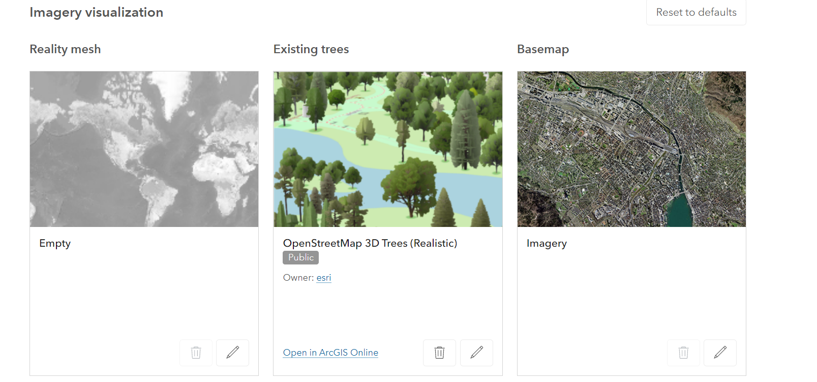
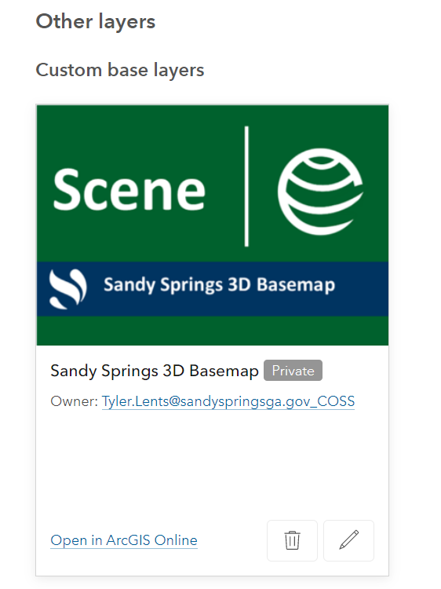
Urban Setup Cont.
By default, Urban uses OpenStreetMap trees and buildings.
Customize the Urban model to use 3D trees and buildings generated in the 3D Basemaps solution.
Also, other layers can be added to the Custom base layers section.
Zoning
Aerial Imagery
Future Land Use

Slide 15
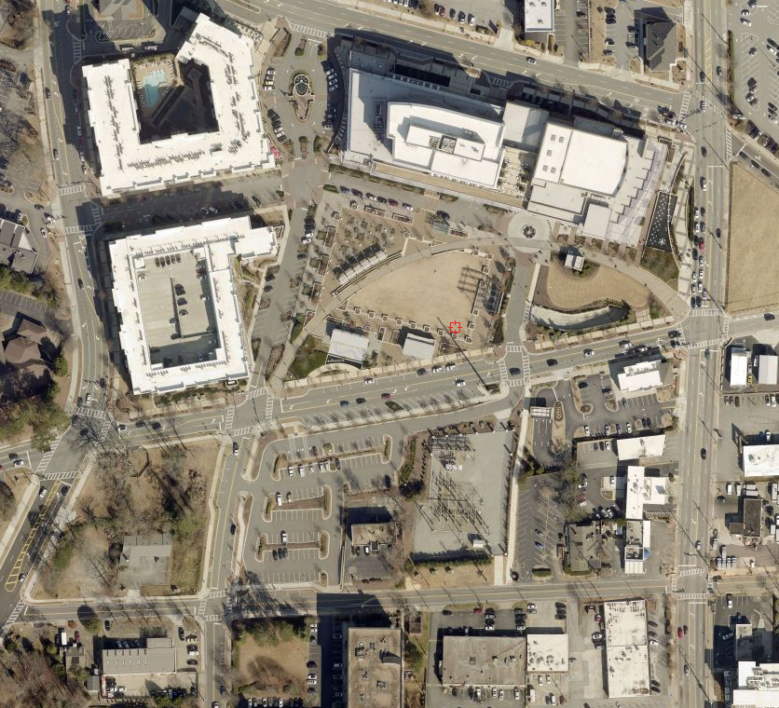
Proposed Mixed Use Development
Urban was used to simulate a proposed development near City Hall.
Development consists of residential, retail/restaurant, office, parking, and hotel space.
This can help the public visualize proposed development in 3D concepts and encourage engagement by allowing the public to leave feedback on projects.
Urban scenarios can be imported into CityEngine to add detail and synced back to Urban.

Slide 16
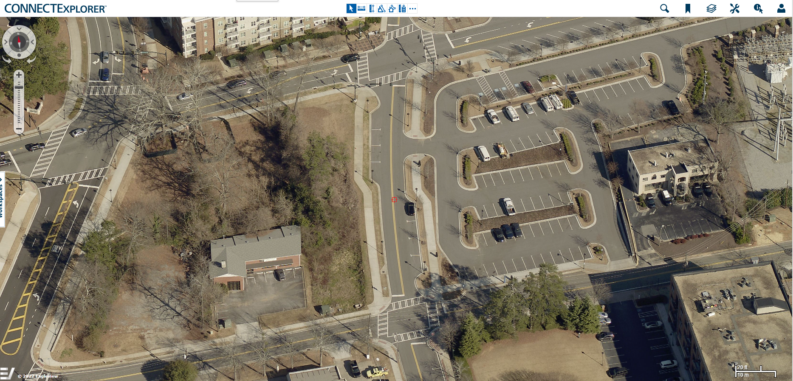

Slide 17
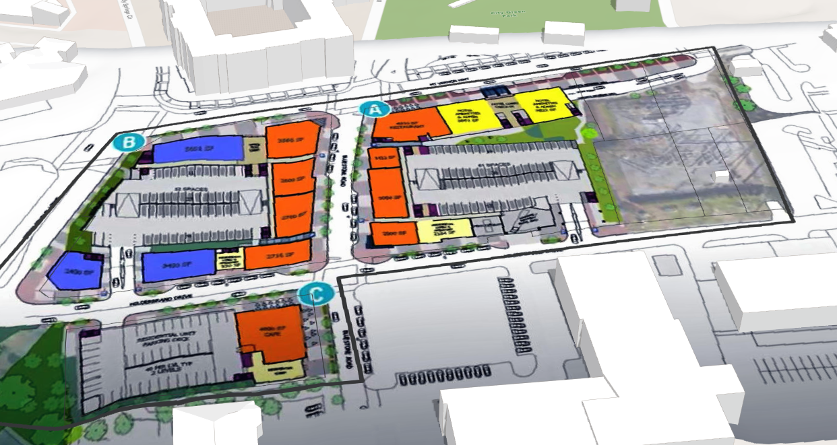

Slide 18
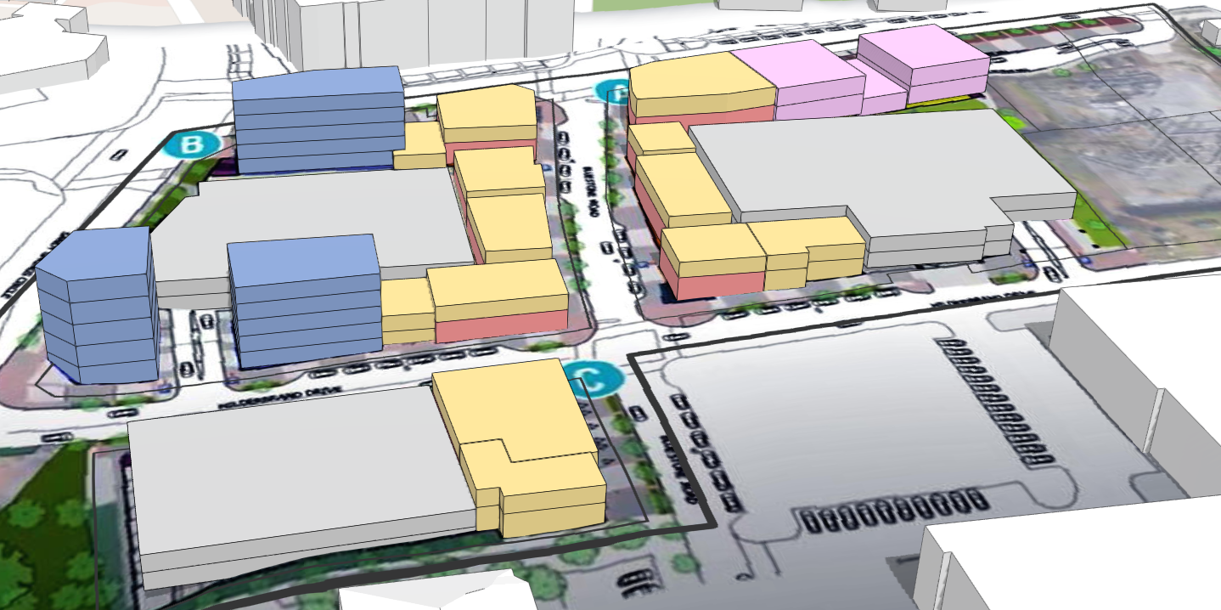

Slide 19
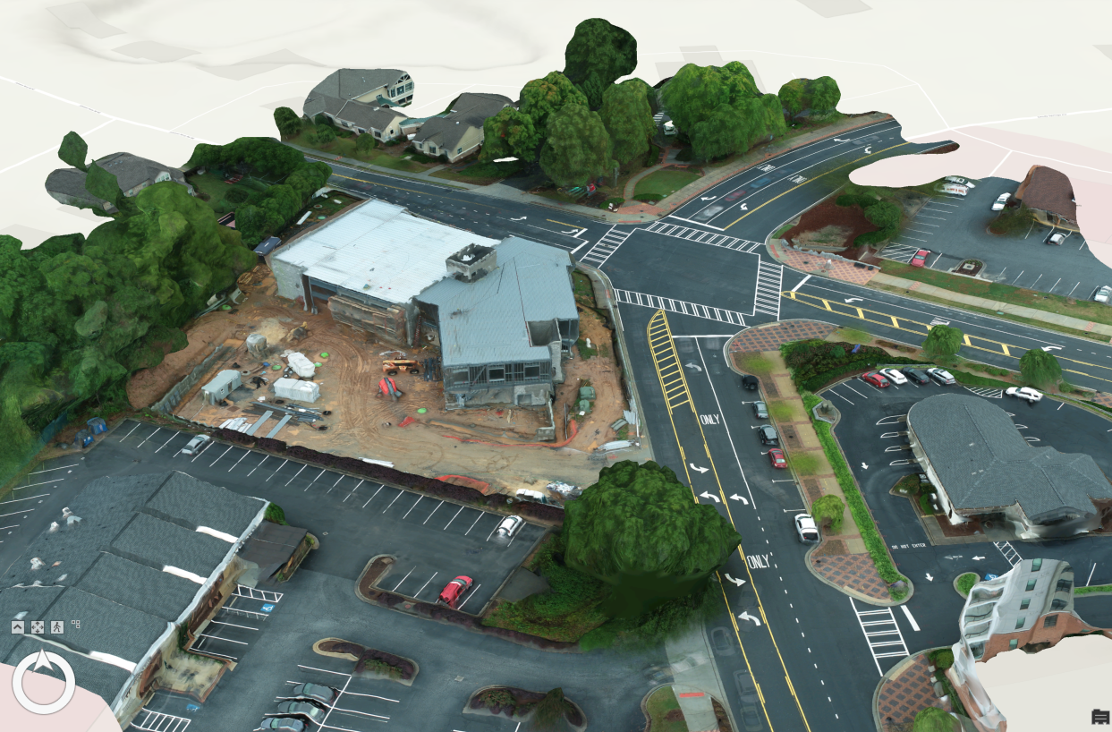
Future Plans and Projects
Metrics dashboard
Jobs
Households
Energy usage
Emissions
3D for another redevelopment
Use Drone2Map to create LoD3 (mesh)

Slide 20
References and Resources
Extract roof forms for municipal development | Learn ArcGIS
Getting to know the 3D Basemaps solution (arcgis.com)
3D Basemaps - ArcGIS Solutions

Slide 21
Thank you! Questions?

