Slide 1

A Year in Review
Highlights from the Georgia Geospatial Information Office for 2023
Please Take Survey at We Eat Lunch

Slide 2


Meet Your Team
Axim/
NV5
1Spatial
GARC
Esri
GAC
Sanborn/
Vexcel
… and many more
Dataprise
AppGeo
DCA
Susan Miller
Geospatial Information Officer
Natalie Lee
Geospatial Data Programs Manager

Slide 3
The State
Geospatial Information Office
Vison: Empower all levels of government to serve Georgia's citizens more effectively through innovative geospatial solutions
Mission: coordinate, promote, and enhance the development, and use in analytics, of geospatial data for the State of Georgia, its agencies, authorities, regions and local governments
Increase governmental efficiency, resulting in lower costs to taxpayers
Protect existing investments in GIS
Improved collaboration through statewide data inter-operability
Leverage and build upon existing data for broad application
Increased access to GIS and geospatial data
Improve governmental effectiveness, increasing the value and delivery of government services
Better decision-making enabled by innovative tools, sophisticated data and advanced analytics
Improved governmental transparency via easily consumable GIS products
Notes:
To orchestrate the state-level efforts of this partnership
Ensure access to vital data for all Georgia governments, businesses, and citizen
…by providing innovative, data-based solutions that empower government to better serve Georgia’s citizens
…. Facilitating increased government efficiency and effectiveness

Slide 4



ENABLE FACILITATED COLLABORATION
Build platforms and relationships to enable increased coordination and collaboration among governmental entities.
DEVELOP GEORGIA
BASE MAPS
Build comprehensive living repository of foundational state geospatial data.
PROVIDE GEOSPATIAL SERVICES
Provide best-in-class geospatial application development and analytics adding value to key state priorities.
Notes:
How do we do it ---- by enabling facilitated collaboration, developing GA basemaps, and providing geospatial services

Slide 5

Georgia's GIO Strategic Planning
How will we get there?
Through implementation of Strategic Goals
Goal 1: Lead Geospatial Coordination and Outreach
Goal 2: Facilitate and Promote the Creation of High-Quality Framework Data
Goal 3: Lead the Development of Policies, Standards, and Best Practices
Goal 4: Establish the Georgia Geospatial Hub 2.0 for all Data Programs
Goal 5: Cultivate the Office
Notes:
Our guiding light is our recently developed Strategic Plan,
In which is outlined 5 overarching goals for our Office, AND the various tactical steps we need to take over the next five years to move the pendulum on all these goals
We will use this framework to provide some highlights regarding our activities in 2023

Slide 6
Highlights from 2023
Goal 1: Lead Geospatial Coordination and Outreach
Goal 2: Facilitate and Promote the Creation of High-Quality Framework Data
Goal 3: Lead the Development of Policies, Standards, and Best Practices
Goal 4: Establish the Georgia Geospatial Hub 2.0 for all Data Programs
Goal 5: Cultivate the Office

Slide 7
Goal 1: Lead Geospatial Coordination and Outreach
  GIO Strategy Plan ~ A path forward
  Supporting Georgia’s Local & Regional Governments
        Swiss Army Knife of Tools & Resources
        Regional Commissions as GIS Service & Partners in State Wide Programs (eg REVAMP, Hazard Mitigation, NG911, etc)
  Georgia Geospatial Advisory Council (GAC) ~ The State Leaders
  who will be our Champion for Data

Slide 8

Georgia Geospatial Advisory Council
The Council exists to promote resources for more effective and efficient accountability, planning, decision-making, and overall services. The Council will utilize the knowledge and practices within the stakeholder community to better position Georgia’s collection, maintenance, and use in analysis of geospatial data in decision-making processes. Through the Council, efficiencies and economies of scale will be realized, ensuring that governments can better leverage the vast collection of data and information that is collected, maintained, and utilized by multiple levels of government within the state.
O.C.G.A § 50-8-301 charges the Georgia Geospatial Advisory Council to act in three primary ways:
Utilize geospatial capabilities in Georgia to meet any federal notification requirements.
Achieve reliable government data interoperability and enhanced delivery of services to Georgia citizens through the geospatial approach; and
Promote any other aspect of data collection, information optimization, and innovation to advance geospatial technology within Georgia.
  Membership Makeup
  State agencies – 4 members
  Regional Commissions – 1 member
  Local Government Associations – 2 members
  Local Governments – 2 members
  Federal Agencies – 1 member
  Private Sector – 1 member
  Not-For-Profit – 1 member
  Academia – 1 member
  At-Large – 2 members
  Utilities – 1 member
  GIO – 1 member
Use the Survey to get involved in a work group!
… this is YOUR group of Champions – and they want YOU to participate and help guide their efforts through Work Groups

Slide 9

Inaugural Council
Andrew Heath
Deputy Chief Engineer, Georgia Department of Transportation
Daphne Rackley
Deputy CIO, City of Atlanta
Dave Wills
Executive Director, Association of County Commissioners of Georgia
Jennifer Zeller
Strategic Solutions Manager of Community & Economic Development, Georgia Power
Greg Whitaker
Executive Director, Georgia Emergency Communications Authority Georgia (representing GEMA-HS)
Miki Schmidt
Division Chief, Science and Geospatial Services, National Oceanic and Atmospheric Administration' s Office for Coastal Management
Rich Johnson
Assistant Vice President of Legislative & Regulatory Affairs, AT&T
Ryan Evans
Director of External Affairs, Department of Community Affairs
Sharon Stanley
Support Services Agency Director, Cobb County
Terrance Rudolph
State Conservationist, U.S. Department of Agriculture's Natural Resources Conservation Service
Larry Hanson, Chair
CEO & Executive Director, Georgia Municipal Association
Blaine Williams, Vice Chair
Manager, Athens-Clarke County Unified Government
Brent Lanford, Executive Secretary
CIO, Middle Georgia Regional Commission (representing GARC)
Susan Miller, Recording Secretary
GIO, State Geospatial Information Office
Georgia’s Advocate and Voice for Data
Empowering Georgia through Geospatial Data
Also known as Our New Body of Champions to help us fight the good fight
Notes:
Core Initiatives:
Enhancing Government Functions: Ensuring government interoperability for improved service delivery to Georgia citizens.
Fostering Innovation: Promoting innovation in data collection, information optimization, and advancing geospatial technology within Georgia.
Ensuring Compliance: Utilizing geospatial capabilities to meet federal and state notification requirements.

Slide 10
Highlights from 2023
Goal 1: Lead Geospatial Coordination and Outreach
Goal 2: Facilitate and Promote the Creation of High-Quality Framework Data
Goal 3: Lead the Development of Policies, Standards, and Best Practices
Goal 4: Establish the Georgia Geospatial Hub 2.0 for all Data Programs
Goal 5: Cultivate the Office

Slide 11
Goal 2: Facilitate and Promote the Creation of High-Quality Framework Data
Lots happening here, so let's outline what will be covered:
Setting the Stage
  Framework Data – What is it?
  Data Themes – Where do they come from?
  Partnership – State-Level Programs & Local Control
  Baselining – Understanding the Health of Georgia's Data House
    External & Internal Assessments
… and 2023 Highlights
  Data Programs: From Pilots to PROGRAMS!
    Deeper Dive:
      Addresses, routable Road Centerlines, Emergency Service boundaries
      DIVA Tools
      Boundary Reconciliation
      Orthoimagery
        Roadway Elements Bonus, maybe
Notes:
I like to think of Framework as analogouswhat datasets are in the Transportation Data Theme with base data

Slide 12
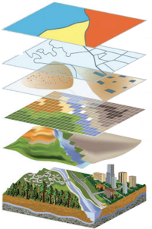
GEORGIA’S BASEMAP, or FRAMEWORK, is made up of the following DATA THEMES
Framework: A comprehensive living repository of foundational state geospatial data
Address Theme
Buildings & Structures Theme
Cadastral Theme
Elevation Theme
Geodetic Controls Theme
Administrative Boundaries Theme
Hydrography Theme
Landuse/Landcover Theme
Orthoimagery Theme
Transportation Theme
“Transportation Data Theme”, includes:
Roads
Airports
Trails
Waterways
Railroads
… other features associated with the transport of people or commerce
Notes:
You can call this phase 1, but maybe just say that Phase 2 will come later.

Slide 13
Data Themes, contain multiple datasets
Transportation Data Theme (sampling)
Admin Boundary Data Theme (sampling)
Airport
Airport Runway
Closed Road
Controlled-Access Highway
Federal Road
Ferry Route
Four Wheel Drive Road
Heliport
International Airport
Local Connecting Road
Local Road
Military Airport
Municipal Airstrip or Municipal Airport
Private Airstrip or Private Airport
Railroad
Railroad Siding or Railroad Spur
Ramp
Regional Airport
State Road
Seaplane Anchorage or Seaplane Base
Snow Trail
Terrestrial Trail
Trail
Tunnel
Water Trail
Water Way
Airport Authority
Census Boundaries
City
Civil Division
Coastal Zone
Community
Congressional District
County (Incorporated & Unincorporated)
Election Precinct
Fire District
Forest
Health District
Historical District
Homeland Security District
Industrial Zone
International Boundary
Island
Metropolitan Statistical Area (MSA)
Military (Air Force, Army, Coast Guard, Marines, National Guard, Navy)
Native American Reservations/American Indian Land
Park
School District
Special Economic Zone
State
Town
Transportation District
Utility District
Watershed

Slide 14
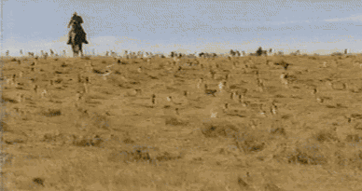
Where do these Data Come From?
Government Sources
Private Sector Sources
Local Governments (e.g. Addresses, Parcels)
Regional Governments (e.g. Comp Plans)
State Agencies (e.g. Floodplains)
Federal Government (e.g. Census)
Custom Data Collections (e.g. LiDAR)
Data as a Service, examples include:
  Imagery
  Landuse/Landcover
    e.g. Building Footprints
Its our job to heard all the data up across Georgia’s:
538 cities
159 counties
12 regional governments
100’ish state entities
~ 800: TOTAL GOVERNMENT DATA SOURCES + PRIVATE SECTOR DATA

Slide 15

Statewide Data Programs + Local Control
Why does the State invest in State-level data creation & maintenance?
Because seamless statewide data is vital, and because data is everywhere, tools and secure infrastructure are not!
Reduces Cost: GIO builds best-in-class tools; pay for them once, for all Georgia local and state gov’t to use
Facilitates Collaboration: Provides platform to share Data and remedy jurisdictional gaps and overlaps
Ensures Security: Guarantees that Data is safe, secure, and accessible at all times
Improves Transparency: Enables accountability and consistent reporting
Protects the Investment: Invest ONCE, use many ways
Notes:
The key to the successful outcome of Data Programs that support such use cases is the marriage of statewide data programs, along with local control of the data

Slide 16
Geospatial Maturity Assessment
External Assessment
Internal Assessment

Slide 17
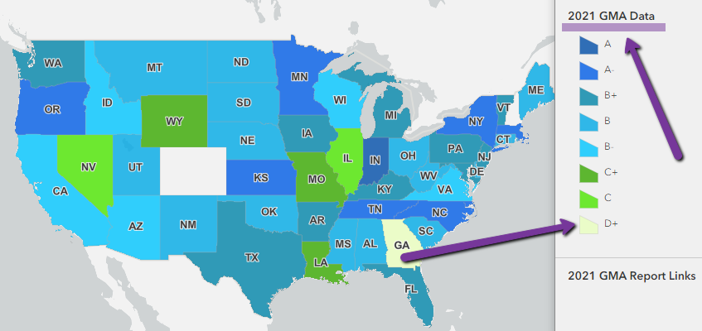
Statewide
Data House
REPORT CARD
The cold, hard truth…
Georgia has not invested in Data at a statewide scale
Georgia is surrounded by all ‘A’ & ‘B’ states
The good news…
… 2023 Assessment recently closed, results coming soon… some grades have improved
Notes:
Georgia attempted to align with state GIS expectations in the first decade of the 2000’s, but the attempt was abruptly cut off by the recession
So we remain woefully behind
The Assessment provides a comprehensive summary of geospatial initiatives, capabilities, and issues within and across each state regarding Data Framework Themes and certain nationwide initiatives.
Self note: Colorado and NEW HAMPSHIRE are the last states to have a GIO and therefore did not reply to this survey

Slide 18
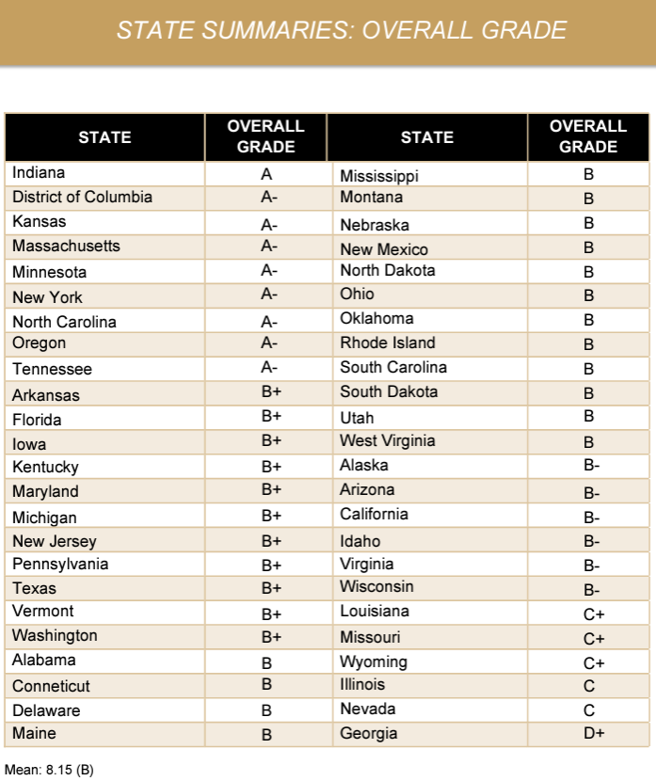
Statewide
Data House
REPORT CARD
State Grades
Only six (6) states below a ‘B-’
Our Closest Advisors/Mentors
… 2023 Assessment recently closed, results coming soon…
Notes:
Georgia attempted to align with state GIS expectations in the first decade of the 2000’s, but the attempt was abruptly cut off by the recession
So we remain woefully behind
The Assessment provides a comprehensive summary of geospatial initiatives, capabilities, and issues within and across each state regarding Data Framework Themes and certain nationwide initiatives.
Self note: Colorado and NEW HAMPSHIRE are the last states to have a GIO and therefore did not reply to this survey

Slide 19
Georgia’s
Geospatial Maturity
REPORT CARD
Collaboration, transparency, and increased efficiency in government are hallmarks of mature state Geospatial Programs.
What goes in to making the grade?
  Level of statewide Coordination focused on the existence of a geographic information officer (GIO) and the powers and resources available to coordinate GIS activities statewide
  Maturity of certain State-level Data Programs
    Addresses
    Parcels
    Elevation
    Orthoimagery
    Routable Road Centerlines
    Geodetic Controls
    Government Units
    Hydrography
Factors within each data program: data coverage (% of state), as well as the breadth & depth of a supporting Data Program that has a living business plan, regular funding, a designated steward, and a formal relationship with local governments, complete with support for ongoing management, quality control, update frequency, standardization, interoperability, and accessibility.
3. (ungraded at present) Health of State Initiatives (e.g. NG911, GeoEnabled Elections, Hydrologic Programs, Broadband, etc)
Notes:
each of t
focused on the existence of a geographic information officer (GIO) and the powers and resources available to coordinate GIS activities statewideen different themes – the eight COGO themes, plus a grade for state-level coordination activities and separate grades for leaf-on and leaf-off orthoimagery.

Slide 20
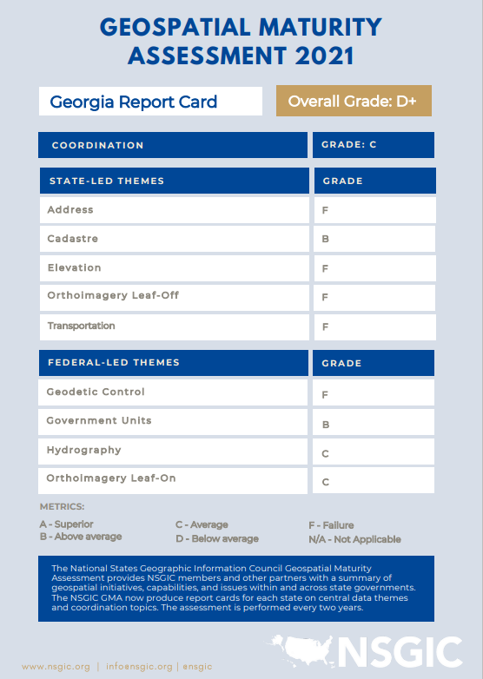
Georgia’s Grade
BREAKDOWN
This is our baseline, from which we can only really go up!!!
Notes:
In addition to an external analysis of the States’ geospatial maturity, lets take a look at what the community has to say when they assessed their own data holdings for a small subset of datasets

Slide 21
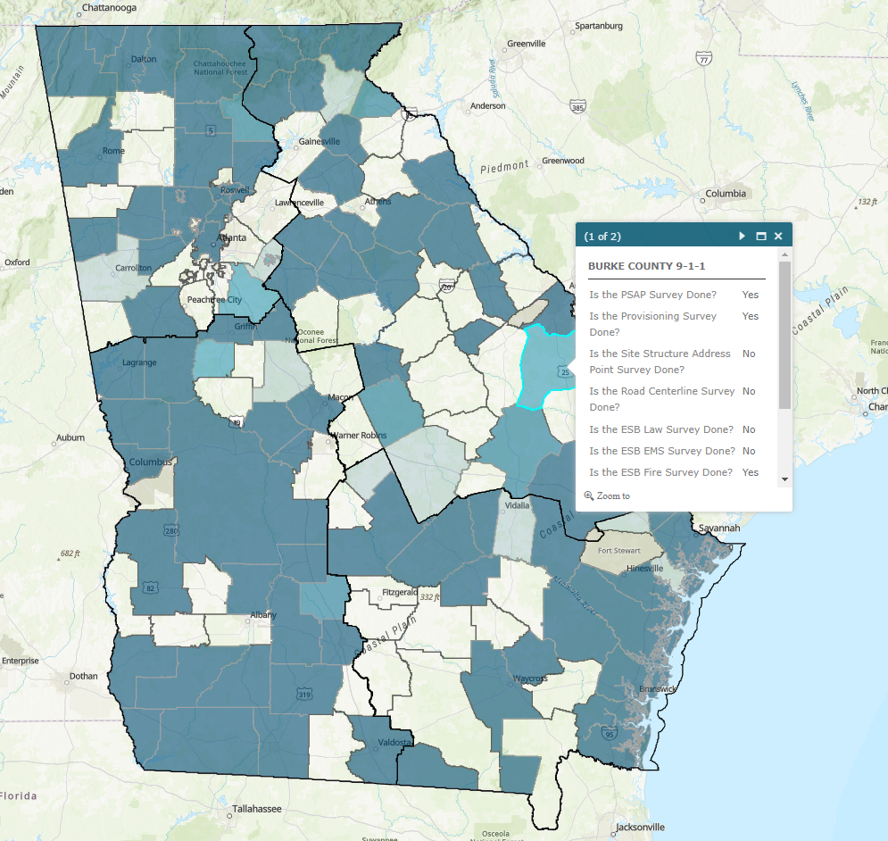
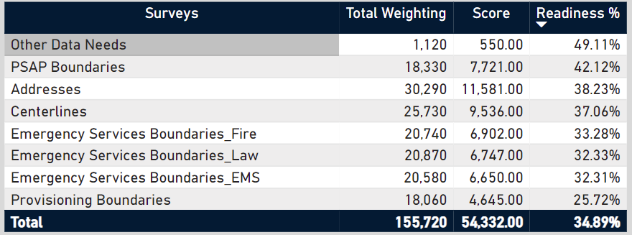
How do Georgia’s
Local Governments Feel About their Data to Support NG911?
Notes:
Goal: Identify the PERCEIVED current state for readiness in Georgia, identify qualitatively where readiness actually may be through dataset specific questions

Slide 22
Pilots to PROGRAMS
At the core of these Programs are a collection of resources we manage, and make available for all Georgia governments to use:
DIVA Tools
Boundary Reconciliation Process
  In partnership with Georgia Emergency Communications Authority (GECA) ~ through the Next Generation 911 (NG911) Program
    Address Data Program is LIVE
    Routable Road Centerline Program is LIVE
    Gov’t Units/Administrative Boundaries Program is LIVE
  In partnership with the GAC, laying the foundation for:
    Landuse/Landcover Program (incl’s: Buildings & Structures)
    Orthoimagery Program (move from ‘pilot’ to Program)
    LiDAR Program (refresh)
Spatial Data Themes
Addresses
Buildings & Structures
Cadastral
Elevation
Geodetic Controls
Gov’t Units/Administrative Boundaries
Hydrography
Landuse/Landcover
Orthoimagery
Transportation

Slide 23
Data Integration, Validation, and Aggregation (DIVA) Tools
A deeper dive…

Slide 24

The Problem with Data
Let’s Talk a Little About Our Data Today – what are our challenges?
It doesn’t agree across jurisdictions
Its not standardized
Its constantly changing
It doesn’t belong to a single person
It can be huge
Overcoming these issue is possible….

Slide 25

DIVA Tools
  Data Integration, Validation, and Aggregation (DIVA) Tools
    Meeting cities, counties, and regional government where they are, and enabling:
      Improved data management for Big Data
      Support and Validate the data conforms to the Georgia Geospatial Data Standards (for addresses, road centerline, and emergency service boundaries (fire, EMS, law enforcement, PSAP))
      Local control
      Interoperability: enabling data to seamlessly flow across artificial boundaries
  ~ crime and hurricanes don’t start & stop at a city or country boundary, so why should the critical data we need to manage these events … we can do better!
Notes:
NATALIE
Geospatial Services Contract Program

Slide 26

What does it DO though…
Start here!
Happy Stakeholders

Slide 27

Who Can Use it?
Any government entity that is a steward of address, road centerline, and boundary data as the authoritative source, OR on behalf of such an authoritative source.
  Addresses
  Road Centerlines
  Emergency Service Boundaries (Fire, EMS, and Police)

Slide 28
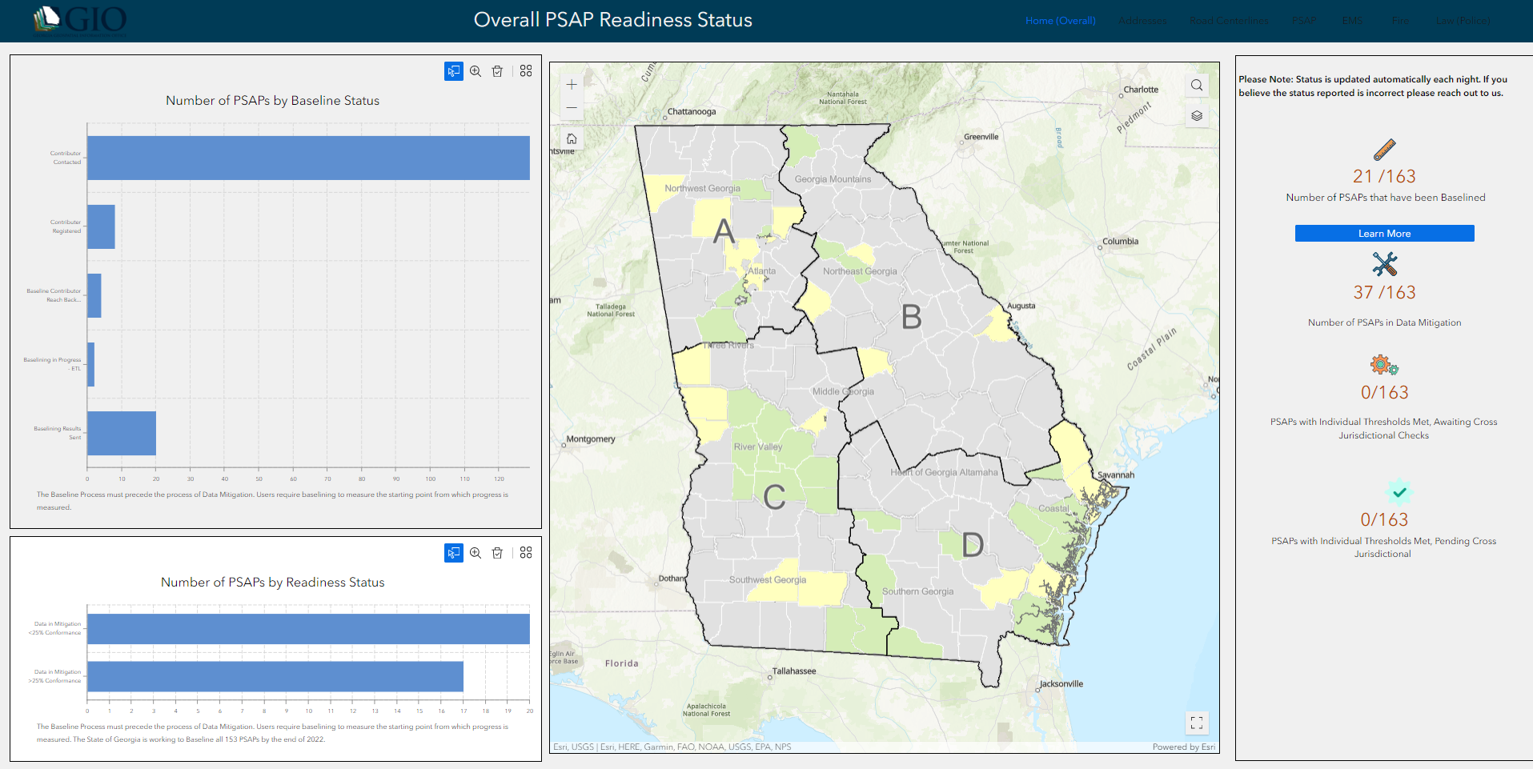
Who is using it already?

Slide 29
Boundary Reconciliation Tools
A deeper dive…

Slide 30
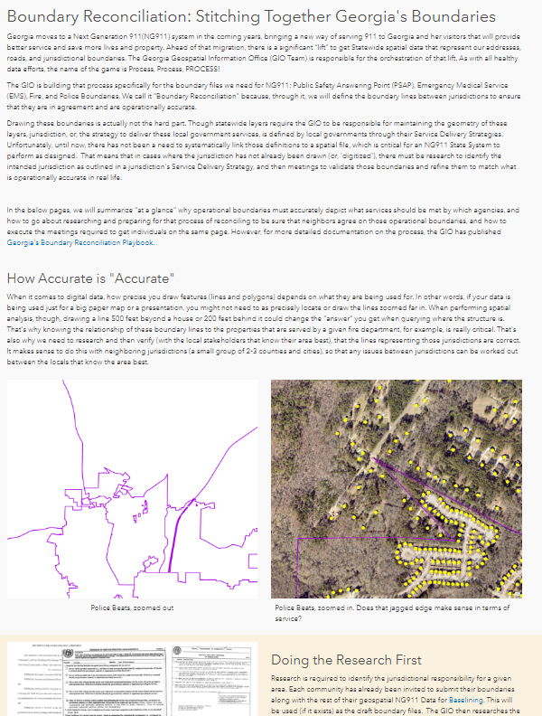
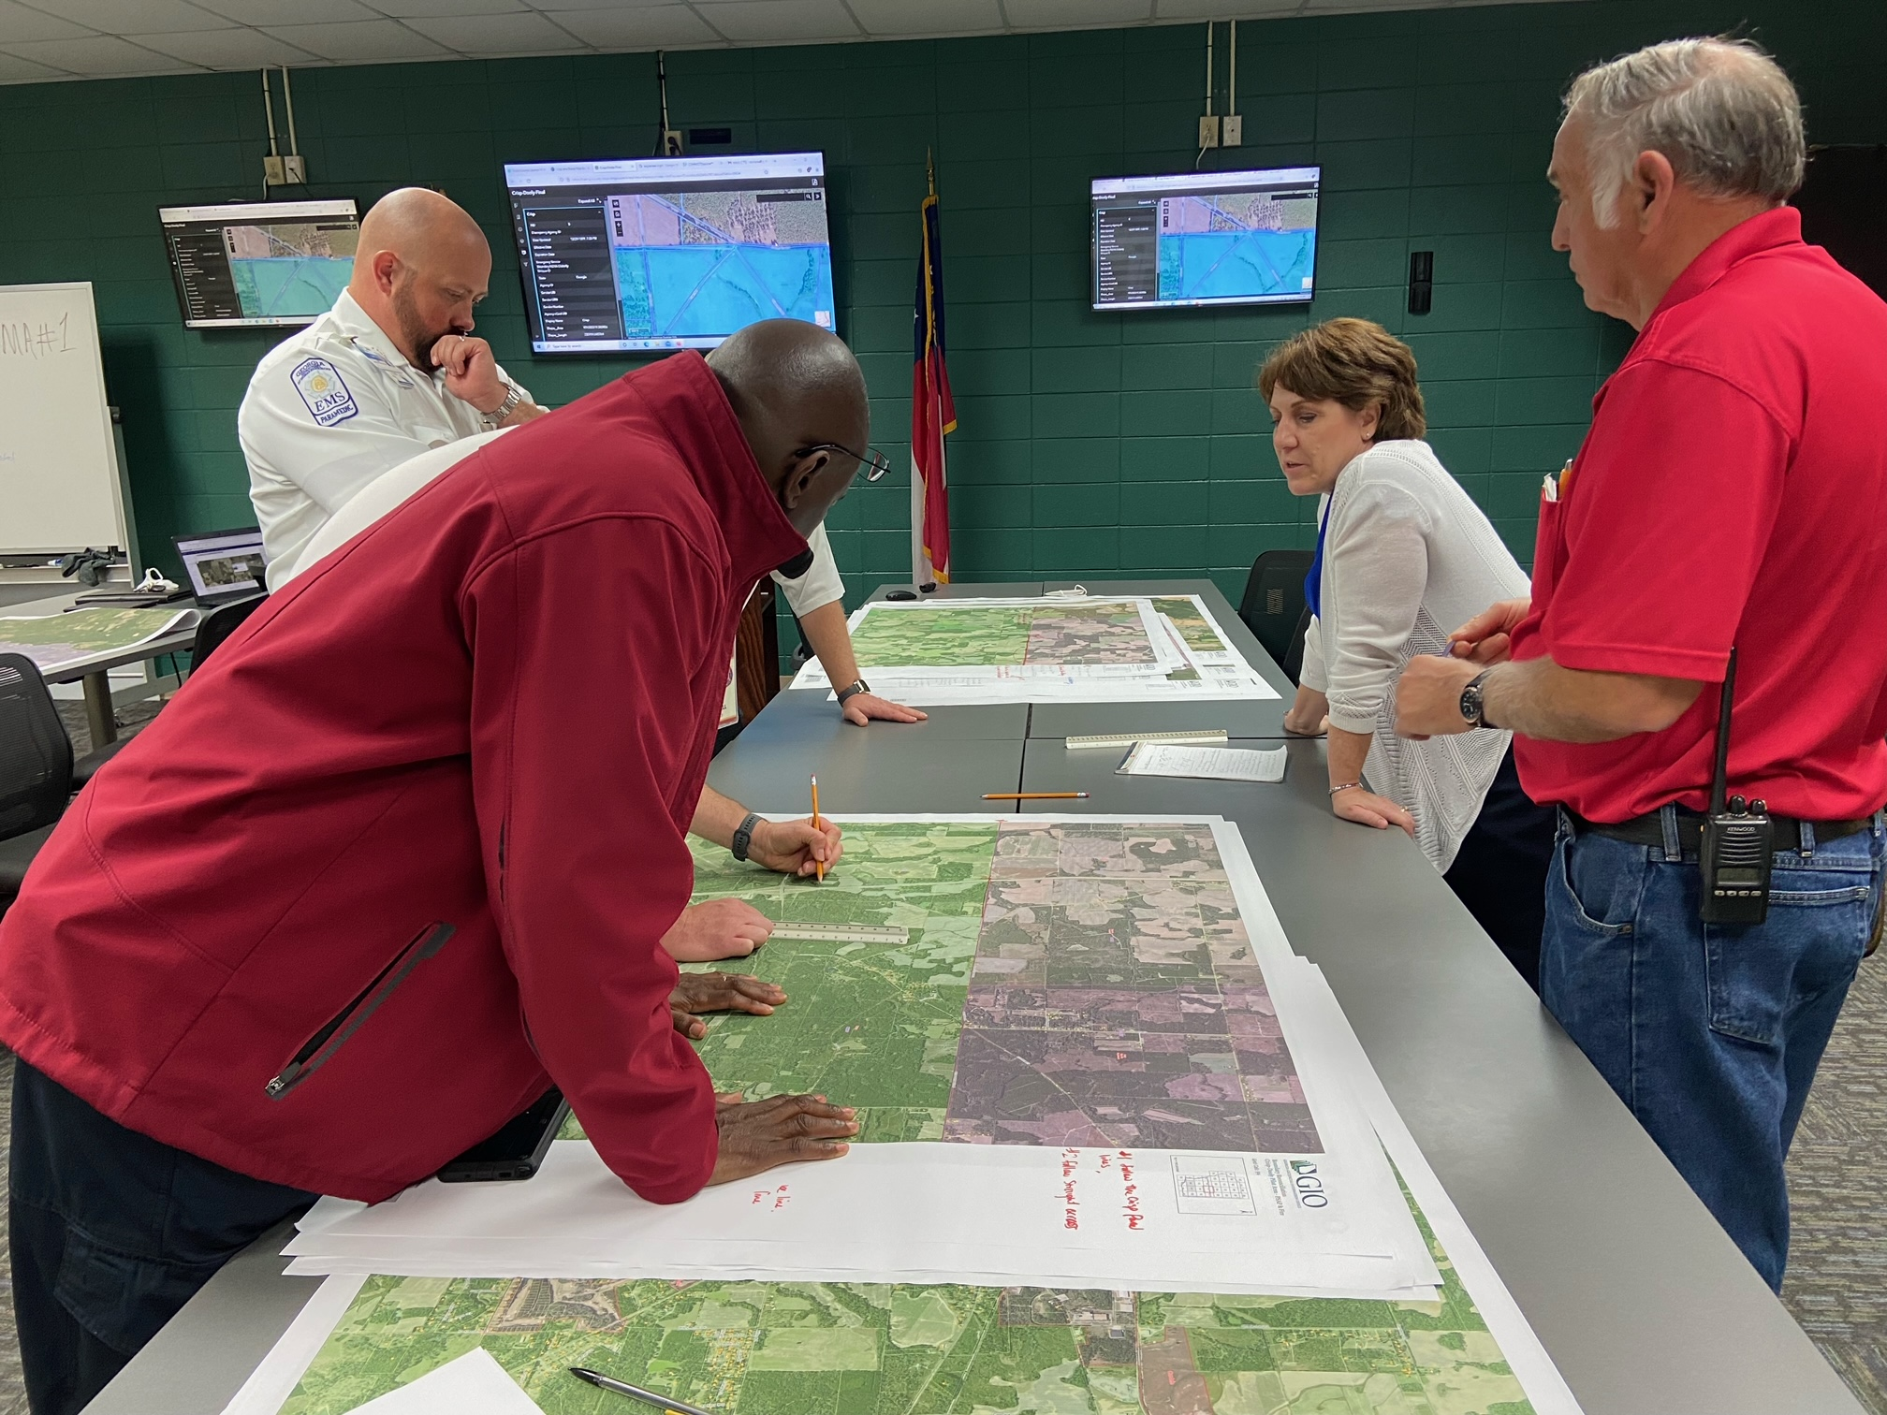
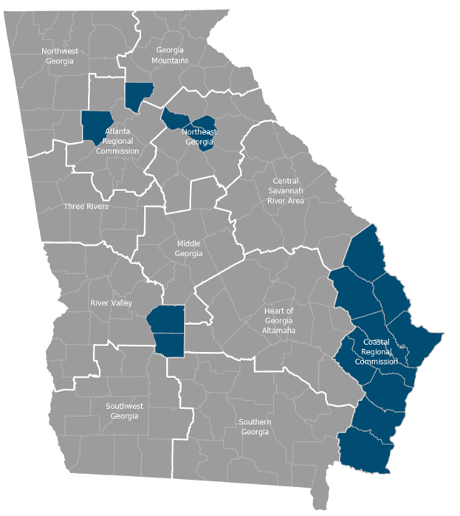
Boundary Reconciliation Playbook
Resources for local governments to help reconcile their service boundaries and why doing so matters.
Based on results of the pilot areas (blue in map)
Step by step instructions
Useful for hiring consultants to help (scope development)
Goes hand in hand with Web App

Slide 31
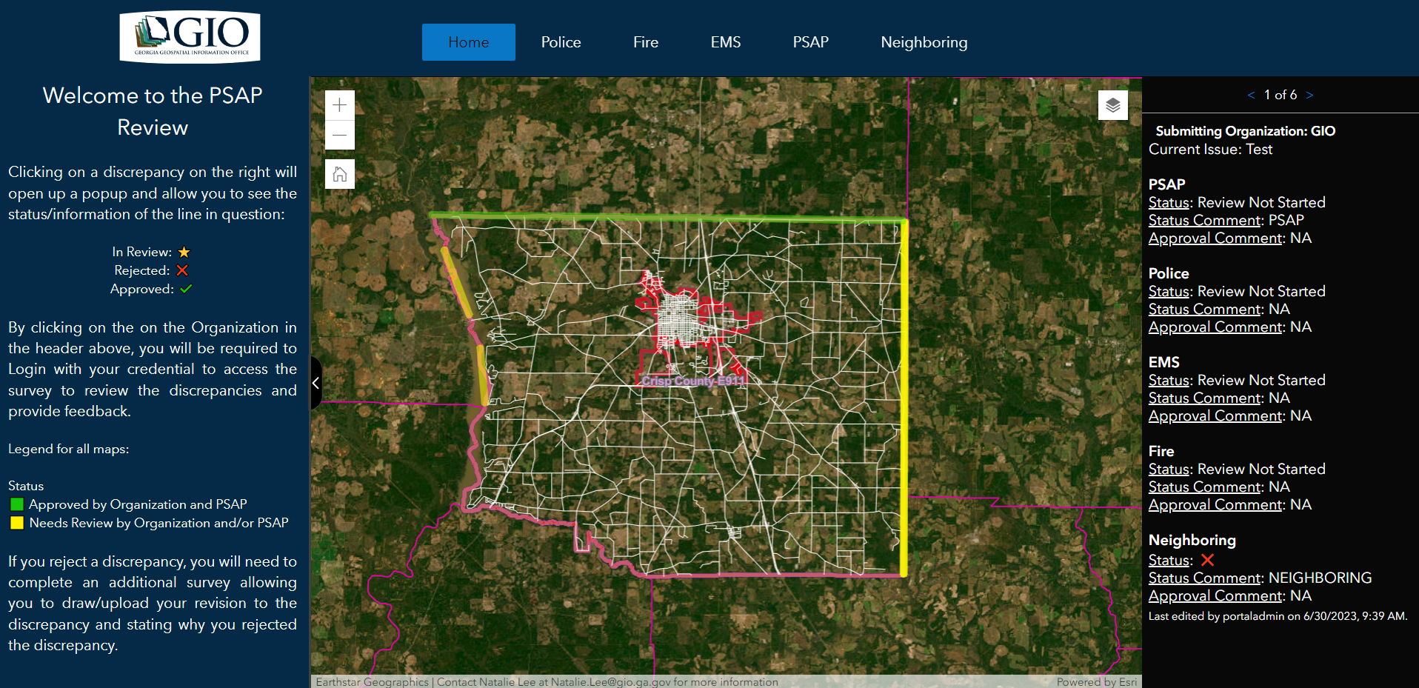
Boundary Reconciliation Application
Facilitates the back and forth that occurs after a Boundary Reconciliation Meeting
Uses experience builder and Survey 123
Builds consensus around edits of a shared border

Slide 32

Getting Access
Boundary Reconciliation Playbook
Boundary Reconciliation tool: EMAIL Info@gio.ga.gov

Slide 33

Tell Us If You Know about the Data Programs

Slide 34
Orthoimagery
A deeper dive…

Slide 35
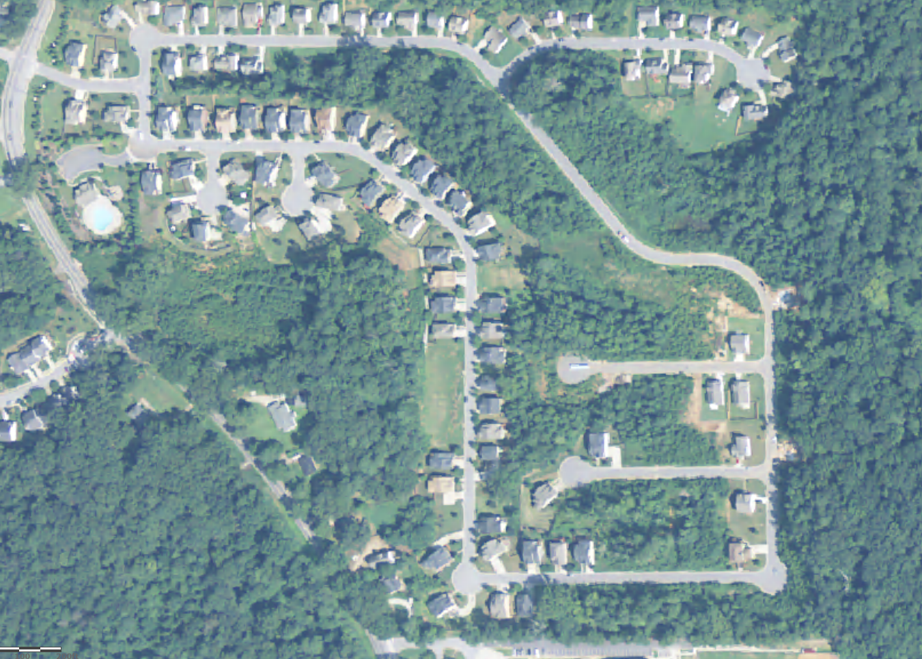
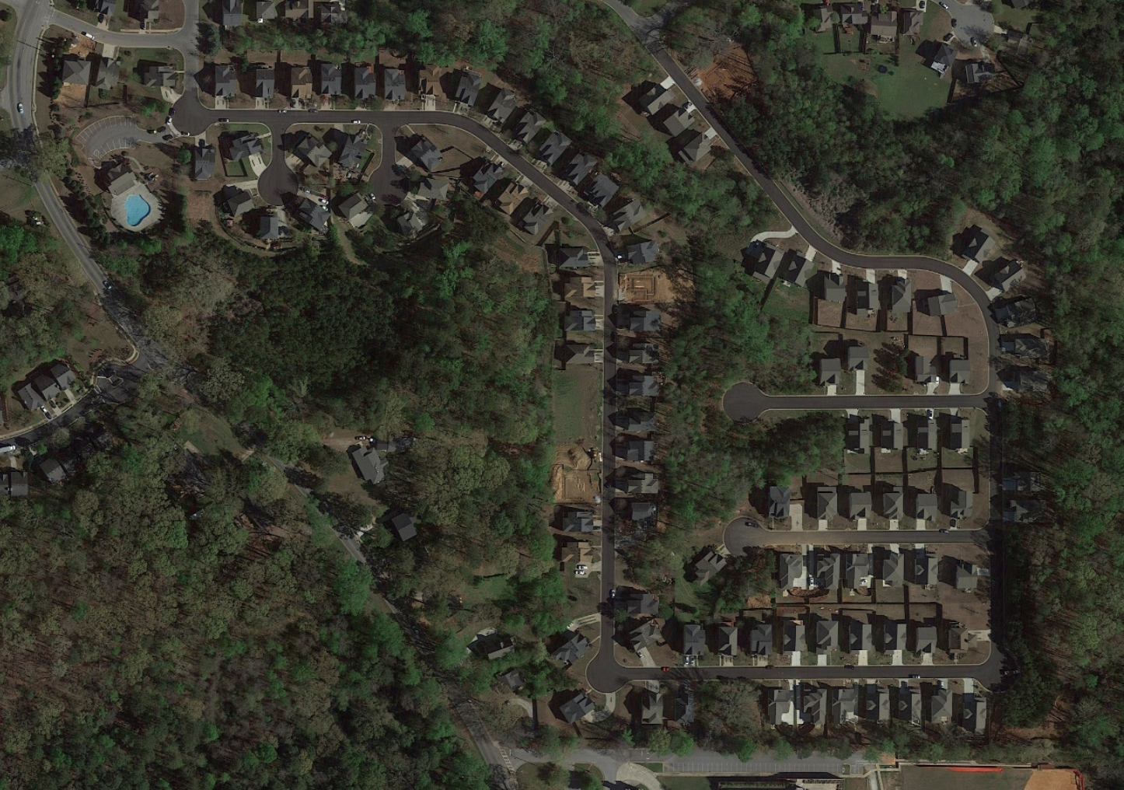
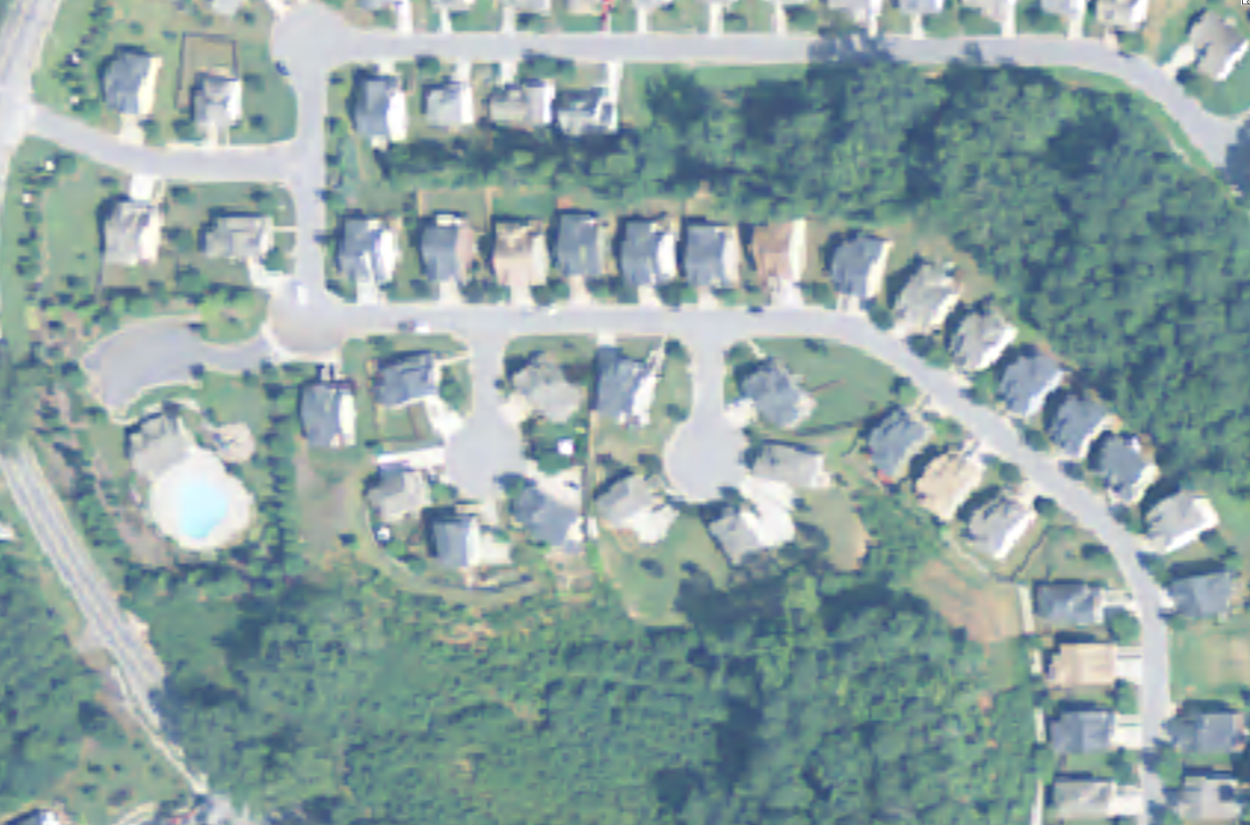
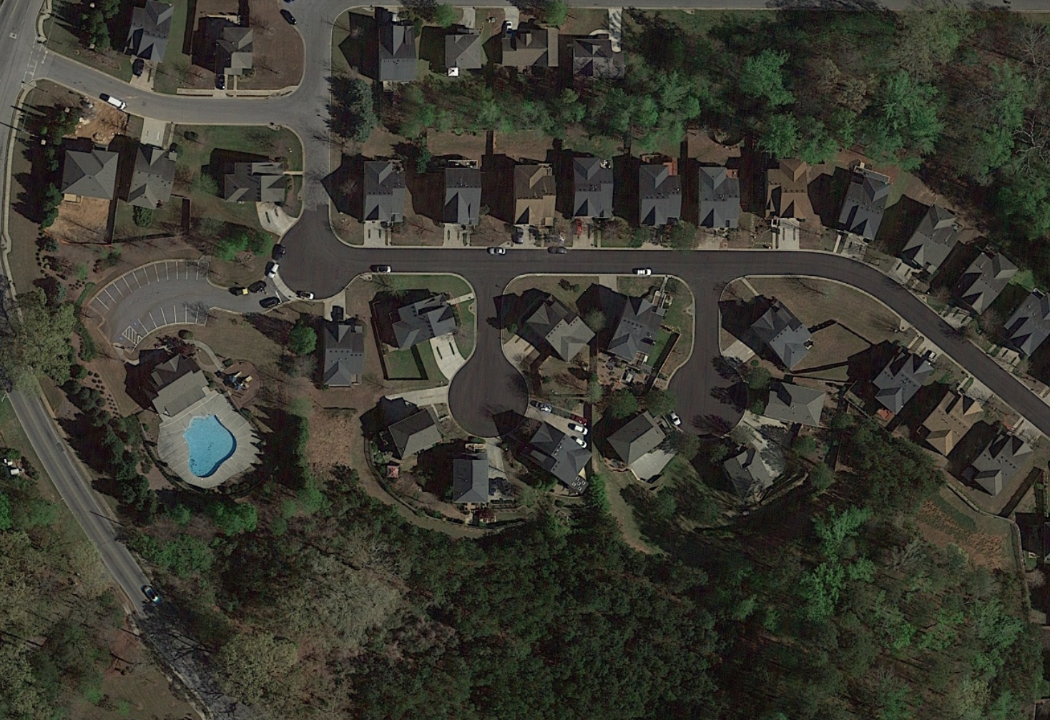
The stage is set for
Statewide Orthoimagery Program
… to be refreshed, and to grow from a “pilot” into a Real Program
2017: Purchased 2014-2017 COTS imagery from Google to support 2020 US Census – no real program, no rollout, no maintenance plan, just a snapshot…
2022: Conducted a robust, DOAS-lead RFP review and selection process, with strong stakeholder support. Review Team including cities, counties, ARC, GDOT, GEMA, GMA, 911, CVIOG, CRC, SGRC, DNR/EPD, OPB, and DCA)
Vendor Selected: Sanborn & Vexcel
1-meter resolution (e.g. NAIP)
Google 6-inch resolution
Available to ALL Georgia Governmental Entities (cities, counties, regions, state)
PLUS, all Federal partners and Contractors working on behalf of a government

Slide 36
Who Uses the Statewide Imagery Program
~ 2,000
Gov’t Staff
~ 100
Gov’t Contractors
(note: these numbers represent adoption without a significant advertising campaign, and old imagery – with an update, a rollout campaign, and three years of refreshes, these numbers are expected to increase significantly)

Slide 37
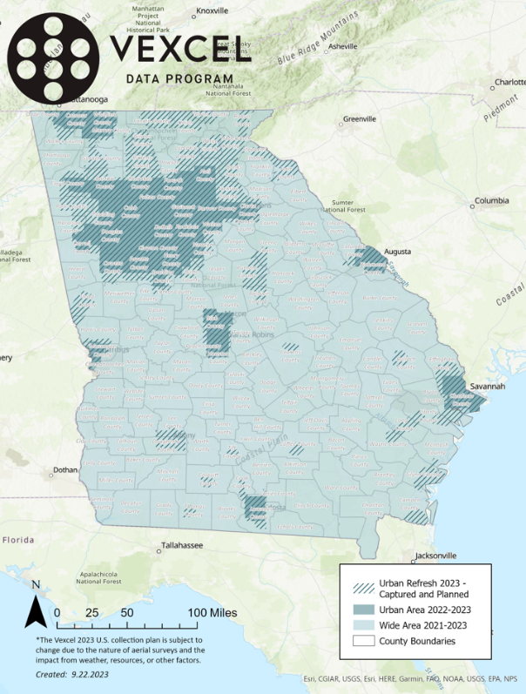
“Urban” (think DARK BLUE)
“Rural”
(think LIGHT BLUE)

Slide 38
What would the State’s Program Include?
INCLUDED
6-inch COTS orthoimagery (color and infrared + 1-mile buffer into surrounding states + hosting)
  Access to the imagery, via a myriad of tools/services to facilitate use (basic to advanced), includes download capabilities
Grey Sky Program access to rapid Post-Disaster Imagery
Leaf-off refresh of the entire State (1/2 the state in year 2, the other half in year 3 (funding partner defines the split)
Custom admin tool to ensure compliance with EULA, and provide a more comprehensive end-user experience
Technical & educational support from Vexcel & Sanborn to ensure the Programs success
Hardcopy
Perpetual license
NOT included in the GIO purchase but can be purchased as a BUYUP at a fixed cost (… and shared with all gov!)
Imagery Upgrades (in urban areas only – see dark blue (both) and hashed(3in only) areas on map)
  3-inch &/or Obliques
Additional Data
  Planimetrics (aka “feature extraction” where items in the imagery (e.g. buildings, roads, etc) are isolated and turned into actionable vector-based data)
    AI-ONLY derived
    AI & Human derived
  Digital Terrain Models (DTM) and Digital Surface Models (DSM) at various scales
Additional Services
  Custom Flights (Imagery & LiDAR)
  Analytics
    Change Detection
    Reprojections/Reformatting
  Hosting
  Support

Slide 39
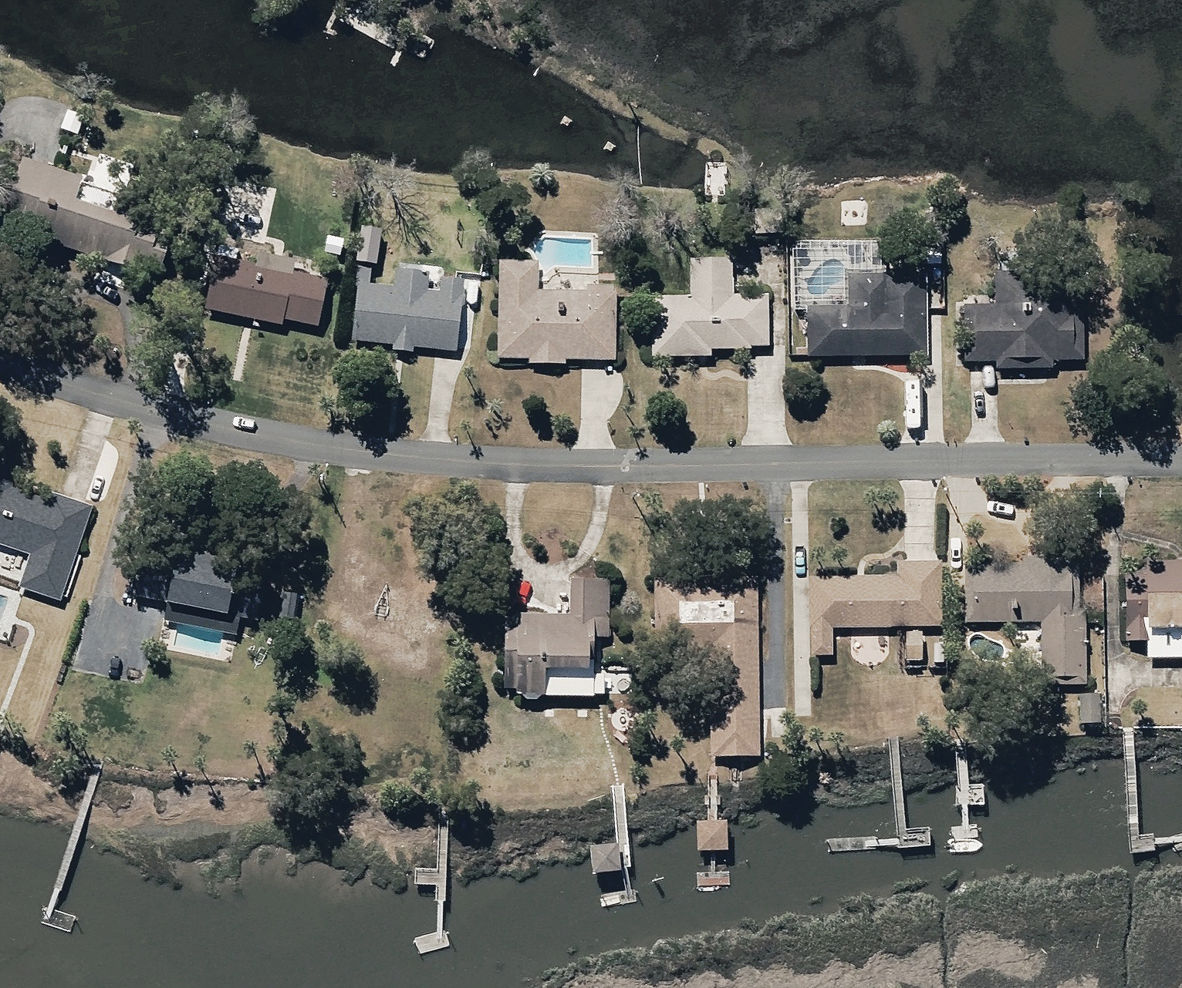
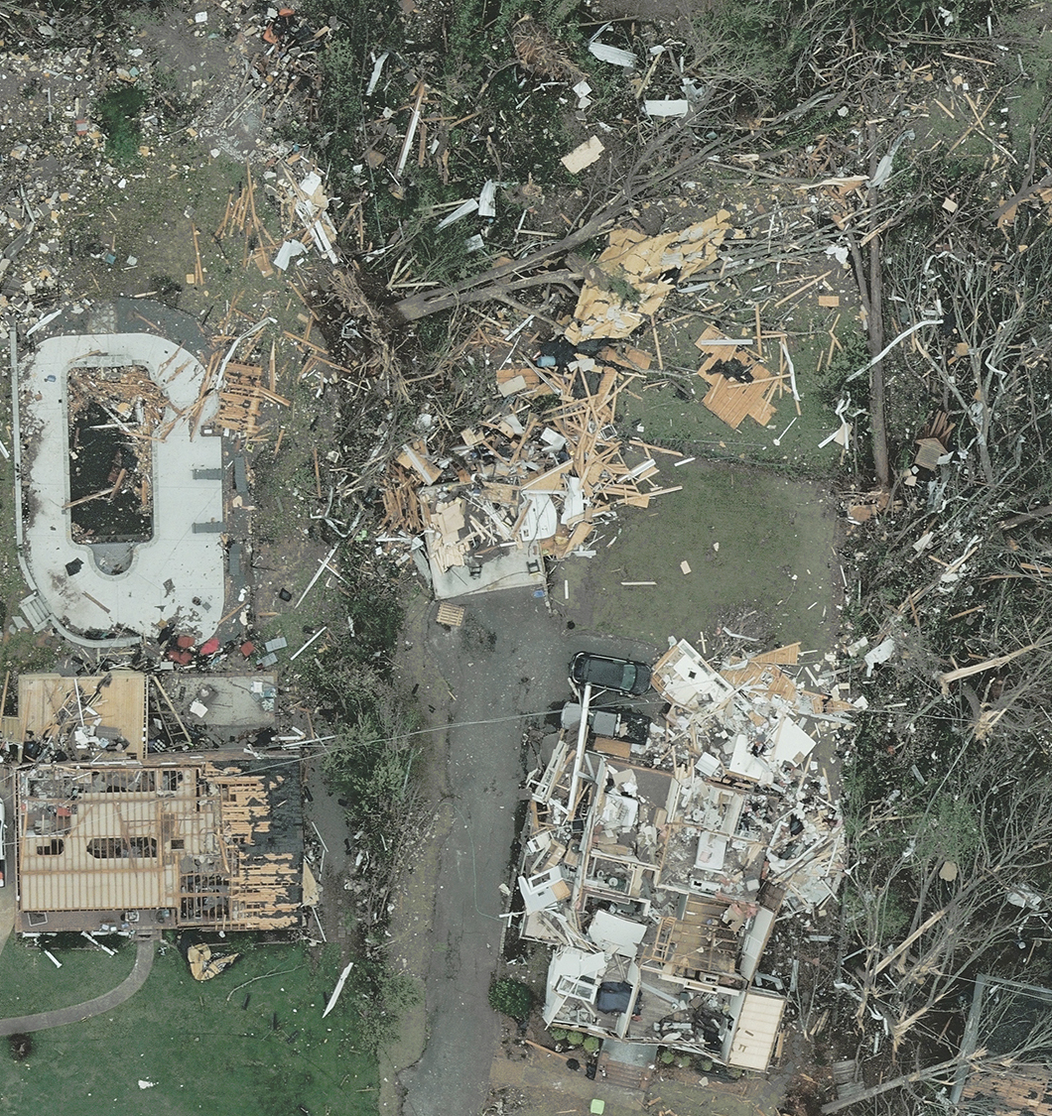
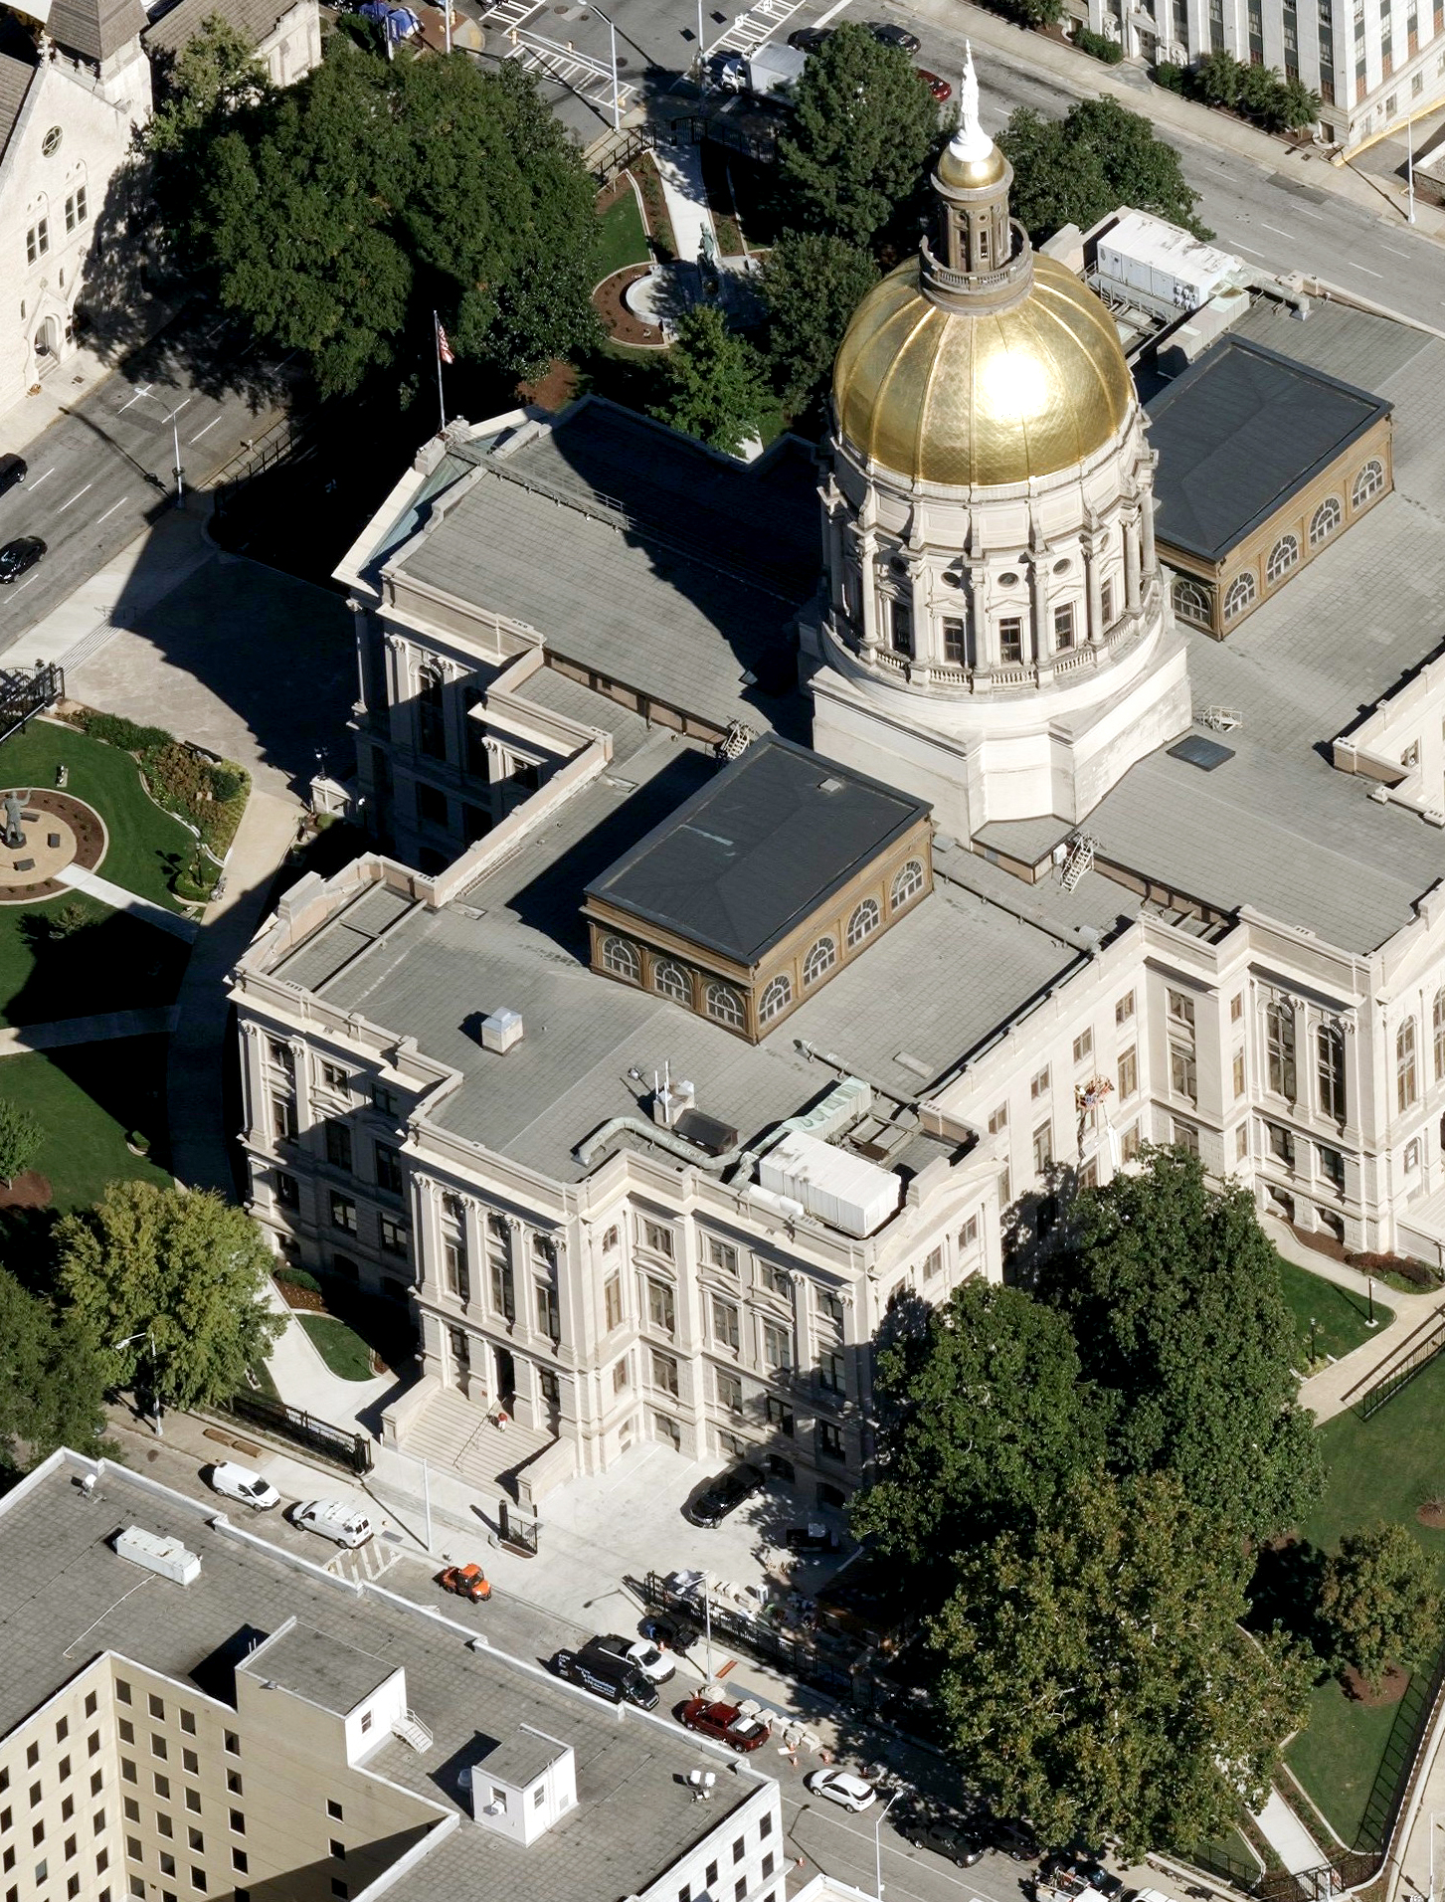
Vexcel Examples

Slide 40
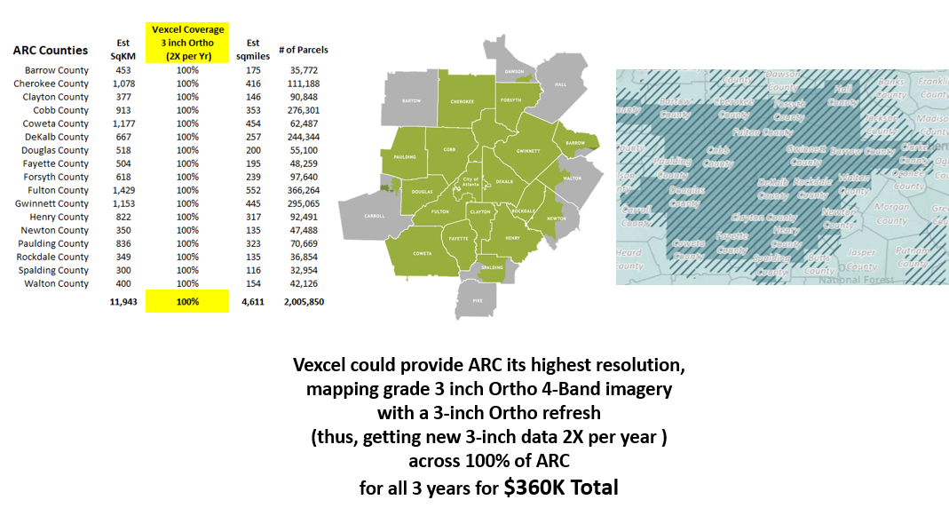
BUY-UP Example

Slide 41
What do the End Users Get?
Deliverables
Individual User-Based Account
Imagery (statewide + 1-mile buffer around the state)
  Ways to Access the Imagery
    Sanborn Geo-Data Explorer™ web application
      A web-based tool designed to allow end users the ability to explore, search, preview, and download available orthoimagery data quickly and easily
    Vexcel Viewer
    Esri Global Atlas Basemap
    Services, to be directly consumed into GIS, Surveying, Engineering applications (e.g. Esri and CAD)
      OGC (Open Geospatial Consortium) compliant Web Map Tile Service (WMTS), and
      OGC compliant Web Map Service (WMS)
  Only things that CAN’T do with the Imagery
    Use it for profit
    Expose the actual pixels to the public (use as a backdrop on public facing websites is absolutely FINE)
Grey Sky Imagery (to facilitate disaster management/planning, rescue/recovery, and improve mitigation planning)
Education & Training (to ensure success)
Technical Support (also to ensure success)
Community of Practice (to expand and enhance the value)

Slide 42
… an added perk/incentive
Roadway Element Data
AI-Derived data from Vexcel – to aid in MIRE compliance

Slide 43
The Offer
Offering us 2,500 urban centerline miles, for one-year, at no extra cost
  Atlanta proper (multiple counties ~1400 centerline miles)
  Leaving ~1,100 for funding partner to choose in other urban areas across the State
Includes:
All the Road Elements in their data dictionary (condition, etc)
PLUS: Change Detection Analytics (e.g. compare 2023 imagery with another year in the past, back to about 2015, and she what's changed) (standard cross walk was rated poor in 2019, and now it’s a high-visibility cross walk)
PLUS: Vexcel will provide an SME to ensure the greatest value and data evaluation

Slide 44


Roadway Data from High-Resolution Aerial Imagery
Roadway Inventories for Bike and Pedestrian Facilities
  Crosswalks (standard and high visibility) at intersections and midblock
  Bicycle lanes (symbols, words and green painted lanes)
  ADA detectable curb mats (truncated dome) and pedestrian refuge islands
2. Roadway Inventories for intersections and approaches
  Exclusive Left-turn and Right-turn lanes
  Presence/Absence of crosswalks
  Presence/Absence of bicycle facilities
3. Condition Assessment of Road Markings for Maintenance Prioritization
  Identification of faded or worn pavement markings
  Development of predication models based on historic imagery
4. ADA Compliance Assessment
  Mapping of required detectable warnings on curb ramps per DOT ADA standards
5. Confirm and Document Installation of Countermeasures
  Creation of as-builts for FWHA proven Pedestrian/Bicyclist countermeasures¹ (e.g., high-visibility crosswalks, advance stop and yield lines, ped. refuge islands).

Slide 45
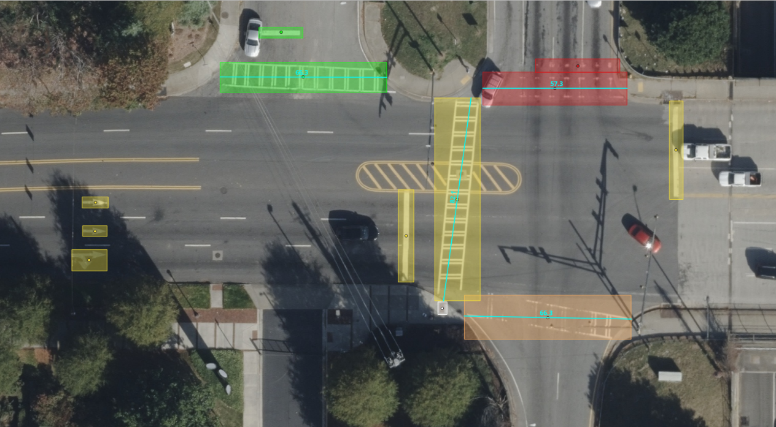
Elements - Roadway
Access 35+ attributes for better, more precise roadway analysis
Pavement Markings
Crosswalks
Bicycle symbols
Arrows
Words
Available for current and historical imagery
Infrastructure
Pedestrian refuge islands
ADA truncated domes “curb mats”
Intersection-junctions
Available for current and historical imagery
Condition Assessment
Pavement marking quality score for prioritizing maintenance
Available for current and historical imagery

Slide 46

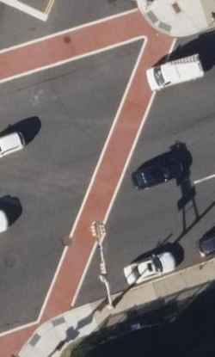
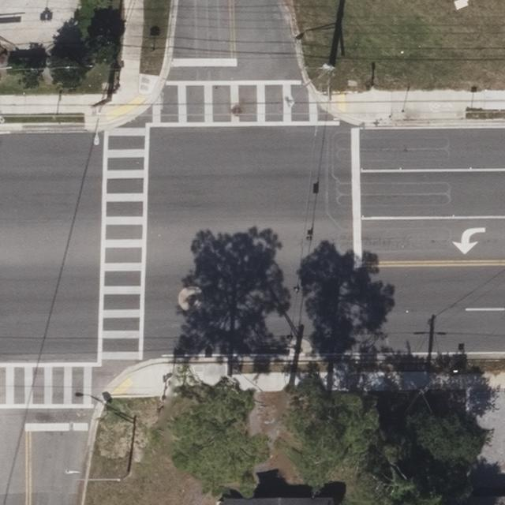
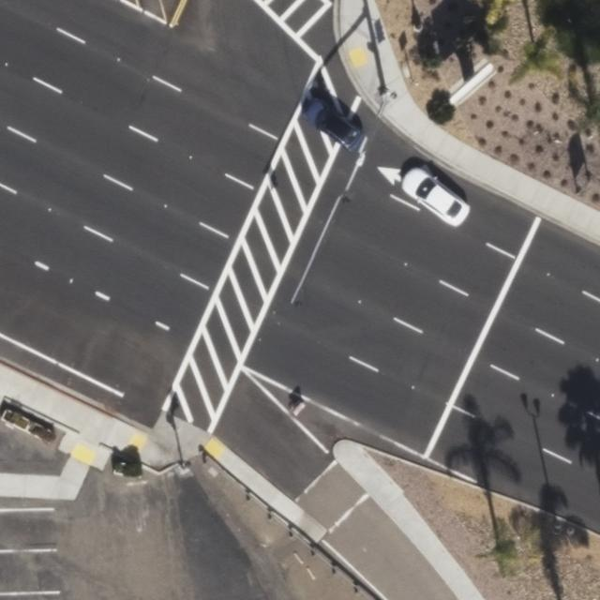

Crosswalk Identification and Classification
Standard
Solid
Zebra
(Continental)
Ladder
Diagonal

Slide 47
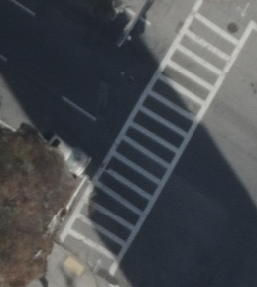
Pavement Marking Condition Scoring
Scored between 1-4 based on pavement marking imagery classified using subjective condition assessment markings.
4 = Great. No visible signs of defects.
3 = Good. Minimal signs of defects.
2 = Fair. Pronounced signs of defects that affect the function of the marking.
1 = Poor. Pronounced signs of defects that significantly affect the function of the marking.
Poor: 1
Fair: 2
Good: 3
Great: 4

Slide 48
Highlights from 2023
Goal 1: Lead Geospatial Coordination and Outreach
Goal 2: Facilitate and Promote the Creation of High-Quality Framework Data
Goal 3: Lead the Development of Policies, Standards, and Best Practices
Goal 4: Establish the Georgia Geospatial Hub 2.0 for all Data Programs
Goal 5: Cultivate the Office

Slide 49
Goal 3: Lead the Development of Policies, Standards, and Best Practices
  We continue to answer questions and provide support on our NG911 Data Standards and Best Practices
  Geospatial Contract Program (GCP)
      Esri
      1Spatial
      Sanborn
      Vexcel
      Axim (NV5)
      Dataprise

Slide 50
Highlights from 2023
Goal 1: Lead Geospatial Coordination and Outreach
Goal 2: Facilitate and Promote the Creation of High-Quality Framework Data
Goal 3: Lead the Development of Policies, Standards, and Best Practices
Goal 4: Establish the Georgia Geospatial Hub 2.0 for all Data Programs
Goal 5: Cultivate the Office

Slide 51

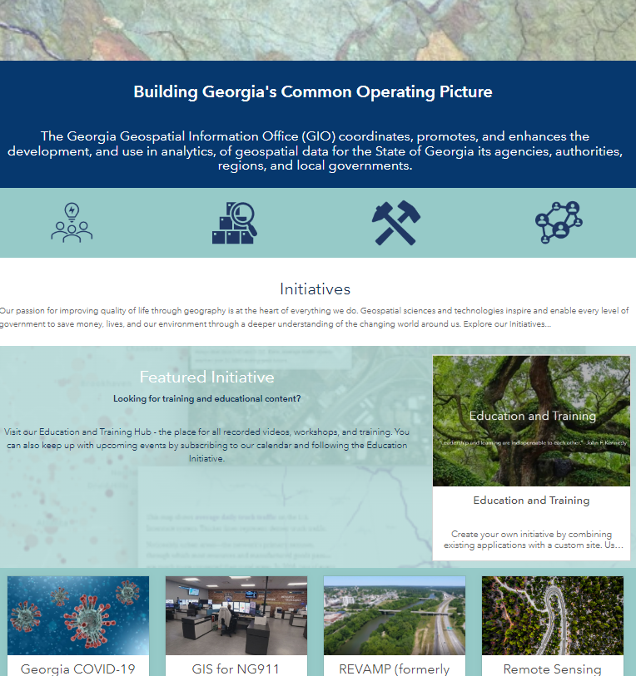
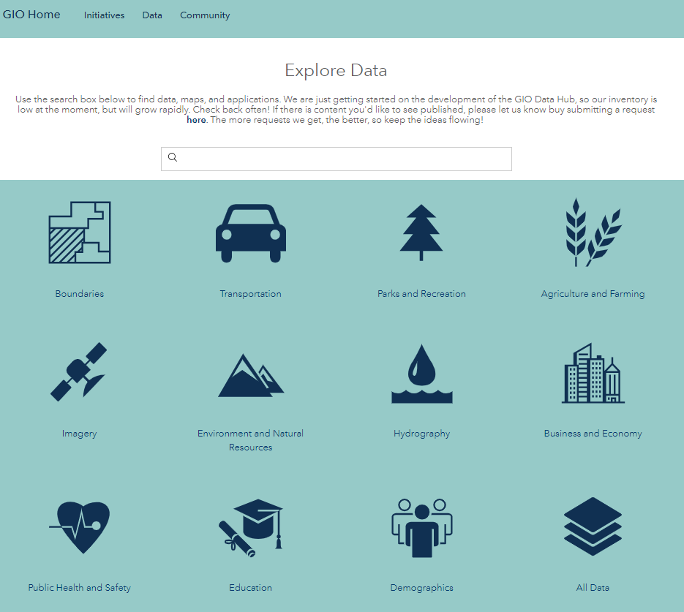
Goal 4: Establish the Georgia Geospatial Hub 2.0 for all Data Programs
    A Robust, Scalable, Cloud-Based, Highly-Secure
    Enterprise Geospatial Ecosystem
    for Georgia
Our Data is Growing! What do you want to see here?
Let us know!
Notes:
I took out the hub tour- I don’t really want to do that yet unless someone asks … but if we did I would probably show them education anyway

Slide 52
Highlights from 2023
Goal 1: Lead Geospatial Coordination and Outreach
Goal 2: Facilitate and Promote the Creation of High-Quality Framework Data
Goal 3: Lead the Development of Policies, Standards, and Best Practices
Goal 4: Establish the Georgia Geospatial Hub 2.0 for all Data Programs
Goal 5: Cultivate the Office

Slide 53
Goal 5: Cultivate the Office
  Secure Deadicated Funding to Increase Capacity & Accelerate Data Programs (through both acquisition and aggregation from Georgia’s greatest asset, its Local Governments)
  New & Expanding State-level Partnerships (strategies/projects)
    Georgia Department of Public Health
    Georgia Department of Transportation
    Georgia Emergency Communications Authority
    Georgia Emergency Management Agency
    Georgia Sentinel Landscape
    Georgia Trauma Commission
      Secretary of State, Elections
  New & Expanding State-level Champions
    Geospatial Advisory Council (GAC) ~ Our Collective Voice

Slide 54
What’s Next?
The GAC – Amplifying the Voice for Georgia’s Data Needs
  Working Groups (tell us what you’d like to have)
  Initiatives (tell us what you’d like to have)
Remote Sensing Program Refresh
  Statewide Imagery
  Statewide LiDAR
Landuse/Landcover Data
  Grants – share your ideas
Outreach and Education (Data Programs and Tools)
A more in-depth Needs Assessment Survey of the Geospatial Professionals in Georgia (a joint effort of the GIO and the Georgia Geospatial Association (GGA))
Data & Tools Harvest

Slide 55
Thank You
Questions

Slide 56
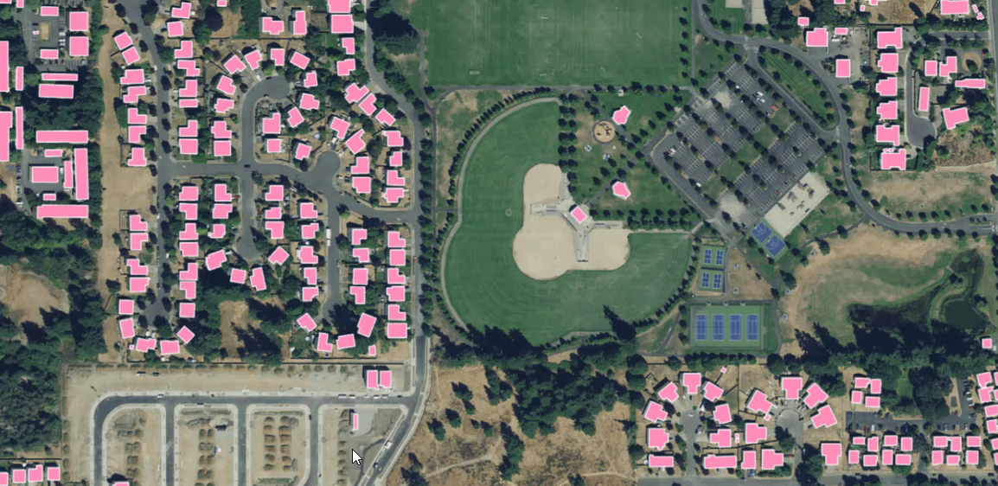
Landuse/Landcover
buildings
roads
bridges
railways
driveways
sidewalks
parking lots
swimming pools
sports fields
water bodies
forests
grasslands
bareland, and
paved areas
….plus height attribution for all buildings, trees, and bridges

