Slide 1
Admin tools to help wrangle AGO org items and credit burn
Ryan Barrett, ARC

Slide 2
AGO-Assistant
ArcGIS Assistant
Geo-Jobe Admin Tools
AGO Admin Dashboard
Python + hosted Jupyter Notebooks

Slide 3
AGO Assistant
Notes:
ArcGIS Assistant is a community-driven app developed by a team from Esri Professional Services. This app streamlines certain administrative tasks for ArcGIS power users who have an advanced understanding of the ArcGIS geoinformation model, and want to perform advanced tasks outside the scope of existing ArcGIS apps.
ArcGIS Assistant is the successor to AGO-Assistant. Read more about the new Assistant, as well as future intentions for the project, in the Guides.

Slide 4
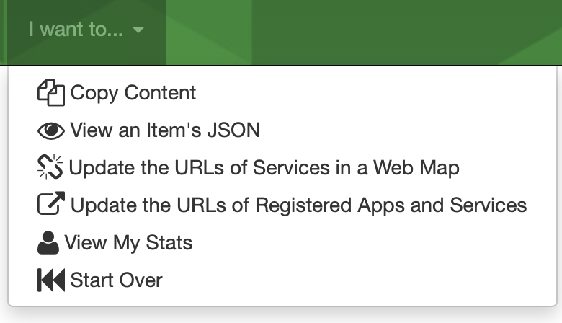
Notes:
ArcGIS Assistant is a community-driven app developed by a team from Esri Professional Services. This app streamlines certain administrative tasks for ArcGIS power users who have an advanced understanding of the ArcGIS geoinformation model, and want to perform advanced tasks outside the scope of existing ArcGIS apps.
ArcGIS Assistant is the successor to AGO-Assistant. Read more about the new Assistant, as well as future intentions for the project, in the Guides.

Slide 5
ArcGIS Assistant
Notes:
ArcGIS Assistant is a community-driven app developed by a team from Esri Professional Services. This app streamlines certain administrative tasks for ArcGIS power users who have an advanced understanding of the ArcGIS geoinformation model, and want to perform advanced tasks outside the scope of existing ArcGIS apps.
ArcGIS Assistant is the successor to AGO-Assistant. Read more about the new Assistant, as well as future intentions for the project, in the Guides.

Slide 6
Notes:
ArcGIS Assistant is a community-driven app developed by a team from Esri Professional Services. This app streamlines certain administrative tasks for ArcGIS power users who have an advanced understanding of the ArcGIS geoinformation model, and want to perform advanced tasks outside the scope of existing ArcGIS apps.
ArcGIS Assistant is the successor to AGO-Assistant. Read more about the new Assistant, as well as future intentions for the project, in the Guides.

Slide 7
Geo-Jobe Admin Tools
Notes:
ArcGIS Assistant is a community-driven app developed by a team from Esri Professional Services. This app streamlines certain administrative tasks for ArcGIS power users who have an advanced understanding of the ArcGIS geoinformation model, and want to perform advanced tasks outside the scope of existing ArcGIS apps.
ArcGIS Assistant is the successor to AGO-Assistant. Read more about the new Assistant, as well as future intentions for the project, in the Guides.

Slide 9
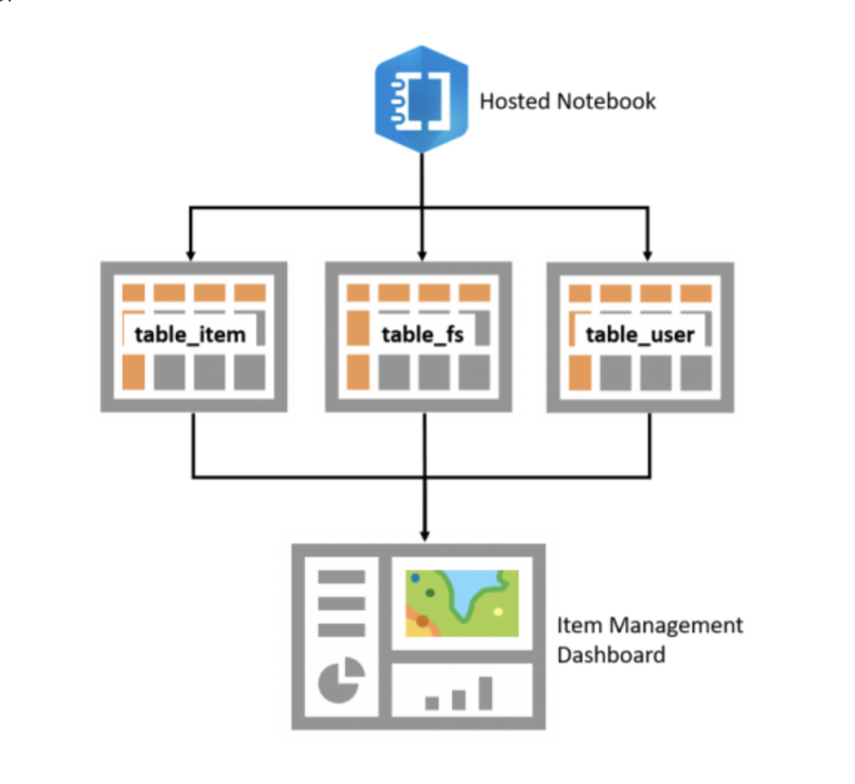
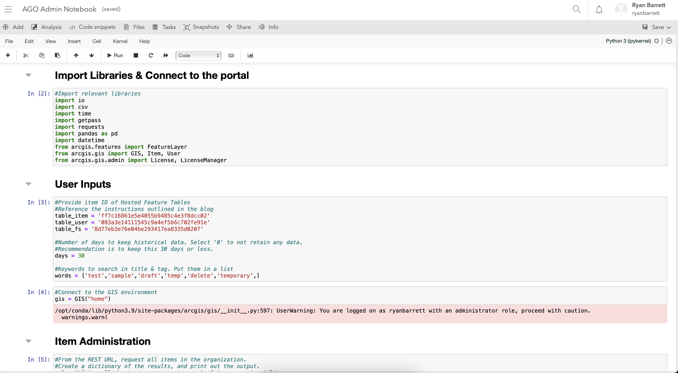
AGO Admin Dashboard
Configured from esri template
Hosted tables, notebook, python API
Updates daily
"# LIMITATION: The current script does not properly account for FS Storage with attachments. As a result, the calculated credit consumption will be higher than actual. Our manual workaround for top level burn rate."
---> While our total AGO org storage and credit burn is not impacted, we do see this affect our data store storage items in the standard AGO credit dashboard & Python API item table.

Slide 11
Other applications of Python + Notebooks
Notes:
ArcGIS Assistant is a community-driven app developed by a team from Esri Professional Services. This app streamlines certain administrative tasks for ArcGIS power users who have an advanced understanding of the ArcGIS geoinformation model, and want to perform advanced tasks outside the scope of existing ArcGIS apps.
ArcGIS Assistant is the successor to AGO-Assistant. Read more about the new Assistant, as well as future intentions for the project, in the Guides.

Slide 12
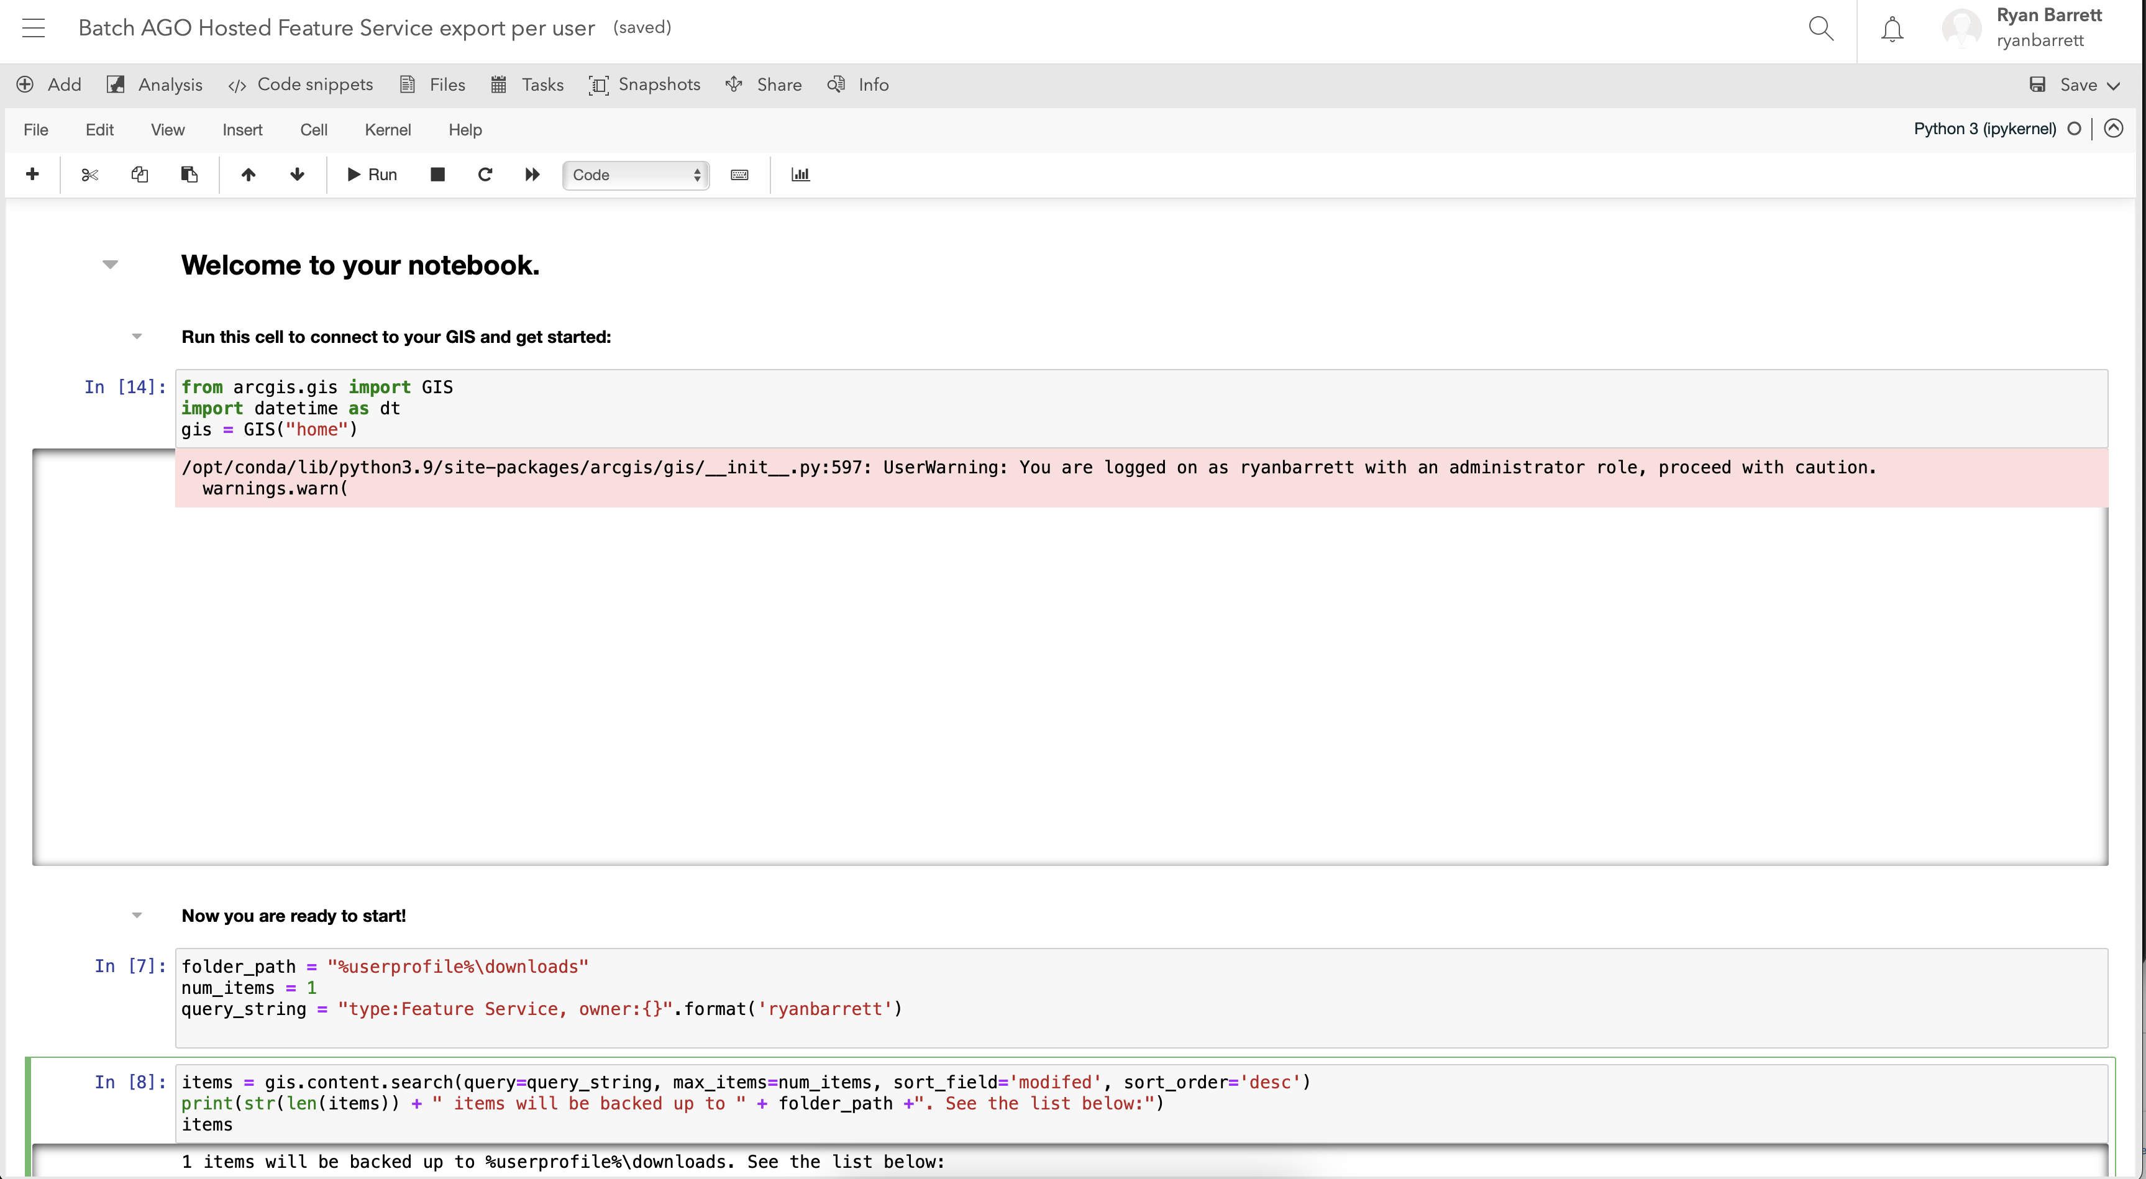
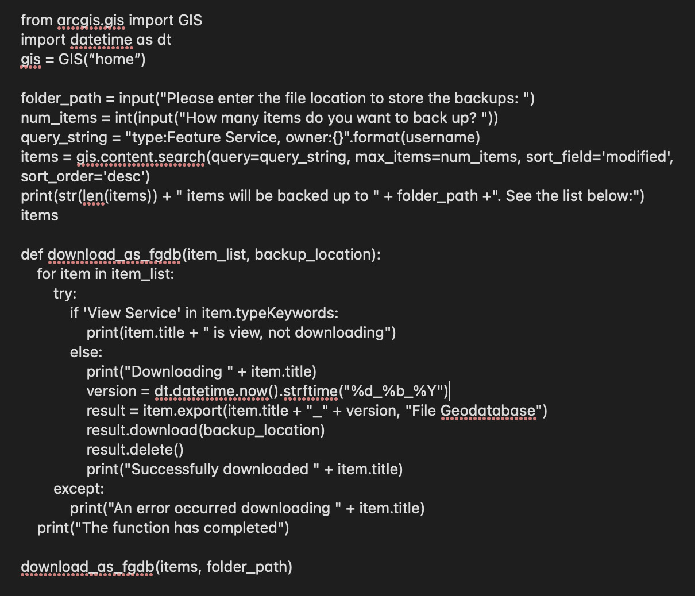
How about...
Batch download hosted FSs
Export gdb to AGO
Optionally delete original FSs
Mods
GIS ("home") rather than creds
Dropped date suffix to make republishing more seamless
folder_path = "%userprofile%\downloads"

Slide 13
Resources
Latest ArcGIS Assistant (beta) & previous AGO Assistant (remapping services still easier)
Geo-Jobe Admin Tools
Managing ArcGIS Online content with ArcGIS Dashboards and ArcGIS Notebooks blog post (including python code,table/dashboard templates)
Python API and Notebooks...How To: Back up hosted content by looping through and downloading hosted feature services in FGDB format (bulk download, save gdb to AGO, optionally delete hosted feature services)

Slide 14
How do you use these tools or others to help with org admin? Thank you!
This Photo by Unknown author is licensed under CC BY.
Notes:
ArcGIS Assistant is a community-driven app developed by a team from Esri Professional Services. This app streamlines certain administrative tasks for ArcGIS power users who have an advanced understanding of the ArcGIS geoinformation model, and want to perform advanced tasks outside the scope of existing ArcGIS apps.
ArcGIS Assistant is the successor to AGO-Assistant. Read more about the new Assistant, as well as future intentions for the project, in the Guides.

