Slide 1
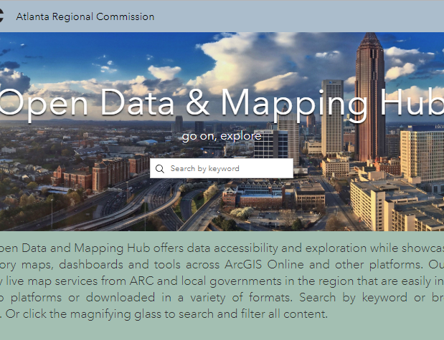
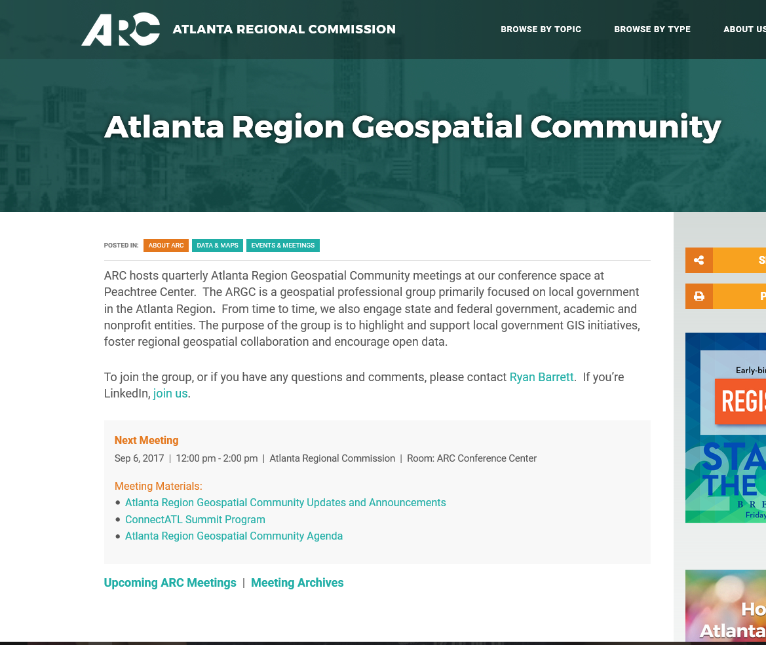
Interact with this presentation at menti.com with code 86 14 5
Atlanta Region
Geospatial Community
August 7, 2019 | Noon – 2pm
ARC Conference Center, Plaza Level, Peachtree Center
arcopendata.com
atlantaregional.org/argc
City of East Point
Spatial Summer 2019
https://data-eastpointgis.opendata.arcgis.com/

