Slide 1
Cost Allocation Techniques & Practices
Atlanta Regional Commission
March 11, 2015
Presented by:
Rich Garrity
RLS & Associates, Inc.
.

Slide 2
Workshop Content
Role of OMB in Cost Allocation
Standardized Approach to Cost Allocation Issues
Concept of Full Cost Identification
Issues in Cost Allocation
Development of Cost Allocation Model
Use of the Cost Allocation Model
Automation of the Cost Allocation Model

Slide 3
Target Audience
Organizations That Need an Approach to Cost Individuals Service Components
Transit Organizations that Provide Service Under a Purchase of Service Arrangement to Other Users/Groups
Transit Organizations that Need to Allocate Costs to Different FTA Programs
Multi-Purpose Human Service Agencies Supported by Multiple Federal Grants

Slide 4
Session Materials
PowerPoint Presentation
Cost Allocation Spreadsheet

Slide 5
Defining a Standardized Approach to Cost Allocation Issues
Module 1

Slide 6
Issues in Cost Allocation
The Term “Cost Allocation” Has Been Used to Describe a Wide Range of Allocation Needs Among Public Transit Operators

Slide 7
Issues in Cost Allocation
In Transit, “Cost Allocation” Can Refer to a Series of Distinct Management/Accounting Practices
Each Cost Allocation Problem Requires a Separate Methodology, Typically Referred to As “Cost Allocation”

Slide 8
Types of Cost Allocation
Financial Based Cost Allocation
Service Based Cost Allocation Plans

Slide 9
Financial Based Cost Allocation
Central Service Cost Allocation Plans
Indirect Cost Allocation Plans

Slide 10
Financial Based Cost Allocation #1
Central Services Cost Allocation Plan
A Publicly Sponsored Transit Program Benefits from the Services of Other Governmental Units and Desires to Claim Costs Incurred by these Units Under its Various Federal Awards
The Public Entity or Governmental Unit Must Prepare a “Central Services Cost Allocation Plan”

Slide 11
Financial Based Cost Allocation #2
Indirect Cost Allocation Plan
An Entity (Public or Private Nonprofit) Provides Multiple Program Services
Certain Overhead and Administrative Costs Incurred by the Entity Benefit All Programs and Services, Including Transit
The Agency Seeks to Recoup These Costs in Their Billings to Various Federal Agencies
The Entity Requires an Approved “Indirect Cost Allocation Rate” in Order for Such Costs to be Reimbursable by the Federal Government

Slide 12
Service Based Cost Allocation
Allocate Costs to Various Types/Modes/Services
Allocate Costs Between FTA Programs
Required in Section 5311 Program
Charter Cost Allocation
Local Match Allocation Plan

Slide 13
Service Based Cost Allocation #1
Service Based Cost Allocation
A Public Transit Agency Coordinates Service With Various Human Service Agencies In The Area
The Transit Provider Has A Policy That Public Transit Funds Cannot Be Used To Subsidize Human Service Agency Client Transportation
The Transit Agency Needs A “Fully Allocated Cost Analysis” To Determine How To Price Contract Services

Slide 14
Service Based Cost Allocation #2
Service Based Cost Allocation
A Transit Agency Receives Funding Under Both FTA Section 5307 And Section 5111
FTA Expects the Grantee to Develop a Reasonable Basis for Allocating Operating Costs Between the Two Funding Sources that is Related to the Service Provided
FTA Requires a “Grant Allocation Plan” to Distribute Costs to the Two Different, But Related Programs

Slide 15
Service Based Cost Allocation #3
Service Based Cost Allocation
A Transit Agency Provides Charter Service in Accordance with 49 CFR part 604
The Transit Agency Must Demonstrate That it Fully Recovers the Cost of Charter Service
The Agency Requires a “Charter Service Allocation Plan”

Slide 16
Service Based Cost Allocation #4
Service Based Cost Allocation
A Regional Transit Authority Provides Service Over a Multi-Jurisdictional Service Area
Each Participating Local Entity Must Share Responsibility for Funding a Portion of the Local Share
The Authority Must Allocate Local Funding Needs In An Equitable Manner To All Participating Jurisdictions

Slide 17
Multiple Cost Allocation Needs
Some Public Transportation Projects May Require Multiple Types of Cost Allocation

Slide 20
Role of OMB in Cost Allocation
Module 2

Slide 21
OMB Role
Office of Management and Budget (OMB)
Predominant Mission Is to Assist the President in Overseeing the Preparation of the Federal Budget and to Supervise Its Administration in Executive Branch Agencies

Slide 22
OMB Role
OMB has Issued Grants Management Guidance in Three (3) Primary Areas
Cost Principles
Grant Management/Administrative Requirements
Audit

Slide 23
OMB Role
Audience Consists of Three Different Types of Grantees
State/Local Governments, Indian Tribal Organizations
Nonprofit Agencies
Education Institutions

Slide 24
Scope of OMB Circulars - Now
Area | Local & State Government | Education Institutions | Nonprofit Corporations
Cost Principles | A-87 | A-21 | A-122
Administrative Requirements | A-102 (49 CFR part 18) | A-110 (49 CFR part 19) | A-110 (49 CFR part 19)
Audit | A-133 | A-133 | A-133

Slide 25
OMB Initiative
OMB, Published, on December 26, 2013, New Guidance in the Federal Register
Consolidated ALL Previous Circulars In the Previous Slide Into One, So-Called “Super Circular” or “Omni-Circular”

Slide 26
OMB Initiative
“Administrative Requirements, Cost Principles, and Audit Requirements for Federal Awards”
Not Really a Circular
Codified at 2 CFR Part 200

Slide 27
Scope of OMB Circulars - 2015
Area | Local & State Government | Education Institutions | Nonprofit Corporations
Cost Principles | 2 CFR part 200
Administrative Requirements
Audit

Slide 28
Key Highlights
Audit Threshold for A-133 Audits Raised to $750,0000
Indirect Cost Rates
Federal Agencies Must Accept Negotiated Indirect Cost Rates
Pass-through Entities (e.g., States) Must Honor Nonprofit’s Negotiated Indirect Cost Rates
New Alternative Ten Percent Rate

Slide 29
Key Highlights
Internal Controls Burden Shifted From Audit to Grants Management Function
Changes to Personnel Documentation
New Standards for Conflict of Interest (COI)
Emphasis on Performance Rather Than Compliance

Slide 30
Key Highlights
Standardization of Application and Award Data
Other Changes That Have Previously Been Adopted by FTA
In Some Instances, Grantees May Find the Regulation More Difficult to Comprehend
Combination, Exceptions, and Retention of Applicability

Slide 31
Embracing the Concept of Full Cost Identification
Module 3

Slide 32
Why Full Cost Identification?
Our Goal - To Answer the Questions:
How Much Does the Transportation Service Cost?
How are We Going to Pay For It?
In Order to Achieve These Goals, Agency and Program Managers Must Use Financial Planning

Slide 33
Why Full Cost Identification?
Assess Performance
Measure Progress Toward the Achievement of Goals and Objectives
Consider Actions Which May Change the Course of Future Events
Modify Policies, Procedures, and Processes

Slide 34
Why Full Cost Identification?
Make Operational Changes, Including Those Leading To:
Service Expansion, Reduction, or Cessation
Increases or Decreases in Services, Revenues, and Staff
Changes or Modifications in Procedures or Other Activities (Such As Marketing or Public Relations)

Slide 35
Why Full Cost Identification?
Transportation Systems Need Complete and Accurate Financial Data in Order to:
Manage the System So That Its Goals and Objectives are Met Efficiently
Know the True Cost of Operating the System so that Costs May be Billed or Allocated Appropriately to the System's Users

Slide 36
Why Full Cost Identification?
Report to the Funding Sources or Purchasing Agencies How Money was Spent, What Revenues were Realized, and the Financial Status of the Organization

Slide 37
Issues in Full Cost Accounting
Lack of Sufficient Account Detail In Organizational Accounting Systems
Failure to Capture and/or Allocate Agency Indirect or Overhead Costs
There Is A Lack Of Common Definitions For Accounts (Non-FTA Programs)

Slide 38
Issues in Full Cost Accounting
Lack of Common Definition of Service
Failure to Capture Service Unit Data
Blended Program Expenditures
Use of Capitated Payments

Slide 39
Financial Planning: Why is This Important?
Planning for Change
Changes We Institute
Changes Forced Upon Us

Slide 40
Issues in Cost allocation
Module 4

Slide 41
Special Issues in Cost Allocation
Full Cost Accounting
Direct and Indirect Costs
Operating and Capital Costs
Fixed and Variable Costs
Notes:
Slide 45
The Office of Management and Budget rests atop the “Cost Eligibility Funnel.”
Experience in early conduct of this course indicates that many Section 5311 grantees are unaware of the importance and role played by OMB in cost allowability, grants management, and audit.

Slide 42
Full Cost Accounting
The Basic Approach Recommended and Used by Successful Business Operations and Transportation Systems is Called “Full Cost Accounting”

Slide 43
Full Cost Accounting
To Use this Approach Requires an Understanding of Basic Cost Concepts and the Use of a Consistent Costing Method

Slide 44
Full Cost Accounting
Using “Full Cost Accounting” Means that the Total Costs of Providing Transportation Services are Considered
Total Costs Include Any Commitment or Use of Time, Money, Physical Resources, and Other Assets of the Agency in the Delivery of Transportation Services

Slide 45
Full Cost Accounting
In Full Cost Accounting, a Value is Given to These Commitments Whether or Not They Result in Immediate Out-of-Pocket Expenditures

Slide 46
Full Cost Accounting
Analyze the Various Functions and Activities that Your Transportation Program Carries Out on a Day-to-Day Basis
Management’s Responsibility is to Identify All Activities That Your Agency Performs in the Delivery of Transportation Services

Slide 47
Full Cost Accounting
Understand HOW the Activity Creates Costs for the Transportation Program
Your Transit Program DOES Something
Your Transit Program BUYS Something
Use a Functional Approach to Cost Recognition

Slide 48
Full Cost Accounting
Functional Areas of Transportation:
Operations
Maintenance
Non-Vehicle Maintenance
General Administration

Slide 49
Full Cost Accounting
The Agency’s Chart of Accounts is the Basic Tool Used to Ensure that All Transportation Costs are Reflected in the Agency’s Accounting System

Slide 50
Direct and Indirect Costs
Direct Costs
Those Expenses Incurred by the Grantee That Are Directly Related and Strictly Benefit Only the Public Transportation Program
Generic Examples:
Compensation of Employees for the Time Devoted and Identified Specifically to the Performance of the Grant
Notes:
Slide 74

Slide 51
Direct and Indirect Costs
Direct Costs
Generic Examples:
Cost of Materials Acquired, Consumed, or Expended Specifically for the Purpose of Providing Public Transit Service
Equipment and Other Approved Capital Expenditures
Travel Expenses Incurred Specifically to Carry Out the Award

Slide 52
Direct and Indirect Costs
Indirect Costs
Indirect Costs Are Those That Have Been Incurred For Common or Joint Purposes
These Costs Benefit More Than One Cost Objective and Cannot Be Readily Identified With a Particular Final Cost Objective Without Effort Disproportionate To the Results Achieved
Notes:
Slide 74

Slide 53
Direct and Indirect Costs
Indirect Costs
Generic Examples
Certain Central Service Costs
General Administration of the Organization
Accounting and Personnel Services Performed Within the Organization the Delivers Public Transit Services
Costs of Operating and Maintaining Facilities

Slide 54
Capital vs. Operating Costs
Operating Costs are Consumed in Less Than One Year (e.g., Wages, Fuel) and Generally Have a Unit Acquisition Cost Lower Than a Threshold Set by the State DOT
Capital Costs are Expenses for Long-Term Assets (e.g., Vehicles, Garages)
Definitions May be Set by the Grantor Agency

Slide 55
Capital vs. Operating Costs
Defining Capital Costs is Important, as 2 CFR part 200.436(c)(2) States that Depreciation Will Exclude:
Any Portion of the Cost of Buildings and Equipment Borne by or Donated by the Federal Government Irrespective of Where Title was Originally Vested or Where it Presently Resides

Slide 56
Capital vs. Operating Costs
What Does this Mean?
If the Cost of the Vehicle (Asset) Was Paid for by a Federal Program, You May NOT Include Depreciation of that Asset in Your Charges to Other Federal Programs in the Cost of Service Provision

Slide 57
Fixed vs. Variable Expenses
Variable Costs Change Relative to the Amount of Service Provided (e.g., Drivers' Wages)
Fixed Costs Do Not Vary with the Amount of Service Provided (e.g., Administrative Salaries)
Total
Variable
Cost
Fixed
Output

Slide 58
Developing a cost allocation model
Module 5

Slide 59
Why Cost Allocation?
More Grant
Funds From ARC??
General Public
Ridership

Slide 60
Why Cost Allocation?
To Determine How Much It Costs to Provide A Specific Transit Service
$16.80
Per
Trip

Slide 61
Why Cost Allocation?
Why Do We Need a Model to Determine Cost?
Why Can’t We Simply Divide Total System Cost by Total System Miles?
Or Total System Cost by Total System Hours?
Consider the Following:

Slide 62
Why Cost Allocation?
Do These Trips Cost the Same?

Slide 63
Why Cost Allocation?
Do These Trips Cost the Same?

Slide 64
Why Cost Allocation?
Transportation Costs are Driven by Two Critical Factors:
Time AND Distance
Our Model Must Take Both Factors Into Account When Costing Transportation Services

Slide 65
Developing a Cost Allocation Model
How Do We Allocate Costs? Don’t Worry, This Process is Not Complicated!
Another Program Mandate????

Slide 66
Developing a Cost Allocation Model
Cost Allocation Assumes:
Total System Costs Can be Allocated to Service Based on the Level of Service Provided
System Average Unit Costs Can Be Used to Estimate Service Costs

Slide 67
Developing a Cost Allocation Model
Assemble Data
Assign Expense Line Items
Calculate Unit Costs
Calculate Unit Costs

Slide 68
Issues in Assembling Data
Where Do We Get Cost Data?
What Time Period Should be Used?
Projected vs. Actual?

Slide 69
Required Data
Twelve (12) Months Actual or Projected Transit Expense Data
Expense Data Will be Classified as Either:
Fixed Expense
Variable Expense
Service Data
Vehicle-Miles
Vehicle-Hours
Passenger Trips

Slide 70
Assigning Cost to Categories
Cost Allocation Involves Taking Each Expense Line Item and Assigning It to Either the Fixed or Variable Category
Variable Expenses are Further Broken Down as Varying Either by:
Hour
Mile

Slide 71
Assigning Cost to Categories
Fixed Costs are Those Costs that Will Not Change As a Result of an Increase or Decrease in Service Levels
Variable Expenses are Those Costs that Will Change if There is a Change in Service Levels

Slide 72
Assigning Cost to Categories
There are No Hard and Fast Rules…..But:
Project Administration Costs are Almost Always Fixed
Understand the Basis of Each Cost Item and Assign Accordingly
Be Logical
BE CONSISTENT

Slide 73
Calculation of Unit Costs
We Now Have a Total of Fixed and Variable Costs
We Need to Calculate Our Unit Costs. There are Three (3) Calculations:
Allocated Hours Cost
Allocated Miles Cost
Allocated Fixed Expense
Demand Response: Ratio
Fixed Route: Fixed Cost Per Vehicle

Slide 74
Calculation of Unit Costs
Allocated Hours Cost:
Total Allocated Hours Cost ÷
Annual Projected Vehicle Hours

Slide 75
Calculation of Unit Costs
Allocated Miles Cost:
Total Allocated Miles Cost ÷
Annual Projected Vehicle Miles

Slide 76
Calculation of Unit Costs
What Do We Do With Fixed Expenses?
There Are Different Approaches - For Most Demand Response Systems in Rural Areas, Fixed Expenses are Expressed as a Percentage or Ratio of Allocated Variable Expenses (Hours Cost + Miles Cost)

Slide 77
Calculation of Unit Costs
In Fixed Route Systems, Fixed Expenses are Expressed as Follows:
(Total Fixed Expenses ÷ Total Vehicles In Maximum Revenue Service)

Slide 78
Calculation of Unit Costs
In Demand Response Systems, the Formula is As Follows:
Fixed Cost Factor =
Total Fixed Expenses ÷ (Total Allocated Hours Expenses + Total Allocated Miles Expenses)

Slide 79
Cost Allocation’s Dirty Secret
At this Stage in the Development of a Cost Allocation Model, We Would Test the Model by Plugging in Total System Hours, Miles, and Vehicle (by Mode) to Test the Model
Problem: the Industry Models Do Not Work in a Multi-Modal Setting

Slide 80
Cost Allocation’s Dirty Secret
The PriceWaterhouse Model Only Works in Fixed Route Systems
The AASHTO/MTAP Model Only Works in Demand Response Systems
In the Real World, Most of Us Operate in a Multi-Modal Environment

Slide 81
Cost Allocation’s Dirty Secret
Problem: Fixed Expenses
Solution: Fixed Expenses Must Undergo a Modal Allocation

Slide 82
Modal Split of Fixed Expenses
Like Indirect Cost Allocation, We Must Chose a Basis That Will Equitably Distribute Fixed Expenses
The Basis is Vehicle Hours

Slide 83
Modal Split of Fixed Expenses
Apply a Ratio of Vehicle Hours by Mode to the Total Amount of Fixed Expenses
(Fixed Route Hours ÷ Total Hours) X Total Fixed Expenses = Allocable Fixed Expenses Attributable to Fixed Route Mode
(Demand Response Hours ÷ Total Hours) X Total Fixed Expenses = Allocable Fixed Expenses Attributable to Demand Response Mode

Slide 84
Modal Split of Fixed Expenses
Now….
Recalculate the Previous Two Fixed Expense Computations
….But Substitute the Modal Allocation of Fixed Expenses for Total Fixed Expenses Used Before

Slide 85
Exercise No. 5
Allocate Fixed Expenses to the Fixed Route and Demand Response Modes
Last Line is the Complicated One
Computation:
{DR Fixed Expenses / [ (∑ DR Miles X Allocated Miles Rate (Ex #4)) + (∑ DR Miles X Allocated Hours Rate (Ex #4)) ] }

Slide 86
Completing the Computations
The Fully Allocated Cost of Service is Equal to (put all three formulas together for each mode):
Demand Response
{(Total Annual Projected Hours x Allocated Hours Cost) +
(Total Annual Projected Miles x Allocated Miles Cost)} +
{DR Fixed Cost Factor x [(Total Annual Projected Hours x Total Allocated Hours Cost) + (Total Annual Projected Miles x Allocated Miles Cost)]}
+
Fixed Route
{(Total Annual Projected Hours x Allocated Hours Cost) +
(Total Annual Projected Miles x Allocated Miles Cost) +
(FR Cost Per Vehicle x No. Peak Vehicle)}

Slide 87
Completing the Computations
To Test our Cost Allocation Model
Plug in Total Annual Projected Hours and Total Annual Projected Miles for Demand Response
Plug in Total Annual Projected Hours and Total Annual Projected Miles for Fixed Route
The Two Totals Should Equal Total Expenses

Slide 88
Completing the Computations
Congratulations … You Have Just Developed a Cost Allocation Model

Slide 89
Applying the Model
Now that We Have Our Model, We Will Put it to Work
We'll Sort Through The X's and O's
By Looking At Allocating the Costs
of Various System Users

Slide 90
Review
We Built a Cost Allocation Model that Uses Generally Accepted Accounting Principles to Allocate Transportation Costs Among Various Agency Users
We Learned How to Use the Model to Determine or Project the Costs for Individual Agency Users

Slide 91
Automating the cost allocation process
Module 6

Slide 92
Overview
As You Can See from the Cost Allocation Model Built Earlier in this Workshop
Cost Allocation Can be Repeated on an Annual Basis
The Process Lends Itself to Spreadsheet Application

Slide 93
Cost Allocation Model
Copy the File “Blank Cost Allocation Model.xls” to a Folder on Your Computer’s Local Drive or Network Drive
Start MS Excel
Navigate to Folder and Open the Model

Slide 94
Cost Allocation Model
Caution
Excel Will Prompt the User With or More User Messages, Such As:
You Must Click the “Enable Content” Button
You Will Be Automatically Taken to the Opening Menu

Slide 95
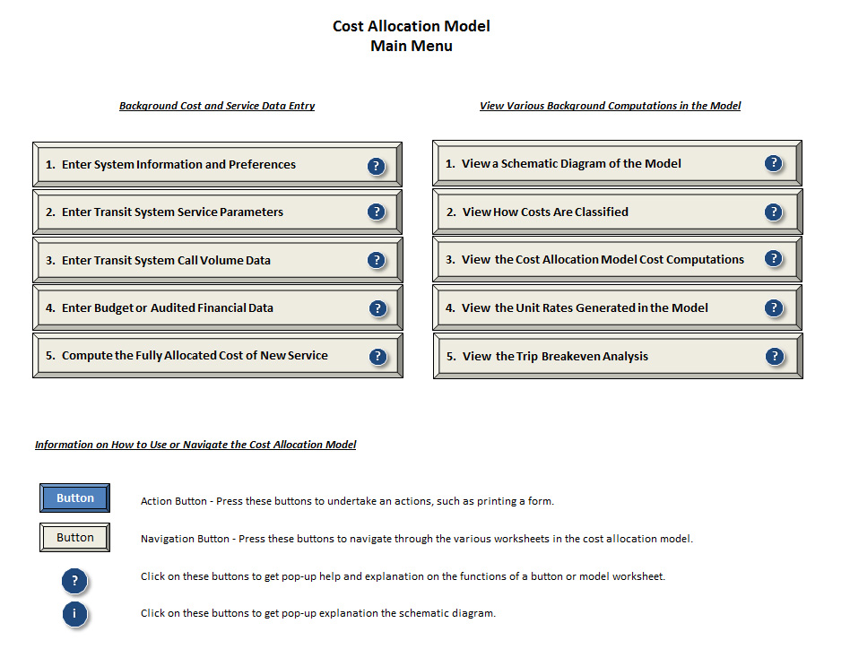
Cost Allocation Model

Slide 96
Cost Allocation Model
The Model is Menu-Driven
Buttons on the Left Side Prompt the User for Input
Buttons on the Right Side Permit User to See the Model’s Computations/Output
Help is Available From Most Screens by Clicking the “?” Or “i” Buttons

Slide 97
Cost Allocation Model
The Model is Built Based on the PowerPoint
Enter Service Data
Parameters About System
Hours, Miles, and Passengers
Enter Budget Data
Compute Unit Rates (Done Automatically)

Slide 98
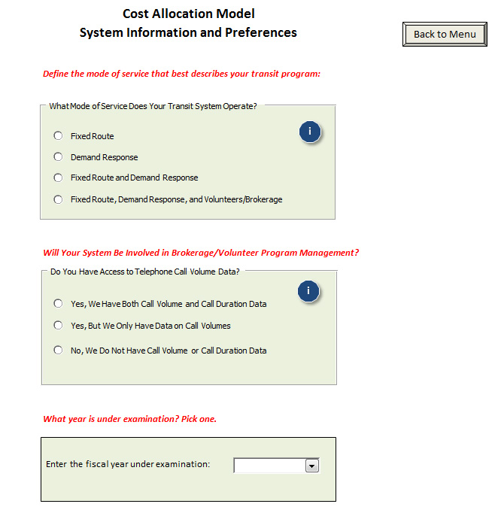
Cost Allocation Model

Slide 99
Cost Allocation Model

Slide 100
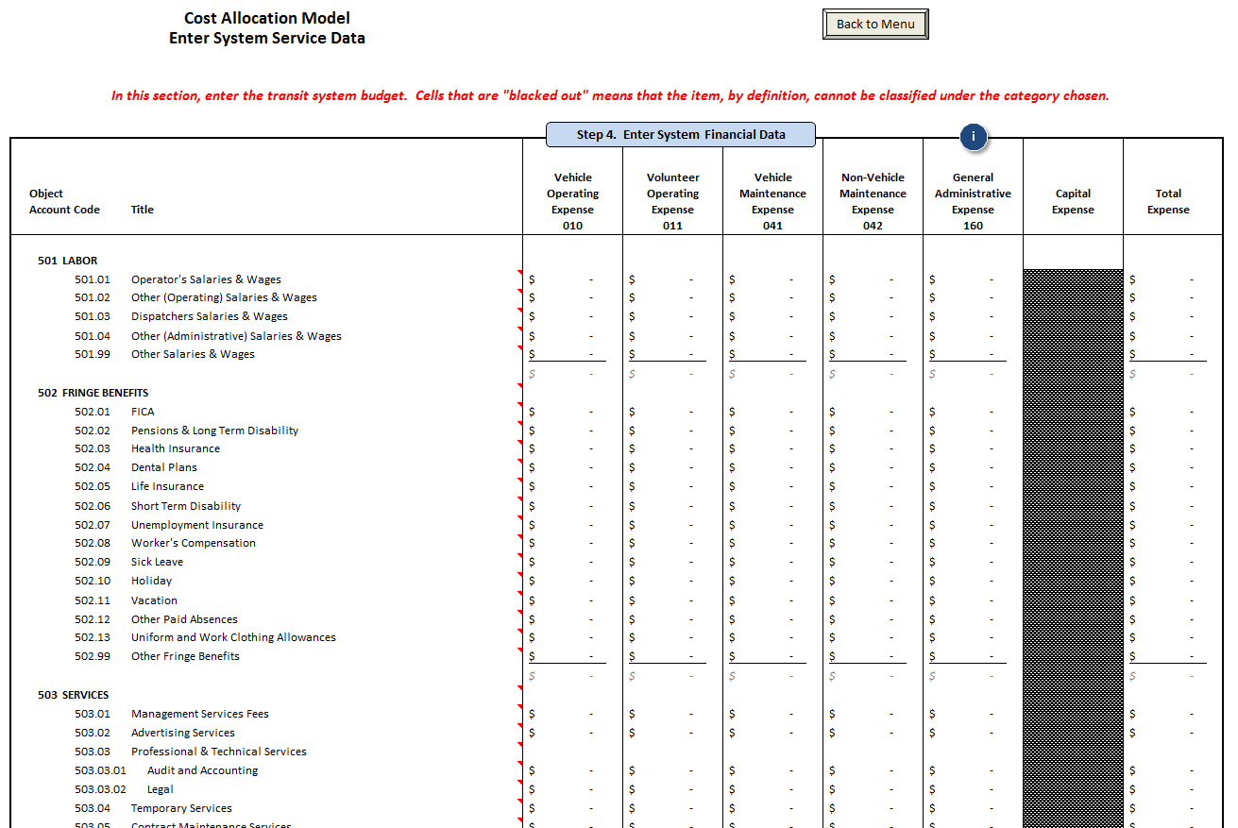
Cost Allocation Model

Slide 101
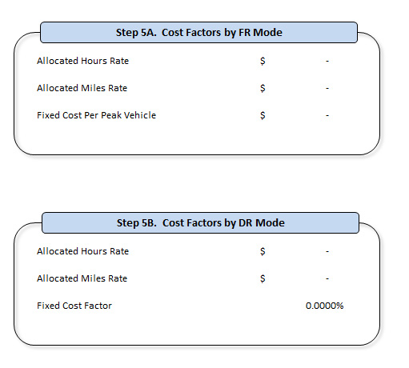
Cost Allocation Model

Slide 102
Cost Allocation Model
Once Service and Cost Data Are Entered, the Model Does a Series of Cost Computations Are Performed in the Background

Slide 103
Cost Allocation Model
The User Can Price Potential Contracts Merely By Entering Hours and Miles of Projected Use

Slide 104
Cost Allocation Model

Slide 105
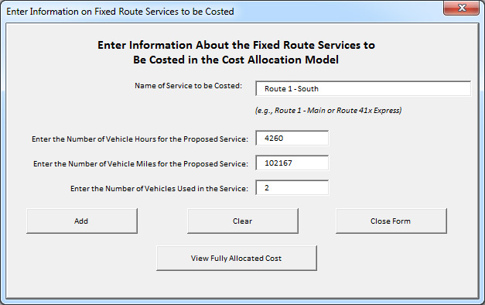
Cost Allocation Model

Slide 106
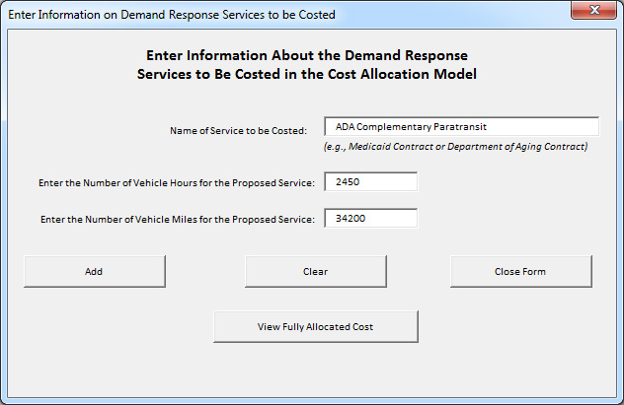
Cost Allocation Model

Slide 107
Using the cost allocation model
Module 7

Slide 108
Using the Model
Pricing Transit Services
Allocating Costs Between FTA Grant Programs

Slide 109
Pricing Contract Services
We Will Examine the Ways in Which A Transit System Can Use Fully Allocated Costs to Develop Unit Pricing for Contracted Services
Various Types of “Unit” Costs
Pro’s and Con’s of Each Unit Cost Type
We Will Calculate Various Units Costs for Our Transit System

Slide 110
Objectives in Our Rate Structure
Our Objectives in the Process:
Simple
Equitable
Reflect Actual Cost of Service Provision
Appropriate Use of Public Subsidies

Slide 111
Alternative Rate Structures
Per Trip
Per Mile
Per Hour
Per Passenger Mile
Per Zone

Slide 112
Price Per Trip
Price Per Trip
Computed as Follows:
Fully Allocated Costs of the Service ÷
No. Projected Passenger Trips

Slide 113
Characteristics of Per Trip Pricing
Simple
Shared Ride Equity
Assumes That Are Trips Have Similar Characteristics
Works Best in Small Service Areas
Greater Risk for Service Provider
Short Trips Subsidize Long Trips

Slide 114
Price Per Mile
Price Per Mile
Computed as Follows:
Fully Allocated Costs of the Service ÷
No. Projected Miles of Service

Slide 115
Characteristics of Per Mile Pricing
Customers Understand Miles
Requires Recordkeeping by Drivers
Cost Per Mile Varies Based on Route Path Driven on a Given Trip
Does Not Address Travel and Wait Time
Dead Head Mileage
Shared Ride Equity Issues

Slide 116
Price Per Hour
Price Per Hour
Computed as Follows:
Fully Allocated Costs of the Service ÷
No. Projected Vehicle Hours

Slide 117
Characteristics of Per Hour Pricing
Requires Recordkeeping by Drivers
Cost Per Hour Varies Based on Route Path Driven on a Given Trip
Addresses Travel and Wait Time
Shared Ride Equity Issues

Slide 118
Price Per Passenger Mile
Price Per Passenger Mile
Computed as Follows:
Fully Allocated Costs of the Service ÷
No. Projected Passenger Miles

Slide 119
Characteristics of Per Passenger Mile Pricing
Equitable
Addresses Shared Ride
Some Shared Ride Equity Issues
Generally Requires Automation to Assist in Billing Computations

Slide 120
Adjourn
Good Luck in Using this Information at Your Own Transit Programs

Slide 121
For More Information
Rich Garrity, Senior Associate
RLS & Associates, Inc.
Corporate:
3131 S. Dixie Highway, Suite 545
Dayton, OH 45439
(937) 299-5007
Rich:
801 S. Shore Drive
Surf City, NC 28445
(910) 328-5770
richg@cris.com

