Slide 1
ARC Area Plan on Aging
FY 2018 Update

Slide 2
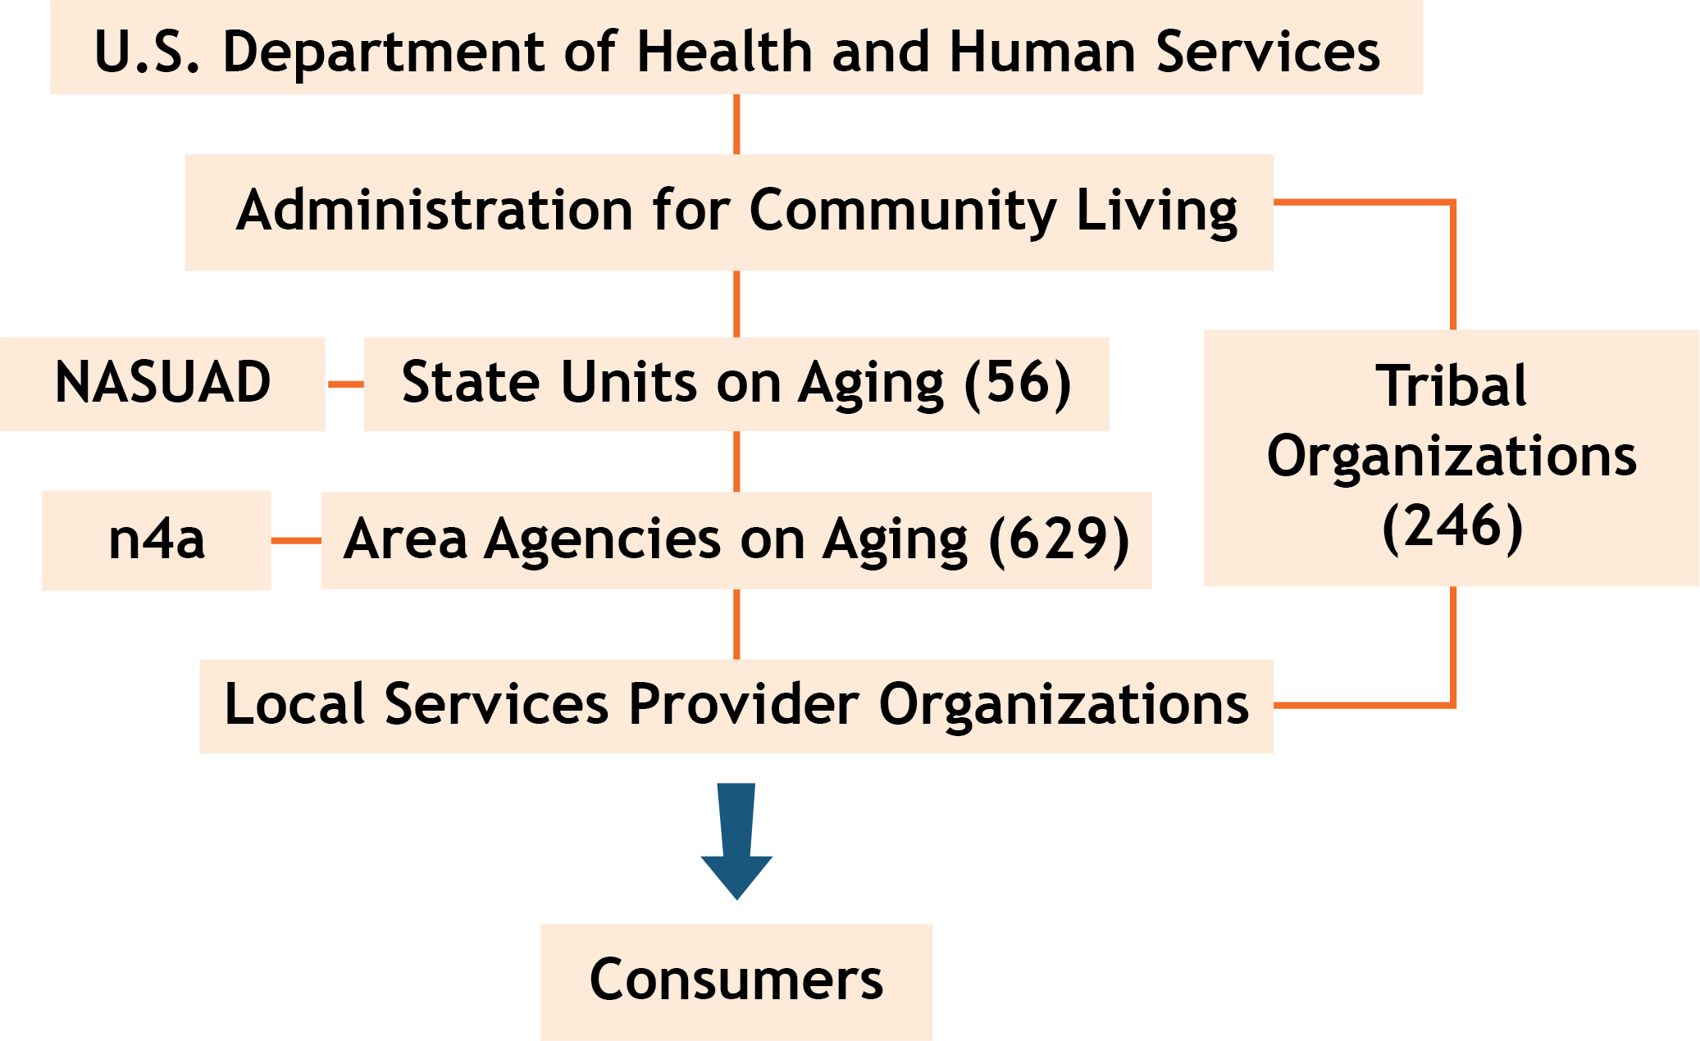
How Older Americans Act (OAA) Funds Flow
National Aging Services Network

Slide 3
Area Plan from FY 2017-FY2020
All goals, objectives and performance metrics developed by Division of Aging Services
Goals and percentage increase expectations are statewide
Baseline data from FY 2015 and 2016 entered when submitted last year (March 1, 2016)
Report period for update is February 1, 2016 -January 31, 2017
Template forms are provided for all responses
Plan goals and objectives are only a portion of ARC’s work

Slide 4
Core Services Provided
ADRC Information Services – 103,877 contacts
Network of 53 senior centers
37,769 senior recreation units
378,470 congregate meals
639,282 home delivered meals
177,449 hours of in home support and respite care
144,433 transportation trips
40,000 persons served – community education and outreach
6,670 units of regional respite vouchers
125 Care Consultation clients
12,382 contacts Legal Aid through Elder Legal Assistance Program

Slide 5
New Revenue Sources

Slide 6
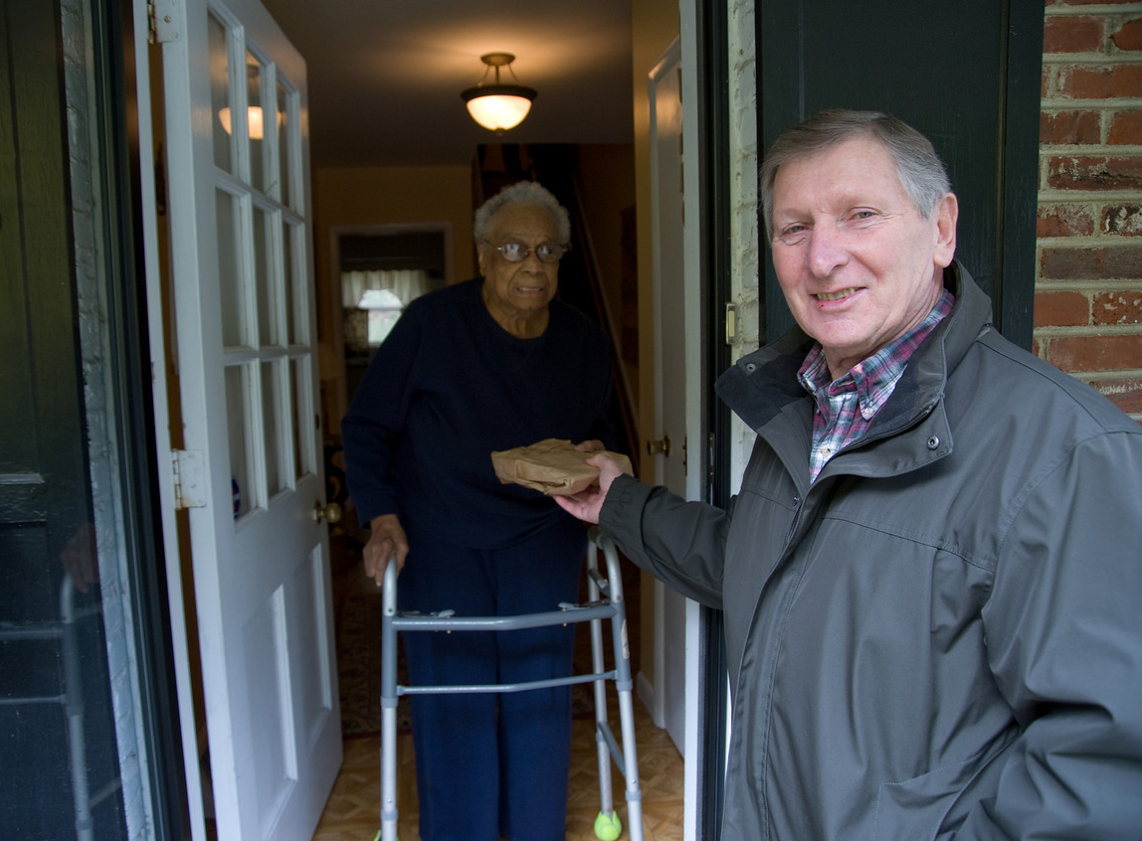
More Underserved Individuals Receiving Services

Slide 7
More Rides

Slide 8
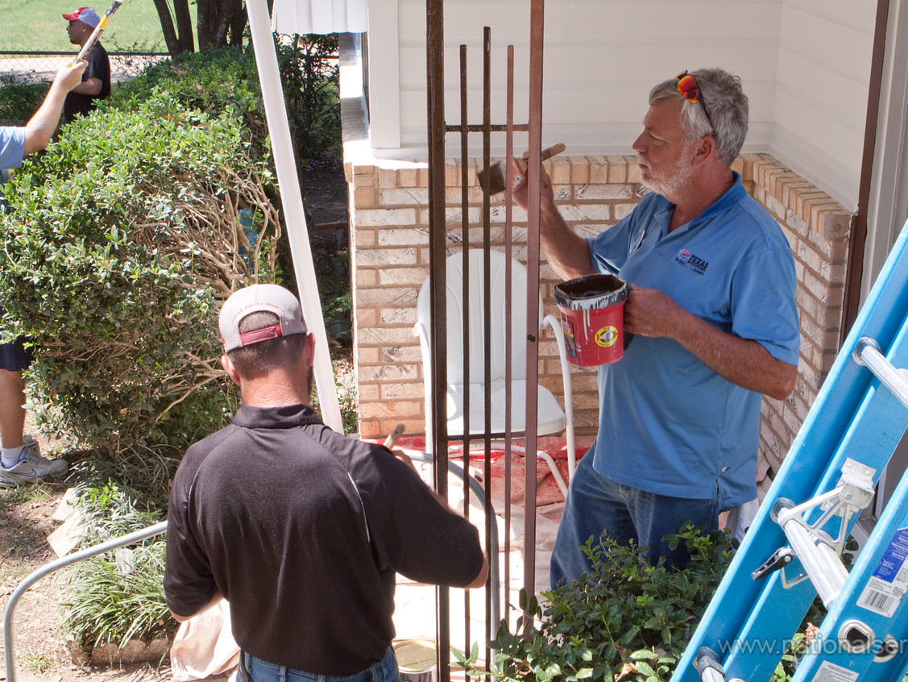
Increase Referrals to Home Repair/Modification

Slide 9
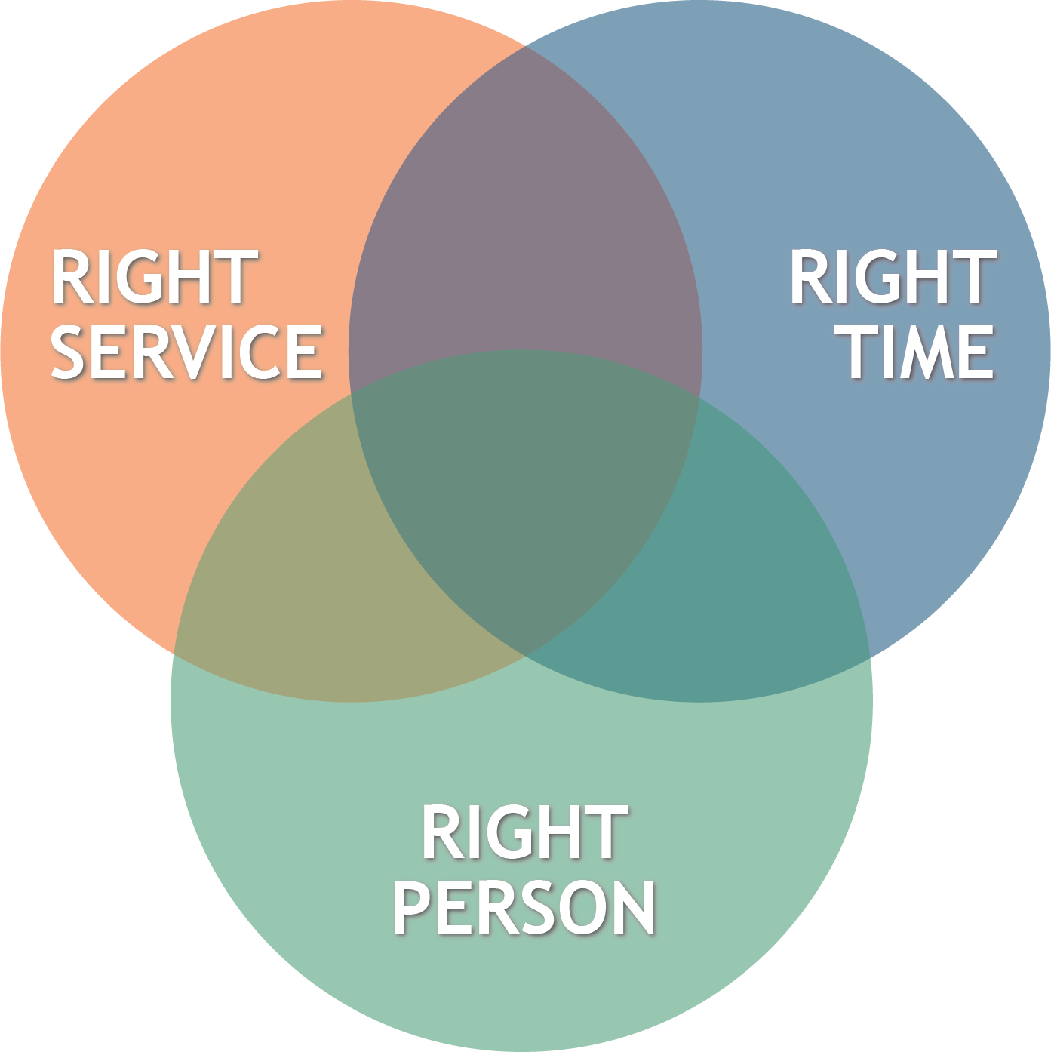
Redesign Access to Services

Slide 10
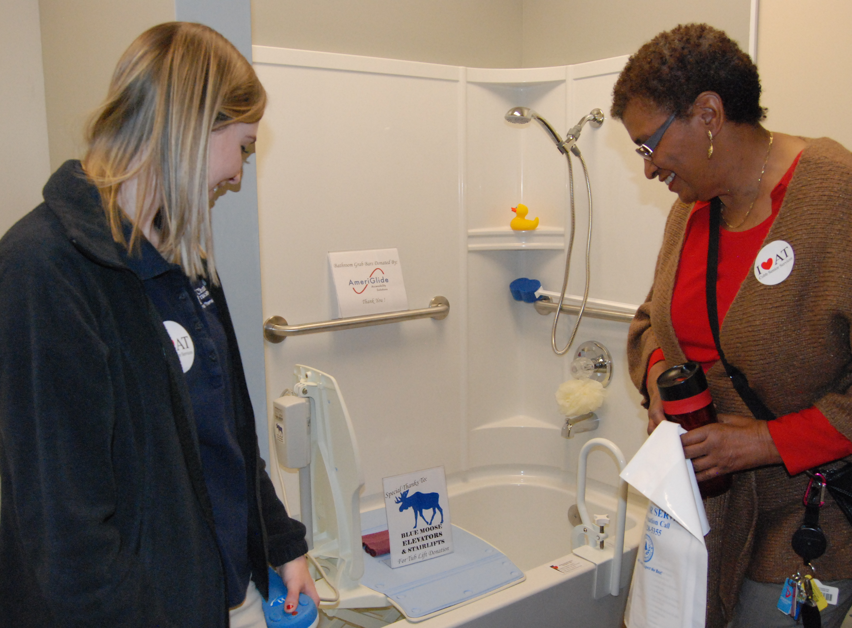
Assistive Technology

Slide 11
More Access to Evidence-Based Health Programs

Slide 12
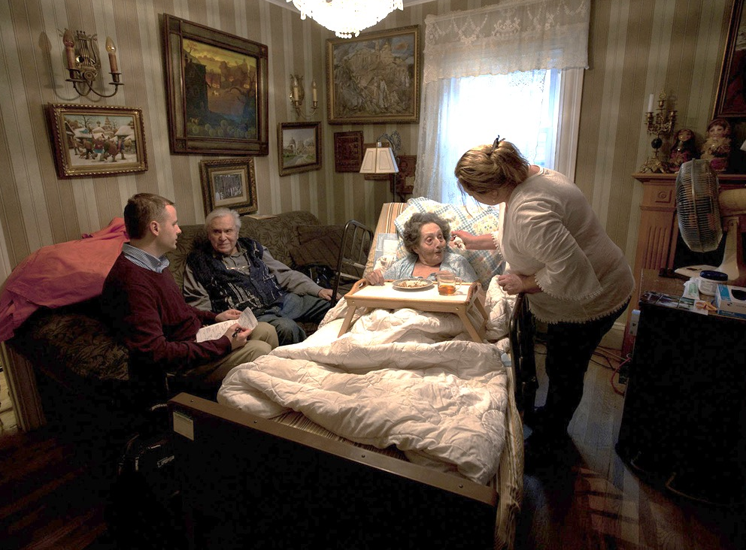
Increase Awareness of Community Options for Care

Slide 13
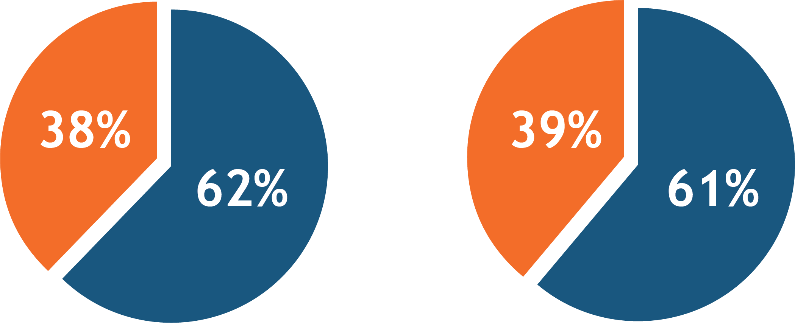
FY 2017/FY 2018 Comparison
FY 17 Allocation
FY 18 Planning Allocation
State & OAA: $18,374,791
State & OAA: $17,534,224
State, $7,054,417
State, $6,852,857
OAA & Other, $11,320,374
OAA & Other, $10,681,367

