Slide 1
CITY OF ALPHARETTA Approach to Low Response Census Tracts

Slide 2
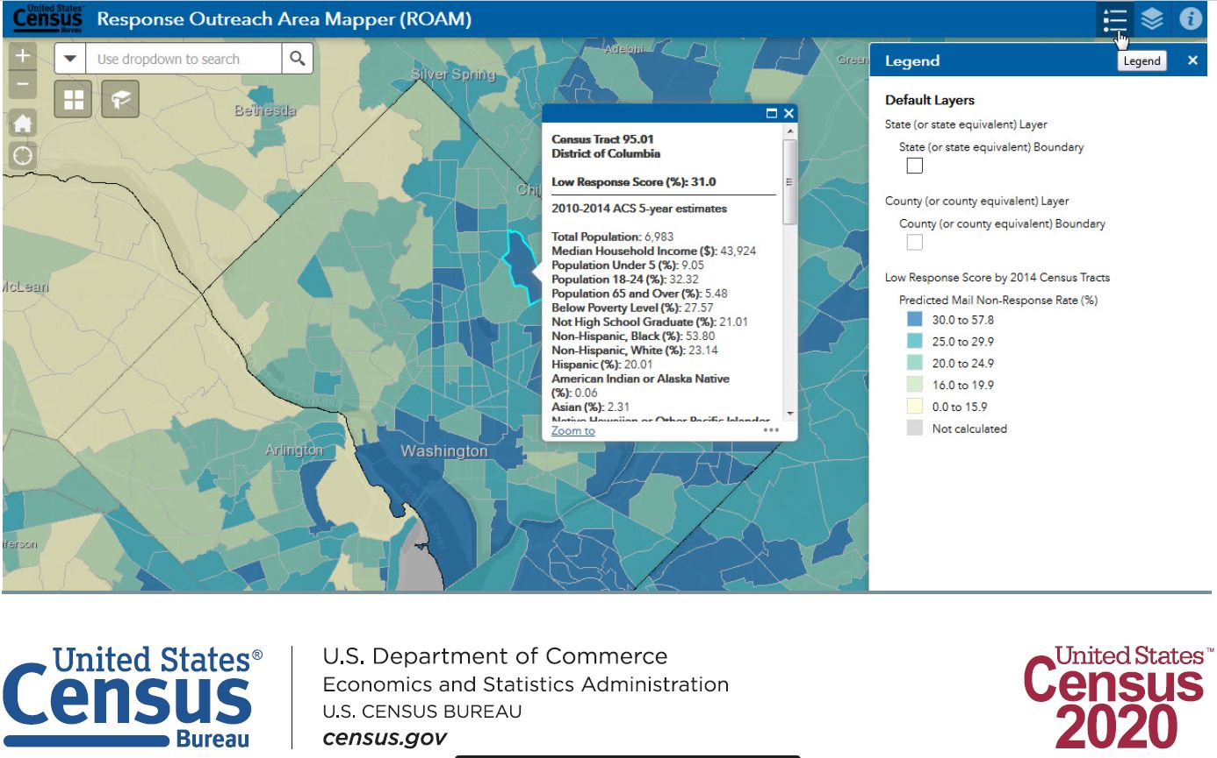

Slide 4
ANALYSIS PROBLEM
CENSUS ROAM 50+ Pieces of Information for EACH Census Track
Population
Median Age
No Health Insurance Age 19-64
Total Housing Units
Vacant Housing Units
Households with Only Smartphone

Slide 5
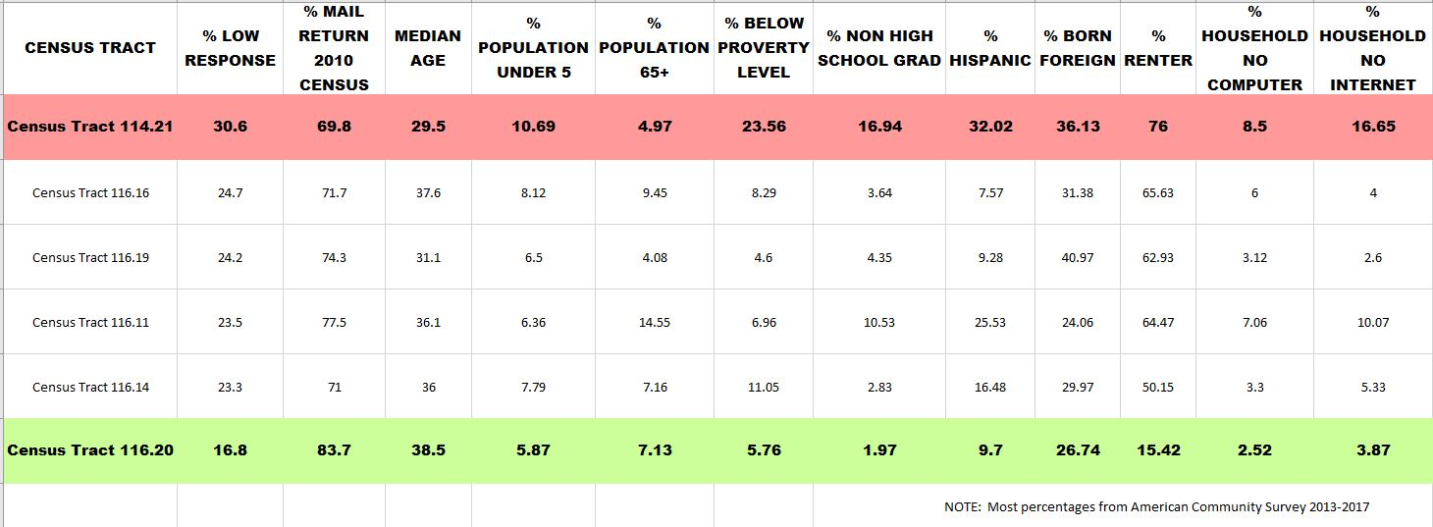

Slide 7
SCHEDULED ACTIVITIES

Slide 8
CITY SANITATION BILL (March 1st)

Slide 9
HOMEOWNERS ASSOCIATION
Source – Public Safety

Slide 10
ALPHARETTA CLERGY LUNCH (February 25th)

Slide 11
IN THE WORKS
Presentation to Spanish Congregation
Letter to area businesses (Meeting with Economic Development Manager)
Announcement in local newspaper
Direct contact with property management companies
Social media – like Nextdoor (reaches 53% of Alpharetta households)
Intercepts at local events or public gatherings

Slide 12
POST APRIL 1st
If Alpharetta notices (thru ROAM automatic response system) that certain Census Tracts or areas are producing a low response the following activities could be initiated:
Direct Mail (Address Points)
Re-Contact HOAs and Neighborhoods
OTHER

Slide 13
QUESTIONS?
What are your ideas for addressing LOW RESPONSE AREAS?

