Slide 1
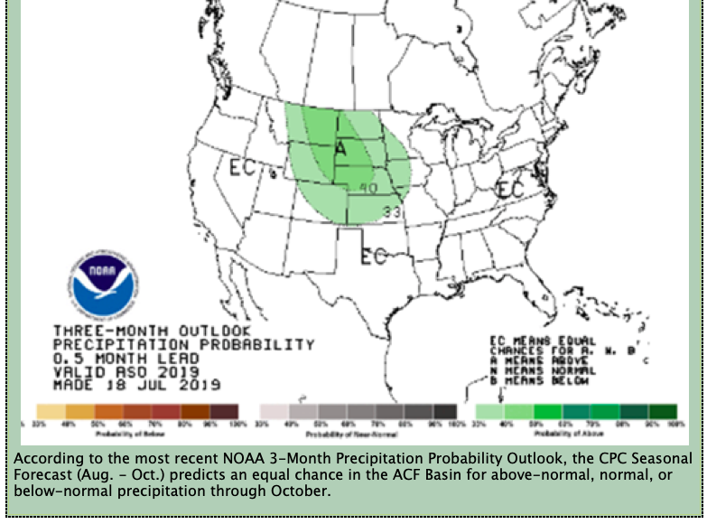
NOAA Three-Month Precipitation Outlook
NOAA “predicts an equal chance … for above-normal, normal, or below-normal precipitation through October.”

