Slide 1
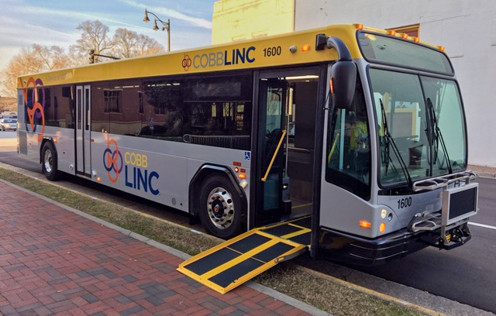
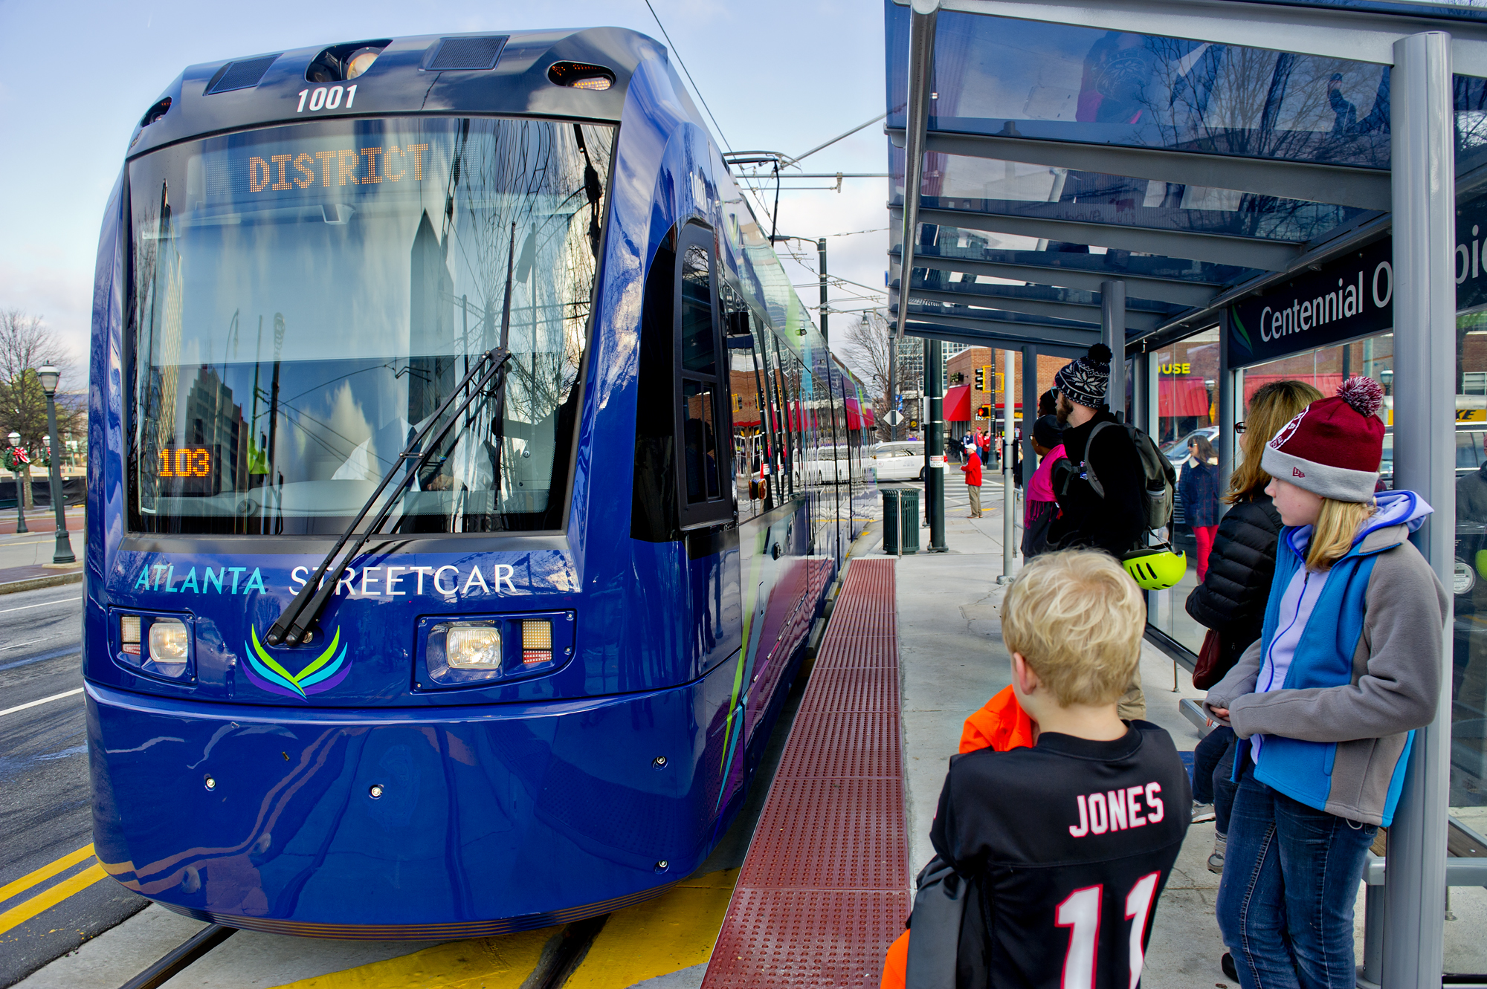
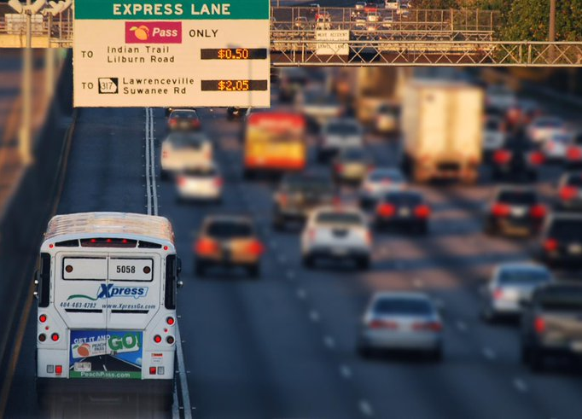
House Commission on Transit Governance and Funding
How Can ARC Add Value to the Dialogue?
ARC Board Work Session
July 26, 2017

Slide 2
Purpose and Goals
...the State of Georgia needs a system of regional, integrated, and comprehensive mass transportation in order for metropolitan areas to thrive economically...
...include an analysis of funding such system and systems...
...emphasize creating efficiency and coordination among providers of mass transportation and offer solutions to improve mobility...
...develop a unified regional governance structure...
...determining a means of funding construction and operation...

Slide 3
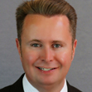
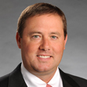
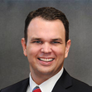
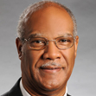
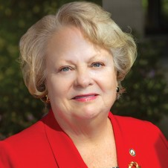
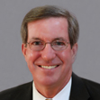
Appointed by House Speaker
Six members, including the chairperson of the House Committee on Transportation and a member representing rural areas of Georgia...
Kevin Tanner, Chairman
Dawsonville
Jason Shaw
Lakeland
Christian Coomer
Cartersville
Calvin Smyre
Columbus
Mary Margaret Oliver
Decatur
Tom Taylor
Dunwoody

Slide 4
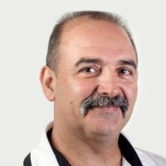
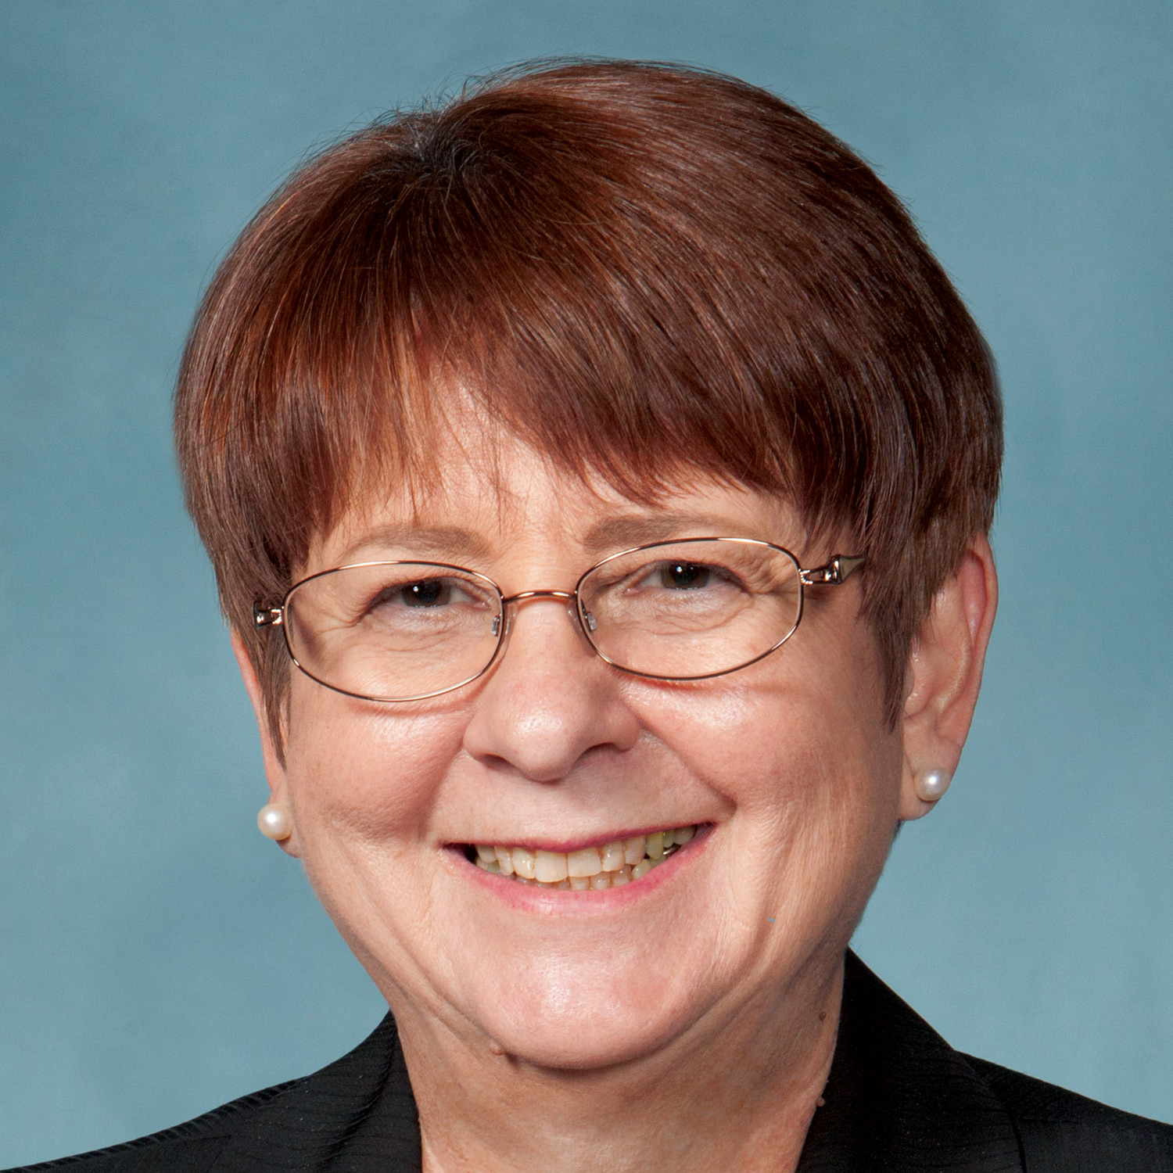
Appointed by House Speaker
Four members who represent entities which provide mass transportation or a county which provides mass transportation...
Liz Hausmann
Fulton County Board of Commissioners
Butch McDuffie
Athens Transit System
Curtis Kolber
Chatham Area Transit
Charlotte Nash
Gwinnett County Board of Commissioners

Slide 5
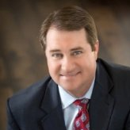
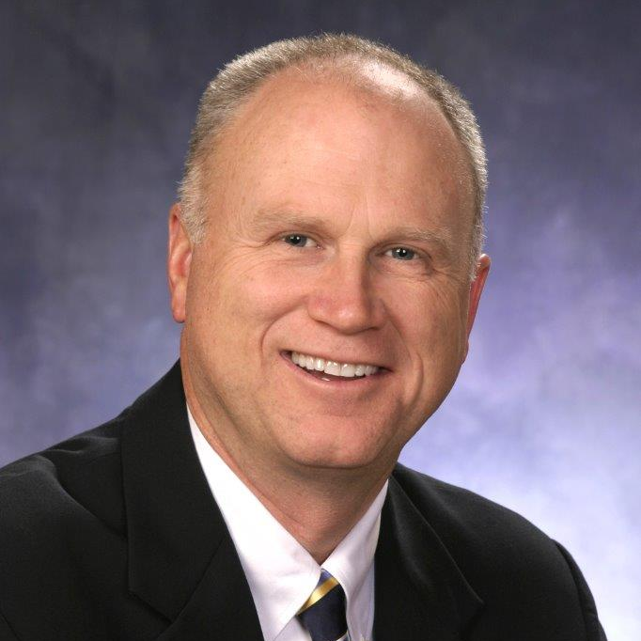
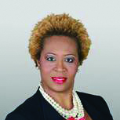
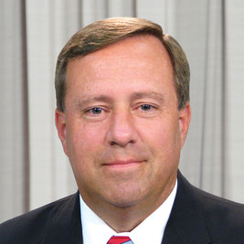
Appointed by House Speaker
Four members who are residents of this state...
Brian Anderson
Columbus Chamber of Commerce
Butch Miller
State Senator (Gainesville)
Rhonda Briggins
Georgia Transit Association
Bob Ott
Cobb County Board of Commissioners

Slide 6
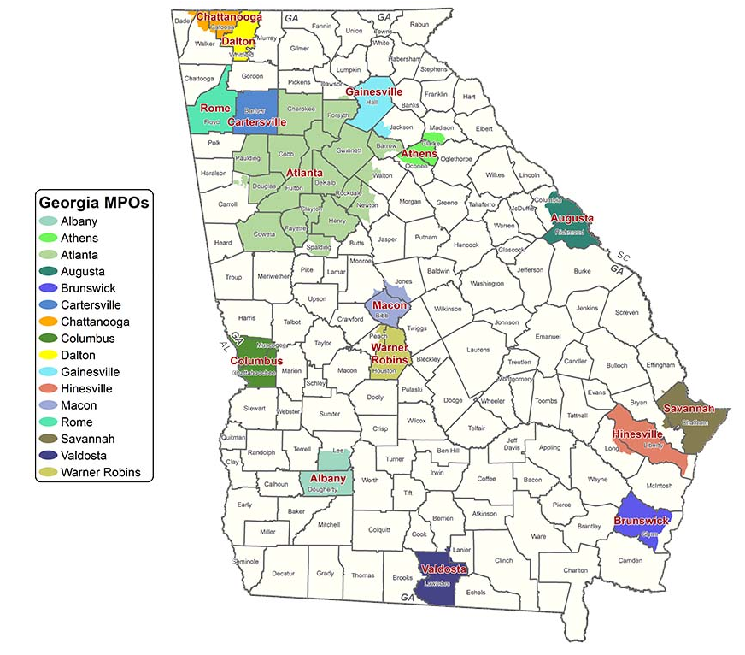
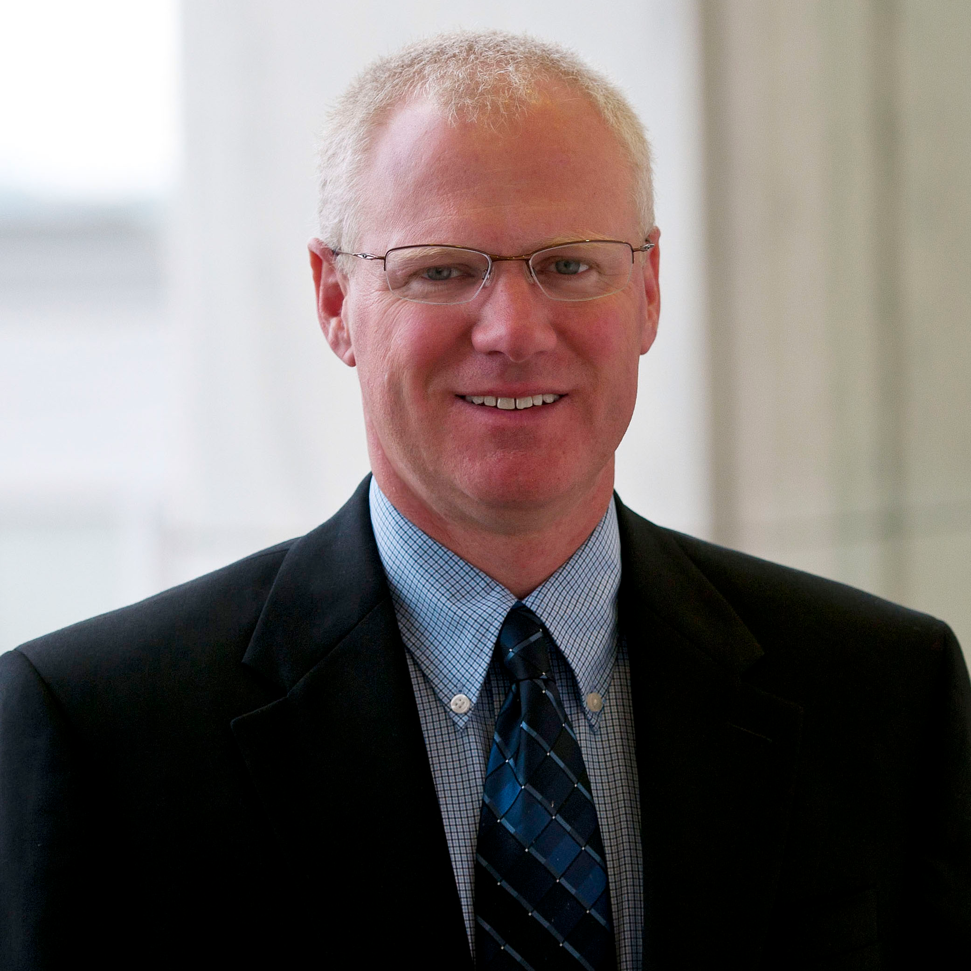
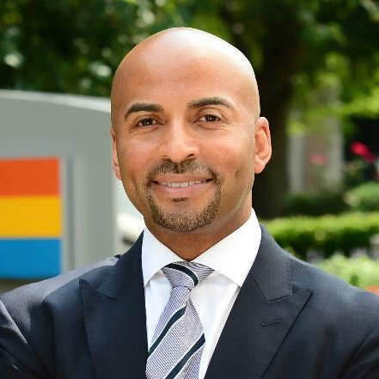
Ex Officio Members
MPO Directors
(Non Voting)
Russell McMurry
GDOT Commissioner
Keith Parker
MARTA CEO
Chris Tomlinson
GRTA Executive Director

Slide 7
Deadline
The commission shall submit the report and proposal required ... not later than December 31, 2018 ... with approval of the Speaker of the House of Representatives, the commission may continue its study until December 31, 2019, at which time its proposal shall be published and the commission shall stand abolished

Slide 8
Discussion Questions
What are the foremost issues for which you believe the Commission should seek solutions?
In our advisory role, what issues and concerns should ARC staff emphasize during the deliberations?
How would you define success at the conclusion of the Commission?

