Slide 1
METRO ATLANTA HOUSING STRATEGY

Slide 2
CALL TO ACTION FOR ARC
Communities across the region are struggling to understand if the housing they have will meet the needs of residents, both now and in the future.
The Regional Economic Development strategy CATLYST identifies “healthy & housed” as a priority.
Communities and partners wrestling with housing issues turned to ARC for data, planning, and technical assistance.
ARC creates housing working groups to provide a space for collaborations and partnerships.
ARC adopts ULI’s Affordable Atlanta framework and begins developing the Regional Housing Strategy.
Notes:
Three pieces to highlight:
From calls for assistance from partners and stakeholders, at the end of 2017, ARC developed a plan to more actively address our region’s housing issues by gathering a number of working groups to provide a space for collaborative work and thoughtful partnership.
In addition, ARC’s Regional Economic Development plan, known as CATLYST, identified “healthy housing” as a priority for metro Atlanta to remain economically competitive, providing a platform for additional perspectives and stakeholders involved in addressing this issue.
Adopting a framework developed by Atlanta’s Urban Land Institute, Affordable Atlanta report, ARC started the process to develop a Regional Housing Strategy for the 10 core-counties. .

Slide 3
A COLLABORATIVE DEVELOPMENT PROCESS
The development of the Atlanta Regional Housing Strategy was the result of extensive outreach and discussions with a broad audience of policy makers, local government officials, business and nonprofit leaders, and other important partners.
One-on-one meetings
Housing Charettes
Research Initiative with GT
Technical groups
ARC External Working Groups
Small group discussions
Peer Exchange
Presentations in various jurisdictions and forums
ARC Internal Working Groups
Focus Groups
Notes:
Adopting a framework developed by Atlanta’s Urban Land Institute, Affordable Atlanta report, ARC started the process to develop a Regional Housing Strategy for the 10 core-counties. Throughout the process we wanted to have continued engagement to ensure Regional ownership and conversation.

Slide 4
REGIONAL HOUSING STRATEGY
EDUCATIONAL. ANALYTICAL. ACTIONABLE
Notes:
ARC has developed the Atlanta Regional Housing Strategy to provide Regional leadership in addressing our housing challenges and to facilitate housing discussion within our communities. Our intent is to foster a balanced mix of housing throughout the region to serve current and future populations, to remain economically competitive and enhance livability of the region.

Slide 5
FOUR ELEMENTS OF THE REGIONAL HOUSING STRATEGY
STRATEGIC FRAMEWORK
STRATEGY TOOL BOX
REGIONAL HOUSING STRATEGY
HOUSING SUBMARKETS
ONLINE RESOURCE
Notes:
To achieve this the Regional Strategy, consist of 4 elements:
Strategic Framework
Six broad housing factors have been identified, that if the region made progress toward would improve our regional housing issues.
Housing Subareas
Through an extensive qualitative and quantitative approach ARC has identified the geography and characteristics of ten distinct sub-regional housing markets across the region.
Strategy Toolbox
A compilation of over 150 tactics from housing studies across the region have been gathered to present a range of options local governments can implement to make progress toward addressing housing challenges.
Online Resource
This website contains the compilation of information developed through this process, including an interactive map, detailed information about each of the ten submarkets, performance measure dashboard, recommended strategies and case studies from around the region.

Slide 6
STRATEGIC FRAMEWORK
KEY ISSUE AREAS AND STRATEGIES TO COMBAT HOUSING ISSUES
STRATEGIC FRAMEWORK
INCREASE
SUPPLY
DEVELOP LEADERSHIP
PRESERVE AFFORDABLE SUPPLY
PROMOTE
HOUSING STABILITY
REDUCE
HOUSING & TRANSPORTATION COSTS
EXPAND
CAPITAL RESOURCES
Notes:
Acknowledging this is a complicated issue, Six broad factors have been identified, that if the region made progress toward would improve our regional housing issues. Going forward these six broad factors will be used for two things, to measure success and to connect what we learn through data (submarket analysis) to how our various county and municipal partners can strategize and plan to address issues (housing strategies).

Slide 7
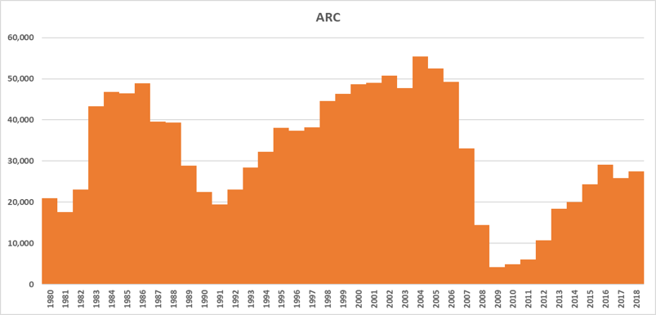
PRESERVE AFFORDABLE SUPPLY
HOUSING TRENDS
INCREASE
SUPPLY
Residential Building Permits – Metro Atlanta
26.7%
Units with Rent Below $800 (2012)
18.2%
Units with Rent Below $800 (2017)
Source: Neighborhood Nexus, SOCDS
Notes:
Atlanta was producing 60,000 units per year in the early 2000s. Today, we are building half that amount.
The current decade is on pace to have the lowest level of new housing construction since the 1940s.

Slide 8
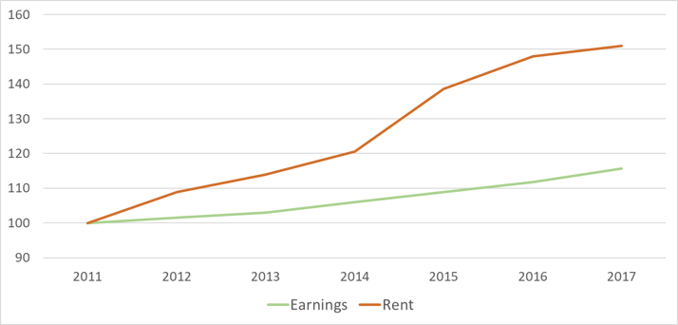
REDUCE
HOUSING & TRANSPORTATION COSTS
HOUSING TRENDS
Rent Growth Outpacing Wage Growth
Source: Neighborhood Nexus, Zillow and BEA
Notes:
$1,013—is about equal to the average asking rent for a one-bedroom unit

Slide 9
FOUR ELEMENTS OF THE REGIONAL HOUSING STRATEGY
STRATEGIC FRAMEWORK
STRATEGY TOOL BOX
REGIONAL HOUSING STRATEGY
HOUSING SUBMARKETS
ONLINE RESOURCE
Notes:
To achieve this the Regional Strategy, consist of 4 elements:
Strategic Framework
Six broad housing factors have been identified, that if the region made progress toward would improve our regional housing issues.
Housing Subareas
Through an extensive qualitative and quantitative approach ARC has identified the geography and characteristics of ten distinct sub-regional housing markets across the region.
Strategy Toolbox
A compilation of over 150 tactics from housing studies across the region have been gathered to present a range of options local governments can implement to make progress toward addressing housing challenges.
Online Resource
This website contains the compilation of information developed through this process, including an interactive map, detailed information about each of the ten submarkets, performance measure dashboard, recommended strategies and case studies from around the region.

Slide 10
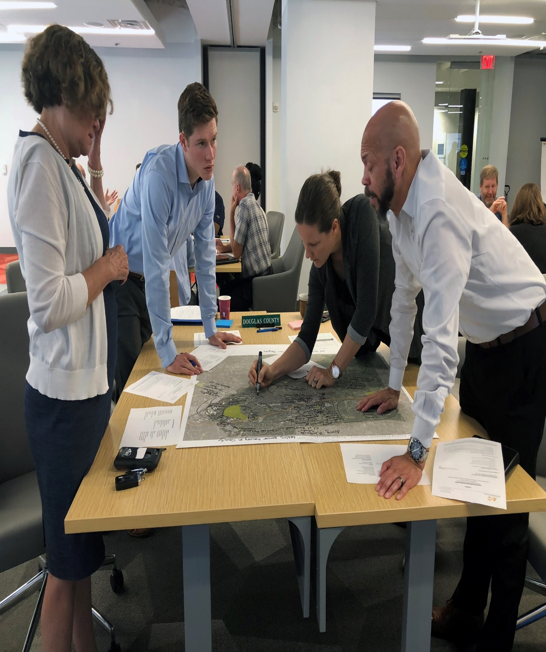
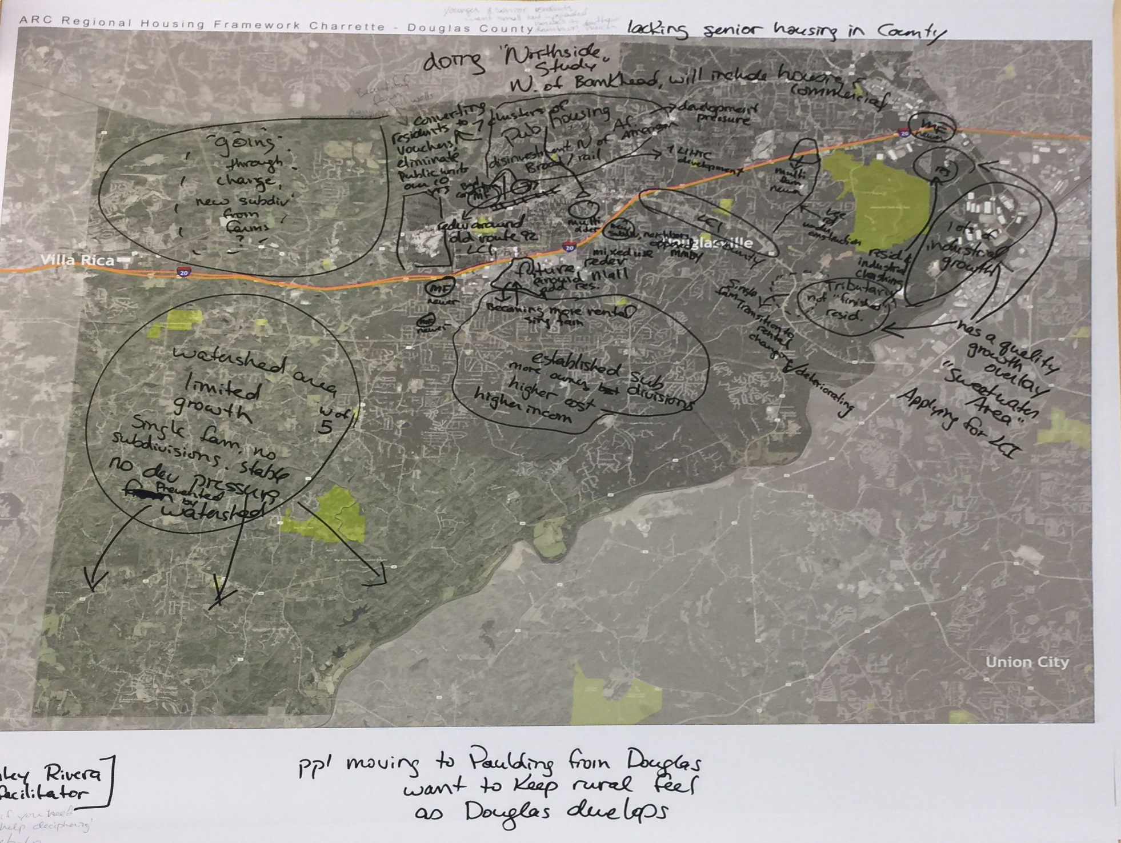
QUALITATIVE INPUT PROCESS
Notes:
Before looking at the data, we wanted to start conversation around the region about what planners and other stakeholders were seeing in their communities.

Slide 11
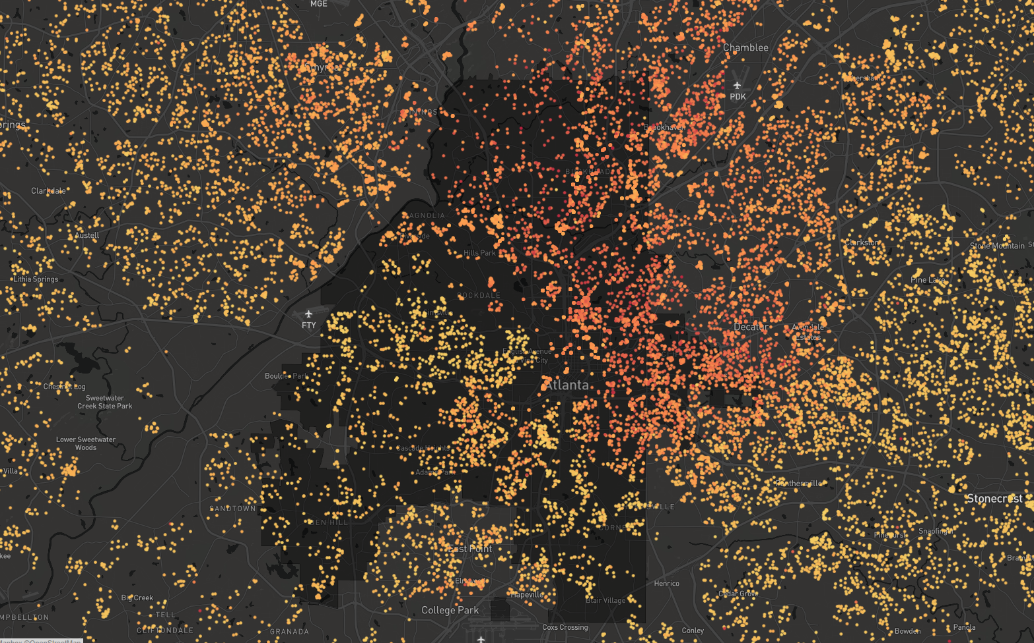
Zillow ZTRAX Data
Transaction Records
Home Sale Price Per Sq. Ft
$20
$600
Notes:
15 million home sale transactions statewide going back to the year 2000 and prior

Slide 12
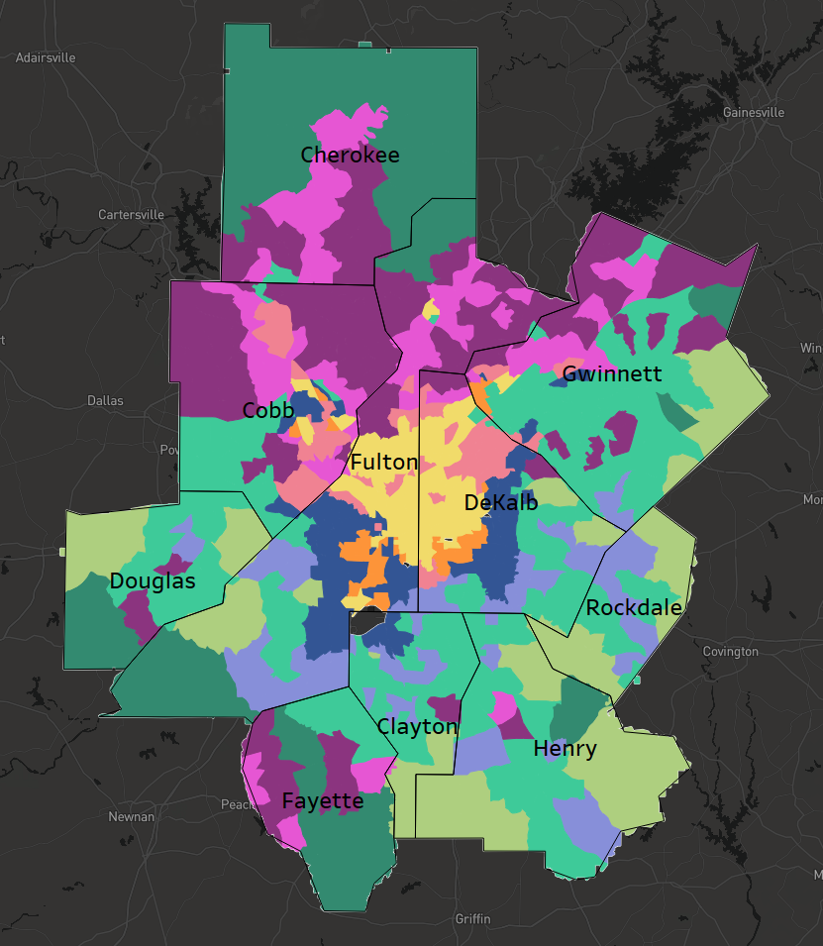
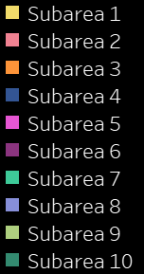
Atlanta Regional
Housing Submarkets
Notes:
The Atlanta Regional Housing Strategy acknowledges this complexity by breaking the Atlanta region into 10 “submarkets” based on housing characteristics such as average sales price, age, type, and size.
The analysis revealed distinct housing submarkets across the region that share common issues. We wanted the submarkets to illustrate directionality in the issue. Online, the Submarket can be viewed by region, county, city or census tract. In addition, an extensive amount of data related to these geographic areas can also be found online.
Now just go through slides quickly to show how they build on each other.

Slide 13
FOUR ELEMENTS OF THE REGIONAL HOUSING STRATEGY
STRATEGIC FRAMEWORK
STRATEGY TOOL BOX
REGIONAL HOUSING STRATEGY
HOUSING SUBMARKETS
ONLINE RESOURCE
Notes:
To achieve this the Regional Strategy, consist of 4 elements:
Strategic Framework
Six broad housing factors have been identified, that if the region made progress toward would improve our regional housing issues.
Housing Subareas
Through an extensive qualitative and quantitative approach ARC has identified the geography and characteristics of ten distinct sub-regional housing markets across the region.
Strategy Toolbox
A compilation of over 150 tactics from housing studies across the region have been gathered to present a range of options local governments can implement to make progress toward addressing housing challenges.
Online Resource
This website contains the compilation of information developed through this process, including an interactive map, detailed information about each of the ten submarkets, performance measure dashboard, recommended strategies and case studies from around the region.

Slide 14
Prioritizing Solution by Submarkets
 | SUBAREAS
STRATEGIES | 1 | 2 | 3 | 4 | 5 | 6 | 7 | 8 | 9 | 10
INCREASE SUPPLY | X | X |  |  | X | X | X | X | X | X
PRESERVE AFFORDABLE SUPPLY |  |  | X | X |  | X | X | X
REDUCE H&T COSTS |  | X |  |  | X
EXPAND CAPITAL RESOURCES | X | X
PROMOTE HOUSING STABILITY |  |  | X | X |  |  | X | X | X
DEVELOP LEADERSHIP |  |  | X | X | X | X | X | X | X
Notes:
The Strategies identify a multitude of tactics stakeholders in various faucets can explore and implement, including state, regional and local governments, elected officials, developers, citizens and others interested in the discussion. Local governments are a very important to solving housing issues, because they have the primary authorities necessary to do so, including using land use zoning to provide realistic opportunities for housing choices in their communities and to remove barriers to development.

Slide 15
FOUR ELEMENTS OF THE REGIONAL HOUSING STRATEGY
STRATEGIC FRAMEWORK
STRATEGY TOOL BOX
REGIONAL HOUSING STRATEGY
HOUSING SUBMARKETS
ONLINE RESOURCE
Notes:
To achieve this the Regional Strategy, consist of 4 elements:
Strategic Framework
Six broad housing factors have been identified, that if the region made progress toward would improve our regional housing issues.
Housing Subareas
Through an extensive qualitative and quantitative approach ARC has identified the geography and characteristics of ten distinct sub-regional housing markets across the region.
Strategy Toolbox
A compilation of over 150 tactics from housing studies across the region have been gathered to present a range of options local governments can implement to make progress toward addressing housing challenges.
Online Resource
This website contains the compilation of information developed through this process, including an interactive map, detailed information about each of the ten submarkets, performance measure dashboard, recommended strategies and case studies from around the region.

Slide 21
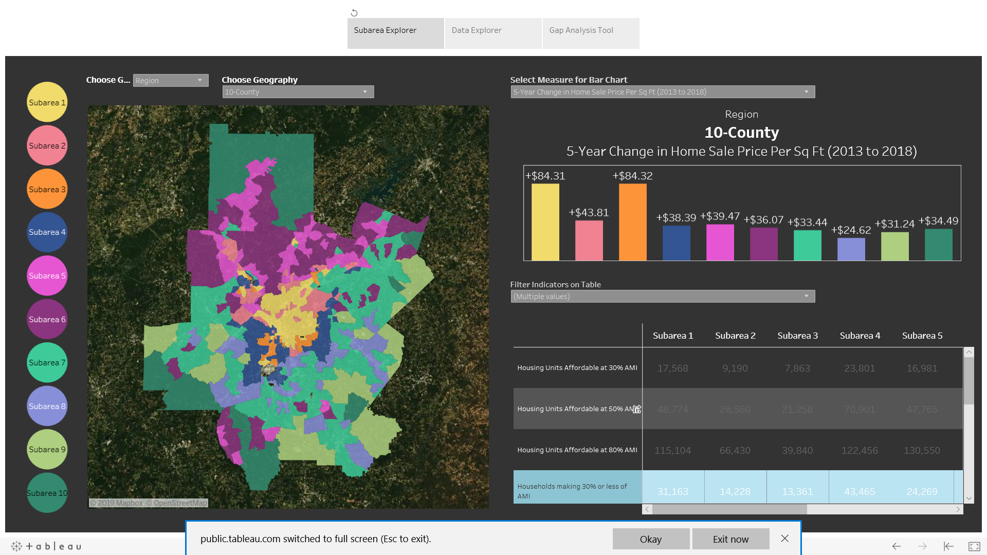

Slide 22
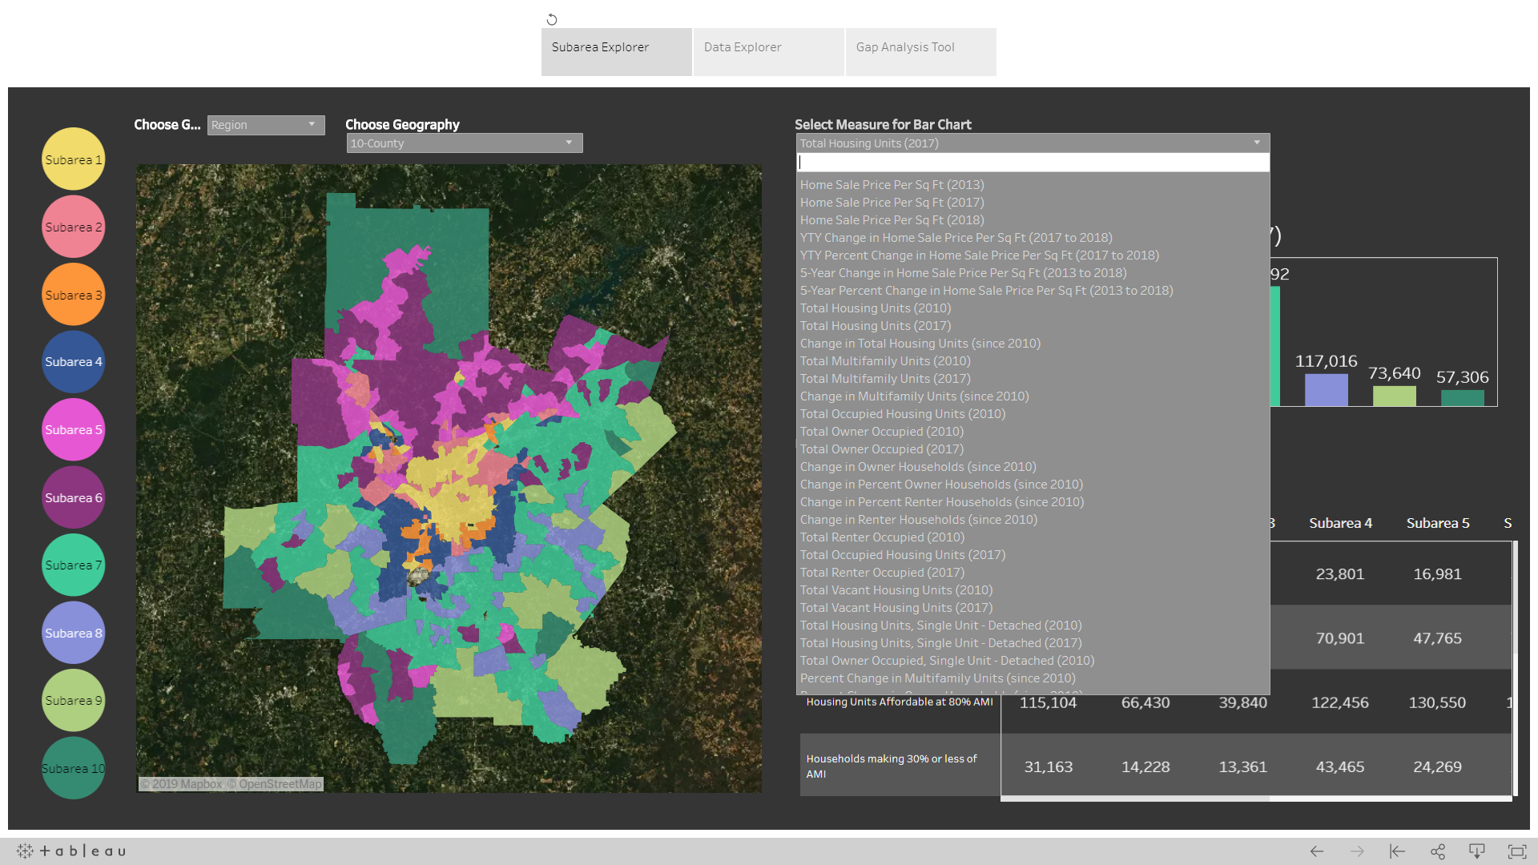

Slide 23
WHAT’S NEXT FOR ARC?
PLANNING
DATA ANALYSIS
CONVENING
REGIONAL HOUSING STRATEGY
Notes:
ARC will continue and expand our current responsibilities related to housing, primarily including planning, data analysis, convening and coordinating. As our commitment to the work, ARC is going to identify several steps we can take to further integrate regional housing goals into our funding support, technical assistance programs and governmental affairs work.

Slide 24
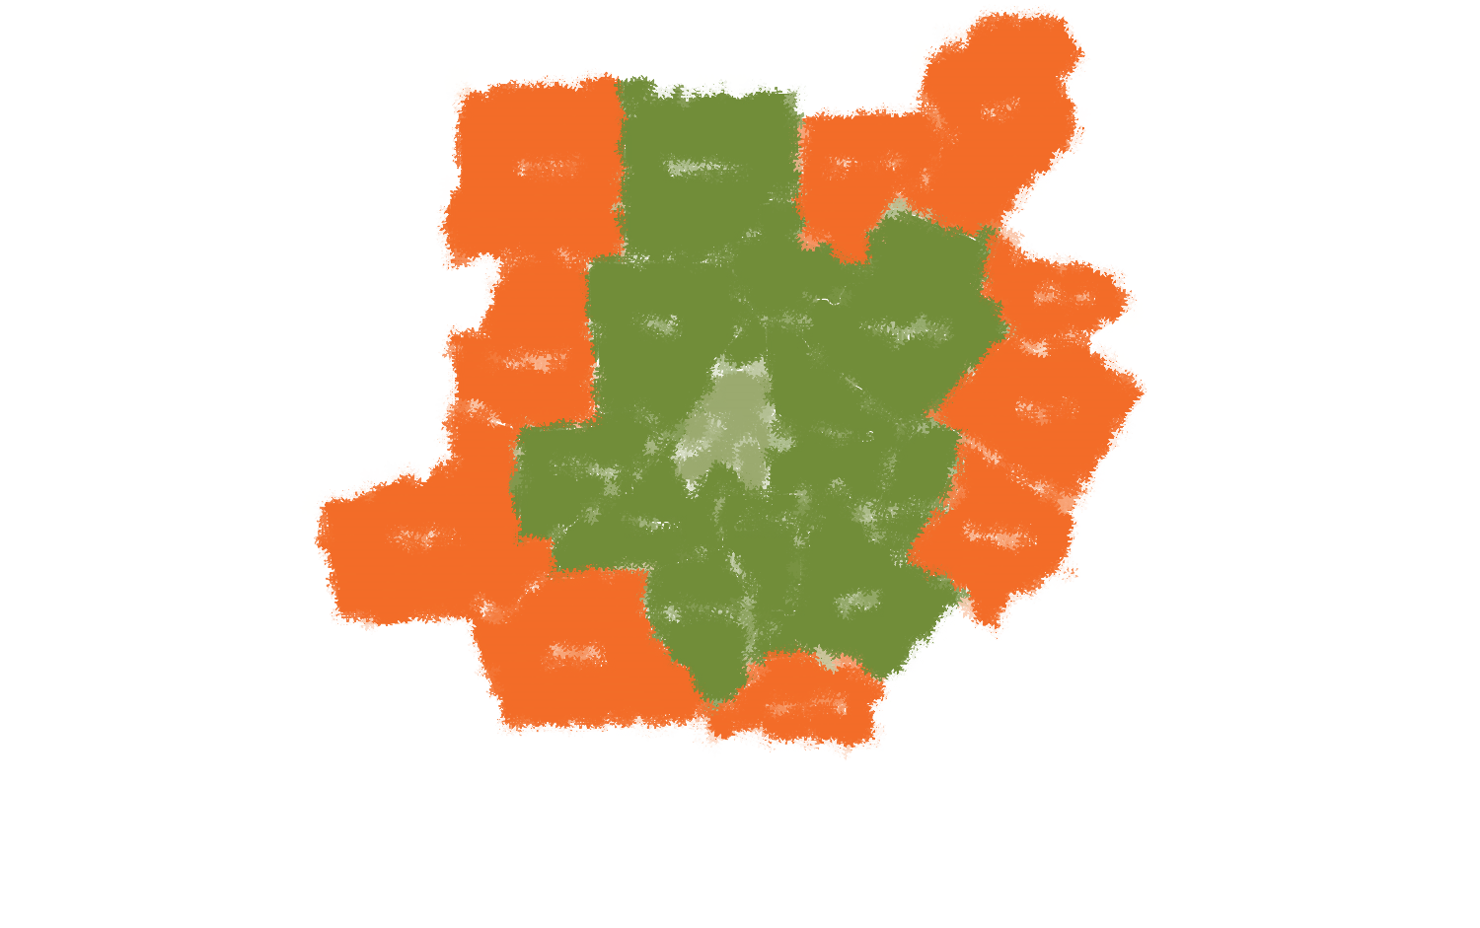
Thank You and Questions
Marisa Ghani
Senior Planner, Atlanta Regional Commission
mghani@atlantaregional.org
(470) 378-1596

