Slide 1
Electric Avenue
Preparing for the Electric Vehicle Surge

Slide 2
Kofi Wakhisi Moderator Planning Administrator
Atlanta Regional Commission
Justin Brightharp Senior Program Manager
Southeast Energy Efficiency Alliance
Yuval Steiman Director, Eco-Compliance & Research
Hyundai Motor North America
Stephanie Gossman
Electric Transportation Manger
Southern Company
Stephanie Valdez Streaty Director of Research & Development
Cox Automotive Mobility

Slide 3
Ask Questions
Use Slido to Ask Questions
Scan the QR Code
Select Breakout Session 2C: Electric Avenue
Type your questions
Or visit slido.com and type the code #6269254

Slide 4
Connect ATL
1
Electric Avenue: Preparing for the Electric Vehicle Surge
Justin Brightharp, Senior Program Manager
August 23, 2022

Slide 5
22
The Southeast Energy Efficiency Alliance (SEEA) promotes energy efficiency as a catalyst for economic growth, workforce development and energy security across 11 southeastern states including Alabama, Arkansas, Florida, Georgia, Kentucky, Louisiana, Mississippi, North Carolina, South Carolina, Tennessee and Virginia.

Slide 6
Areas of Work
Energy Efficiency Policy
Built Environment
Energy Efficient Transportation
Regional Investments

Slide 7
SEEA Region
SEEA HQ

Slide 8
Energy Efficient Transportation – Goals
Collaborate to advance energy efficient transportation in the Southeast
Policies and initiatives that provide equitable access
Engaged and knowledgeable about equitable transportation electrification
Help private businesses utilize electric transportation
technology and provide local jobs in our communities

Slide 9
Energy Efficient Transportation – Opportunities
Equity
Policies and Programs Partnerships
Regional Conversations

Slide 10
Equity
Types of Equity (SEEA)
– Socioeconomic
– Racial
– Geographic
– Access to technology and jobs
Transportation Electrification
– Personal vehicles
– Public transit and school buses
– Rideshare vehicles
– Public and private fleets
Justice40 Initiative
Source: Community Eye Health Journal

Slide 11
Policy & Programs
EV Capable, EV-Ready, EV-Installed Policies
Atlanta, GA
Orlando, FL
Streamlined Permitting for EVSE
Workforce Development
Federal Funding
Clean School Bus Program ($5B)
Clean Infrastructure ($2.5B)
NEVI (GA: $135M)
Carbon Reduction Program ($6B)
Discretionary Grant Programs
Photo by: Andrew Roberts

Slide 12
Partnerships
Partners & Coordination
Electric Utility
Planning, strategy
Private Sector
Public Sector
Nonprofit Sector
Southeast Electric Transportation Regional Initiative (SETRI)
Information sharing
Outreach and awareness

Slide 13
Regional Conversations
Equity
Resilience
Education and roles of state & local governments, and regulatory bodies
Charging infrastructure maintenance
Transportation taxes
Availability of at home charging – Homes and Multi-family
Used vehicle market and supply chain
Future proofing of medium- and heavy-duty vehicles
10

Slide 14
Thank You
SMART ENERGY. STRONG ECONOMY. FOR ALL.
WWW.SEEALLIANCE.ORG
11

Slide 15
Georgia Power Electric Transportation
Stephanie Gossman
8/23/22

Slide 16
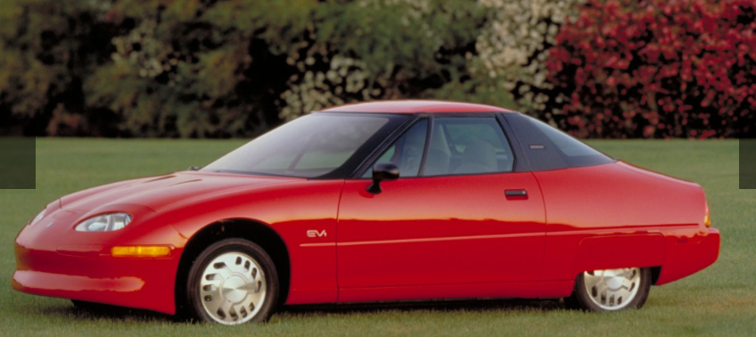
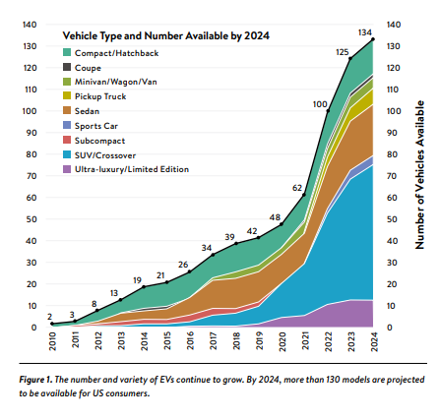
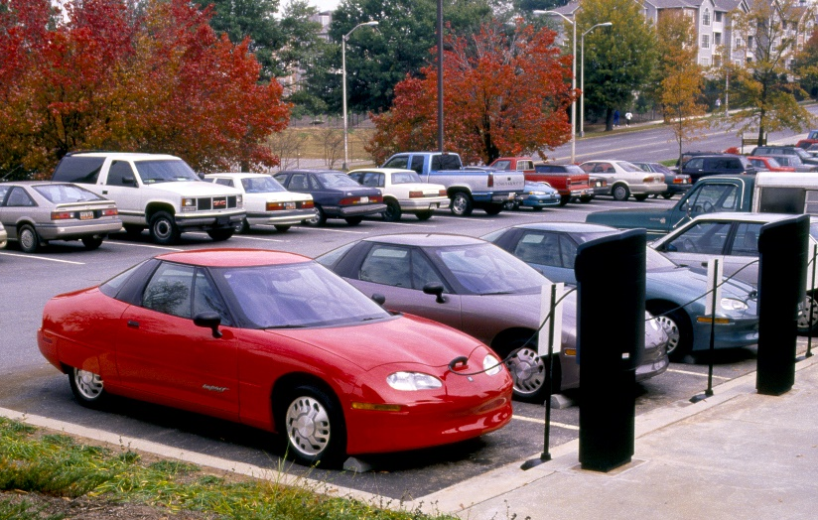
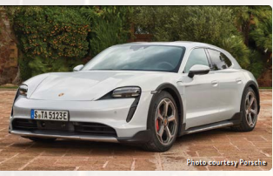
Electric Vehicle Options Increasing
1996: 1 Model
2022: 50+ Models
2024: 130+ Models
Source: EPRI

Slide 17
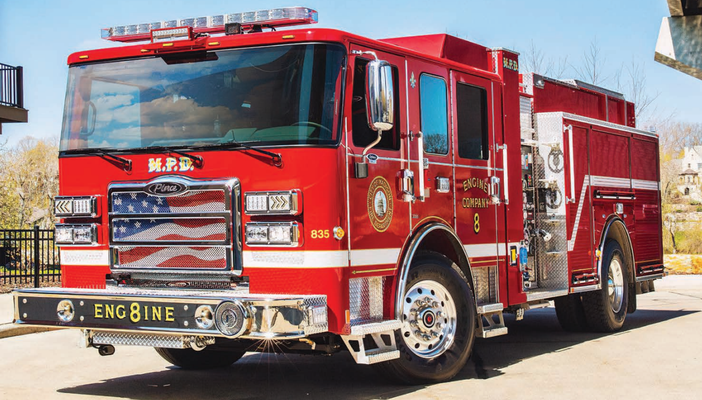
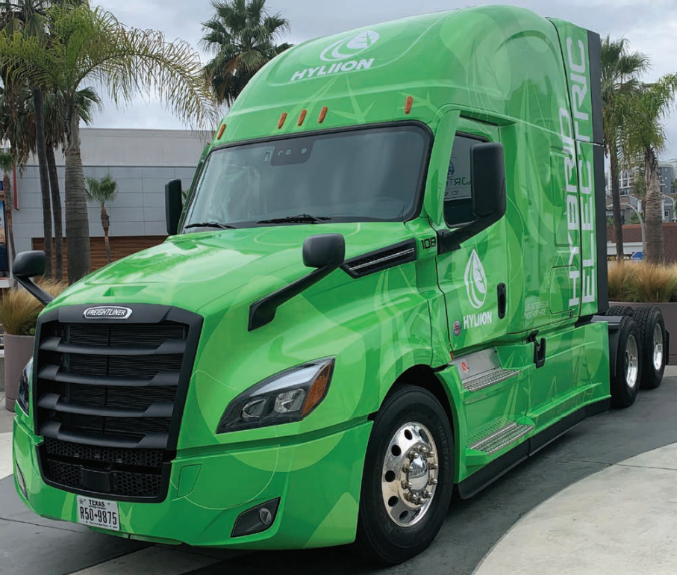
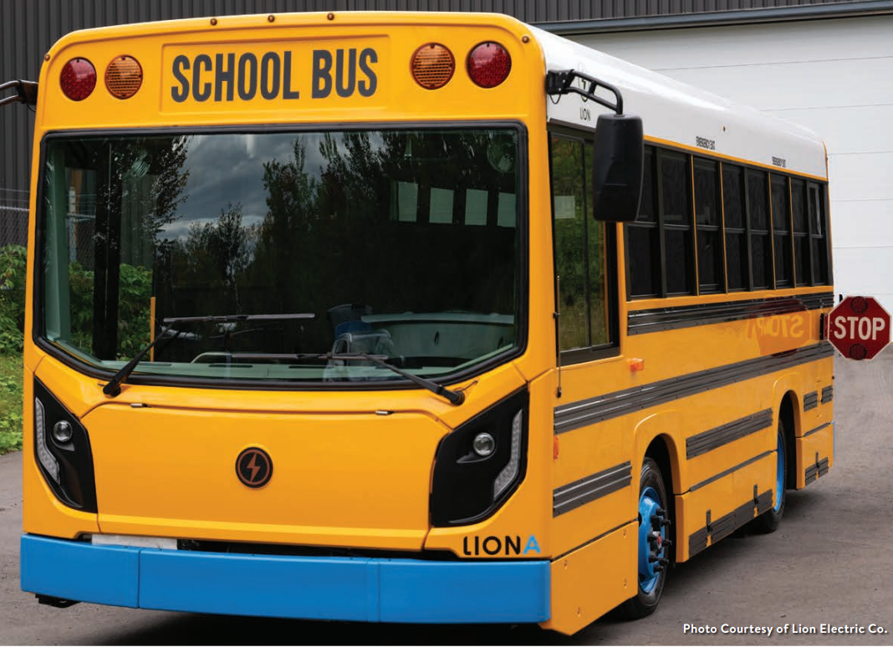
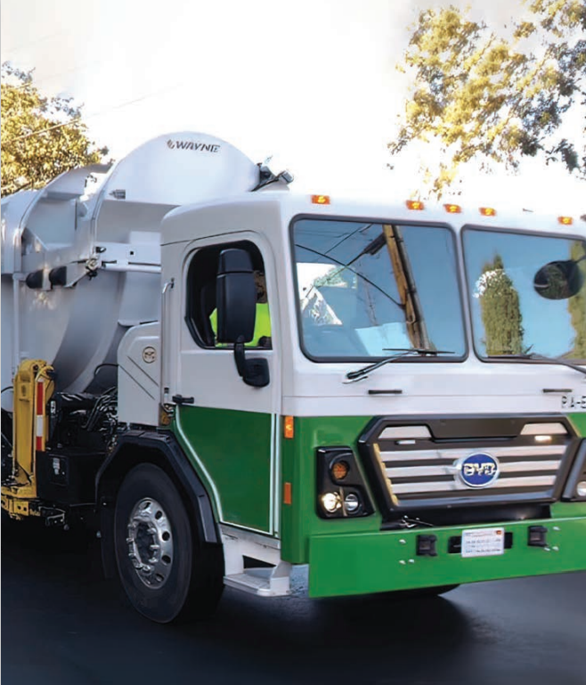
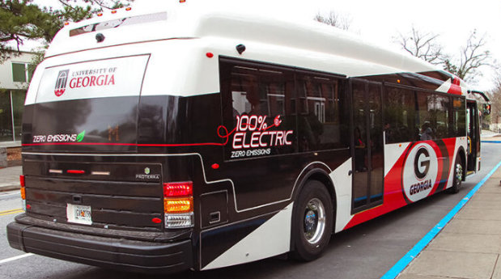
More Commercial Options, too
80 unique EV on-road models by end of 2023
Source: EPRI

Slide 18
Many more charging stations needed by 2030

Slide 19
Georgia Power’s Role
Partner with customers to accelerate the deployment of electric transportation technologies by increasing convenience and reducing barriers to adoption
Expand EV charging infrastructure
Provide consultative services for fleet electrification
Advocate for adoption of electric transportation technologies

Slide 20
Baseline Potential for Electrification in the US
Source: EPRI

Slide 22
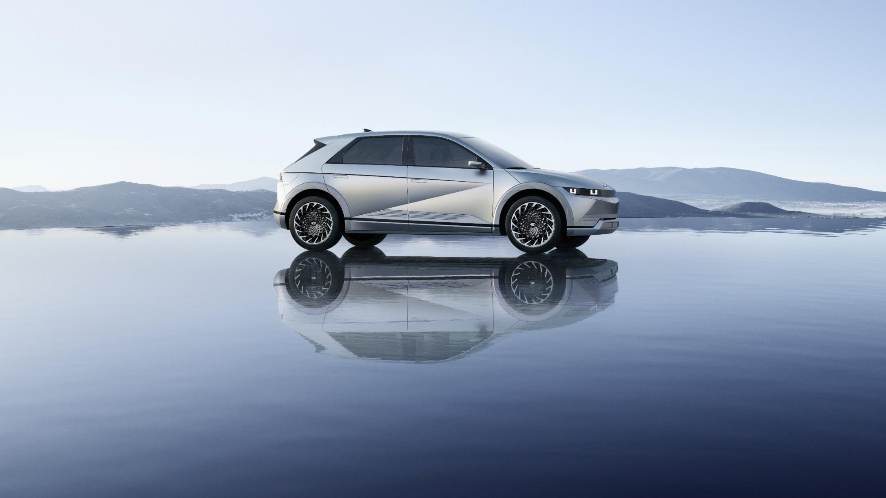
Connect ATL:
Electric Avenue
Yuval Steiman
Director, Eco Compliance and Research
Hyundai motor NORTH America

Slide 23
Hyundai’s North American Presence
Hyundai Motor North America
(Regional HQ)
Hyundai U.S. Operations
Operated in the U.S. for 36 years
Support nearly 100,000 U.S. jobs and contribute $7 Billion+ to the national economy
In 2021 Hyundai & Genesis sold over 780,000 vehicles; nearly half of which were manufactured at Hyundai Motor Manufacturing Alabama
Committed $10 Billion in total U.S. investment through 2025
Hyundai Auto Canada
Hyundai Motor America
Hyundai America Technical Center
Washington D.C. Office
Hyundai Motor Group Metaplant America
Hyundai Motor Manufacturing Alabama
Hyundai Motor Mexico

Slide 24
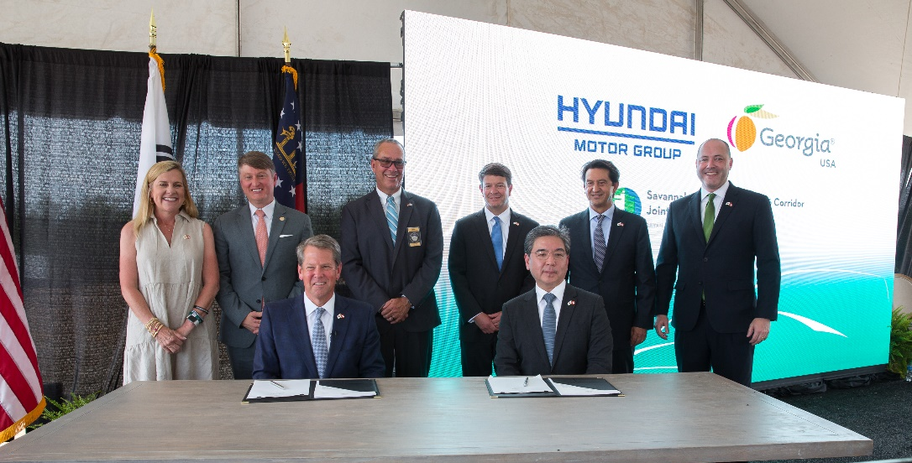
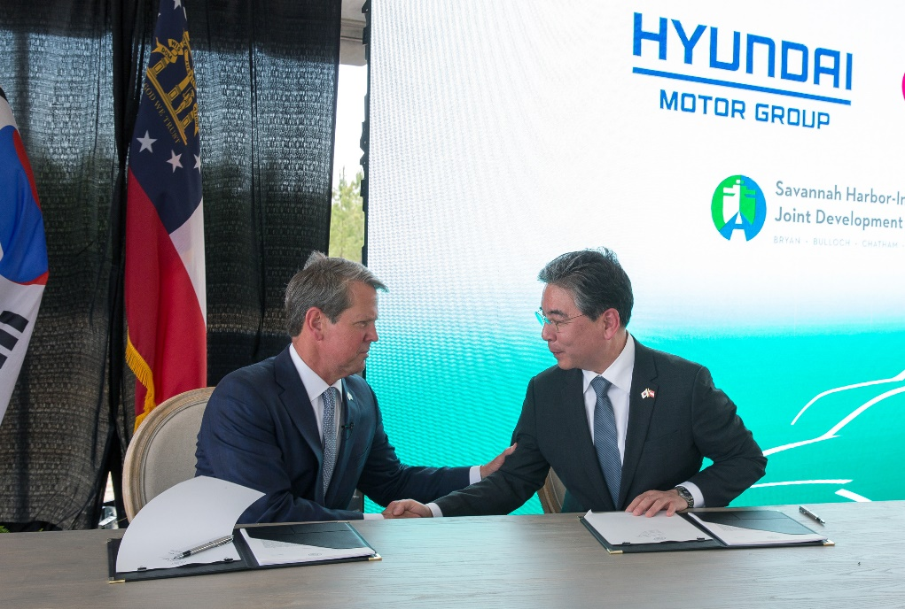
Hyundai EV Plant Coming to Georgia
Hyundai Motor Group Metaplant America
Hyundai Motor Group recently announced plans to build a full electric vehicle and battery manufacturing plant in Bryan County, Georgia
The new facilities represent an investment of approx. $5.54 billion
Expected to create 8,000+ jobs
Tentatively expect to break ground in October, 2022
Commercial vehicle production expected to begin in the first half of 2025 w/ annual capacity of 300,000 units

Slide 25
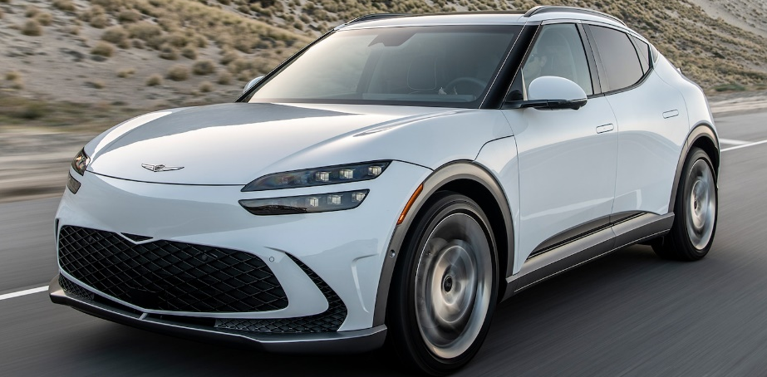
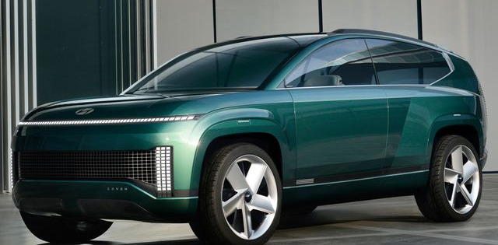
The Race for EV Leadership has Begun
Dedicated e-GMP platform will underpin a family EV models for Hyundai and Genesis
IONIQ 5
GV60
IONIQ 6
7 Concept

Slide 26
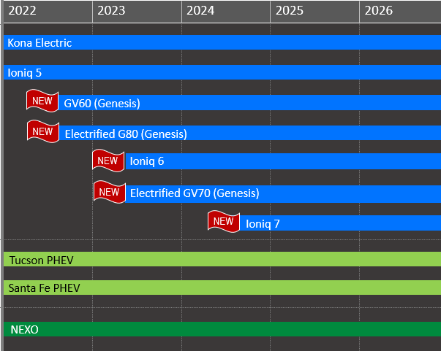
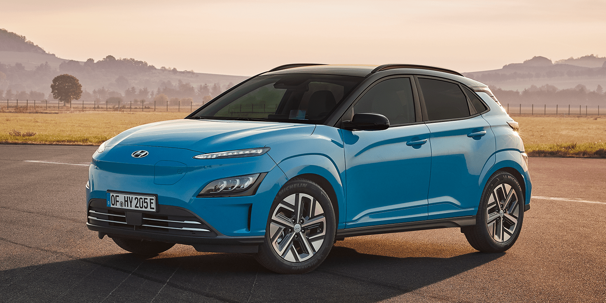
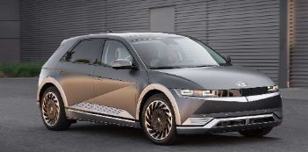
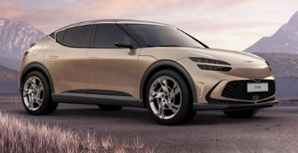
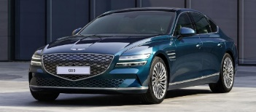
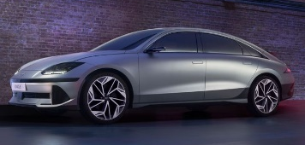
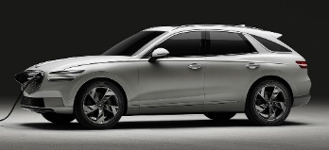
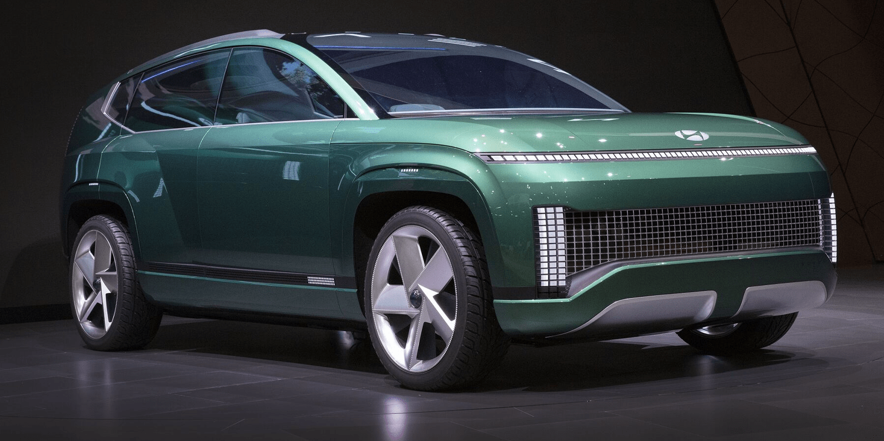
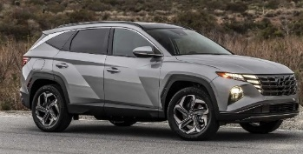
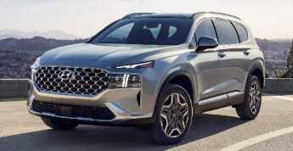
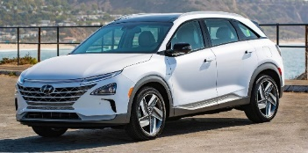
Hyundai’s Commitment to Vehicle Electrification
BEV
Concept Image
PHEV
BEV
FCEV
PHEV
FCEV

Slide 27
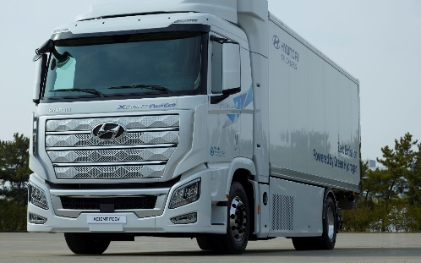
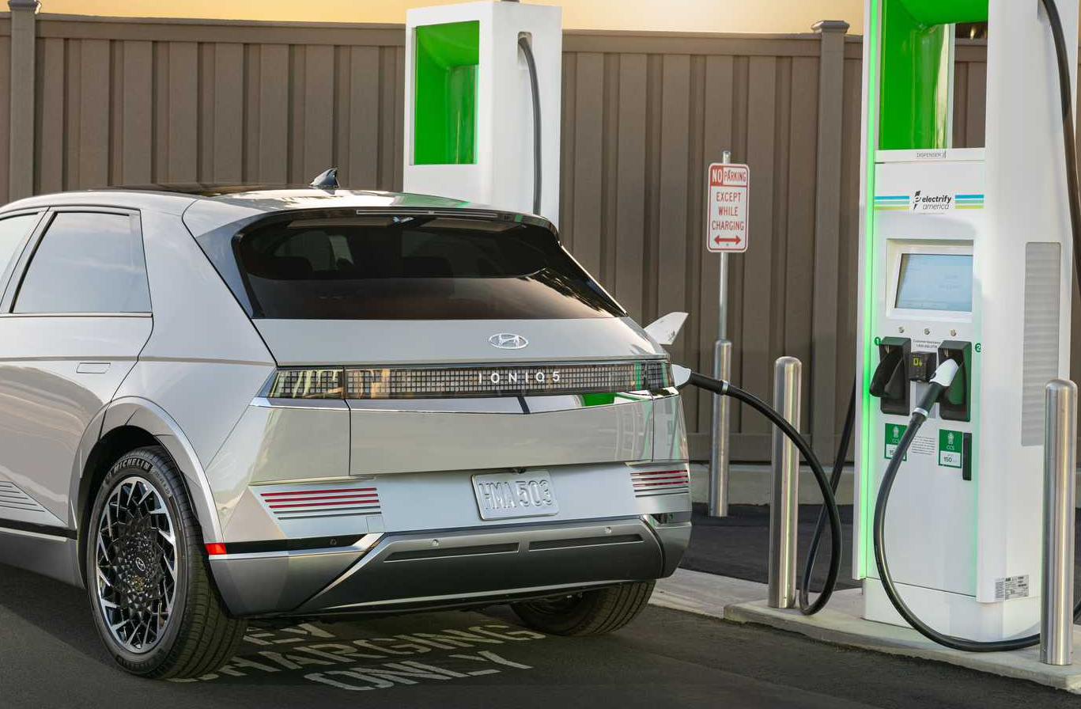
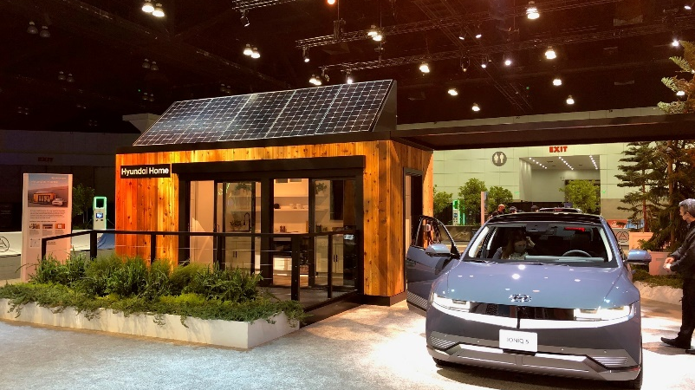
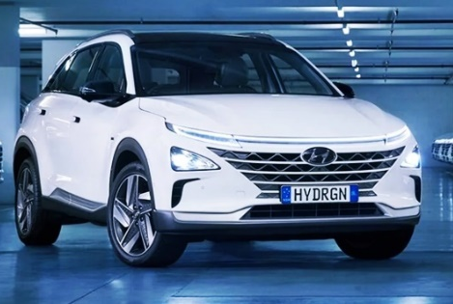
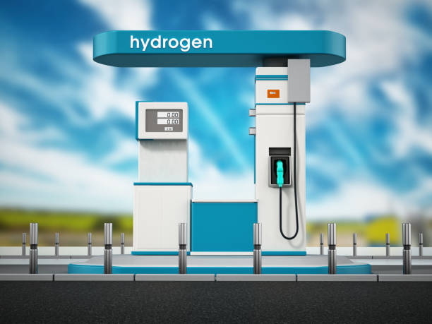
Hyundai is Uniquely Invested in Future Mobility Technologies
Electrification
Hydrogen
Hyundai continues to implement the elements needed for an EV-focused business model, such as infrastructure partnerships, subscription services, energy eco-systems
Xcient – Heavy Duty FCEV
NEXO
FCEV SUV
Hydrogen Infrastructure

Slide 28
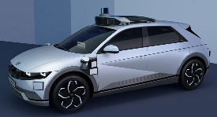
New Era of Mobility
Our strategic vision, simply called ‘Strategy 2025’, will help us emerge as a leader in a new era of mobility.
HMC ‘Strategy 2025’
Smart Mobility Solution Provider
Electric
Vehicle (EV)
Supernal - Advanced Air Mobility
In the post-pandemic era, social values and lifestyles different from the past will prevail...only those companies prepared for continuous transformations will survive and grow.”
Launch IONIQ dedicated EV brand in 2021
Achieve 8-10% global EV market share by 2040
“
+
Develop UAM as an innovative means of transportation to help reduce urban congestion Collaborate with private and public sectors to create a safe and efficient UAM ecosystem
Motional- Autonomous
Driving Technology
Fuel Cell System
Mr. Eui-sun Chung
Chairman of Hyundai Motor Group
Recently launched new ‘HTWO’ brand represents our world-leading hydrogen fuel cell system
Offer models equipped with level 3 autonomous driving technology by 2022
+
Development of a next-gen fuel cell system with multiple applications (UAM, automobiles, vessels and trains)
Commercialization of level 4 and 5 technologies

Slide 29
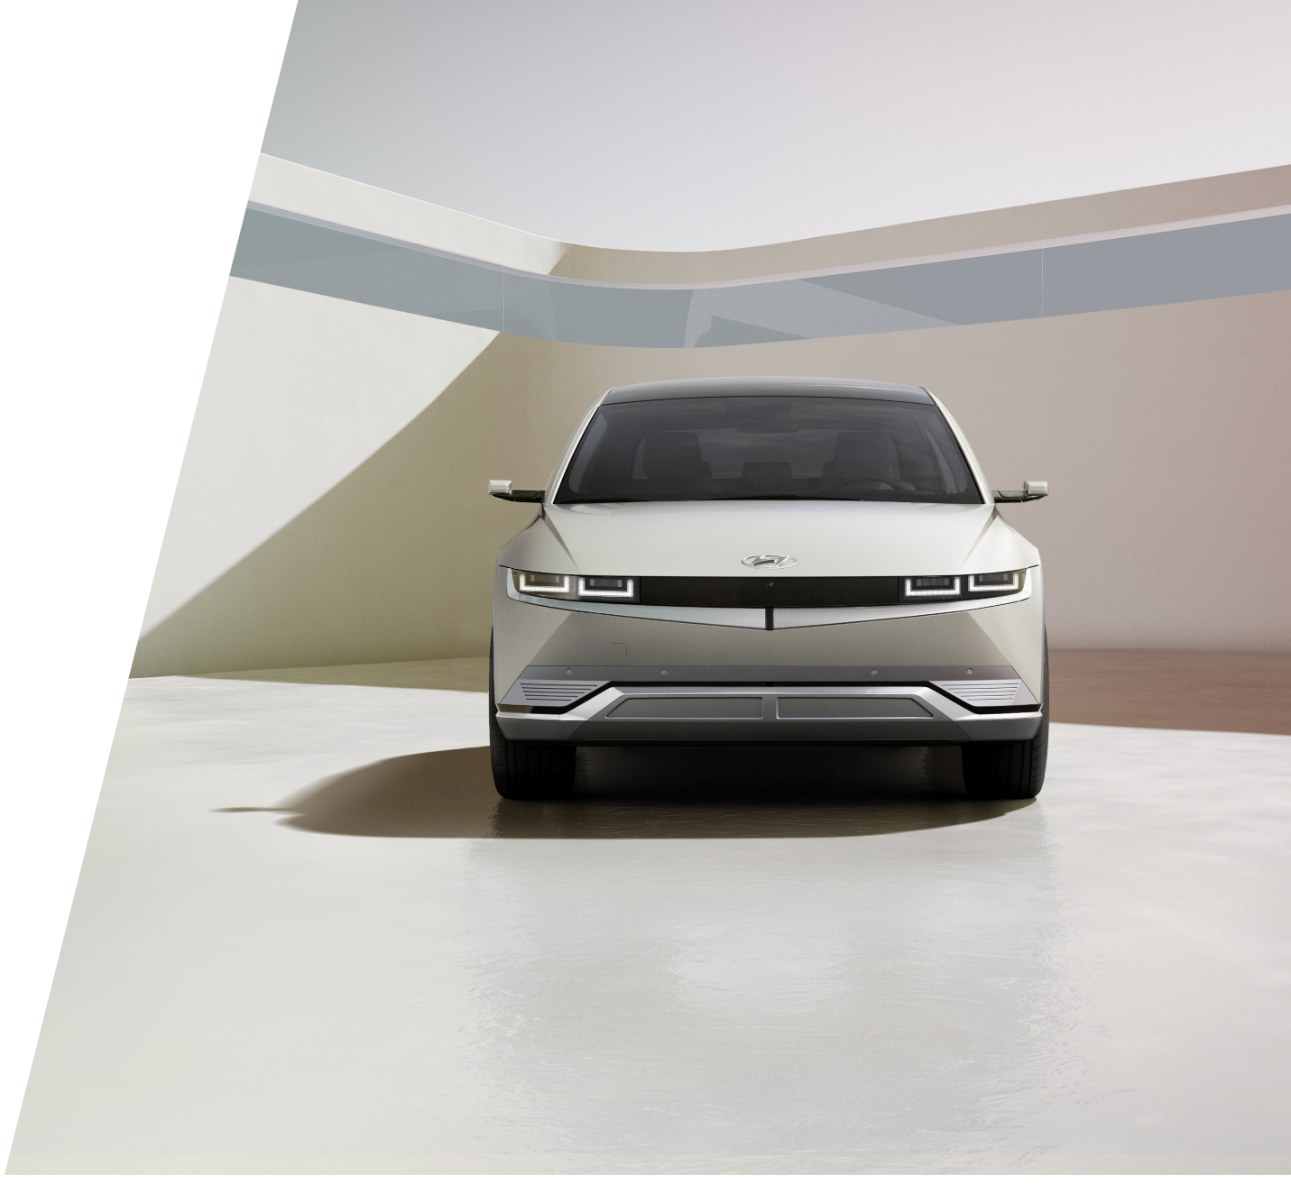
Thank You

Slide 30
Electrification
FTA Connect ATL
The Future of Mobility and Our Communities
Stephanie Valdez Streaty
Director, Mobility R&D
August 2022
Notes:
good mornin,
agends

Slide 31
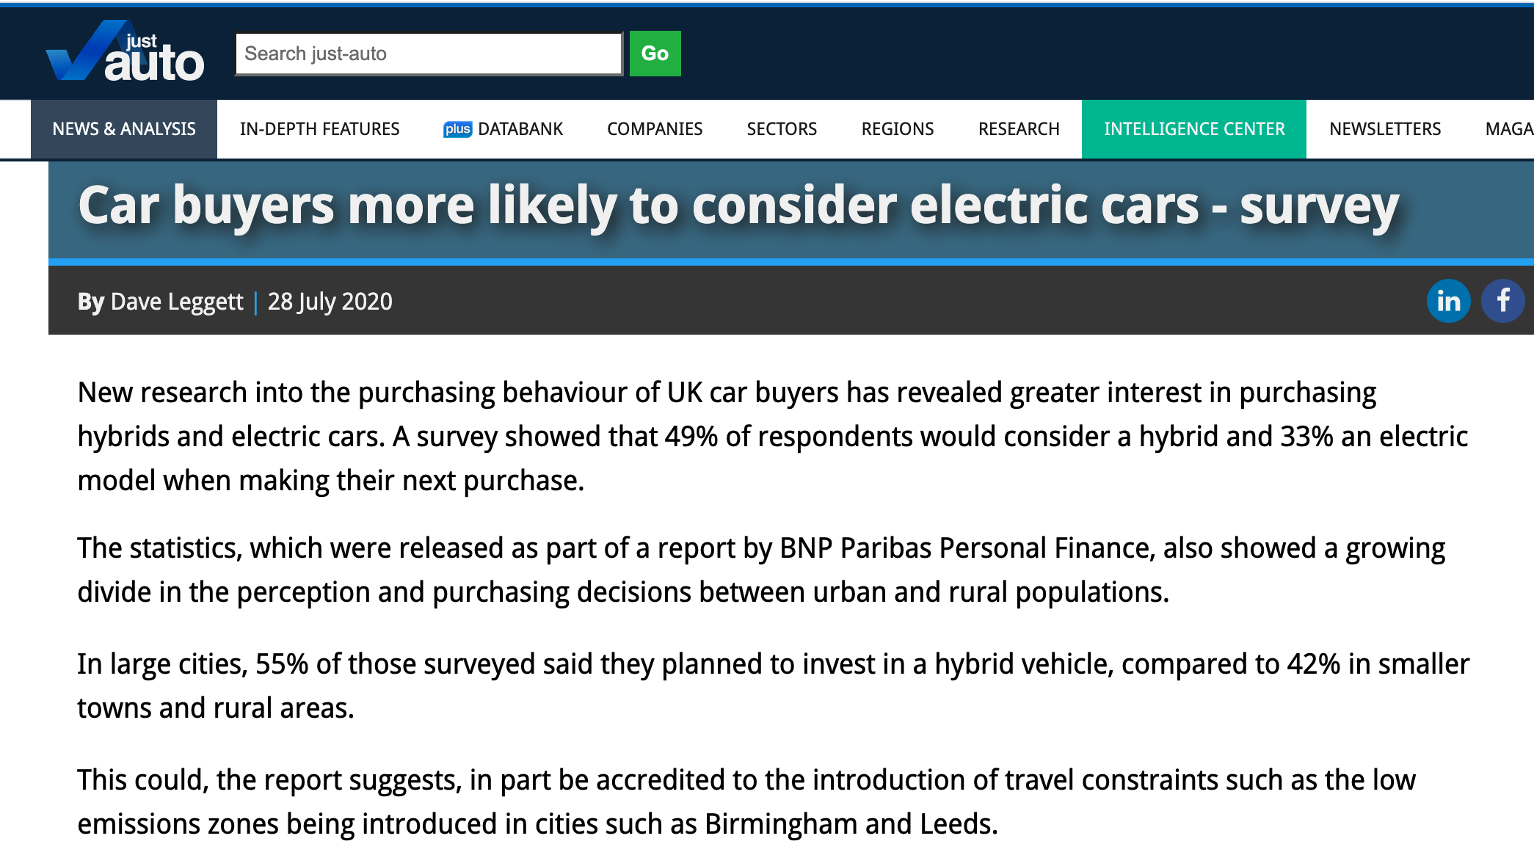
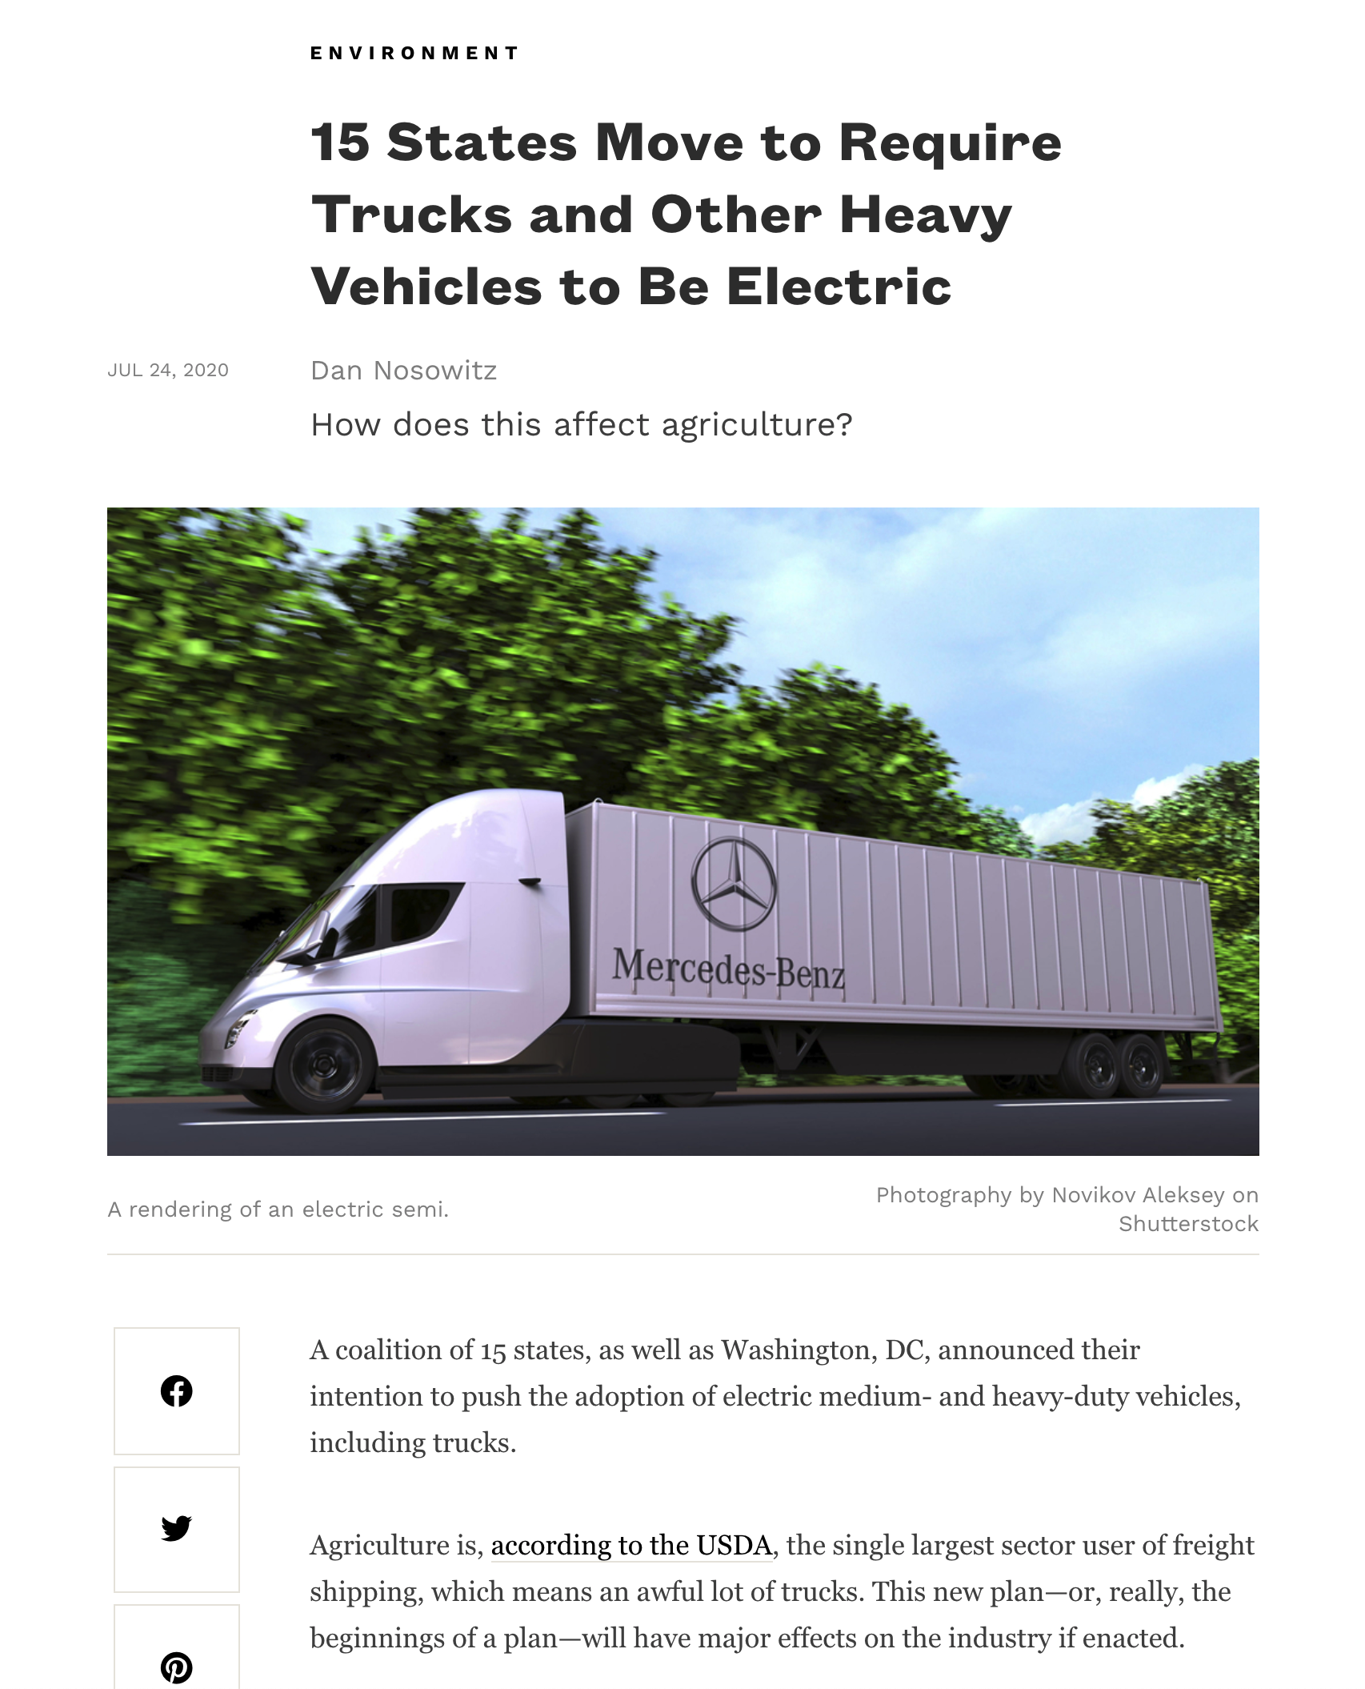
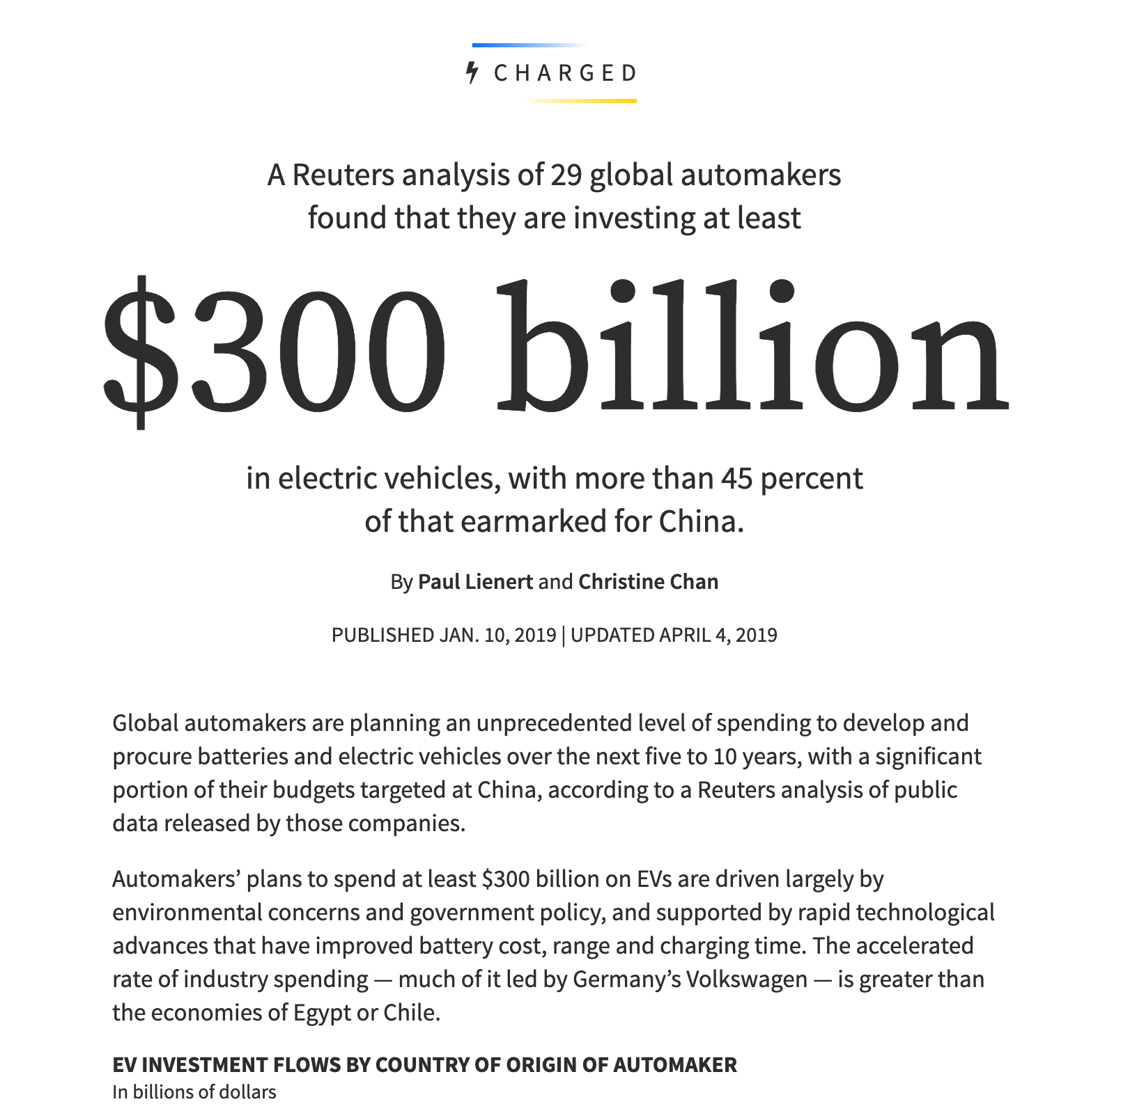
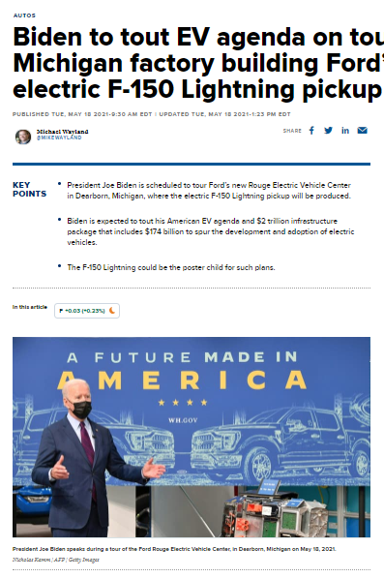
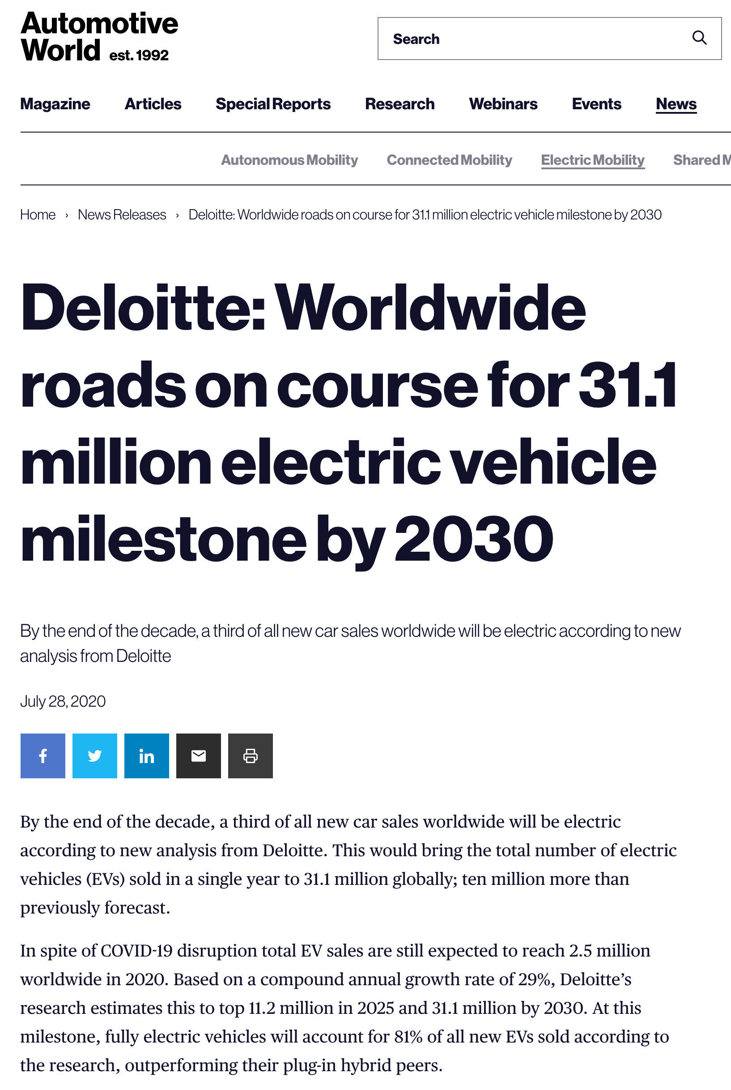
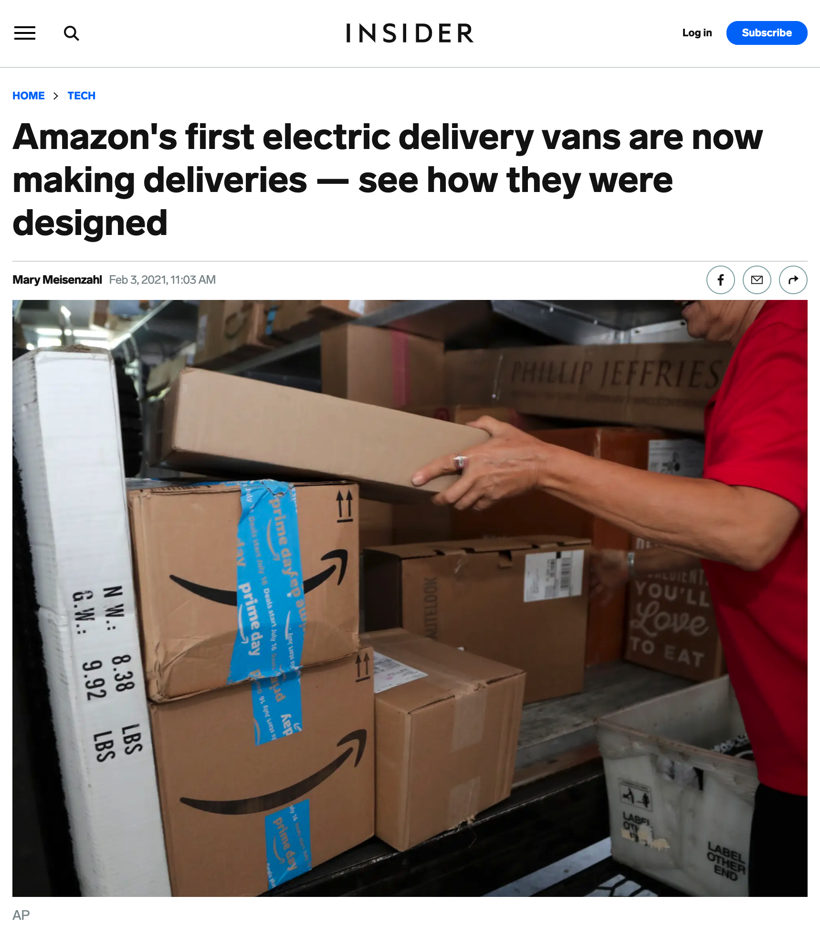
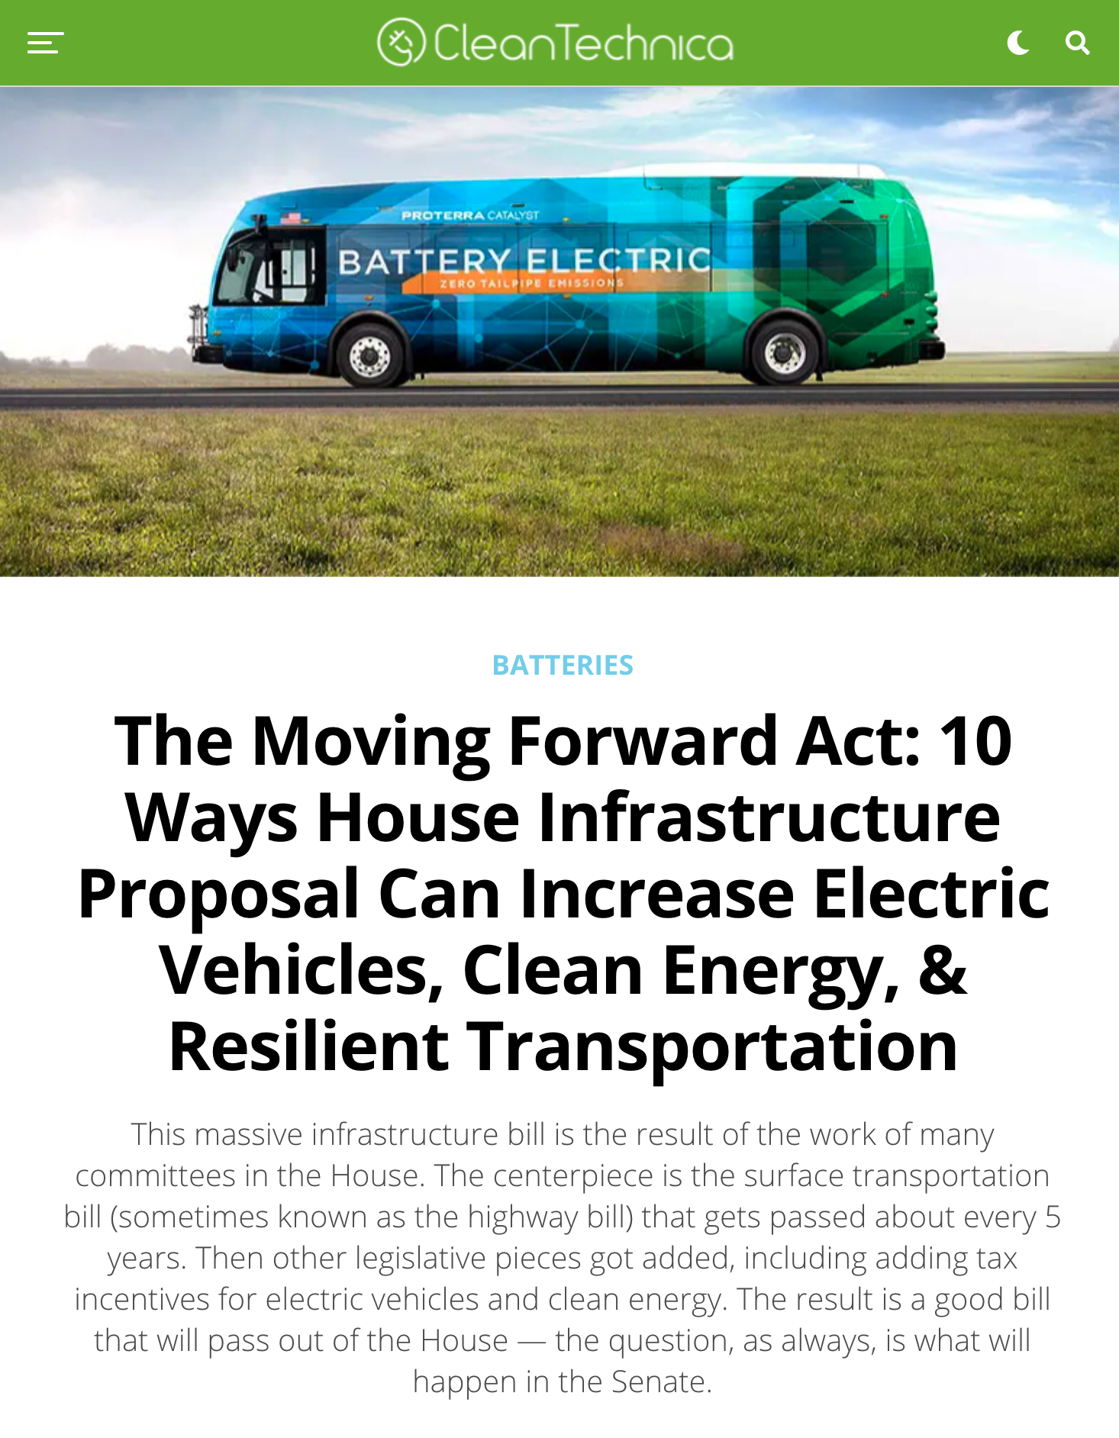
The Electric Future is Here
Notes:
To set the stage, there are a few drivers that are creating this inflection point for EVs
it's a perfect storm of environmental commitments, greater OEM offerings, and changing consumer sentiments
the US rejoined the Paris agreement and that created momentum in this space
Many companies are making carbon neutrality goals and electrification of their fleet is part of the strategy
the auto industry is on track to invest half a trillion dollars in the next five years to make the transition to electric vehicles, Wedbush Securities, an investment firm, estimates. That money will be spent to refit and build factories, train workers, write software, upgrade dealerships and more.
Companies are planning more than a dozen new electric car and battery factories just in the United States.
There is so much information in the news about Evs – consumers are becoming more aware and interested –we're seeing that in the sales data

Slide 32
Changing Consumer Sentiments
Notes:
Now let’s talk about the consumers and their changing sentiments
According to a recent E&Y study things are changing
52% of consumers in research are considering an EV for their next vehicle
Historically, EV buyers have been older, white affluent men. They are more likely to own luxury vehicles and have multiple vehicles for versatility.
Now EV considerers are • 47% female • 58% millennial/ gen z • 44% non-white
While we know EVs have lots of benefits including
A 58% lower total cost of operation vs combustion, inclusive of 60% savings in fuel and 25% savings in maintenance
eco friendliness and the
fact that EVs are a heck of a lot of fun to drive
We know consumer are becoming more interested in EVs; however, there are some barriers that remain
now I'll highlight some consumer insights from our EV adoption study that was released in November

Slide 33
Cox Automotive Research Finds
TOP BARRIERS TO EV
(Among EV Non-Considerers)
57%
51%
42%
lack of charging
stations in my area
(2019: 64%)
Too expensive
(2019: 52%)
Concern about battery not holding charge (2019: 51%)
41%
37%
% concern about cost of battery replacement (2019: 41%)
Low mileage range (2019: 47%)
Source: 2021 Cox Automotive Path to EV Adoption Study
Notes:
Barriers to adoption are improving; however there is work to be done to mitigate those concerns
The top 5 barriers to EV adoption remain the same compared to our 2019 study; with the number one concern being that there simply aren’t enough charging stations where customers live. The good news. As you saw on the previous slide, there is a lot of investment in play to build out the infrastructure
As you can see on this slide, there are also concerns about
battery range – not holding enough charge and range
Cost – to buy and replace battery
On next few slides, we'll take a deeper dive into some of the consumer sentiments in these areas

Slide 34
Desired Battery Range Among Considers Has Increased
Min Acceptable
Estimated
Desired
2021
miles
2019
miles
2021
2019
2019
2021
184
217
240
272
300
341
miles
Average EV Range:
(Source: SBD)
2019
2021
195 257
Notes:
Let's talk about battery range, this next slide speaks to consumer’s desired battery range for EVs
The takeaway is that among EV considerers the minimum acceptable range has increased nearly 20% over the last three years from 184 miles to nearly 220
While during this same time the estimated average range of an EV increased to 272 miles
Desired range also increased to nearly 350 miles – up 14% from 2019
The good news is that at the average EV range has meaningfully increased over the last three years from 195 miles to 257 – growth of nearly 32%
so. The reality is that it’s improving at a faster rate than considers desires – definitely a good thing
New Technology in both Battery Efficiency and Charging efficiency are being developed
Battery Range is increasing with Lucid already at 500miles and OneNextEnergy announced a 1,000-mile range battery retrofitted tesla prototype

Slide 35
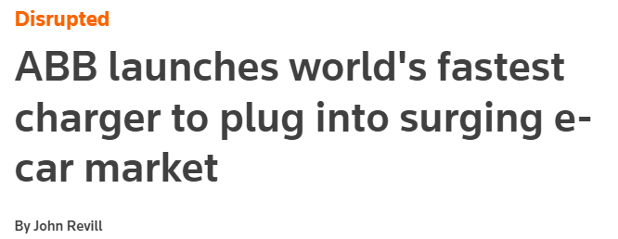
CONSIDERERS EXPECT TO CHARGE FASTER BY OVER 30 MINS…
ACCEPTABLE TIME TO CHARGE FROM FULLY DEPLETED
TO FULLY CHARGED (Minutes)
Average acceptable
time to charge
61 mins
Among Considerers
“can fully charge any electric car within 15 mins” - ABB
95 mins
Among Owners
Notes:
Now let’s go to expectations about charging time for EV considerers and owners
EV considerers have challenging expectations of what is an acceptable amount of time to charge their car at the different locations.
They say that just over an hour is the acceptable time, while EV owners accept longer charging times.
Overall, Considerers expect faster charging by over 30 minutes compared to EV owners.
Charging time will only continue to improve with technology advancements.
One example is the Ford and Purdue partnership .
Ford Motor Co is working with scientists at Purdue University in Indiana on a patent-pending plan to slash the average time it takes to recharge all-electric vehicles at charging stations from an estimated 25 minutes to less than 5 minutes.

Slide 36
Consumer Tipping Point
Price parity between evs and ice is tipping point
Impact of pricing to ev consideration
EV CONSIDERATION
(Total Vehicle Intenders)
IF EV IS SAME PRICE AS
GAS VEHICLE
IF EV IS PRICED $5,000
LESS THAN GAS VEHICLE
Total Vehicle
Intenders
38%
EV Non-
Considerers
Source: 2021 Cox Automotive Path to EV Adoption Study
Notes:
Cost is the most important factor in EV consideration based our research.
EV adoption would be accelerated if we are able to reach price parity between EVs and ICE vehicle – that would be the tipping point! Let’s get to the lift in EV consideration right away.
Currently, 38% of in-market shoppers are considering an EV. If EV is the same price as a gas engine equivalent vehicle, that level of consideration goes up to 59% and if EVs were $5000 less than a gas engine equivalent vehicle, then it goes up even higher to 71%!
Of course, we had the Non-considerers weigh in as well to better understand how price elasticity impact EV consideration.
About 1/3 of Non-considerers would intend to purchase an EV if the EV and ICE vehicle are equal in price and the level on consideration will increase to 49% if EV was priced $5000 less than an ICE vehicle.
So it will be key for battery prices to drop to achieve this price parity since Evs have about a 12K premium over ICE vehicles.

Slide 37
Consideration Increases with Battery Certificate
PRICE SAVINGS* ON BUYING USED EV
EV CONSIDERATION WITH
BATTERY DEGRADATION
WITHOUT
Battery Certificate
WITH
Battery Certificate
$20K
66%
(with 20% degradation)
36%
(with 30% degradation)
72%
(with 20% degradation)
41%
(with 30% degradation)
*Based on 2021 ATP on Used EV and New EV from KBB data
Source: 2021 Cox Automotive Path to EV Adoption Study; KBB.com data
Notes:
As we saw, prices is a barrier for many consumers – ev premium 10 -12K
Battery price trends; price parity
So it will be important to have more reasonable options – such as Used EVs
In analyzing our KBB transaction data, there is about a $20K saving in purchasing a Used EV over a New one.
In our research, we found that One of the ways to drive Used EV consideration is by providing the assurance of a battery certificate, which shows that the EV battery health is verified and degradation is minimal.
The certificate itself will be able to drive up consideration.

Slide 38
Protecting our planet starts with building innovative end-to-end battery solutions.
Notes:
Are EVs green? That conversation occurs a lot.
I did research last year, I found that It takes almost twice amount of carbon to build an EV; however at about 17.5K miles, EVs are better than ICE; it takes about 500K gallons of water to obtain 1metric tone of lithium
So, it’s going to be imperative that we green the grid and have a closed loop system for EV batteries
I’m going to highlight a couple things we’re doing at Cox in this area.

Slide 39
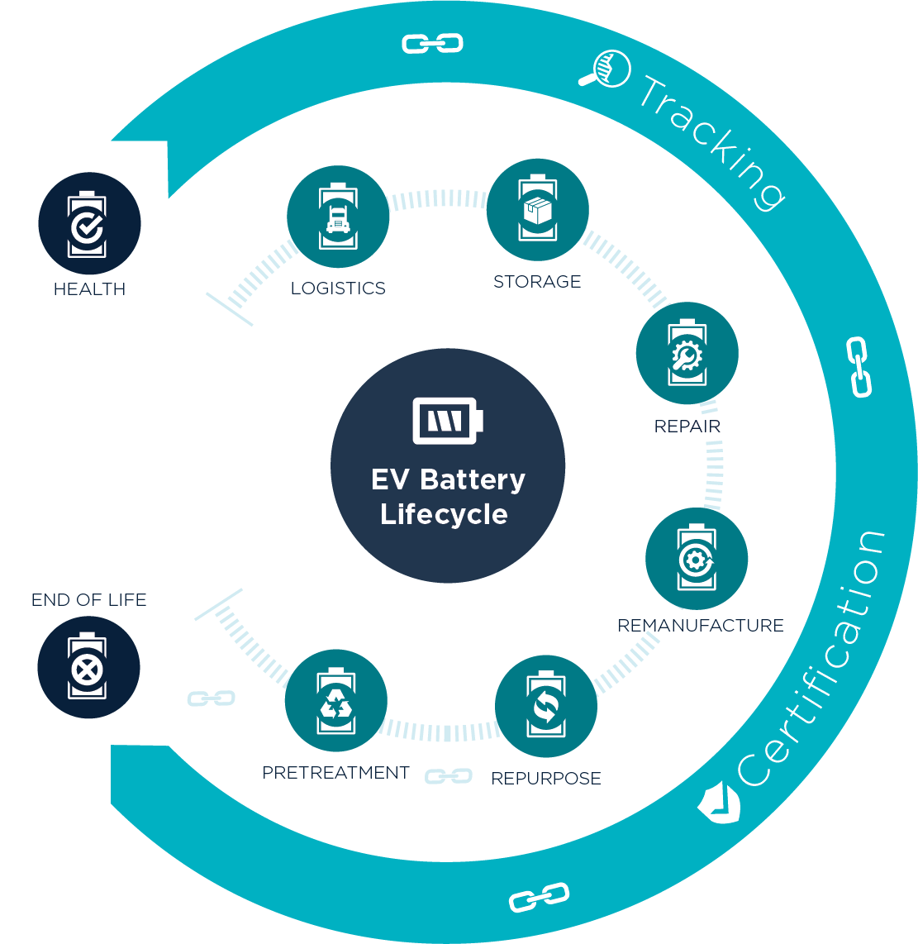
EV battery services
We are on a mission to enable a more sustainable future with end-to-end EV battery services.
We are extending the EV battery lifecycle through a closed-loop system that reduces the environmental impact of metals mining and supports the extension of EV battery first lives and end-of-life reuse and recovery treatments:
Battery Health: Guide to servicing recommendations
Remanufacturing: Battery remanufacturing or refurbishment per OEM standards
Logistics: Forward and reverse transport of packs between partners for servicing
Pretreatment Recycling: End-of-life treatment of packs
Storage: Monitored, climate-controlled pack storage
Tracking: Digital chain of custody for each EV battery

Slide 40
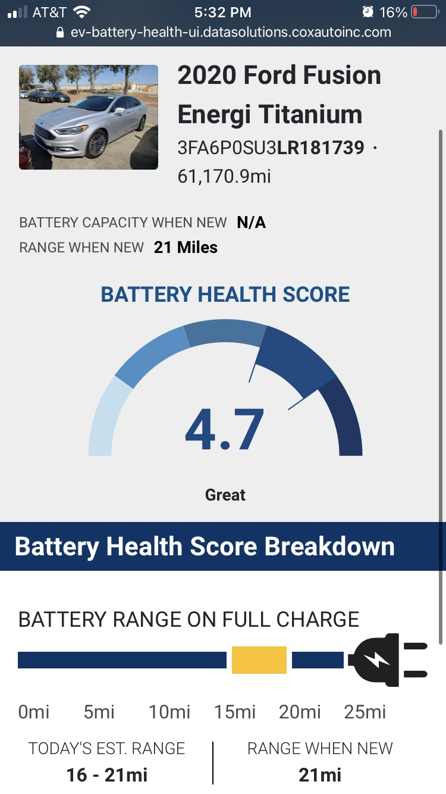
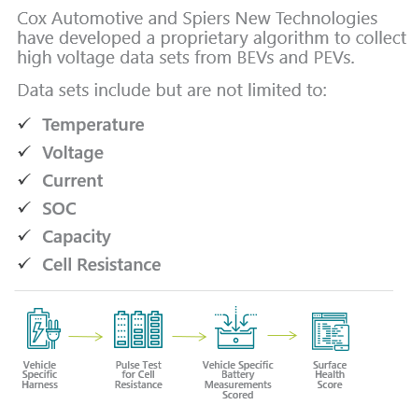
Battery Health
Nissan Leaf SV
30-40%
As the number of EVs in wholesale increases, an objective way to measure battery health is needed
OF EV COST IS THE BATTERY PACK

Slide 41
THANK YOU

