Slide 1
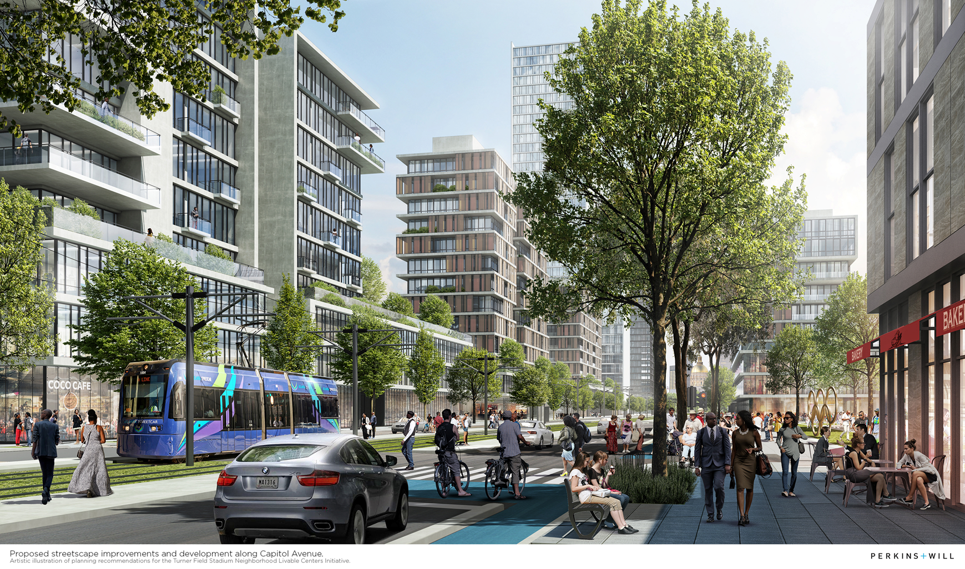
Metropolitan Transportation Plan (MTP) Transit Update
MTP Transit Changes & Assumptions
MTP Major Transit Expansion List

Slide 2
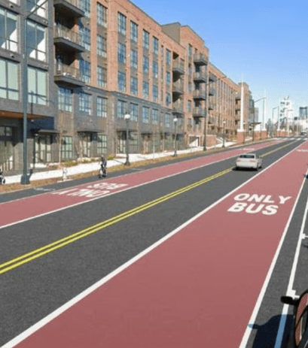
Key Transit Assumptions & Changes for the MTP Update
ARC & ATL Authority Planning & Coordination
ATL Regional Transit Plan
Includes local transit plans and projects
ARTP project list
Informs local transit referendum list
Informs Priority Investment List
Projects for consideration in State Bond or Transit Trust Fund
ARC MTP
Federally mandated plan including all modes in the MPO region.
Fiscally Constrained Plan
ARC & ATL Staff are coordinating project lists and other transit financial assumptions for consistency across plans.

Slide 3
Key Transit Assumptions & Changes for the MTP Update
Under IIJA - Approximately $4.6 B in annual FTA Capital Improvement Grants (New & Small Starts) funding may be available per year. Up from $2.1 B in 2022
Atlanta UZA Projected share is approx. $1.65 B (2025-2050)
Under IIJA – Changes to Capital Improvement Grants (CIG) Thresholds
Small Starts - Total project cost of under $400 M or seeking CIG funding of less than $150 M
New Starts - Total project cost of over $400 M or seeking CIG funding of more than $150 M
Federal CIG Participation Rate
New Starts 45% to 50%
Small Starts 60%

Slide 4
Key Transit Assumptions & Changes for the MTP Update
Projects by sponsors with dedicated local revenue sources will be programmed based on implementation priorities and schedules submitted by those agencies
Projects submitted by sponsors that will require discretionary FTA CIG funding within the next 5 years (TIP Period) are included if the have entered the FTA CIG Project Development Phase
Projects submitted by sponsors without a current dedicated revenue source will be included in the constrained plan, but will be placed in the 2050 network; can be advanced when and if long-term funding is in place

Slide 5
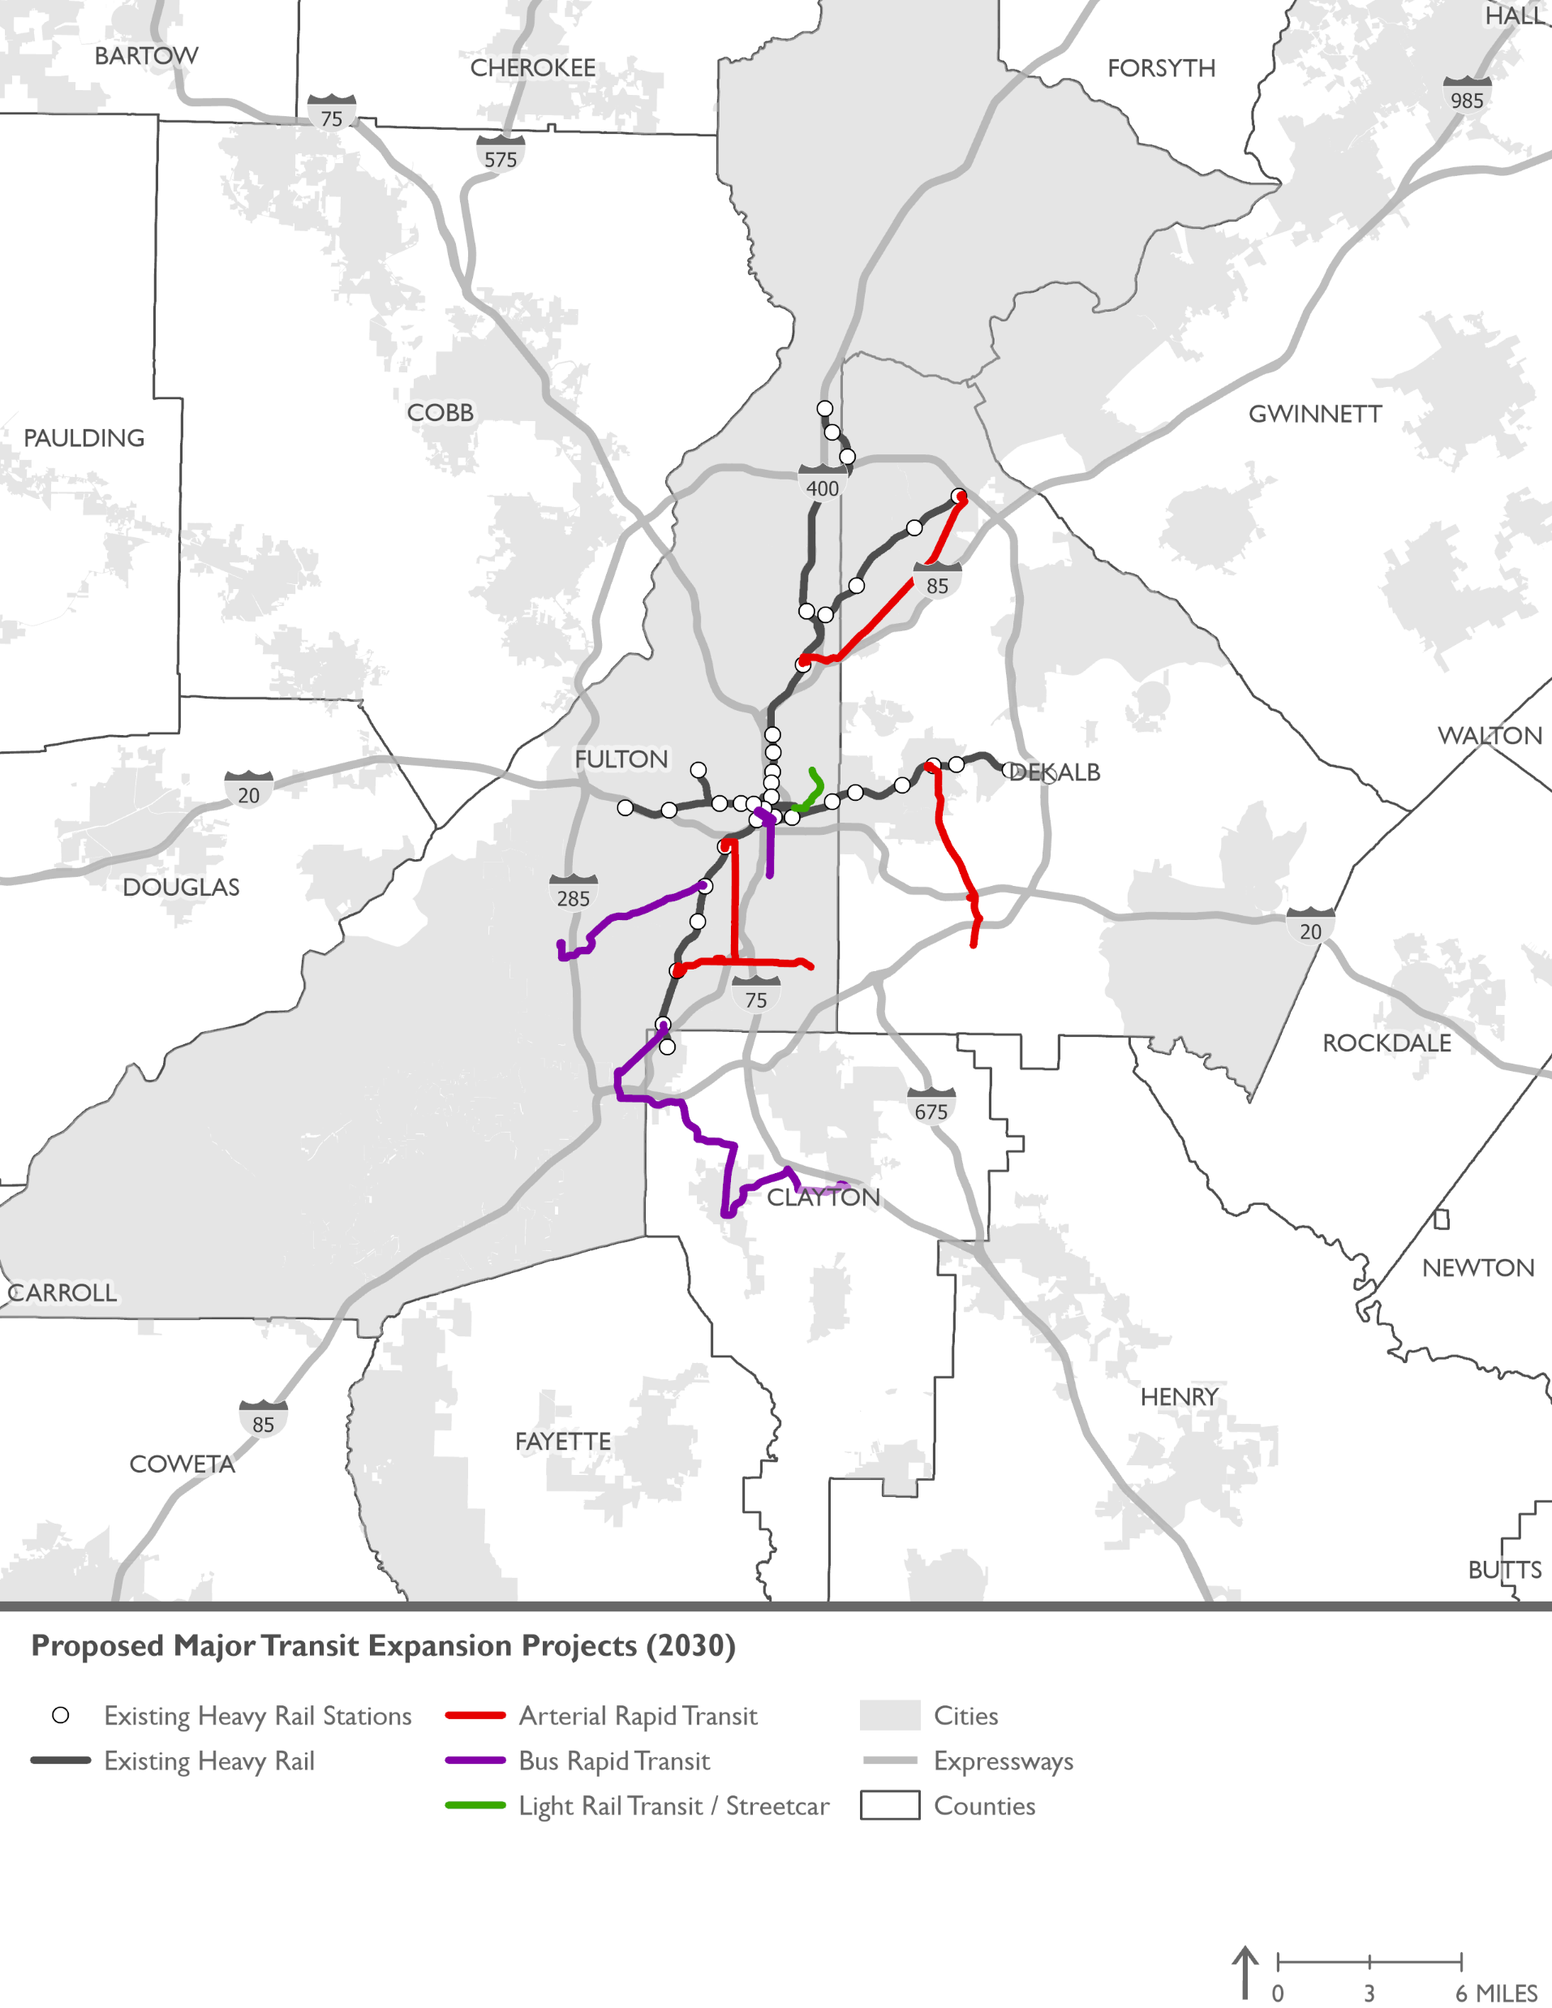
2030 MTP Network Year Proposed Major Transit Expansion Projects
Project | Mode | Limits | Capital Cost | Primary Funds
Summerhill BRT | BRT | MARTA 5 Points to Southside Beltline | $91 M | TIGER Grant
Campbelton Corridor | BRT | Oakland City MARTA Station to Greenbriar Mall/Barge Road | $308 M | FTA Small Starts*
Clayton Southlake BRT | BRT | College Park MARTA to Southlake Mall | $374 M | FTA Small Starts*
Streetcar East Extention | LRT / Streetcar | Jackson Street to Ponce City Market | $230 M | Local
Cleveland Ave ART | ART | MARTA EP Station to Jonesboro Rd. | $48 M | Local
Metropolitan Pkwy ART | ART | MARTA W End Station to Cleveland Ave | $12 M | Local
Buford Highway ART | ART | MARTA Lindberg Sta to MARTA Doraville Sta | $40 M | Local
Candler Road ART | ART | MARTA Avondale Sta to GSU: Perimeter College | $41 M | Local
*In FTA Small Starts Project Development Phase

Slide 6
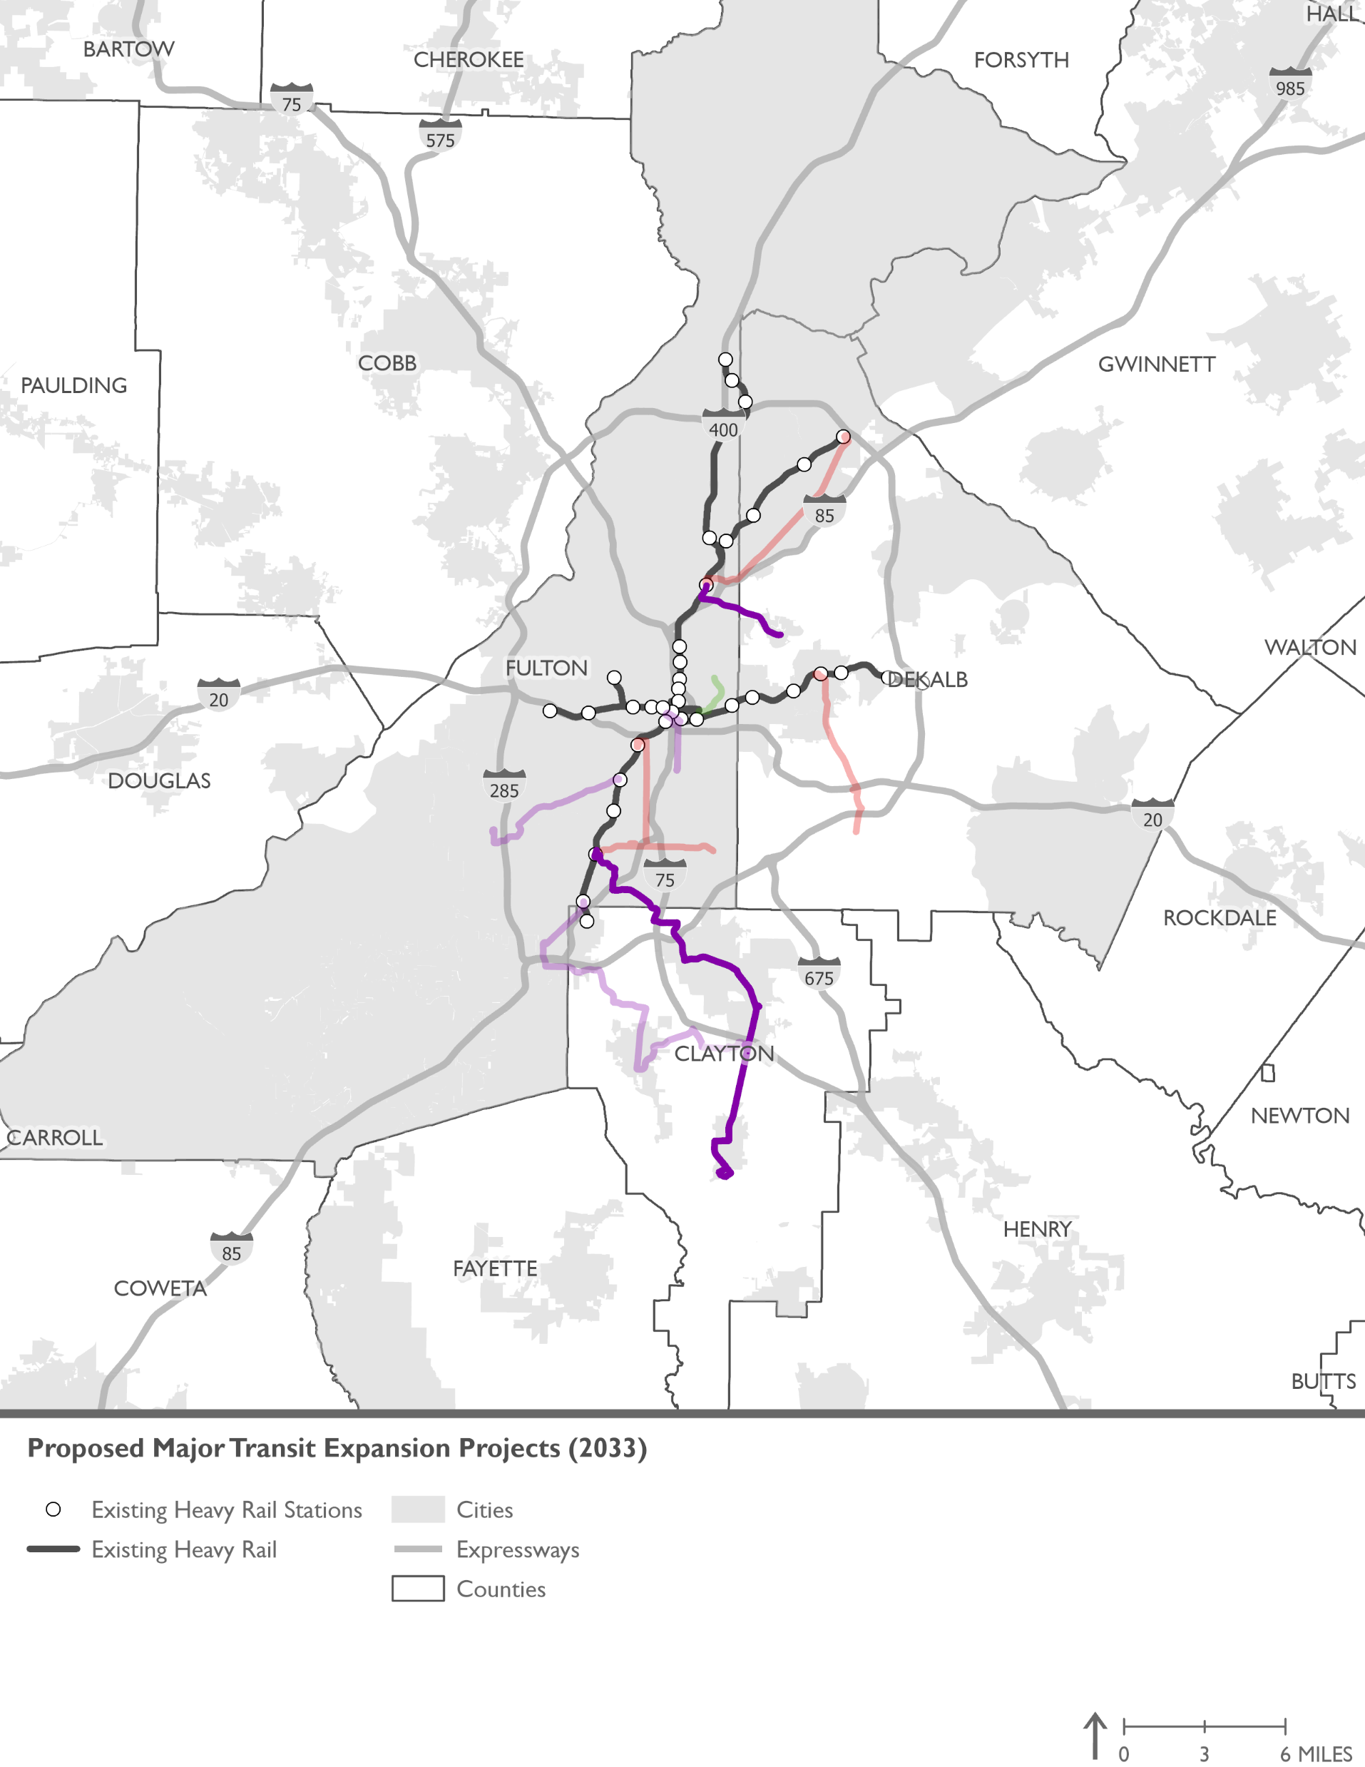
2033 MTP Network Year Proposed Major Transit Expansion Projects
Project | Mode | Limits | Capital Cost | Primary Funds
SR 54 BRT | BRT | MARTA EP Station to Clayton Justice Center | $600 M | FTA New Starts
Clifton Corridor Phase 1 | BRT | MARTA Lindberg Sta to Emory University | $600M | FTA New Starts

Slide 7
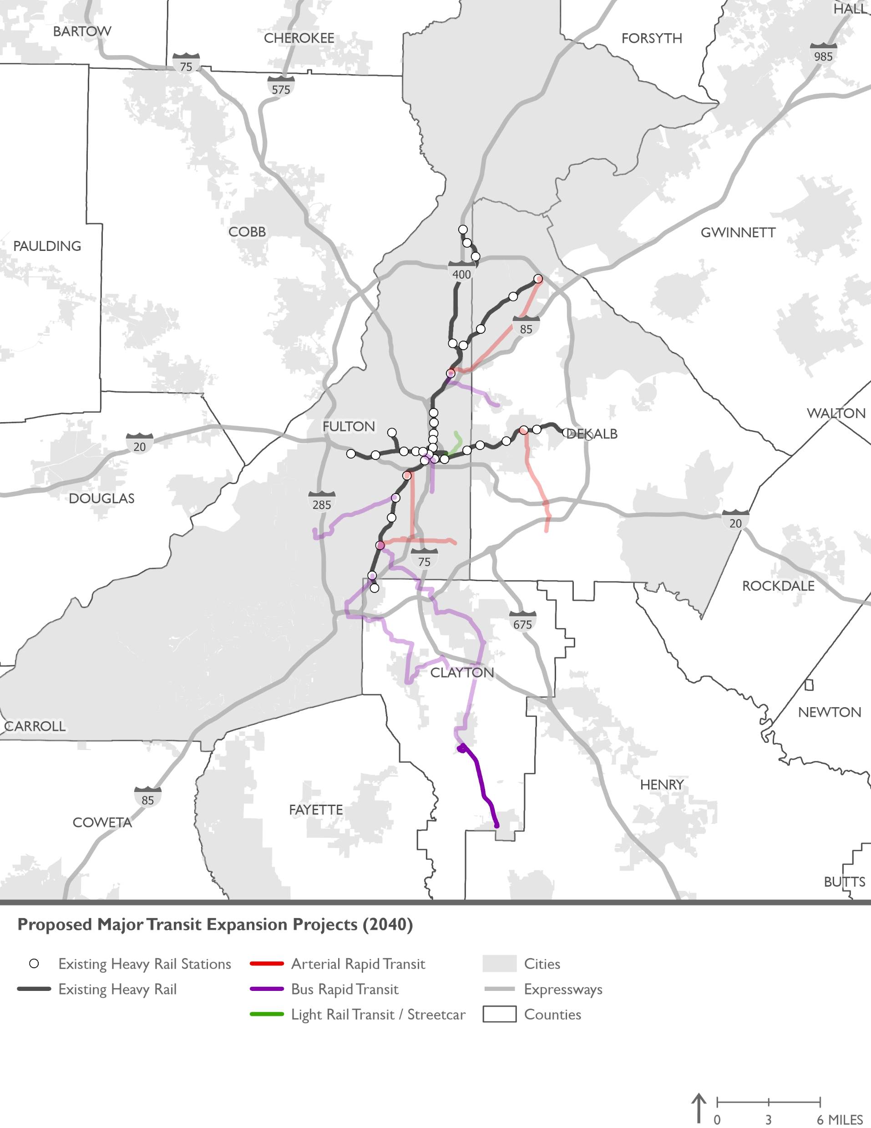
2040 MTP Network Year Proposed Major Transit Expansion Projects
Project | Mode | Limits | Capital Cost | Primary Funds
SR 54 BRT Phase 2 | BRT | Clayton Justice Center to Love Joy | $300 M | FTA New Starts

Slide 8
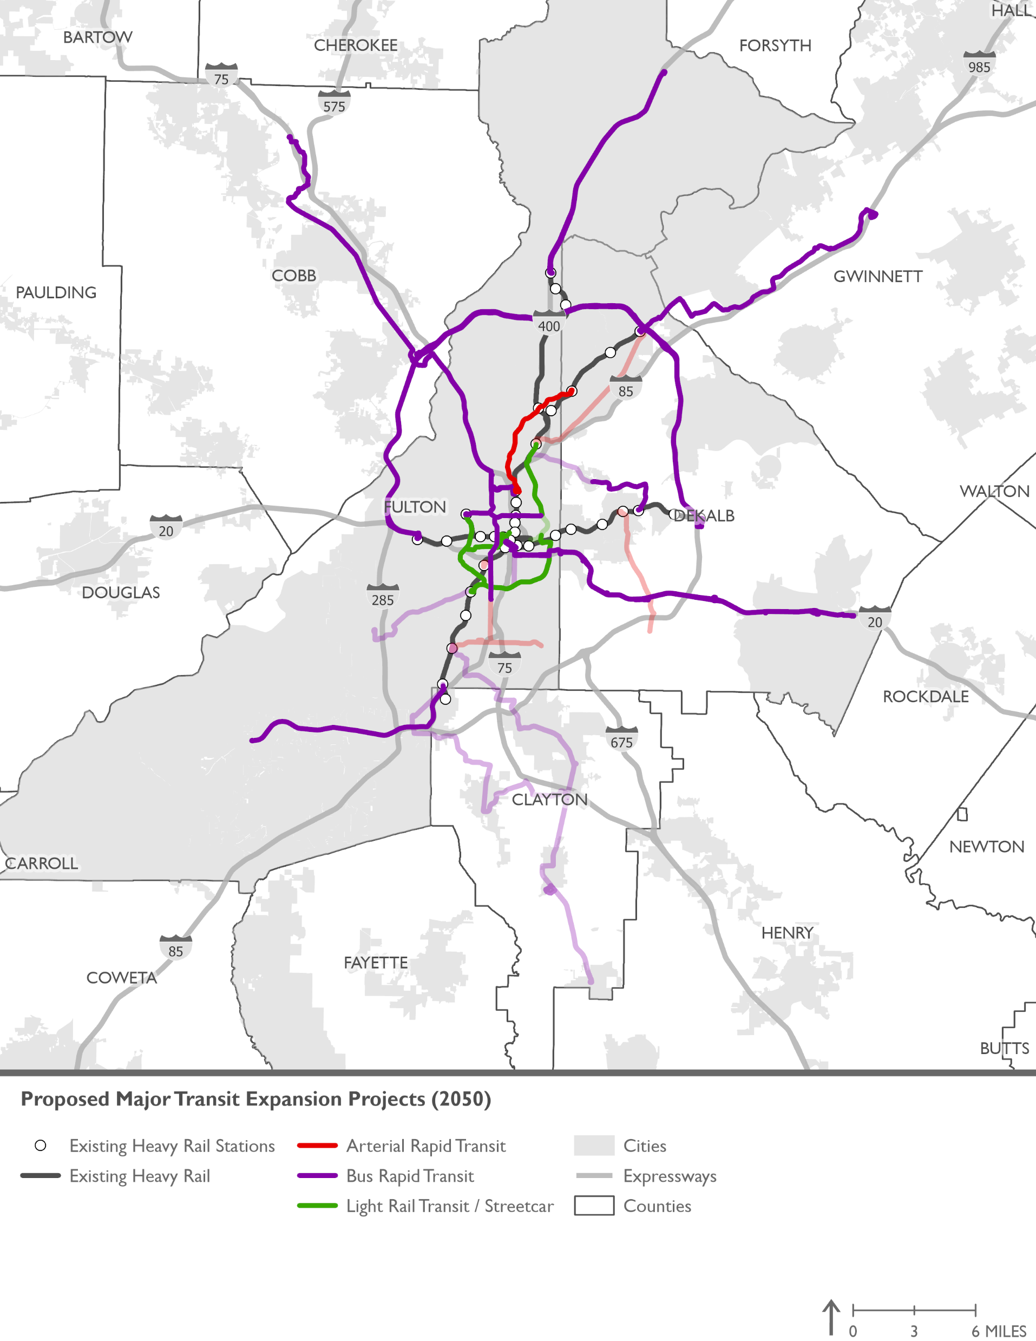
2050 MTP Network Year Proposed Major Transit Expansion Projects
Project | Mode | Limits | Capital Cost | Primary Funds
Beltline NE | LRT | Ponce City Market to MARTA Lindberg Sta | $174 M | FTA New Starts
Beltline SE | LRT | Irwin Street to University Avenue | $283 M | FTA New Starts
Beltline NW | LRT | Westview Dr. @ Langhorn ST. to MARTA Bankhead Station | $97 M | FTA New Starts
Beltline SW | LRT | Westview Dr. @ Langhorn ST. to MARTA S. Rail Line | $180 M | FTA New Starts
Clifton Corridor Phase 2 | BRT | Emory University to MARTA Avondale Sta | $700 M | FTA New Starts
South DeKalb Transit Initiative | BRT* | Downtown Atlanta to Stonecrest Mall | $289 M | FTA New Starts
GA 400 BRT | BRT | MARTA North Springs to Windward Parkway | $358 M | FTA Small Starts
South Fulton BRT | BRT | MARTA College Park to SR 92 | $165 M | Federal
I-285 Top End BRT | BRT | MARTA HE Holmes to MARTA Indian Creek | $530 M | FTA New Starts
*Current model assumption

Slide 9
2050 MTP Network Year Proposed Major Transit Expansion Projects (Continued)
Project | Mode | Limits | Capital Cost | Primary Funds
North Avenue BRT Phase 1 | BRT | MARTA North Ave. to Ponce City Market | $36 M | Local
North Avenue BRT Phase 2 | BRT | MARTA North Ave. to MARTA Bankhead | $63 M | Local
Northside Drive BRT | BRT | Atlanta Metro College to I-75N | $167 M | FTA New Starts
Peachtree Road ART | ART | MARTA Arts Center to MARTA Brookhaven | $6 M | Local
Streetcar West Extention | LRT/ Streetcar | Centennial Olympic Park to Westview Drive @ Langhorn Street | $219 M | Local
Cobb/NW Atlanta High-Capacity Transit | BRT | Kennesaw State University to Midtown Atlanta | $419 M | FTA New Starts
I-85 / Satellite Blvd Corridor High-Capacity Transit | BRT | MARTA Doraville to Sugarloaf Mills | $408 M | FTA New Starts
*Current model assumption

Slide 10
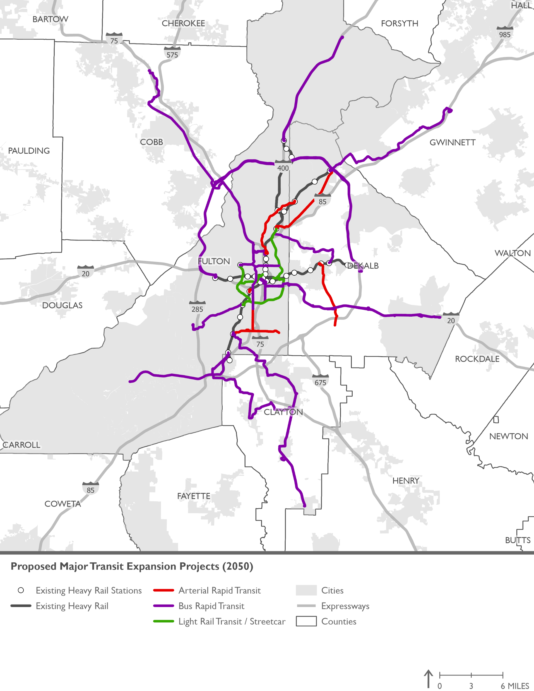
Proposed Major Transit Expansion Projects – Combined 2030 to 2050 Network Years
QUESTIONS?
*Current model assumption

