Slide 1
IIJA Update
Transportation Coordinating Committee
July 14, 2023

Slide 2
Topics
Regional Charging and Fueling Infrastructure Grant Application
Currently Open Key Funding Opportunities
Recent Funding Award Announcements
Regional Track Record for IIJA Discretionary Funding
Proposed Concept for Improving Outcomes

Slide 3
Regional CFI Grant Application
$14.8 million federal funding request, leveraged by private sector contributions for an overall project cost of $35.2 million
Concept developed in partnership with Racetrac, Inc. and Volta Charging
DC fast charge stations at 8 to 10 locations along alternative fuel corridors to supplement NEVI program implementation
Level 2 chargers at up to 100 commercial businesses around the region that will be available free of charge to users
ARC must still follow a fair and open procurement process to select final implementation partners
Experience provided a good model for regional collaboration on future discretionary programs

Slide 4
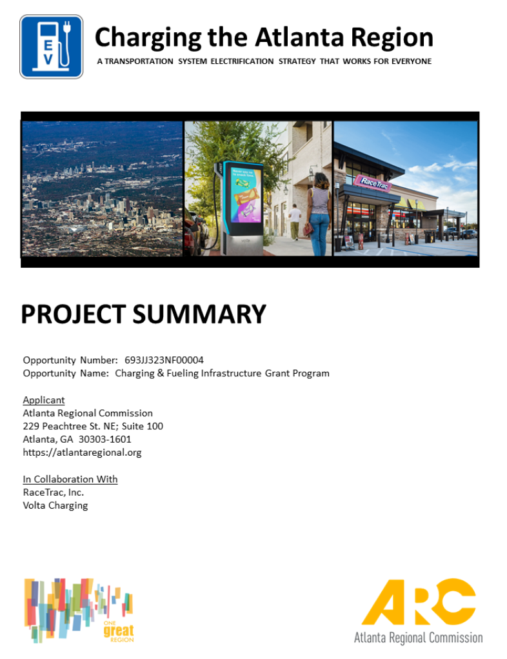
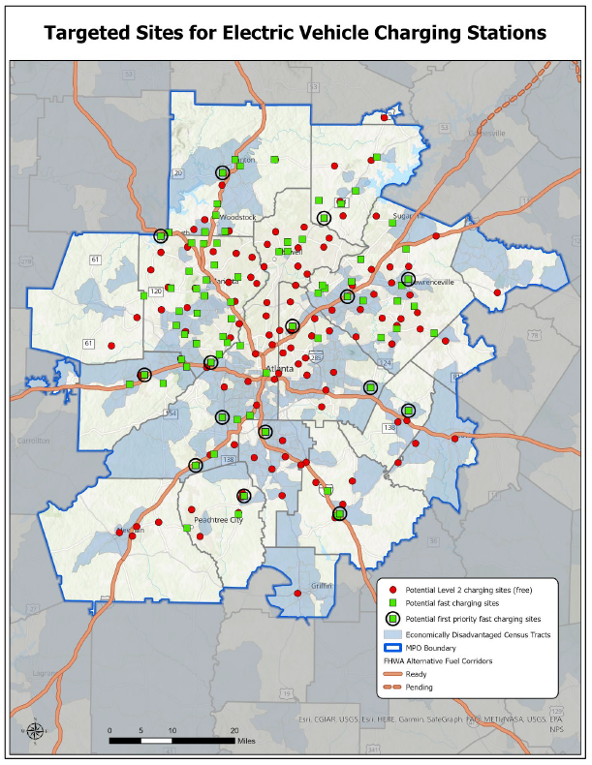
Regional CFI Grant Application

Slide 5
Currently Open Key Funding Opportunities
Promoting Resilient Operations for Transformative, Efficient and Cost-Saving Transportation (PROTECT)
$848 million available; applications due August 18
National Infrastructure Project Assistance (MEGA)
$1.8 billion available; applications due August 21
Joint NOFO with INFRA and RURAL
Nationally Significant Freight and Highway Projects (INFRA)
$3.1 billion available; applications due August 21
Joint NOFO with MEGA and RURAL

Slide 6
Currently Open Key Funding Opportunities
Clean School Bus Rebate Program
$400 million available
Applications due August 22
Reconnecting Communities and Neighborhoods
Combines Reconnecting Communities Pilot Program from IIJA with Neighborhood Access and Equity Program from IRA
$3.35 billion available
Applications due September 28
In addition to traditional planning and construction grants, dedicated funding for Regional Partnership Challenges Grants ($450 million)

Slide 7
Reconnecting Communities and Neighborhoods Program

Slide 8
Recent Funding Award Announcements
Railroad Crossing Elimination Program
Announced on June 5
$570 million available
DeKalb County will receive $460,460 for planning related to conversion of an at-grade crossing to grade separated
Gwinnett County will receive $888,000 for feasibility studies at three locations
Low or No Emission / Bus and Bus Facilities Programs
Announced on June 26
$1.7 billion available
Georgia State University will receive $22,286,475 to buy electric vehicles for the Panther shuttle system
Local and Regional Project Assistance Grants (RAISE)
Announced on June 28
$2.2 billion available
City of Atlanta will receive $25 million to construct a segment of the Northeast Beltline Trail
Gwinnett County will receive $20 million to replace the Gwinnett Place Transit Center

Slide 9
Regional Track Record for IIJA Discretionary Funding
For key programs, there have been a total of 12 NOFOs since January 2022
Average period for applications to be submitted = 84 days
Average time for award announcements to be made = 112 days
Total of $15.3 billion awarded
Projects in the region received a total of $169.4 million (1.10% of total)
The Atlanta region comprises about 1.54% of the nation’s total population
Excluding SS4A, about 15% of applications in 2022 were funded (compared to 17% nationally)
The region is significantly underperforming on MEGA, INFRA, Bridge Investment and ATTAIN programs (no awards) and Railroad Crossing Elimination Program (0.24%)
Five NOFOs are either active or have recently closed, representing an additional $8.65 billion of available federal funding

Slide 10
Proposed Concept for Improving Outcomes
Builds upon the “Reconnecting Communities” and “Justice40” initiatives
Can provide a common and unifying theme which ties together discretionary program applications which ARC leads and supports
Communicates a thoughtful, methodical and long-range approach to decision-makers in DC

Slide 11
IIJA Update
Transportation Coordinating Committee
April 7, 2023

