Slide 1
TIP/MTP Amendment 8
Transportation Coordinating Committee Meeting| July 14, 2023

Slide 2
Contents
Purpose and Summary of Amendment
Amendment Milestones
Questions
All amendment 8 resources available at www.atlantaregional.org/amendment

Slide 3
Purpose of Amendment 8
Incorporate new discretionary funds in the TIP
Congressionally Directed Spending (earmarks)
https://www.appropriations.senate.gov/congressionally-directed-spending-requests
Competitive grant funding authorized by IIJA (administered directly by US DOT)
https://www.fhwa.dot.gov/bipartisan-infrastructure-law/grant_programs.cfm
Handling via amendment per recent FHWA guidance
Non-conformity amendment

Slide 4
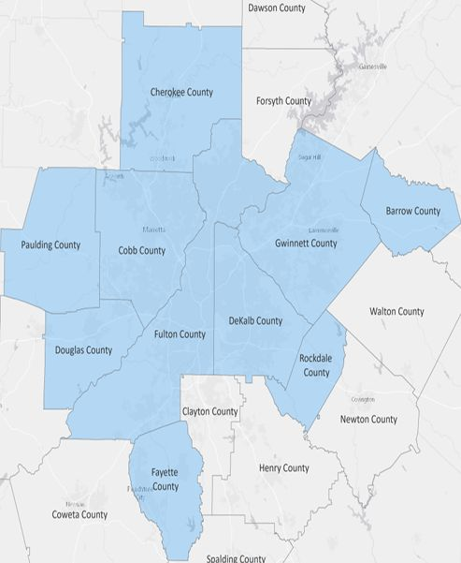
Amendment 8 Project Summary
Amendment 8 adds 25 new projects and modifies 2 existing TIP projects:
10 Safe Streets and Roads for All planning grants
14 Congressionally Directed Spending grants
1 Strengthening Mobility and Revolutionizing Transportation (SMART) grant for Gwinnett (Singleton Road)
1 Rebuilding American Infrastructure with Sustainability and Equity (RAISE) grant for MARTA (Five Points Station)
1 Reconnecting Communities grant for Roswell (GA 400)

Slide 5
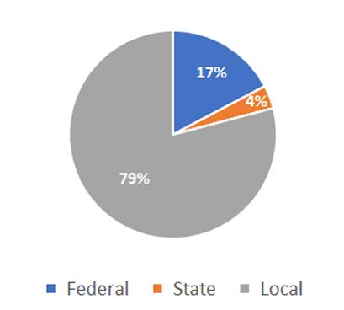
Amendment 8 Financial Summary
Amendment 8 proposes the following financial changes to the TIP:
Total funding increase of $383.9 million
Additional $66.4 million in federal discretionary sources
Additional $13.8 million in state funding
Additional $303.7 million in local funding
$200.5 million of this local funding figure sourced from More MARTA sales tax commitments for Five Points renovation project
Remaining $103.2 million in local funding for required non-federal local match and local funded portions of other amendment 8 projects

Slide 6
TIP/MTP Amendment 8 Major Milestones
Project list compilation and partner coordination – April through June
30-day Public Comment period – June 29 through July 28
Public Hearing – Friday, July 14 (TCC meeting)
Proposed committee and board action
ARC TCC – August 4
ARC TAQC – August 9
ARC Board – August 9
GRTA Board – August 9
Submit documentation to US DOT and US EPA for approval – August 9
Conformity Determination expected by late August 2023

Slide 7
Questions

