Slide 1

Recommendations
TAQC Meeting, March 15, 2018
Daniel Studdard, AICP, ARC Principal Planner

Slide 2

Regulatory “Perfect Storm”
Hours of Service (HOS) Requirements
Electronic Logging Devices (ELDs) Dec. 2017

Slide 3

ATRI Critical Issues in the Trucking Industry 2017
2) ELD Mandate
3) Hours of Service Requirements
4)Truck Parking

Slide 4
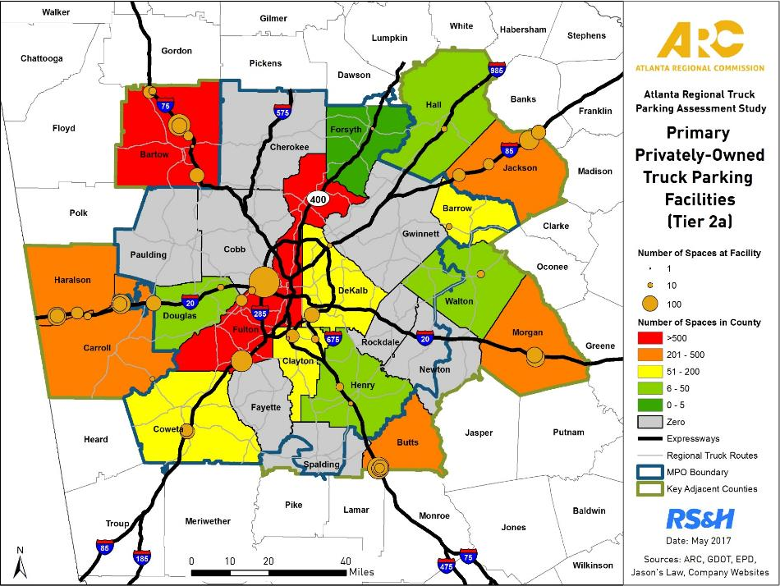
Private Spaces by County
County | Spaces
Fulton | 698
Bartow | 575
Butts | 450
Carroll | 360
Haralson | 332
Jackson | 309
Morgan | 259
Coweta | 165
DeKalb | 114
Clayton | 105
Barrow | 85
Henry | 40
Walton | 25
Douglas | 20
Hall | 19
Forsyth | 5
Total | 3,561

Slide 5
Truck Driver Survey Results
277 Responses
How long does it usually take you to find truck parking in the Atlanta region?
Length of time | Response
Less than 15 minutes | 1.3%
15 – 30 minutes | 6.5%
30 minutes – 1 hour | 41.3%
More than 1 hour | 51.0%

Slide 6





Draft Strategies
Report and Executive Summary available at:
www.atlantaregional.org/truckparking
1. Add / Expand Truck Parking Supply
2. Develop Truck Parking Policies
3. Develop Truck Parking Partnerships
4. Improve Sharing of Truck Parking Information
5. Monitor/Incorporate Future Use of Technology

Slide 7

Strategy 1: Add/Expand Supply
1.1 - Comprehensive Transportation Plans (CTPs)
  Authorized truck parking
  Unauthorized truck parking locations
1.2 - Freight Cluster Plans
  Inventory authorized & unauthorized parking
  Identify potential solutions
1.3 - Local Government / CID Solutions
  New truck stops
  Expand existing truck stops
  Shippers / receiver agreements
  Existing / closed rest areas
  Vacant industrial spaces / brownfield sites
  Park-and-ride lots (PM only)
  Shopping centers

Slide 8
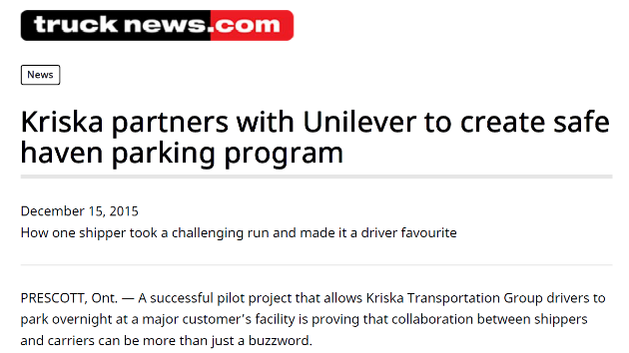
Add / Expand Supply
Example: Pilot Parking Program
Drivers Requirements:
  Wear safety vests at all times
  Carry a flashlight at night
  Follow safety rules
  De-couple tractor from trailer
  May not move tractor
  Preferential treatment for no-idle cabs
Notes:
1) So uncommon this made the news
2) Developed a set of policies so already developed for others to implement

Slide 9

Strategy 2: Policy Development
2.1 – Share Warehouse/Distribution Costs/Benefits
  Require/incentivize shippers and receivers to provide parking
  Promote new truck parking
      Industrial areas / freight clusters
      CIDs
  2.2 – Review Development of Regional Impact (DRI) Requirements
  Truck stops
  Warehouse / distribution centers

Slide 10
Strategy 2: Policy Development
2.3 – Promote Local Government Actions
  Review zoning codes
  Address any truck parking deficits, as needed
2.4 – Develop Zoning Template Language
  Restrictions, permitted uses, design/aesthetic controls
  Examples: Buffers, plantings, lighting, electrification systems, and/or security
2.5 – Incentivize Off-Peak Freight Operations
  Allow truck drivers to get closer to shippers / receivers
  Reduce miles driven and air emissions

Slide 11

Strategy 3: Partnerships
3.1 – Provide ongoing updates to the Freight Advisory Task Force (FATF)
3.2 – Provide truck parking information and resources to stakeholders and planning partners
3.3 – Attend relevant meetings and participate in speaking opportunities
3.4 – Participate in FHWA National Coalition on Truck Parking / FHWA coordination
3.5 – Continue to discuss truck parking policy priorities, initiatives, and projects
Notes:
Are there any priority partnerships?
Anyone / group missing?

Slide 12
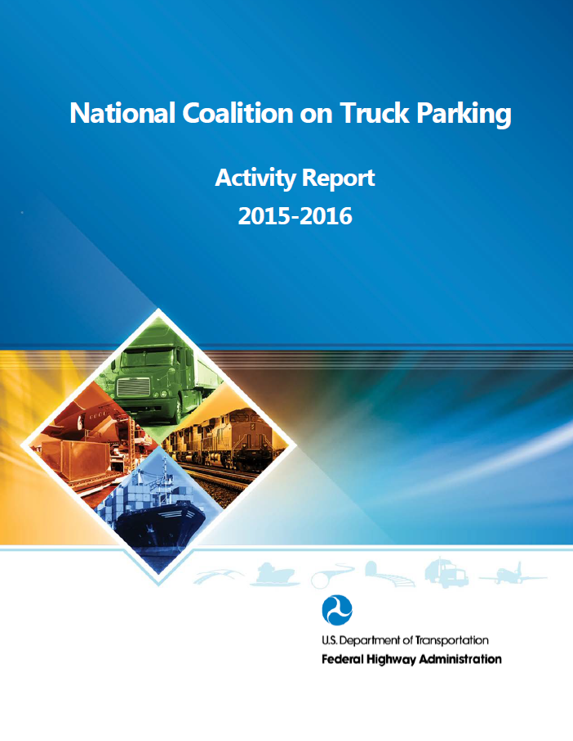
FHWA National Coalition on Truck Parking
June 2017 “Activity Report”
Four (4) Working Groups to Assess:
  Parking Capacity
  Technology and Data
  Funding, Finance and Regulations
  State, Regional and Local Government Coordination
Notes:
Working groups will start meeting in November 2017

Slide 13

Strategy 4: Information Sharing
4.1 – Serve as regional clearinghouse for truck parking information
4.2 – Monitor opportunities to implement real-time truck parking availability systems or implement other technology solutions
Strategy 5: Monitor / Incorporate Future Technology
5.1 – Dock Management Technology
  5.2 – Connected and Autonomous Vehicles
  5.3 – Internet of Things (IoT)/Physical Internet

Slide 14
Questions?
Daniel Studdard, AICP, ARC Principal Planner
dstuddard@atlantaregional.org

