Slide 1
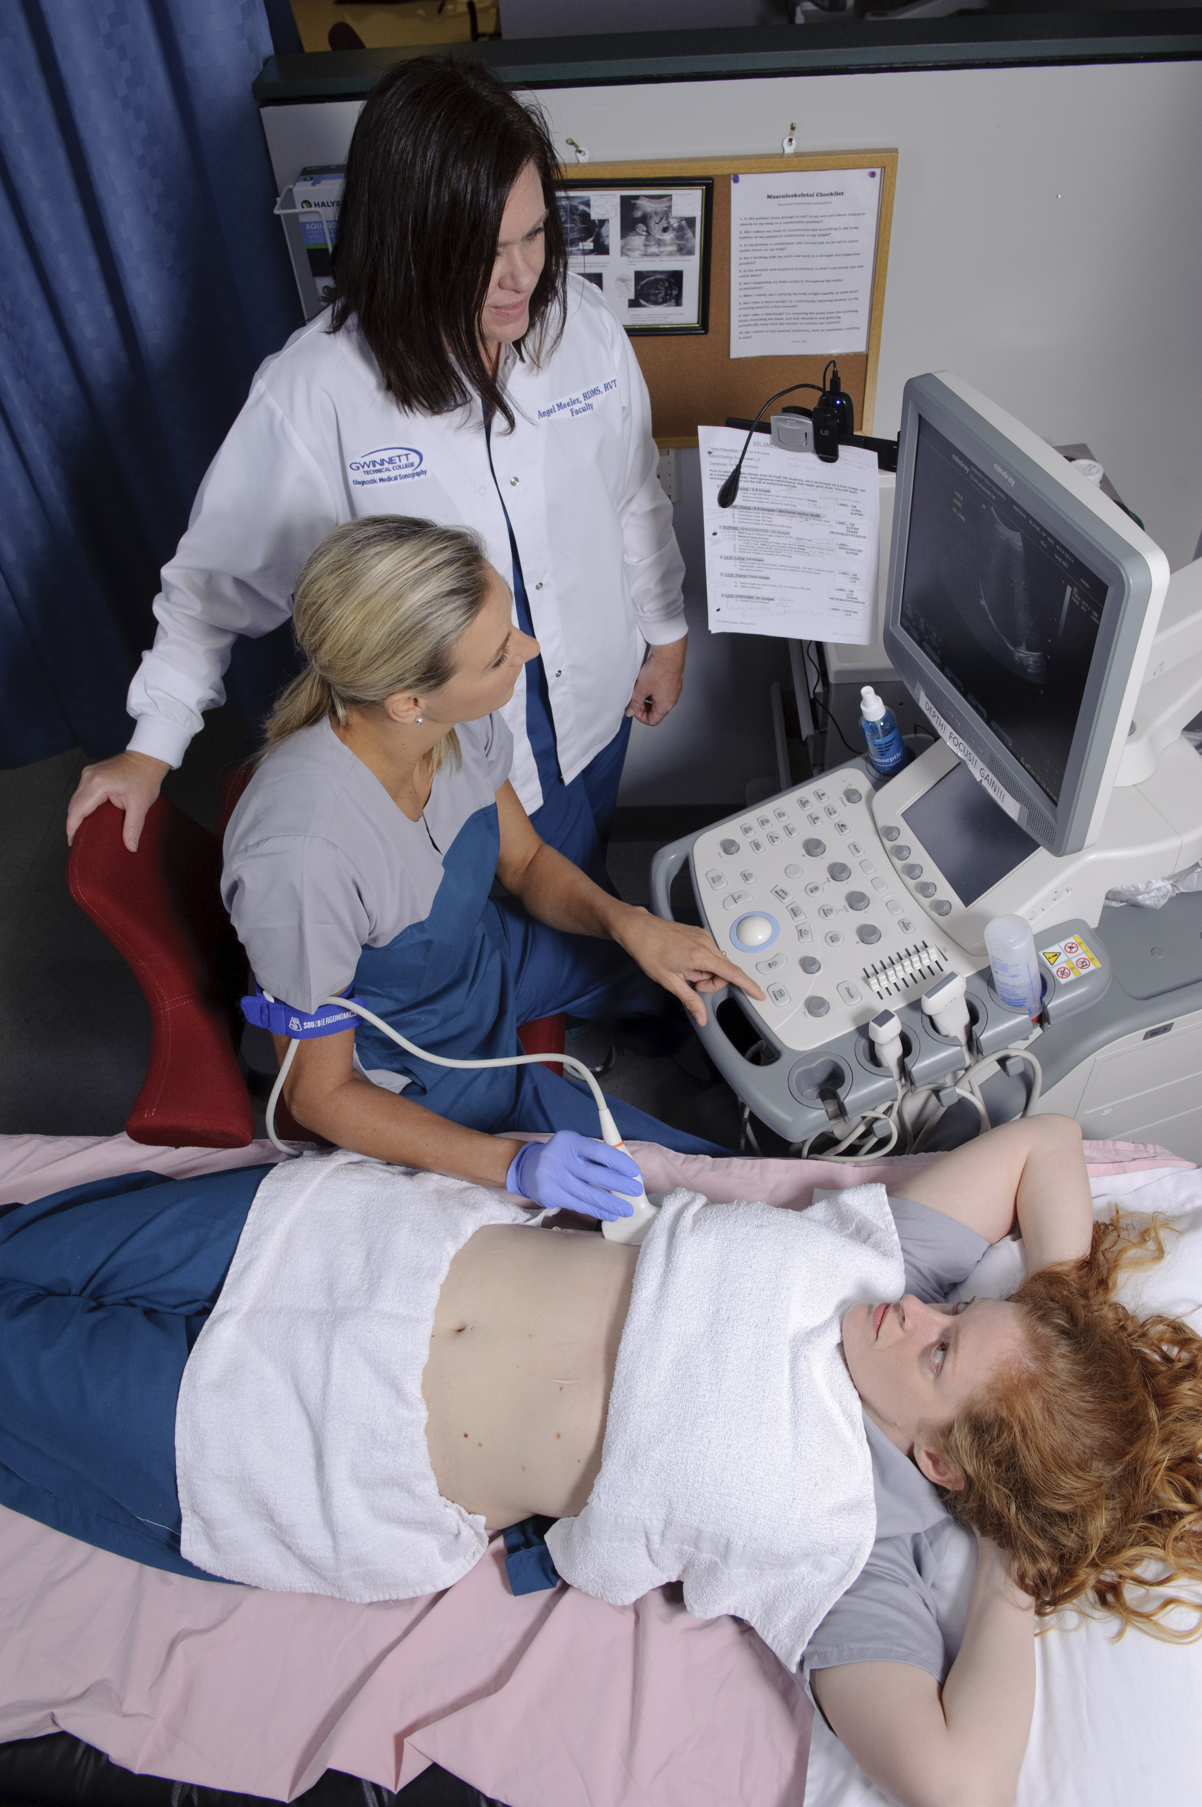
Workforce Development is an interconnected set of solutions to meet local employment needs.
Notes:
The Workforce Solutions Group at ARC works with a variety of partners to deliver comprehensive workforce development services to our two primary customers:
Job Seekers
Business
Our focus is on developing talent, providing supportive services, and connecting potential workers to business with employment vacancies.

Slide 2
Job Seeker Customer Visits Are Down
Notes:
As we have come out of the recession and are approaching full employment, our focus has shifted from assisting recently laid-off workers to develop new skills and find jobs, to assisting businesses to fill their vacancies
As you can see, overall visits to our career resource centers have been trending down over the last five years:
about a 41% decrease
This corresponds to a downward trend in the unemployment rate during the same timeframe from 8.7% to 4.7%
Not surprisingly, the biggest change in our job seeking customers is with dislocated workers – those people who lost their job in the previous 6 months
Our full program enrollment numbers are also decreasing, but at a slower rate
from 2,654 to 2,083 participants annually
about a 22% decrease

Slide 3
Over 60,000 Metro Job Postings
Notes:
Even though our unemployment rate is below 5%, there are still approximately 137,000 people in metro Atlanta considered unemployed (out of work and looking for jobs)
At the same time, over the last 90 days, there were over 60,000 unique job postings in metro Atlanta
By far, the most openings are for Registered Nurses and Truck Drivers;
these 2 account for almost 30% of the job openings
As a workforce board, our focus is shifting from assisting the recently laid-off, to working with long term unemployed
This also requires us to work more directly with local businesses to identify their needs, develop appropriate training programs, and connect them with job seekers

Slide 4
Workers Commute to Their Jobs
Notes:
Even with these efforts and over 100,000 job seekers, we are hearing from businesses that job vacancies are staying open longer and it is more difficult to find adequate candidates
In talking with both job seekers and businesses, we hear about a variety of barriers to employment
The most often cited barriers to employment per the job seeker
Child Care and Transportation
Often cited issues from employers for new workers:
Pass a drug test and show up to work on time
A common factor, of course, is a struggle for reliable transportation to the job site
This relates to many of the issues discussed earlier this morning about a housing-jobs balance, and is also evidenced by the shear volume of workers that commute outside of their home county to work
Weather by choice or necessity, most people do not live proximate to their workplace
Many workers, particularly lower income, are not able to live in areas of the region that may be closer to their jobs or other employment opportunities due to affordability issues.
This further emphasizes the interconnectedness of the many disciples that ARC covers.

Slide 5
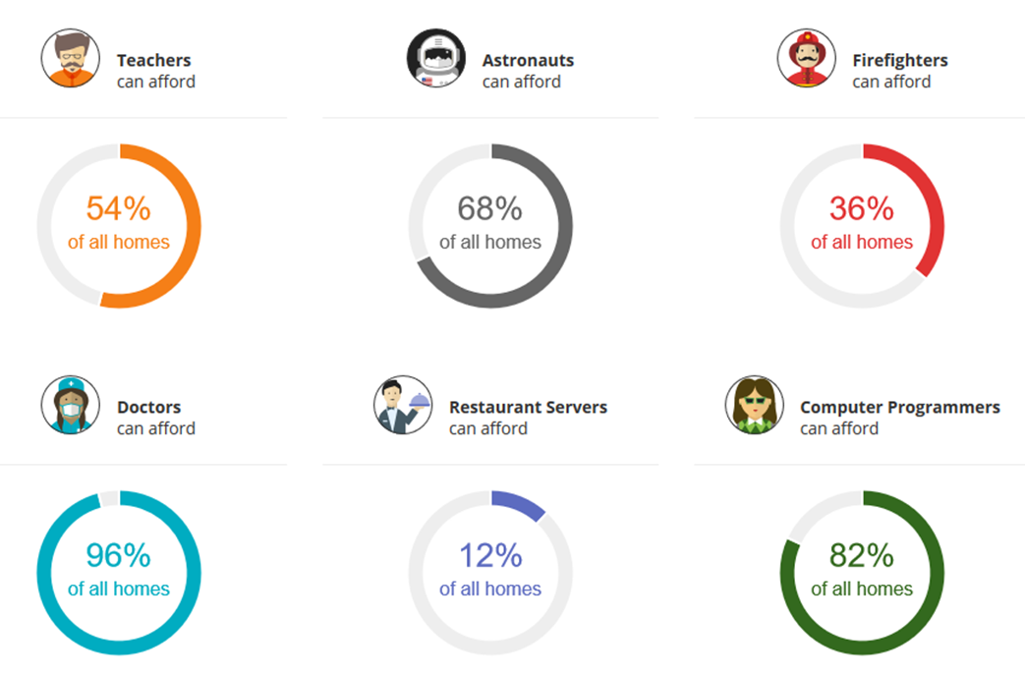
Percentage of Homes Affordable to Occupations
Source: Estately Inc.
Notes:
Many workers, particularly lower income, are not able to live in areas of the region that may be closer to their jobs or other employment opportunities due to affordability issues.
This further emphasizes the interconnectedness of the many disciples that ARC covers.

