Slide 1
2020 Census
New Construction Program
Atlanta Regional Office
Managing Census Operations in:
AL, FL, GA, LA, MS, NC, SC
Notes:
Good morning/afternoon, my name is (insert NAME), from the Census Bureau’s (insert Division or Regional Office). Thank you for the opportunity to speak with you today to promote the our 2020 Geographic Partnership Programs.

Slide 3
2020 New Construction Program
Non-Title 13.
Decennial program designed to capture new addresses for housing units that will be habitable on Census Day (April 1, 2020).
Address submissions will require either:
State/County/Tract/Block Geocodes or
Latitude/Longitude Coordinates
Available in Self-Response Type of Enumeration areas.
New addresses in non-Self-Response areas will be captured during field operations.

Slide 4
4

Slide 5
New Construction Program Schedule
Program Activity | Timeframe
April 2019 | Invitation Letters and Registration Forms Mailed to Highest Elected Officials (HEOs), Tribal Chairs (TCs), and Governors
June 14, 2019 | Registration Deadline
September 2019 | Registered Participants Receive/Download their Materials
September 2019 | New Construction Training Webinars begin
October 2019 | Participation E-mail Reminders sent
November 22, 2019 | Submission Deadline – NO EXTENSIONS!
December 2019 | Thank You/Closeout Notices sent to participating governments

Slide 6
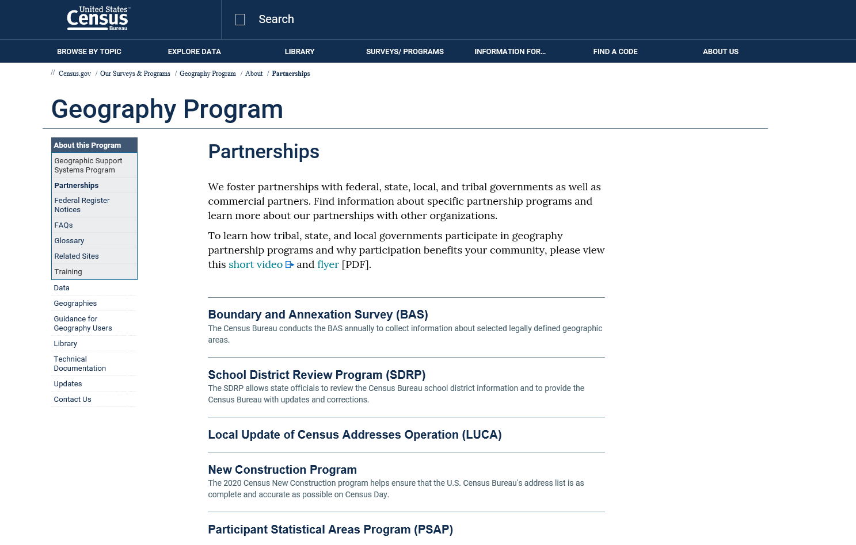
https://www.census.gov/programs-surveys/geography/about/partnerships.html
Visit Our Census Geographic Partnerships Page

Slide 7
Contact Us
Atlanta Regional Census Center Geography Department
(470) 889-6550
atlanta.rcc.geography@2020census.gov
Notes:
You have our business cards. However, these are the general numbers for our office.

