Slide 1
In My Backyard
Maintaining Public Trust When Implementing New Technologies and Infrastructure

Slide 2
Katina Lear
Assistant Director of Strategic Communications
Georgia Department of Transportation
Brandon Branham Assistant City Manager & Chief Technology Officer
City of Peachtree Corners
Emily Torres-Cullinane Director of Community Engagement
Boston Region Metropolitan Planning Organization
Jake Stine General Manager, Advanced, Complex & Emerging Wireless Solutions
AT&T
Dr. Malika Reed Wilkins Moderator Chief External Affairs Officer
Atlanta Regional Commission

Slide 3
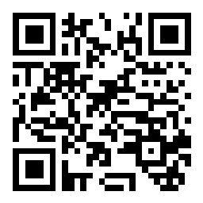
Ask Questions
Use Slido to Ask Questions
Scan the QR Code
Select Breakout Session 1C: In My Backyard
Type your questions
Or visit slido.com and type the code #6269254

Slide 4
Leveraging Integrated Communication and Outreach Strategies to Effectively Engage Audiences
Katina Lear
Assistant Director of Strategic Communications
Georgia Department of Transportation

Slide 5
Georgia Infrastructure By The Numbers
50,000+
Lane Miles of Interstates & State Routes
14,750
Total Bridges 6,730+ State Owned
#1
State for Business
8 Straight Years
10.62M
Total Population
316,849,253
Daily Vehicle Miles Traveled
123 Counties Served by Georgia Transit Systems
5
Notes:
Georgia DOT is responsible for planning, constructing, maintaining, and improving the state’s roads, bridges, and interstates, and works closely with local transit agencies, State Road and Tollway Authority (SRTA), municipalities, and other organizations to improve mobility across the state.
Our stakeholders and audiences are at the center of all we do. Whether we are promoting safe driving habits, alerting motorists of traffic impacts, coordinating with stakeholders, or encouraging public participation on one of our many programs/projects, its important that we communicate effectively to build relationships, and ultimately trust.

Slide 6
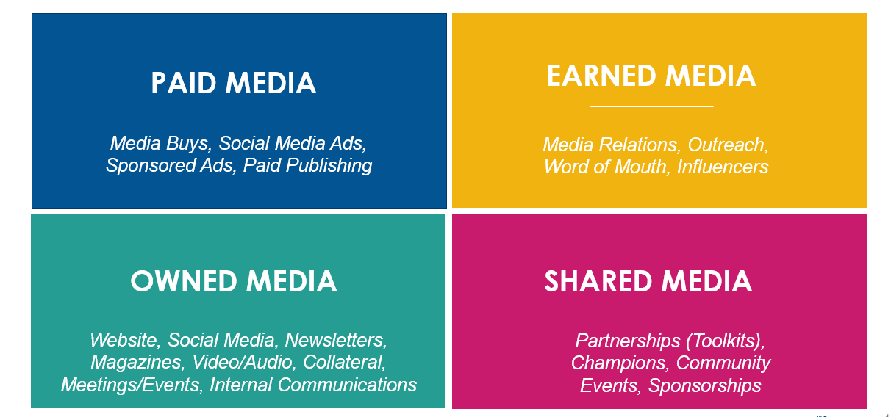
Integrated Communication & Outreach Strategies
6
Notes:
Integrated approaches to communications and outreach plays an integral role in communicating our brand, programs, and project-specific messages to our various audiences.
Some of you may be familiar with a PESO Media Model – if not, PESO stands for paid, earned, shared, and owned media. The communication and outreach tactics in each square are unique, but all related.
We evaluate the various approaches to engage with the public based on audience needs and interests. We don’t necessarily leverage all of these tactics at the same time, but these integrated communication and outreach efforts directly contribute to the success of our Department and help build our reputation, credibility, and trust among audience groups.
Leveraging integrated communications and outreach is essential and helps:
Garner greater visibility
Allows cohesive messaging across multiple channels
Saves time and is cost effective
And improves results
Tailoring communication strategies and tactics for your audience during the Public Involvement process can effectively reach and engage audiences “where they are” and garner greater public participation.

Slide 7
Increased Digital Presence & Reach
Virtual Meeting Rooms
Website Refresh
New TikTok Channel &
Utilize Paid Social Media
Virtual Presentations & Meetings
COMING SOON Podcast Series
7
Notes:
The pandemic also rapidly changed the way we conducted business, so the utilization of technology has become more vital than ever.
We greatly enhanced our digital Public Involvement engagement efforts with the implementation of virtual public meetings which offered custom web pages, interactive virtual meeting rooms, and/or virtual presentations and Q&A discussions with project staff. For many of our projects, we experienced greater public participation by offering virtual PI events.
We also have increased the distribution of information, leveraging digital communication channels: launching new Department website, managing more project web pages, and focusing more on paid and organic social media strategies to inform, connect, and engage with audiences.
Over the years we also increased the amount of video content as video performs best across digital platforms and it captures a viewer’s attention longer. As a result, we launched our TikTok channel this year which acts as an extension of our other social media channels but is solely video. This new communication channel for the Department continues to do well, capturing the attention of many of our existing audiences that have migrated to the new social platform and engaging with newer, younger audiences.
We also continue to look for innovative communication and outreach strategies so we can engage with our audiences in manners that best interest and resonate with them. For example, with the continued rise in popularity of podcasts, we are working towards launching a Podcast series by the end of the year.
How we meet people where they are (TikTok, maybe a mention of podcast)
Mention the Ray and how we work with them/communications-wise – development of new technologies in a real-world environment (Allie will likely be in the audience)
Mention of how we are promoting submission of the NEVI plan (media push, website, etc)
Maybe mention launch of new website
Podcast – Coming Soon

Slide 8
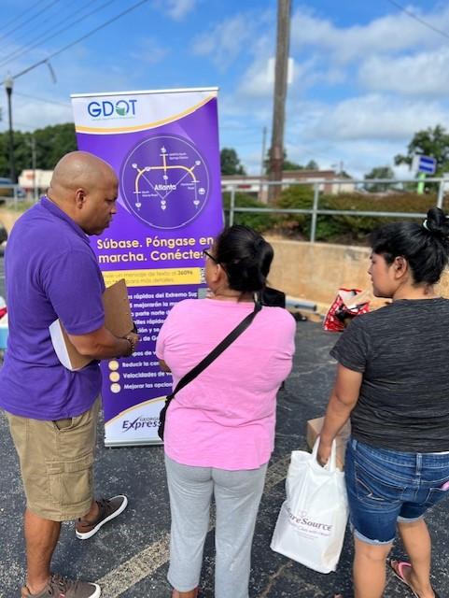
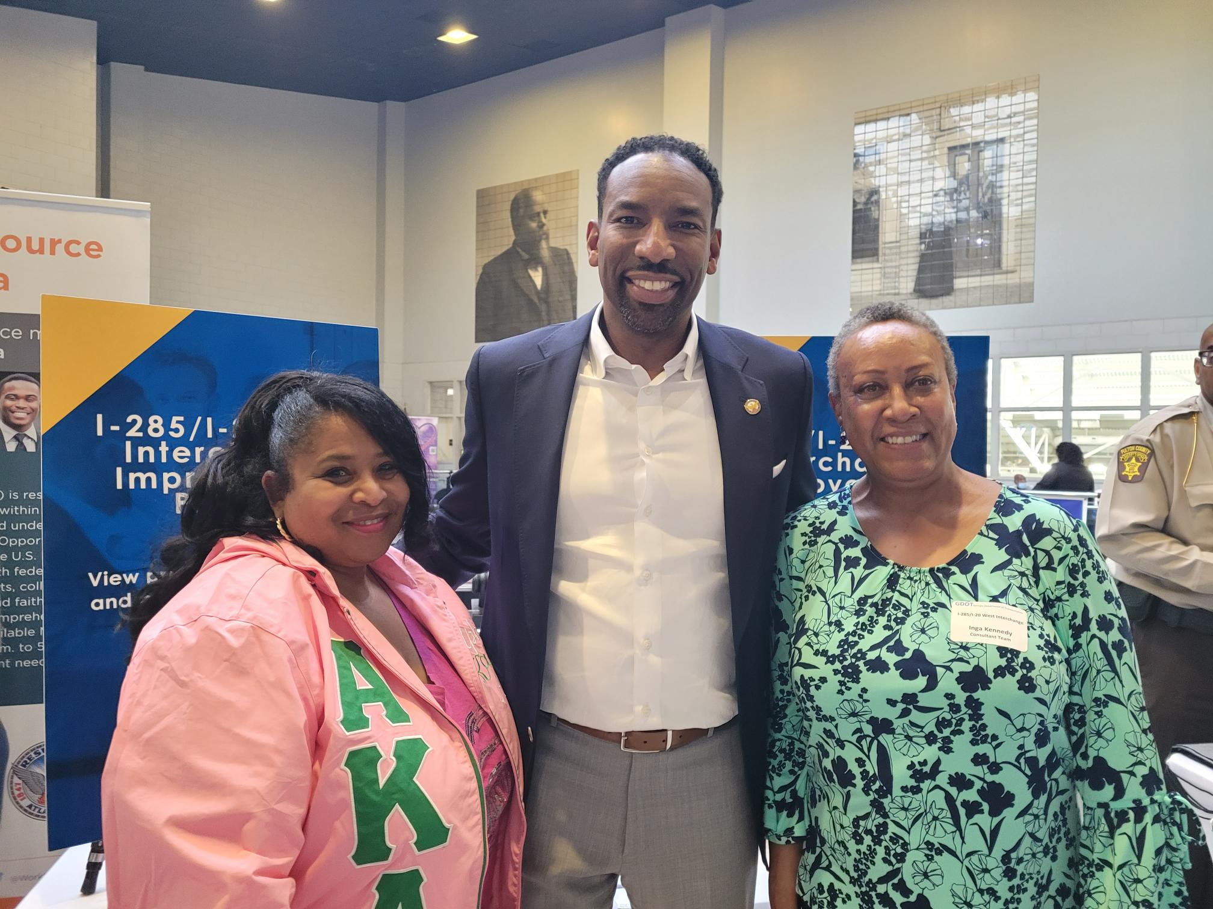
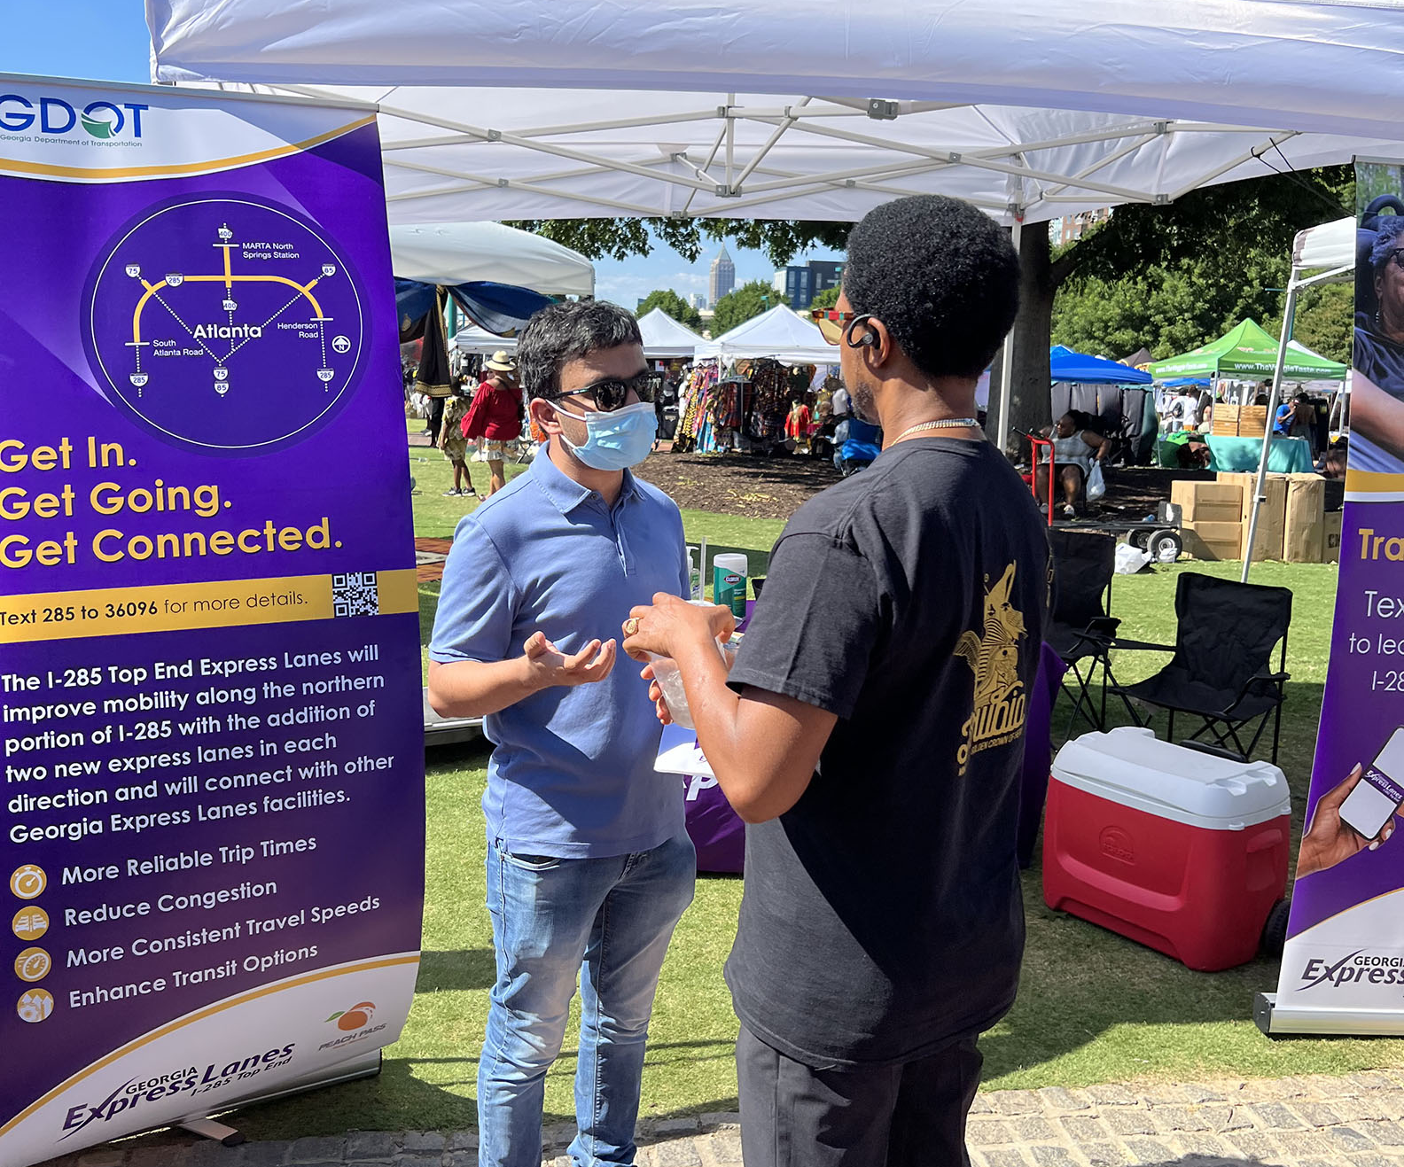
Engaging Environmental Justice Communities
There is not a one-size-fits all approach to EQUITY
Place a greater emphasis on PROACTIVE engagement with underserved communities
Utilize more INTEGRATED communication and outreach tactics for engagement
8
Notes:
It’s critical that we take on an integrated approach to reaching ALL of our communities. Many of our projects include diverse groups of individuals within the community and there is NOT a one size fits all approach to equity.
Environmental Justice is the fair treatment and meaningful involvement of all people regardless of race, color, natural origin, or income, and avoiding disproportionate adverse impacts on affected minority and/or low-income populations. Justice40 is seeking to address inequities that disproportionately harm low-income and underserved communities across America. Justice40 expectations are evolving from federal government (top down), but also at a community level as their expectations are also changing.
We are no longer solely focused on just “receiving input” – We must take a more proactive approach to engaging underserved communities, leveraging a more expansive, inclusive approach to Environmental Justice community outreach and engagement.
At Georgia DOT, we are working to reevaluate and enhance our approach to public outreach with Environmental Justice communities, explore opportunities to enhance partnerships and build new ones by listening, allocating resources, understanding barriers, and supporting mitigation plans and benefit agreements.
We are committed to learning and continued collaboration with locals, community organizations, and residents.
The way we plan, design, and deliver transportation infrastructure is changing. It’s critical Georgia DOT stays current on federal and community expectations for engaging Environmental Justice communities.

Slide 9
Best Practices & Lessons Learned
RESEARCH, RESEARCH, RESEARCH
Research audience base prior to public involvement process and/or communication outreach strategies
Analyze and understand stakeholder and audiences’ motives and apply communication and outreach tactics that will be most influential, and how specific audience groups prefer to receive information
Continuous research is pivotal to ensure goals are being reached and allow adjustments to PI approach
Market research is key staying ahead of industry trends and best practices while continuing to adhere to federal, state, and local expectations
PLAN STRATEGICALLY
Develop strategies and tactics across multiple channels that ensure successful engagement and participation to reach goals
Utilize multiple channels of communications to extend reach and amplify message
Tailor communication tactics to reach specific target audience groups
Monitor and measure communication and outreach efforts – test and try new approach tactics
9

Slide 10
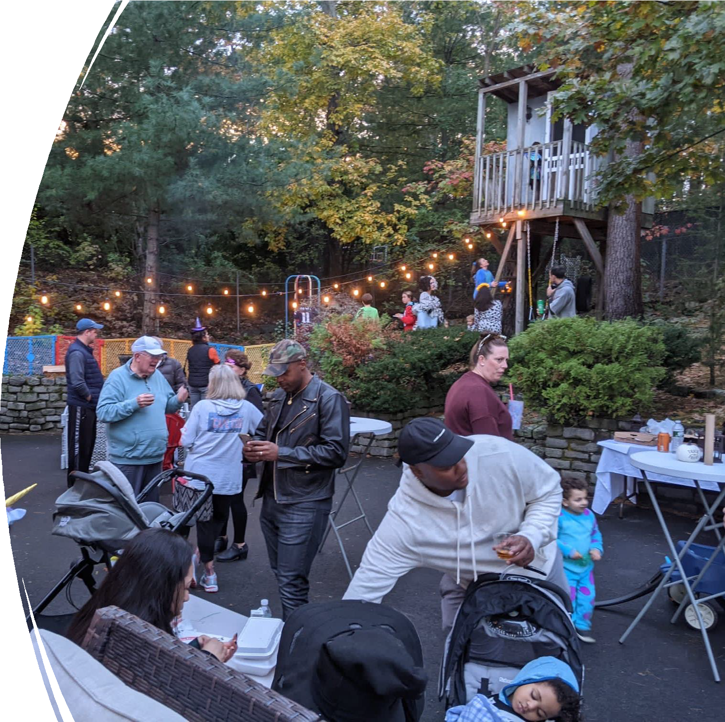
ConnectATL 2022 Summit
In My Backyard: Maintaining Public Trust When Implementing New Technologies & Infrastructure
Emily Torres-Cullinane
Director of Community Engagement Metropolitan Area Planning Council Tuesday August 23, 2022

Slide 11
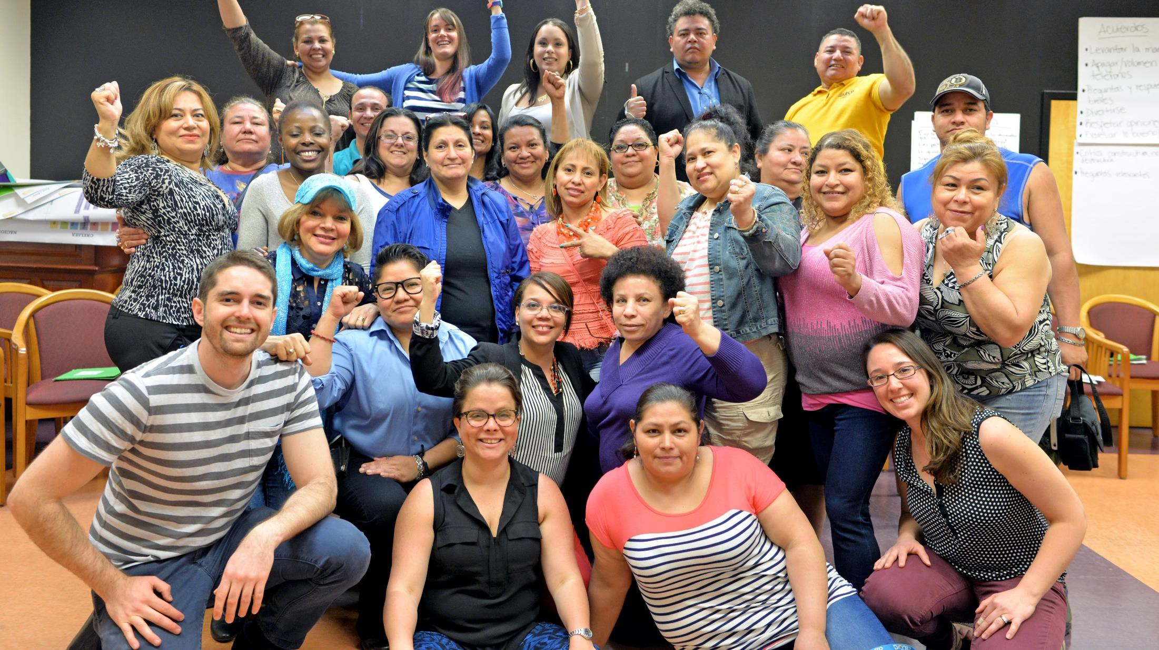

Slide 12
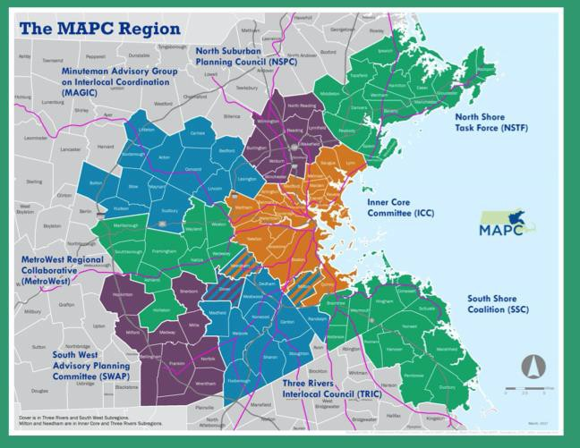
What is MAPC?
The Metropolitan Area Planning Council (MAPC) is the regional planning agency serving the people who live and work in the 101 cities and towns of the Metropolitan Boston region.
Our Mission: Our mission is to promote smart growth and regional collaboration.
Areas of Work: arts and culture, clean energy, climate, community engagement, land use planning, economic development, environment, housing, public health, public safety, transportation, public procurement

Slide 13
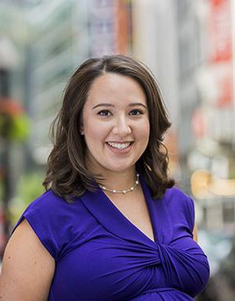
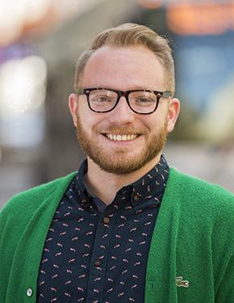
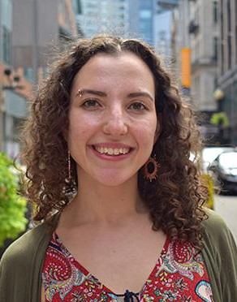
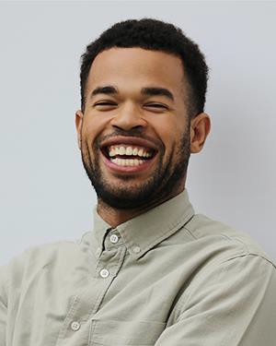
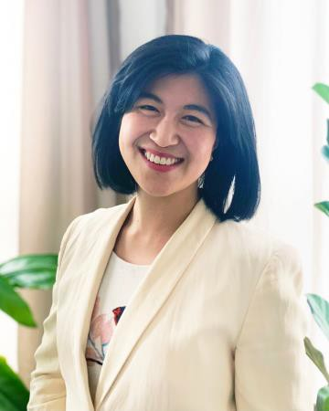
Community Engagement Department Staff
Emily Torres- Cullinane Director of Community Engagement
etorres@mapc.org
Christian Brandt,
AICP
Community
Engagement Manager cbrandt@mapc.org
Sasha Parodi Event Planner & Special Projects Specialist sparodi@mapc.org
Najee Nunnally
Gloria Huangpu
Community
Community
Engagement Specialist Engagement Specialist
nnunnally@mapc.org
ghuangpu@mapc.org

Slide 14
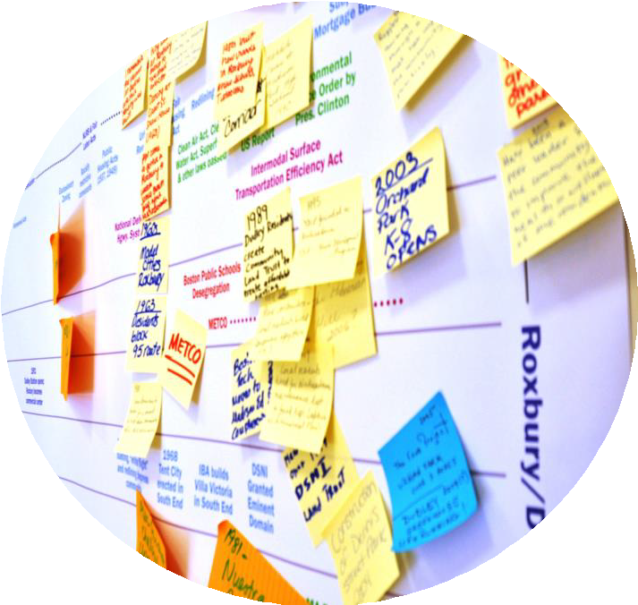
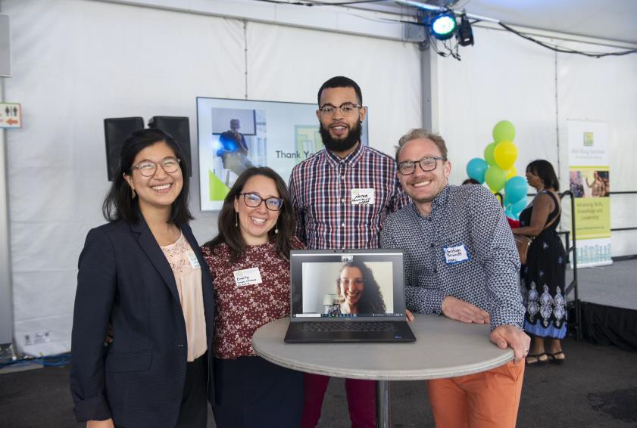
Department Values
Equity • Transparency • Stewardship • Accessibility
Resilience •Transformation • Accountability
Current Offerings & Projects
Technical Assistance to Municipalities & Partners
Community Engagement Strategy Development
Facilitation & Meeting Design: In-Person, Virtual & Hybrid
Partnership & Network Development
Workshops & Trainings
Digital Divide Research
Diversity, Equity & Inclusion Municipal Coalition

Slide 15
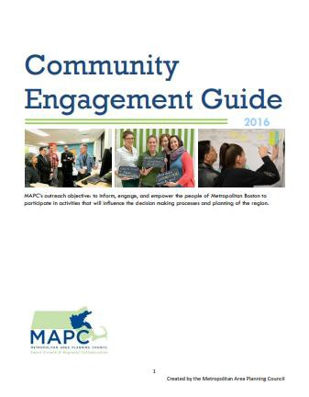
Community Engagement Model
5 Steps:
Purpose of Engagement
Stakeholder Analysis
Resources, Opportunities, and Scale
Messaging Strategy
Tactics and Approaches

Slide 16
Engagement & Technology: Lessons Learned
Reducing barriers to engagement should be top of mind when planning public outreach.
Equitable community engagement requires intentional partnership, two-way relationship building, transparency, and meaningful collaboration.
Training and investing in local
stakeholders strengthens local planning capacity, builds trust and civic infrastructure.
Overcommunication is key, sharing messages via different channels, and simplifying language.
Learn the technology – inside and out. Familiarize yourself with the tools, beta test them, identify worst case scenarios and prepare for solutions.

Slide 17
Virtual "Representative Town Meeting"
2020-2021
This Photo by Unknown author is licensed under CC BY-SA.

Slide 18
Navigating during the meeting
Minimize, Maximize, Close Window
Indicates who is sharing screen, can not change view
If you are having any technical issues, please contact:
1-781-493-4299
Interim Library Director, Amber
Use the chat, raise your hand, ask a question
Leave the meeting
Mute, adjust audio

Slide 19
Trusted guides who assist community members in internet adoption and the use of computing devices. Digital navigators help demystify technology by providing one-on-one ongoing assistance to connect residents to affordable internet, devices, technical skills, and application support.
Digital Navigators
Credit: National Digital Inclusion Alliance

Slide 20
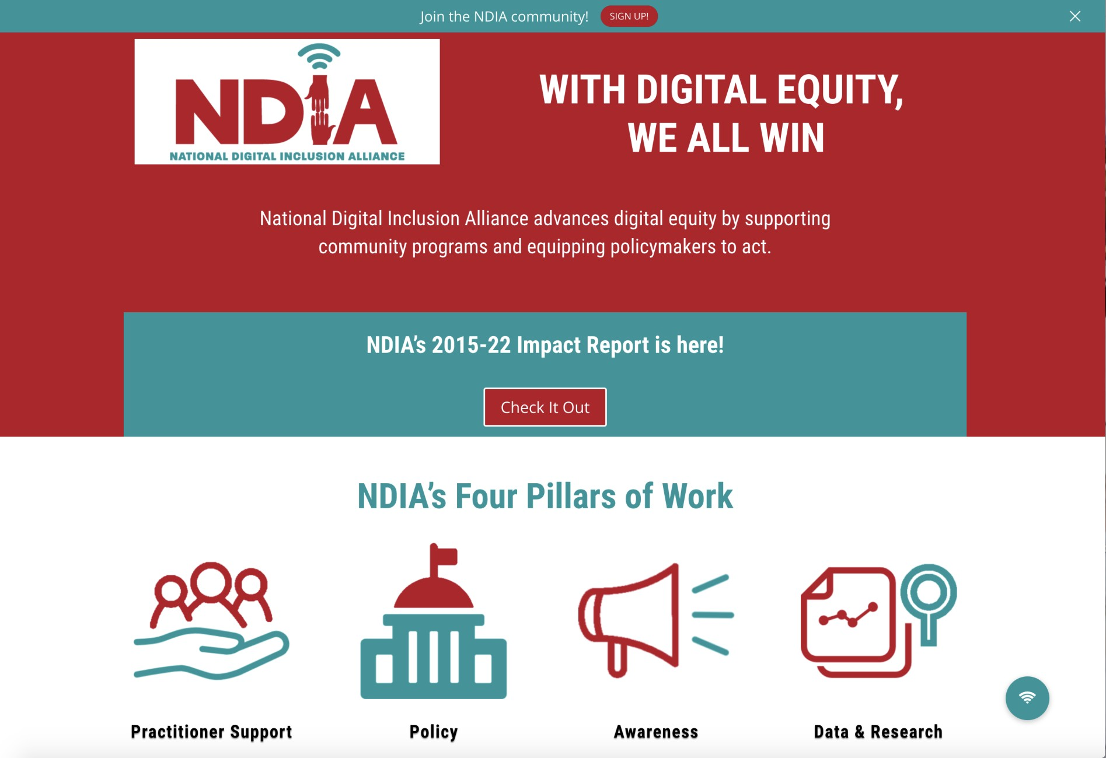

Slide 21
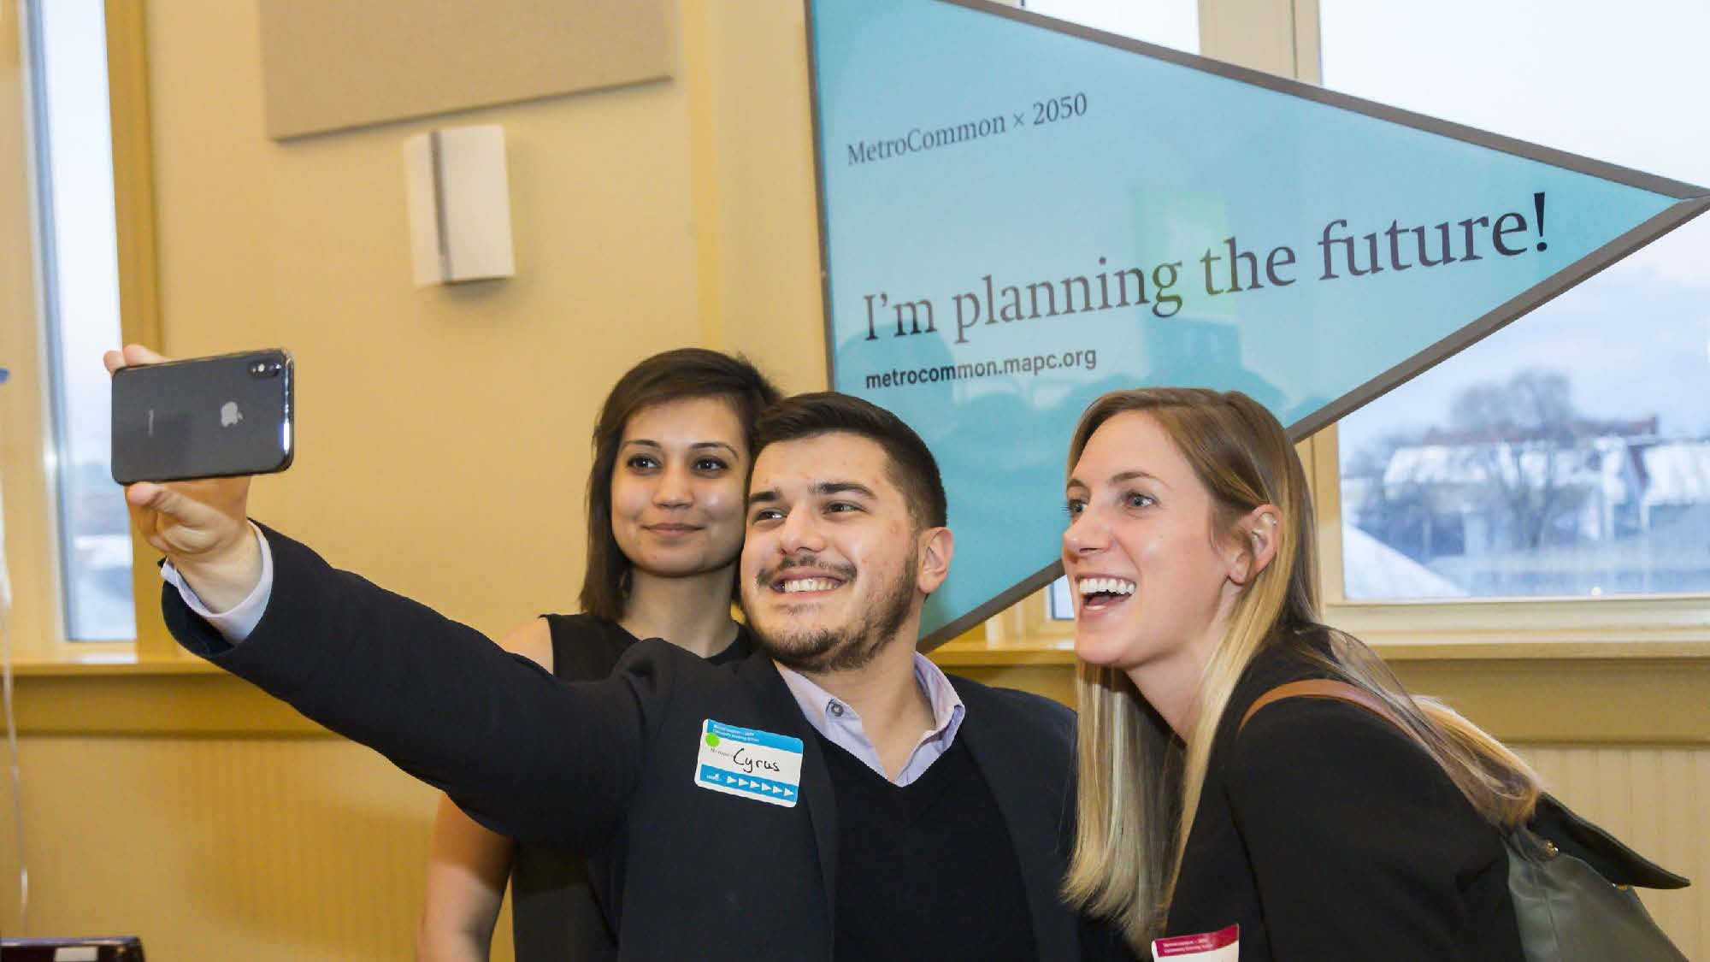
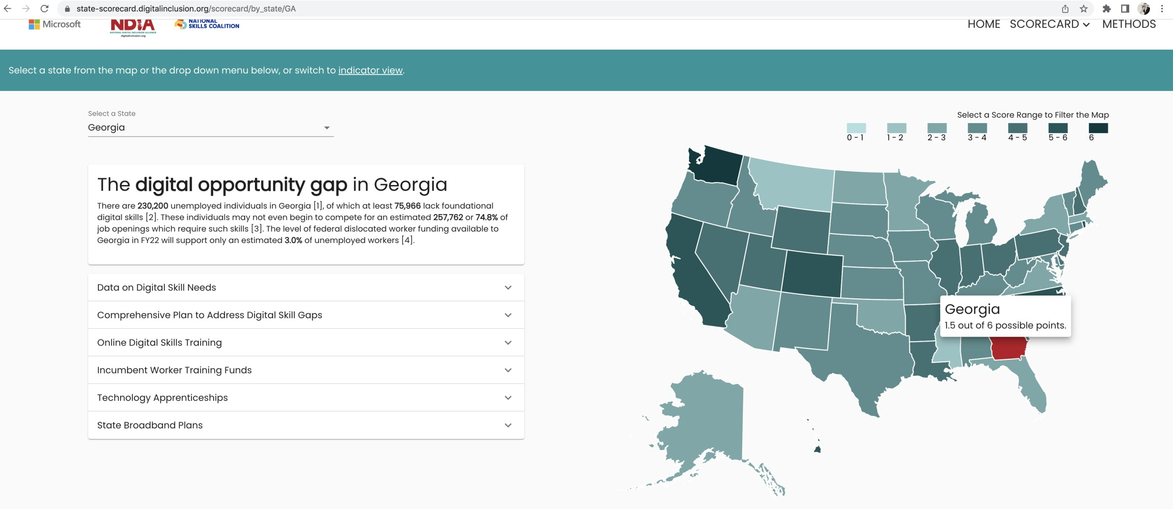

Slide 22
Thank you
Emily Torres-Cullinane
Director of Community Engagement Metropolitan Area Planning Council etorres@mapc.org

