Slide 1
TDM Coordinating Committee Meeting – October 22, 2019

Slide 2
Agenda
Welcome
Acceptance of August 26th, 2019 TDMCC Meeting Summary
Public Comment Period
Regional TDM Network
Administrative Items
Regional Commuter Survey
Biketober Modal Promotion
Announcements
Adjourn

Slide 3
What is TDM?
Transportation Demand Management (TDM) means the use of strategies to inform and encourage travelers to maximize the efficiency of a transportation system leading to improved mobility, reduced congestion, and lower vehicle emissions.

Slide 4
Benefits of TDM
Real Options for Commuters
Transportation Demand Management programs and policies aim to provide commuters with a mix of reliable and affordable transportation options. Supported with effective marketing and advanced technologies, commuters can make informed choices to meet each trips unique needs, while considering cost, time, and convenience.
Reduced Traffic Congestion
With even a small reduction in the number of single occupancy vehicles on our nation’s roads, commuters can see significant reductions in congestion. TDM supports the most efficient use of our existing infrastruc-ture by increasing per person throughput and allowing more people to use our infrastructure.

Slide 5
Benefits of TDM
Improved Public Health and Safety
With reduced reliance on personal vehicles, our communities will see cleaner air leading to direct improve-ments in public health. TDM initiatives that support increased levels of walking and cycling also enhance overall quality of life; and more people on our streets and sidewalks will create safer neighborhoods.
Connecting People to Jobs & Supporting Economic Activity
With more commuting options and less traffic, people will have better and more reliable access to jobs. Busi-nesses will see increased productivity from employees who spend less time stuck in traffic; and products will move quicker to market.

Slide 6
Leading Metro Atlanta Into The Future

Slide 7
The Atlanta Region’s Plan
“governs and contributes to the work we do”

Slide 8
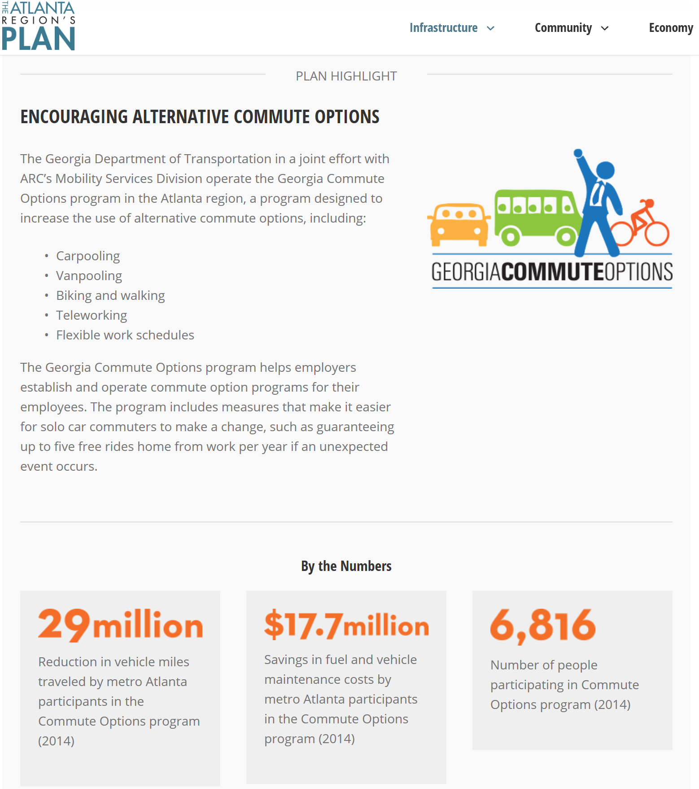
The Atlanta Region’s Plan and GCO

Slide 9
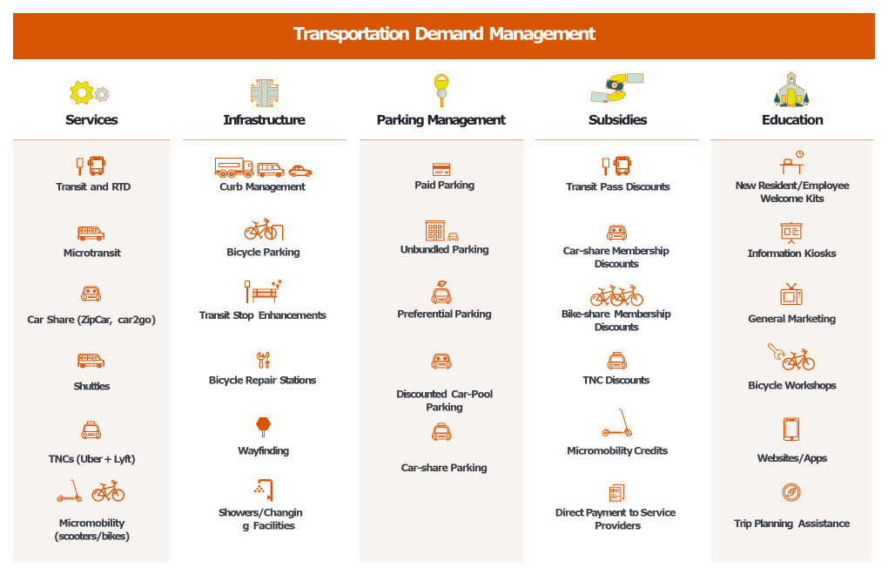

Slide 10
Regional TDM Program Framework

Slide 11
TDM Program Funding Flow
Federal Highway Administration
Georgia Department of Transportation
Atlanta Regional Commission
Transportation Management Associations
Georgia Commute Options

Slide 12
ARC Regional TDM Program

Slide 13
Georgia Commute Options 2019 Regional Commuter Survey
Casey Sloan, ARC

Slide 14
Agenda
Survey Objective
Survey Design
Survey Implementation
Survey Expansion
Preliminary Results

Slide 15
Survey Objectives
Conducted every 3-5 years through the regional Transportation Demand Management (TDM) program, currently Georgia Commute Options (GCO)
Understanding commute travel patterns of residents of the Atlanta Region
Employed, 18 years of age or older
Understand awareness about and usage of commute options programs and services
Understand incentives for and barriers to alternative mode use
Compare results to previous iterations of the RCS
2014, 2010, 2007

Slide 16
Survey Design
Address based Sample Approach
Sample addresses from 19 county region
Sampling plan done taking residence and workplace into account
Done in three waves
Pilot testing critical
Questionnaire design to be consistent with previous Regional Commuter Surveys
Updated to reflect newer modes like TNCs
Incentives vital
$250 Amazon Gift Card

Slide 17
Survey Implementation
Addresses purchased from M-S-G
Pilot done in 2018
10,000 postcards sent
Addresses sent out in two waves
Wave 1 in February 2019 – 150,000 postcards sent
Wave 2 – Outreach to people from 2017 NHTS add-on
Wave 3 in May 2019 – 150,000 postcards sent
Relied on ARC to increase public awareness about survey

Slide 18
Survey Implementation
 | Frequency | Percent of Total | Response Rate (Percent)
Pilot | 115 | 2.3 | 1.2
Wave 1 | 2,236 | 43.8 | 1.5
Wave 2 (Panel) | 130 | 2.5 | 11
Wave 3 | 2,619 | 51.4 | 1.7
Total | 5,100 | 100.0

Slide 19
Expansion to Regional Employee Population
Survey sampled by home county, but also “oversampled” some counties to collect minimum samples for destination/work location sub-areas
This disproportionate sampling required that the data be “expanded” to match the actual regional employee distribution by home county
Core Counties - Clayton, Cobb, DeKalb, Fulton, Gwinnett
Other County groupings - NE (Barrow, Forsyth), NW (Cherokee, Paulding, Bartow), SE (Henry, Walton, Newton, Rockdale, Spalding), SW (Coweta, Douglas, Fayette, Carroll)
The data also were adjusted to match regional race and age distributions
Race – Non-Hispanic White, African-American, Hispanic/Latino, All Other Races
Age - 18 to 34, 35 to 44, 45 to 54, 55 or more
Expansion applied 2013–2017 Census/ACS Data* for region/race/age combinations
All results shows in presentation reflect the expanded/adjusted data, so accurately represent the regional employee population
Census/American Community Survey (ACS) Tables B23002 and C23002 – Employment status by sex, age, and race

Slide 20
Survey Samples and Total Regional Employees
 | 2019 RCS | 2014 RCS
Respondents (sample) | 5,100 | 4,814
Regional employees 18+ | 2.95 M | 2.94 M
Confidence level | 95% + 1.37% | 95% + 1.37%

Slide 21
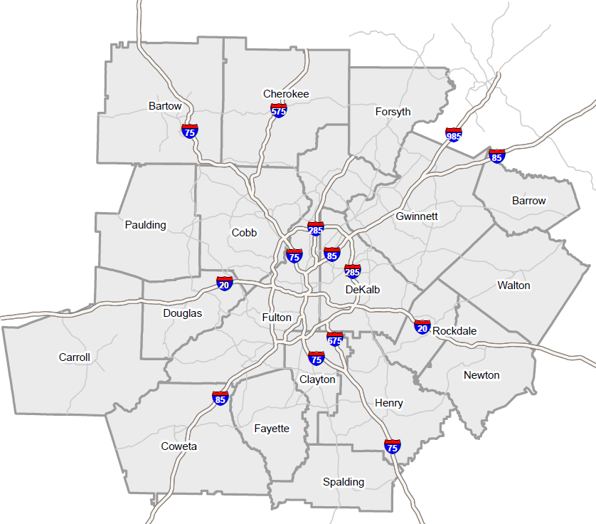
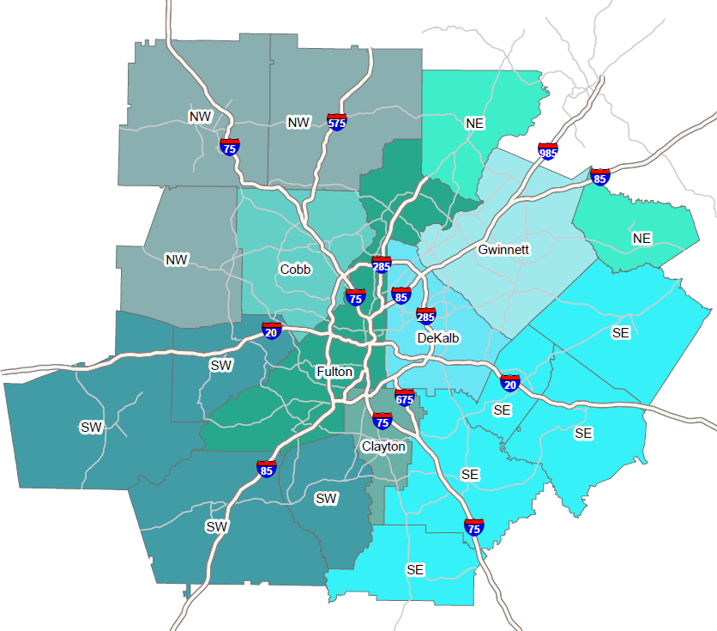
Residence Counties

Slide 22
Origin Counties
(n = 5,100)

Slide 23
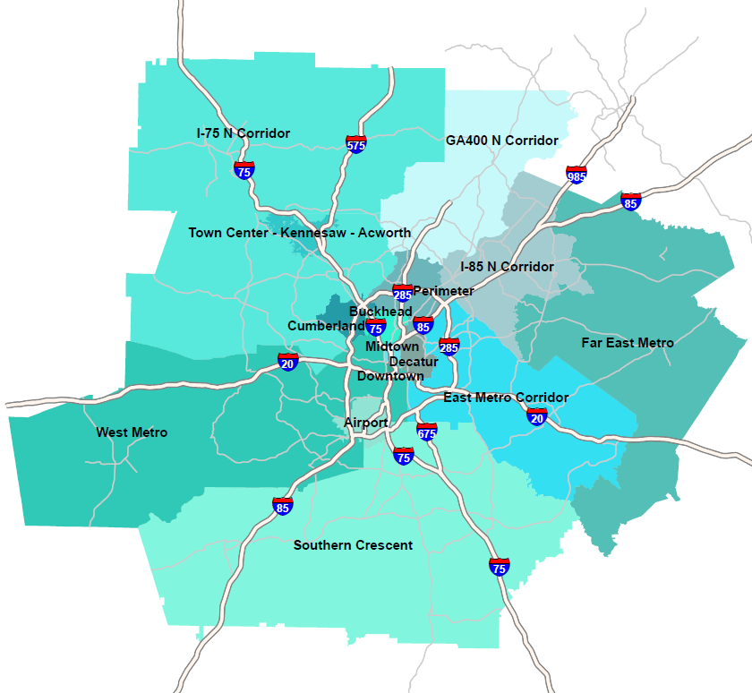
Major Destinations

Slide 24
Destinations
(n = 5,100)

Slide 25
Commute Flows
Origin | Airport | Buckhead | Cumberland | Decatur | Downtown | East Metro Corridor | I-75 North Corridor | I-85 North Corridor | Midtown | North Fulton / 400 Corridor | Perimeter | Southern Crescent
Clayton | 18% | 3% | 4% | 2% | 10% | 4% | 2% | 5% | 5% | 2% | 4% | 42%
Cobb | 3% | 7% | 24% | 3% | 12% | 4% | 18% | 3% | 11% | 4% | 10% | 0%
DeKalb | 4% | 7% | 4% | 14% | 10% | 22% | 0% | 7% | 10% | 6% | 12% | 3%
Fulton | 8% | 11% | 6% | 6% | 13% | 5% | 2% | 4% | 19% | 14% | 10% | 3%
Gwinnett | 1% | 5% | 2% | 5% | 5% | 10% | 0% | 49% | 6% | 8% | 8% | 1%
NE | 0% | 3% | 3% | 3% | 6% | 4% | 2% | 27% | 2% | 39% | 10% | 0%
NW | 3% | 5% | 12% | 1% | 6% | 1% | 40% | 2% | 4% | 18% | 8% | 0%
SE | 11% | 2% | 2% | 5% | 11% | 19% | 1% | 11% | 6% | 2% | 2% | 29%
SW | 14% | 4% | 10% | 3% | 8% | 2% | 4% | 2% | 10% | 1% | 5% | 36%

Slide 26
Travel Time to Work
(n = 5,100)
Average one-way commute (minutes)
2014 | 43
2019 | 38

Slide 27
Travel Distance to Work
(n = 5,100)
Average one-way commute (miles)
2014 | 23
2019 | 18

Slide 28
Social Media Use
2019 RCS
n = 5,100
2014 RCS
n = 4,814
Q90a Which of the following social networking applications do you currently have an account with?
Notes:
88% of Respondents Had an Account With at Least One Social Networking App: Facebook (74%), Linkedin (54%), Instagram (48%)
Use of all apps increased notably since 2014

Slide 29
Travel/Trip Information Application
n = 5,100
Q90b Which of the following types of travel or trip applications have you used?
Notes:
84% of Respondents Had Used at Least One Travel/Trip Info Application: Wayfinding (71%), Ride-hail (Uber/Lyft) (44%)

Slide 30
Commute Perceptions
2019
n = 4,735
2014
n = 983
Q45 – Would you say your commute is easier, more difficult, or about the same now as it was one year ago?
Notes:
In 2019, 33% of Commuters Reported a More Difficult Commute than a Year Ago – Higher than the 24% Who Reported More Difficulty in 2014
More difficult commutes were related to: more congestion (80%), slower trip (68%),more stressful (40%), construction along route (36%), longer distance (21%).
Easier commutes were related to: faster trip (50%), shorter distance (47%), less congestion (42%), less stressful (30%), using Express Lane (9%), started using alt mode (15%).

Slide 31
Primary Alternative Modes

Slide 32
Primary Alternative Modes

Slide 33
Duration of Alternative Mode Use (Primary Mode)
Bus n = 256
Train n = 285
Carpool n = 179
Bike/walk n = 150
Q30 How long have you been using <type of transportation> to get to work?

Slide 34
Telework Frequency
42% telework – even if only occasionally
36% increase from 2014, 66% increase from 2010, and 83% increase from 2007
Of these, 11% telework full time
Telework Days | 2019 | 2014 | 2010 | 2007
Less than one time per month | 17% | 13% | 13% | 15%
1-3 times per month | 28% | 23% | 29% | 24%
1-2 days per week | 33% | 26% | 30% | 37%
3-4 days per week | 10% | 11% | 9% | 14%
5 or more days per week | 11% | 26% | 17% | 10%

Slide 35
Formal and Informal Telework Programs
Teleworkers
n = 2,170
Non-teleworkers
n = 2,795
Q10 Does your employer have a formal teleworking program at your workplace or do you telework under an informal arrangement between you and your supervisor? (asked of teleworkers)
Q15 Does your employer have a formal teleworking program at your workplace or permit employees to telework under an informal arrangement with the supervisor? (asked of non-teleworkers)

Slide 36
Employer Offered Commute Options
2019 RCS
n = 4,719
2014 RCS
n = 3,393
Q83 Shown below are some other services or benefits that your employer might make available to help you with your commute. For each service, please indicate if: it is available and you have used it, it is available and you have not used it, it is NOT available
Notes:
57 % of Respondents Said their Employers Offered Commute Services in 2019. Telework and Alt Work Schedules Were Most Widely Available.
About 15% of workers said their employers offered transit subsidies, transit information, and information on other travel options. Services available in 2019 largely mirrored those in 2014, with small percentage changes for some services

Slide 37
Societal Benefits of Alternative Modes
Other 2019 Benefits
Quality of life - 3%
Shorter commutes – 3%
Reduce greenhouse gas – 2%
Reduce road wear – 2%
2019
n = 5,100
Q52. What impact or benefit does a community or region receive when people use these types of transportation?
Notes:
60% of Respondents Cited Societal Benefits from Commuters Use of Alternative Modes

Slide 38
Personal Benefits of Alternative Modes
Alt mode commuters
n = 767
Q53 You said you (bicycle, walk, carpool, vanpool, ride public transportation) to work some days. What benefits have you personally received from traveling to work this way?
Notes:
95% of Alternative Mode Users Mentioned a Personal Benefit from their Use of the Alt Mode One-third of alt mode users said they avoided stress and saved money by using alt modes. About two in ten benefitted by using time productively or getting exercise.

Slide 39
Influence of Different Benefits to Shift from Driving Alone
Services | Mean 2019 | Mean 2014
$5 a Day (was $3 per day in 2014) | 3.2 | 2.8
GRH | 3.1 | 3.1
$40-$60 Gas Cards | 3.0 | 3.1
Accumulate points redeemable for gift cards and merchandise | 2.7 | 2.4
Discounted transit pass | 2.6 | 2.2
Charity contribution | 2.2 | 2.6
System tracks your pollution reduced | 2.2 | 2.4
System that tracks financial savings | 2.2 | 2.2
$25 Prizes | 2.2 | 2.0
Public recognition | 1.5 | 1.5
2019 n = 3,920
2014 n = 710
Q44 How much would each of the following benefits influence you to try another type of transportation for your trip to work. (1 = no influence for you, 5 = great deal of influence)
Notes:
Incentives to Shift From Driving Alone to Alt Modes Appeared to Have Modest Influence for Most Respondents – No Service Was Rated Higher than 3.2 on a 5-point Scale (5 = great deal of influence)
Commuters rated $5 per day incentive, point program, and transit passes higher in 2019 than in 2014. Ratings for other services were generally similar in 2019 and 2014.

Slide 40
Awareness of Georgia Commute Options Program and Incentives
17% of respondents were aware of the Georgia Commute Options Program
A majority of respondents were not aware or didn’t know about the incentive programs
Of those aware, 62% never participated, 23% previously participated and 15% currently participating
Awareness of Incentive Programs | 2019
No, have not heard of any of these programs | 75%
Don’t know | 7%
Guaranteed Ride Home program (GRH) | 9%
$25 Prizes | 5%
$3 A Day | 4%
Gimme Five | 4%
$40-$60 Gas Cards | 3%

Slide 41
Prompted Awareness of Commute Options Programs
25%
of commuters who knew of GCO had used GCO services
Overall name awareness
n = 4,814
How learned about GCO
n = 779
Used GCO service
n = 727
Q60 Have you heard of a program in the Atlanta region called Georgia Commute Options or GCO?
Q67 How did you learn about Georgia Commute Options?
Notes:
When Asked a Prompted Question About Georgia Commute Options, 15% of Commuters Said They Heard of GCO, Lower than in 2014 (23%)
45% learned about GCO via the radio, but 26% said their source was “employer” and 17% heard from word of mouth. Digital media sources were more common in 2019 than in 2014.

Slide 42
Commute Ad Awareness/Messages Recalled
28% of respondents said they heard/saw commute ads in past year
61% who were aware of ads could name a specific message
General Commute
Top Ad Sources:
Radio – 48%
TV news – 31%
Social media 28%
Billboard – 21%
Website – 15%
Newspaper – 14%
Email – 11%
Employer poster – 9%
Employer Intranet – 9%
Pandora/Waze – 6%
Commute Services
Infrastructure Initiatives
Recall any ad/news report
n = 5,086
Recall specific messages
n = 1,335
55 Next, do you recall seeing or hearing any advertising or news reports in the Atlanta region in the past year about transportation services or information that could assist you with your travel to and from work?
55a Where did you hear or see the advertising or news report?
56 What did the advertising or news report say, or what messages do you recall?
Notes:
28% of Respondents Recalled Hearing/Seeing Commute Ads in the Past Year – Similar to 2014 (32%)
61% who were aware of ads could name a specific message

Slide 43
Action After Hearing/Seeing Ad
Tried/started alt mode for commute
n = 1,470
Q57 After seeing or hearing this ad or news report, did you take any of the following actions to try to change how you travel around the Atlanta area?
Notes:
25% of Respondents who Recalled Messages Took an Action to Try to Change their Commute – Nearly Twice the 2014 Rate (13%)
Most sought information, but more than one in ten tried or started using an alternative mode for their commute

Slide 44
2019 Atlanta Bike Challenge: Biketober Bennett Foster Joel Wascher

Slide 45
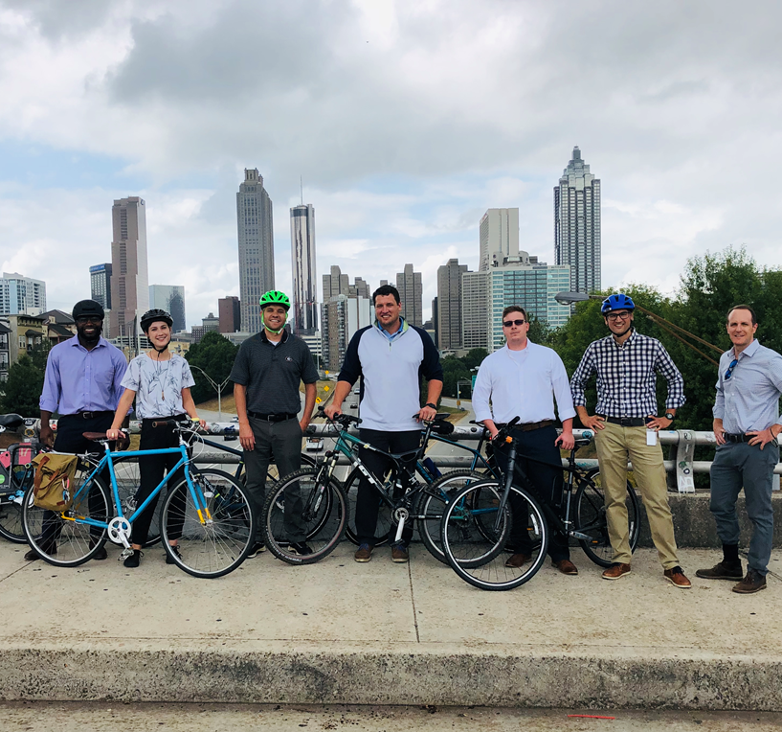

Slide 46
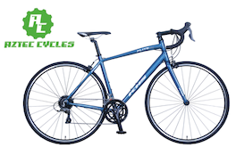
People I Partnerships I Planning
Make it fun, appealing, and engaging
Engage People
Recruit Partners
Source Prizes
Develop Message
Coordinate Paid Social
Targeted Emails
In-App Announcements
Promo Pack
(web and in-person)

Slide 47
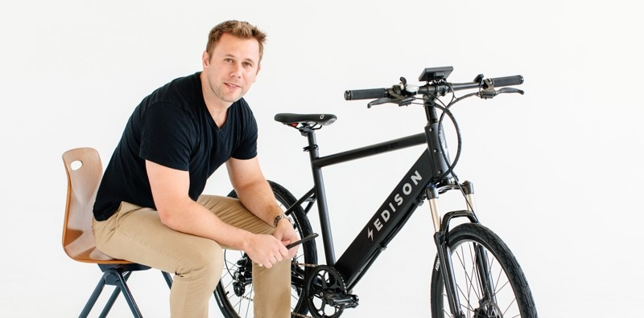
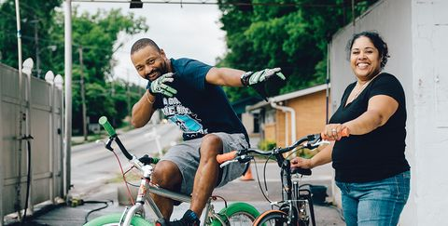
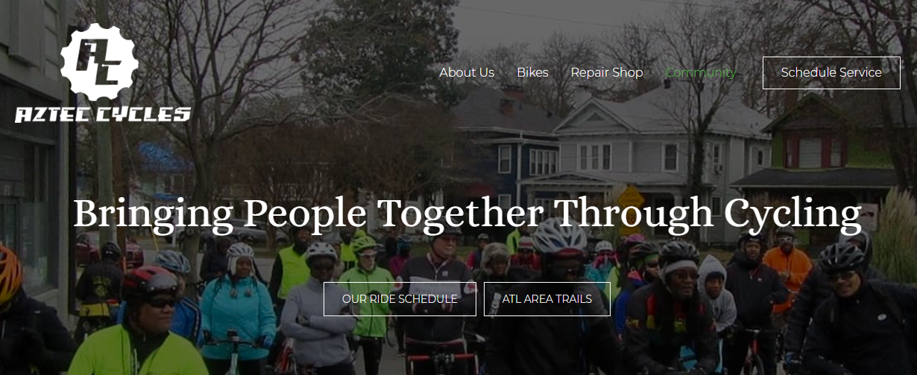
More than Prizes
Edison Electric Bike Co.
Bike 1: Early Bird Registration
Bike 2: Overall Challenge
Aztec Cycles
Bike 3: KHS Flite 280 for Overall
Why Edison and Aztec?
Local Businesses
Commuter- AND
Community-centric

Slide 48
Ad Targeting/Retargeting
Ad Objective: Website Traffic: Landing Page Views
Messaging: Sign up for Biketober and enter for a chance to win a bike
Ad Unit: Carousel Ad with
CTA to visit GCO website
Audience: GCO Custom Target &
Love to Ride saved audience
Timing: September 1-September 30
Biketober Sign Up Experience with
Facebook Ad Pixel
Users sign up for Biketober and opt in to enter the bike giveaway
Ad Objective: Website Traffic: Landing Page Views
Messaging: Remind registrants to log their Biketober miles
Ad Unit: Carousel Ad with
CTA to visit GCO website
Audience: Saved audience from Biketober registration page
Timing: October 1-October 31
User abandons sign up
Ad Objective: Website Traffic: Landing Page Views
Messaging: Complete your Biketober registration
Ad Unit: Carousel Ad with
CTA to visit GCO website
Audience: Saved audience of users who abandoned Biketober registration
Timing: September 8-September 30

Slide 49
Facebook Ad 1 – Registration
Ad Copy
#Biketober is back! Atlanta’s favorite challenge returns in October with prizes, events and friendly competition. Register today for a chance to win a free bike from Edison Bicycles.
Link: https://www.lovetoride.net/atlanta
Link description: Ready to Ride?
*Select “Sign-up” action button
Pending creative from LTR
Pending creative from LTR
Pending creative from LTR
Pending creative from LTR
Campaign Objective
Website Traffic: Landing Page Views
Flight
9/3-9/22

Slide 50
Whitelisted Posts
Partner Posts: from Atlanta Bike Coalition and Atlanta Streets Alive
Ad Copy
#Biketober is Back and we’ve partnered with @Georgia Commute Options for Atlanta’s favorite challenge. Start a team and get ready to participate in this friendly competition throughout October. Register today for a chance to win a free bike from Edison Bicycles.
Link: AtlBikechallenge.com

Slide 51
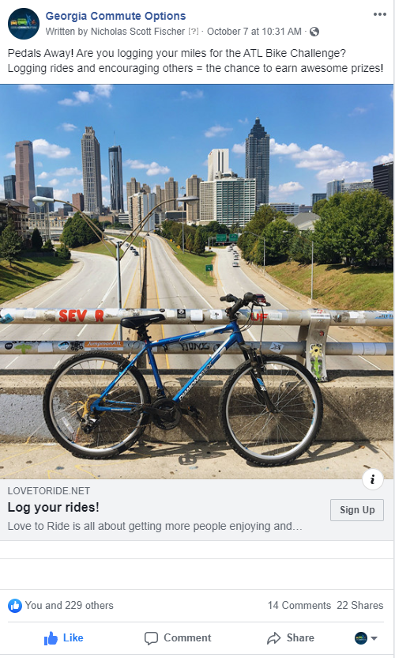
Paid Social Overview
Results:
Reach - 680,000
Impressions – 1.9M
Clicks – 17,149

Slide 52
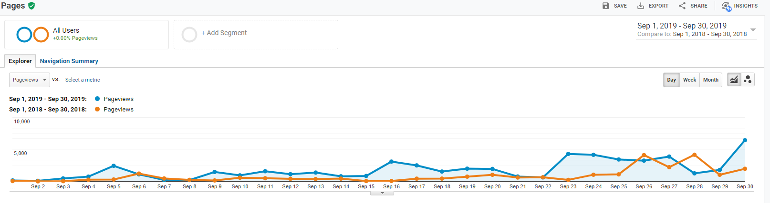
Pre Registration Results- on Bike Challenge Site
Users – 10,008 – Up 122% from 2018
Sessions – 15,602 – Up 130%
Pageviews – 54,632 – Up 118%
Look-Alike
Audience

Slide 53
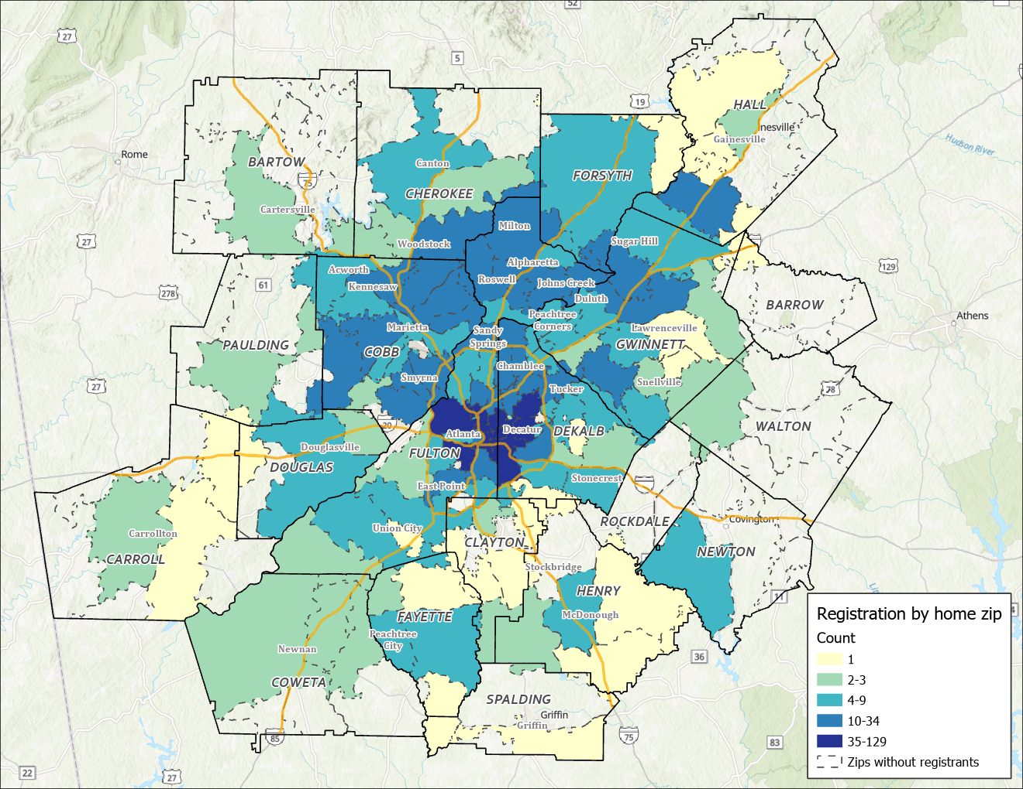
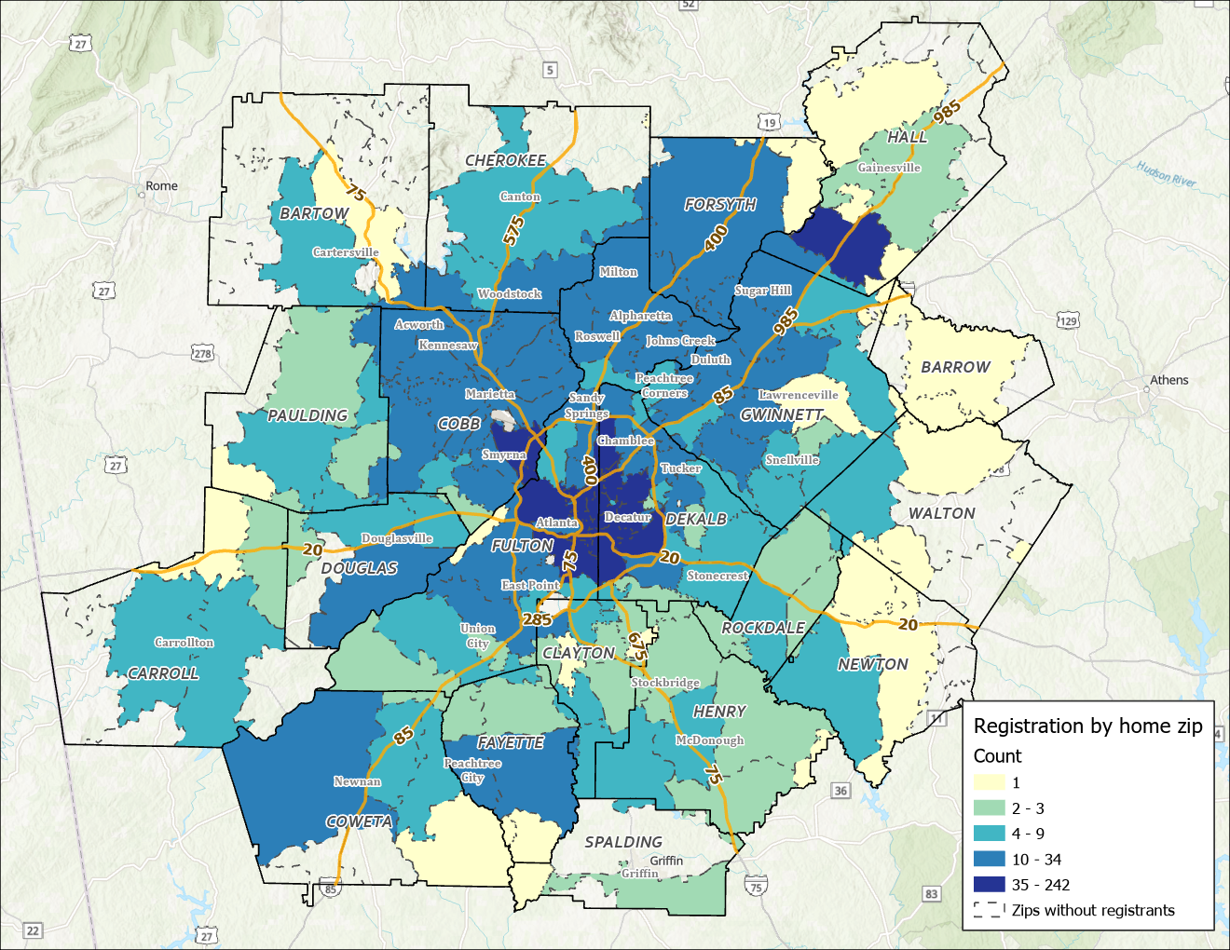
Registration
90% increase in registration since September 24 with notable increases around the metro region
September 24th
^{2,136 Registrants}
October 10th
^{4,066}

Slide 54
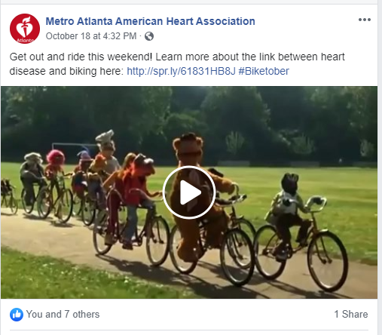
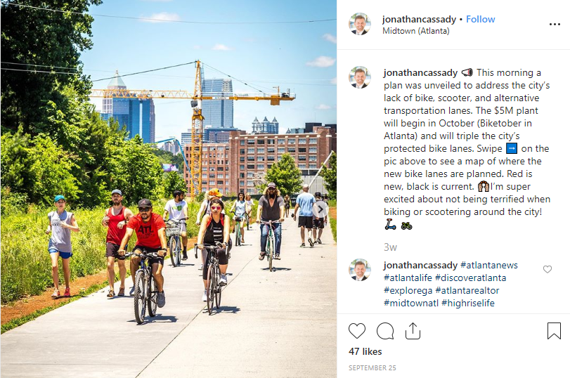
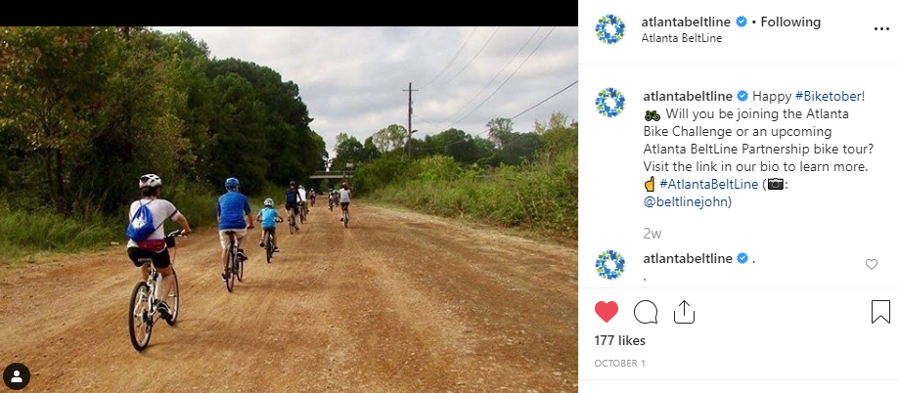
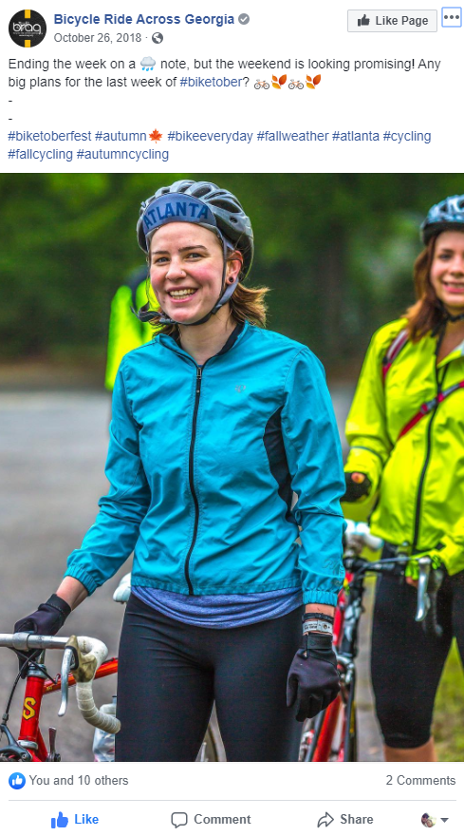
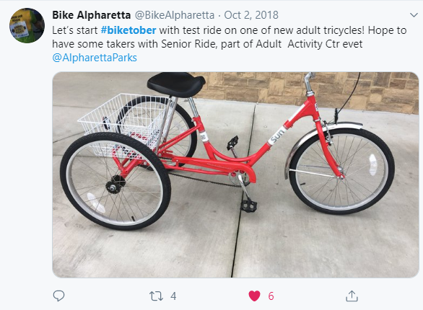
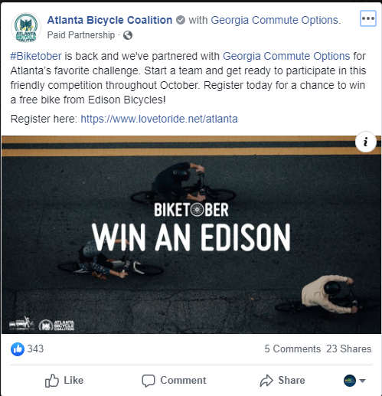
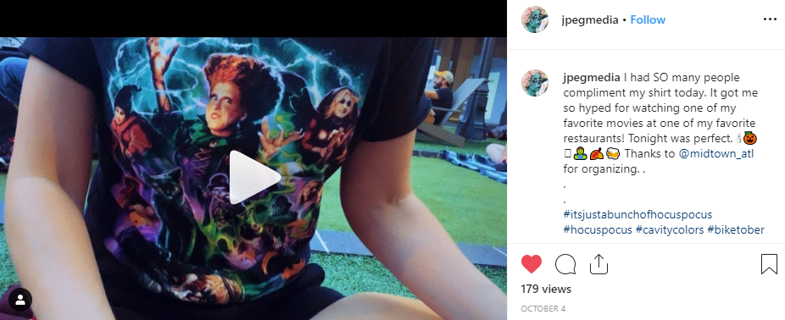
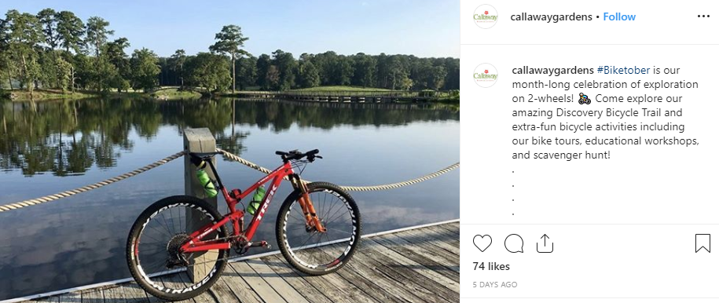
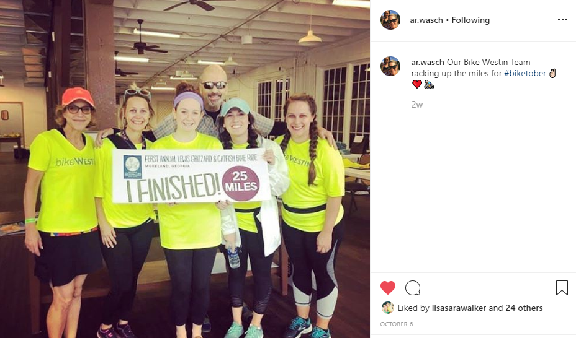
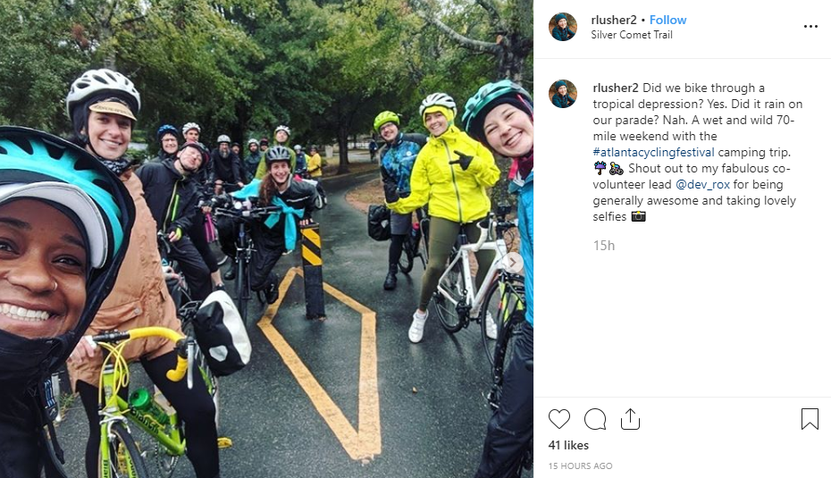
Organic Social Engagement

Slide 55
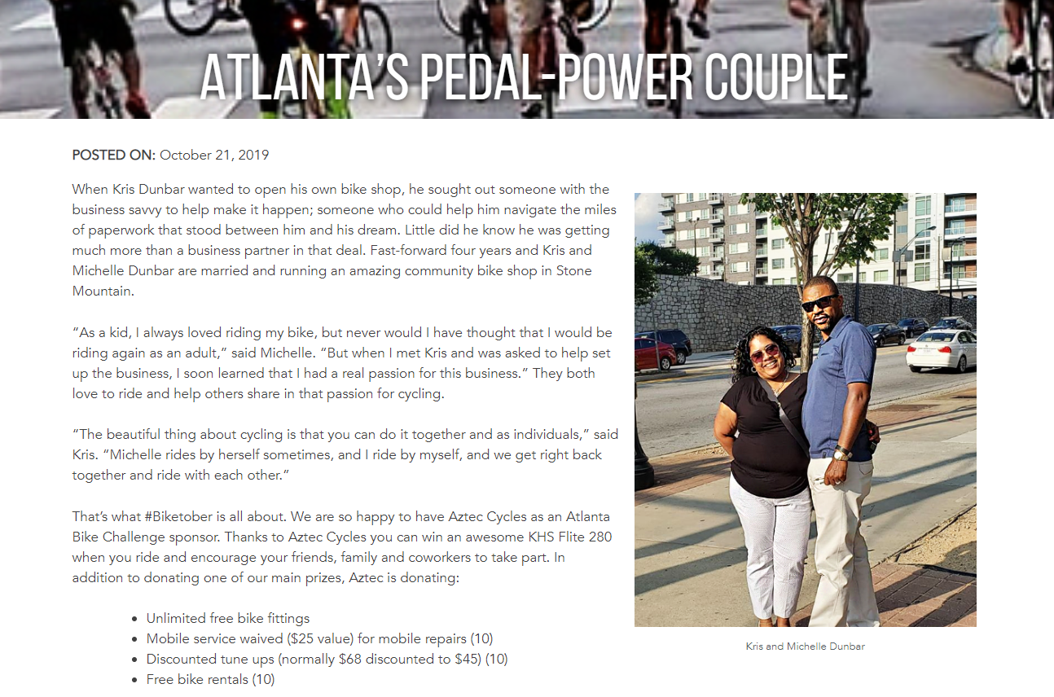
Engaging Content

Slide 56
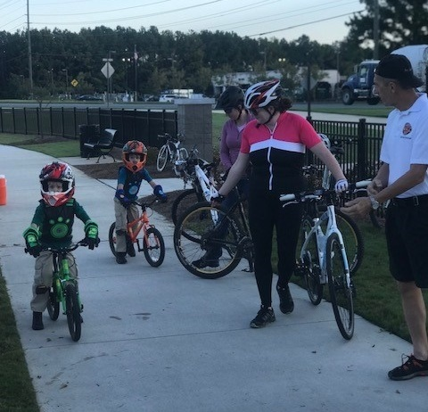
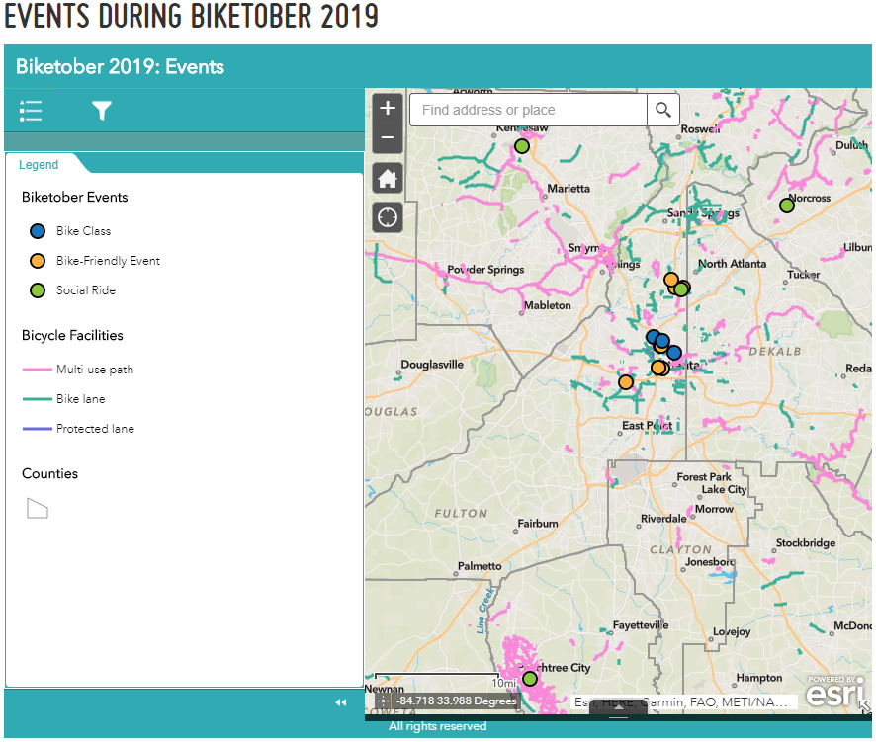
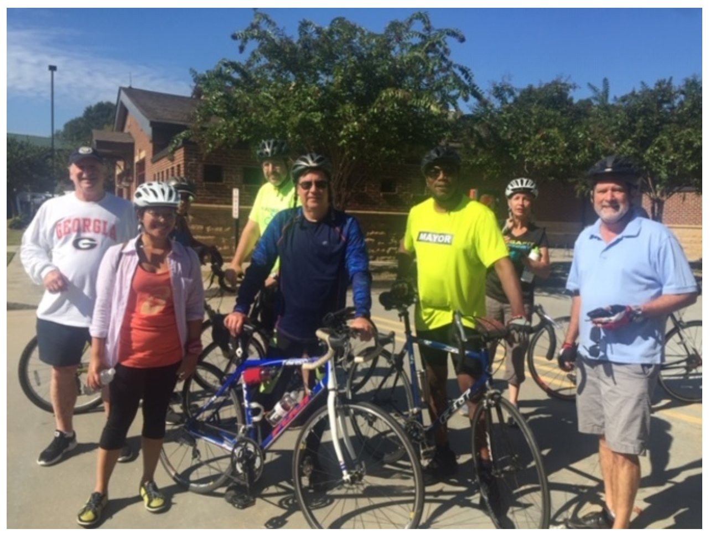
Participation and Encouragement
Event Page (External)
5 Bike Classes
7 Bike-Friendly Events
4 Social Rides
GCO Outreach Events (Internal)
23 Tabling Events
7 Company Benefit and Wellness Fairs
WHEELS UP BIKE RIDE WITH MAYOR EASTERLING
Biketober 2019 Event Page
PEDAL NORCROSS WITH MAYOR NEWTON

Slide 57
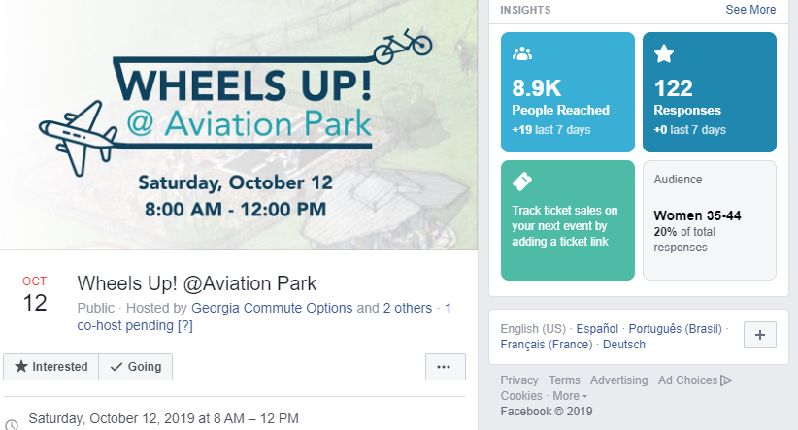
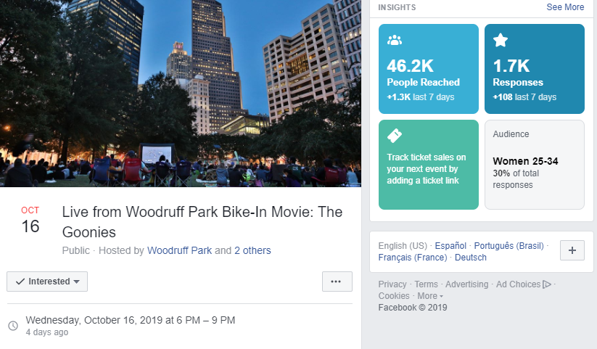
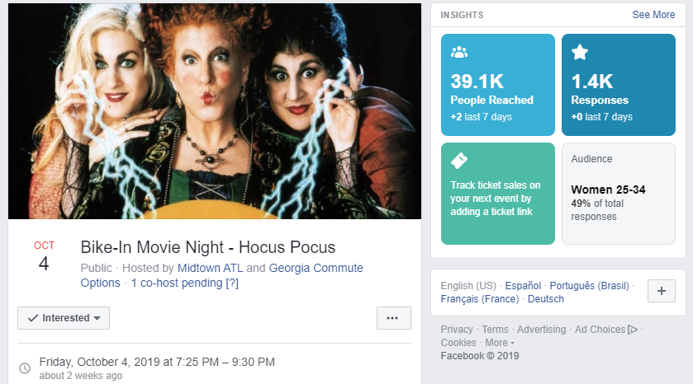
Partner Events and Engagement

Slide 58
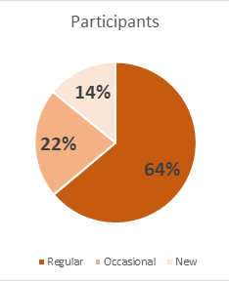
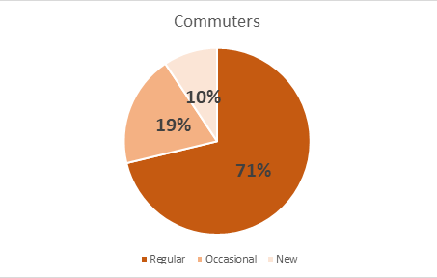
2018 Results
253 organizations
2,493 registrants
1,909 participants
325 new riders
260,573 miles logged
54% of new riders riding more often!
45% biking to work more often!
2019 Goals
300 organizations
2,700 registrants
2,000 participants
360 new riders
2019 as of October 10th
328 organizations
4,066 registrants
2,245 participants
315 new riders
TIMELINE
Kickoff with GCO and TMAs: August 26 → Outreach and Marketing Launch: September 1 – 30 → Challenge: October 1 – 31
December 1: Analysis and Evaluation: Baseline and 4-Week Post-Survey

Slide 59
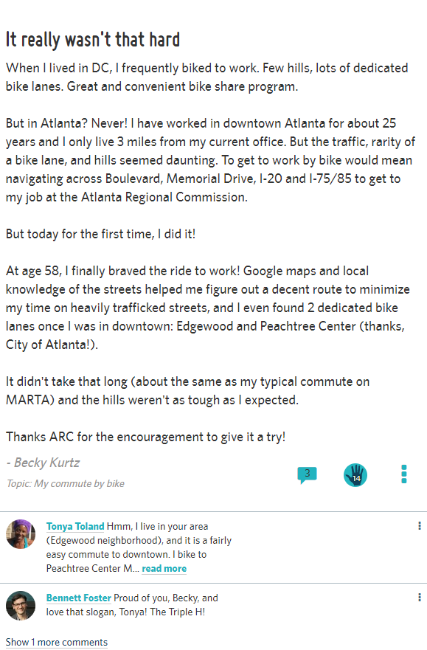
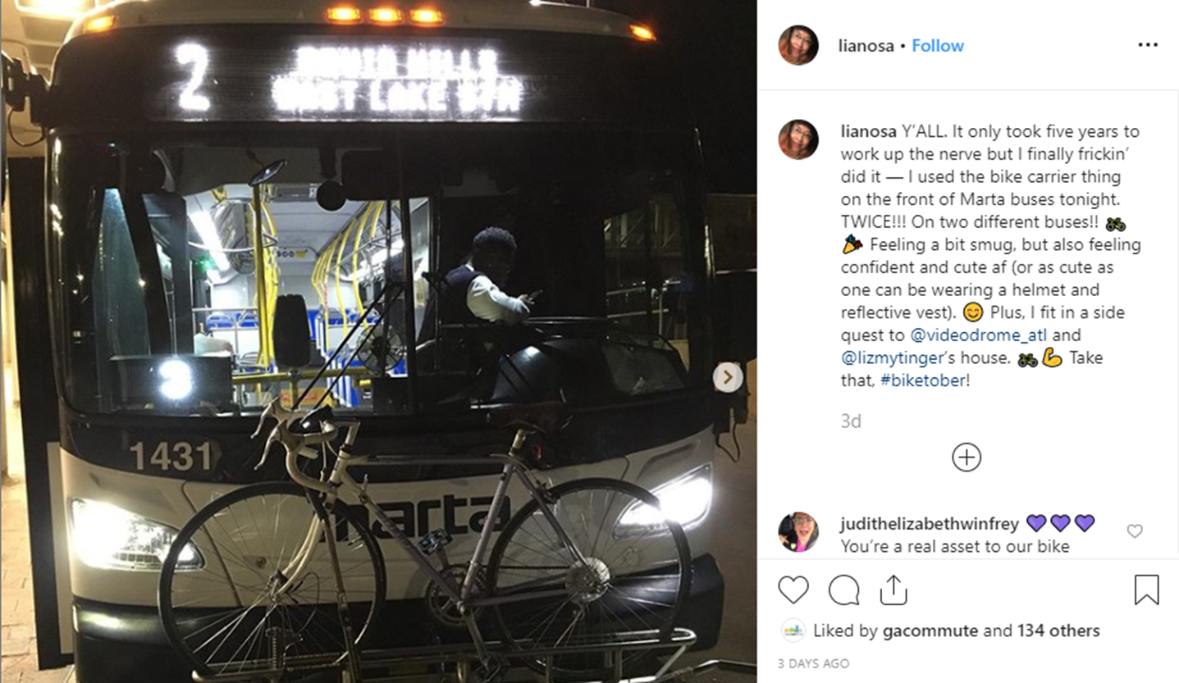
Success stories

Slide 60
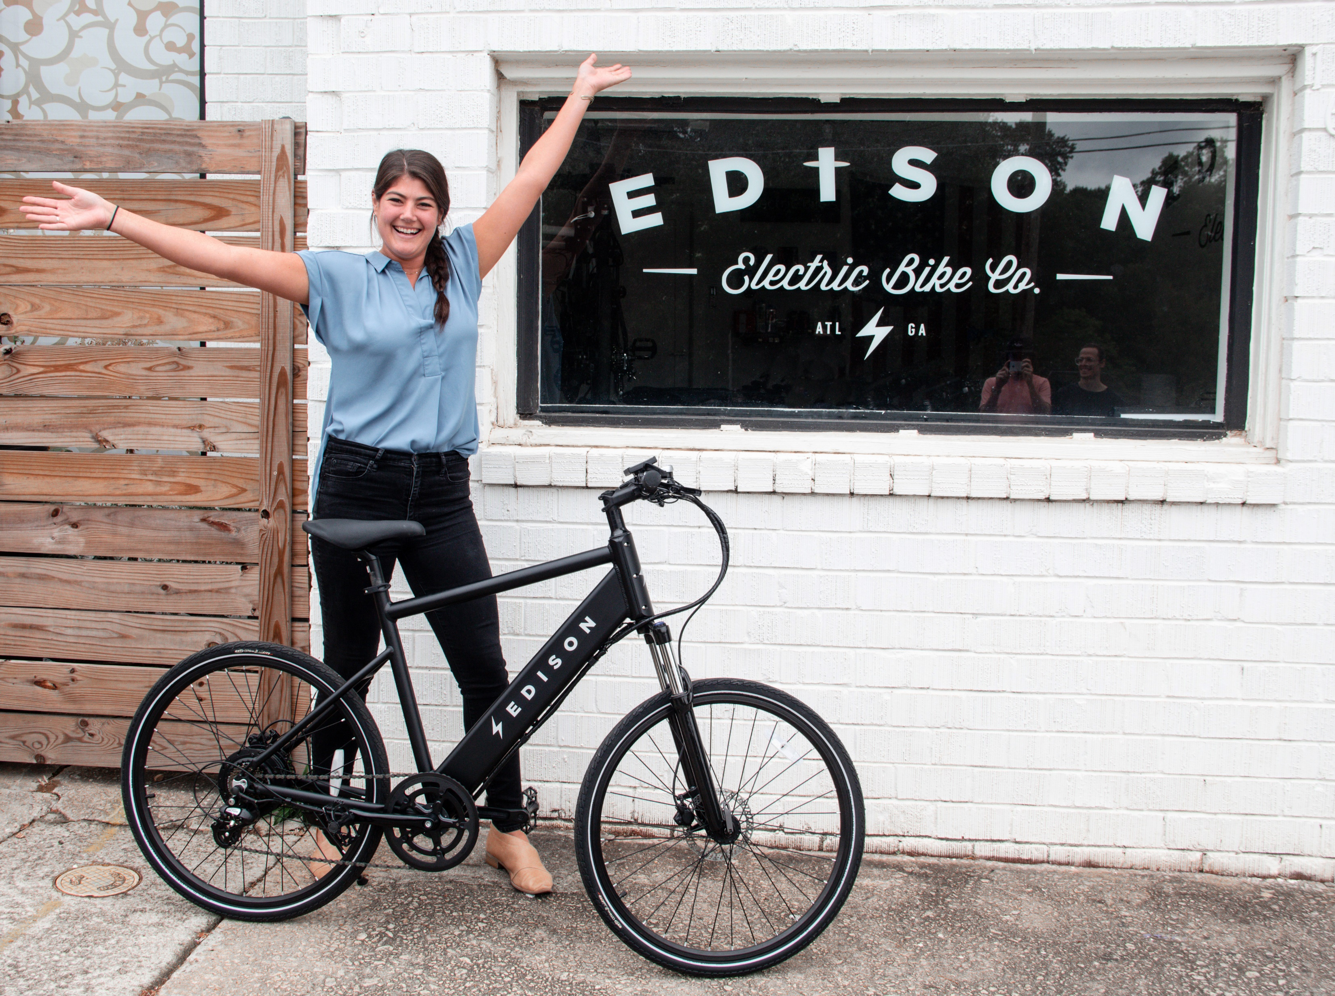
Key Takeaways
Marathon vs. Sprint
Leverage Partnerships
Valuable Prizes
Targeted Promotions

Slide 61
TDM Coordinating Committee Administrative Items
Jill Goldberg

Slide 62
Administrative Items - Members
Member terms
Rolling 1/2/3 year terms
Random drawing – December 17, 2019
Standing members – one each
GDOT
FHWA
MARTA
ATL
ARC – as Chair

Slide 63
Administrative Items
Sub-committees
Research & Policy
Technology
Adoption of Charter – February 2020

Slide 64
Administrative Items - Next TDMCC Meetings
Tuesday, December 17, 9:30 to 11:30 AM
Tuesday, February 18, 2020, 9:30 – 11:30 AM
Tuesday, April 21, 2020, 9:30 – 11:30 AM
Tuesday, June 16, 2020, 9:30 – 11:30 AM
Tuesday, August 18, 2020, 9:30 – 11:30 AM
Tuesday, October 13, 2020, 9:30 – 11:30 AM
Tuesday, December 8, 2020, 9:30 – 11:30 AM
Email us: TDMCommittee@atlantaregional.org
Website: https://atlantaregional.org/transportation-mobility/boards-and-committees/transportation-demand-management-coordinating-committee/

Slide 65
Upcoming TDM Related Events
State of the Region – November 8
Telework Summit - November 13
Telework Week – November 18-22

