Slide 1
ARC Board Retreat:
Growth Trends in the Region and
the Impact on Housing Affordability
Mike Carnathan
Manager, Research & Analytics
ARC Board Retreat
July 26, 2017

Slide 2
Population Trends

Slide 3
4th in Population Growth, 2010-2016
Source: US Census
Notes:
And as you can see here, the South Atlantic region – Virginia, the Carolinas, Georgia and Florida – is expected to add more people than any other region in the nation over the next 25 years or so. This should bode well for our economic future. Still, there are plenty of opportunities for us to make sure metro Atlanta not only participates in this growth, but becomes the place to be for the next generation of creative workers.

Slide 4
4th in Population Growth, 2015-2016
Source: US Census
Notes:
And as you can see here, the South Atlantic region – Virginia, the Carolinas, Georgia and Florida – is expected to add more people than any other region in the nation over the next 25 years or so. This should bode well for our economic future. Still, there are plenty of opportunities for us to make sure metro Atlanta not only participates in this growth, but becomes the place to be for the next generation of creative workers.

Slide 5
Comparing Population Growth Curves
2000-2006 & 2010-2016
Source: US Census
Notes:
And as you can see here, the South Atlantic region – Virginia, the Carolinas, Georgia and Florida – is expected to add more people than any other region in the nation over the next 25 years or so. This should bode well for our economic future. Still, there are plenty of opportunities for us to make sure metro Atlanta not only participates in this growth, but becomes the place to be for the next generation of creative workers.

Slide 6
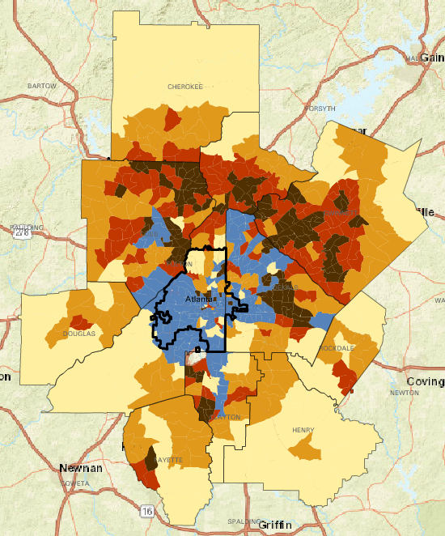
Population Growth by Decade, 1980-1990
Strong Population Growth
Population Decline
Source: Geolytics’ Neighborhood Change Database

Slide 7
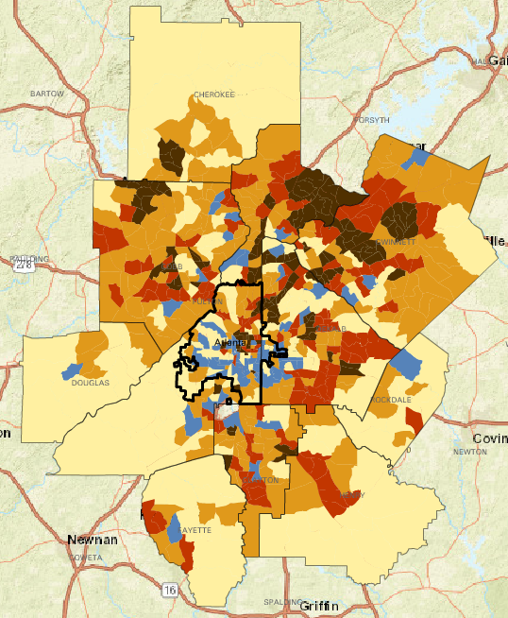
Population Growth by Decade, 1990-2000
Strong Population Growth
Population Decline
Source: Geolytics’ Neighborhood Change Database

Slide 8
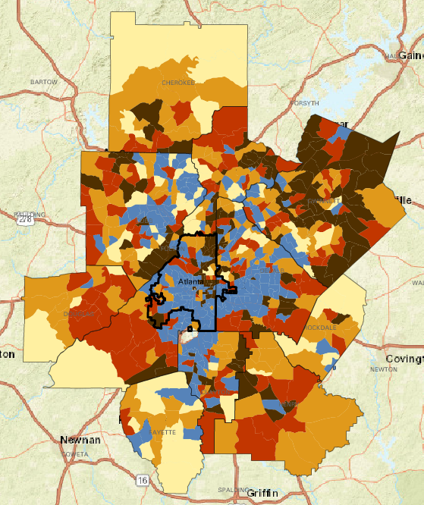
Population Growth by Decade, 2000-2010
Strong Population Growth
Population Decline
Source: Geolytics’ Neighborhood Change Database;
ARC Processing

Slide 9
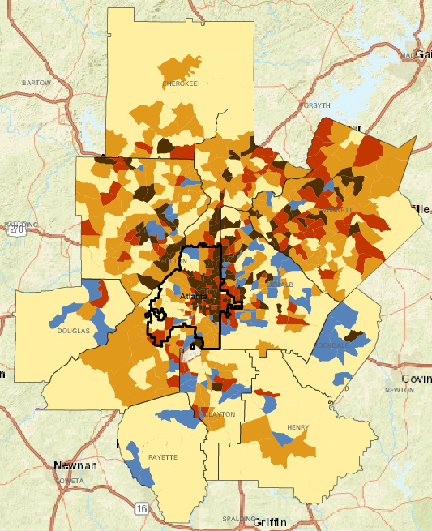
Population Growth by Decade, 2010-2016
Strong Population Growth
Population Decline
Source: 2010 Census; ESRI

Slide 10
ARC’s Population Estimates

Slide 11
DRAFT: ARC’s 2017 Population Estimates for 10-County Region
 | 2010 | 2011 | 2012 | 2013 | 2014 | 2015 | 2016 | 2017 (DRAFT) | Change: 2016-2017
Atlanta Region | 4,107,750 | 4,142,300 | 4,179,500 | 4,219,600 | 4,272,300 | 4,332,600 | 4,401,800 | 4,480,100 | 78,300
Cherokee | 214,346 | 218,500 | 220,800 | 223,300 | 227,500 | 233,300 | 240,100 | 247,400 | 7,300
Clayton | 259,424 | 260,000 | 262,300 | 263,700 | 264,700 | 266,900 | 270,600 | 275,300 | 4,700
Cobb | 688,078 | 693,600 | 699,500 | 707,500 | 717,100 | 727,600 | 737,500 | 750,300 | 12,800
DeKalb | 691,893 | 694,400 | 700,700 | 706,600 | 712,900 | 718,400 | 725,000 | 733,900 | 8,900
Douglas | 132,403 | 133,000 | 133,900 | 134,700 | 136,000 | 137,400 | 139,000 | 140,900 | 1,900
Fayette | 106,567 | 107,100 | 107,500 | 108,200 | 109,500 | 110,700 | 112,300 | 114,000 | 1,700
Fulton | 920,581 | 928,200 | 936,100 | 945,400 | 958,100 | 970,400 | 985,700 | 1,002,800 | 17,100
Gwinnett | 805,321 | 814,100 | 823,100 | 832,200 | 844,100 | 859,800 | 877,100 | 894,000 | 16,900
Henry | 203,922 | 207,800 | 209,500 | 211,300 | 214,500 | 218,700 | 223,600 | 229,000 | 5,400
Rockdale | 85,215 | 85,600 | 86,100 | 86,700 | 87,900 | 89,400 | 90,900 | 92,500 | 1,600
City of Atlanta | 420,003 | 420,700 | 421,600 | 422,800 | 426,900 | 431,700 | 439,600 | 449,500 | 9,900

Slide 12
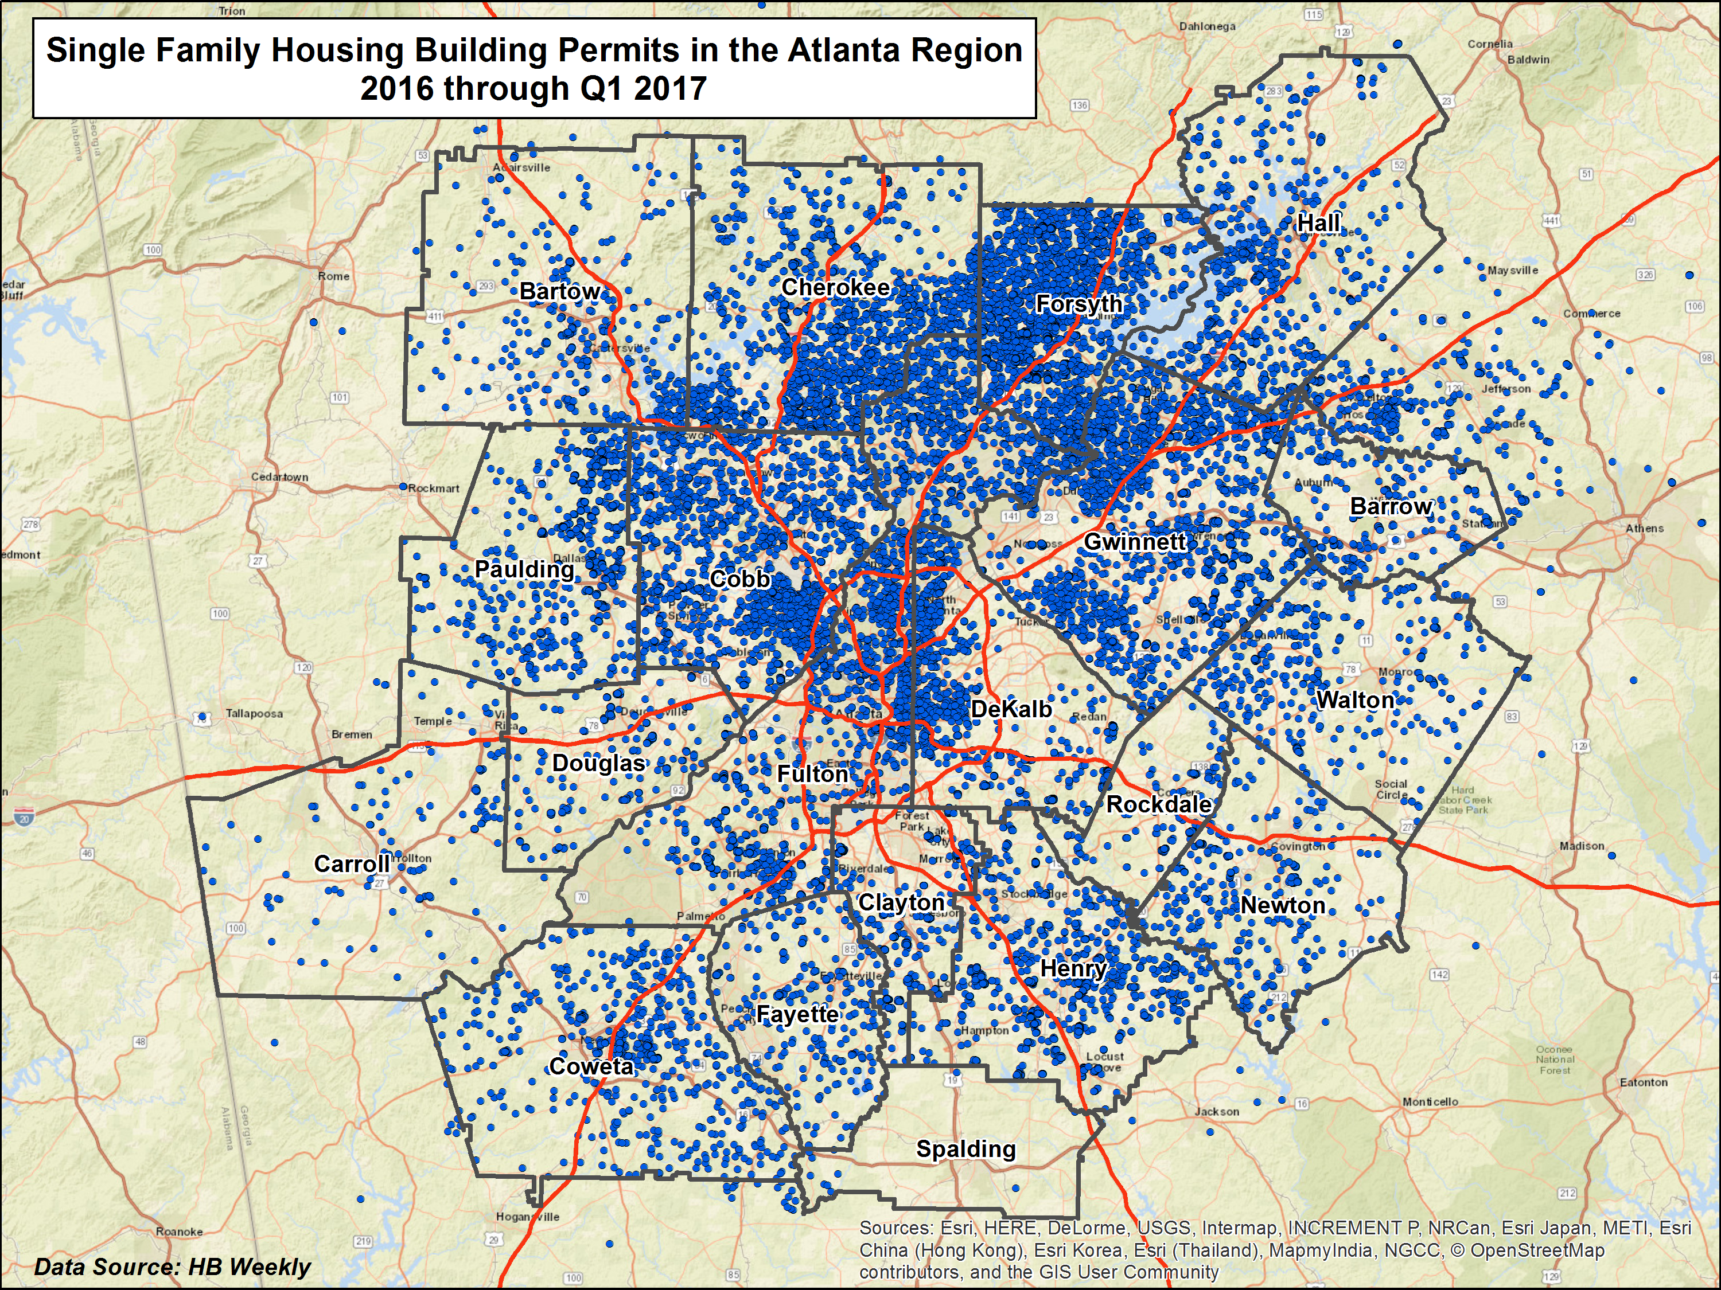
Source: ARC Analysis HB Weekly Data

Slide 13
ARC’s Forecasts

Slide 14
Overall Employment & Population, 2015-2040
Source: ARC Forecasts, series 15

Slide 15
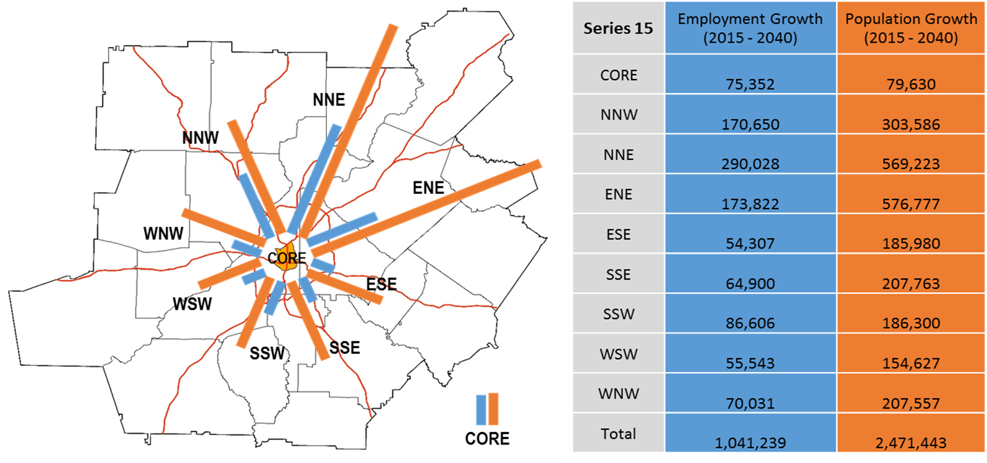
Directions of Growth, 2015-2040
Source: ARC Forecasts, series 15

Slide 16
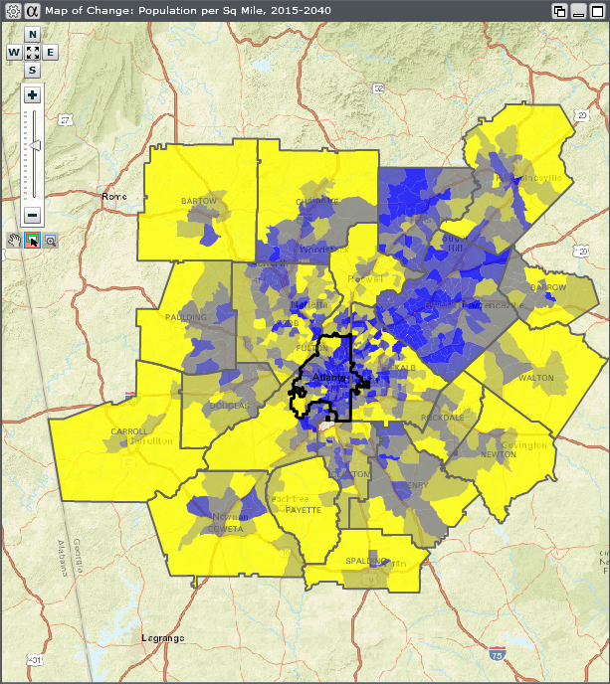
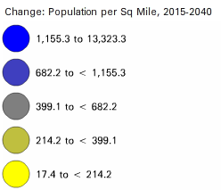
Population density change by census tract
2015-40
Source: ARC Forecasts, series 15

Slide 17
Comparing Changes in North and South of I-20
Source: ARC Forecasts, series 15

Slide 18
Key Issue: Housing Affordability

Slide 19
Overall, Metro Atlanta Is an Affordable Place
U.S. Average
Source: Housing Opportunity Index, NAHB (Q1, 2017)

Slide 20
Key Point: Household Formation and
Home Ownership Rates Declining

Slide 21
Home Ownership Rates Way Down, Especially for Millennials
 | Home Ownership Rates by Age
 | 2000: Ages 34 and Under | 2000: Ages 35-44 | 2000: 45 and Older | 2015: Ages 34 and Under | 2015: Ages 35-44 | 2015: 45 and Older
Cherokee | 70.1% | 86.5% | 89.2% | 53.6% | 72.6% | 84.5%
Clayton | 37.9% | 61.0% | 77.9% | 23.0% | 43.8% | 67.6%
Cobb | 40.6% | 72.1% | 83.9% | 31.1% | 53.9% | 78.7%
DeKalb | 31.4% | 60.7% | 76.0% | 23.0% | 43.8% | 70.5%
Douglas | 53.4% | 76.2% | 85.4% | 40.6% | 62.7% | 78.5%
Fayette | 63.1% | 85.3% | 91.9% | 45.6% | 76.0% | 88.0%
Fulton | 25.5% | 55.7% | 68.0% | 23.4% | 42.3% | 65.1%
Gwinnett | 49.1% | 76.3% | 85.0% | 36.4% | 61.4% | 78.7%
Henry | 74.9% | 86.4% | 90.1% | 41.8% | 67.4% | 83.0%
Rockdale | 46.0% | 73.4% | 85.4% | 36.4% | 61.3% | 80.4%
Source: U.S. Census; 2000 Census and 2011-2015 ACS

Slide 22
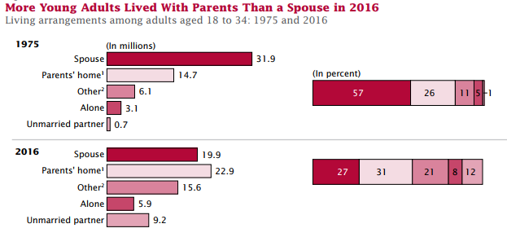
“Living with Parents” Most Popular Living Arrangement for Millennials
Source: 2011-2015 ACS and “The Changing Economics and Demographics of Young Adulthood: 1975–2016”, U.S. Census

Slide 23
Key Point: Housing Costs Are Rising Fast!

Slide 24
Home Prices Almost Back to Pre-Recession Peak
Source: Case-Shiller Index

Slide 25
Building Permits Way Off
Source: SOCDS

Slide 26
Escalating Prices Correspond to Dwindling Supply
Source: Zillow

Slide 27
Inventory Down in Every County
Source: Zillow

Slide 28
Home Prices Rising Faster Than Wages
(Not inflation adjusted)
Source: Zillow and BEA

Slide 29
Key Point: Transportation Costs Complicate Affordability

Slide 30
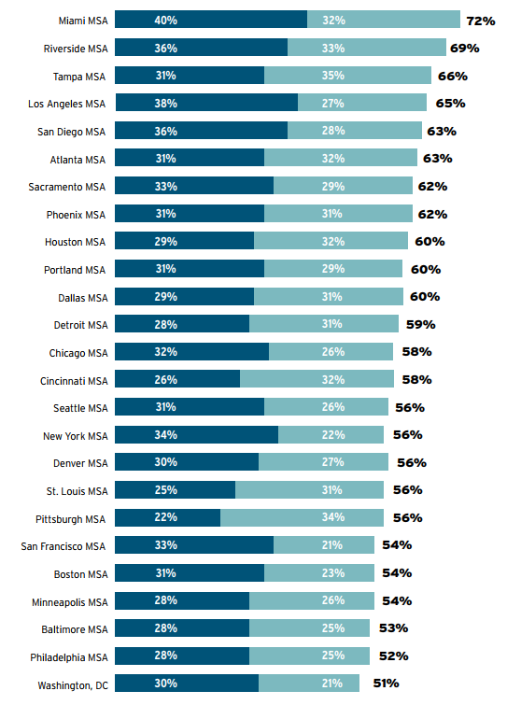
Add in Transportation costs, however, and metro Atlanta’s “affordability” flips
CNT – “Losing Ground”
Housing Opportunity Index, NAHB

Slide 31
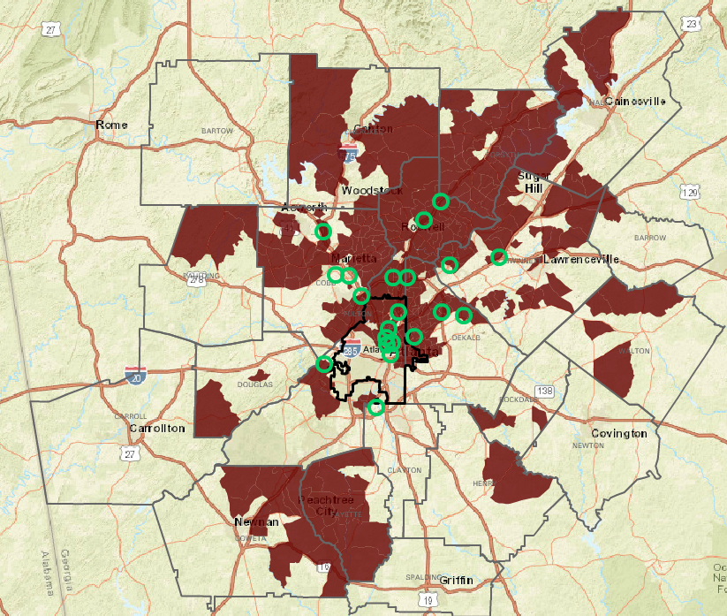
Housing Values Are Higher Near Major Employment Centers
*Browns represent highest home prices & green circles represent largest job centers
Source: ARC, 2010-2014 American Community Survey

Slide 32
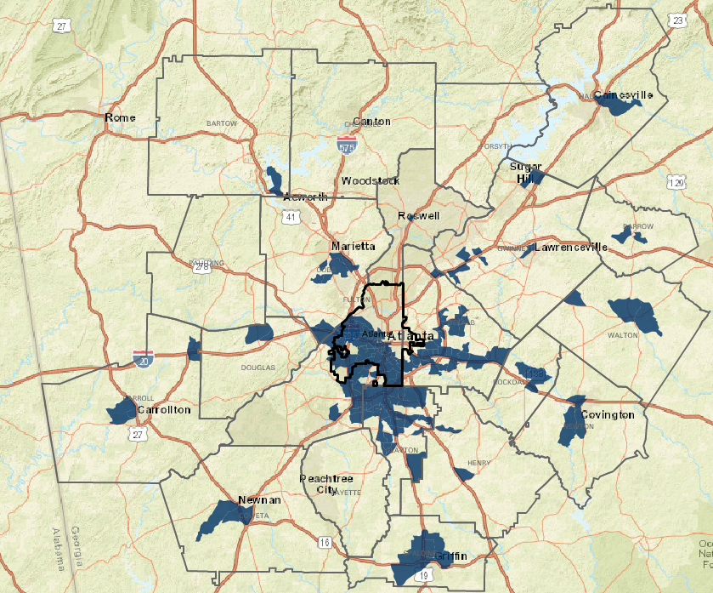
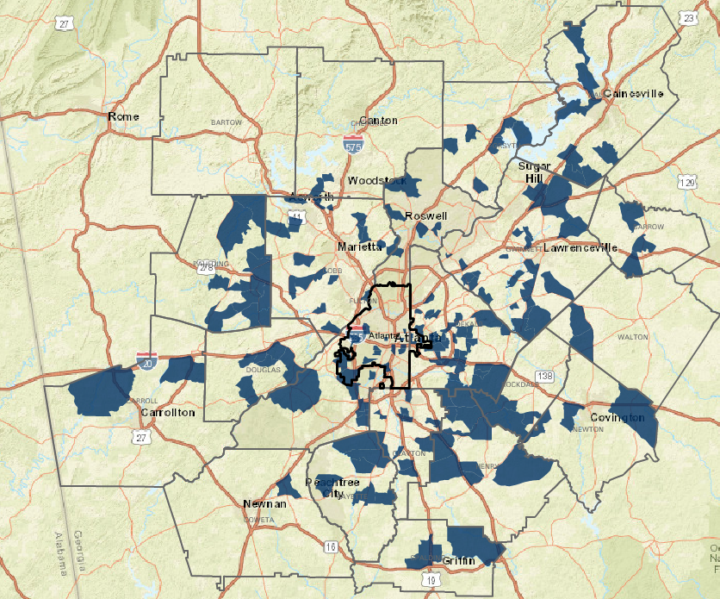
A spatial mismatch exists between the location of low-income workers & low-income jobs
Where Low-Income Workers Live
(~$15,000 annually)
Where Low-Income Jobs Are Located
(Paying ~$15,000 Annually)
*Blue shades represent higher concentrations of both low-income workers and low-income jobs
Source: Longitudinal Employer-Household Dynamics (LEHD),
U.S. Census Bureau via Neighborhood Nexus

Slide 33
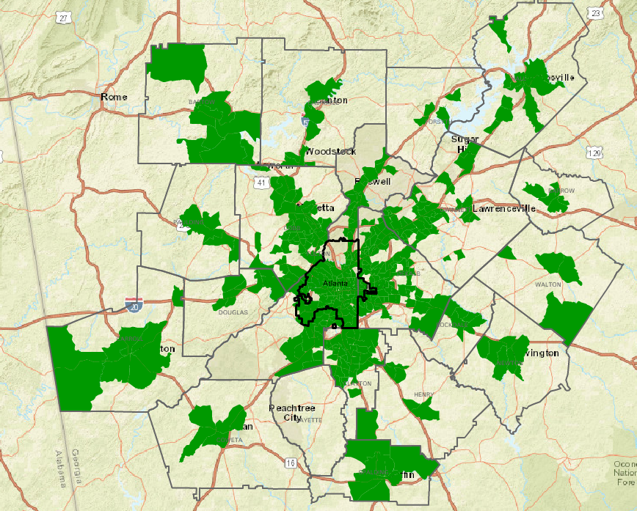
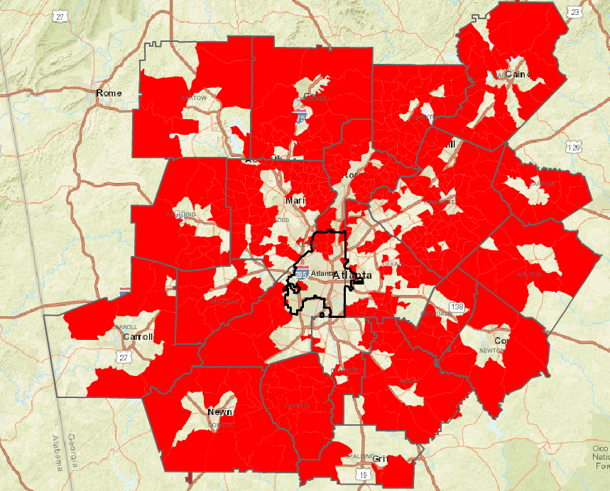
Transportation Costs Complicate The Affordability Picture…
Where a Family of Four (Two Commuters, Two Kids) That Makes the Area Median Income (~$57,000)
Can Live if they Want To Pay…
… less than 50% on Housing and Transportation Costs Combined.
… more than 50% on Housing and Transportation Costs Combined.
Source: Location Affordability Portal

Slide 34
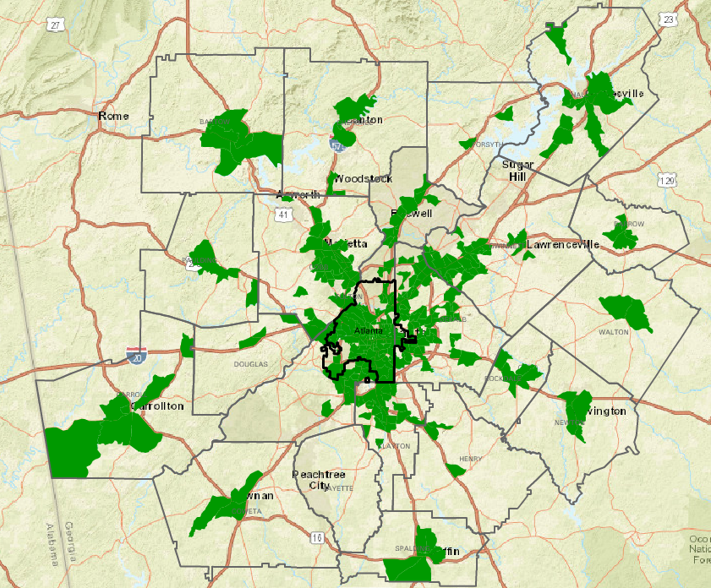
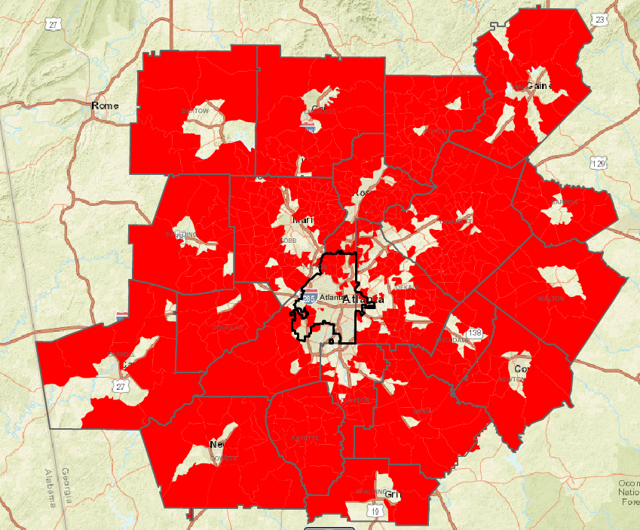
…Especially for Moderate Income Retirees…
Where a Retired Couple Who Makes 80% of the Area Median Income (~$46,000)
Can Live if they Want To Pay…
… less than 50% on Housing and Transportation Costs Combined.
… more than 50% on Housing and Transportation Costs Combined.
Source: Location Affordability Portal

Slide 35
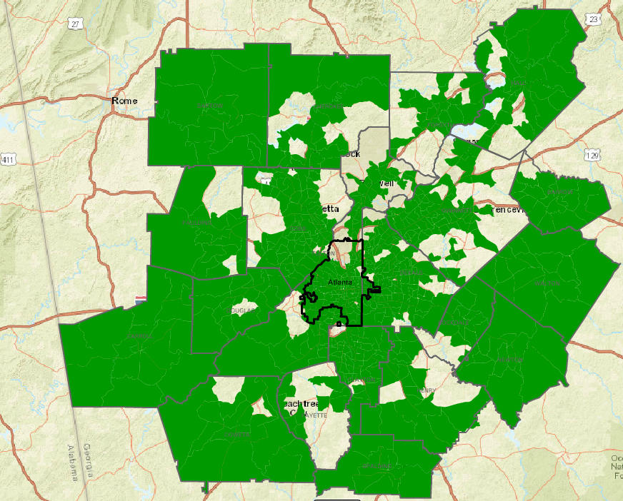
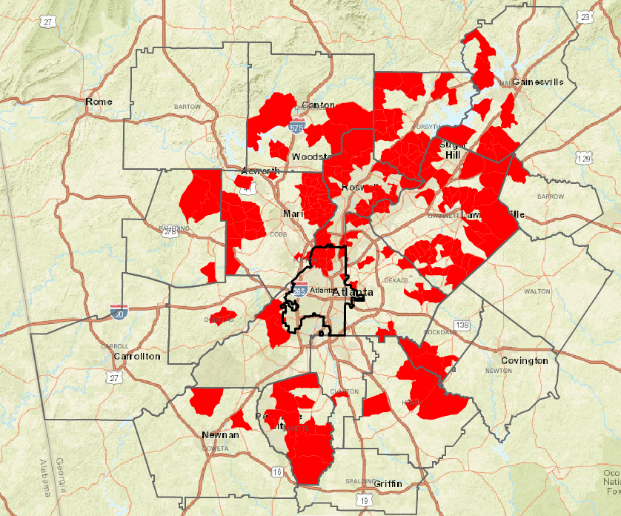
Transportation Costs Complicate The Affordability Picture
Where a Family of Four (Two Commuters, Two Kids) That Makes 150% Area Median Income (~$85,000)
Can Live if they Want To Pay…
… less than 50% on Housing and Transportation Costs Combined.
… more than 50% on Housing and Transportation Costs Combined.
Source: Location Affordability Portal

Slide 36
Key Point: Rents Are Rising Fast Too, Everywhere, Furthering Our Affordability Crunch

Slide 37
Significant Rent Increases in Atlanta (City)
Source: Rainmaker Insights

Slide 38
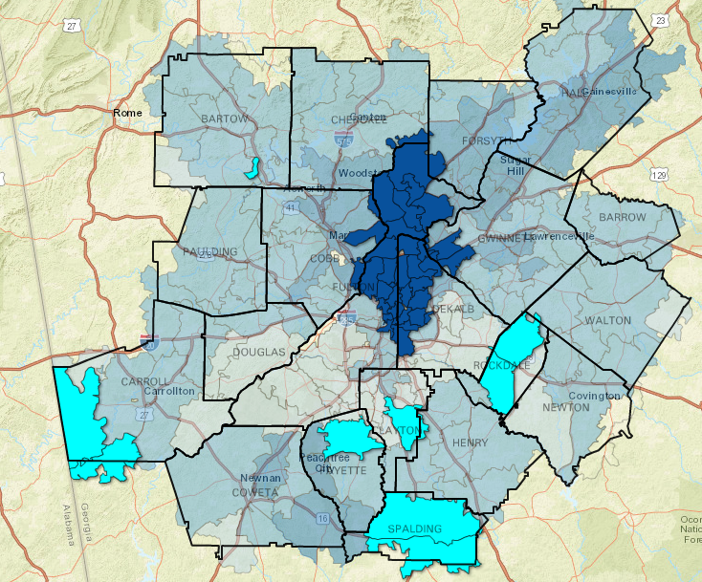
Most Significant Rent Increases are in the Suburbs
% Change in Average Monthly Rent, 2011-2016
21.2% - 42.6% (Highest)
Median Rent for dark blue areas?
$1,675 - $4,850
-7.0% - 0% (Lowest)
Source: Zillow, via Neighborhood Nexus

Slide 39
… Yet Affordable Units (Especially for Extremely Low Income) are Decreasing
Source: Urban Institute, “Mapping America’s Rental Housing Crisis” (http://apps.urban.org/features/rental-housing-crisis-map/)

Slide 40
Many Units’ Affordability Set To Expire Soon
Source: National Housing Preservation Database

Slide 41
Key Point: Residential Patterns (i.e. Segregation) Are Exacerbating The Issue

Slide 42
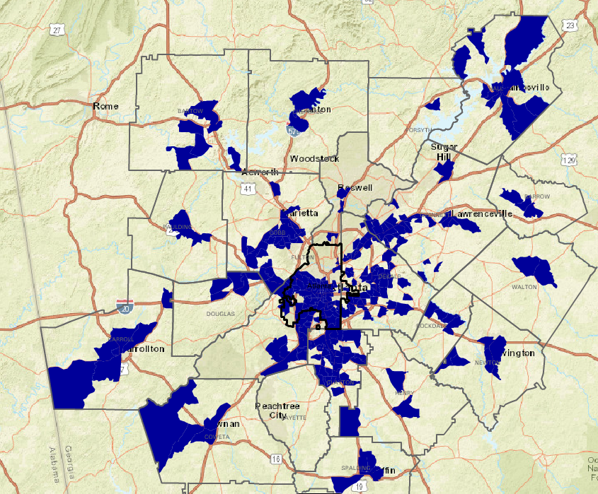
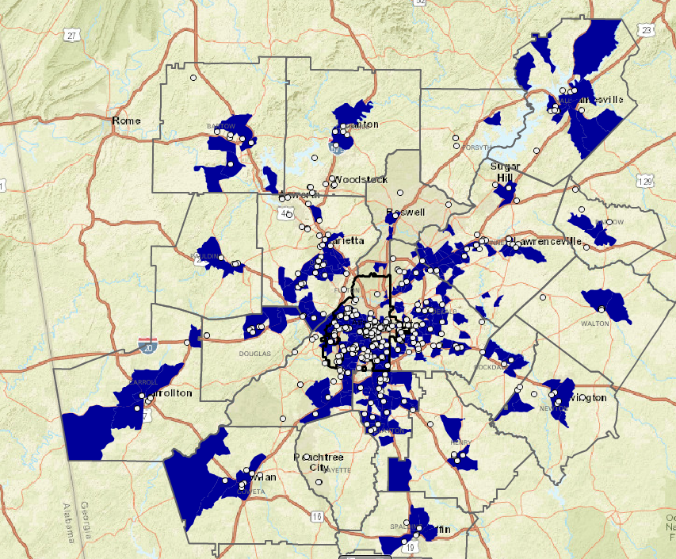
Subsidized Units Located in Low-Opportunity Areas
% in Poverty and
subsidized housing unit locations
20% or Above
Subsidized Housing Units
Source: 2011-2015 ACS & National Housing Preservation Database, via Neighborhood Nexus

Slide 43
Low-Opportunity Areas Continue The Poverty Cycle
Source: GOSA, via Neighborhood Nexus
Source: DPH, via Neighborhood Nexus

Slide 44
Residents Struggle with Housing Costs in High Poverty Neighborhoods…
Source: 2010-2014 American Community Survey, via Neighborhood Nexus

Slide 45
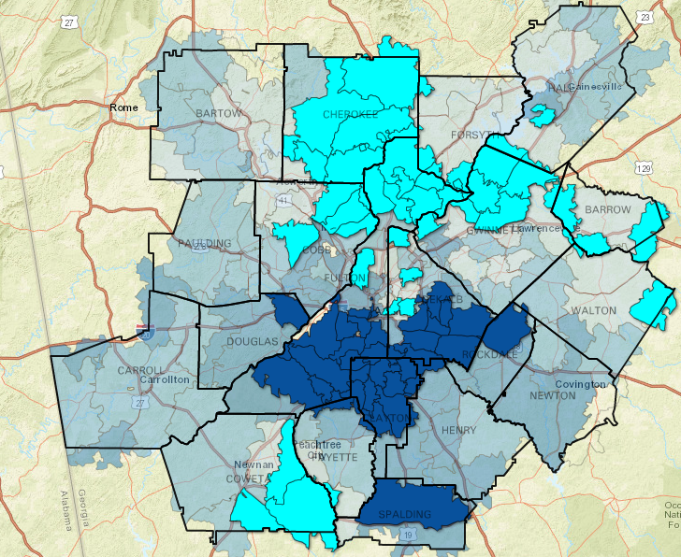
… and struggle in other ways as well…
% of Homes with “Negative Equity”
(Owe more on the house
than what it is worth)
20.9% - 49.2%
4.5% - 7.5%
Source: Zillow, via Neighborhood Nexus

Slide 46
… and struggle in other ways as well…
% of Homes with “Negative Equity”
(Owe more on the house
than what it is worth)
27.4% - 53.4%
15.6% - 27.4%
11.8% - 15.6%
8.6% - 11.8%
0% - 8.6%
Source: Zillow, via Neighborhood Nexus

Slide 47
Summary
Home ownership and household formation rates down dramatically, compared to historic trends
Home prices rising significantly – faster than wages – due in large part to dwindling supply
Adding in transportation costs worsens an already worsening affordability picture
Rental market offers no relief – rents are rising dramatically as well, especially in the suburbs
Majority of low-income housing located in low opportunity areas, maintaining the cycle of poverty

Slide 48
Discussion?
What is the biggest issue in your jurisdiction as it relates to affordable housing?
What are the local barriers to being more proactive with some of these housing issues?
Do you see issues in older adults accessing basic services, like healthcare, groceries or senior centers?
What about workforce training – have you heard of any issues of people seeking training having a hard time getting the training they need?

Slide 49
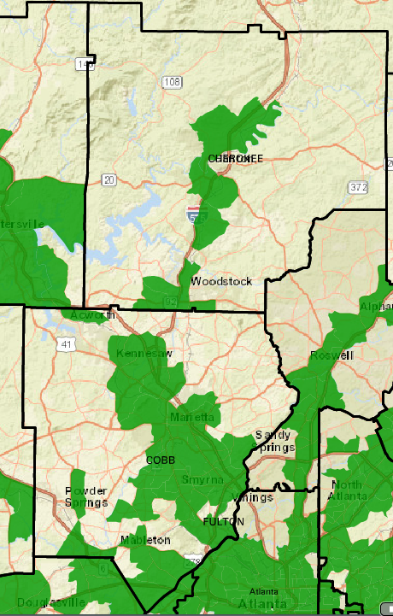
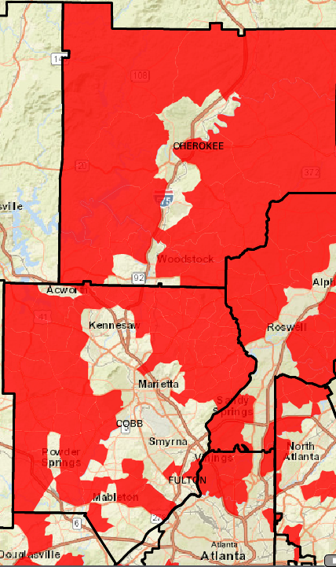
Where a Family of Four (Two Commuters, Two Kids) That Makes the Area Median Income (~$57,000)
Can Live if they Want To Pay…
… less than 50% on Housing and Transportation Costs Combined.
… more than 50% on Housing and Transportation Costs Combined.
Cherokee & Cobb

Slide 50
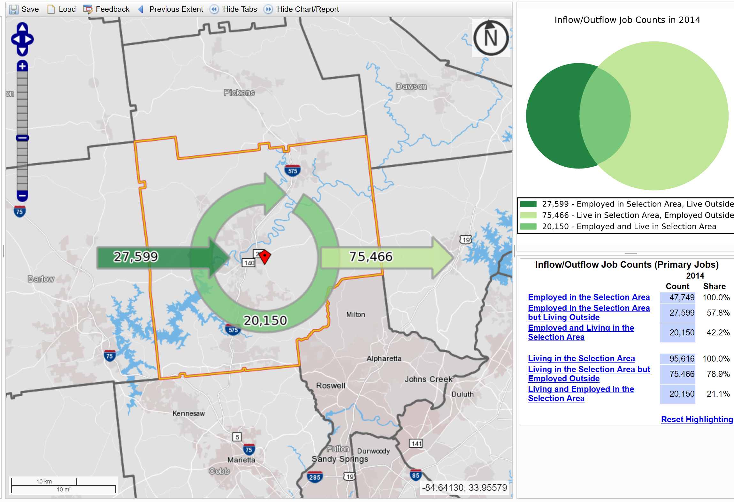
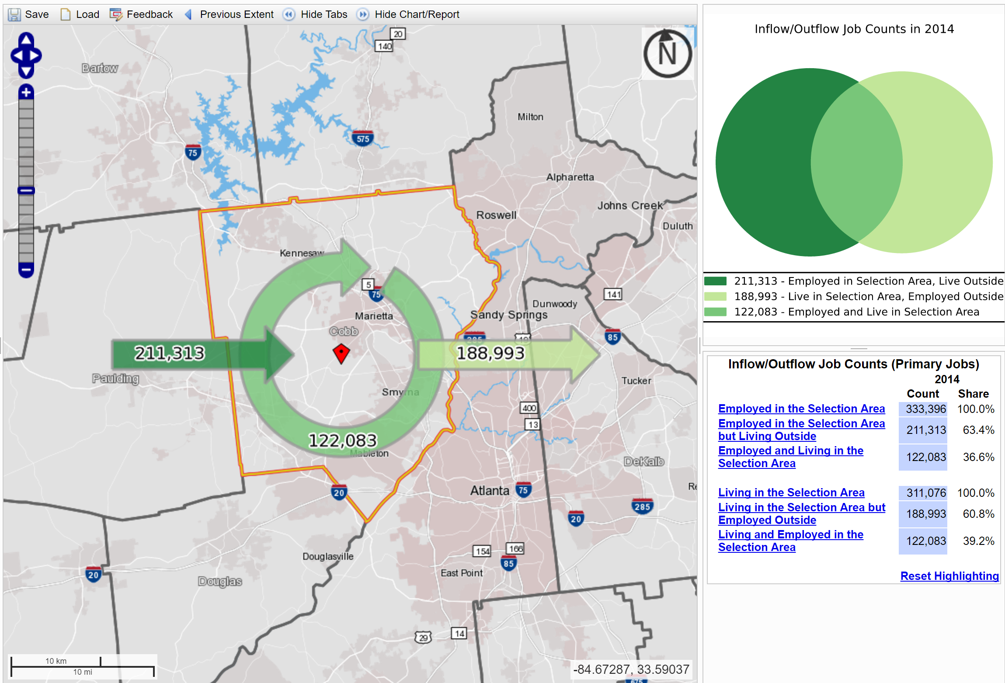
Worker Inflow/Outflow – Cherokee
Worker Inflow/Outflow – Cobb
Almost 79% of workers living in Cherokee leave the county for work. But 58% of jobs in Cherokee are held by non-residents.
Almost 61% of workers living in Cobb leave the county for work. But 63% of jobs in Cobb are held by non-residents.

Slide 51
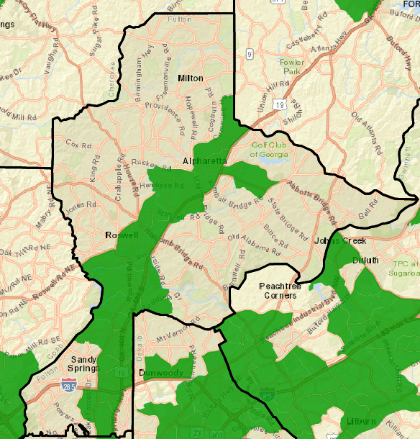
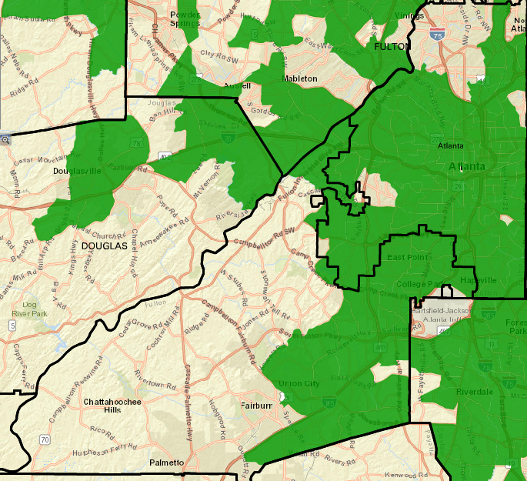
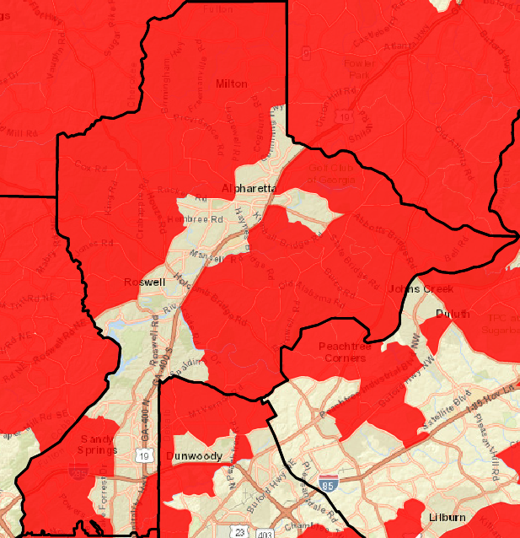
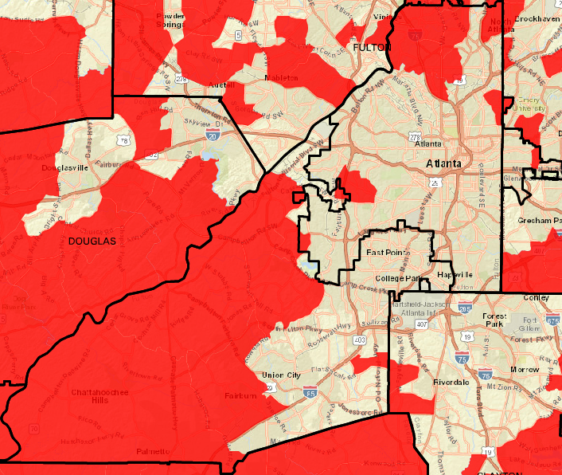
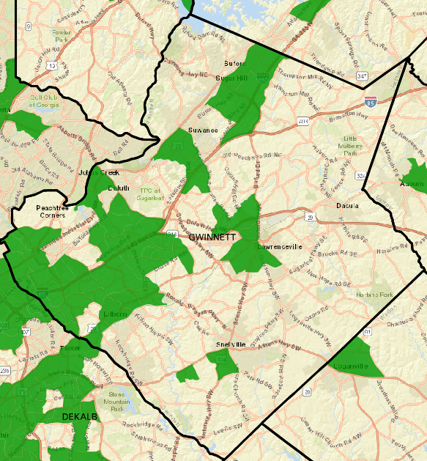
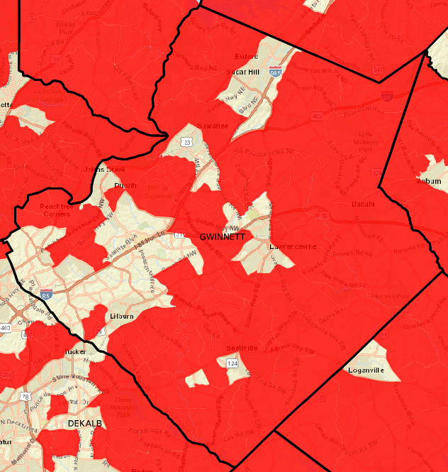
Where a Family of Four (Two Commuters, Two Kids) That Makes the Area Median Income (~$57,000)
Can Live if they Want To Pay…
… less than 50% on Housing and Transportation Costs Combined.
… more than 50% on Housing and Transportation Costs Combined.
Fulton & Gwinnett

Slide 52
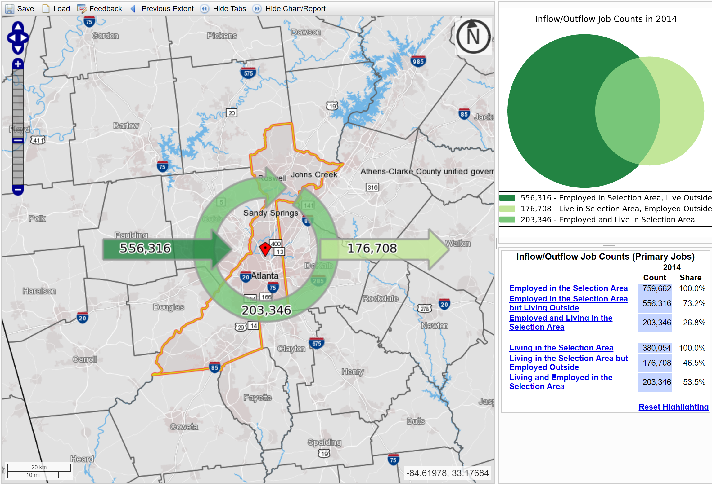
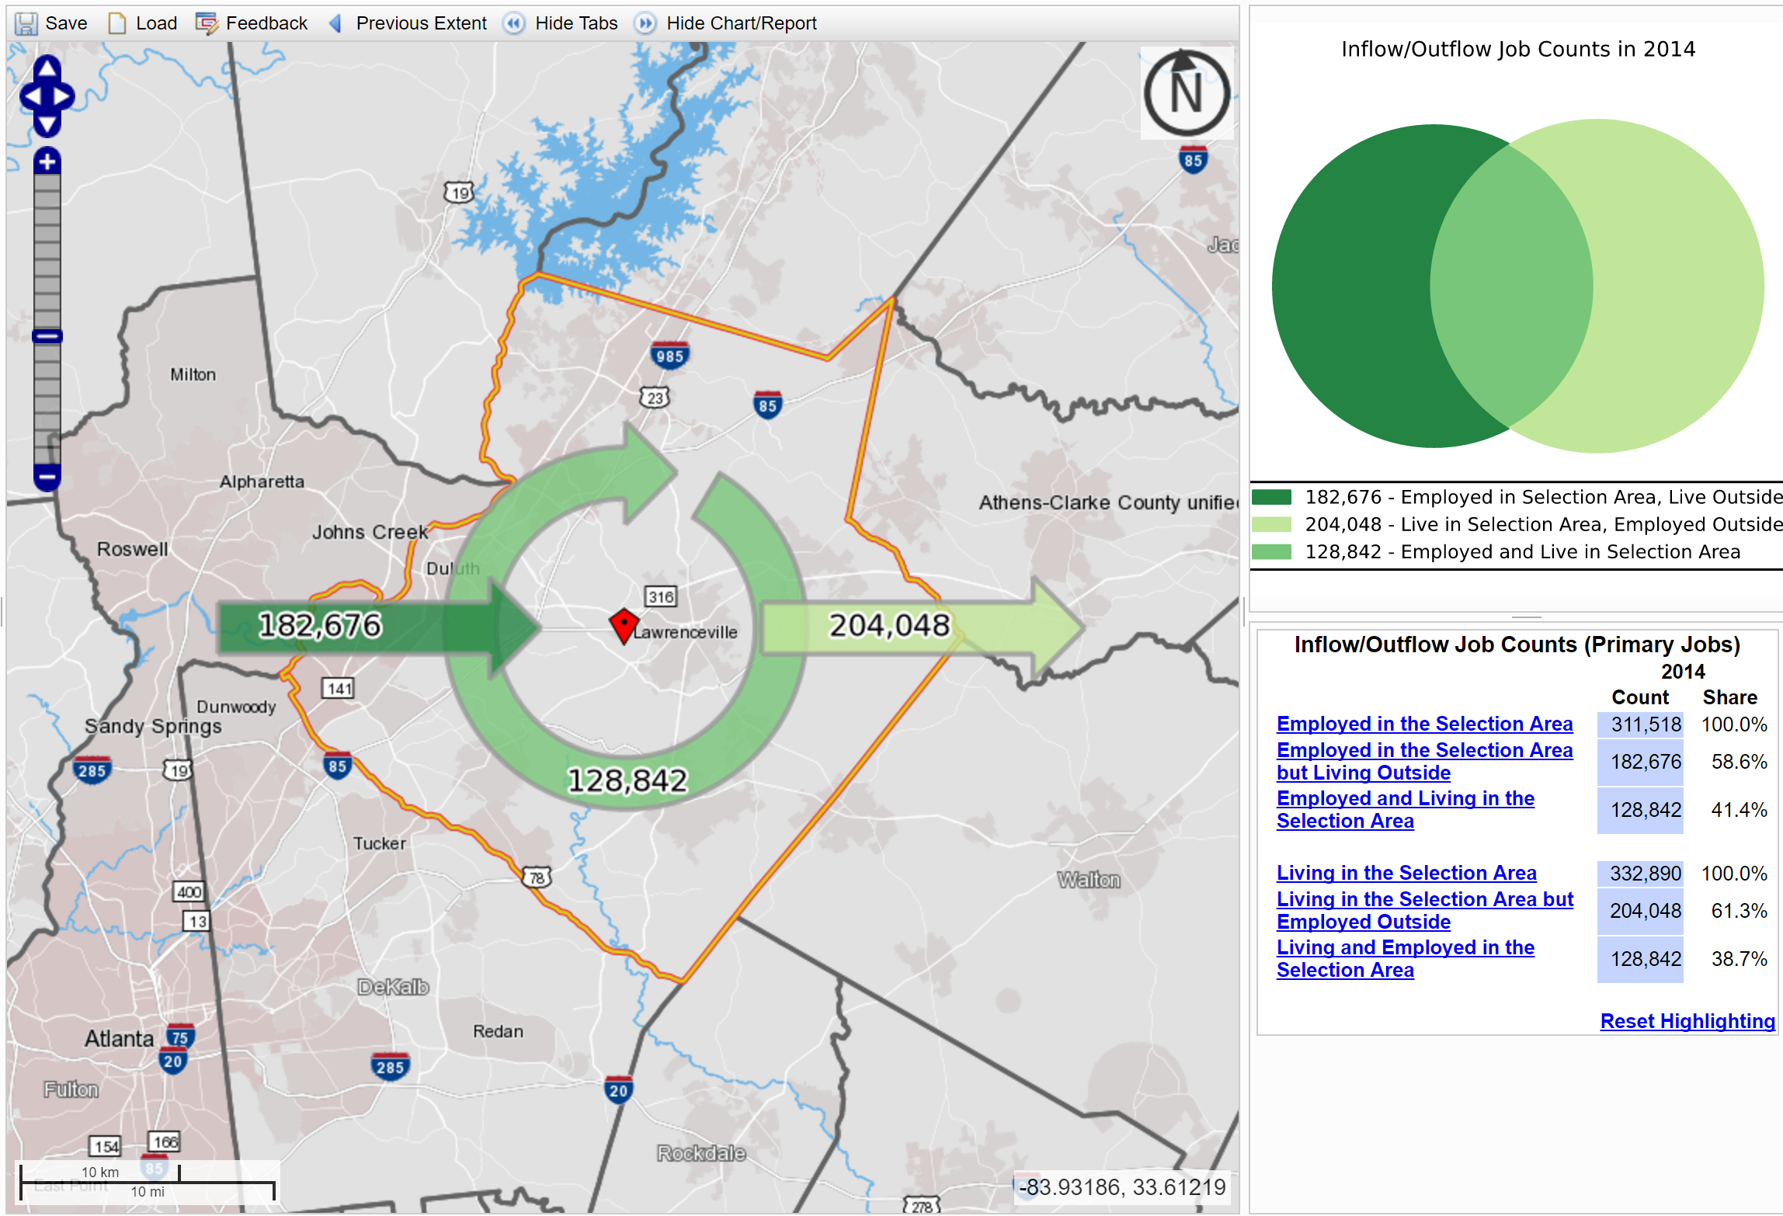
Worker Inflow/Outflow – Fulton
Worker Inflow/Outflow – Gwinnett
Only 47% of workers living in Fulton leave the county for work. But 73% of jobs in Fulton are held by non-residents.
Almost 61% of workers living in Gwinnett leave the county for work. But 59% of jobs in Gwinnett are held by non-residents.

Slide 53
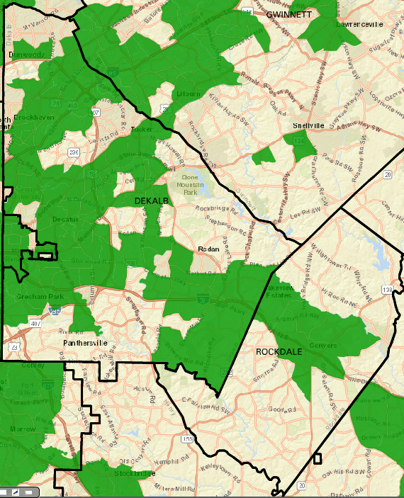
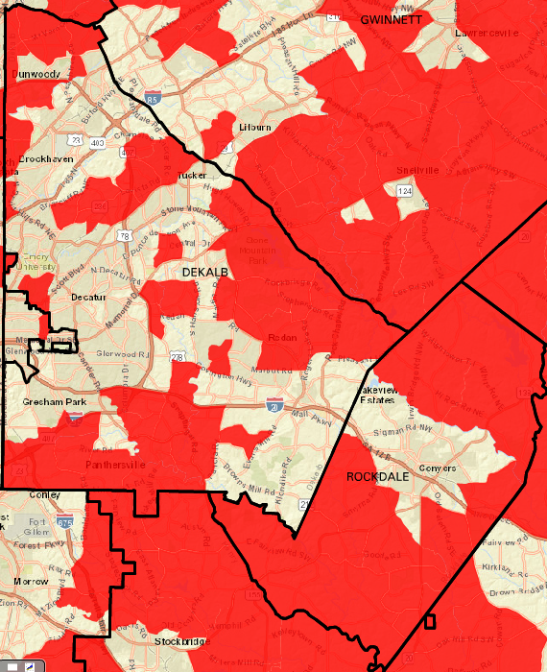
Where a Family of Four (Two Commuters, Two Kids) That Makes the Area Median Income (~$57,000)
Can Live if they Want To Pay…
… less than 50% on Housing and Transportation Costs Combined.
… more than 50% on Housing and Transportation Costs Combined.
DeKalb & Rockdale

Slide 54
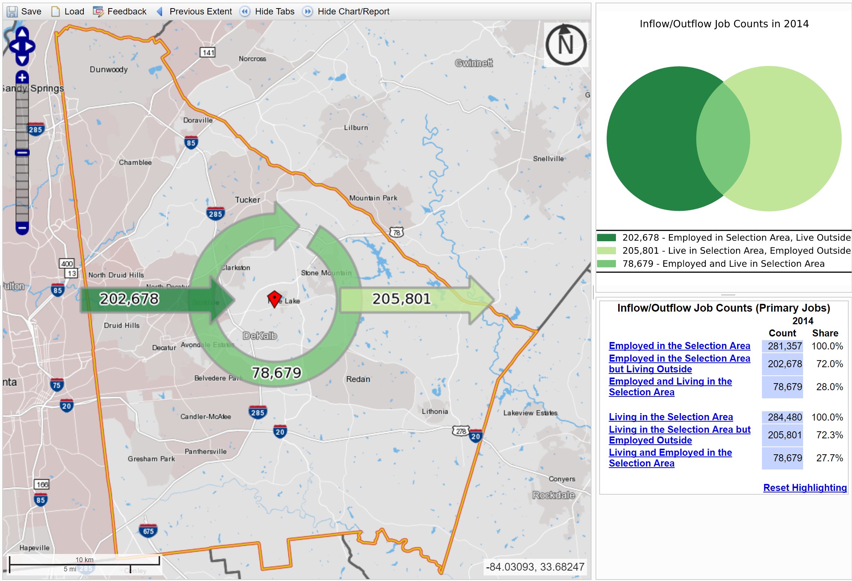
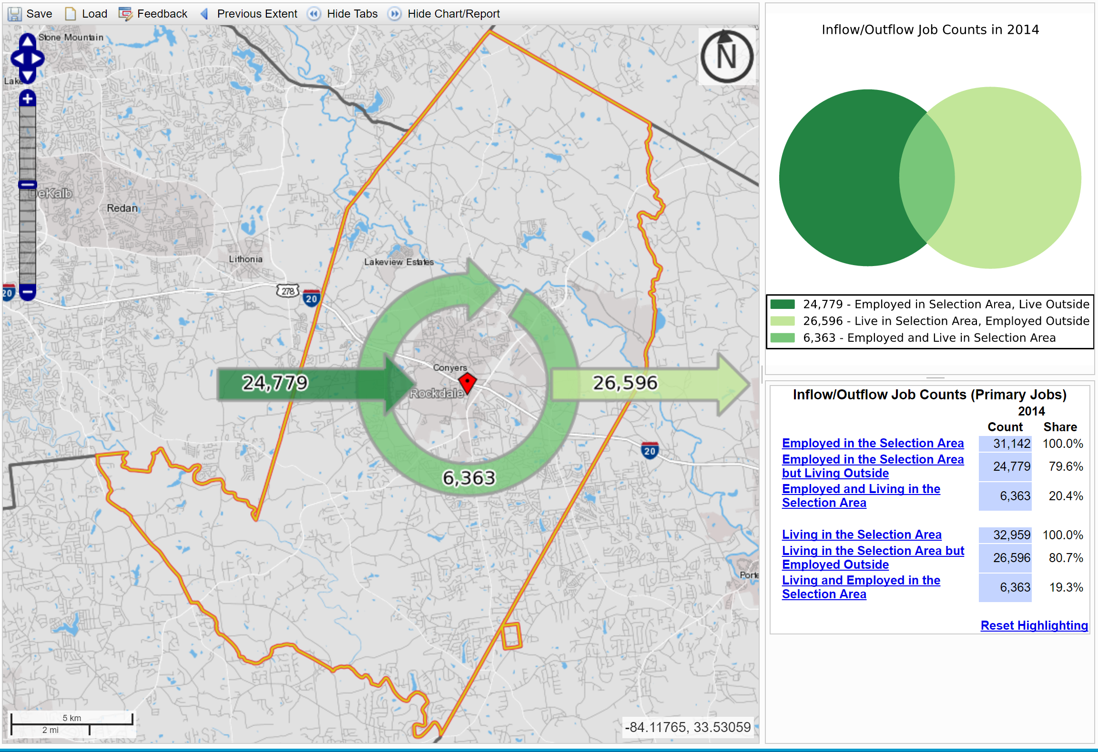
Worker Inflow/Outflow – DeKalb
Worker Inflow/Outflow – Rockdale
Almost 72% of workers living in DeKalb leave the county for work. But 72% of jobs in DeKalb are held by non-residents.
Almost 81% of workers living in Rockdale leave the county for work. But 80% of jobs in Rockdale are held by non-residents.

Slide 55
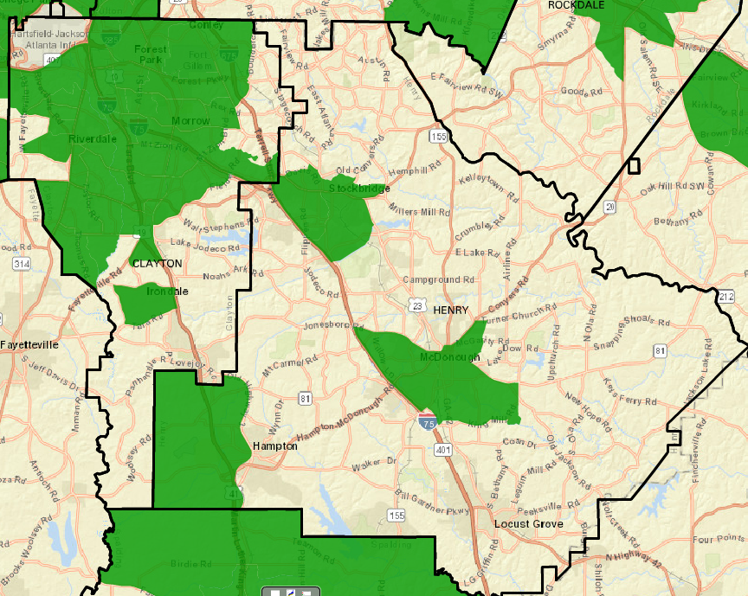
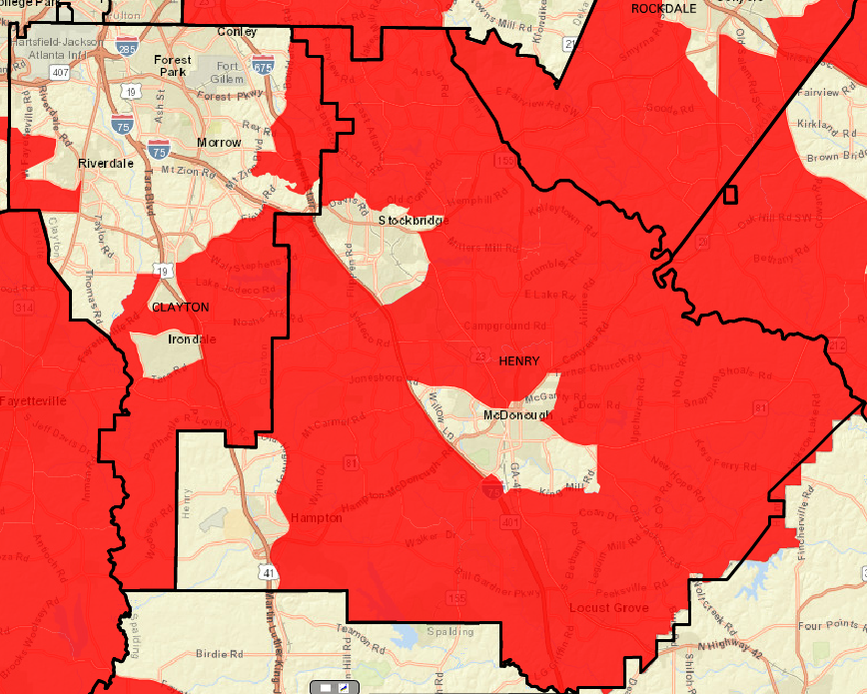
Where a Family of Four (Two Commuters, Two Kids) That Makes the Area Median Income (~$57,000)
Can Live if they Want To Pay…
… less than 50% on Housing and Transportation Costs Combined.
… more than 50% on Housing and Transportation Costs Combined.
Clayton & Henry

Slide 56
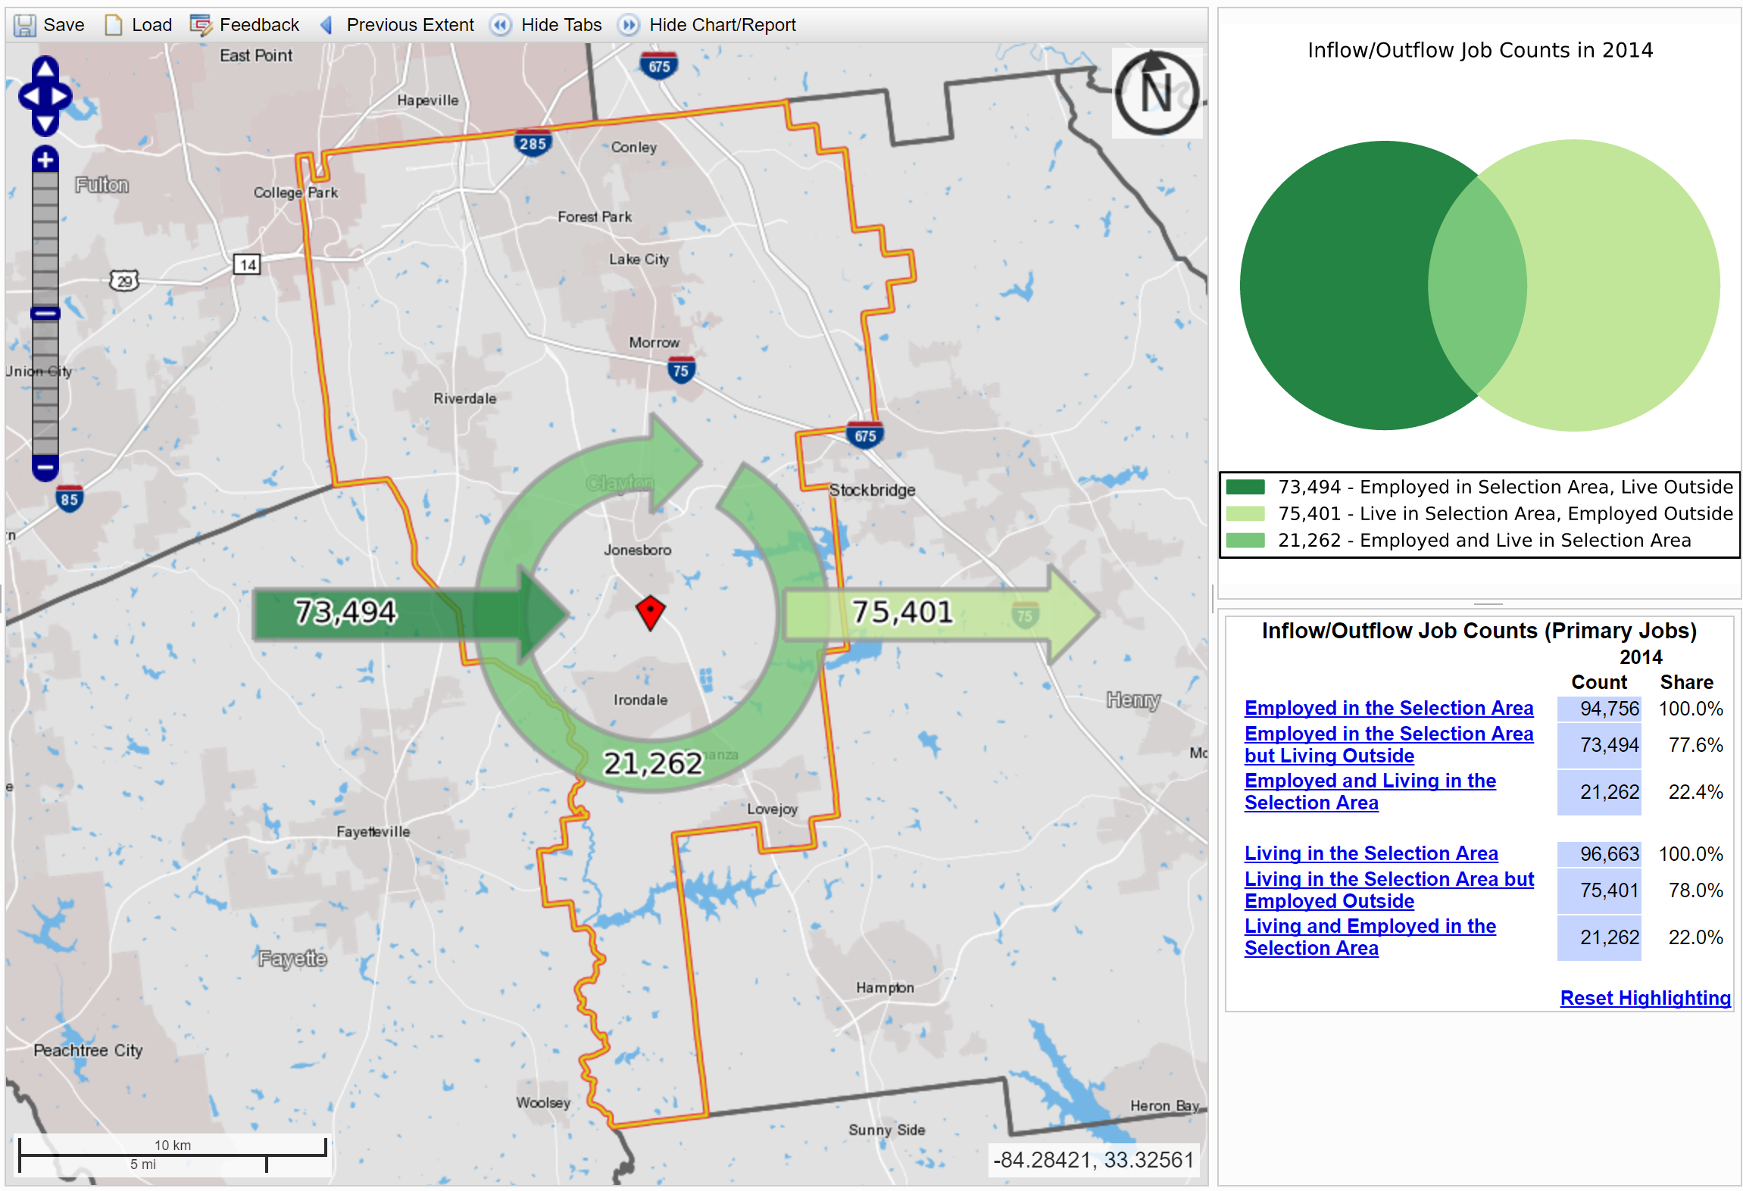
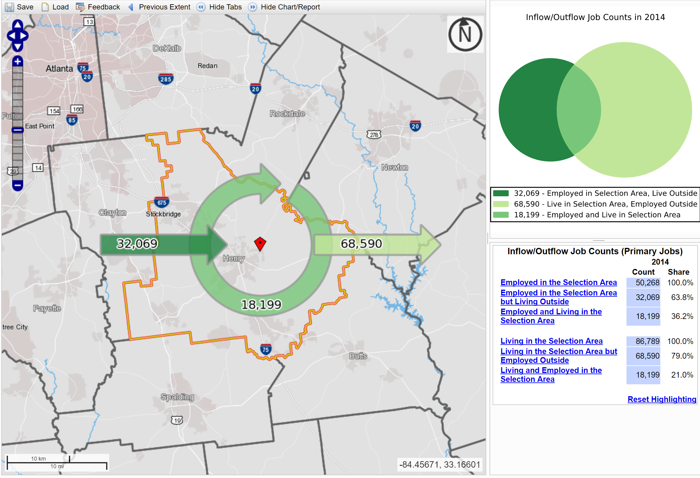
Worker Inflow/Outflow –Clayton
Worker Inflow/Outflow – Henry
Almost 78% of workers living in Clayton leave the county for work. But 78% of jobs in Clayton are held by non-residents.
Almost 79% of workers living in Henry leave the county for work. But 64% of jobs in Henry are held by non-residents.

Slide 57
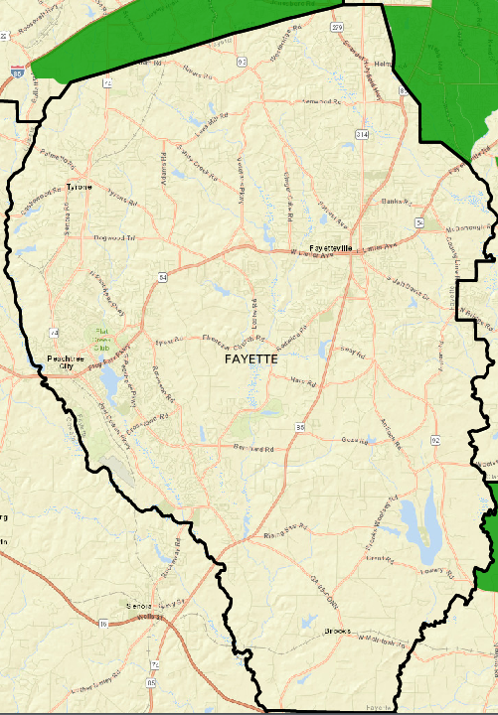
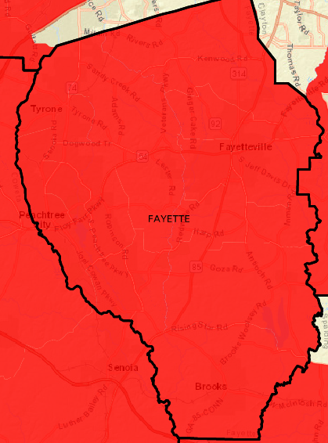
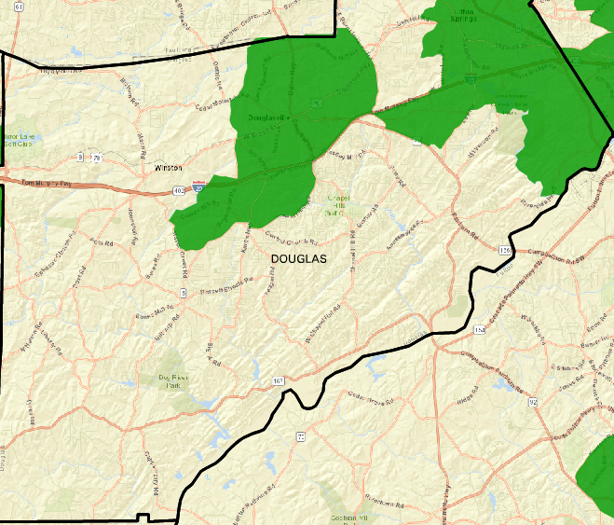
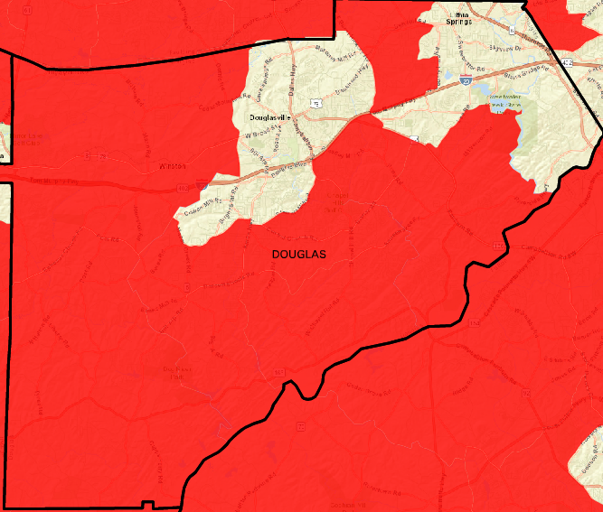
Where a Family of Four (Two Commuters, Two Kids) That Makes the Area Median Income (~$57,000)
Can Live if they Want To Pay…
… less than 50% on Housing and Transportation Costs Combined.
… more than 50% on Housing and Transportation Costs Combined.
Douglas & Fayette

Slide 58
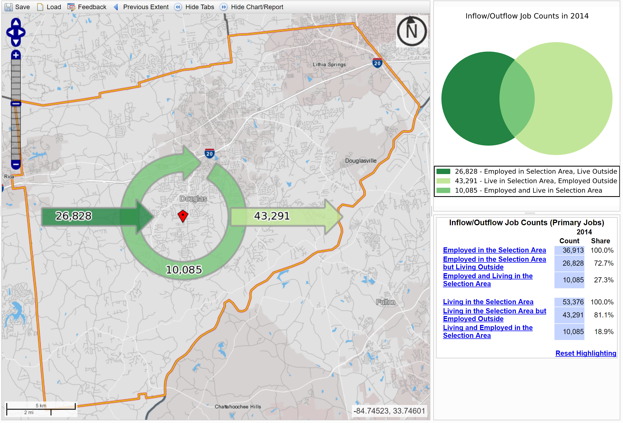
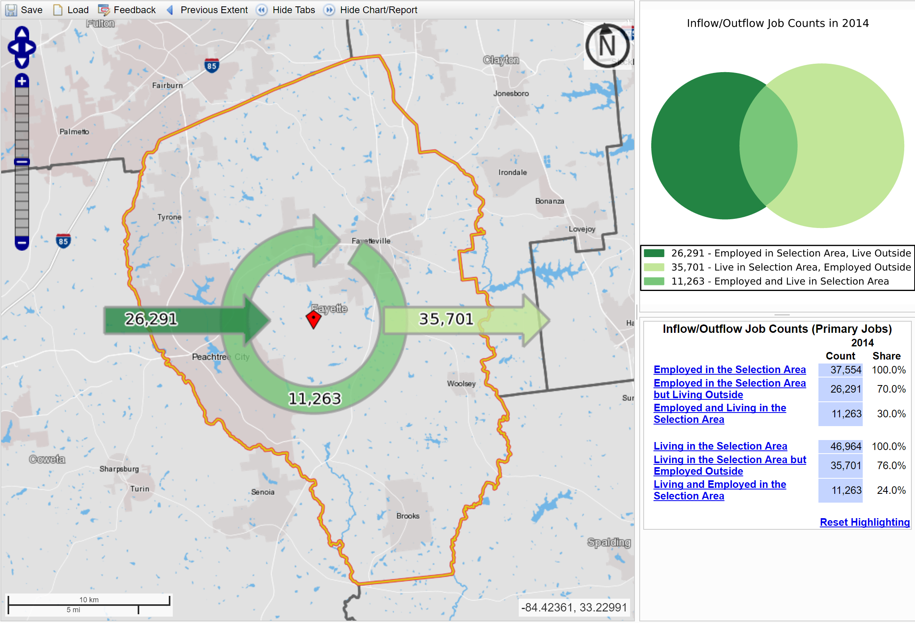
Worker Inflow/Outflow –Douglas
Worker Inflow/Outflow – Fayette
Almost 81% of workers living in Douglas leave the county for work. But 73% of jobs in Douglas are held by non-residents.
Almost 76% of workers living in Fayette leave the county for work. But 70% of jobs in Fayette are held by non-residents.

