Slide 1
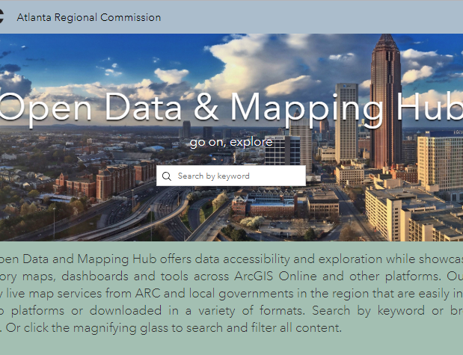
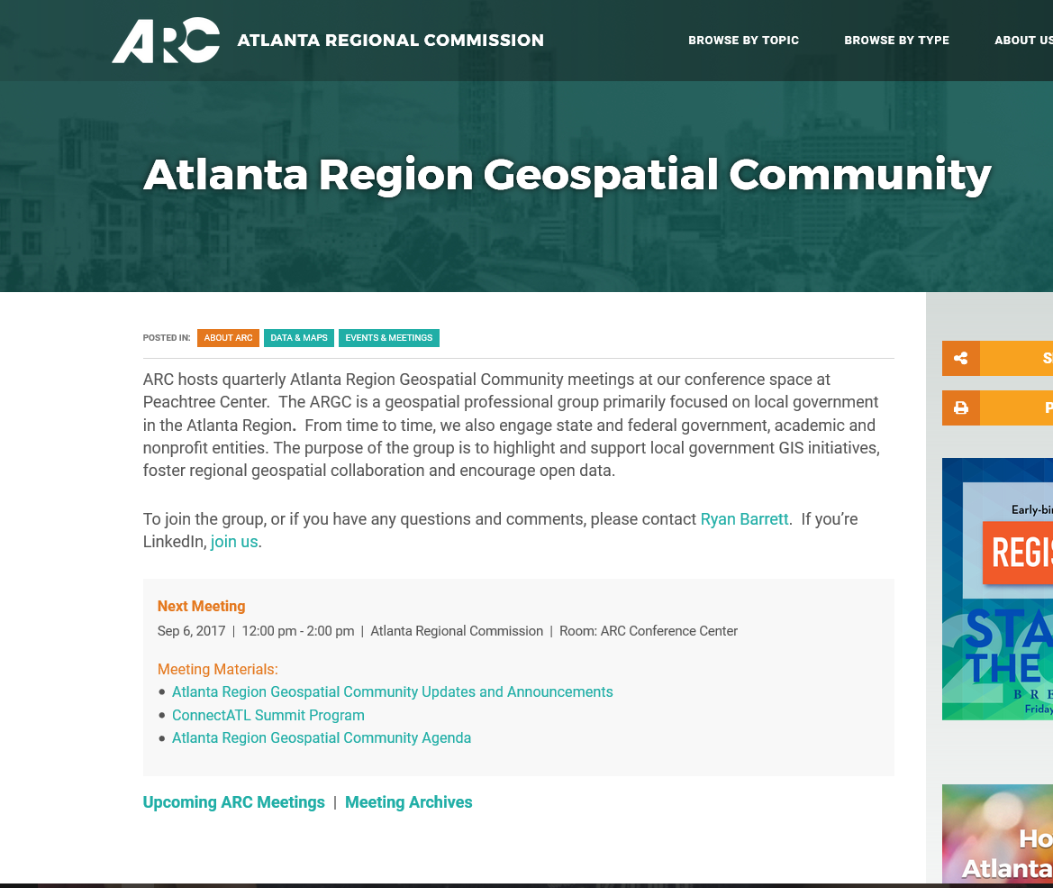
Interact with this presentation at menti.com with code 62 74 24
Atlanta Region
Geospatial Community
February 5, 2020
Conference Center, Plaza Level, Peachtree Center
Next Meeting Date: Friday May 1, 2020
WiFi credentials: AtlRegional-Guest | Community
arcopendata.com
atlantaregional.org/argc

Slide 2
Agenda
Lunch, Topic Time, poster gallery
Introduction, updates and announcements
Tragedy to Turning Point: The Journey of Alpharetta 911 to NG9-1-1 Carl Hall, City of Alpharetta
Lightning Round: The Shape of Water Dominic Maldonado, City of East Point
Thunder Demo: DeKalb County 2018 Annual Development Report Story Map Katherine Pearson Wells, DeKalb County
Thunder Demo: City of Alpharetta’s Approach to Low Response Census Tracks Steven Wardrup, City of Alpharetta
Adjourn

Slide 3
ARGC Participation GISP Points
Earn GISP points through membership, attendance, presentations and poster displays.
Request your summary letter of participation to submit to GISCI.
Updates & Announcements
Notes:
Earn GISP points through membership, attendance, presentations and poster displays.
Request your summary letter of participation to submit to GISCI.

Slide 4
Esri’s Training Program offers a variety of free, online courses: For instance, Esri now offering MOOCs (Massive Open Online Course) such as Spatial Data Science, Spatial Analysis, GeoApps and Cartography. With nearly five hundred free courses available, you’re certain to find an Esri course that fits your work. Tip: When searching courses, select the ‘Maintenance’ and ‘Free’ checkboxes under Product.
Interested in coding and technology, explore these platforms: General Assembly, Free Code Camp, W3Schools, CodeAcademy, Udacity and FutureLearn. Additional opportunities are offered by Amazon AWS and Google. LinkedIn/Lynda offers a free, one month trial membership.
Looking for something less technology oriented? Coursera and EdX offer thousands of courses from many top universities (Harvard, Stanford, CalTech). Here’s a list of curated Coursera courses. When viewing a course description in EdX, you may notice a fee associated with receiving a certificate. You can skip the certificate and fee by looking for the “or study for free” option to enjoy free enrollment. Even MIT offers free online courses!
Need credits to maintain your LEED certifications? Explore GreenCE and GBRI.
APA offers online education Certification Maintenance opportunities for AICP Members and the folks at NNIP offer a wide variety of interesting training links.
We want to hear from you! Help us grow our list of training opportunities by sharing your favorite free or low cost course or learning platform. Send links and details.
Online Training Resources
Notes:
Newest addition is ESRI Spatial Data Science MOOC. We want to hear from you! Help us grow our list of training opportunities by sharing your favorite free course or learning platform. Send links and details through the form.

Slide 5
Census Update
PSAP Verification phase happening now
Last opportunity to review and modify 2020 tracts and BGs
Deadline to report changes is 2/14/2020, submit data by 4/14/20
PSAP is a county-level program but cities can weigh in too
2020 Boundary and Annexation Survey (BAS)
Cities report any annexations or Census boundary corrections
First deadline is March 1st 2020, final deadline is May 31st
Data submitted by 3/1/2020 will be reflected in next ACS
Important update, boundaries will be used in 2020 tabulations
Complete online response form, use script tools to process any annexations or boundary corrections
pdigirolamo@atlantaregional.org for any questions
Updates & Announcements

Slide 6
Statewide Imagery through GA GIO Imagery Program
High-resolution statewide imagery (3 band) tile service available to all government entity employees in Georgia - details and FREE registration
Contractor registration also now available
To help secure ongoing funding to maintain and update imagery beyond this pilot please share your success stories if your office has benefited – either by government employees or through the work of a contractor
Updates & Announcements

Slide 7
Events
Association of American Geographers Annual Meeting April 6-10 in Denver
ConnectATL Summit March 31 at GA International Conf Center
ESRI User Conference July 13-17 in San Diego
GAURISA luncheon Second Tuesday, rotating locations
Georgia Geospatial Conference Oct 11-13 in Savannah
GeoTAC (Georgia Geospatial Technical Advisory Committee, formerly GISCC) meeting Monthly virtual sub-committee and quarterly in-person
Metro Atlanta Geospatial Society Meetup
Announce additional events next at menti.com
Career Opportunities
City of Atlanta Seeks GIS Coordinator (CLOSES TODAY!)
Atlanta Regional Commission Research & Analytics Group seeks part-time/internship position with our Neighborhood Nexus team with strong communications focus
Georgia Geospatial Information Office Seeks two full-time and one internship positions:
Geospatial Solution Engineer
Business Development Specialist
Communications Intern: Despite the job description saying “mapping” this is a Communications Internship, not a mapping internship. It will, however, be working in the Geospatial Information Office.
Announce additional opps next at menti.com
Updates & Announcements
Notes:
GAURISA next meeting: SS Census

Slide 8
Interact with this presentation
Go to menti.com Enter 62 74 24
Updates & Announcements

