Slide 1
Urban Resilience and Equitable Engagement:
An Oakland Case Study
Atlanta Regional Commission
Land Use Coordinating Committee
December 17, 2020
Alexandria McBride, Chief Resilience Officer, City of Oakland

Slide 2
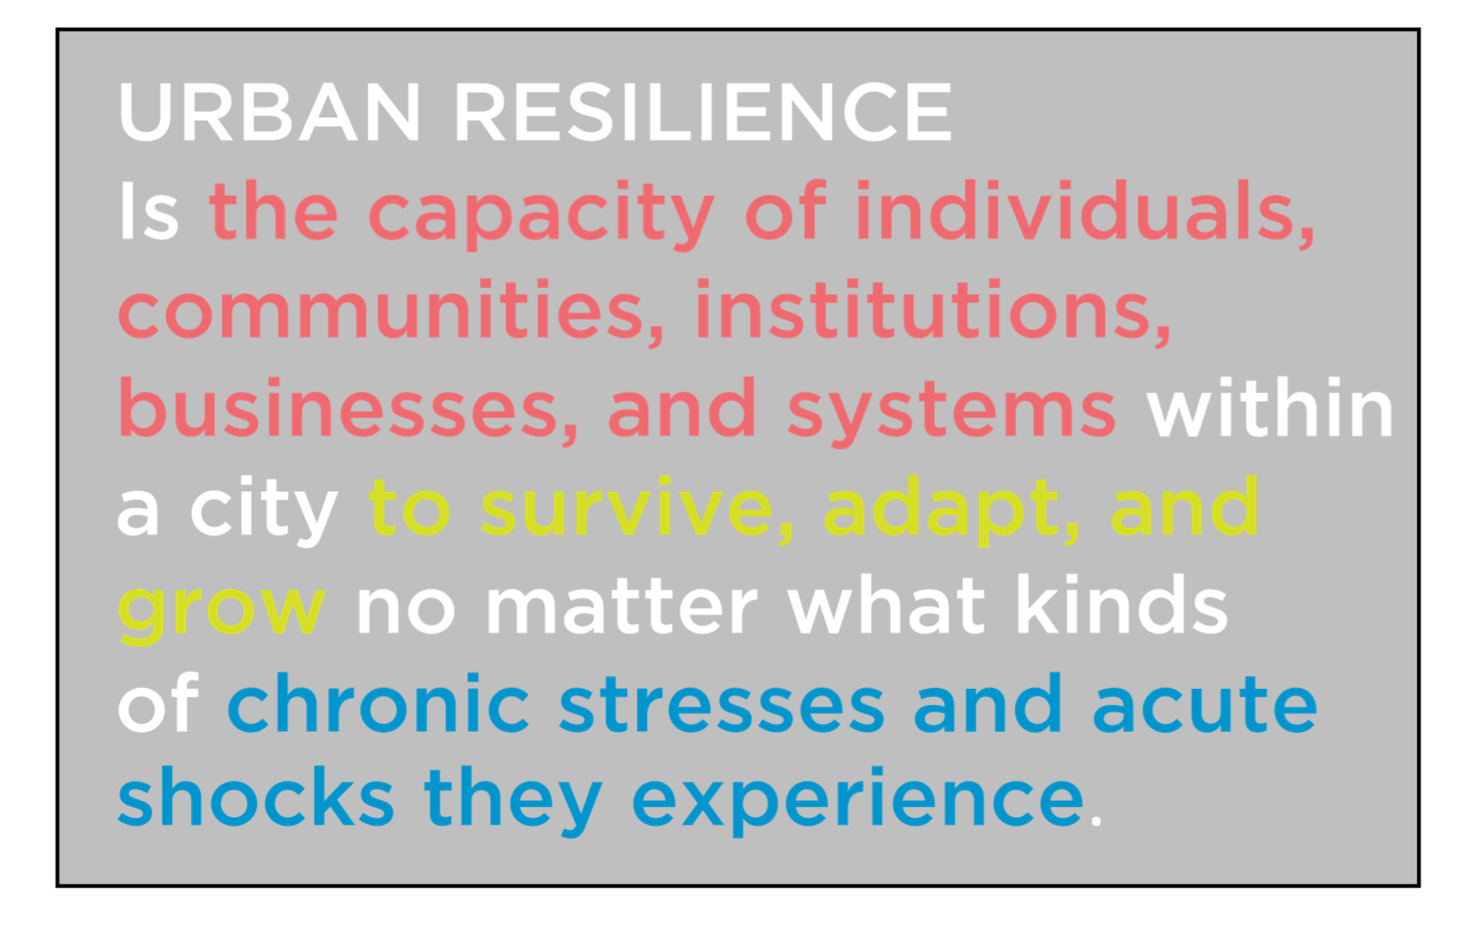
Source: 100 Resilient Cities. NAM Convening. February 2019.

Slide 3
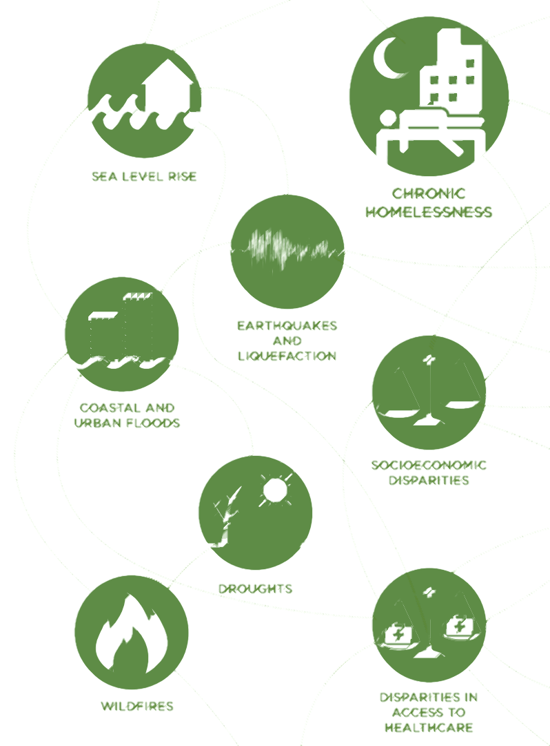
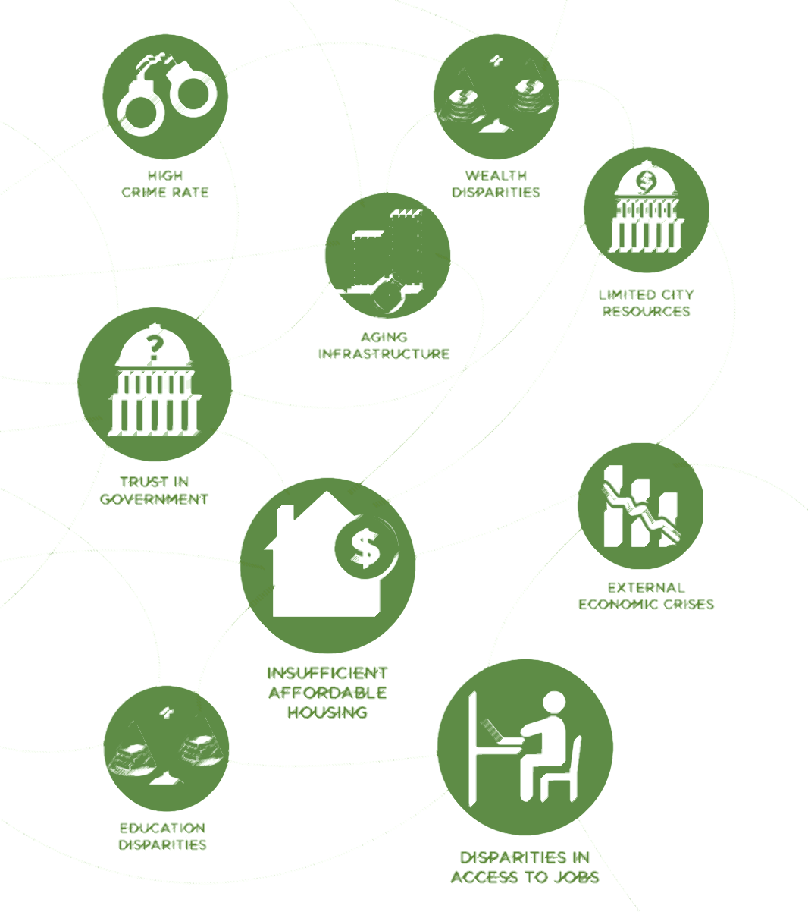
Oakland’s Shocks and Stresses

Slide 4
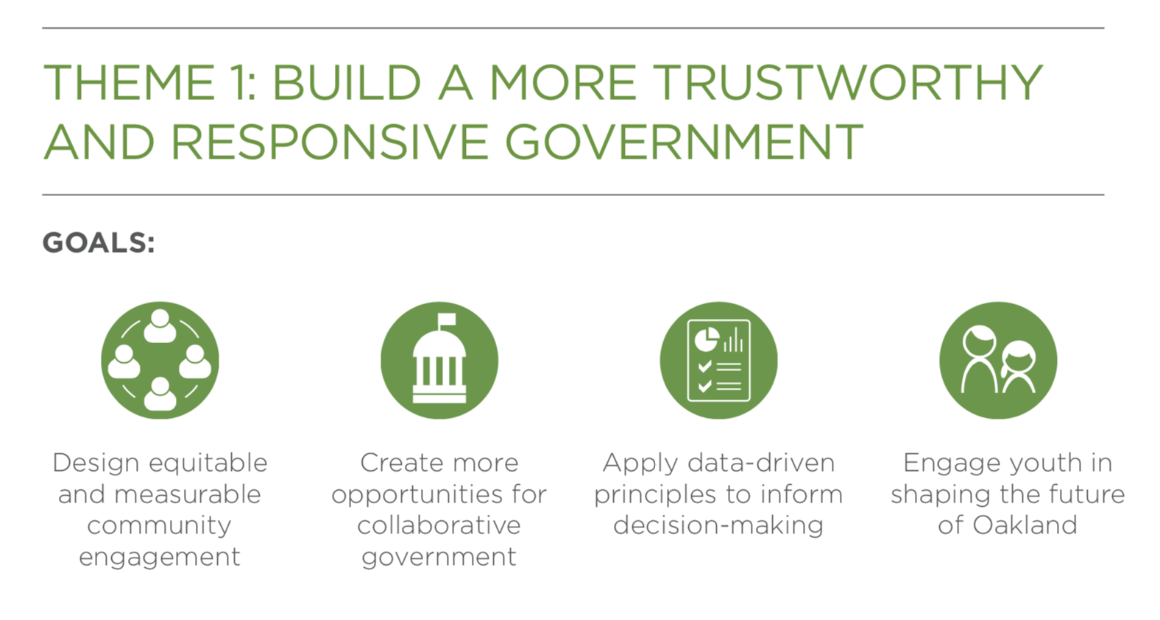
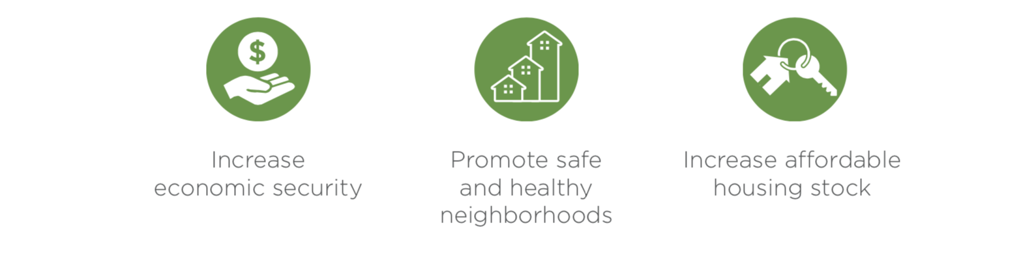
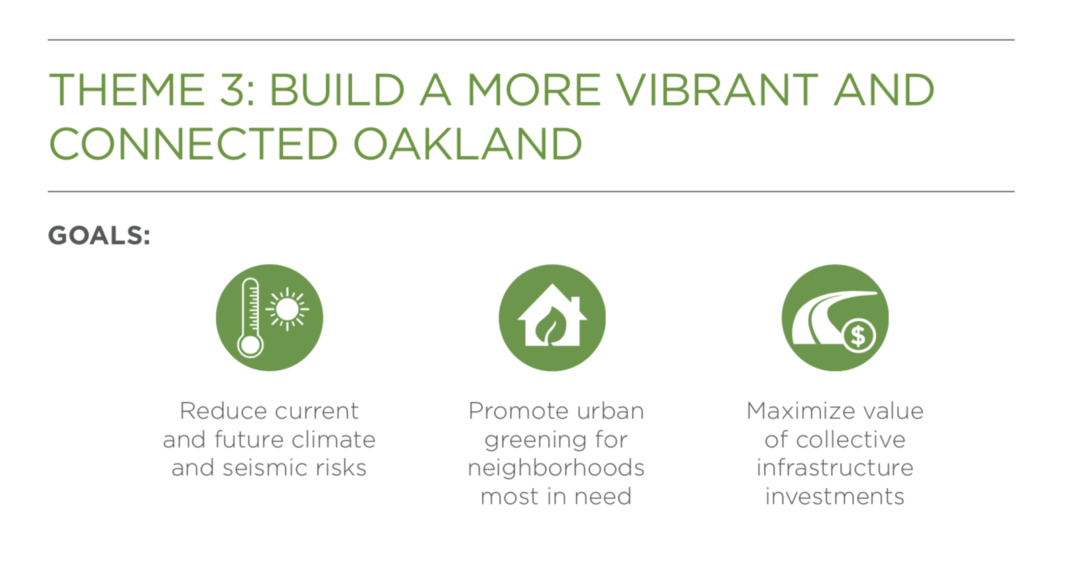
Resilient Oakland
Priorities
Build a more trustworthy and responsive government
Stay rooted and thrive in our town
Build a more vibrant and connected Oakland

Slide 5
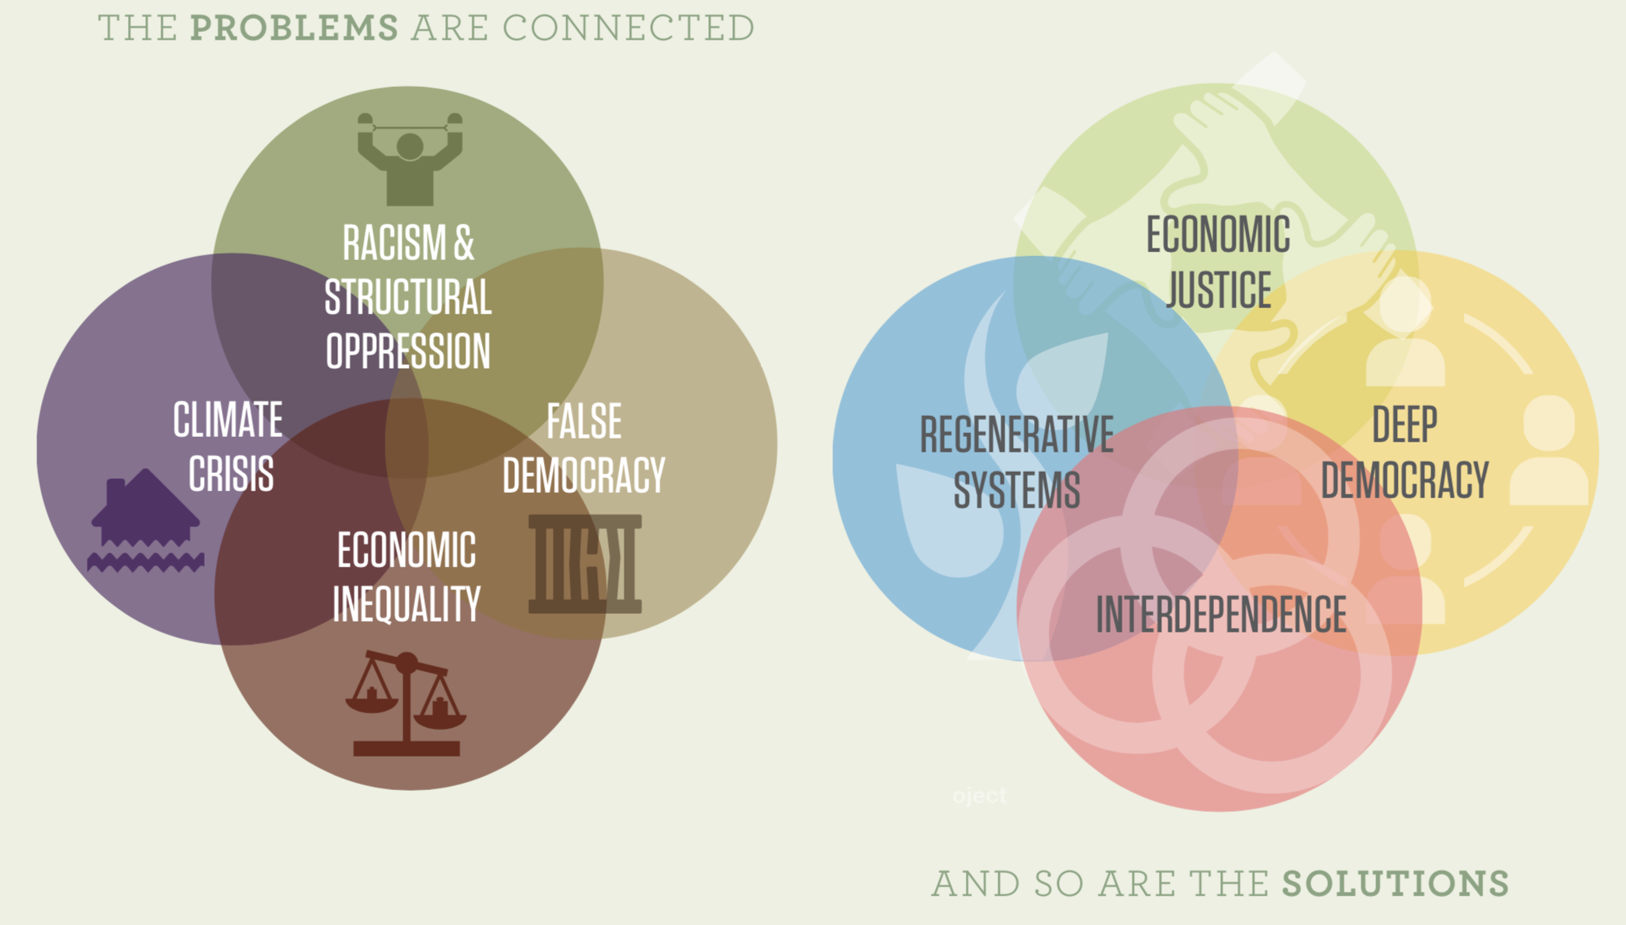
Source: Movement Strategy Center. Community Driven Climate Resilience Planning
Notes:
KETA - Problems
Note that our current collaboration with the city is aimed to transform our sense of false democracy to true deep deomocracy
COLIN - Solutions

Slide 6
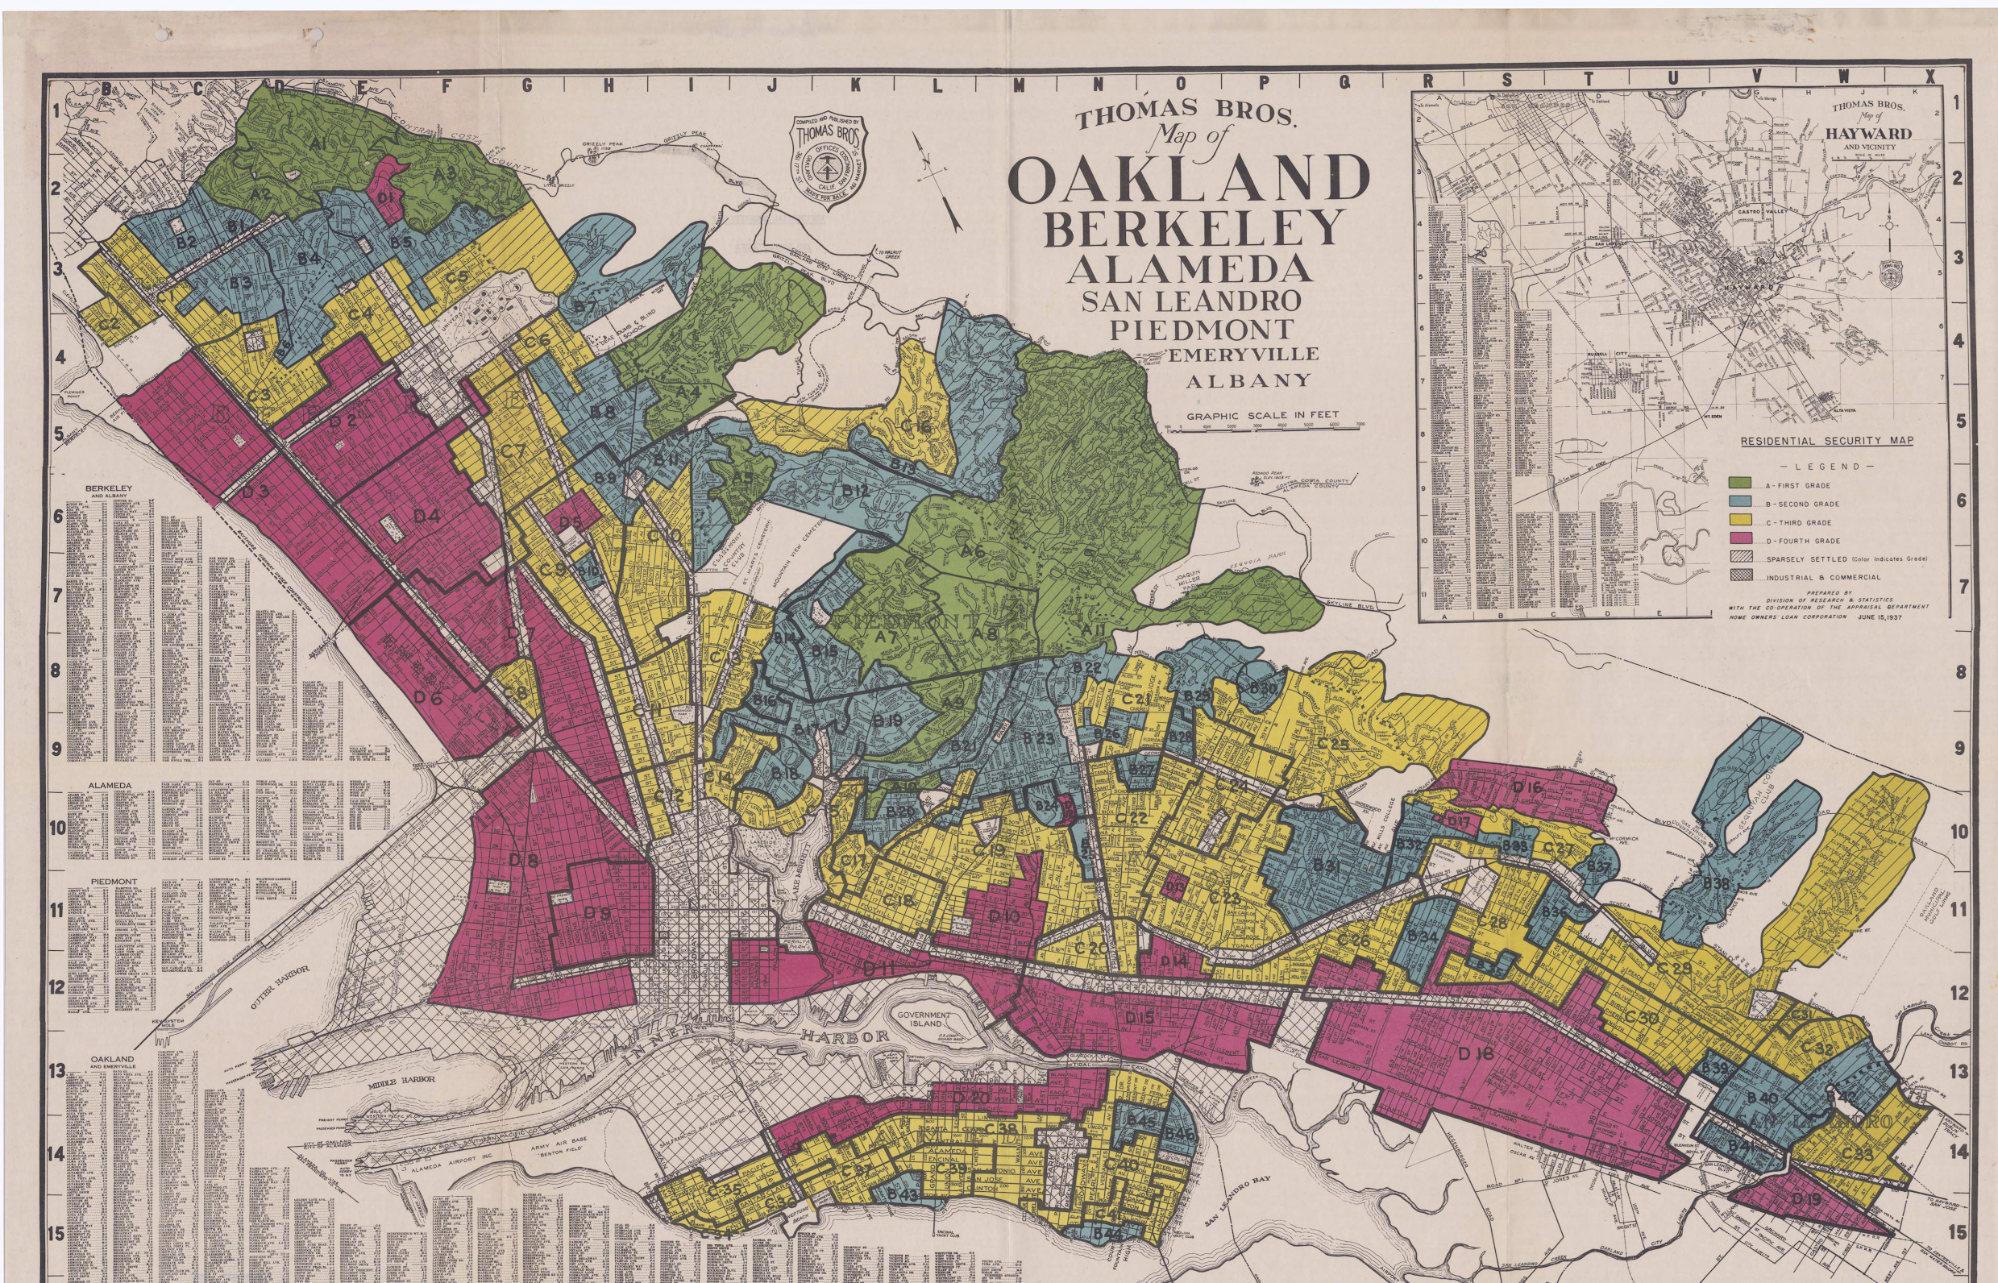
Oakland’s Legacy of Redlining

Slide 7
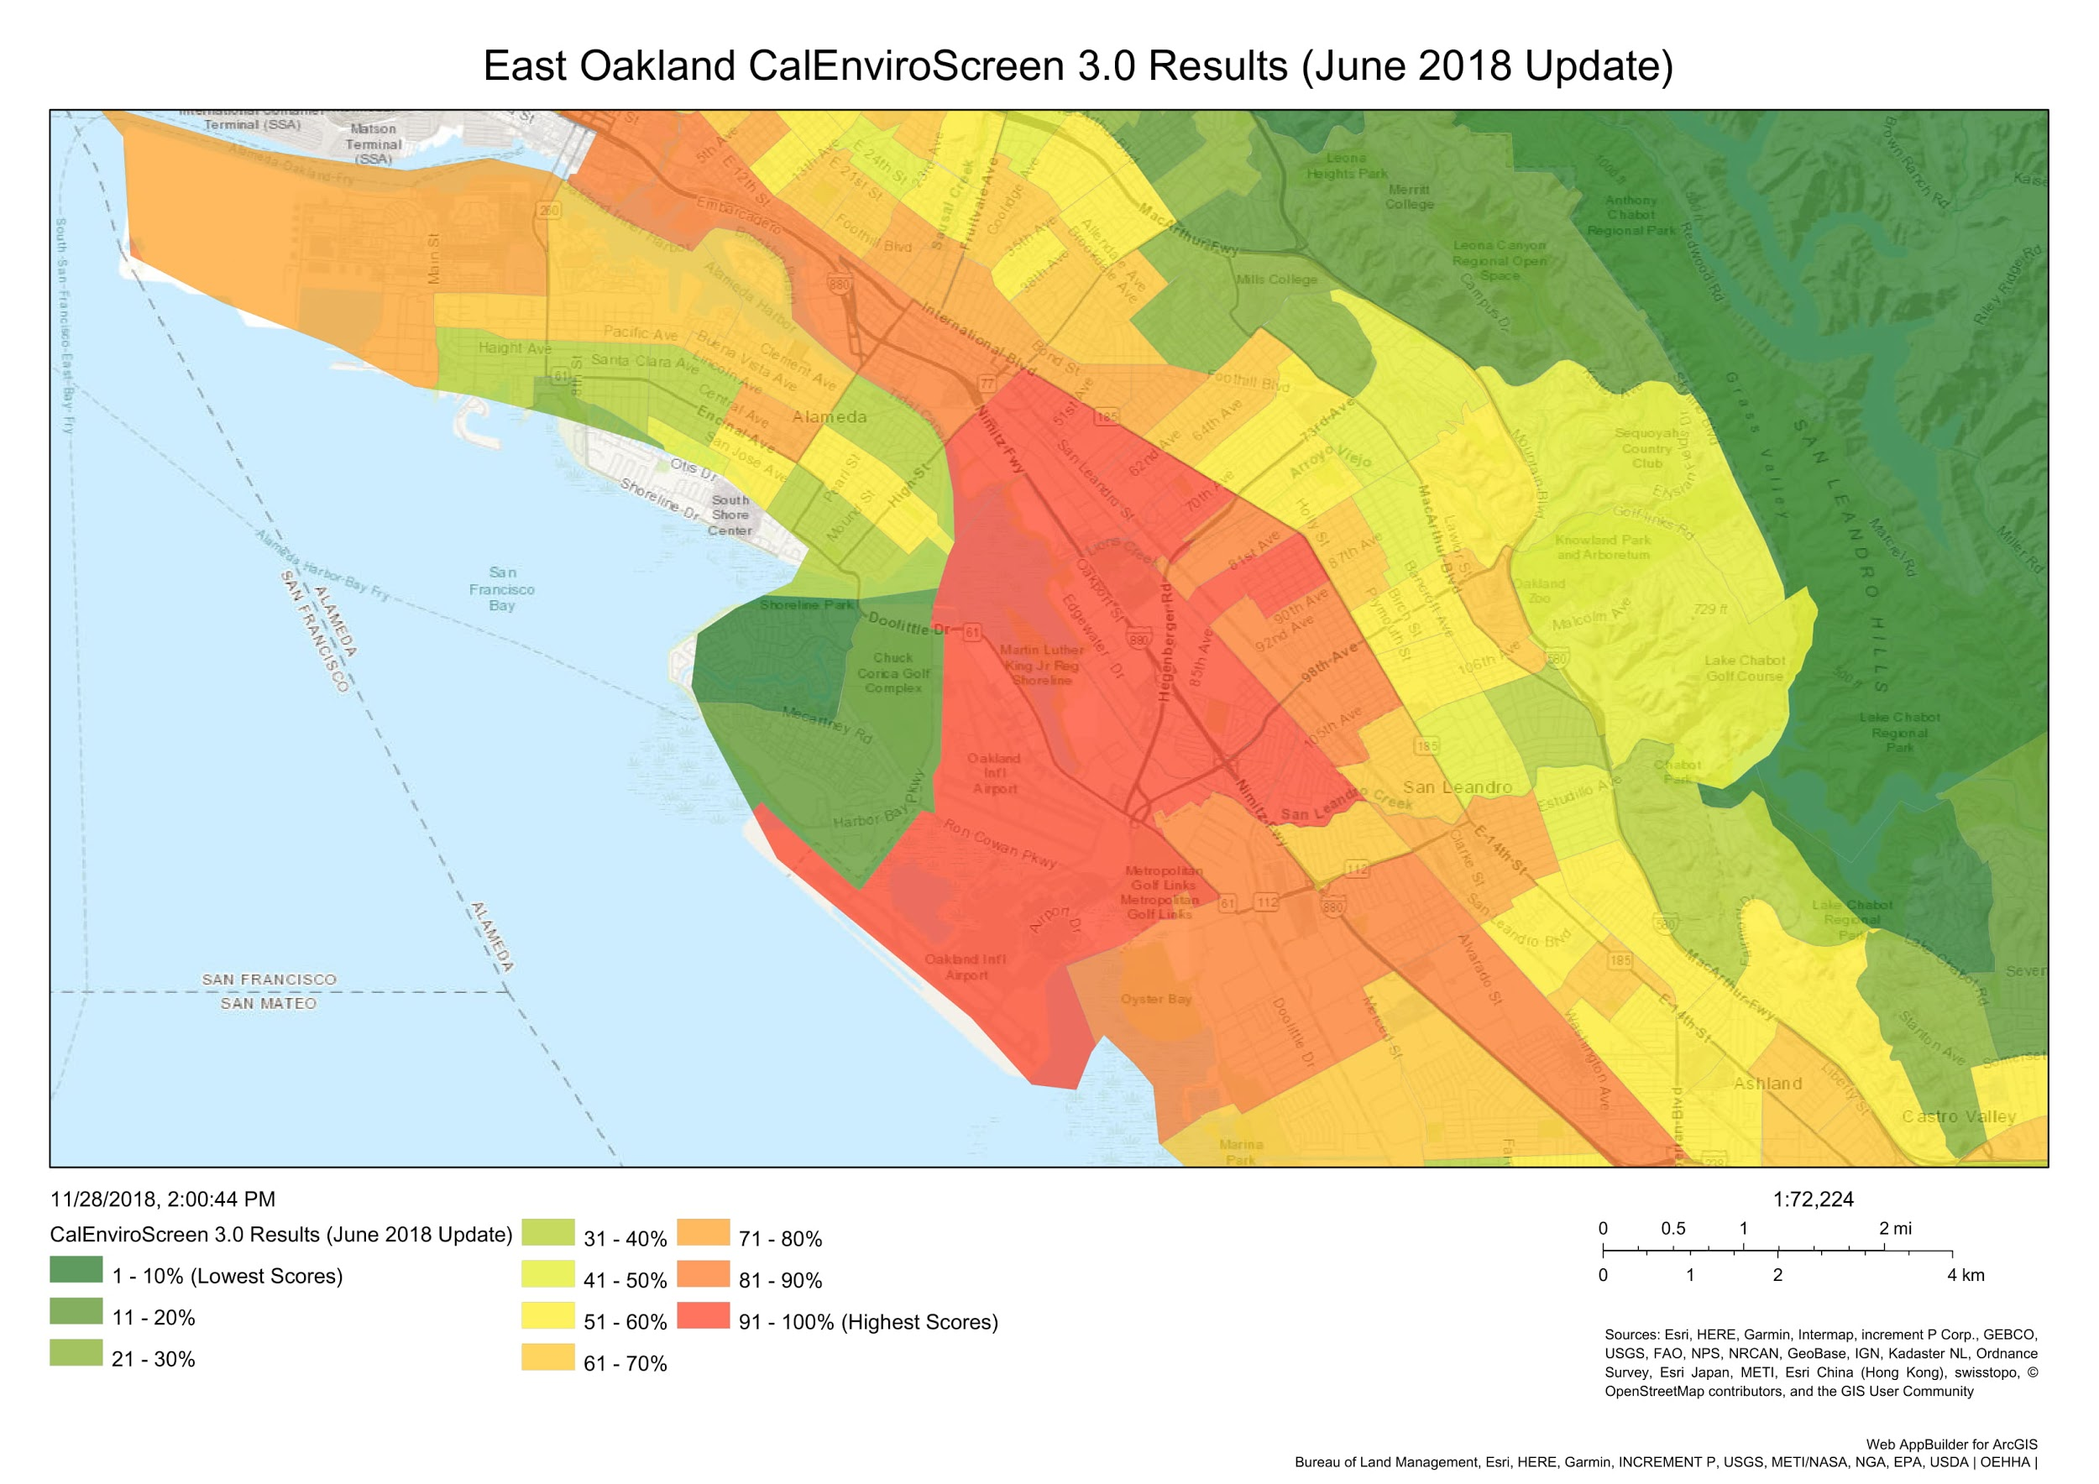
Oakland’s Disproportionate Environmental Burdens

Slide 8
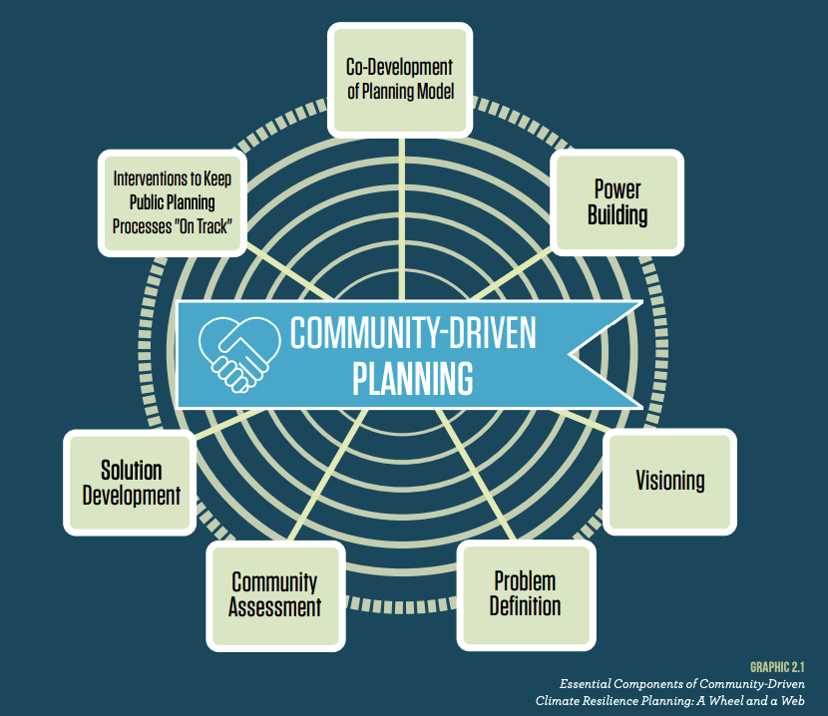
Source: Movement Strategy Center. Community Driven Climate Resilience Planning

Slide 9
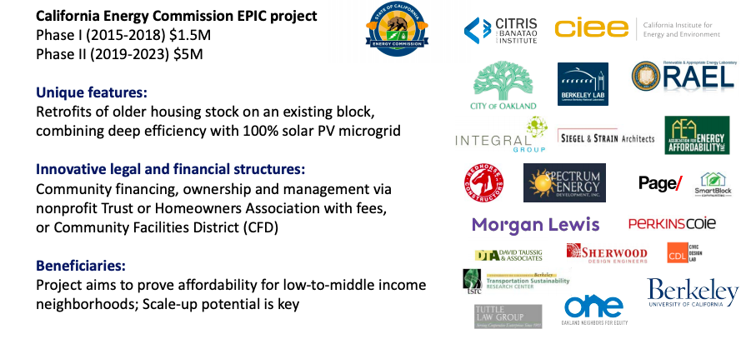
EcoBlock – A Zero Net Energy, Low Water-Use Retrofit Neighborhood
Source: Dr. Alexandra von Meier,:The Oakland EcoBlock, Phase II, CPUC Equity Workstream Meeting October 6, 2020

Slide 10
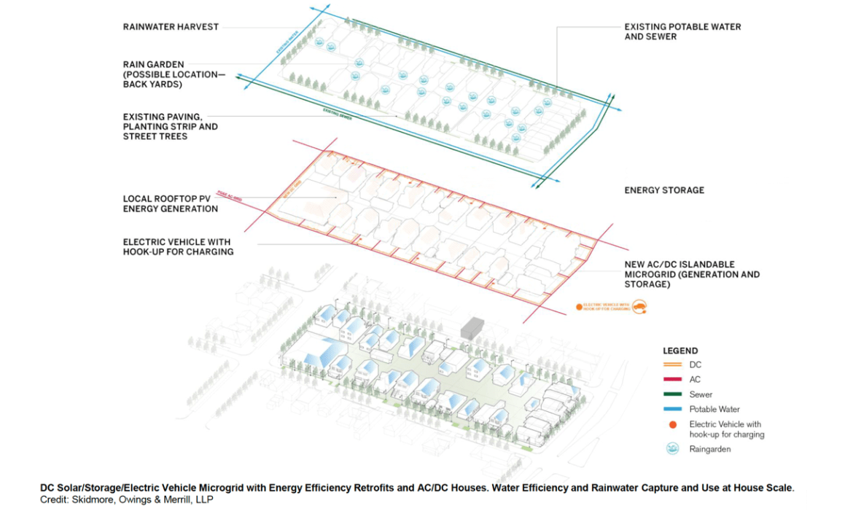
EcoBlock - Proposed Model

Slide 11
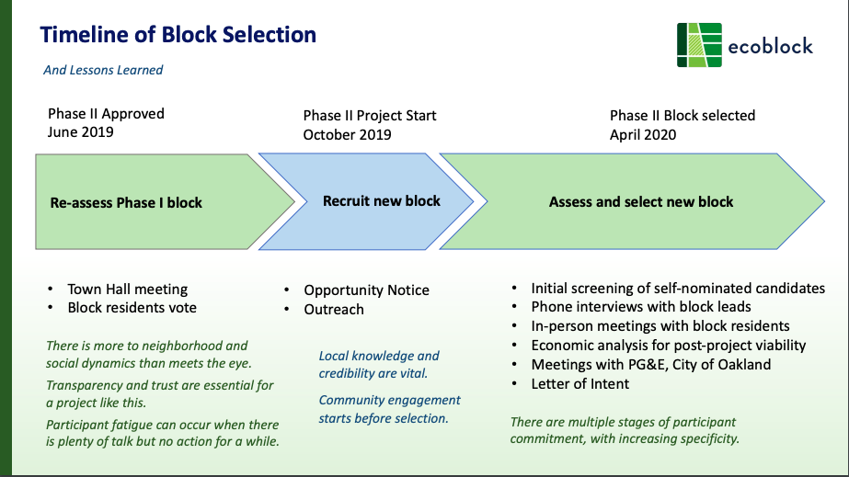
Environmental Justice and COVID-19
Source: Dr. Alexandra von Meier,:The Oakland EcoBlock, Phase II, CPUC Equity Workstream Meeting October 6, 2020

Slide 12





Better Neighborhoods, Same Neighbors
An East Oakland Neighborhood Initiative
Vision: An East Oakland with healthy surroundings, safe and accessible transportation and thriving arts and culture that builds community wealth and ensures housing is a human right for existing East Oakland residents.
Summary: Five projects led by the principles of community engagement, workforce development, displacement avoidance and climate resilience
Project Area: A 5 square mile area in East Oakland centered in six neighborhoods: Melrose, Highland/Elmhurst, Sobrante Park, Brookfield Village/Columbia Gardens, Stonehurst, Coliseum/ Rusdale/ Lockwood/ Havenscourt.
Implementation:$28.2 M in grant funds to be spent across a five-year period
ACTS Community Development Corporation

Slide 13
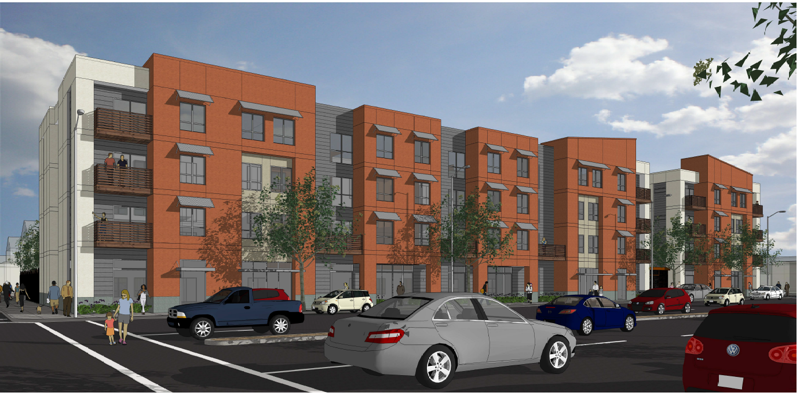
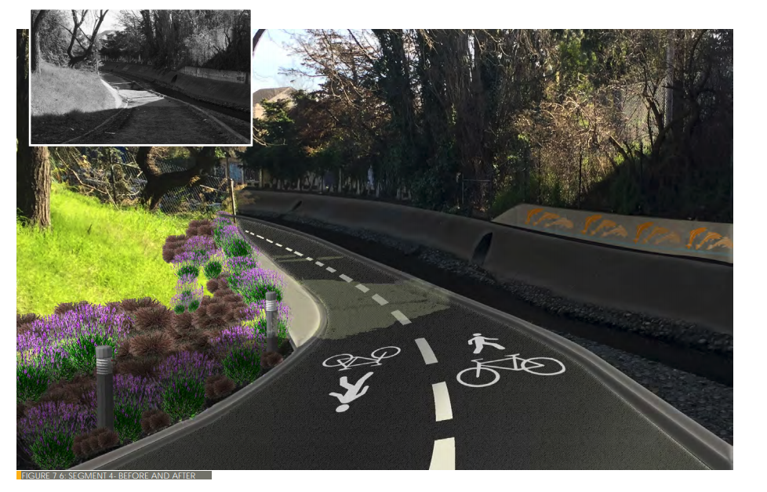
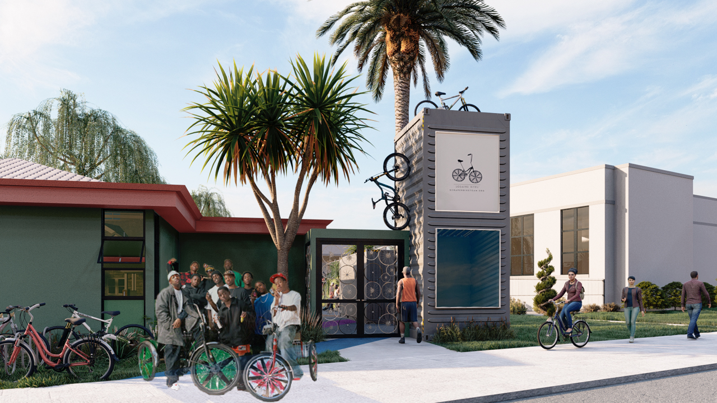
Impact
  55 units of affordable housing (20-50% AMI) and a health clinic
  A new 2-acre certified organic nursery in Sobrante Park creating a local food hub
  1.2 mile greenway segment linking MLK Shoreline Park to Madison Park Academy along San Leandro Creek
  A permanent bike shed/lending station and Scraper Bike share to 500 youth
  2,000 trees and install living walls
  An estimated 100+ jobs and training
  Reduction of 8,749 Metric tons of carbon dioxide, equivalent to taking 1,900 cars off the road for one year

Slide 15



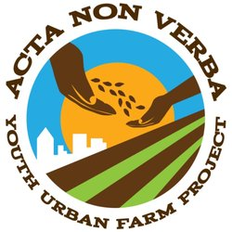









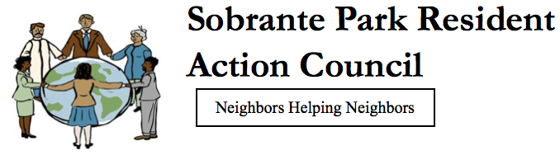






Partners
Notes:
COLIN
Hyper collaboration across non profit sectors to take a holistic approach at revitalizing the community

Slide 16
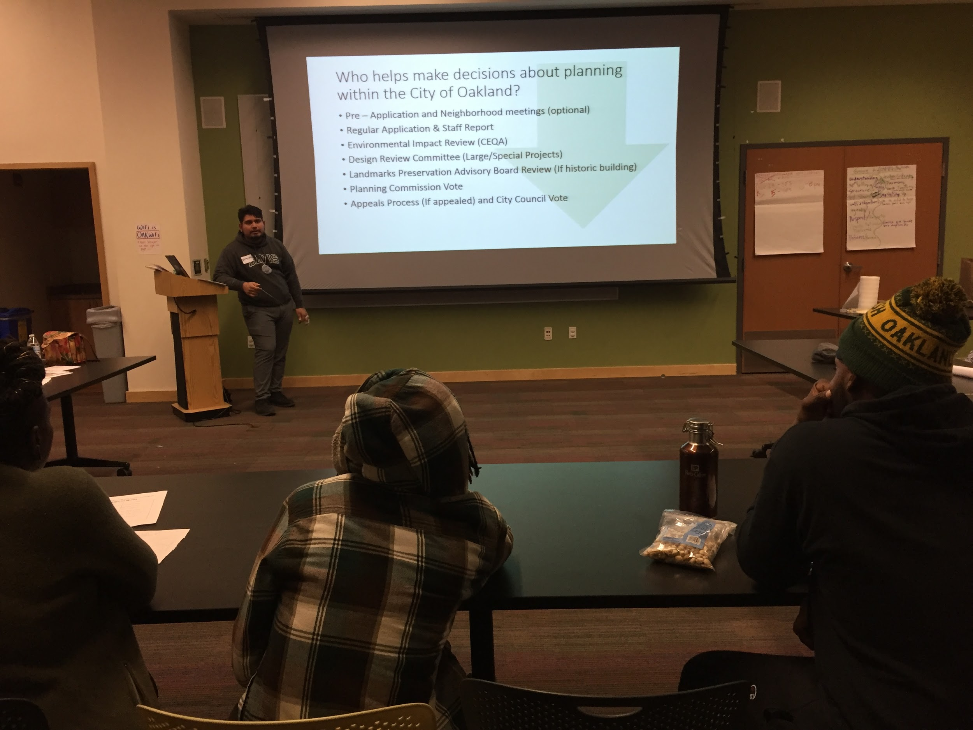
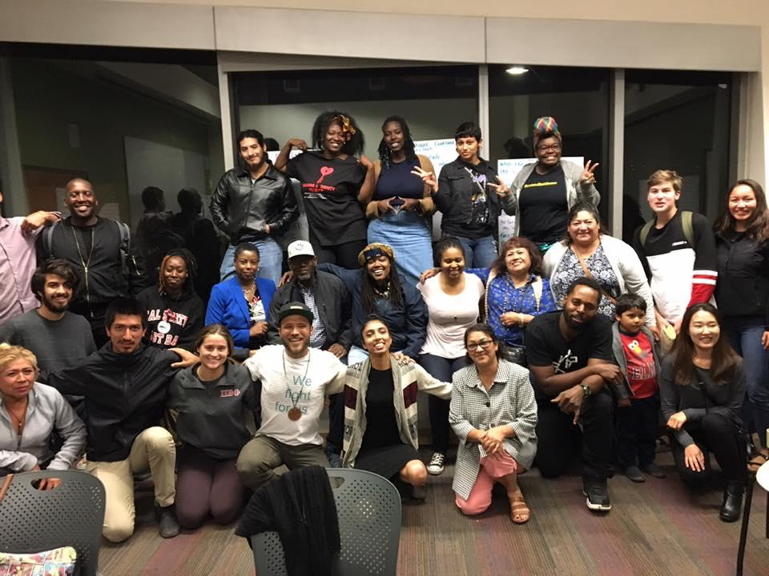
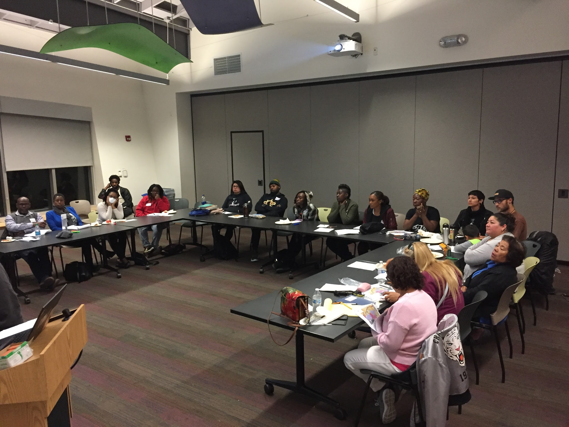
Partners

Slide 17
Contact Info
Alexandria McBride
amcbride@oaklandca.gov
1 Frank H. Ogawa Plaza (City Hall)
Oakland, CA 94610
510-238-6454

