Slide 1
Metropolitan Transportation Plan (MTP) Update
TCC
January 13, 2023

Slide 2
Executive Summary
ARC is required to update the Metropolitan Transportation Plan (MTP) every four years. Each Plan update provides an opportunity for regional policymakers to reset regional policy and priorities. An important element of this Plan update process is understanding alternative futures and scenarios. A major work session is planned for April with regional policymakers to discuss alternative futures and regional disrupters.
During 2023, ARC staff will work with the TAQC and ARC Board to:
Revisit the regional policy framework
Assess “disrupters” that will impact the region in the future
Review alternative scenarios for the region
Conduct the work necessary to adopt an updated Metropolitan Transportation Plan (MTP) in January 2024

Slide 3
Metropolitan Transportation Plan Update
2050 is the horizon Year for the Plan
$173 billion Total value of all of the investments in the Plan
The last full update of the Plan was adopted by the Board in Feb 2020
This update will be adopted by the TAQC and the Board in January 2024

Slide 4
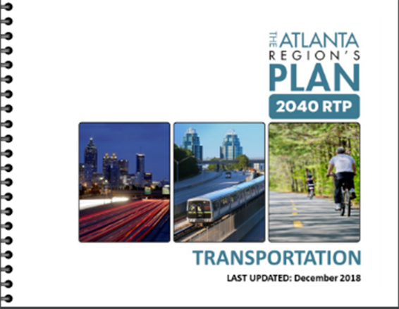
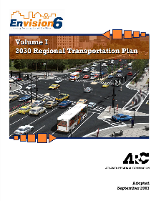
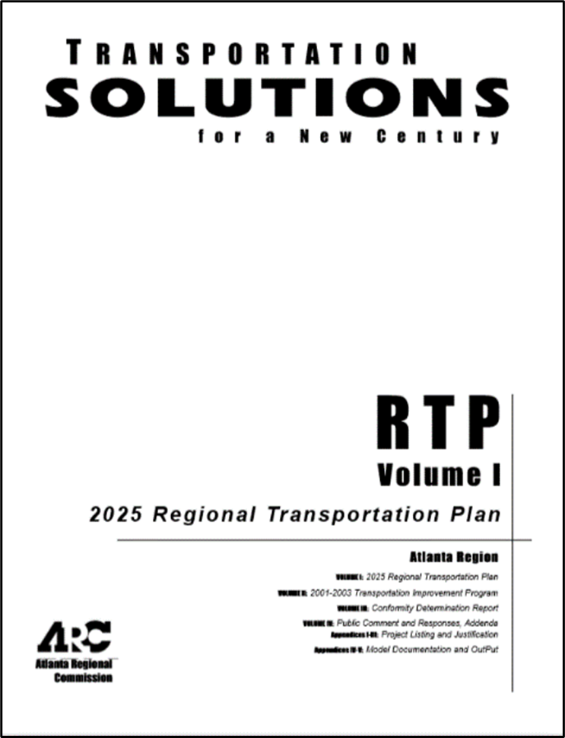
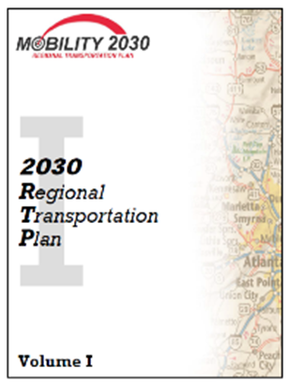
Time for Emergence of a New Vision for Metropolitan Atlanta
One Great Region
Prior Planning Work and Opportunity to Craft an Updated MTP
The Atlanta Region’s Plan
Updated Baseline Scenarios and Policy Framework
The Atlanta Region’s Plan
Reflected transit referendums
Plan 2040
Envision 6
Scenario Planning Emphasis
Transportation Solutions for a New Century
Mobility 2030
Addressed Issues with declining funding
Responded to a larger region
Transit emphasis and Express Lanes
VISION 2020
MTP that brought region out of non-attainment.
Establishes vision for growth
2000
2004
2006
2011
2016
2020
2024

Slide 5
Project Management

Slide 6
2023 MTP Work Activities
Final Review and Approval Required: January 2024
Milestone
Joint ARC Board & TAQC Working Session
Milestone
Joint ARC Board & TAQC Meeting
First Read of MTP Update
2023
Jan | Feb | Mar | Apr | May | Jun | Jul | Aug | Sep | Oct | Nov | Dec
Policy Framework and Scenarios
Demographic Forecasts
Financial Forecasts
Alternative Futures
MTP Documentation Update and Engagement
Community/Stakeholder Engagement
Documentation, Projects, and Approvals
95%
Key ARC Board / TAQC Coordination Points
Final Review & Approval: Jan. 2024

Slide 7
Critical Success Factors
1) Take stock of existing conditions and establish a new baseline for transportation planning and decision-making and 2) Develop strategic forecasts, scenarios and policy to guide future investment decisions.
1
2
Public participation strategy that includes local government coordination; Speaker’s bureau and public meetings; Focus groups and small group discussions; Virtual public involvement; ConnectATL
Meeting evolving federal planning emphasis areas, including Climate, Electrification, Equity / Justice40, and other items in the IIJA and Executive Orders
3
4
Coordinate with State-level planning directions associated with mobility, including the STIP update, MMIP, freight and electrification
Respond to updated local and regional program adjustments, including MARTA’s program and ARC’s emphasis on land use, housing and the Unified Growth Policy Map
5

Slide 8
Scenario Planning Process at a Glance

Slide 9
Scenario Planning helps Policymakers Understand the Future and what Paths can Lead to Success
To best understand and plan for the future, it is critical to identify the primary drivers of change. Extensive work was previously done on identifying these drivers of change. The time has come to update and revise the drivers of change and discussion on drivers of change and scenarios will be the focus of discussion at our April work session.
One Great Region
Drivers of Change
Today

Slide 10
In order to support the long-term outcome of having “One Great Region” we need to understand where potential policy interventions are needed
Alternative scenarios helps to inform this process and provides policymakers with information on the future.
Policy Support
Positive Direction
2023
Driver
Negative Direction
Incentives
Policy Interventions

Slide 11
The Atlanta Region was one of five regions selected by USDOT to received supplemental funding assistance to implement next generation scenario planning between 2015 and 2017. A key outcome was identifying disruptive changes impacting the region.
Drivers of Change
Universe of Drivers of Change
SOCIAL
National and regional experts, as well as policy makers, recommended identifying drivers of change through a a process called “STEEP”
National Expert Review Process
Stakeholder Survey
Policymaker Work Sessions
TECHNOLOGY
ECONOMIC
ENVIRONMENTAL
POLITICAL

Slide 12
Nine Key Drivers of Change – or Disruptors – Were Identified and Scenarios were Built Around Addressing these Challenges
Autonomous Vehicles
Spatial, Racial and Economic Equity
Climate
Change Regulations
One key emphasis area was technology and the impact on workplaces and travel
Other critical drivers of change included the emergence of Georgia as a freight hub, climate change regulations, and a changing population
Aging of the Population
Transportation Finance Structure
Water
Supply
Intelligent Infrastructure & Technology
Ridehailing Services
Port
Traffic

Slide 13
Highlights of Prior Scenario Planning Work that Supported the Current Regional Vision

Slide 14
Prior Scenario Planning Assessed Four Alternatives

Slide 15
Key Challenge: The Most Significant Disruptors can be Unexpected
Autonomous Vehicles
Spatial, Racial and Economic Equity
Climate
Change Regulations
COVID 19 has fundamentally changed the region
Has impacted commutes, housing, and regional growth
Aging of the Population
Transportation Finance Structure
Water
Supply
Pandemic
Intelligent Infrastructure & Technology
Ridehailing Services
Port
Traffic

Slide 16
Moving Forward it is Critical to Focus on System Shocks
What other unexpected system shocks could our region experience in the future?

Slide 17
ARC will use new tools (VisionEval) to Assess Future Scenarios*
INPUT
Regional Context | Local Actions |  | Collaborative Actions
 | Community Design | Marketing & Incentives | Vehicles & Fuels | Pricing
Demographics Income growth Fuel price | Transit service Future housing (single and multi-family) Parking fees Bicycling | Travel demand management strategies Car sharing Education on driving efficiency Intelligent transportation systems | Vehicle fuel economy (mpg) Fuel types Commercial fleet information | Pay-as-you-drive insurance Gas taxes Road user fees
*Illustrative examples of inputs that can be adjusted in model and does not include all variables.

Slide 18
Performance Metrics will Help Inform Discussions for the April Working Session
Annual CO2 Emissions
(total and per capita)
Transit ridership
(total and per capita)
Walking/bicycling trips
(total and per capita)
Annual hours of delay
(per capita)
Vehicle miles traveled
(per capita)
Vehicle operating cost
(per capita)
Social cost of transportation
(per household)
Test Other Policymaker
Identified Scenarios
Through VisionEval
512 model runs to test and evaluate alternative futures
as a starting point

Slide 19
Policymaker Feedback….What are the Key Drivers of Change Post-Pandemic? Examples
What are we missing?
?
Housing affordability relative to national peers
The ability to afford rents and mortgages has historically been one of region’s great assets
Impact of remote working on job centers and communities
How will job centers and communities respond? Is this a permanent change in the way we work?
Federal policy Changes and iija
Onshoring of manufacturing for electric vehicle industry
and the Executive order to assess net-zero greenhouse gas emissions by 2050

Slide 20
Policymaker Feedback for Today…
In preparation for the April Working Session please provide feedback on:
What do you see as the primary “drivers of change” in the future?
2) Are there planning scenarios that ARC should test?

