Slide 1
ARC BOARD & TRANSPORTATION AND AIR QUALITY COMMITTEE (TAQC)
ARC’s Regional Safety Strategy
Final Review and Action
January 13, 2023

Slide 2
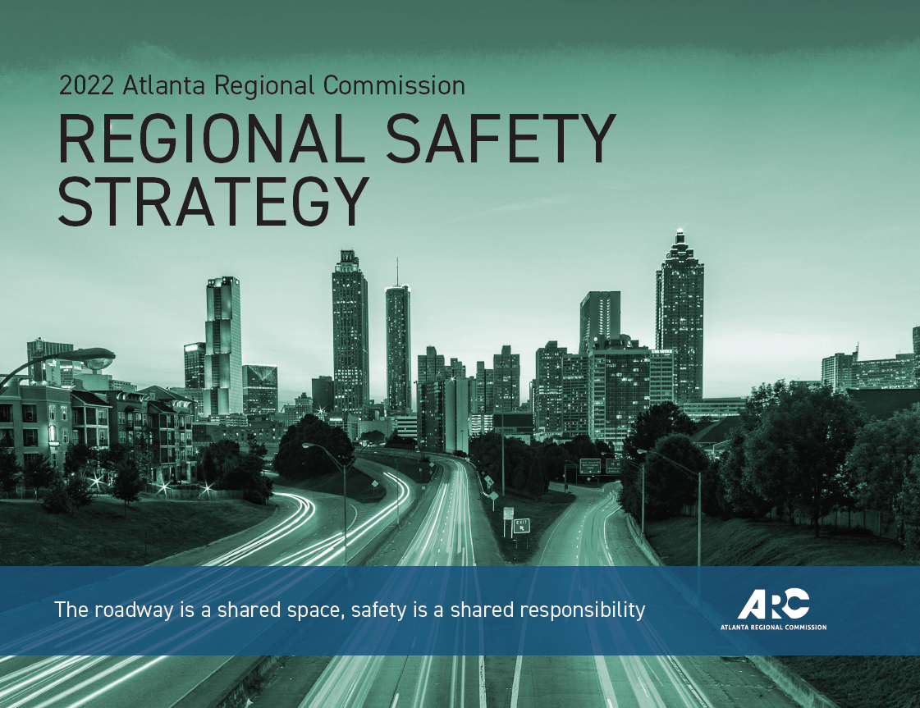
What is the Regional Safety Strategy (RSS)?
Regional strategy to guide ARC and its partners in proactively achieving safety goals and building a safe transportation system for all users in the Atlanta region:
Advances safety in a unified way
Shifts towards more proactive approach, rather than reacting to past trends
Address rising severe crash trends and maximize impact of increased funding
Prior review with policymakers in March, July, Nov., December

Slide 3
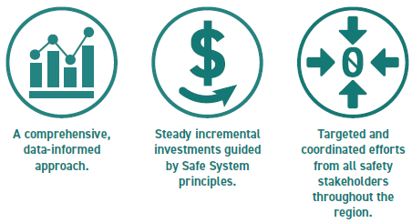
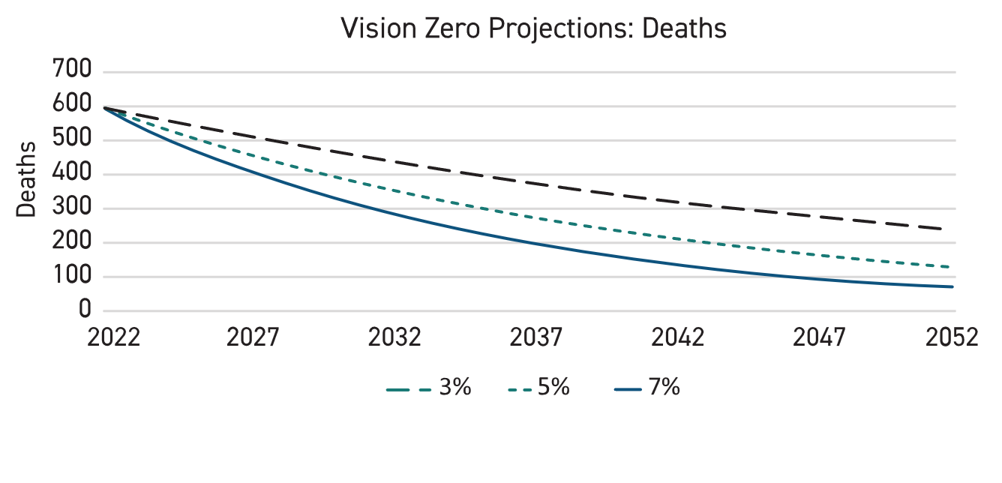
Vision Zero Goal
Vision Zero: pro-active goal for zero fatalities & serious injuries
ARC will adopt 5% reduction each year for all safety targets.
Notes:
Vision Zero has been part of several previously adopted plans, including the current RTP. The plan clearly reaffirms it and sets us on a better path to achieve it.
5% reduction will be based on most recent historical data, so it will reset each year as prior year’s crash data and VMT are updated.

Slide 4
2023 Safety Targets
Performance Criteria | 2023 Statewide Target | 2023 ARC Target
Fatalities | 1,680 | 595
Serious Injuries | 8,966 | 2,719
Fatality Rate | 1.360 | 0.998
Serious Injury Rate | 7.697 | 4.557
Non-Motorized Fatalities and Serious Injuries | 802 | 393
*These ARC targets represent:
Crash & traffic data from just MPO region
5% reduction across the line from previous year

Slide 5
Regional & Local Partnerships
Regional components serve as coordinated approach for ARC and partners to:
Shift to proactive approach
Develop regional goals/plans
Establish/monitor safety performance targets
Evaluate/prioritize projects
Allocate funds
Local components serve as guidance for local agencies to:
Improve safety in their communities
Integrate safety in project planning and development
Identify safety issues proactively
Address safety issues with proven safety countermeasures
Prioritize projects and strategies for funding and implementation
Notes:
The RSS includes complementary regional and local components to provide guidance for action at both levels.
The regional components of the RSS serve as a coordinated approach for ARC and other state and regional partners to:
Shift to a more proactive approach to safety
Develop regional goals and plans
Establish and monitor federal safety performance targets
Evaluate and prioritize projects
Allocate funds
The local components of the RSS serve as non-regulatory guidance for local agencies to:
Improve safety in their own communities
Integrate safety in project planning and development
Identify safety issues and project locations using a proactive, risk-based approach
Target risk factors with proven safety countermeasures
Prioritize projects and strategies for funding and implementation

Slide 6
Questions and thanks to….
Byron Rushing
RSS Project Manager
Atlanta Regional Commission
470-378-1628
brushing@atlantaregional.org
Tejas Kotak
RSS Deputy Project Manager
Atlanta Regional Commission
470-378-1560
Tkotak@atlantaregional.org

