Slide 1

Overview of Regional Transportation Planning
CP6850C / EH584 – Public Health and Built Environment
October 7, 2022
David Haynes
Atlanta Regional Commission

Slide 2
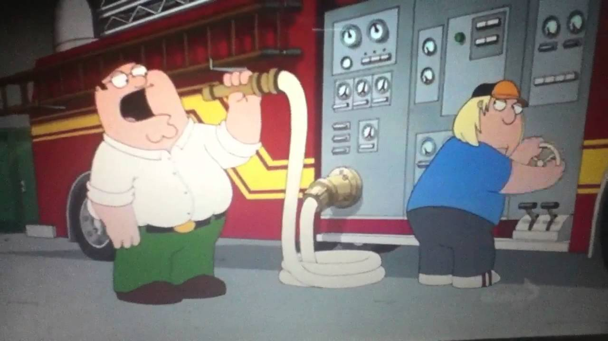
Today’s Agenda

Slide 3
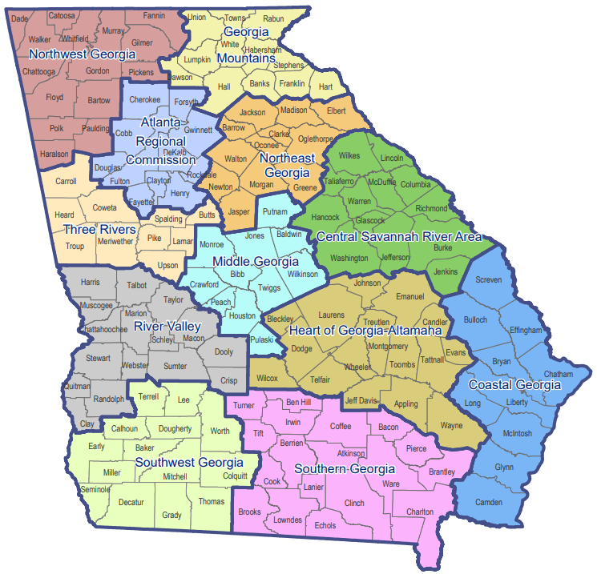
Georgia’s Regional Commissions

Slide 4
The Many Roles of the Atlanta Regional Commission

Slide 5
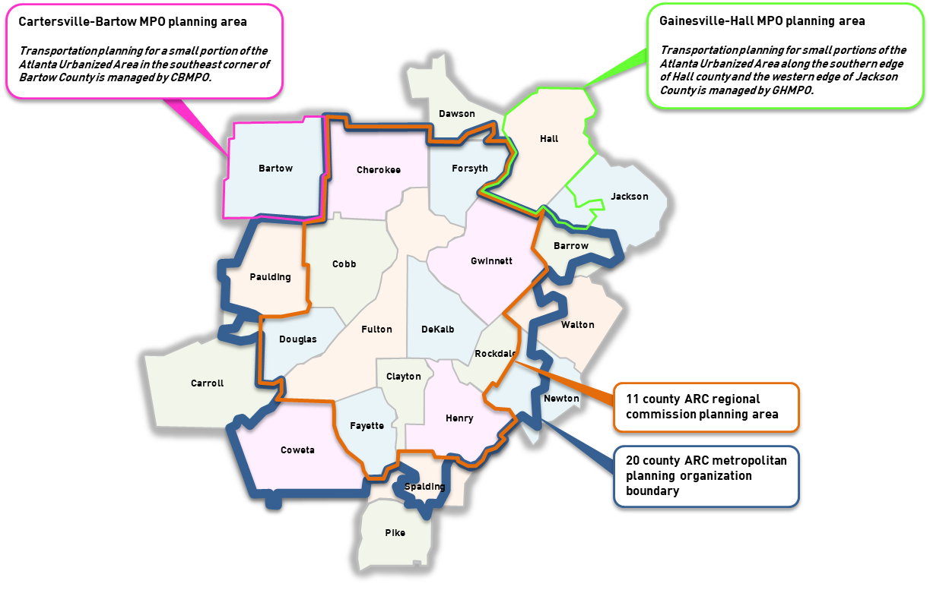
ARC’s Metropolitan Planning Organization (MPO) Area

Slide 6

The Role of an MPO
Required by the Federal-Aid Highway Act of 1962 for any urbanized area with a population greater than 50,000.
Urbanized area boundaries are established based on decennial census data for population/housing density
Planning area must include any additional area expected to become urbanized over the next 20 years
ARC is designated by the Governor and the region’s elected officials as the MPO for the Atlanta region.
GDOT, transit operators and any government in the Atlanta region cannot receive federal transportation funds unless federal planning requirements are met, and the project is listed in the Transportation Improvement Program (TIP) and the Regional Transportation Plan (RTP).

Slide 7
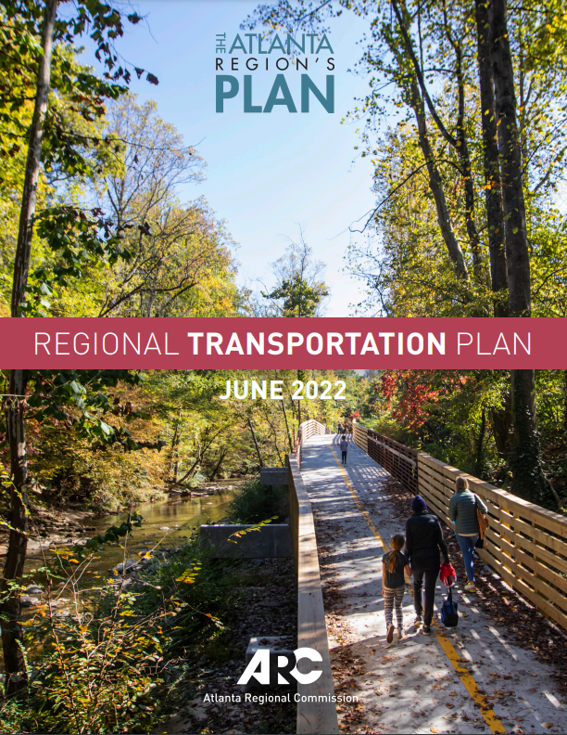
Regional Transportation Plan (RTP)
Multimodal (roads, transit, bicycling, walking, etc.)
Horizon year must be at least 20 years in the future (2050)
Can consider multiple future scenarios, but official plan must use official population and employment forecasts
Fiscally constrained ($173 billion)
Meets all federal air quality conformity requirements
The Transportation Improvement Program (TIP) is the first six years of the RTP and identifies project scopes, schedules, costs and funding sources with more precision
Comprehensive update required at least every four years (but plan may be amended at any time)

Slide 8
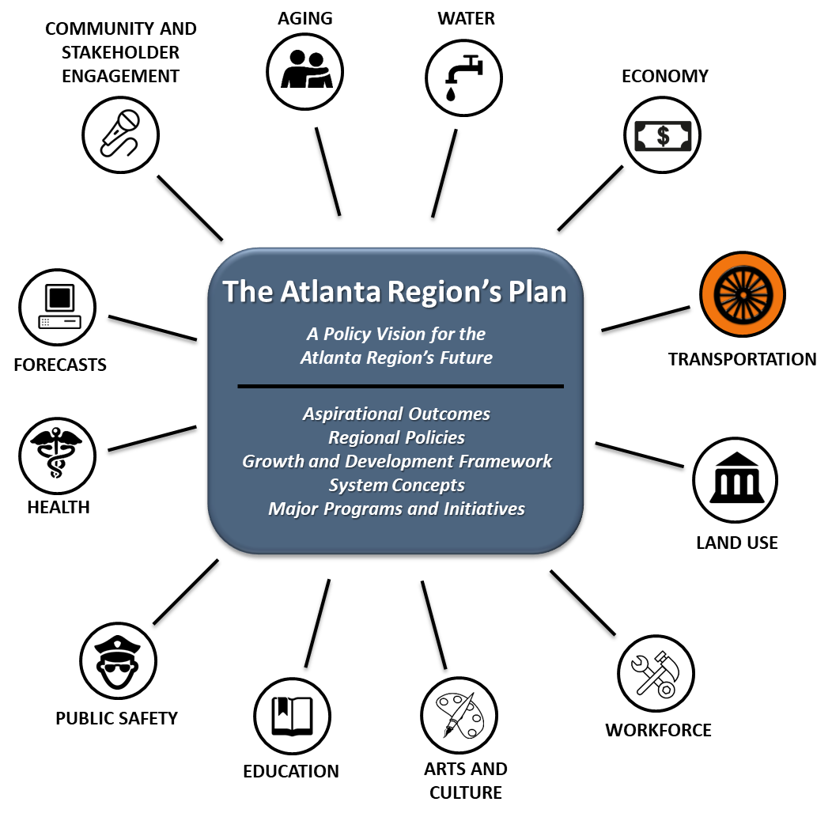
The RTP is one component of The Atlanta Region’s Plan

Slide 9
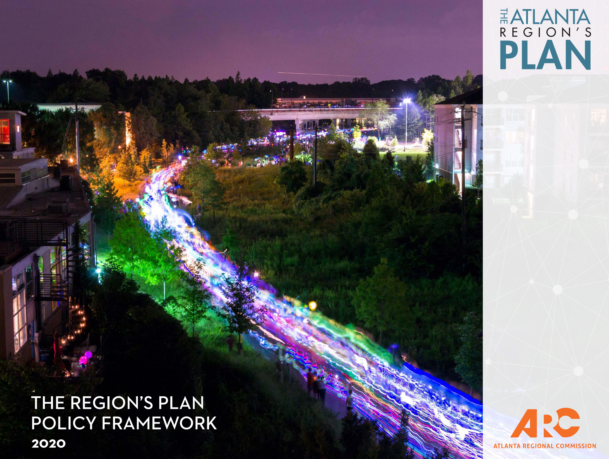
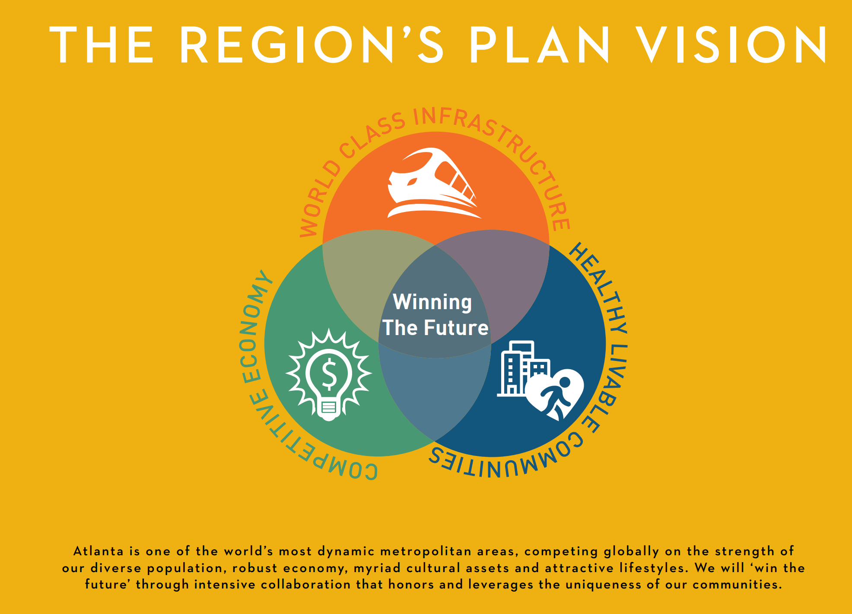
Our current policy framework (under revision)

Slide 10
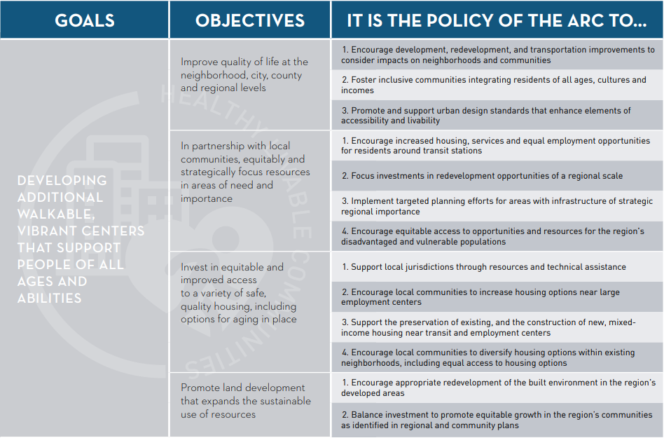
Healthy livable communities goals and objectives

Slide 11
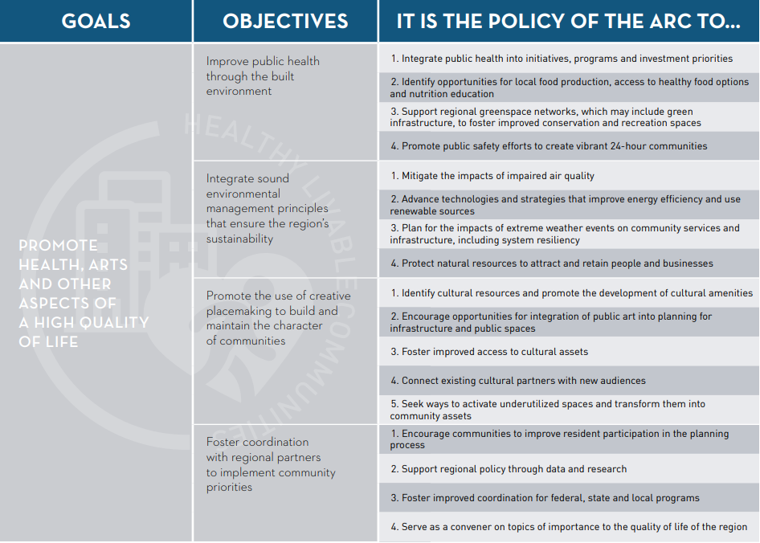
Healthy livable communities goals and objectives (cont’d)

Slide 12
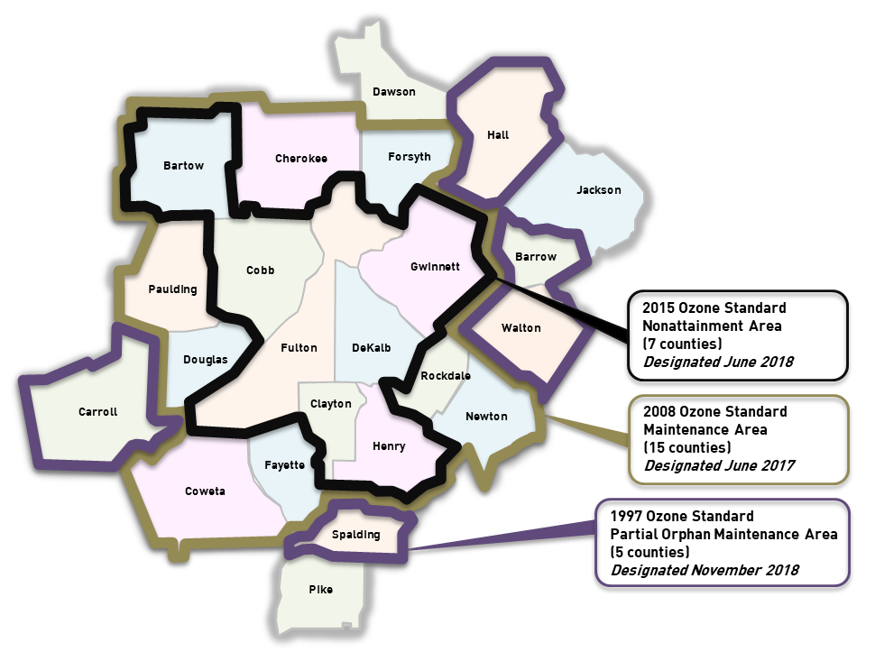
Air quality planning boundaries

Slide 13
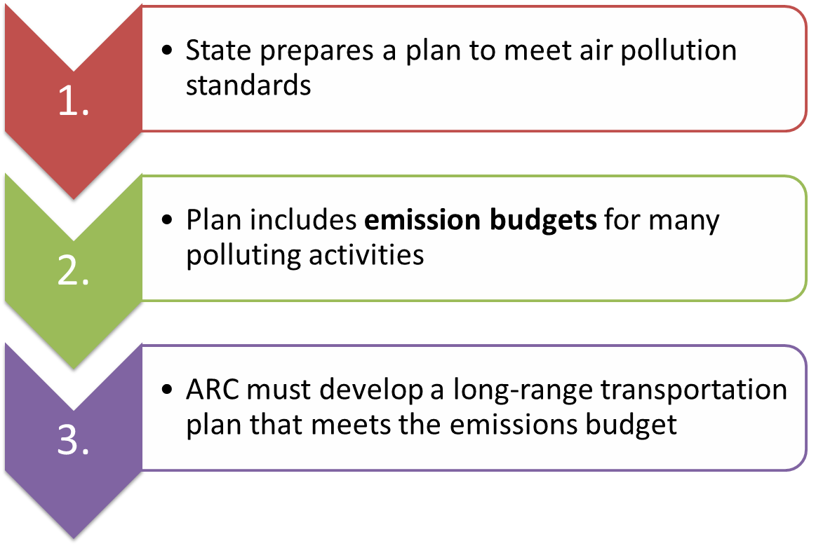
Air quality conformity process (greatly simplified)

Slide 14
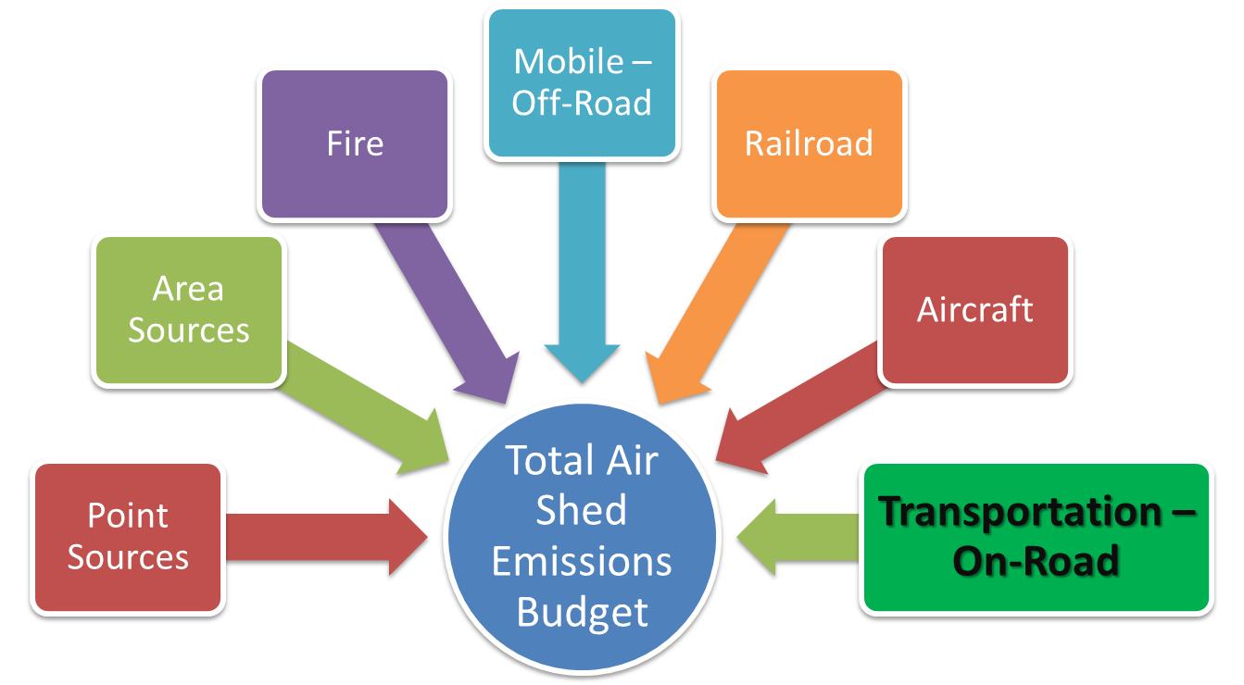
Components of the emissions budget

Slide 15
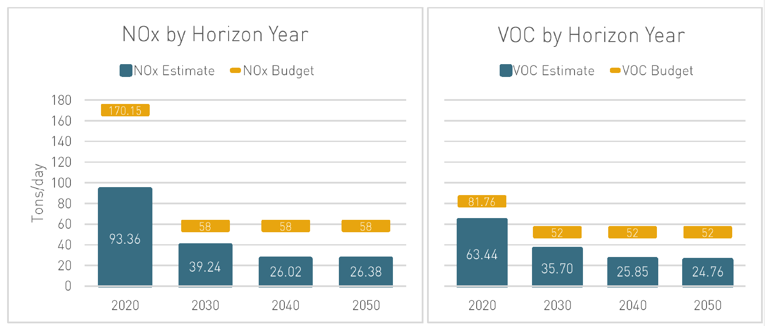
Most recent air quality conformity analysis (Nov 2021)

Slide 16
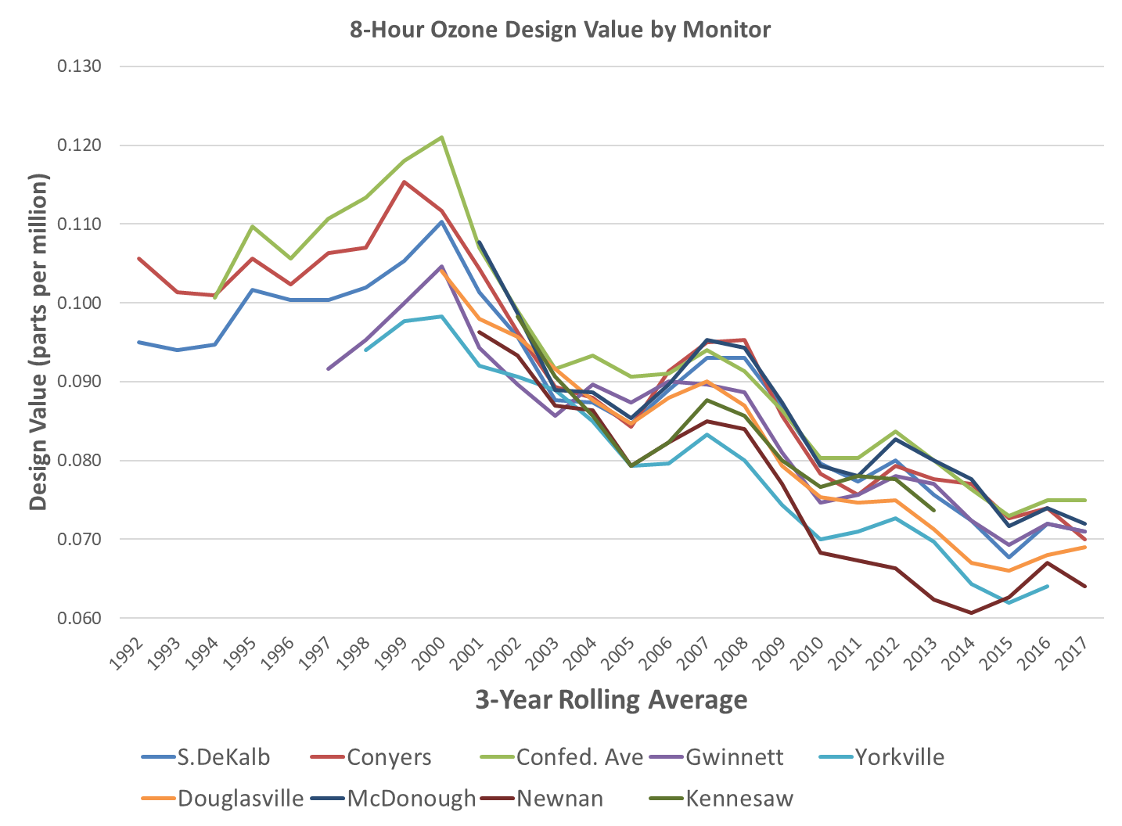
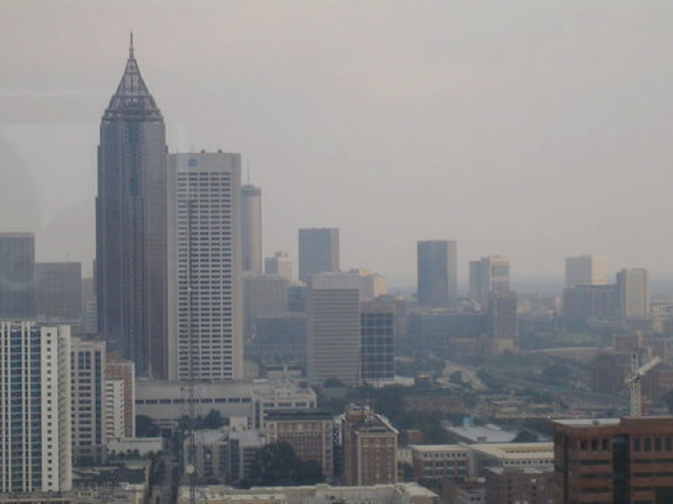
Air quality has improved since the 1990s

Slide 17
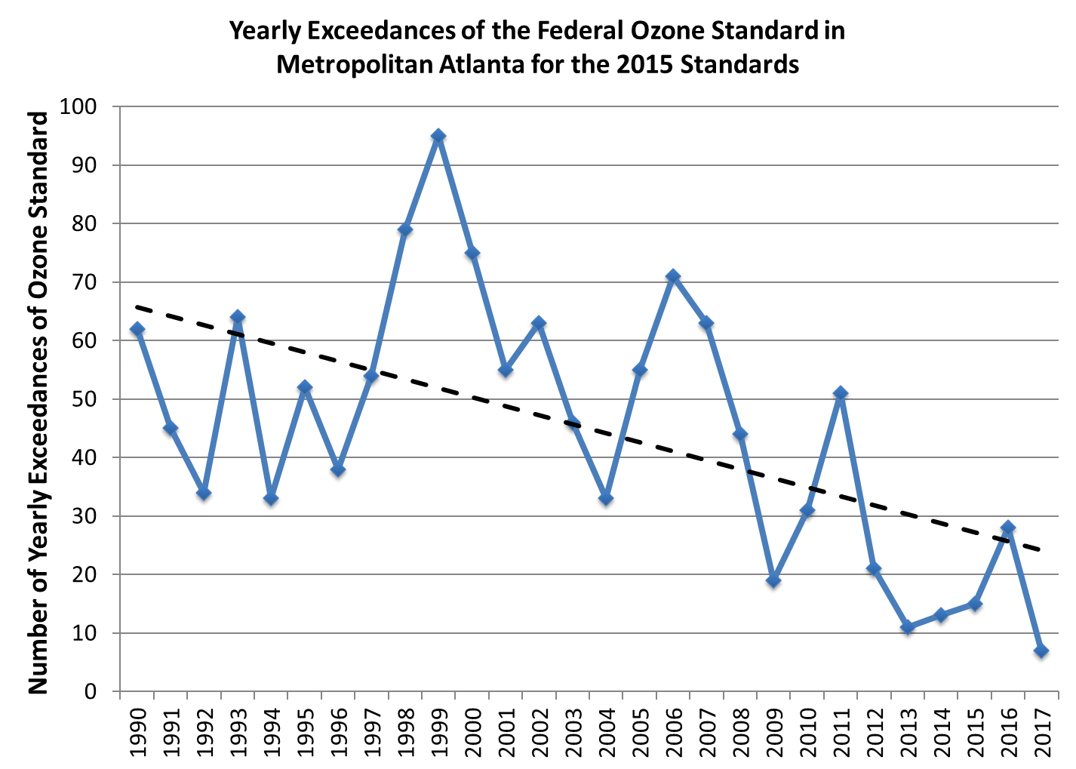
Air quality has improved since the 1990s (cont’d)

Slide 18
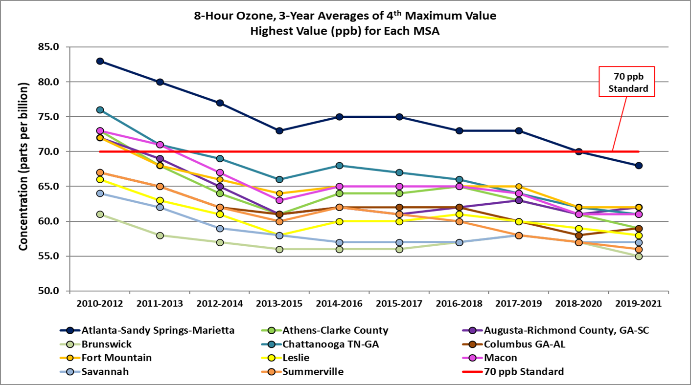
Good news! We now meet the ozone standard

Slide 19
ARC directs some federal transportation spending
Federal Highway Administration (FHWA) Program | Annual Federal Funding Amount - ARC
Surface Transportation Block Grant (STBG) Program | $99,000,000
Congestion Mitigation and Air Quality (CMAQ) Program | $29,000,000
Transportation Alternatives Program (TAP) | $15,000,000
Carbon Reduction Program (new) | $12,000,000
Total MPO-Directed Funds | $155,000,000
Note: Approximately $1.5 billion allocated additionally through GDOT

Slide 20

How decisions are made on ARC directed funds
Notes:
The manual that describes how TIP projects are evaluated and chosen.
Source: https://cdn.atlantaregional.org/wp-content/uploads/project-eval-documentation-2019.pdf

Slide 21
Project evaluation criteria
Mobility & Access
Equity
Safety
Resiliency
Improves congestion
Multimodal design
On priority networks
EJ Analysis
Proximity to subsidized housing
Safe systems design
Addresses causes of historical crashes
Improves air quality
Stormwater adaptation
Asset management
Notes:
Four major criteria based on evolution of ARC and federal priorities

Slide 22
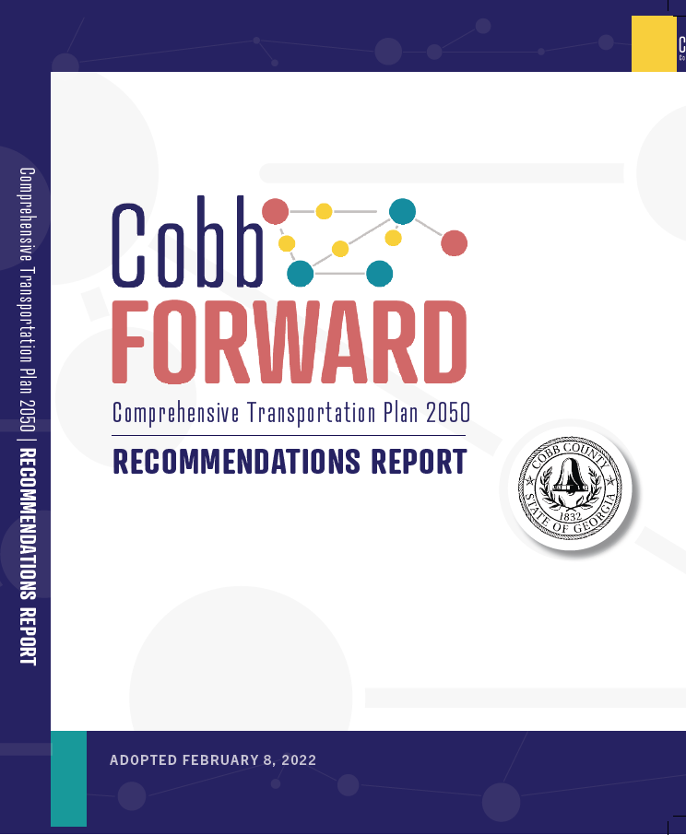
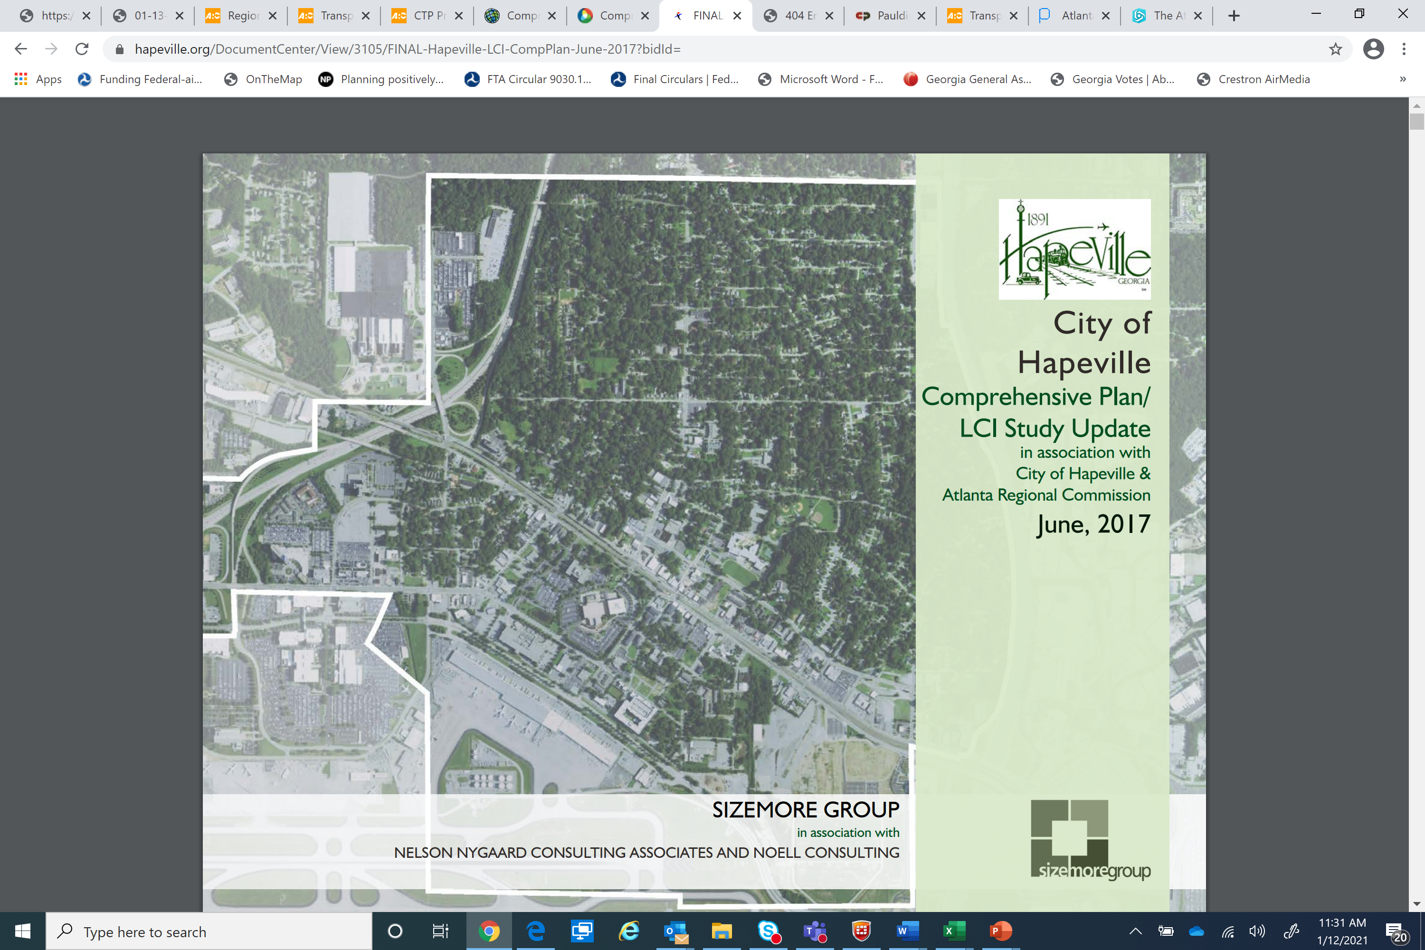
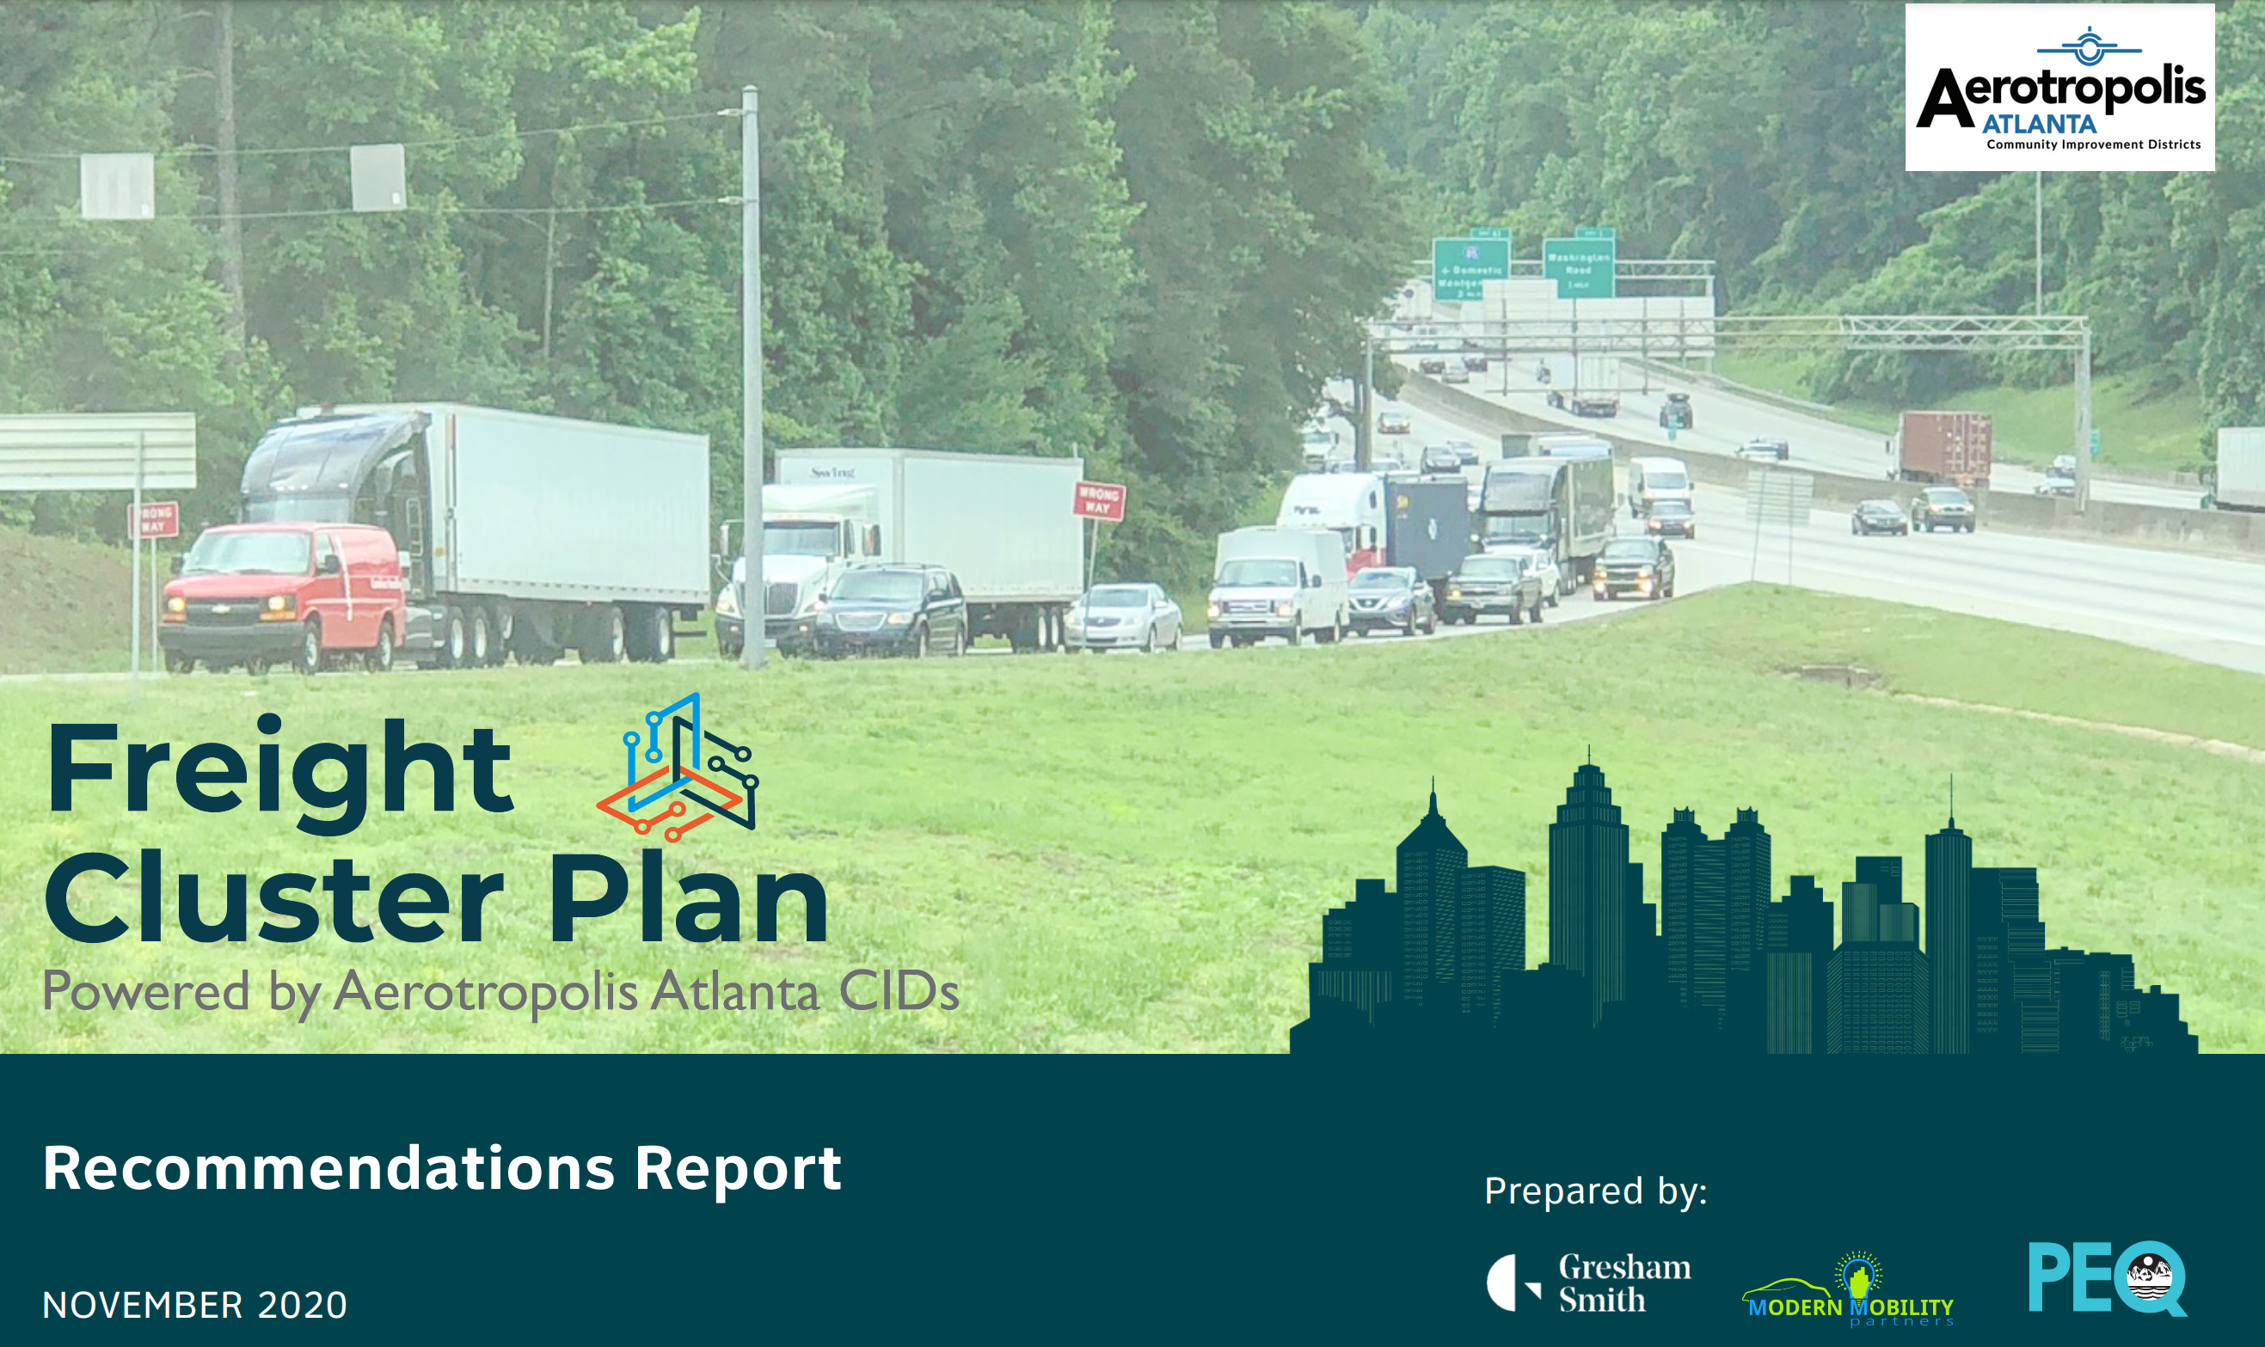
Potential projects are identified in numerous ways
At the county level Comprehensive Transportation Planning Program
At the community level Livable Centers Initiative Planning Program
Freight Cluster Area Planning Program
At the problem level Regional Transportation Planning Studies Program
Notes:
Four major criteria based on evolution of ARC and federal priorities

Slide 23
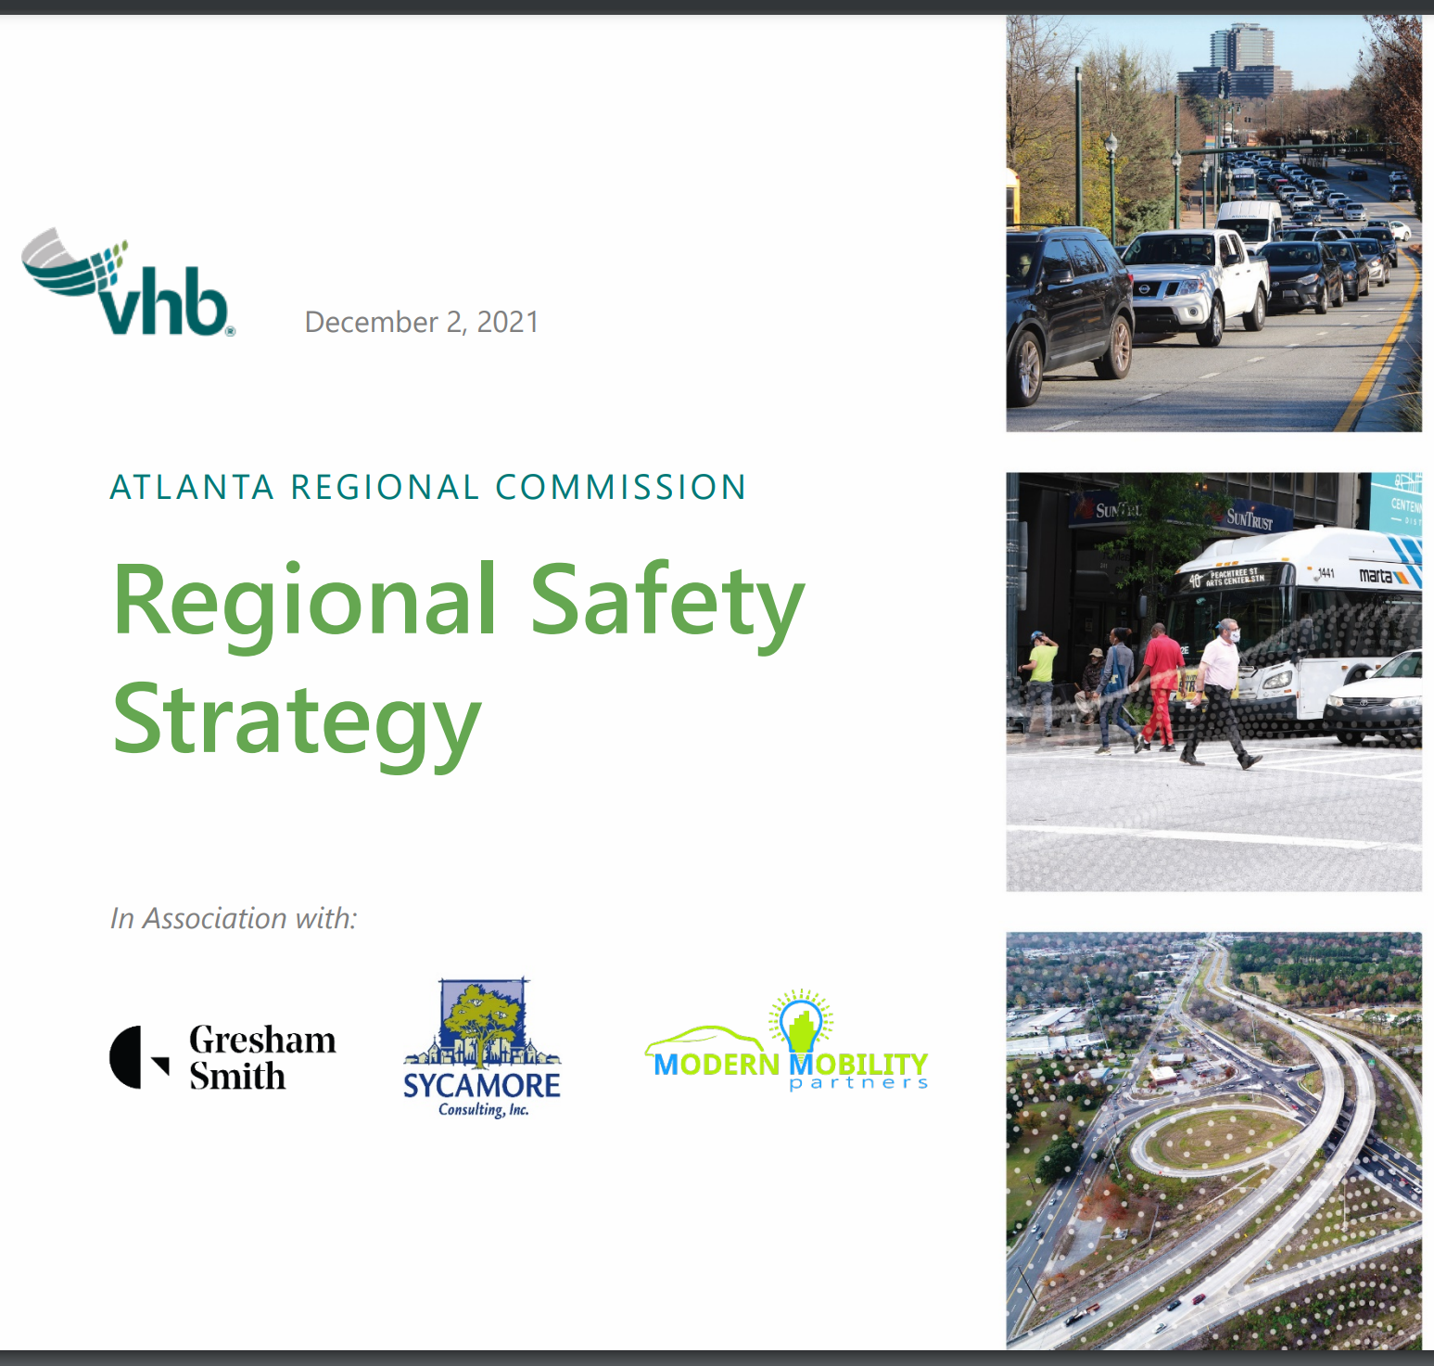
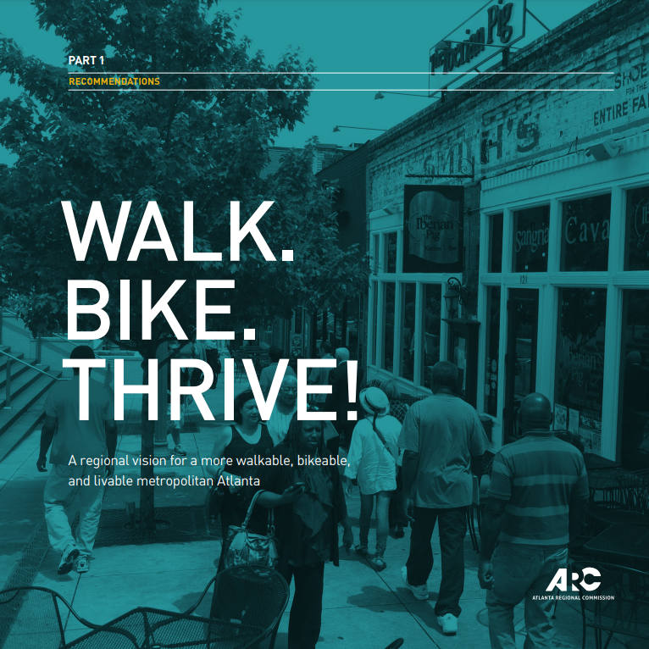
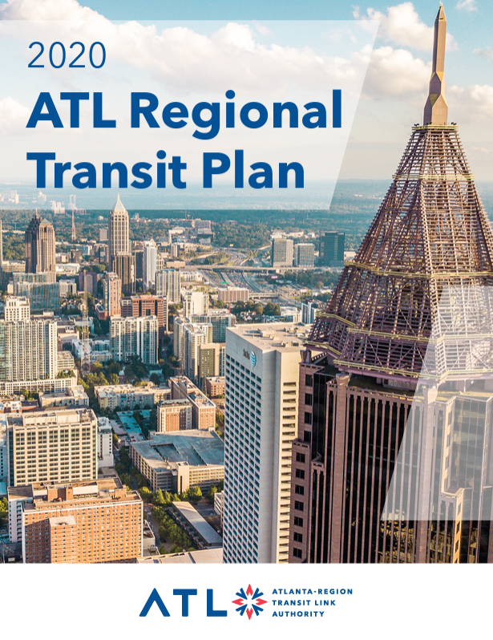
Projects are also identified based on issues and modes

Slide 24

Infrastructure Investment and Jobs Act (IIJA)
Signed into law (PL 117-58) on November 15, 2021
Commonly referred to as the Bipartisan Infrastructure Law
Covers five fiscal years (FY 2022-2026)
$1.2 trillion authorized for a wide variety of infrastructure, including about half for transportation
Roughly 400 programs, over half of which will be awarded through nationwide competitive processes

Slide 25




Key administration objectives
EQUITY
CLIMATE CHANGE
WORKFORCE
DEVELOPMENT
Implementation guidance from agencies will be critical in the coming months and years

Slide 26

Relevance of IIJA programs to the Atlanta Region
LOW OR NO
RELEVANCE
404 TOTAL PROGRAMS*
HIGH RELEVANCE
236
168
Examples: tribal, ferry, rural, mining, and marine programs; programs directed to specific agencies or geographic areas
The initial count of 404 distinct programs is subject to change as ARC continues to review and organize information from multiple sources. Each program’s relevance to the region may also change as official guidance and details become available. For more information, visit www.atlantaregional.org/iija.

Slide 27
IIJA programs relevant to the Atlanta Region
Broadband & Cybersecurity
236 TOTAL PROGRAMS
Other*
15
20
Climate, Energy & Environment
91
* Examples: Natural Gas Distribution Infrastructure Safety and Modernization Grants; Emergency Preparedness Grants; Appalachian Regional Commission Funds; National Geological And Geophysical Data Preservation Program
Transportation
110

Slide 28
IIJA discretionary programs relevant to region
Broadband & Cybersecurity
Other
10
11
168 TOTAL PROGRAMS
$332 billion
Climate, Energy & Environment
Transportation
78
69

Slide 29
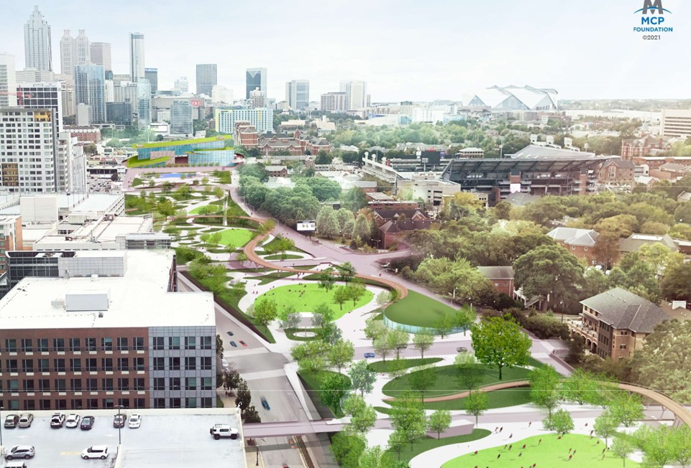
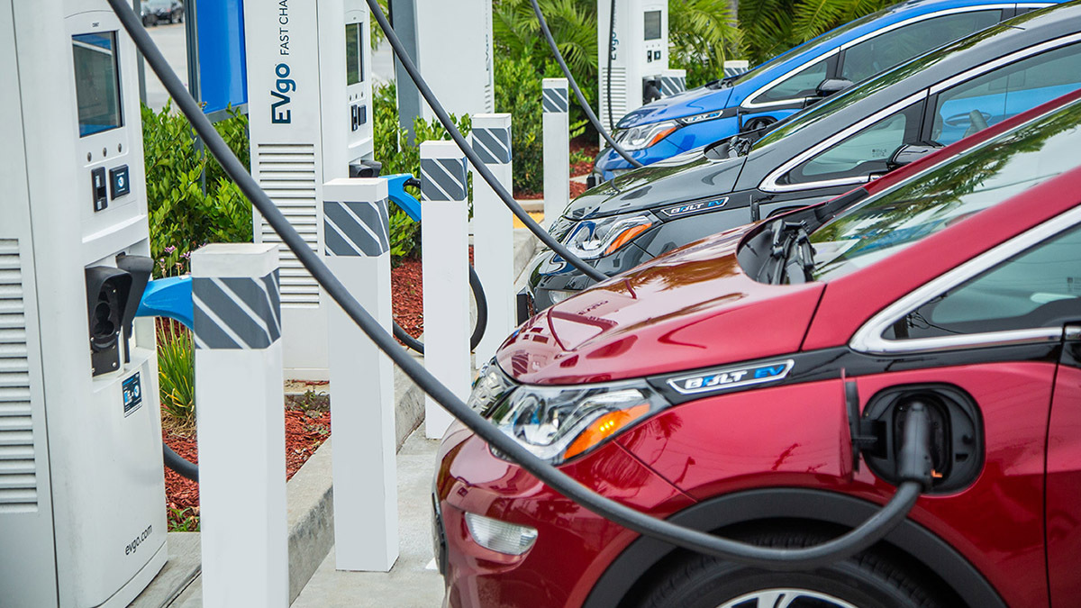
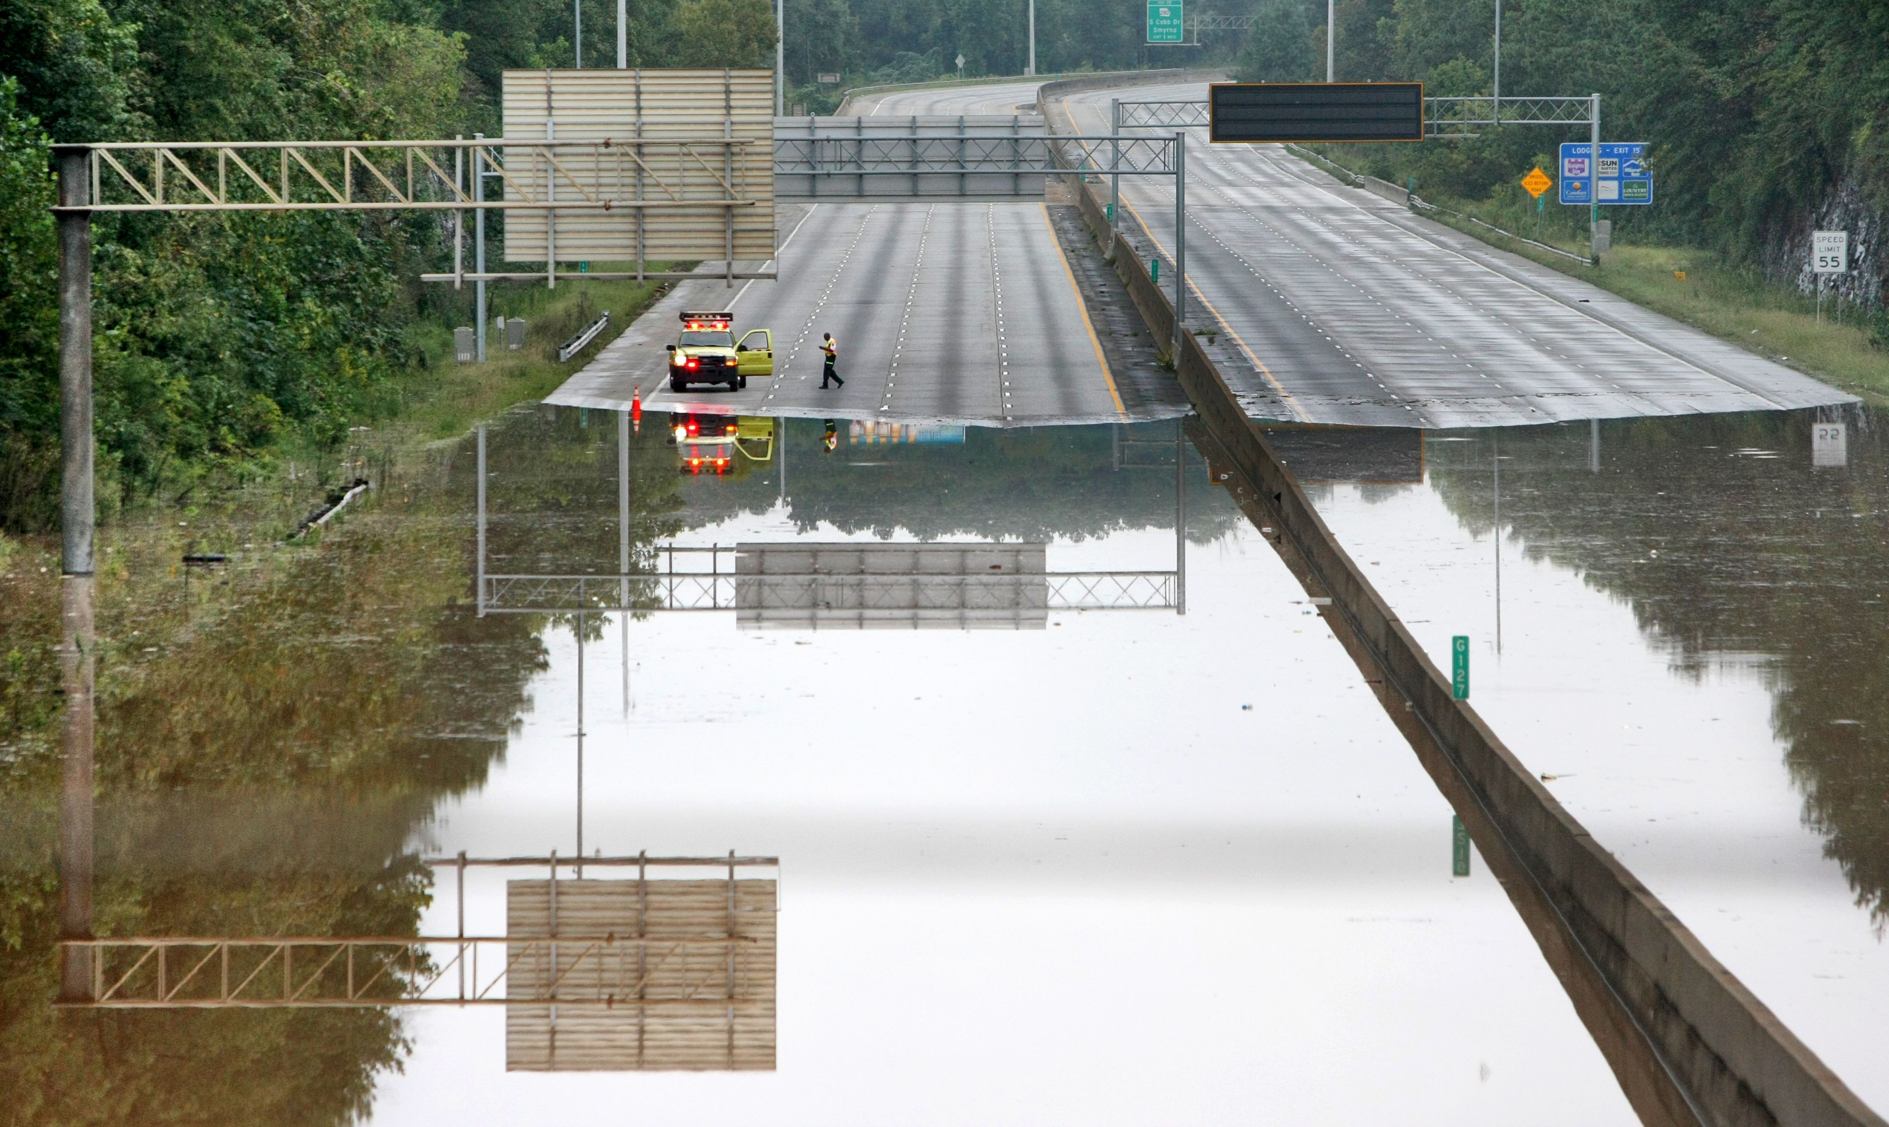
Selected USDOT discretionary programs
Reconnecting Communities Pilot Program
Charging and Fueling Infrastructure Grants
Promoting Resilient Operations for Transformative, Efficient, and Cost-Saving Transportation (PROTECT)
$1.0 Billion
$2.5 Billion
$1.4 Billion
Notes:
These three programs are all new to IIJA. Largest discretionary program is for bridges ($15.5 billion), which is in addition to a formula program for the same purpose that has $26.7 billion. Another large program is INFRA ($15.0 billion). The PROTECT program also has a formula component with $7.3 billion. The Reconnecting Communities Program is a big priority for Senator Warnock…what happened to the Sweet Auburn community when the Downtown Connector was built has shaped his views on this.

Slide 30
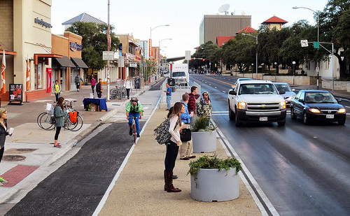
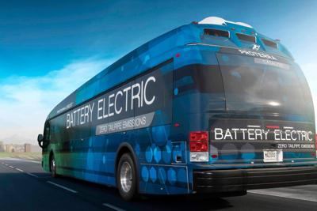
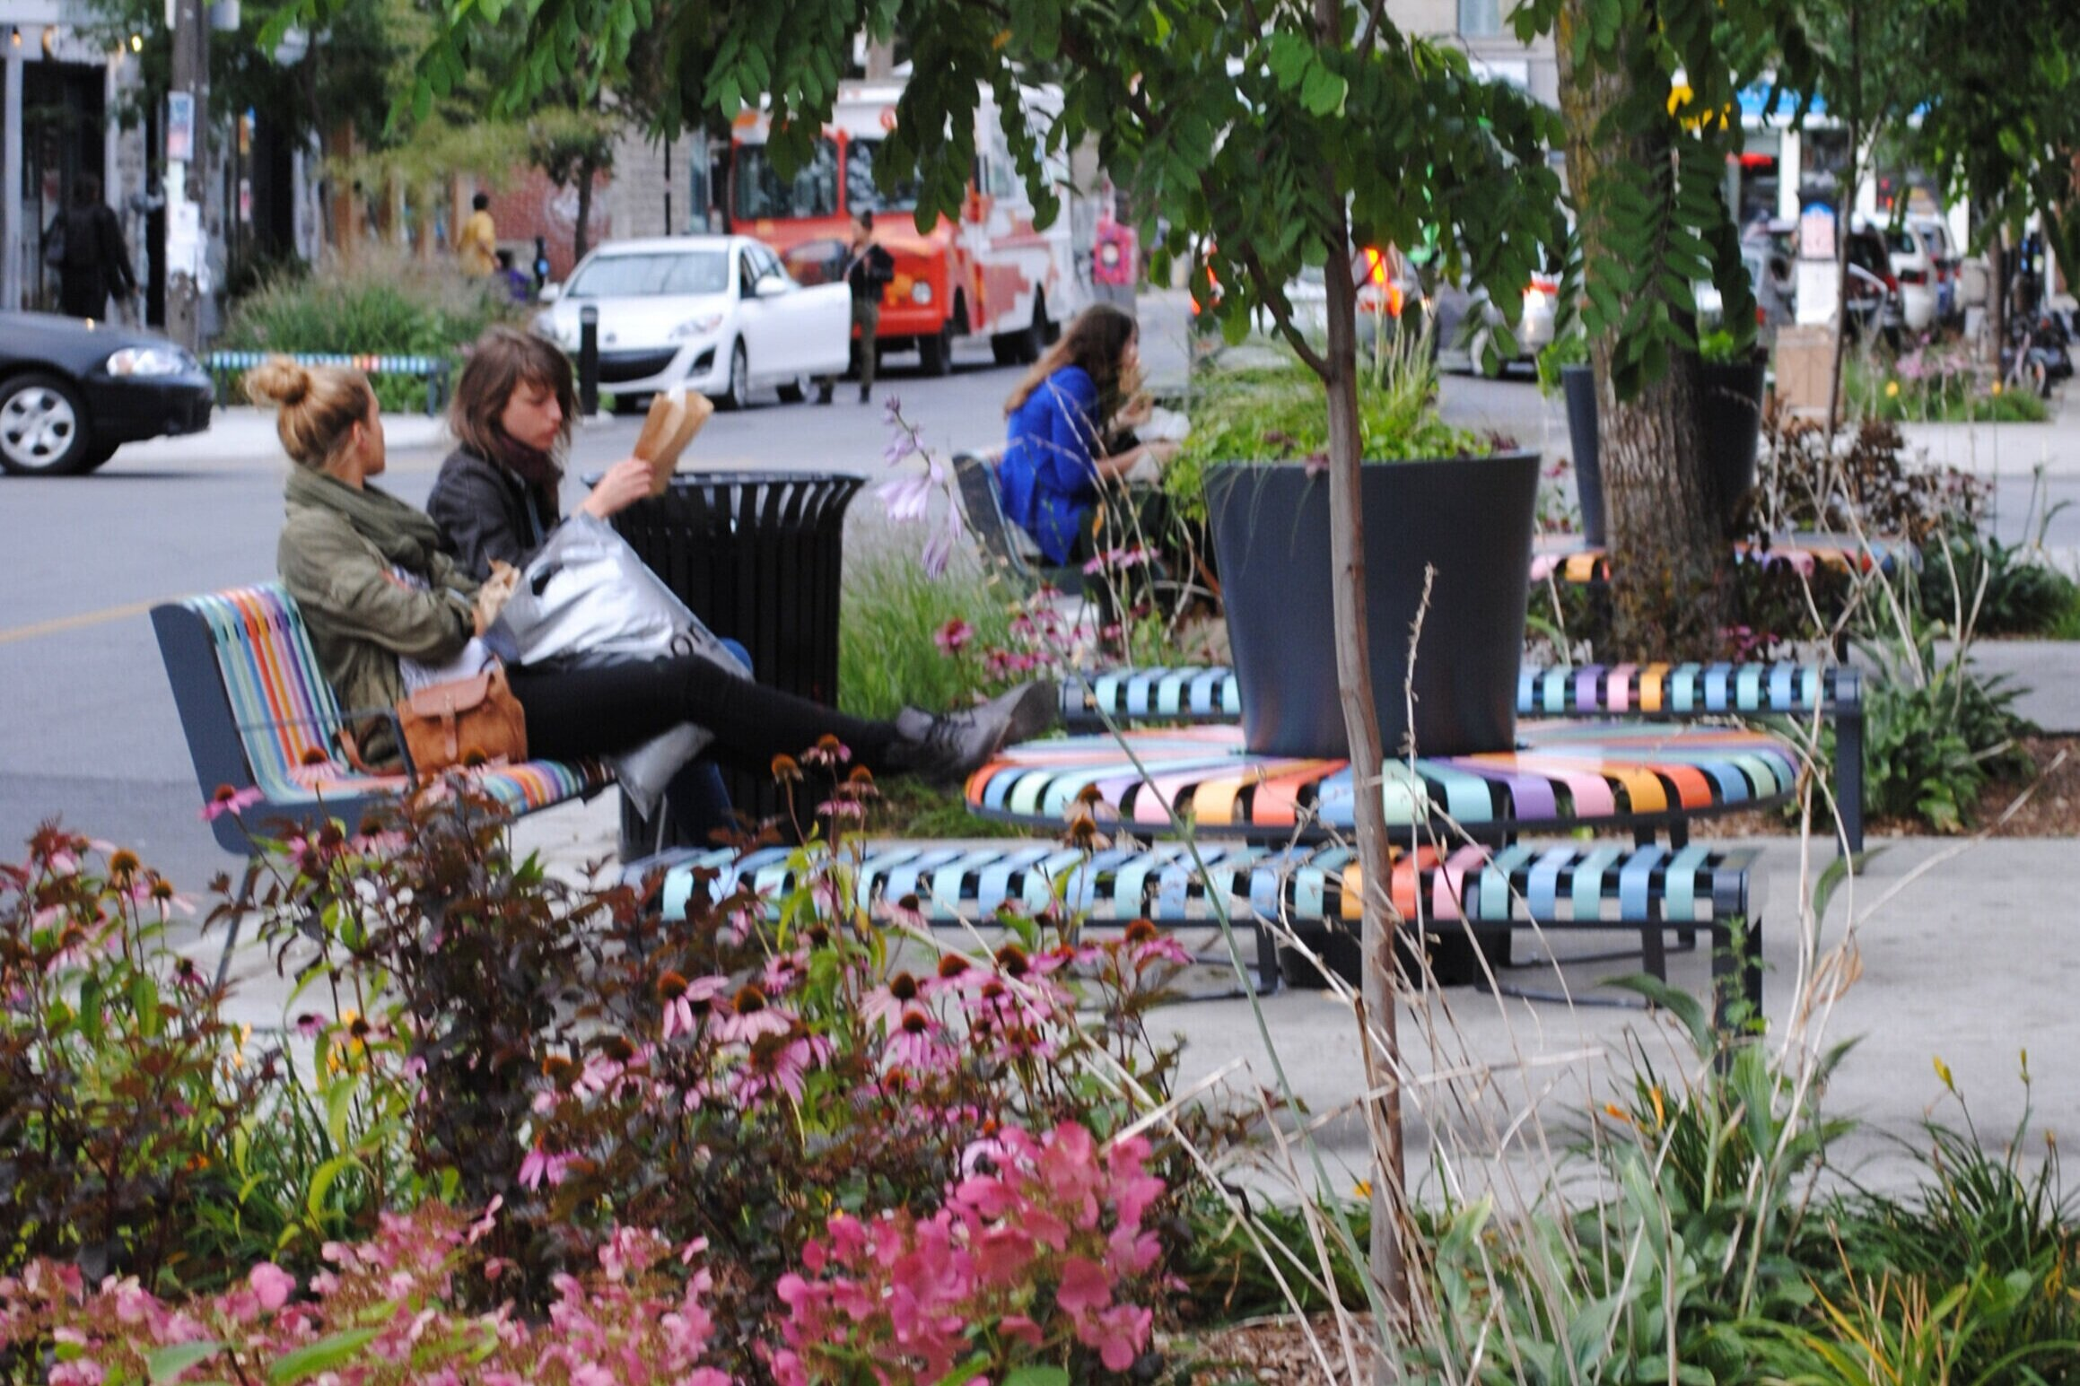
Selected USDOT discretionary programs
Safe Streets and Roads for All
Low or No Emission Bus Grants
Healthy Streets Program
$6.0 Billion
$5.6 Billion
$500 Million
Notes:
Most funding is in a couple of programs that focus on traditional large-scale investments (Local and Regional Project Assistance Grants (RAISE) has $15 billion, and same amount for National Infrastructure Project Assistance (Megaprojects)). These are smaller programs but highlight the priorities of the administration. May want to point out that no money was actually appropriated for the Healthy Streets Program in FY 2022, despite the fact that the law authorized up to $100M each year. SS4A NOFO is currently open.

Slide 31
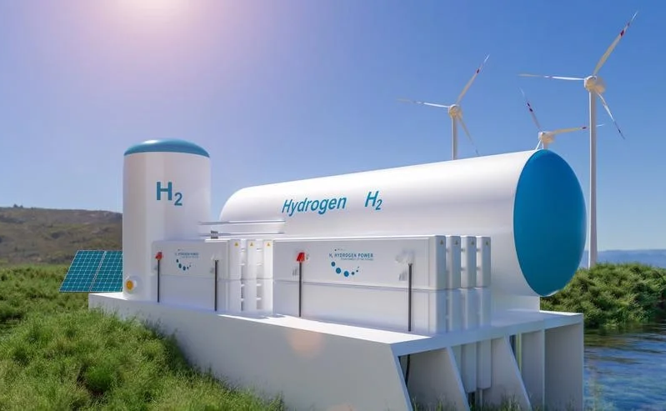

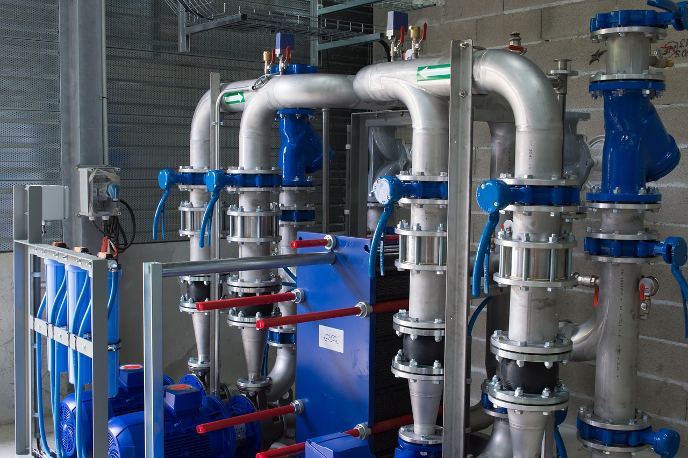
Selected USDOE and EPA discretionary programs
Battery Manufacturing and Recycling Grants
Water Infrastructure Improvements for the Nation’s Small and Underserved Communities
Regional Clean Hydrogen Hubs
$8.0 Billion
$3.0 Billion
$5.0 Billion
Notes:
This is a small sample of dozens of programs to strengthen our existing energy grid, promote clean energy alternatives and improve the safety of our water supply and distribution system. Senator Ossoff is making major push for Georgia to secure one of the four hydrogen hubs. A letter signed by dozens of state officials was sent to the DOE Secretary earlier this week.

Slide 32

There are many variables on the path to the future
VISION

Slide 33

Predicting the future is not easy
  “I think there is a world market for maybe five computers.”
Thomas Watson, IBM Chairman (1943)*
* Maybe?

Slide 34






ARC’s scenario planning process (2015-2017)
Universe of Drivers of Change
SOCIAL
TECHNOLOGY
National Expert Review Process
Stakeholder Survey
ARC Board Work Session
ECONOMIC
ENVIRONMENTAL
POLITICAL

Slide 35









The Atlanta Region’s key drivers of change (2017)
Autonomous Vehicles
Spatial, Racial and Economic Equity
Climate
Change Regulations
Aging of the Population
Transportation Finance Structure
Water
Supply
Intelligent Infrastructure & Technology
Ridehailing Services
Port
Traffic

Slide 36

Building alternate futures
ALTERNATE FUTURES

Slide 37


Oops…
Autonomous Vehicles
Spatial, Racial and Economic Equity
Climate
Change Regulations
Aging of the Population
Transportation Finance Structure
Water
Supply
Intelligent Infrastructure & Technology
Ridehailing Services
Port
Traffic
COVID-19

Slide 38
Well, wait a minute…
Autonomous Vehicles
Spatial, Racial and Economic Equity
Climate
Change Regulations
Aging of the Population
Transportation Finance Structure
Water
Supply
Intelligent Infrastructure & Technology
Ridehailing Services
Port
Traffic

Slide 39

Increase focus on the impacts of system shocks

Slide 40


Thanks for listening!
David W. Haynes
Long Range Transportation Plan Manager
dhaynes@atlantaregional.org
470.378.1571
www.atlantaregional.org

