Slide 1
Update and Discussion on IIJA Coordination Transportation Coordinating Committee / IIJA Consortium January 13, 2023

Slide 2
Strategic Goals
The purpose of this strategy is to develop an implementable plan and approach for ARC to respond to IIJA that:
1
2
Provides ARC with the structure, process and information to drive regional benefit from IIJA grant opportunities
Helps ARC to promote and incentivize
regional coordination
3
4
Provides local jurisdictions with the information to be effective in grant applications
Demonstrates and improves ARC’s value
add to the region
5

Slide 3
Federal Implementation Priorities
Workforce
Development
IIJA places focus on creating job opportunities with fair wages and high labor standards. Certain IIJA grants set-aside funds specifically for this purpose. Key programs include the Workforce Development, Training, and Education Program; the State Digital Equity Capacity Grant Program; and the Digital Equity Competitive Grant Program.
IIJA encourages funds to be invested equitably, including through the Justice40 initiative, which seeks that 40% of overall benefits from federal investments in climate and clean energy reach underserved communities. Federal agencies are taking steps to ensure that IIJA programs are accessible to underserved communities, including by offering technical assistance and simplifying the funding process. Certain programs have carved out funds for disadvantaged communities.
Multiple IIJA programs including Reconnecting Communities, Community Charging, and the Broadband Equity, Access, and Deployment Program emphasize equity goals in their program design.
Equity
IIJA makes funding available to prioritize building resilient infrastructure that can withstand the impacts of climate change. A handful of programs within IIJA focus specifically on bolstering resilience, such as the PROTECT program, while others support resiliency through development of electric vehicle charging infrastructure, new battery development programs, and programs that promote innovation to advance clean energy technologies and water infrastructure.
Resilience
It will be important for the region to account for and reflect federal priorities in application development processes. Moreover, there is the opportunity for the region to leverage IIJA resources to establish coordinated programming that addresses regional workforce, equity, and resilience challenges and goals.
Source: https://www.whitehouse.gov/briefing-room

Slide 4
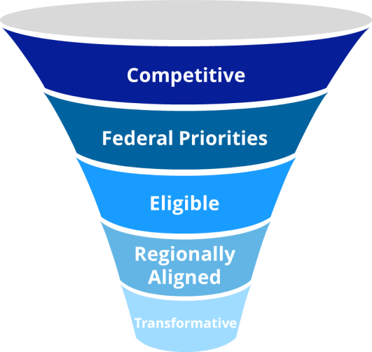
Grant Prioritization
The strategy is to focus attention to a set of target grants that yield the biggest impacts to the region
Prioritization Criteria
Potential Priority Grants*
With over 250 competitive programs, a smaller priority set of grants need to be identified to focus the region’s resources on high-value opportunities and benefits from IIJA.
The graphic to the right displays the criteria established by the Infrastructure Consortium to narrows down the total pool of competitive IIJA grants to a smaller, more meaningful set of competitive opportunities that align with the region’s priorities.
Competitive: Focusing on competitive IIJA grants only
Federal priorities: Emphasizing policy themes such as equity, resiliency, sustainability, and workforce development that are embedded in IIJA
Eligible: Further focusing on grant opportunities that are targeted to MPOs, cities, counties, and/or transit authorities
Regional Alignment: Narrowing in on grant opportunities that align
with the objectives and policies contained in the region’s plan
Transformative: Identifying the subset of such grants that offer the greatest potential to positively impact the region, address infrastructure deficiencies, and catalyze transformative projects
Bridge Investment Program
Capital Investment Grants
Clean School Bus Program
Local and Regional Project Assistance Grants (RAISE)
Low or No Emission (Bus) Grants
National Infrastructure Project Assistance (Megaprojects)
Nationally Significant Freight and Highway Projects (INFRA)
Safe Streets and Roads for All
Reconnecting Communities
Regional Hydrogen
Promoting Resilient Operations for Transformative, Efficient, and Cost-Saving Transportation (PROTECT )
Strengthening Mobility and Revolutionizing
Transportation (SMART)
* Illustrative examples only – priority grants to be confirmed

Slide 5
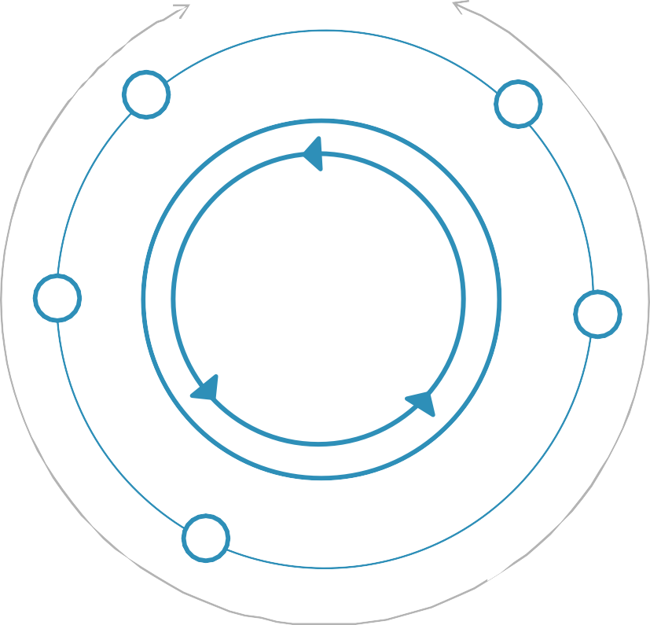
Application Support Model
Application Support
Identify and Target Priority Grants
Focus on a smaller number of priority grants to focus resources and efforts
Streamline Information Flows
Provide frequent updates on eligible projects, evaluation priorities, deadlines, award
limits, and other IIJA program information to recipients
Facilitate Project Sourcing
Identify eligible projects from regional and local plans and in collaboration with local agencies
Assist with Grant Application
Provide resources such as grant writing, technical support, and support in identifying match funding sources
Foster Collaboration
Promote collaboration including for multi-jurisdictional opportunities and projects
Surface Competitive Projects
Identify potentially-competitive projects by performing an initial regional evaluation based on federal priorities and program scoring criteria

Slide 6
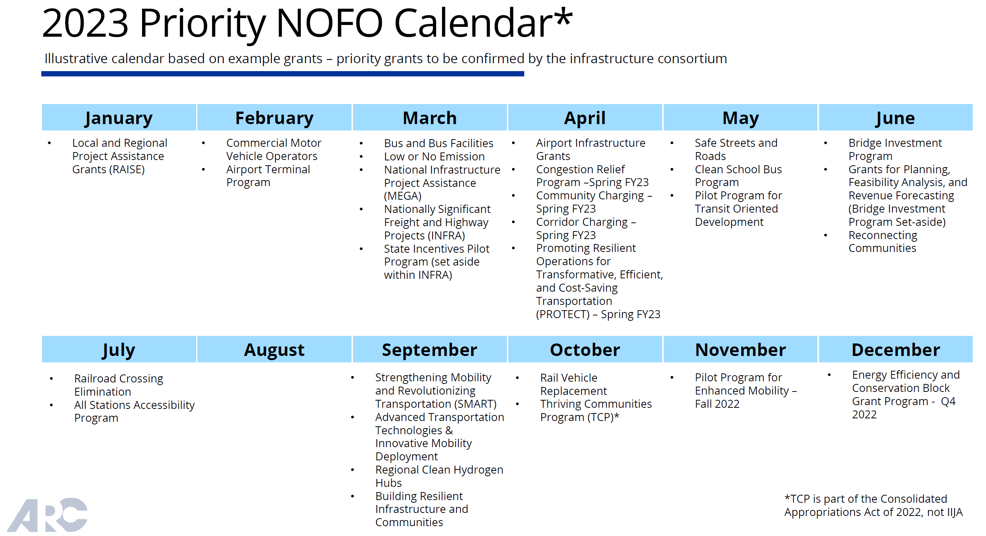
Anticipating Q1 NOFO Calendar

Slide 7
Infrastructure Consortium Activities: January 2023
Primary focus: Preparing for RAISE Grants due on February 28
RAISE Projects of Interest Expressed to ARC staff through December 15
$1.5 billion available
TAQC/Board briefing: Wednesday, January 13
Consortium meeting: In conjunction with TCC on Friday, January 15
Review critical program criteria
Identify and discuss priority applications
Identify resources needed to support sponsors
HUB 404 (Buckhead; MARTA)
Old Highway 5 corridor (Cherokee) - joint application with County and the cities of Woodstock, Holly Springs and Canton
Peachtree Creek Greenway Phase II (Brookhaven)
The Stitch (City of Atlanta)
Others?

Slide 8
Infrastructure Consortium and Caucus Activities: February-March 2023
Primary focus: Early Identification of MEGA and INFRA projects
Pending Near Term Opportunities
Future Consortium meetings:
Friday, February 10
Friday, March 10, 2023
Policy maker coordination:
Combine with ARC Board and TAQC meetings
MEGA / INFRA / Rural
Possibly $2.85 billion available
Community / Corridor Electric Vehicle Charging
Possibly $500 million available
PROTECT Program
Possibly $280 million available

Slide 9
Discussion on ARC Support Roles
Identifying Projects for Consideration
Consolidate info on awards to serve as a resource library for future applications?
Nominations for ARC to assume a lead coordination and/or application role?
Improving Information Sharing
Suggestions for improving the online database and biweekly newsletter?
Does GDOT track statewide submissions for major programs (e.g. RAISE and Reconnecting Communities)?
Are counties always aware of submissions by cities, CIDs and other entities?
How can we better collect, compile and share information on what’s being submitted?

