Slide 1
GIO Update for the Atlanta Regional Geospatial Community
Transportation
Economic Development
Health
Community Development
Social Services
Utilites
Public Safety
Fire
Facilities
EMS
Engineering
Innovation
Land Management
Seeing is believing. That’s why visualization technologies – particularly geospatial tools – are indispensable components of Government services. Leveraging these technologies opens the door to better planning, decision-making, economic development, citizen services and public safety.
Susan Miller, State Geospatial Information Officer

Slide 2
Why DEVELOP A Geospatial Information Office In Georgia?
How did we get here?

Slide 3
A very brief history of Statewide GIS in Georgia…
1970-90: INNOVATION
Georgia is a national leader: Strong GIS Coordination at State-scale
Remote Sensing
Georgia GIS Data Clearinghouse & statewide data creation (mid 90’s)
2000’s-2013: STATE FUNDING ELIMINATED
GIS Professionals continued to do their work, but on their own
Silos, duplication of effort, lack of standards-based data development/maintenance, little data interoperability…
2013-present: COLLABORATIVE PARTNERSHIP BUILDS THE STATE GIO
2013: Interagency Task Force created to assess the need for a Georgia GIO
2014: State commissions a GIO Sustainability Study, which outlines the path to success
2015: GARC applies for and receives a U.S. Economic Development Grant and they hire the 1st Geospatial Information Officer as a pilot project (Projects & Programs begin taking shape)
2017: Office becomes permanent & legislation passed to establish a Governance body

Slide 4
Georgia’s First Geospatial Information Office
Mission….to coordinate, promote and enhance the development, and use in analytics, of geospatial data for the State of Georgia, its agencies, authorities, regions and local governments

Slide 5
GIO Clients/Constituents
State Level
National Level
Georgia’s Cities
Georgia’s Counties
Regional Government
State Agencies / Authority
State Organizations / Groups
Political Leadership
State Higher Level Education
Private Sector
Federal Agencies / Authorities
National Organizations / Groups
Private Sector

Slide 6
Programs/Projects underway within the GIO that will hopefully benefit you and your Communities…
GIO Sustainability
Geospatial Software Program
Spatial Data Program
Remote Sensing Program
THREE
TAKE HOMES

Slide 7
GIO Sustainability Secure: Authorization, Authority, & Funding
Authorization & Authority
Office became permanent, and is administratively housed with DCA
Georgia House Bill 183 passed 2017 (“Georgia Geospatial Advisory Council”) …
Its Purpose: Enable the mission of the GIO to advance the use of geospatial sciences/technology throughout Georgia
Its Design: multijurisdictional body, made up of a diverse stakeholder community, which includes Federal, State and Local gov’t as well as the private sector
Role and Responsibilities
Governance Council: secure funding, implement necessary legislation, identify synergies & economies of scale, act as SMEs regarding the business needs of government at all scales --- essentially pave the way and set priorities for the Office to execute on a state-wide strategic plan
In support of… Communities of Practice (e.g. GIS Coordinating Committee): SME’s of GIS/RS, technical advisors, the “do-ers” and “implementers” – where the rubber meets the road!

Slide 8
State Geospatial Software Program
New Statewide Contract w/Esri (“MPA” or Master Purchasing Agreement)
Procurement vehicle that streamlines the purchasing of Esri software and services
Available to ALL Georgia Governmental Entities
Does NOT negatively impact any existing ELA’s or other contracts with Esri
Provides 15% price discount on all new software purchases
MPA will last seven (7) years and be managed by GIO & DOAS
Includes provision to add new, and remove deprecated products
Full Rollout & Implementation Plan is under development (for immediate support Robert Hathcock, Esri Local Gov’t Team)
#1

Slide 9
State Spatial Data Program
Cadastral
Transportation
Administrative Boundaries
Elevation
Hydrography
Orthoimagery
Buildings & Structures
Addresses
Geodetic Controls

Slide 10
State Spatial Data Program
Cadastral
Transportation (“Map 21”)
Administrative Boundaries (“BAS”)
Elevation
Hydrography
Orthoimagery
Buildings & Structures
Addresses (“LUCA”)
Geodetic Controls

Slide 11
State Remote Sensing Program Includes, but is not limited to acquisition, sharing/hosting, training…etc
Remote sensing is the art and science of making measurements of the earth surface (land, water & atmosphere) using sensors (e.g. cameras, lasers) on airplanes or satellites. These sensors collect data that provide specialized capabilities, which is then integrated into a GIS
Two major components of our Remote Sensing Program include:
Orthoimagery
LiDAR (Light Detection and Ranging) – used to derive Elevation, among other things

Slide 12
Statewide Orthoimagery Program
Huge “Thank You” to Department of Community Affairs for funding this 1st round of statewide pre-packaged imagery
Imagery Program
All kinds of imagery can be included – orthos (true color and IR), obliques, UAVs etc….
For our first effort through the State Imagery Program we have purchased a statewide pre-packaged imagery package for use by all governmental entities
6-inch
True Color (IR avail for $$$)
Flown/collected over the last 3 years
Mix of leaf-on & leaf-off
Available to you via a streaming service
Available to you for FREE, for 1-2 yrs as a pilot project – if you find it useful GIO will work to extend the Program & find funding

Slide 13
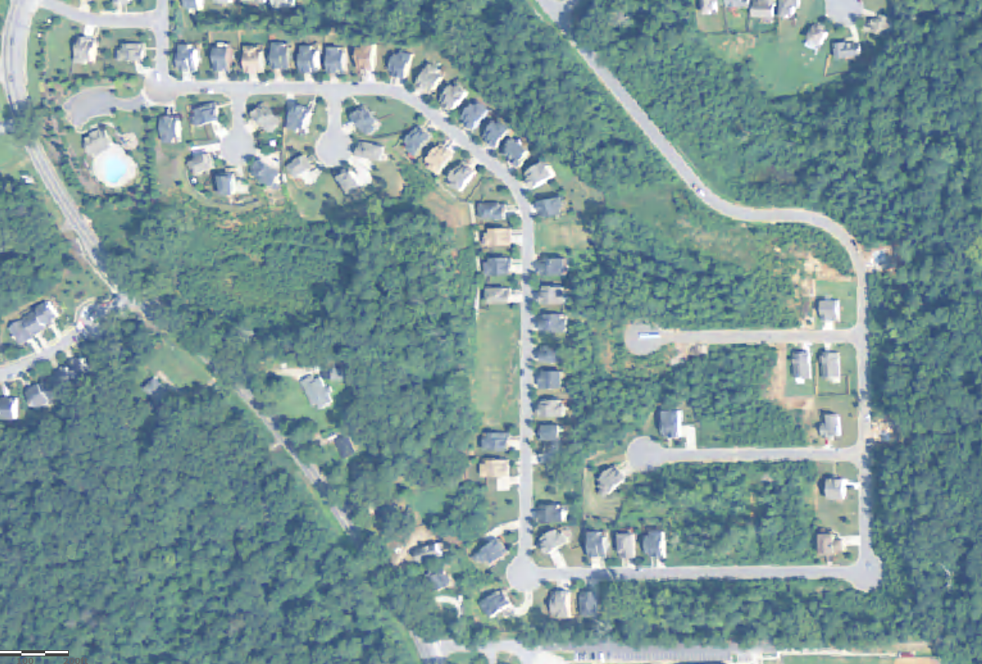
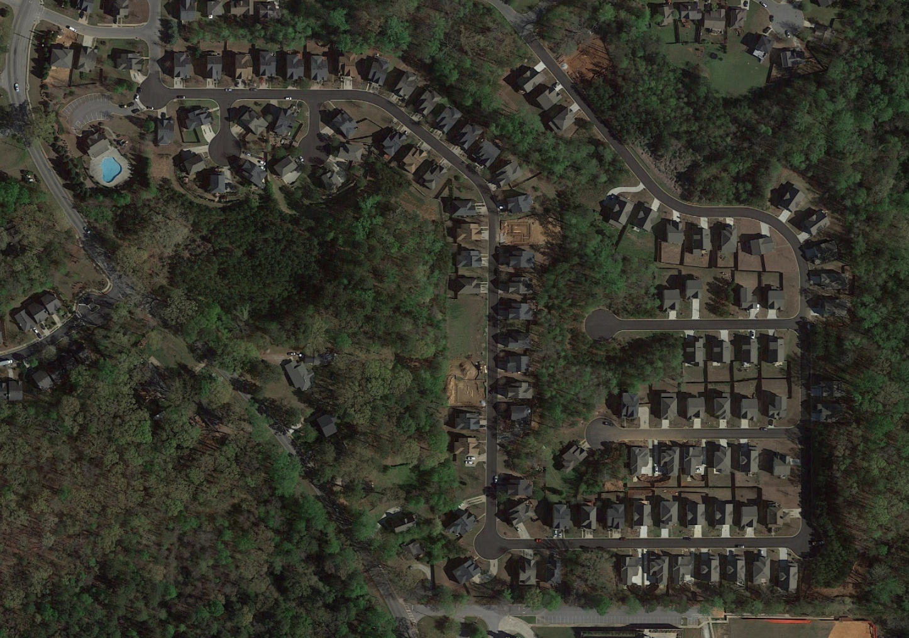
1-meter resolution
6-inch resolution

Slide 14
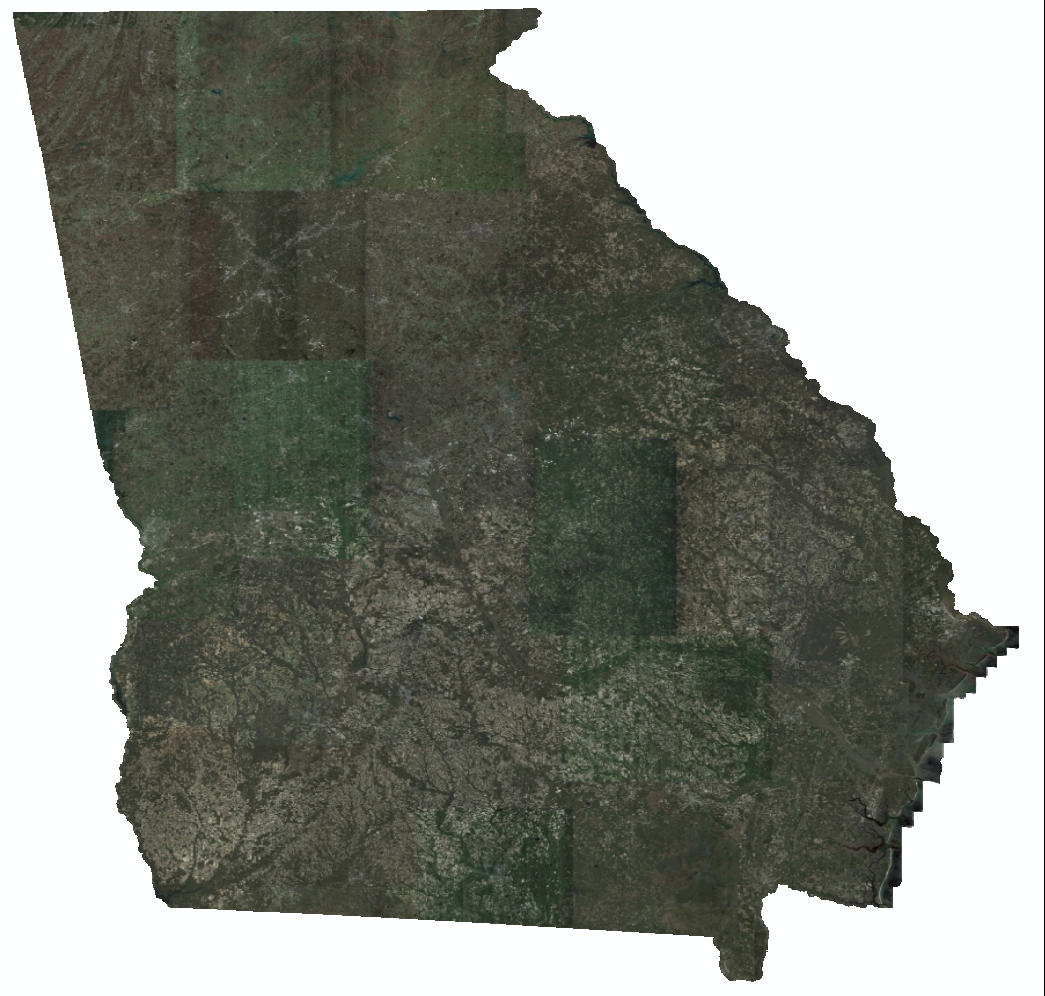
Example Usage
Change detection
Automated data development
Engineering design (coarse scale)
Infrastructure development & maintenance
Transportation
Planning
Emergency Management
Economic Development

Slide 15
Contractual Specifications
Imagery is available to all state, regional and local government through streaming service (web map tiled service, or “WMTS”)
Imagery is available to private consultants working under contract with a governmental entity and who meet specifications under vendor contract
Current purchase is for the imagery available at the time of the purchase, updates (new flights) sold separately 😊

Slide 16
Technical Specifications
Mix of leaf-off and leaf-on statewide imagery flown over the last 36 months
0.5’ GSD (6” pixel resolution) three-band digital aerial imagery
Fourth band (CIR) is available for purchase
Sun angle > 30 degrees
Ortho-corrected to an auto-correlated Digital Elevation Model (DEM)
Horizontal accuracy meets 1” = 100’ scale mapping standards (positional accuracy of CE90 one meter)
No cleanup of routine blemishes typically associated with elevated structures (bridges)

Slide 17
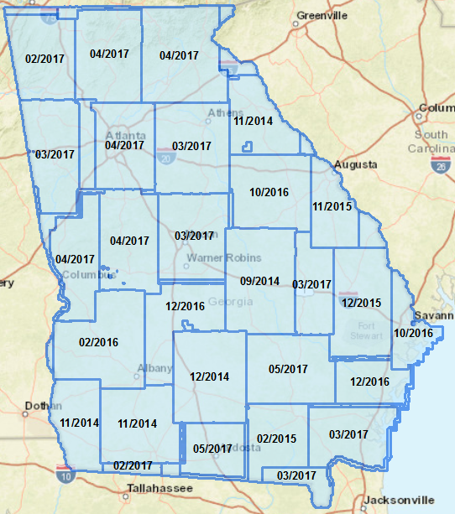
Statewide Orthoimagery Package – Acquisition Map

Slide 18
Statewide Orthoimagery Package – RECAP
Statewide pre-packaged imagery package for use by all governmental entities
6-inch
True Color (IR avail for $$$)
Flown/collected over the last 3 years
Mix of leaf-on & leaf-off
Available to you via a streaming service
(Its “pre-packaged”, which means you get what you get, with the option to purchase updates, IF they are flown)
#2
HOW TO REGISTER:
https://georgia-form.appgeo.com/

Slide 19
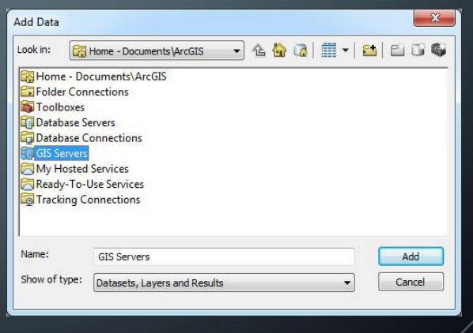
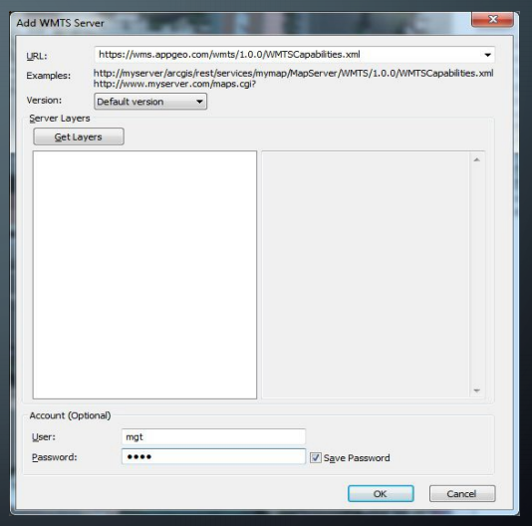
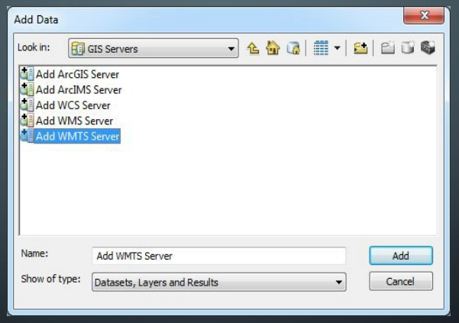
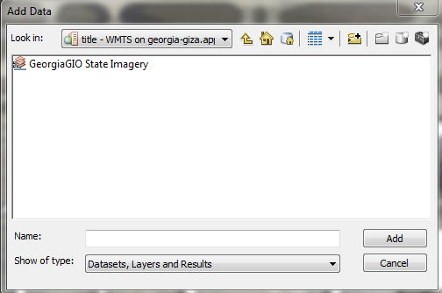
1
HOW TO REGISTER: https://georgia-form.appgeo.com/
3
4
2

Slide 20
LiDAR

Slide 21
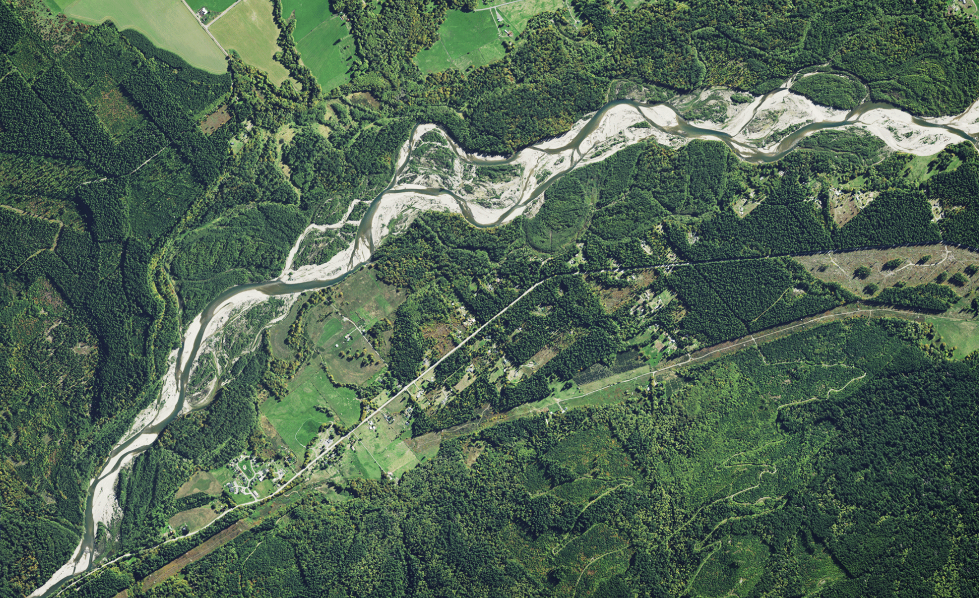
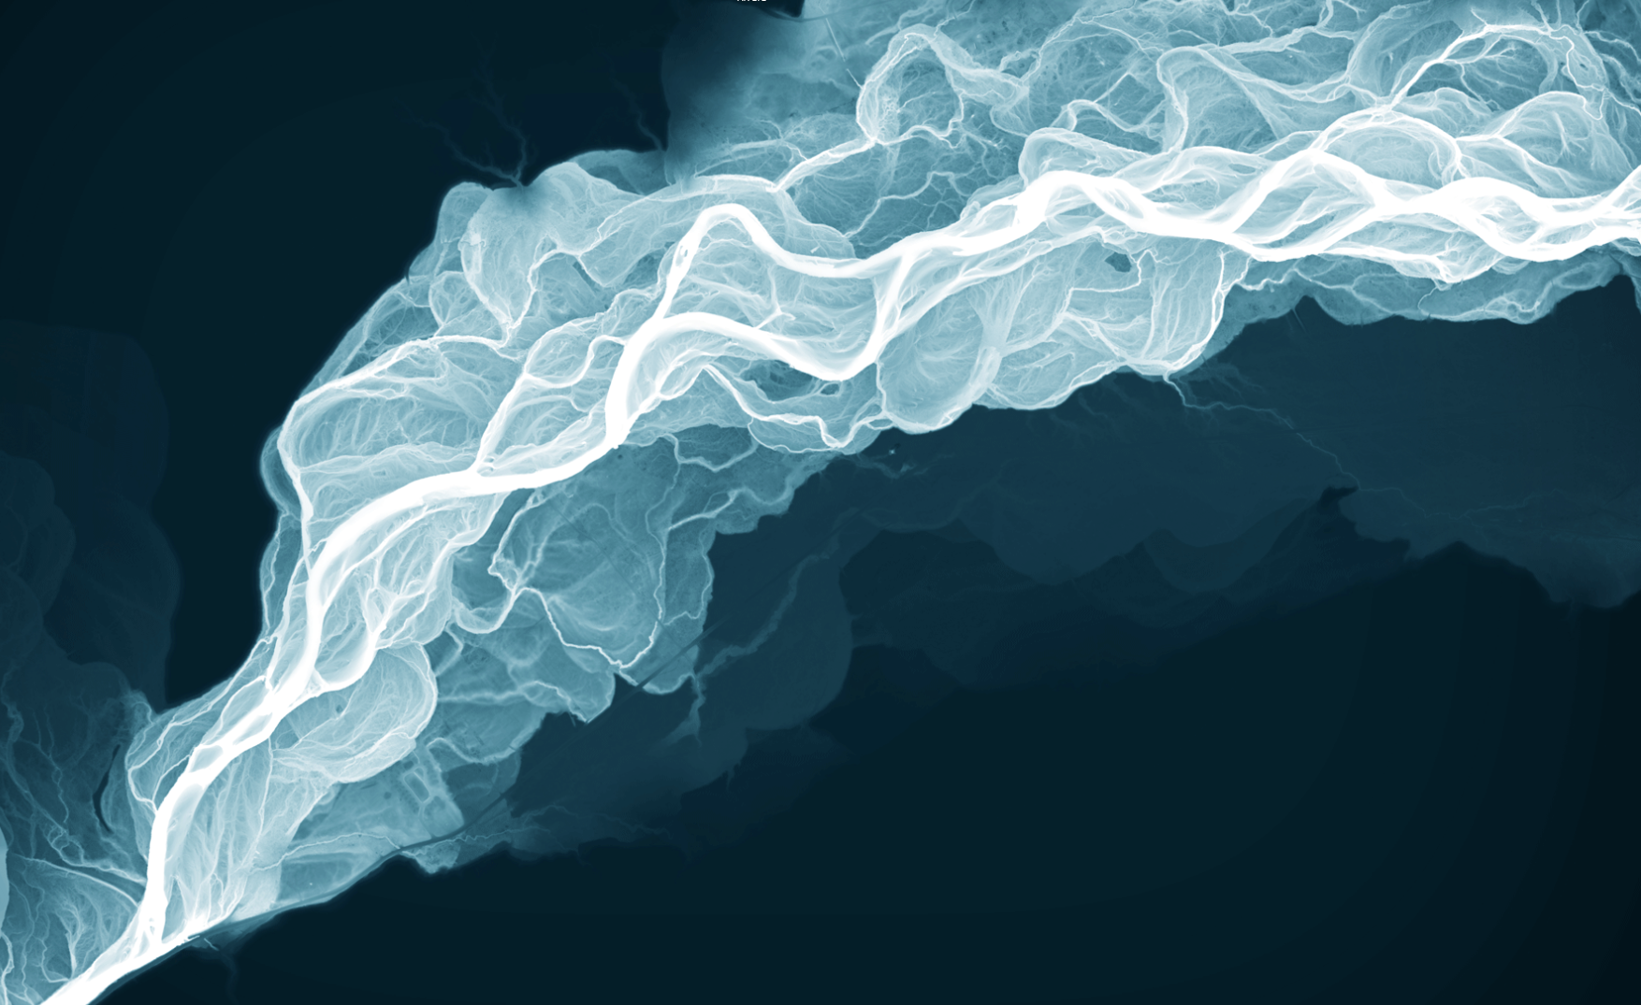

Slide 24
Conservative benefits estimates for the top 10 business uses of LiDAR for Georgia (Dewberry, 2011)
Rank | Business use | Annual benefits (millions)
1 | Infrastructure and construction management | $2.23
2 | Natural resources conservation | $2.08
3 | Flood risk management | $1.84
4 | Agriculture and precision farming | $1.20
5 | Forest resources management | $0.46
6 | Water supply and quality | $0.29
7 | Aviation navigation and safety | $0.15
8 | Geologic resource assessment and hazard mitigation | $0.11
9 | Coastal zone management | $0.08
10 | Sea level rise and subsidence | $0.06
 | Total | $8.50 million

Slide 25
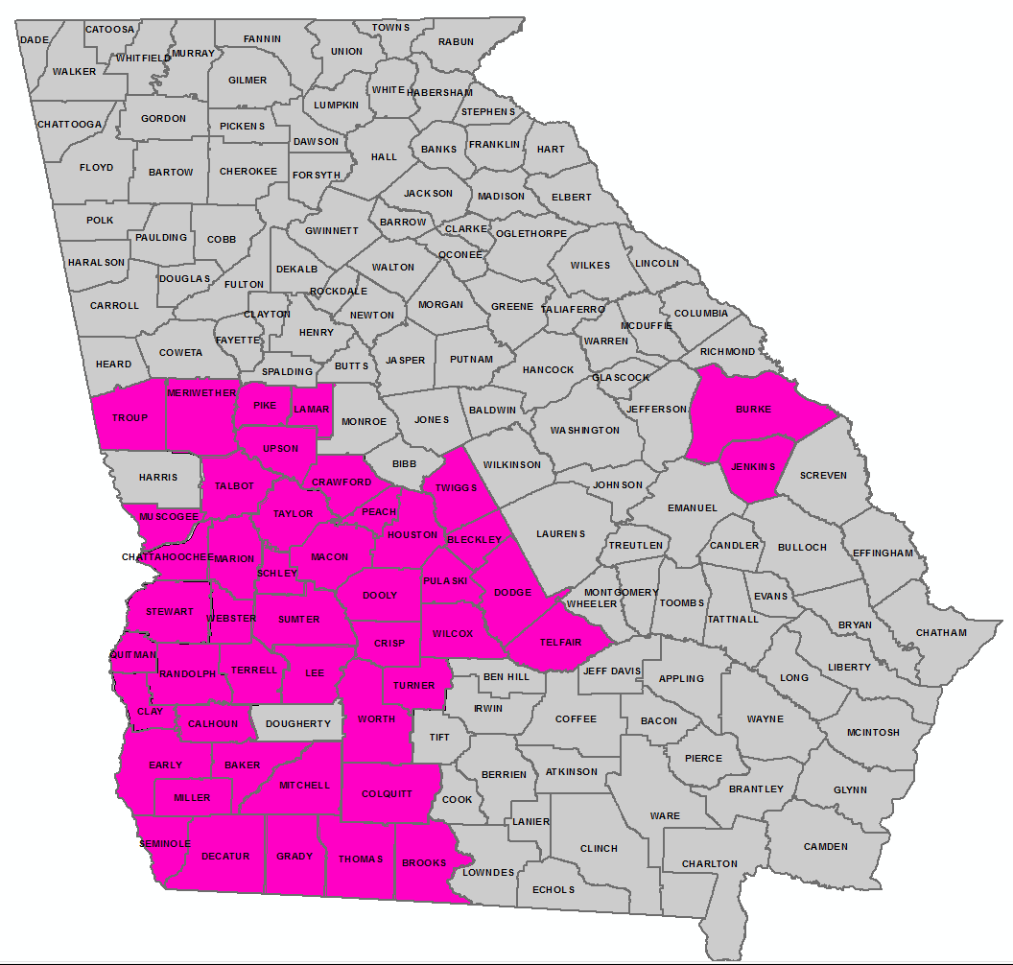
Recap on 2017 Collaborative Outcomes
Partnership between:
GA NRCS
GA EPD
GA GIO
Award a U.S. Geologic Survey Grant (called “3DEP”) to acquire high-level LiDAR for
46 Georgia Counties

Slide 26
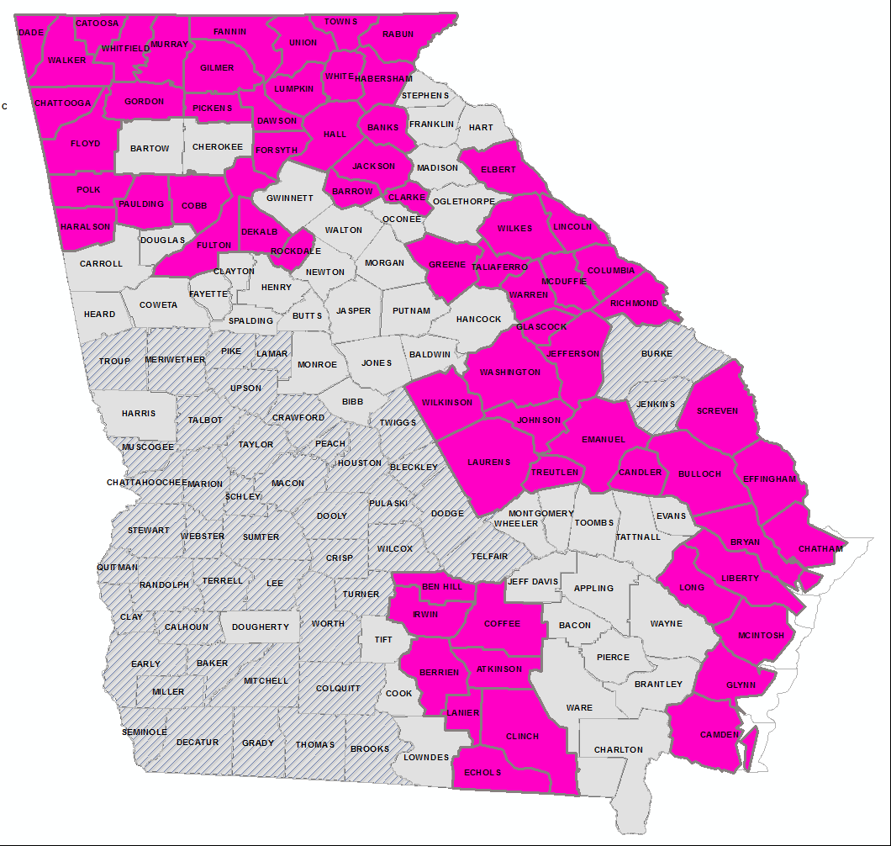
2018 3D Elevation Grant (3DEP)
We WON!!!
Summary
We brought $1.5M to the table
We get $5M in product
67 Georgia Counties
Partnership between:
NEW: Regional Commissions 30+ Partners ($350,000)
Faith Bryan (GMRC) & Hunter Key (CRC)
GIO (State & Federal partners ($1,150,000) – NRCS & EPD

Slide 27
Regional Commission | Commercial Value of GRANT (aka $$$ saved)
Atlanta | $ 288,000
Coastal | $ 1,319,000
Central Savannah River Area | $ 1,085,000
Georgia Mountains | $ 632,000
Heart of Georgia Altamaha | $ 905,000
Middle Georgia | $ 477,000
Northeast | $ 317,000
Northwest | $ 1,030,000
River Valley | $ 1,235,000
Southern | $ 981,000
Southwest | $ 1,446,000
Three Rivers | $ 429,000
 | $ 10,144,000
GIO: State LiDAR Program
113 Counties will have QL2-level LiDAR
$10M

Slide 28
Benefit to Atlanta Regional Commission
of having a State LiDAR Program
5 Counties will have QL2-level LiDAR
~ $300k
#3

Slide 29
Summary
Program/Project Development
Geospatial Software Program
Keep Esri Statewide Contract in mind for your members
15% off new purchases
Spatial Data Program
Progress on Transportation, Admin Boundaries, Imagery and Elevation --- PLEASE PARTICIPATE well in Map 21, BAS, LUCA
Remote Sensing Program
Imagery – 6in for the State
LiDAR – 113 Counties across the State

Slide 30
Thank You, for all that you Do & for having me here today

